Slide 1


Maine Office of Tourism
Report
January 26, 2012

Slide 2
Mission
Serve as the state’s customer focused travel marketing organization with a core responsibility of presenting the activities and amenities of Maine that are most integral to the target markets’ decision making process.

Slide 3
Goals & Objectives
Position Maine as a world-class, four season tourist destination
Increase Maine’s share of the New England travel market and secure it by maintaining positive awareness and high levels of repeat visitors
Expand Office of Tourism-private industry partnerships

Slide 4
Goals & Objectives
Maximize the value of each visitor by encouraging longer trips with deeper excursions into the less traveled areas of the state
Return at least $2 in tax revenue for every $1 invested in tourism

Slide 5
Visitor Tracking Research
2011 Summer Season
Topline Report

Slide 6
Estimated Visitation
to Maine
Summer 2011
9.5 million overnight visitors
13.8 million day visitors.

Slide 7
Residence of
Overnight Visitors
Massachusetts - 21%
New York – 20%
Pennsylvania – 9%
Ontario – 8%
New Jersey – 7%
Connecticut – 6%
Maine – 6%
New Hampshire – 5%
New Brunswick – 4%

Slide 8
Residence of
Day Visitors
Maine – 37%
Massachusetts – 35%
New Hampshire – 15%
New Brunswick – 7%
Quebec – 2%
Vermont – 2%

Slide 9
Primary Purpose of Overnight Leisure Trips

Slide 10
Primary Purpose of Leisure Day Trips

Slide 11
Trip Activities
Overnight Visitors
Outdoor activities…………..64%
Shopping……………………62%
Resting/Relaxing……………53%
Enjoying ocean views…….....44%
Sightseeing………………….40%
Visiting family/friends………33%
Driving for pleasure…………31%
Going to the beach……..…….31%

Slide 12
Trips Activities
Day Visitors
Shopping……………………….50%
Outdoor activities………………42%
Enjoying ocean views…………..37%
Resting/Relaxation.......................35%
Driving for pleasure………….....26%
Visiting family/friends.................26%
Sightseeing……………………...26%
Going to the beach………………23%

Slide 13
Length of Stay
1 Night…………….15%
2 Nights……………27%
3 Nights……………19%
4 to 7 Nights……….31%
8+ Nights……………8%
Mean Number of Nights
Summer 2010 – 3.9
Summer 2011 – 3.9

Slide 14
Types of Lodging
Paid Lodging
Hotel / Motel / Resort 42%
Cabin / Cottage /Condo 8%
Inn / B&B 7%
Tent Campground 3%
RV Park / Campground 2%

Slide 15
Travel Planning Sources
Internet……………………..65%
Friends/Relative..…………..43%
AAA………………………..21%
Travel Guides……………….15%
Travel Books.………………10%
Travel Magazines…..………..8%
Articles………….…………..8%
CVBs….……………………5%
Travel Agents..………...........4%
Chambers of Commerce….…3%

Slide 16
Online Travel Planning
Top Five Online Resources Used
Search Engines - 43%
NET Maine regions’ sites- 35%
Visitmaine.com - 31%
Accommodation websites - 22%
AAA – 23%

Slide 17
Repeat vs. First Time Overnight Visitors

Slide 18
Repeat vs. First Time Day Visitors

Slide 19
Regions Visited

Slide 20
Recommendation of Maine as a travel destination

Slide 21
Marketing Maine: 2011
Research driven
  Demographic
Goals
  Increase number of first time visitors
  Continue to communicate
  “There’s More to Maine”

Slide 22
Marketing Maine: 2011
Continued focus on primary markets
  Boston
  New York
  Other New England states
  Eastern Canada

Slide 23
Marketing Maine: 2011
Drove traffic to visitmaine.com
Generated requests for
Maine Invites You
Motivated visitors through Getaways and Events
Notes:
We will continue these as calls to action for 2012.

Slide 24
Marketing Maine: 2011
Television
  Boston
  New York
  National Cable
  Hartford
Online
  Boston.com
  Frommers
  Weatherbug
  Trip Advisor
Print
  Down East
  Yankee
  Real Maine Weddings
  Audubon
  New York Times “T”
  Snow Goer Vacation Guide
Radio
  Boston

Slide 25
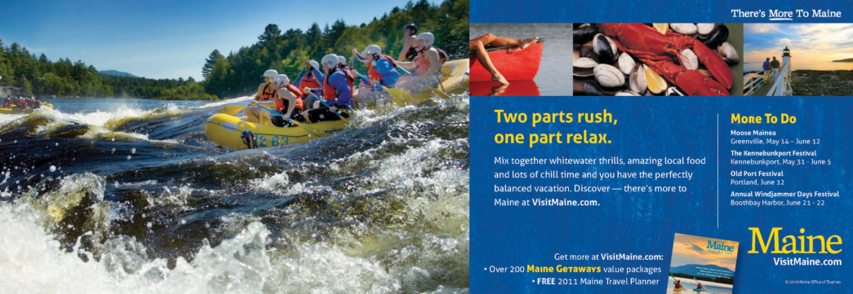
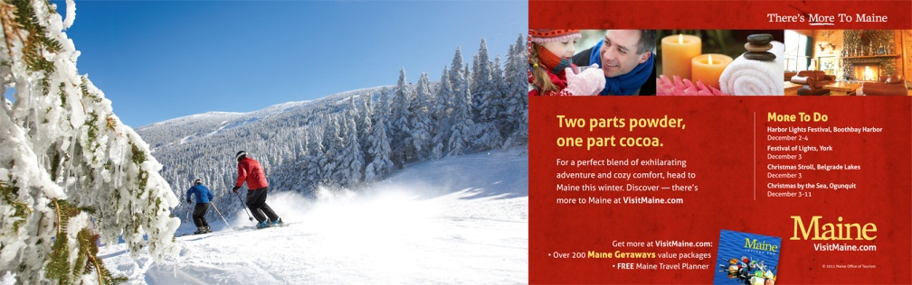
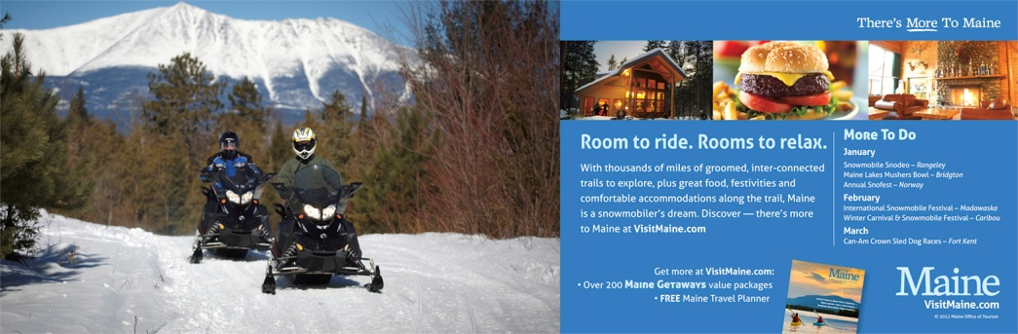



Slide 26
Summer 2011
Television Ad

Slide 27
Marketing Maine: 2011
Email
  Targeted lists key activities
  Full list – season reminders
International
  Trade & Media
Social Media
  Facebook
  Twitter
  You Tube
  Foursquare
Public & Media Relations
  Fam trips
  Media outreach
Consumer Travel Shows

Slide 28
Highlights: 2011
2011 summer visitation to Maine showed an increase of 8.5% in overnight trips versus 2010.
Maine continues to have strong repeat visitation - well over 80%.

Slide 29
Highlights: 2011
Visitmaine.com surpassed the 2 million mark for unique visitors in 2011 – 27.65% increase over 2010
Assisted 68 U.S. and international media and travel trade resulting in nearly $20 million in media exposure in print alone.

Slide 30

Highlights: 2011
Increased Facebook fans from 3000 to over 45,000
  Reinforce our strengths
  Highlight little known facts about Maine
  Engage prospects and repeats

Slide 31
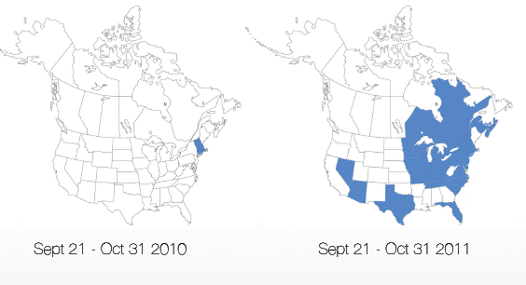
Highlights: 2011
  Pay-per-click campaign
  expanded national reach
Notes:
Low cost tactic to reach potential first time visitors
Allows for real-time analytics and flexibility

Slide 32
Highlights: 2011
Interactive Map on visitmaine.com
Visitmaine.com mobile platform
3 new videos
  Lighthouses
  Fall Touring
  Paddling in Maine

Slide 33
Marketing Maine: 2012
Integrated Approach
  Paid Media
    Print, broadcast, online, mobile
  Earned Media
    Public & Media Relations
  Owned Media
    Web, email, mobile
  Social Media
    Facebook, Twitter, You Tube, Foursquare
Notes:
Outdoor enthusiast, cultural explorer and luxury traveler.

Slide 34
Marketing Maine:
Winter 2012
Paid media - print, online & radio
  Short, close media targeted based on winter weather
  Boston, New England, Canada
  Mediamark Research (MRI) data to identify targets and media habits
Notes:
Targeting winter outdoor enthusiasts by age, household income and media habits.

Slide 35
Marketing Maine:
Winter 2012
Placements will be mix of:
  Retargeting: those who have visited the Maine website
  Behavioral Targeting: those who have visited winter sports, travel and Maine sites
  Contextual Targeting: those who have read articles on winter activities
Notes:
We will continue to use earned, owned and social media as part of the winter 2012 marketing mix.

Slide 36
Marketing Trends:
Our Future
Strong spend by the younger generation – Gen Y and X are spending on luxury – but want good value.
Value continues to be king – even the affluent are focused on good value.
Evoke emotional connections
“Diverse aware” – duel pronged strategy for over 50 and under 50.
Notes:
Marketing is more dynamic than ever and requires new ways of thinking.
You can no longer focus too much on one target and forget the others.

Slide 37
Marketing Trends:
Our Future
Three take-aways: Caution – Curation – Contentment
    Caution – Consumers are vigilant. Want vacation that is risk free.
    Curation – Circles of intimacy – manage information and relationships.
    Contentment – Spontaneity and fun snatched away. Meaning will define context of happiness.
Notes:
Cuation - Risk and uncertainty abounds.
Curation - Marketing is imperative in the form of conversations. This is why social media is so important
Contentment –More internally directed.

Slide 38
Marketing Maine:
Our Future
Continue to build upon state agency partnerships
Continue to be active participants in tourism related initiatives
Evaluate research needs, potential gaps and existing data
Integrate psychographic data

Slide 39
Marketing Maine:
Our Future
Continue to develop relationships and expand market presence in Canada
Increase visitors in paid accommodations
Expand national reach
Engage prospects
Connect emotionally to new and repeat visitors
Notes:
As a final note, we are about to embark, with all of you on developing our next 5-year strategic plan.
At the closing of this general session, I’ll be back to present what else the future has in store for us.

Slide 40

How to Connect
MOTPartners.com
  Business listings
  Event listings
  Getaways and Specials
  Industry information
    Research
    Media Plan
    Presentations
    Advertising
PR Partners Program

Slide 41
Maine Office of Tourism
Report
January 26, 2012

