Slide 1

Convergence of Marketing & PR
Integrated Communications Strategies
Notes:
When I got into PR, it was all about pushing out messages and information. There really wasn’t much concern about hearing what customers had to say. They had very little power. We, the people who were controlling the messages, were in charge. That has really changed over the course of the last 30 years. Those changes, and how you can deal with them, are the topic of my talk today.
Forget Travel Agents, Social Media Has the Power
Survey finds many business travelers consult social media websites like Facebook for help and recommendations with their trips.
By Courtney Rubin | Jun 24, 2010
0
inShare
Tweet
Today's Editor's Picks
The Industry With the Worst Websites
4 Ways to Sell Unsexy Products
5 Easy Ways to Boost Your Click Rates
Sh*t Entrepreneurs Say
That VC Is NOT Your Friend
Looking to attract the youngest generation of business travelers? A new survey suggests you should focus on social media.
Business travelers age 21 to 34 are twice as likely as any other age group to consult theirFacebook friends before making work trip decisions, says an Embassy Suites Hotelsurvey. Nearly half of the young professionals surveyed turn to Facebook, as opposed to 26 percent of older travelers.
As for other social media consulted: 22 percent of young travelers looked at MySpace(compared to 13 percent of all other travelers), 17 percent went to Twitter(versus 8 percent of other travelers), 11 percent to Google Buzz (compared to 7 percent), and 9 percent to LinkedIn (compared to 5 percent).
Social media is particularly important for hotel choice, with 33 percent of all travelers turning to it for help with that decision. Sixteen percent of respondents said social media convinced them to book the hotel they had in mind, and 13 percent said it had the power to convince them to switch their hotel choice.
The annual survey – conducted among 700 Americans who'd taken at least one business trip in the past year – revealed that 43 percent of workers said they were traveling less for business this year because of the economy. That's a decrease from last year's 51 percent.
But nearly three-quarters of respondents (71 percent) said tough times had changed the way they traveled. Nearly a third of those surveyed said they now flew coach, 27 percent cut back on meals, and 17 percent even shared rooms with colleagues.
Not surprisingly, more than half of all travelers (56 percent) listed location and price as the top two factors in choosing a hotel. All things being equal, if respondents had to choose between free breakfast and a free shuttle service to the airport, twice as many would take the free food. The favorite freebies: 27 percent named the cooked-to-order breakfast, 26 percent the shuttle service to and from airports, and 19 percent the daily appetizers and drinks. The fitness center came in last on the list, with 15 percent listing it as their top choice.
An unrelated Hilton Hotels survey earlier this year revealed women secretly lovebusiness travel because they like having someone clean up after them – but the current survey suggests male travelers put more emphasis on luxury than women. The men showed a stronger preference for flying first class (29 percent to 16 percent) and staying in five-start hotels (33 percent to 26 percent).
Read more:
Why Women Secretly Enjoy Business TravelPrivate Sale Websites for Travel
Courtney Rubin
Inc. contributing editor Courtney Rubin was for five years a London-based staff writer for People magazine. Rubin, a former senior writer forWashingtonian magazine, has written for the New York Times magazine,Time, Marie Claire, and other publications. She is the author of The Weight-Loss Diaries.

Slide 2
A Word from our sponsor….
You don’t have to write everything down.
I will e-mail you a copy of this presentation.
There’s just one catch.
Give me your business card and I will subscribe you to my monthly e-newsletter, “The NMC Report,” filled with more good info like you’re going to hear today.
Notes:
How we are defining PR today as all the activities an organizations engages in to build relationships with key constituencies, or stakeholders. We used to think of PR as being media relations, but today we’re defining it as relationships with customers, neighbors, owners, competitors, thought leaders, public officials and everyone who is touched by an organization.

Slide 3
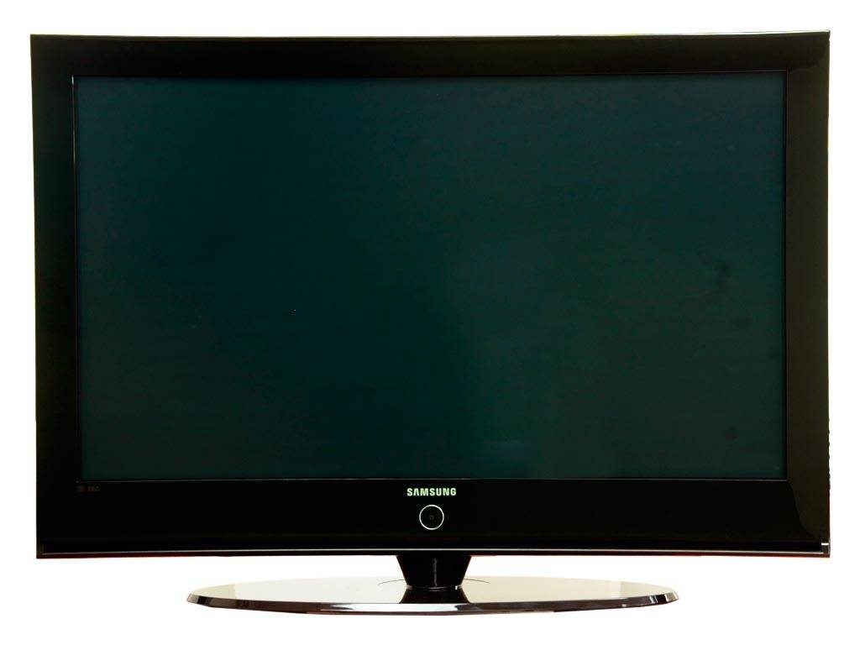
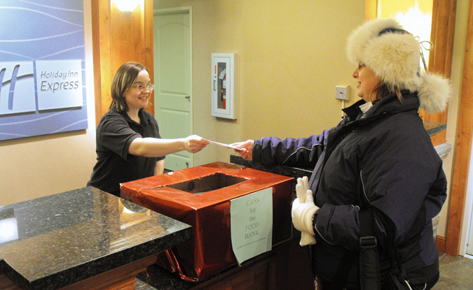

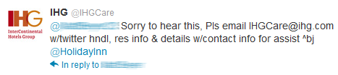
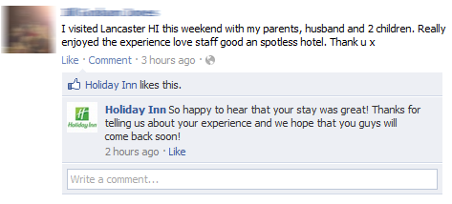

What Creates Brand Perception?
Ads
Interactions
Notes:
Ads create an initial perception, but are only somewhat effective at altering perception. Since a brand is something you feel in your heart as well as think about in your head, it takes more than a simple ad to really penetrate a customer. Real-time interactions immediately effect perceptions customers have. People will judge your business based on how well the employees embody and personify the brand; how they make you feel; whether they truly care about the customer and what the customer is thinking and feeling. I was not involved in developing this campaign, but I think that the “Sugarloafer” campaign is brilliant. What it means to be a Sugarloafer……both employees and guests all personify the Sugarloaf brand. As you are allocating your marketing budget, think first of training your employees in communicating the brand. Think of Zappos. Every one of their employees is fully empowered to communicate the brand to their customers. If you want to see an example of how a company truly empowers its employees go to www.zapposinsights.com.

Slide 4


Who Can Change Perception?
Advertisements
Press Releases
Somewhat Effective
Family / Friends
Very Effective
Employees
Most Effective
Notes:
Employees have the power to immediately change the perception one has of a business for better or worse. Your marketing strategy needs be turned inside out. If you have beautiful ads, a gorgeous website and press releases that promote how great you are, but your front desk person snarls when you walk in, then everything will backfire. I’m talking about building relationships with your customers that are long lasting and engaging, so they become lifelong loyal customers.

Slide 5
Targeting Desirable Customers
Starts With Creating Personas
Look at your guest list or customer list and
come up with three or four distinct personality/demographic/psychographic types.
Give them names, envision what they look like.
Figure out what media and messaging will best attract them to your property or business.
Notes:
Performing some research to identify the lifestyles and motivations of 3 or 4 distinct groups of customers allows a business to identify key messages which are attractive to each customer subset.

Slide 6
Convergence of Marketing & PR
Poor Quality of Relationship =
Ineffective Ads
High Quality of Relationship =
Very Effective Ads
Notes:
If people do not trust your brand, they will certainly not trust your ads.
If people trust your brand, ads have the power to connect and inform. After the Gulf Oil Spill in 2011, BP launched an ad campaign trying to say that no oil had flowed into the Gulf, but nobody believed them. They spent millions on this ad campaign but it was totally ineffective. Their relationship with their publics was nil. Nobody trusted them.

Slide 7
The Engagement Continuum
Engaging directly with people
Evaluate quality of engagement and relationship
Evaluate key message penetration
Dissemination of new strategy to staff
Refinement of overall communications strategy
Evaluation of feedback / criticism
Refinement of business actions / services
Notes:
What we’re talking about today is measuring your engagement at every step of the relationship. The engagement channel allows a business to assess the relationship it has with its public, collect valuable feedback from customers, and establish relationships which improve trust and loyalty. There is a relationship survey called the Grunig Survey which is a series of agree or disagree statements that measure people’s relationship with an organization (reference Katie’s book page 58.) Example: Our work with CVA. (see Matt’s notes)

Slide 8




The Organic Sales Continuum
Customer Acquisition
Positive Customer Experience
Customer shares experience online & with friends and family
Potential customers see positive reviews
Notes:
The organic sales continuum demonstrates how customer experiences have a direct effect on a businesses ability to acquire new customers. If you do marketing for a tourism business, and you are not taking advantage of this continuum, then you are missing out! With sites like TripAdvisor, Yelp and Chowhoud, even Facebook and Foursquare, people can leave their remarks, either positive or negative. Your goal must be to create great experiences for your guests, then encourage them to share their experiences with their friends and family online. You can even create YouTube testimonials of your customers talking about their experiences and post it on YouTube…..which is the second most popular search engine next to Google!

Slide 9
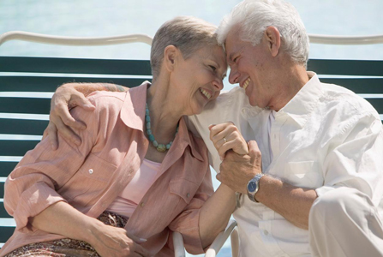
Betty & Henry
The Retired Couple
Notes:
Developing personas is, I believe, one of the most exciting and effective marketing techniques EVER. This technique allows you to put a real name and face on your customers. You need to think of your customers (or guests) as individuals, not just as a ‘mass’ of people. And not every retired couple or college student is the same, so you can’t just break customers down by age groups. Betty and Henry are personas we have developed for Linekin Bay Resort. We created them, then analyzed what media impact them. Betty and Henry are actually avid Facebook users because they each have grandchildren from previous marriages who live far away. So we know that Facebook is a great way to reach them.

Slide 10

The Jensen Family
Laid Back and Relaxed Travelers
Notes:
The Jensen Family is another one of Linekin Bay Resort’s Personas.

Slide 11
Targeting With The Long Tail of the Web
The web allows you to target very specific groups, such as, for example:
People who like to travel with their pets
Couples who are interested in gourmet cooking
Families interested in ski vacations with
apres-ski activities
Really, any combination you can imagine can be found on the web…so be creative!
Notes:
It is a known fact that people are typing in longer and longer search terms than ever before, so as marketers we can take advantage of that:
Hotel with pet-friendly rooms at ski mountain offering alpine and nordic skiing with gourmet food and wine.

Slide 12
Key Word Targeting
Once you have identified the niche audiences you are going to target, then create your list of key words. Be sure to use those key words in your website, your social media, your press releases and any other online communications. Google will send people to your website if they are searching for those terms.

Slide 13
Five Traditional PR Tasks and
Their Social Equivalents
Identify key messages, programming –
create content calendars
Create media list – identify digital influencers
Build media relationships – engage with
digital influencers
Secure media placements – secure Facebook posts, shares, tweets, etc.
Pitch – reach out to digital influencers

Slide 14
What is Social Media?
Any form of electronic communication where users create online communities
  Information
  Ideas
  Personal messages
Other content – videos, photos
Provides direct connection to the end user
Focus is on
  Interaction
  Engagement
  Relationships

Slide 15
Why YOU need social media
Attract more customers,
more people are online
Get feedback, testimonials
Engagement
Social media isn’t a “trend”

Slide 16
Changing consumer
Value is key – hunting for deals
Brand loyalty has decreased
Wants information quickly and
planning made easy
Wants to engage in dialogue
Notes:
Sites like yelp, tripadvisor and chowhound allow people to leave feedback immediately. LISTENING is as important as posting. RESPONDING is an art form.

Slide 17
Start with a plan
Determine your audience.
Discuss appropriate content.
Staffing - who will do it and when?
Updates and monitoring, how often?

Slide 18
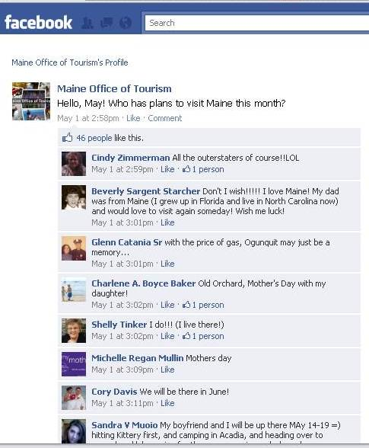
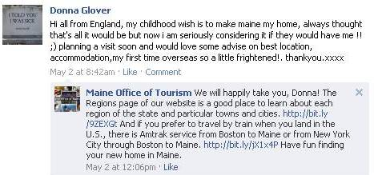
Interaction, Engagement, Relationships
How do we encourage I, E, R?
Ask for it!
  Pose questions
  Ask for opinions
  Create polls
  Invite them in…

Slide 19
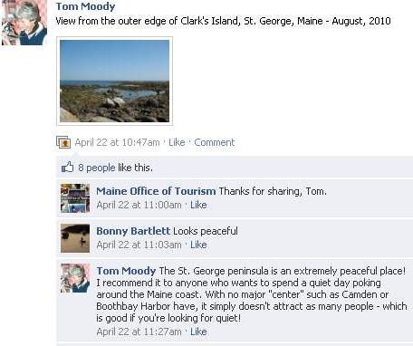
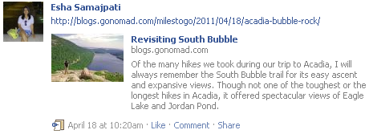
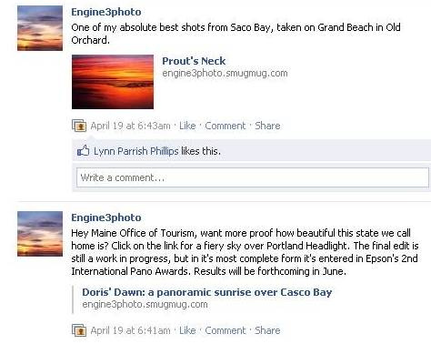
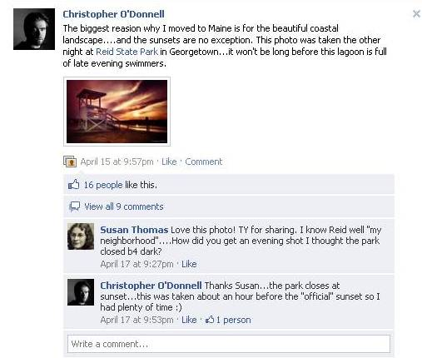
Interaction, Engagement, Relationships
Encourage user-generated
content

Slide 20
Interaction, Engagement, Relationships
Encourage user-generated content

Slide 21
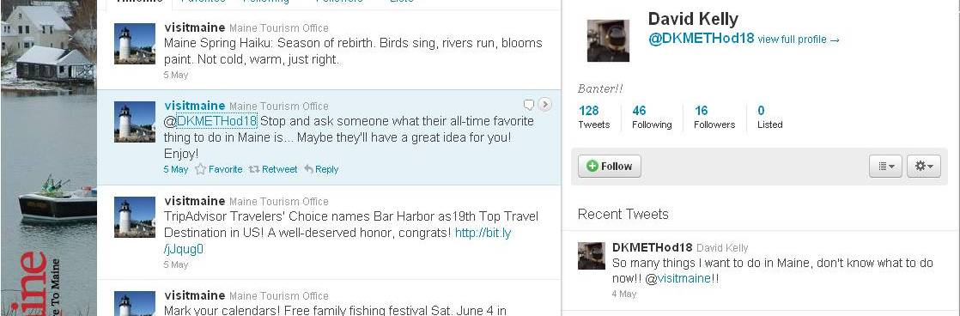
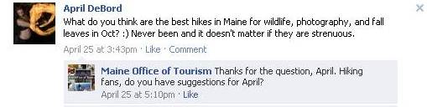
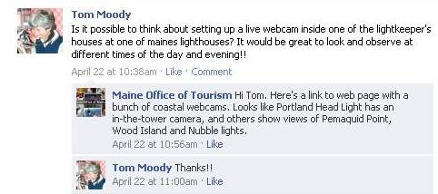
Interaction, Engagement, Relationships
Be responsive

Slide 22
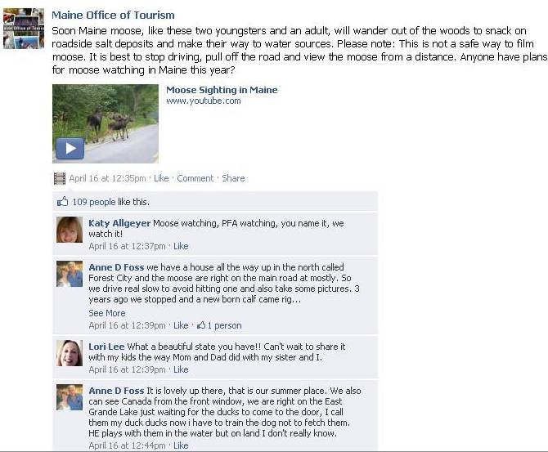
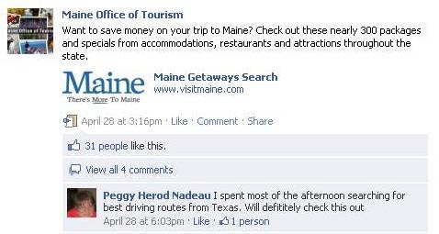
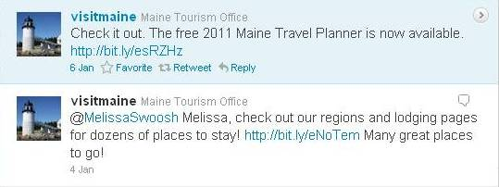
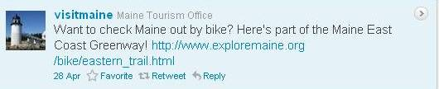
Interaction, Engagement, Relationships
Provide useful information

Slide 23
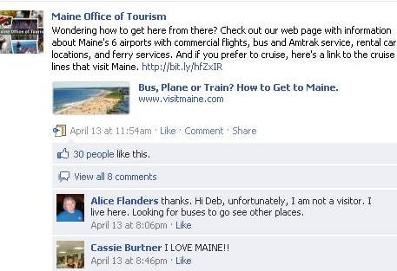
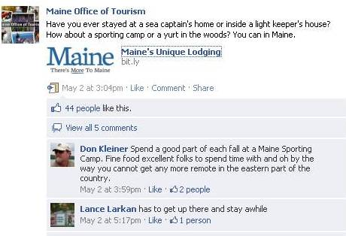
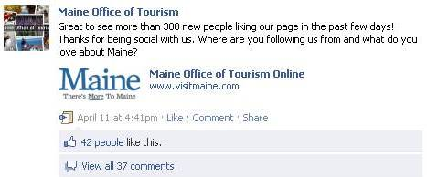
Interaction, Engagement, Relationships
Drive traffic to website

Slide 24
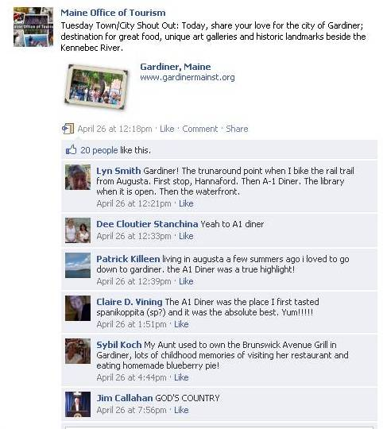
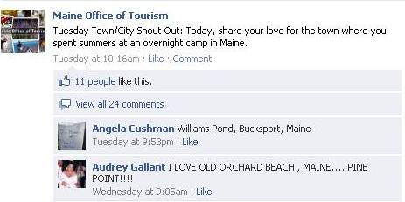
Interaction, Engagement, Relationships
Tuesday Town/City Shout Out

Slide 25
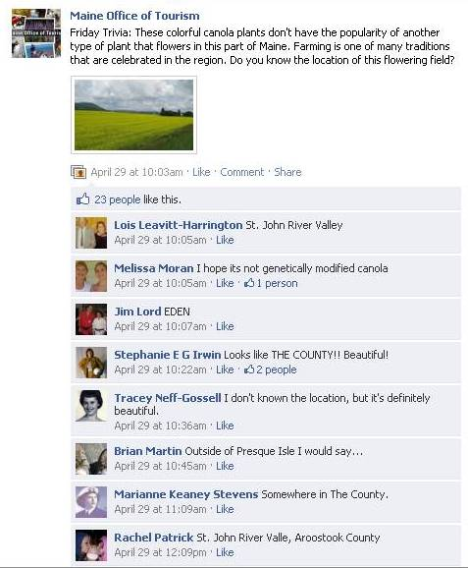
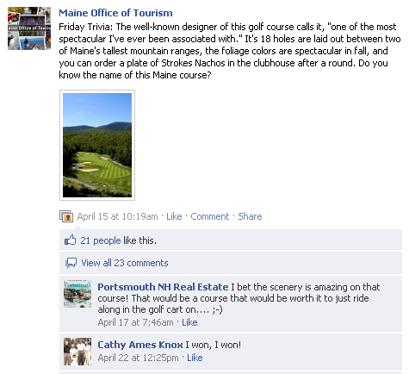
Interaction, Engagement, Relationships
Friday Trivia

Slide 26
Posting Tips
At least once a day
Time of day = unique audience
Ask questions for more engagement
Include links, photos and videos

Slide 27


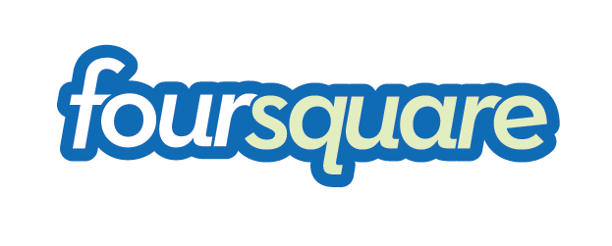


More Social Interaction
Trip Advisor
Google Places
Facebook Places
Foursquare
YouTube
Twitter
QR Codes

Slide 28
Location-based social networking
website for mobile devices
Users “check-in” at venues using a mobile website, text messaging or application
Selecting from a list of venues that the application locates nearby.
8 million registered users.

Slide 29
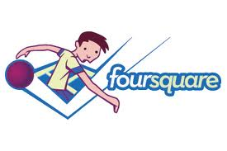
Get started….
Claim your business/venue
Engage with Foursquare users
  Offer and respond to tips
  Offer specials
  Reward “Mayor”

Slide 30
YouTube is the #2 search engine after Google.com to find information or entertainment.
Creating a site is free.
Video is more engaging than text or photos.
Allows you to upload and promote videos, create your own “channel” and embed video on your website.

Slide 31
It’s about the details
Use keywords in your descriptions for better SEO for your business or brand
  An empty description is a missed opportunity.
Put your website at the end of your video.
Videos should be one of the following:
  Funny
  Cute
  Informative
  Motivating (call to action)

Slide 32

…is it worth it?
Offers a social networking and microblogging service
Enables users to send and read other users' instant
messages called tweets
Tweets - text-based posts of up to 140 characters displayed
on the user's profile page
The more people you follow the more people will follow you
Great for up-to-date information - special rates, weather conditions, crisis management, etc.

Slide 33
Who uses
300,000 NEW users per month.
18-34 year olds spend 4.3 times the amount of time on Social Media than they do on TV, radio and the newspaper. Twitter targets a large part of this group.
Similar to Facebook - largest demographic is the
35-44 year olds.
About 25% of Twitter users are high income earners and a large part of the following are older business professionals.

Slide 34
What do you “tweet” about?
Be an influencer, lots of celebrities are on Twitter.
Add value with every tweet you send.
Don’t tweet about your schedule. Ex: Had a cup of coffee.
You can offer tips, resources, links to other valuable
sites, news, feedback, you name it.
Questions, polls, and surveys are great tools for engaging your audience and can be used as your focus group for new products or services that you're about to launch.

Slide 35
More Twitter Advice
Share links and information
Opinions
Humor
Questions
Pictures

Slide 36
What are others saying about you?
Twilerts
  Don’t need a Twitter account
  Delivered to your Inbox
  Observation only
TweetDeck
  What are people saying about your community
  An opportunity for you to respond
Socialmention.com
NutShellMail.com
Monitor TripAdvisor
  Share comments with your staff

Slide 37
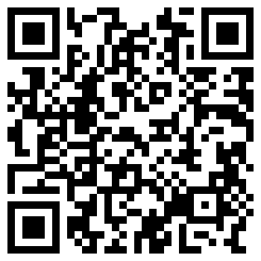
QR Codes
Use QR Codes creatively to help mobile user connect more easily
  Websites
    Specific pages
  Foursquare check-ins
  Facebook pages

Slide 38
Mobile Marketing
Trip Research While In Maine
  Roughly 25% of visitors use their mobile device to perform additional trip research while in Maine
  This percentage is increasing significantly year after year.
Are You Showing Up
In The Search Results?

Slide 39
Why Are People Searching?
Mobile resources have up to date information.
Reviews can give people an idea of what
to expect.
Directions will take people straight to the location, no hassle!

Slide 40
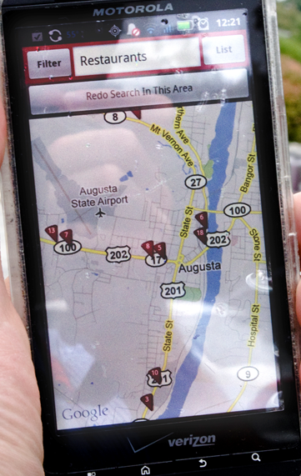
How Do I Get There?
Get discovered and get found.
  Is your listing accurate?
    Some sites automatically fill in data – business owners can update and make changes to their listing.
  Is your location precise?
    Is your “thumbtack” off by a ¼ mile? If people can’t find it, they’ll go somewhere else!

Slide 41
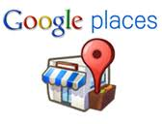



Get Started
Google Places
Yelp
Foursquare
Yellow Pages

Slide 42
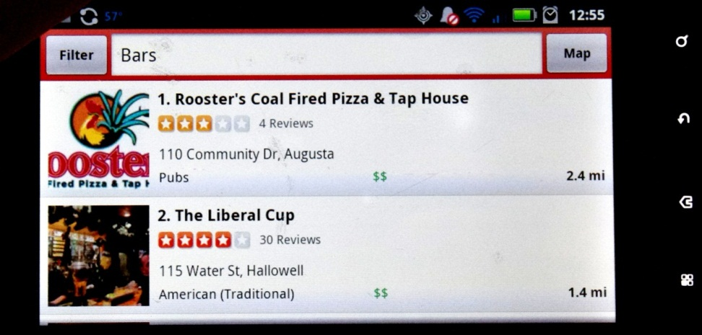
Reviews – Check Them Out!
What are people saying about your business?
  Are there any spam/untrue tales that
  should be removed?
How do you compare to your competitors?
This is valuable feedback:

Slide 43
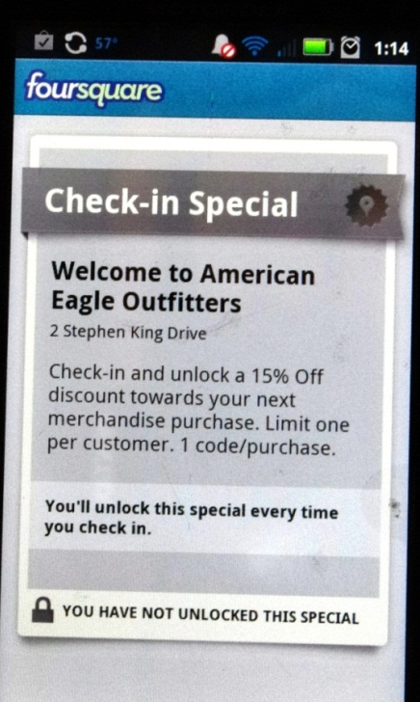
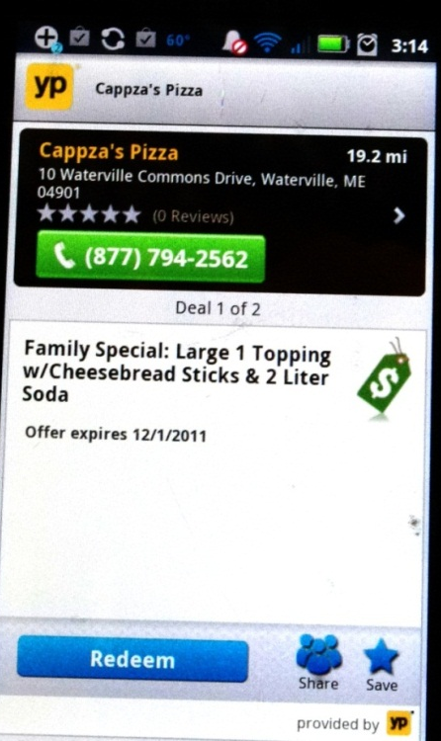
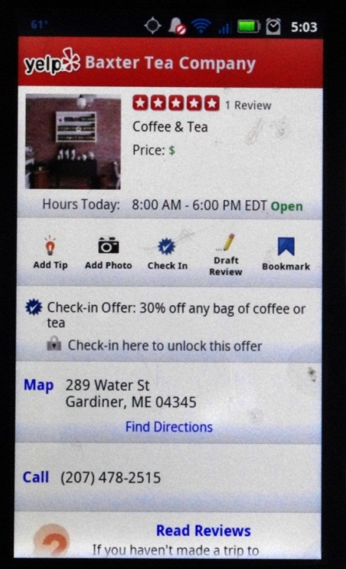
Deals/Offers/Coupons
Offer coupons and discounts through apps to get people to choose YOU

Slide 44
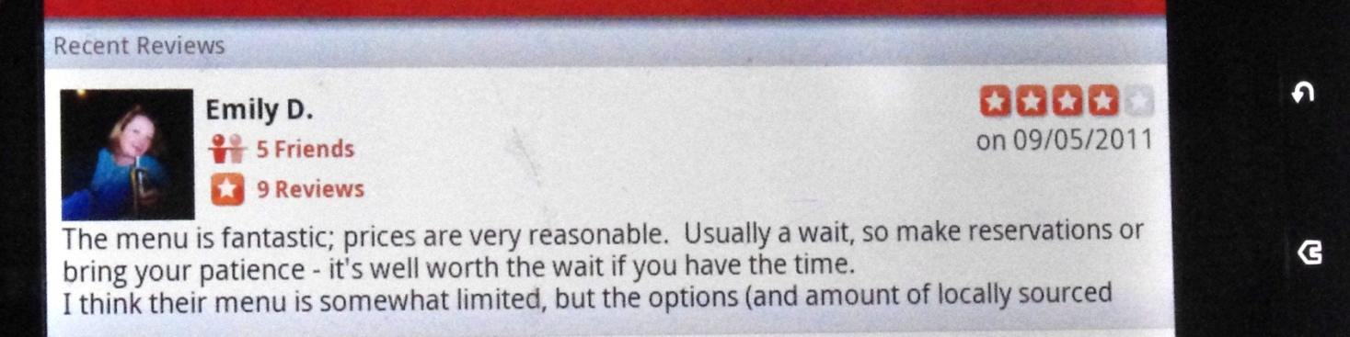
Social Media Tie-In
When people check in, all of their friends
will see it via Facebook or Twitter
Friend > Friend recommendations are the
most powerful kind.
People use these apps with their friends

Slide 45
Strategic Marketing Plans
We create “Marshall Plans” for our clients, which
are road maps to customer engagement. The plans include:
Competitive analysis
SWOT analysis
Message Mapping
Targeted Audiences
Best media to connect messages with targets
Notes:
A unique differentiating brand story is the foundation of this plan. This brand story should appeal to the personas that the business has identified.

Slide 46
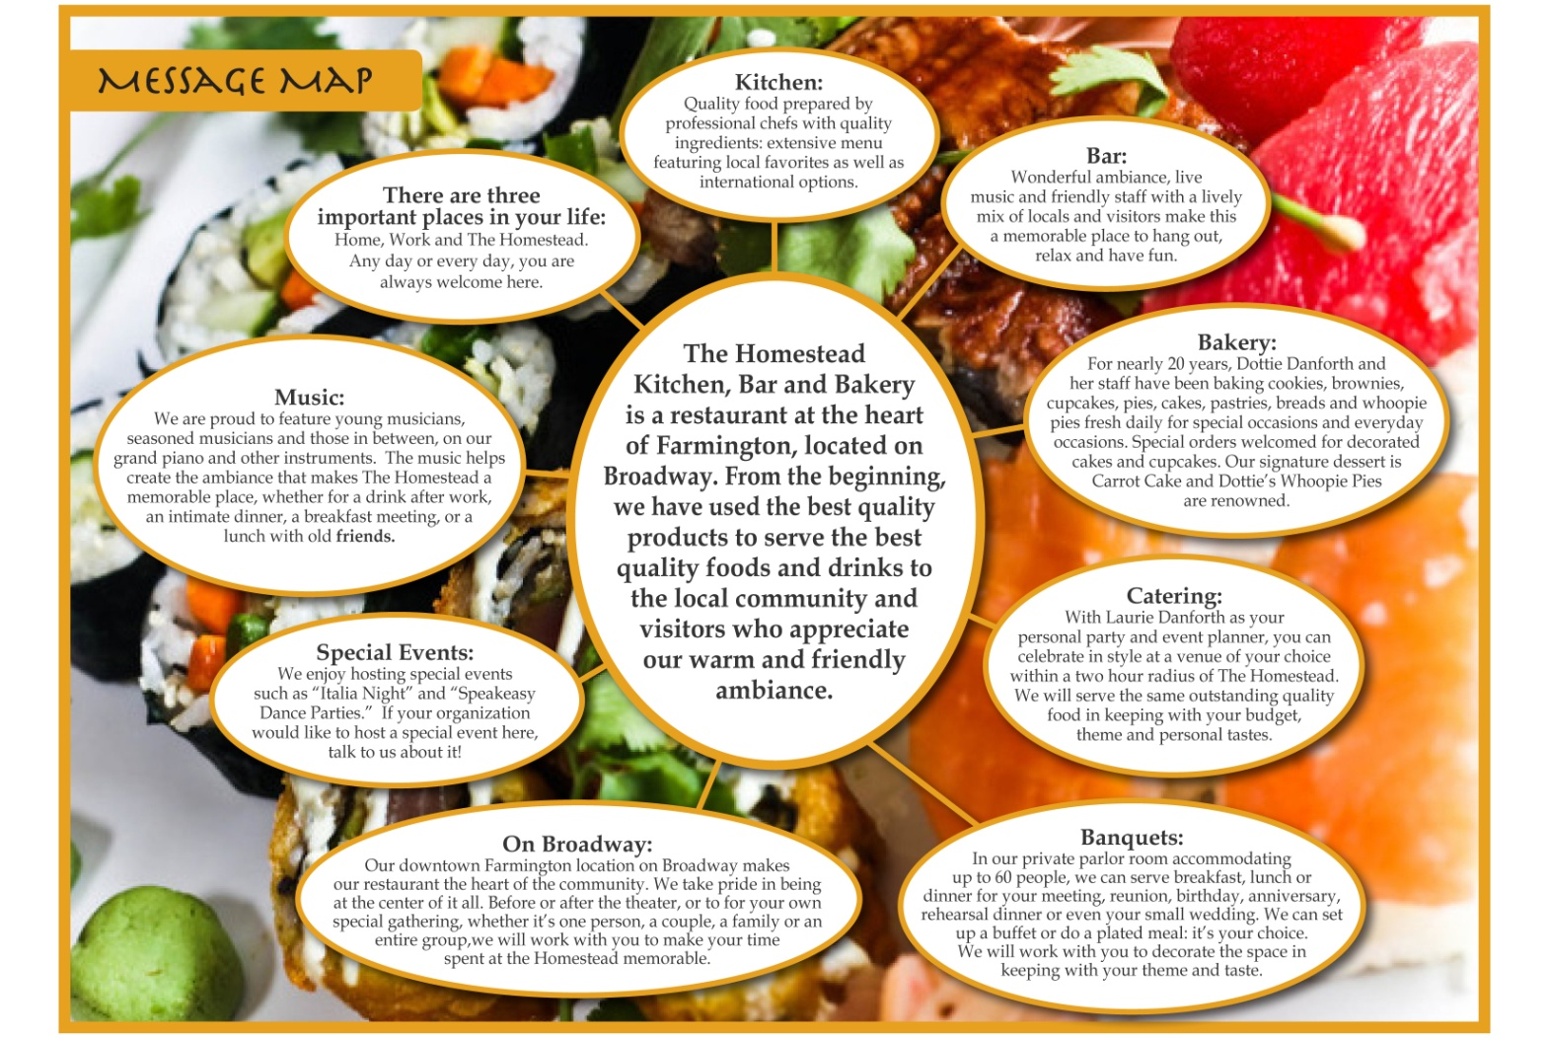
What is a Message Map?

Slide 47
Recommended Reading
Katie Delahaye Paine ― Measure What Matters,
Online Tools for understanding customers, social media, engagement and key relationships
Seth Godin ― Tribes, We Need You to Lead Us
Scott Stratten ― Unmarketing, Stop Marketing,
Start Engaging

Slide 48
One final message from our Sponsor
Visit the NMC booth at the Trade Show during the breaks and get a wonderful caricature drawing of yourself!
Register to win a Visa gift card valued at $100 and you will receive a complimentary subscription to “The NMC Report”
I will choose one business card from the participants in this seminar at the end of the day to win Katie Paine’s book.

Slide 49
My Contact Info
Nancy Marshall, Agency Principal
Nancy Marshall Communications
PO Box 317 | Augusta, ME 04332
nmarshall@marshallpr.com
www.maineprmaven.com: my blog
Also follow NMC on Facebook and Twitter

