Slide 1
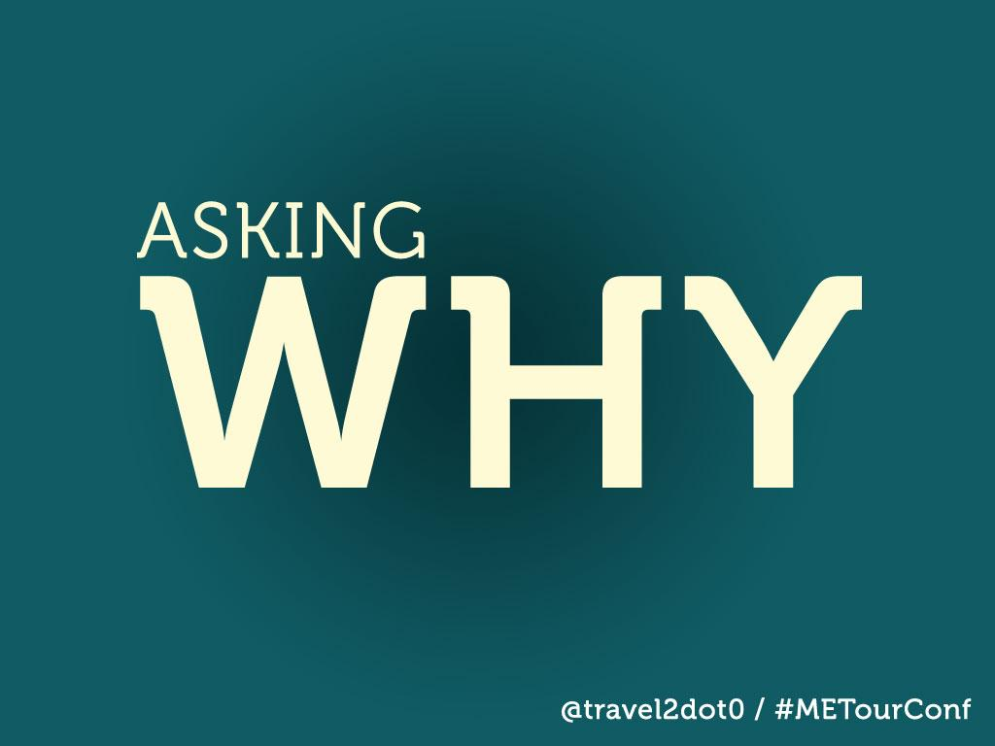
Notes:
Hi.
You made the right choice.
Best looking, or at least best dressed.

Slide 2

Notes:
So thank you for being here.
I am excited.
Happy to be in Maine.
Let's get out of that coffee coma and have some fun.

Slide 3
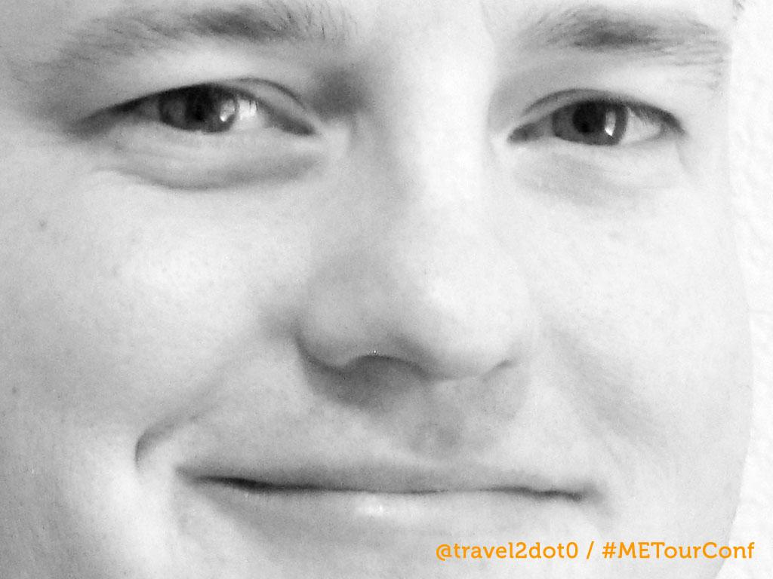
Notes:
Who I Am.
Background.
Travel 2.0 = We help destiantions answer tough questions.
I don't like the status quo, less is more, DMOs love to copy each other.
I will not tell you to have a Facebook page, mobile app or even a website.
I am here to help you...

Slide 4
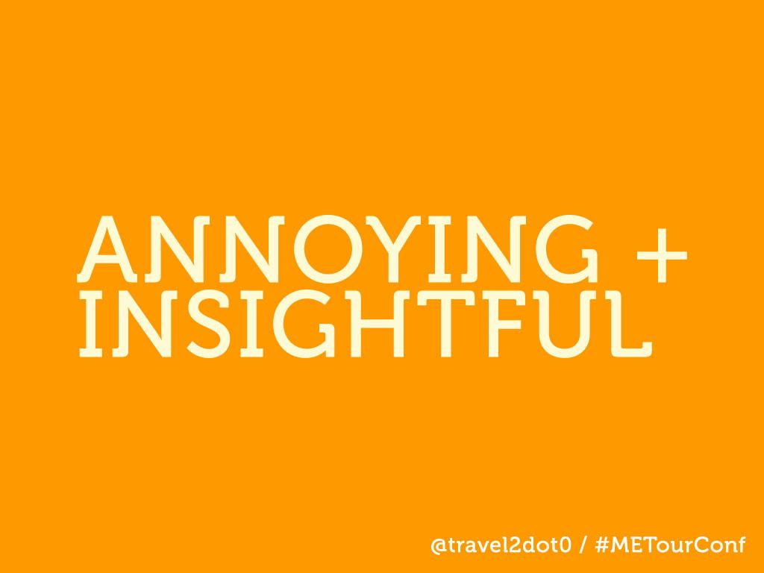
Notes:
Why I am here.
I am here to change your thinking.

Slide 5

Notes:
What you will learn.

Slide 6
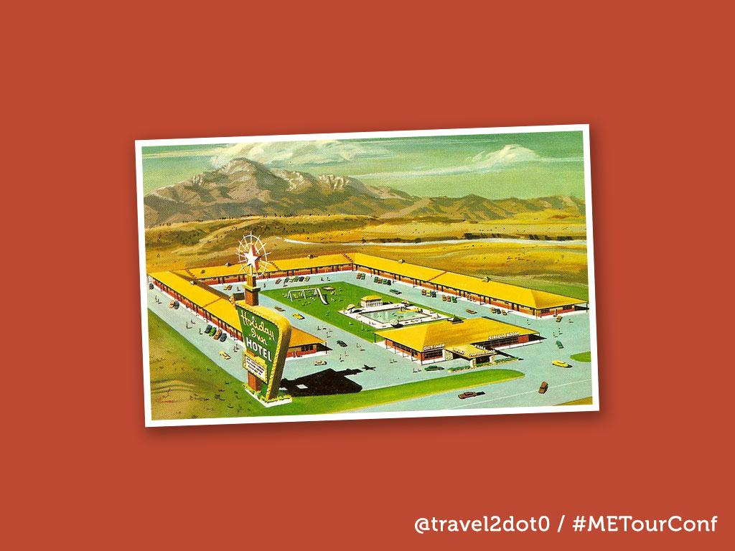
Notes:
Story about dad.
Instead of the one-on-one opportunity, we now have an opportunity to connect to the masses.
Carolann talked about this idea this morning. To convince the visitor to come to Maine, you need that authentic voice...freinds, family, connections...saying that Maine it great.
Digital now gives us that opportunity.
But it also presents us with some challenges.

Slide 7
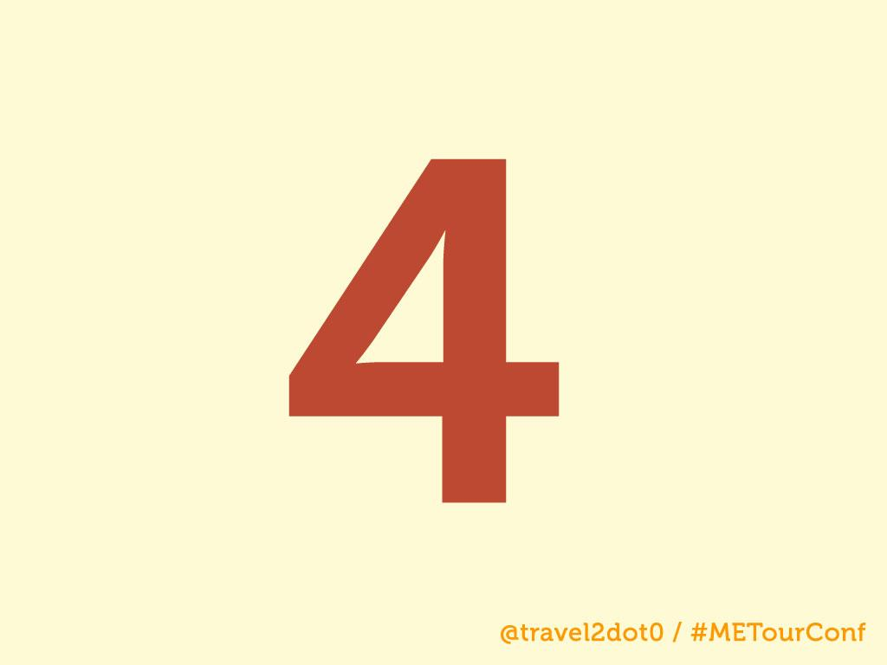
Notes:
Challenges, Strategy, Future, Thinking.

Slide 8

Notes:
We are all facing the same challenges...web, social, mobile, there is a new social site born every 15 minutes.
It is why you are in this session, well, and you heard I was the best-looking presenter at the conference today.

Slide 9
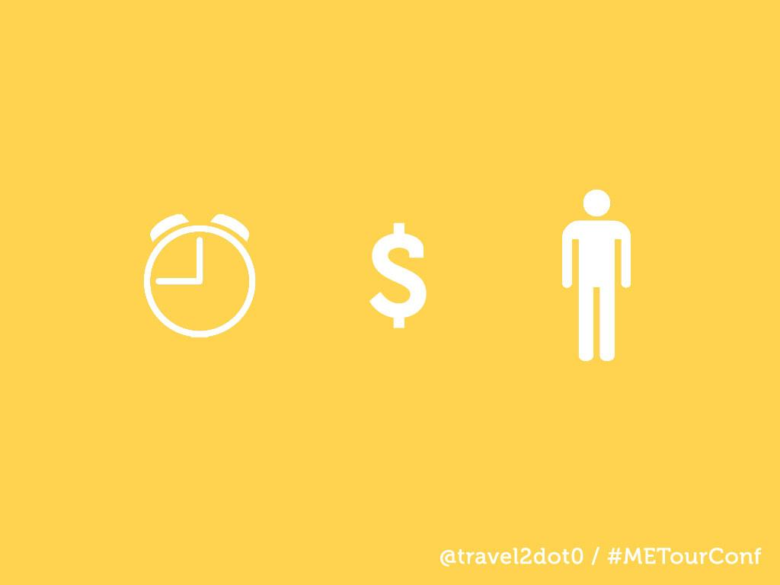
Notes:
Time, money, people.
Digital roller coaster.
Social ROI.
What is the ROI of your cell phone?

Slide 10
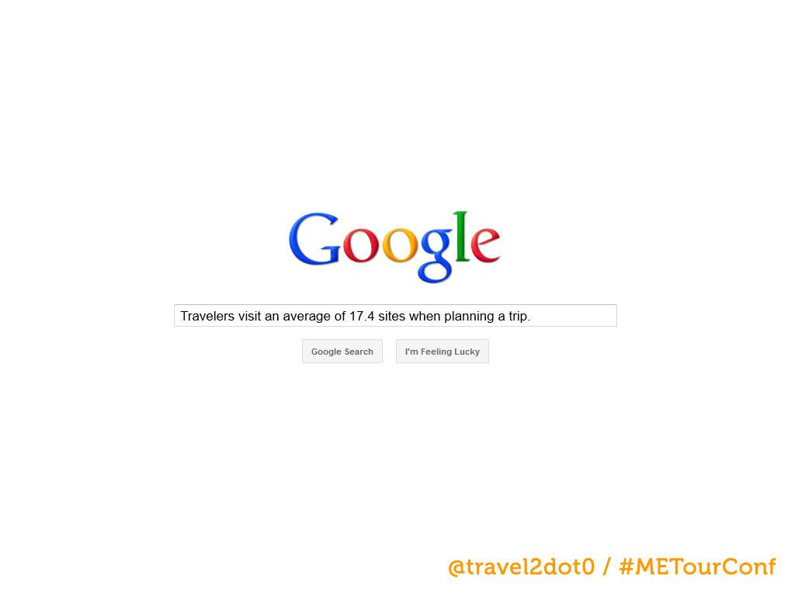

Slide 11
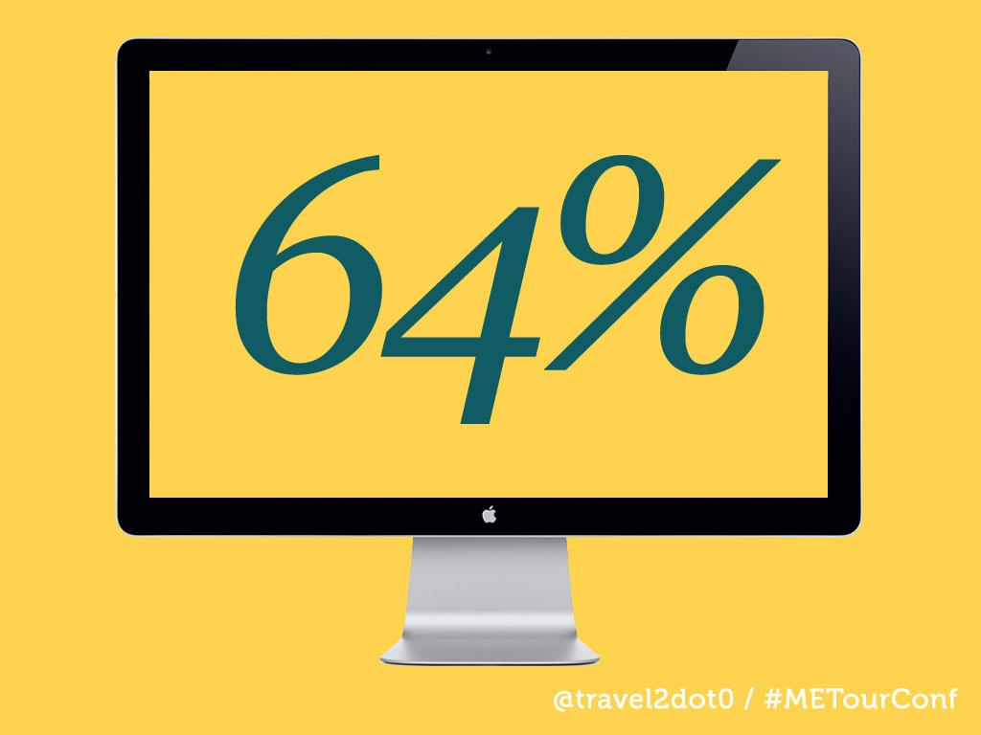
Notes:
64% of travelers say they planned part of the trip with social media. Source: Starwood Hotels & Resorts, Nov. 2010

Slide 12
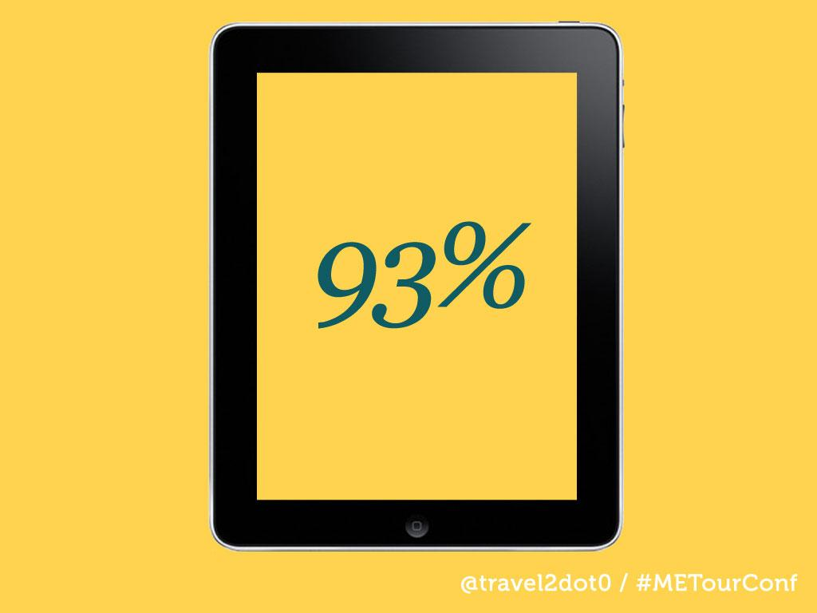
Notes:
93% of travelers (with an iPad) regularlly engage with the device while traveling. Source: Greystripe, September 2011.

Slide 13
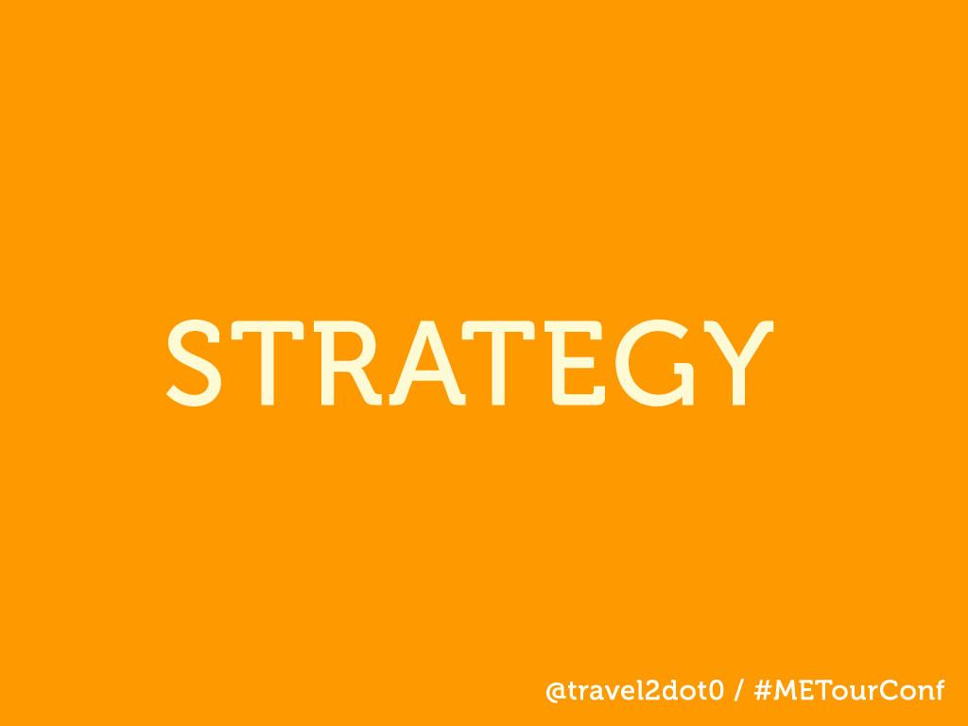

Slide 14
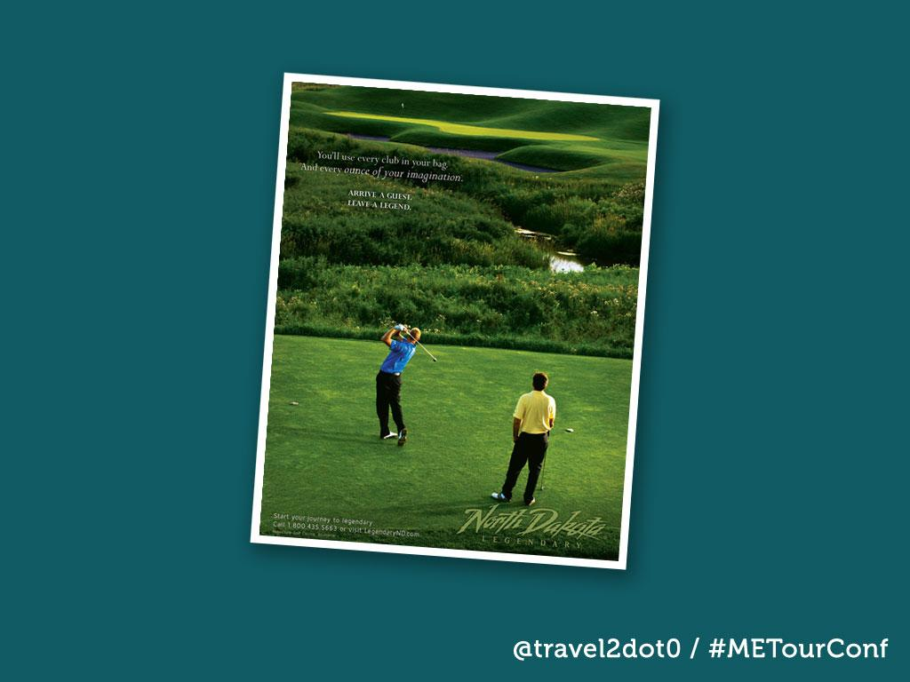
Notes:
Brand > Goal > Digital
We usually start here. Hey, we are great at everything! I just wrote a story about a DMO advertising a bar, everyone has a bar! Tell me what is unique.
When you get down to the digital level, typically, you see two things: over-the-top and hidden in the sand. Reno story. Dallas story.

Slide 15
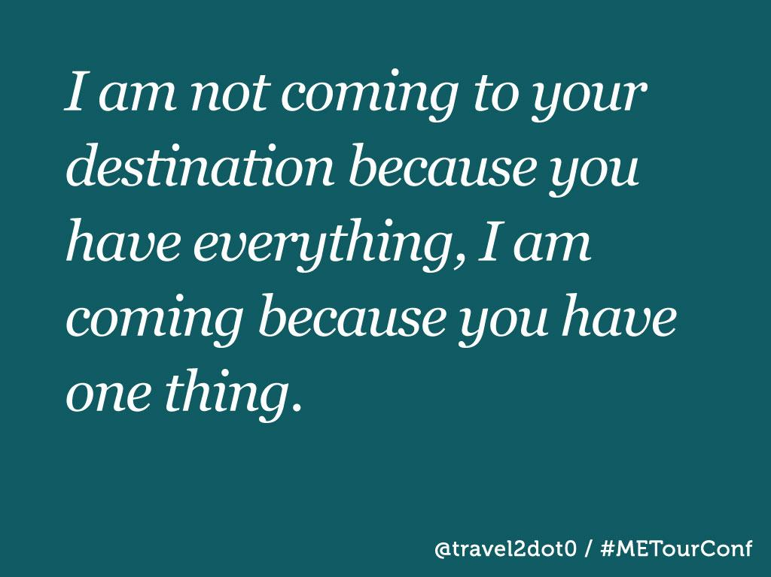
Notes:
Post
P is People. Don't start a social strategy until you know the capabilities of your audience. If you're targeting college students, use social networks. If you're reaching out business travelers, consider ratings and reviews. Forrester has great data to help with this, but you can make some estimates on your own. Just don't start without thinking about it.
O is objectives. Pick one. Are you starting an application to listen to your customers, or to talk with them? To support them, or to energize your best customers to evangelize others? Or are you trying to collaborate with them? Decide on your objective before you decide on a technology. Then figure out how you will measure it.
S is Strategy. Strategy here means figuring out what will be different after you're done. Do you want a closer, two-way relationship with your best customers? Do you want to get people talking about your products? Do you want a permanent focus group for testing product ideas and generating new ones? Imagine you succeed. How will things be different afterwards? Imagine the endpoint and you'll know where to begin.
T is Technology. A community. A wiki. A blog or a hundred blogs. Once you know your people, objectives, and strategy, then you can decide with confidence.

Slide 16
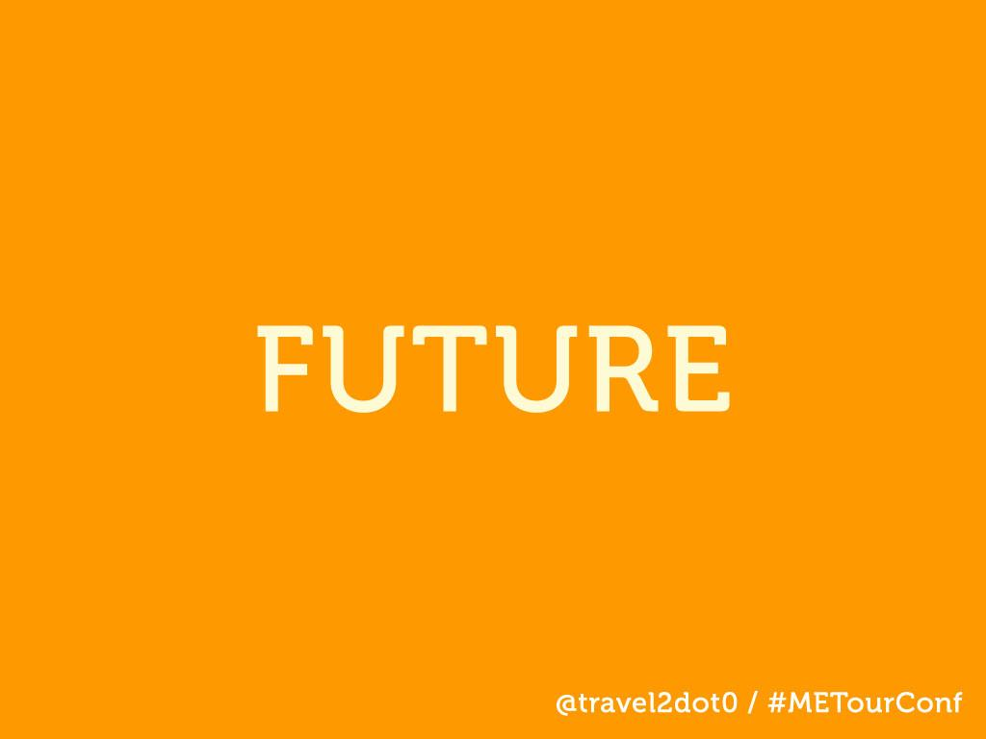

Slide 17

Notes:
Specifically content curation.

Slide 18

Notes:
If you not fast, your last.
People want information now. This is how you gain and keep marketshare in the digital decade.

Slide 19
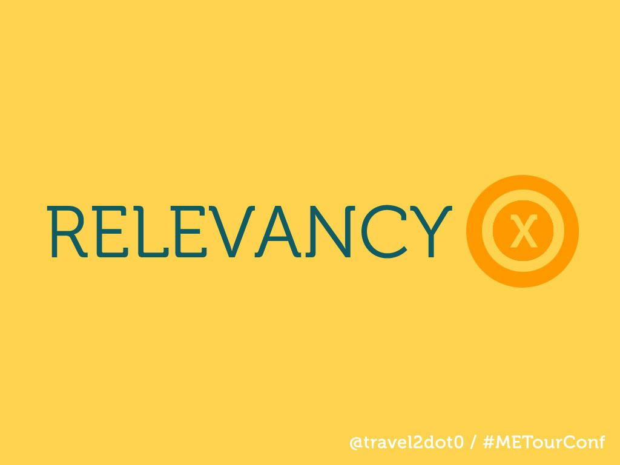
Notes:
You no longer have to find the information, the information finds you. Based on Likes, past behavior, location, etc.

Slide 20
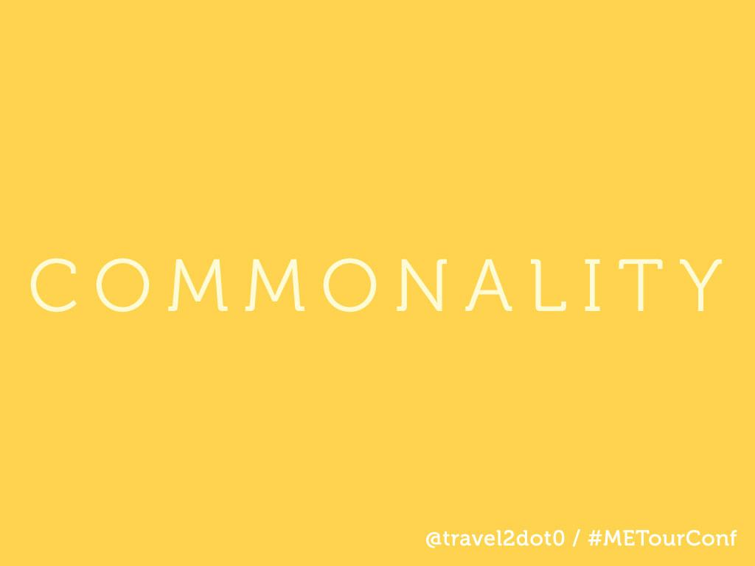
Notes:
There is no more mobile. The is not more web. There is simply digitial. Consumers want the same interaction across all of your networks.

Slide 21

Notes:
If content is king, story is the queen. Carolann talked about an emotional connection this morning. And you are the start of that emotional connection. Your experience, your story. Everyone wants to travel like a local.

Slide 22


Slide 23
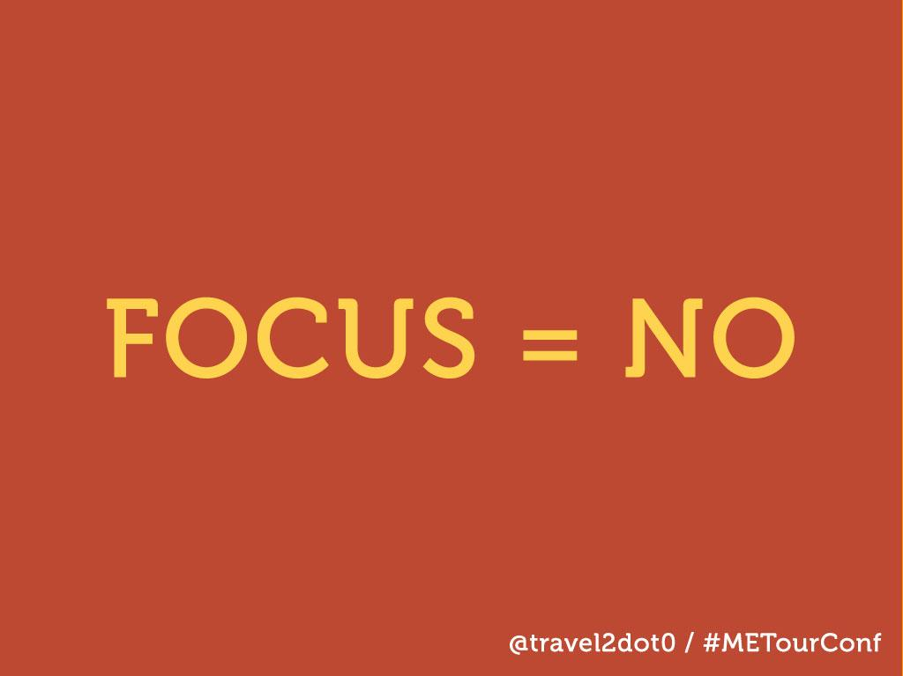

Slide 24
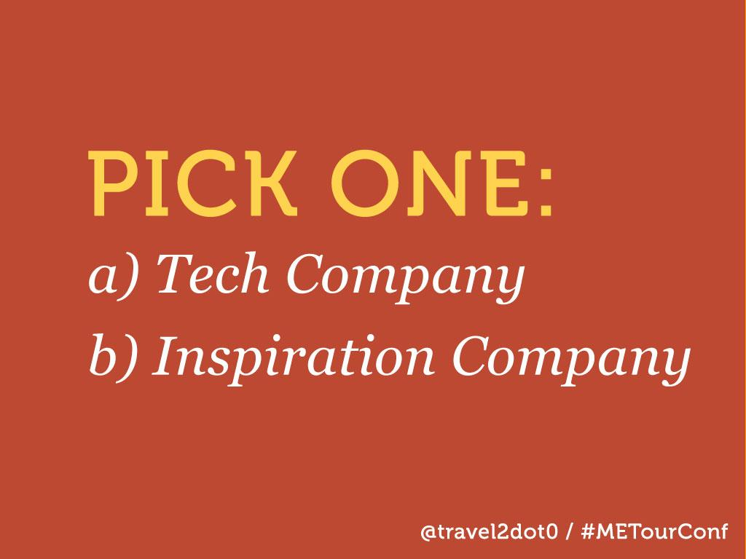

Slide 25
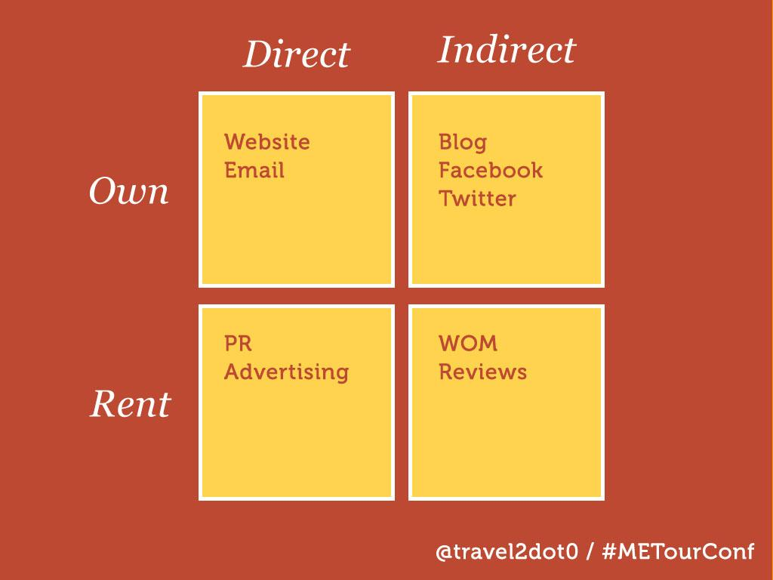
Notes:
Time Required

Slide 26

Notes:
Consideration Square

Slide 27

Notes:
We all have challenges, but those challenges present us with some great opportunites.
Opportunites to connect directly with our visitors.
To show them the wonders of our destination.
To help them find that local spot with all of the cars out front.
Make no mistake, this is a tough time to be in destination marketing.
But it is also an amazing time.
As you are faced with these new challenges, these new social networks, these new demands.
Stop and think. Take the time to develop your plan, think about Post, ask yourself why. Take time to think.
This is a great job.
Thank you.

Slide 28


Slide 29
