Slide 1

How To Facilitate ONLINE Learning
With Katrina Kennedy

Slide 2
Today’s Schedule
9:00 -10:30
Zoom
10:45-12:00
Zoom
10:30-10:45
Break

Slide 6
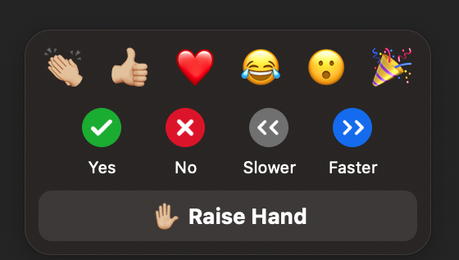

Slide 7
Navigating Zoom! Scavenger Hunt
Raise your hand
In the chat box type something UNINTERESTING about yourself
Select the GREEN CHECK (in Reactions) when you are done
Lower your hand
Use the Green Annotate Pen in the left corner to stamp the screen

Slide 8
What are you wondering…

Slide 9
Do I have any pets?
Do I have children?
Do I have any hobbies?
How long have I been doing this?
What’s my favorite…?
What’s the last book I read?

Slide 10
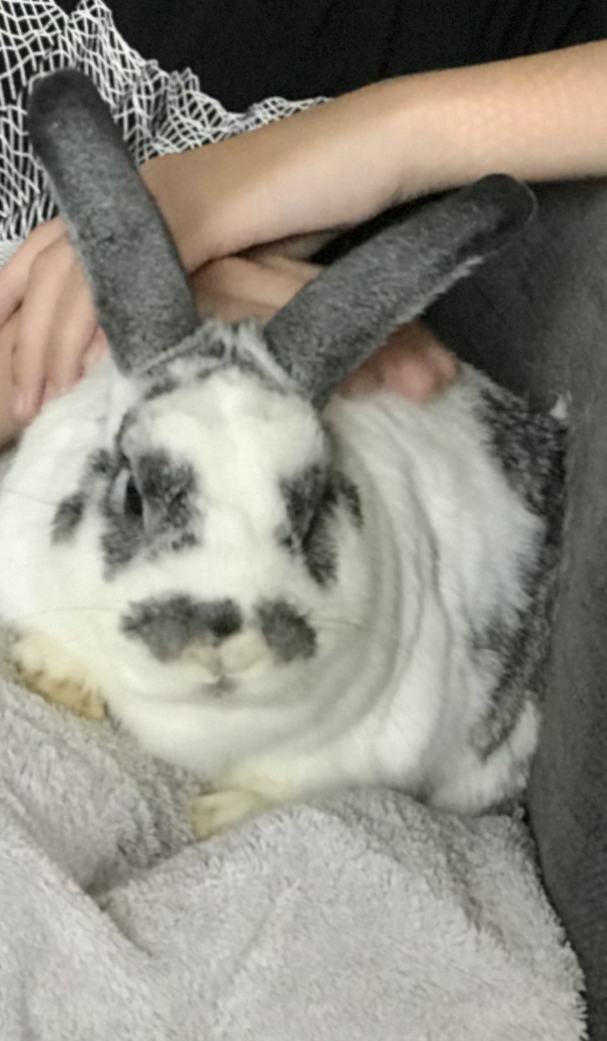


Me in 6 photos

Slide 11


Slide 12
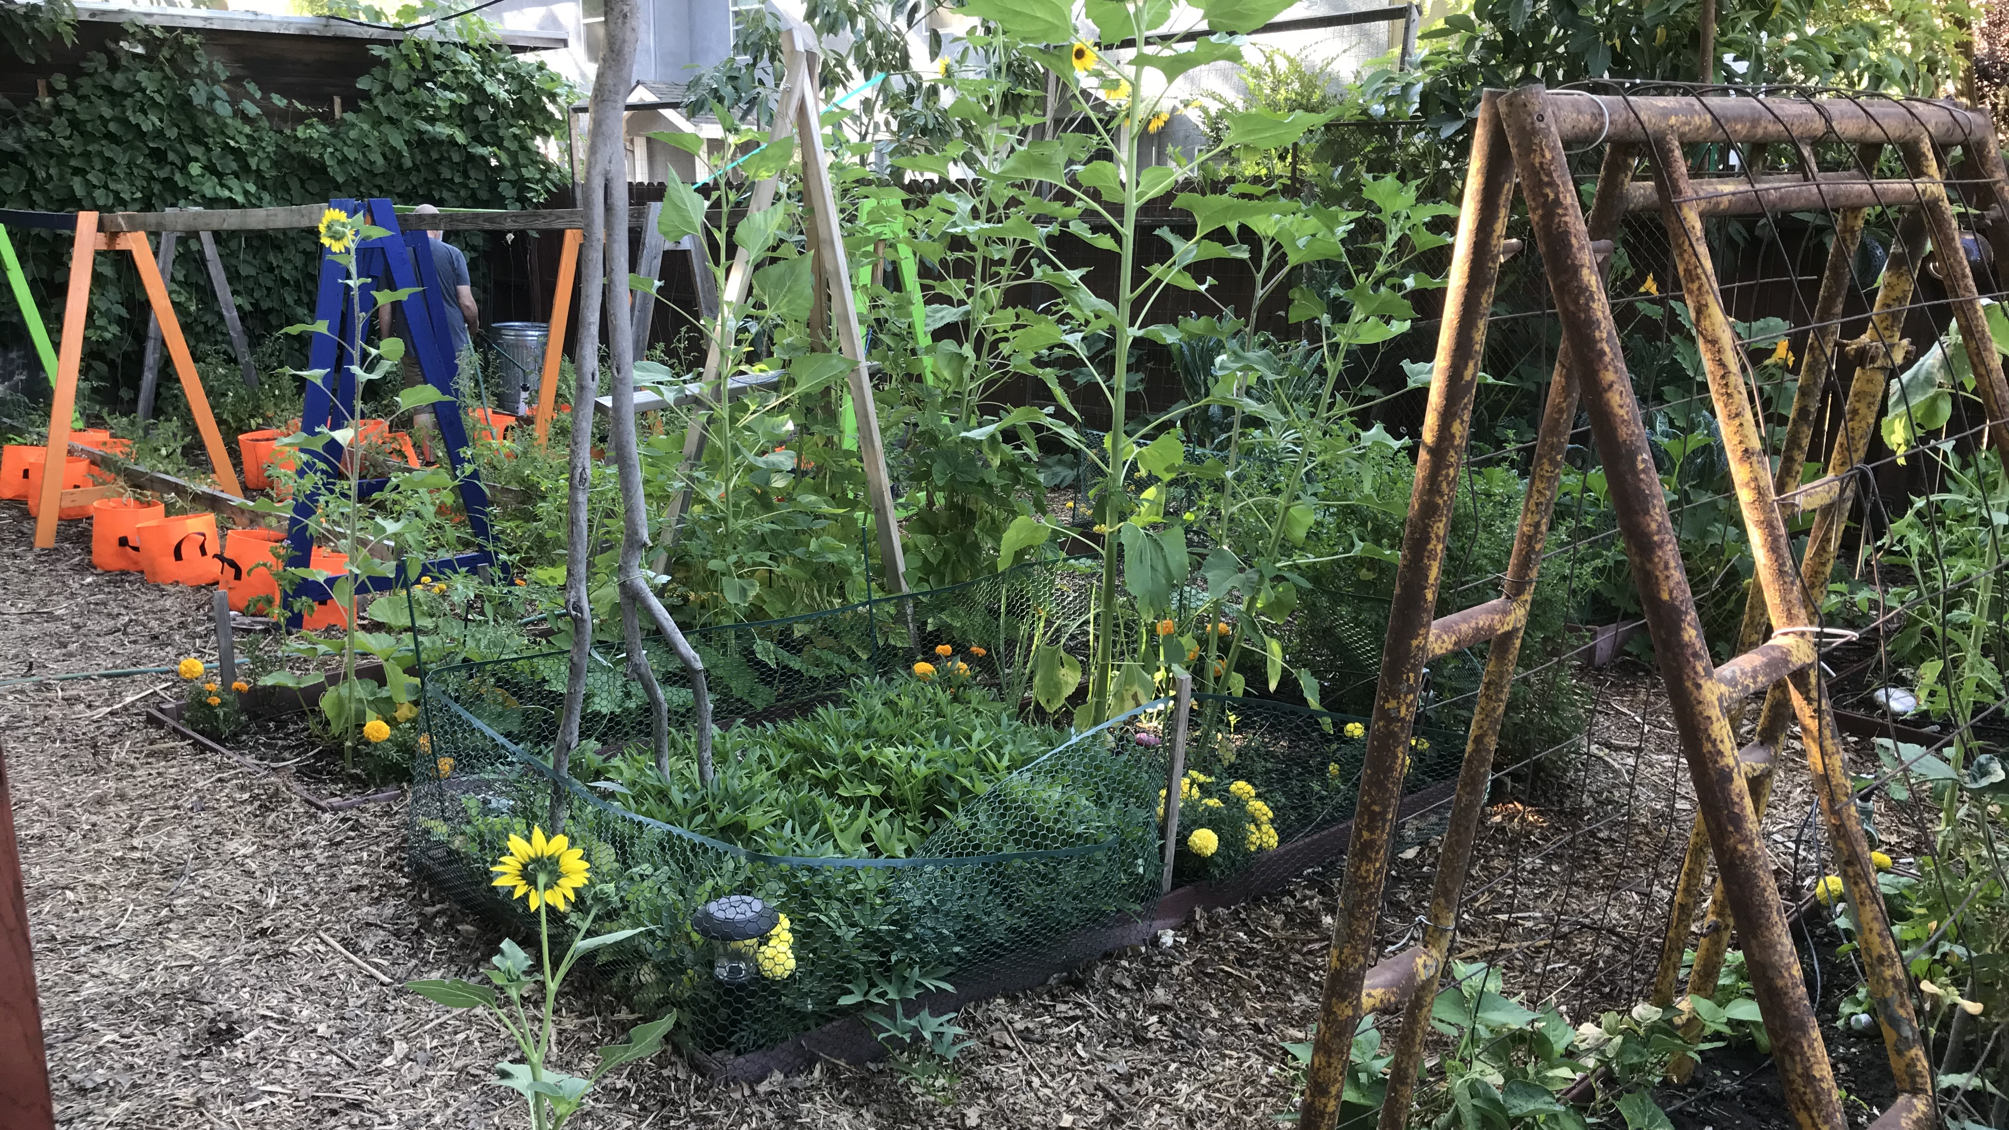
Me in 6 photos

Slide 13
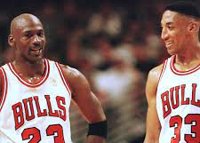



Guess The Year?!

Slide 14






Me in 6 photos

Slide 15


Slide 16
Objectives
Use a variety of techniques to engage learners.
1
Deliver clear instructions to learners.
2
Ask meaningful questions that get responses.
3
Use signposts to transition throughout training.
4
Practice phrases to use while facilitating learning.
5
Evaluate your facilitation skills using a detailed checklist.
6
Use VIEW OPTIONS/Annotate/STAMP to stamp your objective

Slide 17






20 Questions Minus 14
Your name.
What you do (not in code).
The objective you selected.
Something you are proud of.
What do you want learners to do after training?
Are you a Vacationer, Explorer, or Prisoner?

Slide 18



Prisoner
Vacationer
Explorer

Slide 19
20 Questions –Minus 14
3-4 per group
12 minutes
Say
Discuss
Avoid
Discuss
Say hello to each other!
Discuss your answers
Avoid reading down your list
If time allows, discuss what you noticed about 20 Questions, Minus 14
Join
Join your room

Slide 20
20 Questions Minus 14
Your name.
What you do (not in code).
The objective you selected.
Something you are proud of.
What do you want learners to do after training?
Are you a Vacationer, Explorer, or Prisoner?

Slide 21
What Makes Training A Great Experience For You?

Slide 22
Begin with the learner in mind.

Slide 23
How do we learn?

Slide 24


Slide 25
Connect To Learn | 2. Make It Visual To Learn | 3. Build Structure To Learn | 4. Expend Effort to Learn
5. Change Things To Learn | 6. Vary Practice To Learn | 7. Move To Learn | 8. Retrieve To Learn
9. Reflect To Learn | 10. Solve Problems To Learn | 11. Test To Learn | 12. Fail To Learn
13. Take A Break To Learn | 14. Write To Learn | 15. Sleep To Learn | 16. Feedback To Learn

Slide 26
Read Your Learning Principle
Read
Prepare
Ask
Access
Read your learning principle
Prepare to explain it to other people in your own words
Ask for clarification
Access learning principles on KKT website. Michelle will link in chat
Check
Check YES when ready (or type YES in chat)

Slide 27
Learning Principles Room Hop
18 minutes
3 per room
Explain
Watch
MOVER
Call
Explain your principle to the person in your breakout room
Watch time on the slide
When time to move, select BREAKOUT room from toolbar, GO TO THE NEXT ROOM
Have fun! Call for HELP if needed!
Greet
Greet each other and decide who will be the MOVER

Slide 28
No Breakout rooms?
Click the …

Slide 29
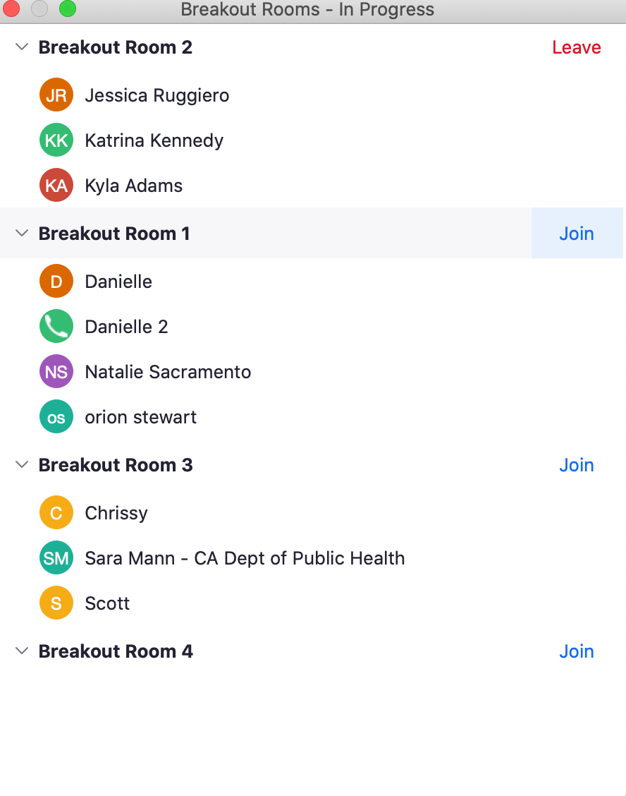

Slide 30
Greet each other! Select your MOVER.
(2.5 minute timer)

Slide 31
Share your learning principles!
(three-minute timer slide)

Slide 32
MOVERS! MOVE TO THE NEXT ROOM
No Breakout rooms?
Click the …

Slide 33
Greet each other!
(30 second timer)

Slide 34
Share your learning principles!
(three-minute timer slide)

Slide 35
MOVERS! MOVE TO THE NEXT ROOM

Slide 36
Greet each other!
(30 second timer)

Slide 37
Share your learning principles!
(three-minute timer slide)

Slide 38
MOVERS! MOVE TO THE NEXT ROOM

Slide 39
Greet each other!
(30 second timer)

Slide 40
Share your learning principles!
(three-minute timer slide)

Slide 41

We are closing the rooms!

Slide 42
Connect To Learn | 2. Make It Visual To Learn | 3. Build Structure To Learn | 4. Expend Effort to Learn
5. Change Things To Learn | 6. Vary Practice To Learn | 7. Move To Learn | 8. Retrieve To Learn
9. Reflect To Learn | 10. Solve Problems To Learn | 11. Test To Learn | 12. Fail To Learn
13. Take A Break To Learn | 14. Write To Learn | 15. Sleep To Learn | 16. Feedback To Learn

Slide 43
Connect To Learn | 2. Make It Visual To Learn | 3. Build Structure To Learn | 4. Expend Effort to Learn
5. Change Things To Learn | 6. Vary Practice To Learn | 7. Move To Learn | 8. Retrieve To Learn
9. Reflect To Learn | 10. Solve Problems To Learn | 11. Test To Learn | 12. Fail To Learn Failed recipe recovery ideas
13. Take A Break To Learn | 14. Write To Learn | 15. Sleep To Learn | 16. Feedback To Learn

Slide 44

What Do You Wonder About The Learning Principles?

Slide 45
What Do You Wonder About The Learning Principles?

Slide 46
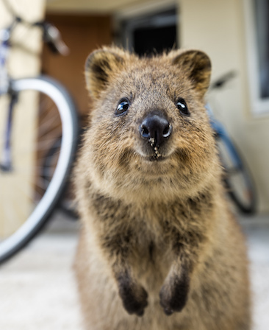
We’ll return in 15 minutes.
Enjoy your break!
Take a walk
Stretch
Stand up
Drink some water
This Photo by Unknown Author is licensed under CC BY-SA-NC

Slide 47
What Makes Instructions Clear?

Slide 48
Clear Instructions
Are visual
Begin with a verb
Are Specific
Use clear language
Include time
Are chunked

Slide 49
Phrases to Say, Phrases to Avoid
3 per room
12 minutes
Pick
Share
Pick
Discuss
Check
Pick a facilitator
Share page 6
Pick YES or NO for each
If no, discuss a better phrase
Check your answers on page 17 when done

Slide 50
Which phrases stood out for you?

Slide 51
Which phrases were easy to identify?

Slide 52
Which phrases were more difficult to identify?

Slide 53
What did you learn from the phrases?

Slide 54
How will you change your phrases in your next classes?

Slide 55
Raise your hand if you’ve asked a question and NO ONE responded

Slide 56






6 Ways To Get Responses
”Give me three answers.”
If ready to move forward
Wonder Wall
Return with 2
Quiz Them
Annotate FAQs

Slide 57
How To Ask Questions
Keep it simple
Avoid and/or
Pause
Repeat question
Give specific way to respond
Acknowledge answer

Slide 58
How To Answer Questions
Pause
Repeat the question in your answer
Keep it brief
Refer to slide if possible
Acknowledge question
Say, “I don’t know, but let me find the answer for you…”

Slide 60

What’s A Signpost
A sign giving direction & distance
Found at crossroads
Now, I’d like to talk about...

Slide 61
I’d like to change the subject…
Let’s move forward to …

Slide 62
Breakout:
Signpost
12 minutes
Join
Join your room
Decide
Decide who will go first
Share
Share a story for 30 seconds
Signpost
At 30 seconds, use signpost to your next story
Dis

Slide 63
Possible Stories
Anything work related!
Your first pet
Your favorite pet
Your last vacation
Your next vacation
A favorite food
A least favorite food
How you became a trainer

Slide 64
Take a deep breath.
Decide who will go first.
Wait until the slide transitions to begin.
(30-second timer)

Slide 65
Share your story.
At the halfway point, signpost!
(1-minute timer)
signpost

Slide 66
Discuss what you noticed.
Next person be ready when the slide transitions.
(1-minute timer)

Slide 67
Share your story.
At the halfway point, signpost!
(1-minute timer)
signpost

Slide 68
Discuss what you noticed.
Next person be ready when the slide transitions.
(1-minute timer)

Slide 69
Share your story.
At the halfway point, signpost!
(1-minute timer)
signpost

Slide 70
Discuss what you noticed.
What can you take away from this activity?
(1-minute timer)

Slide 71
We are closing the rooms!
You have one minute to continue your discussion

Slide 72
5 Ways You Were Engaged Today
Take two minutes
Write down ways you were engaged today

Slide 73


One thing you learned
One thing you’ll stop doing
SPIN
One word to describe your experience
One thing you’ll start doing
An activity you loved
tekhnologic
Notes:
5 Segments

Slide 74
Jennifer | A | Kelly | Marie
Brianne | Kelly M | Jeff | Andrew
Zac | Shola | Kim | Shannon
Lynn | Christopher

Slide 75
Paired Reflection
2 per room
5 minutes
Join
Discuss
Discuss
Join your breakout room
What you’ve learned in class
How your learning relates to your own work

Slide 76
Discuss
What have you learned so far in class?
How does your learning relate to your own work?

Slide 77

Use page 3 to write notes you want to remember.

Slide 78

See you tomorrow for practice!
Be ready with a 3-5 minute portion of a training
Think about:
1.Connecting to learners
2. Using learning principles
3.Expressing a clear purpose

Slide 79

7 Methods For Managing Behavior
Create a positive environment
Create connection
Set clear expectations
  Schedule
  Response method
  Cameras/Mics
Provide clear instructions
Engage, engage, engage
Assume the best
Address problems quickly

