Slide 1

Welcome!
Close things you aren’t using
Turn on your camera
Unmute yourself, say hello!
Click on participants, see who is here
Try Speaker View and Gallery view
Write down our producers #

Slide 2
Training for Trainers
With Katrina Kennedy

Slide 3
Navigating Zoom! Scavenger Hunt
Open the Participants Box
Raise your hand
In the chat box type, “I want to learn to _________.” (insert your response)
Send a private chat to Katrina with an obstacle you might have today
Give a thumbs up reaction when you are done
Lower your hand

Slide 4
Today’s Schedule
8:30-10:00 Zoom
10:00-10:15 Break
10:15-12:00 Zoom
1:01- 2:00
Zoom
2:10-2:25 Break
2:25-4:00 Zoom
12:00-1:01 Lunch

Slide 5
Objectives
Use a systematic approach to training
Identify performance issues in the workplace
Analyze situations to identify potential training needs
Analyze the target audience
Complete a task analysis
View Options
Annotate
Select Stamp

Slide 6
Learners Need To Connect To Three Things
Each other
Facilitator
Content

Slide 7






20 Questions Minus 14
Your name
What you do (not in code)
The objective you selected
What are you most proud of?
What training skill do you want to improve?
Are you a Vacationer, Explorer, or Prisoner?

Slide 8
Training
Sex
Education
Sex
Presenting
Sex

Slide 9
Training is ______________ based and _______ focused.
performance
learner

Slide 10
ADDIE – Systematic Approach To Training
Implement
Evaluate
Develop
Design
Analyze

Slide 11

Quick Quiz Answers
1. In general, workplace performance is more affected by <☐environmental ☐individual> factors.

Slide 12
2. Training is often <☐necessary ☐sufficient> but rarely <☐necessary ☐sufficient> to produce long term results.

Slide 13
3. Training, as an intervention to improve performance, is most appropriate when staff lack <☐knowledge & skills ☐motivation>.

Slide 14
4. It is cheaper and easier to fix the <☐individual ☐environment>.

Slide 15
5. A strong indicator that training will not produce desired performance is that workers <☐lack requisite skills and knowledge ☐could perform correctly in the past>.

Slide 16
6. If staff are not performing as desired after they were trained,<☐ provide refresher training ☐suspect that it is not a knowledge or skill issue>.

Slide 17
7. Bright, capable people who have demonstrated past performance success are <☐ generally secure ☐often insecure> in a new job.

Slide 18
8. Excellent training, well designed and delivered, that produces strong learning results <☐guarantees ☐does not guarantee> high rates of transfer to the job.

Slide 19
9. What supervisors do with the trainees before training has a <☐high ☐moderate ☐low> impact on post-training transfer.

Slide 20
I would perform better if…
I knew the expectations of the job and had more specific job feedback and better access to information
I had better tools and resources to work with
I had better financial and nonfinancial incentives/consequences for doing my work
I received more and better training to do my job
My personal characteristics and capacities better matched the job
I cared more and really wanted to do my job better
Notes:
Ask them to select their personal answer and write it down.
Ask them to select the answer a few of their employees might select.
ONLY ONE RESPONSE ALLOWED!

Slide 21






Gilbert’s Behavior Engineering Model – Page 10
Environment | Information | Resources | Incentives & Consequences
Individual | Knowledge & Skill | Capacity | Motivation
35%
26%
14%
11%
8%
6%

Slide 22
View Options/Annotate/Text
What can you recall from this morning?
1 | 2 | 3
4 | 5 | 6

Slide 23
What do you recall?
Alexis | Peter | Cheuk | Rachel | Sierra
Ray | Dawn | Anna | Trina | Trent
Ken | Nicholas | Jeremy | James | Susan
Maya | Stephanie | Thanh | Thomas | Kristin
Nicole | Dana | Phi | Julie

Slide 24
The Situation
From 2013 to 2016, the total number of crashes involving CHP officers and employees increased by 23 percent, even as the annual number of miles driven went up by only 2 percent. The number of at-fault collisions are up by one-third.

Slide 25
What do you want people to do after training?
Task
Noun
Action Verb

Slide 26

learn
know
understand

Slide 27
Active Verbs For Tasks (And More)
KNOW* | UNDERSTAND*
Recognize | Describe
Define | Identify
Describe | Select
List | Summarize
Name | Explain
State | Restate

Slide 28
Active Verbs For Tasks (And More)
APPLY | ANALYZE | EVALUATE | CREATE
Choose | Calculate | Detect | Construct
Demonstrate | Categorize | Monitor | Design
Show | Compare | Check | Generate
Operate | Contrast | Arrange | Plan
Complete | Differentiate | Justify | Invent
Classify | Investigate | Prioritize | Predict

Slide 29
Write Tasks
Answer telephone
Telephone
Answer
Big list of verbs on Page 18

Slide 30
Have you done any these of these in the last seven months?
If you have then, View Options/Annotate/Text to add your initials to the BINGO card. Shout BINGO if you get one!
Used View Options, Annotate to stamp my arrow on Bingo card | Planted a garden | Typed 2 things I learned on day 1 into chat | Ordered take out | Read news at 2AM
Left dirty dishes in the sink over night | Took a walk | Cooked with an ingredient buried in freezer | Finished a book | Arrived late to a virtual meeting.
Zoomed with a relative | Cooked a new dish | FREE SPACE | Did something for yourself | Took a daytime nap
Cried | Met someone new in class. | Lost internet connection during a meeting | Missed your coworkers quirky ways | Sent Private Chat while Katrina was talking
Voted early | Realized you are stronger than you thought | Ordered a case of something | Appreciated something you never thought you would | Ate something you’ve never eaten

Slide 31
Training For Trainers
Day 2 | Design

Slide 32
Performance Goal: Manage Incoming Calls
Task | Steps | Methods
1. Answer telephone | 1.1 Pick up phone 1.2 Greet caller with four part greeting: 1.2.1. Good morning 1.2.2. Department of Great Ideas 1.2.3. This is Sue 1.2.4. How may I transfer your call?
2. Transfer call | 2.1. Identify extension caller want to reach 2.2. Place caller on hold 2.3. Dial extension

Slide 33
Audience
Degree
How well is it performed?
Condition
What do you expect them to do?
Behavior
Who is the intended learner?
What are they given to perform the task?

Slide 34
Training Design Approach
Feedback Method
Application Method
Presentation Method
Review Method

Slide 35



PAF+R
  Video
  Lecture
  Reading
  Demonstration
  Case study
  Drill
  Role Play
  Practice Exercise
  Peer to Peer
  Instructor
  Answer Key
  Consequences
Presentation
Application
Feedback

Slide 36
Performance Goal: Manage Incoming Calls
Task | Steps | Methods
1. Answer telephone | 1.1 Pick up phone 1.2 Greet caller with four part greeting: 1.2.1. Good morning 1.2.2. Department of Great Ideas 1.2.3. This is Sue 1.2.4. How may I transfer your call? | P: Video Example of Call A: Role play of mock call F Peer review
2. Transfer call | 2.1. Identify extension caller want to reach 2.2. Place caller on hold 2.3. Dial extension | P: Demonstration A: Simulation – classroom phone F: Instructor verbal feedback

Slide 37
What Do You Recall?
1 | 2 | 3
4 | 5 | 6

Slide 38
Before we get started @ 8:30 – Add your answers!
View Options/Annotate/Text to add your answers
In The Last 7 Months…
Best thing that happened to you | Coolest thing you've learned | Best meal you've eaten
Best TV show, Movie, or Book | Best activity you’ve experience in virtual meeting or training | One thing you recall from last week’s class

Slide 39
Training For Trainers
Day 3 | Develop

Slide 40
Use View Options>Annotate>Stamp To Stamp Your:
Energy
Focus | 0 |  | 10
Interest | 0 |  | 10
 | 0 |  | 10

Slide 41

Write The Words: Know The Purpose
Draw The Target

Slide 42
What message are you conveying?

Slide 43
Begin With The End In Mind

Slide 44
What Are You Trying To Convey?
How | Why
When | Where

Slide 45
Which Works For Your Message?
PowerPoint
Hand Out
Participant Guide
Tools
Audio Visual
PP2
PP
HO
HO3
PG
PG 5-7
T
T-Name
AV
AV-Name

Slide 46

Write The Words: One Idea Per Slide
Draw The Fingers

Slide 47
“Your slides should be a billboard not a document!”
Lee Jackson (Author)

Slide 48

Consider What Is Happening In Your Brain!
Keep your slides simple
Use more slides with less on them
If you are reading out loud, they’ve already passed you
Consider -- Where is the learner looking?

Slide 49
Keep Your Slides Simple

Slide 50
More slides with less on them

Slide 51
Where are you looking now?

Slide 52
Does size matter?

Slide 53
Which line do you prefer?
Which line do you prefer?
Which line do you prefer?
Which line do you prefer?
Which line do you prefer?
40 point -- Title
24 point -- Body

Slide 54
Use your style guide! Page 38

Slide 55

Write The Word: Use The Principles
Draw The Bars

Slide 56
Nine Design Principles
Alignment
Hierarchy
Contrast
Repetition
Proximity
Balance
Color
Space
Unity

Slide 57
Quick Quiz Before We Begin
Agree ✓or Disagree X
Use View Options/Annotate/Stamp to add your answer
We listen before we look
One idea per slide
Use center alignment when only a few words
Leave negative space
Every slide needs a photo
More slides, less on them
Our eye goes to the big, bold, bright things
Use left alignment
Use arrows to get attention

Slide 58


Write The Words: Avoid Boring Bullets
Draw The Bullet Points

Slide 59
No Boring Bullets
Place in shapes
Place next to photos
Consider it an image
Draw a diagram
Create a table

Slide 60
Change Bullets To SmartArt
Select bullet box
Home/Convert to SmartArt
Select SmartArt
Customize

Slide 61
Where is the learner looking?

Slide 62

Write The Words: Make It Related
Draw The Family

Slide 63

Make It Related
Use images that support your purpose
Avoid images just to fill space
Balance images with text
It’s okay to leave some white space
Learners will appreciate it

Slide 64

Write The Words: Think in Threes
Draw the die

Slide 65


Slide 66


Slide 67

Write The Words: Don’t Drown in Detail
Draw the swimmer

Slide 68
What is one thing you recall from our last three days together?
Alexis | Peter | Danny | Rachel | Sierra
Ray | Dawn | Anna | Trina | Trent
Ken | Stephanie | Jeremy | James | Susan
Maya | Dana | Thanh | Thomas | Kristin
Nicole |  | Phi | Julie

Slide 69
Training For Trainers
Day 4 | Implement

Slide 70
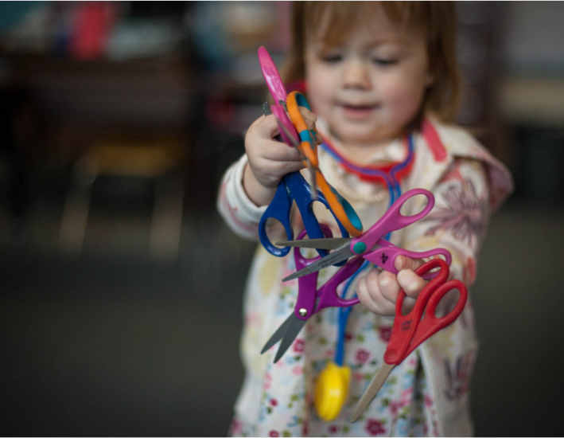
“People only learn from experience when they think back on their experience.”
Thiagi, thiagi.com

Slide 71
What can you recall about last week’s class?
What was easy about last week’s class?
What was difficult about last week’s class?
What was the value of last week’s class?
How will you use the information from last week’s class?

Slide 72


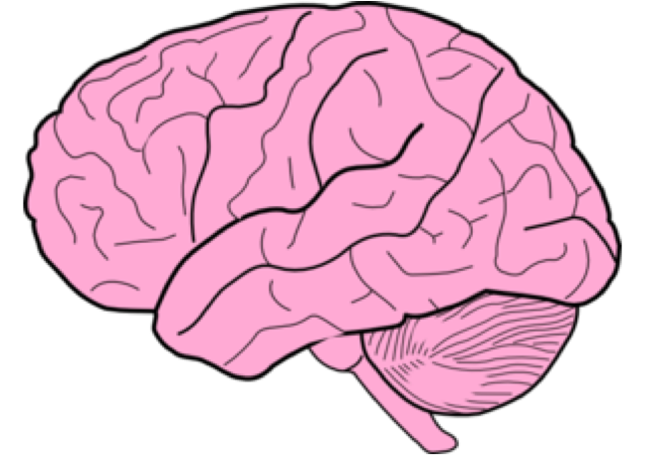


What can you recall about last week’s class?
What was easy about last week’s class?
What was difficult about last week’s class?
What was the value of last week’s class?
How will you use the information from last week’s class?

Slide 73
What have you noticed about WFH?
What do you like about WFH?
What is difficult about WFH?
What have you learned about WFH?
What will you do differently the next time you WFH?

Slide 74


Slide 75
Calming Your Nerves
Breathe
Routine
Purpose
Preparation
Find A Face

Slide 76

Reframe nervousness as excitement.

Slide 77
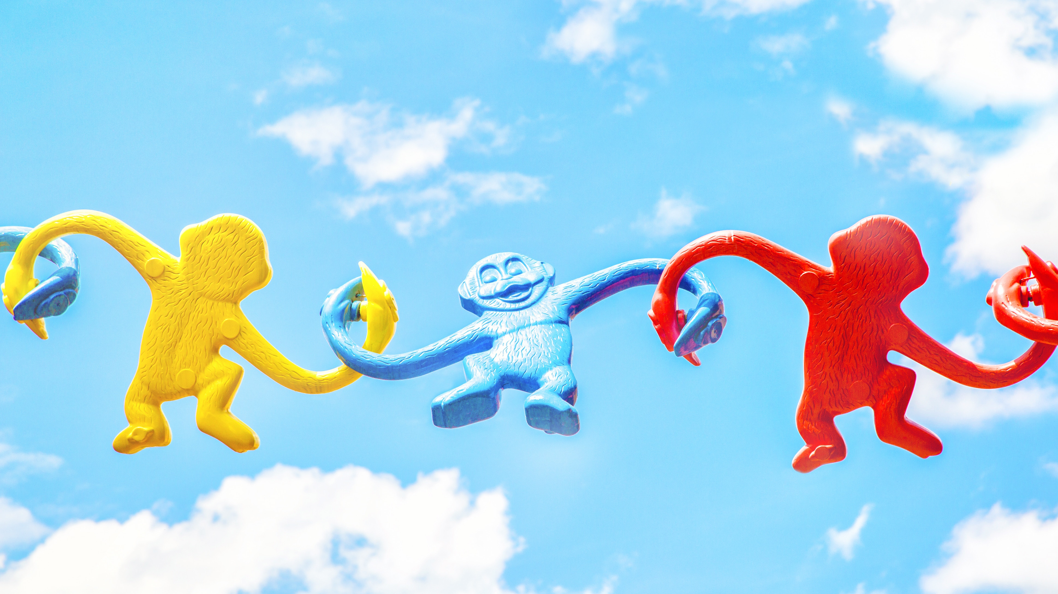
nercited

Slide 78
Co-Training
Things will go wrong.
Create agreements before they go wrong!

Slide 79
Co-Training
When…
We will…

Slide 80
Co-Training
When one of us shares incorrect information, we will discuss it on break and share the correct information when we return.
We agree to, not correct each other in front of class.

Slide 81
The Rambler
The Opinionated
The Talker
The Ghost
The Griper
The Quiet Withdrawn
The Heckler
The Side Talkers
The Texter
The Hostile Resistor
The Chronically Late
The Sharpshooter

Slide 82
Training for Trainers
Day 5 | Evaluate

Slide 83
ADDIE – Systematic Approach To Training
Implement
Evaluate
Develop
Design
Analyze

Slide 84
How do you know training was successful?

Slide 85

Write The Words: Level One | Reaction
Draw The Smiley Face

Slide 86

Write The Words: Level Two | Learning
Draw The Brain

Slide 87

Write The Words: Level Three | Behavior (changed on the job)
Draw The Dancer

Slide 88

Write The Words: Level Four | Results
Draw The Graph

Slide 89
4 Levels Of Training Evaluation
LEVEL 1
Reaction
Did they like it?
LEVEL 2
Learning
Did they get it?
LEVEL 3
Behavior
Are they doing it?
LEVEL 4
Results/Impact
Is it impacting the job?
Return On Investment
Is it worth the money spent?

Slide 90
Jack Phillip’s Approach To Evaluation
Return on Investment
Is it worth it?
Net program benefits
ROI=
Program costs

Slide 92
Level One | Reaction

Slide 93
Specific
Clear
Measure one thing (watch for ands)
20 words or less
State in the positive
Use statements, not questions when possible
Avoid slang

Slide 94
Use an odd numbered Likert scale
5 4 3 2 1
Label at extreme ends of scale
Strongly Strongly
agree disagree
5 4 3 2 1

Slide 95
Level One Evaluations
Instructor
Content
Overall Impression

Slide 96
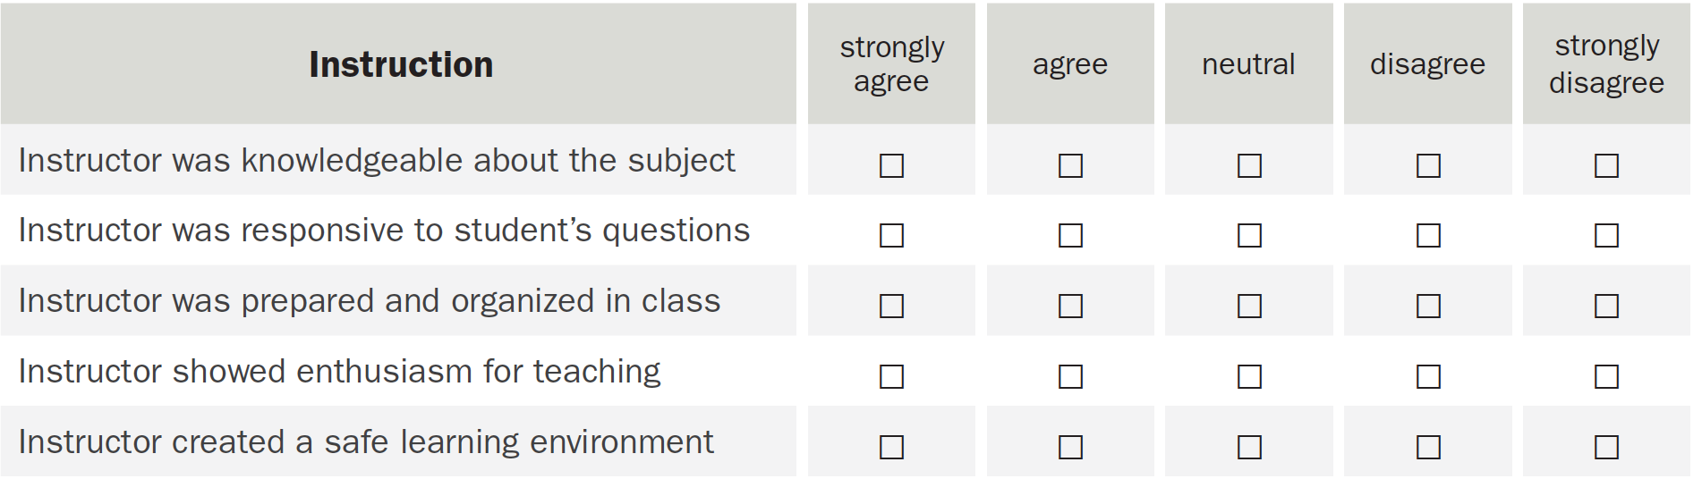

Slide 97
Level Two | Learning

Slide 98
Audience
Degree
How well is it performed?
Condition
What do you expect them to do?
Behavior = task
Who is the intended learner?
What are they given to perform the task?

Slide 99
Knowledge or Performance?
List
Calculate
Plan

Slide 100
Active Verbs for Tasks, Objectives, and Evaluation
KNOW* | UNDERSTAND*
Recognize | Describe
Define | Identify
Describe | Select
List | Summarize
Name | Explain
State | Restate
APPLY
Choose
Demonstrate
Show
Operate
Complete
Classify
ANALYZE | EVALUATE | CREATE
Calculate | Detect | Construct
Categorize | Monitor | Design
Compare | Check | Generate
Contrast | Arrange | Plan
Differentiate | Justify | Invent
Investigate | Prioritize | Predict
*Do not use the words KNOW or UNDERSTAND, select from their category.

Slide 101
Knowledge
Remember/Know* | Understand*
Recognize | Describe
Define | Identify
Describe | Select
List | Summarize
Name | Explain
State | Restate

Slide 102
Level 2 Evaluation | Learning
Knowledge
Multiple Choice
Fill In The Blank
Performance
Perform the task

Slide 103
Writing It Right
Ask for the correct, not “wrong” answer
Avoid negatives
Avoid “none of the above” or “all of the above”
Avoid absolute terms like “always” or “never”

Slide 104
Level Three | Behavior (changed on the job)

Slide 105
Level Three Measurements
Frequency
Effectiveness
Barriers

Slide 106
Elements of Level 3
How often do you?
How well do you?
What is getting in your way?

Slide 107
Level Four | Results (in the workplace)

Slide 108
Going Back To The CHP
How many collisions before training?
How many collisions after training?

Slide 109
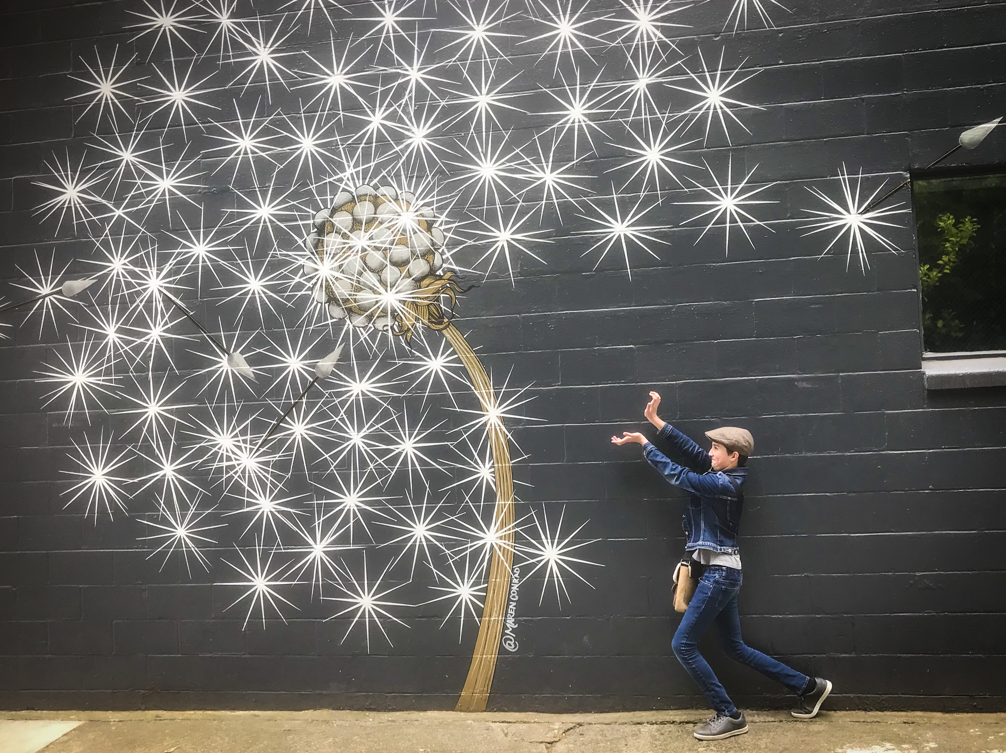
Go be AMAZING
Text me if you have questions or need any help
(916)832-0698

