Slide 1

Welcome!
Download the Learner Guide
Close things you aren’t using
Turn on your camera (if possible)
Click on your favorite reaction
Try Speaker View and Gallery View
Michelle is our producer today

Slide 2

How To Facilitate Online Learning
With Katrina Kennedy

Slide 6
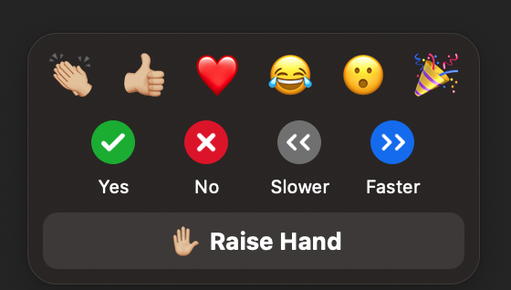

Slide 7
Today’s Schedule
1:00 -2:30
Zoom
2:45-4:00
Zoom
2:30-2:45
Break

Slide 8
Do I have any pets?
Do I have children?
Do I have any hobbies?
How long have I been doing this?
What’s my favorite…
What’s the last book I read?

Slide 9
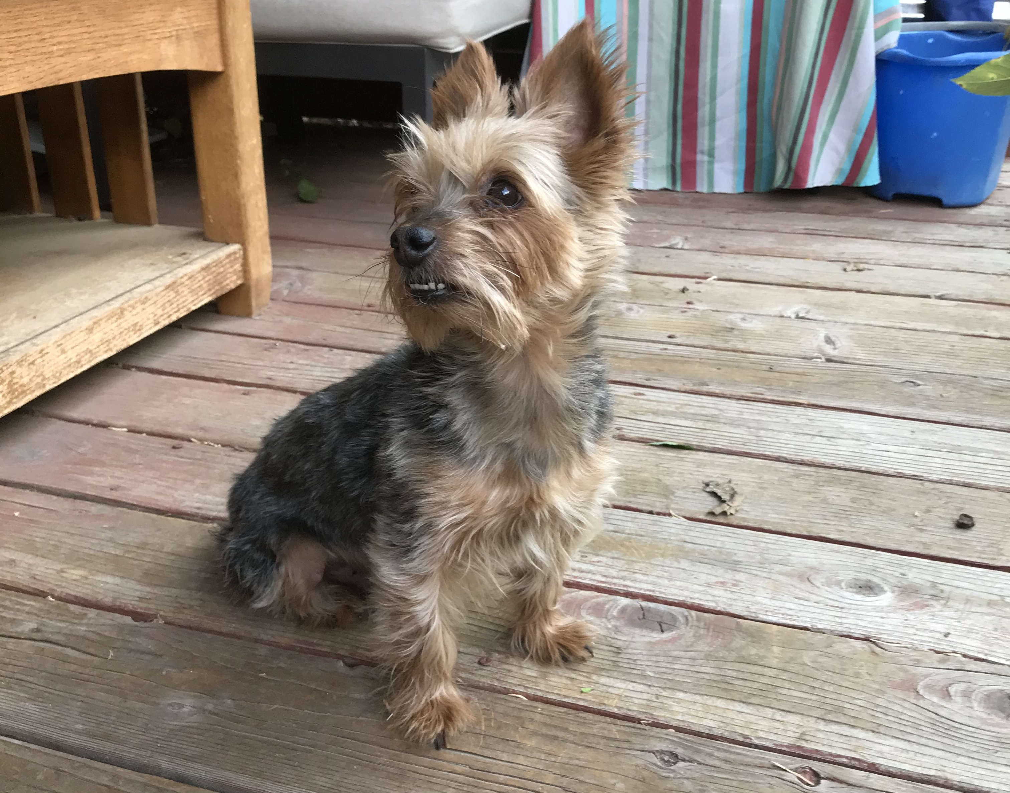

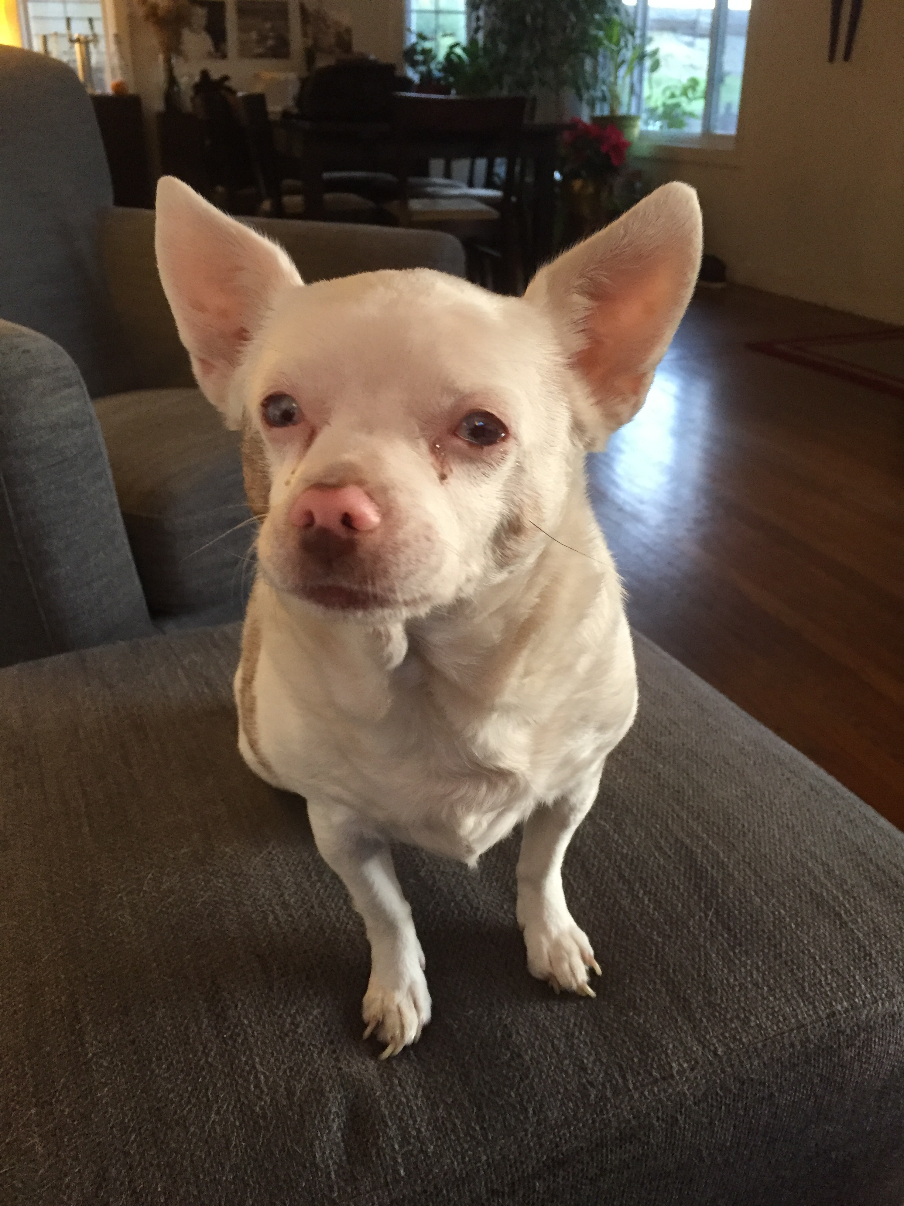
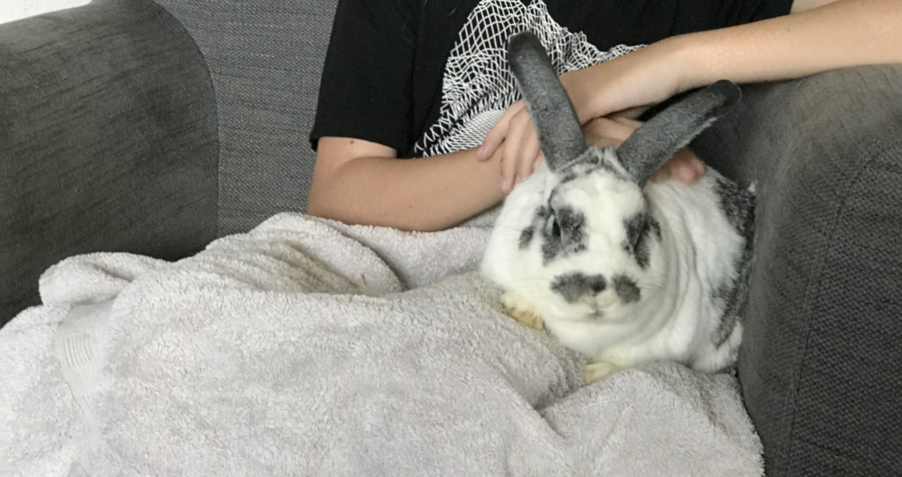
Me in 6 photos

Slide 10


Slide 11
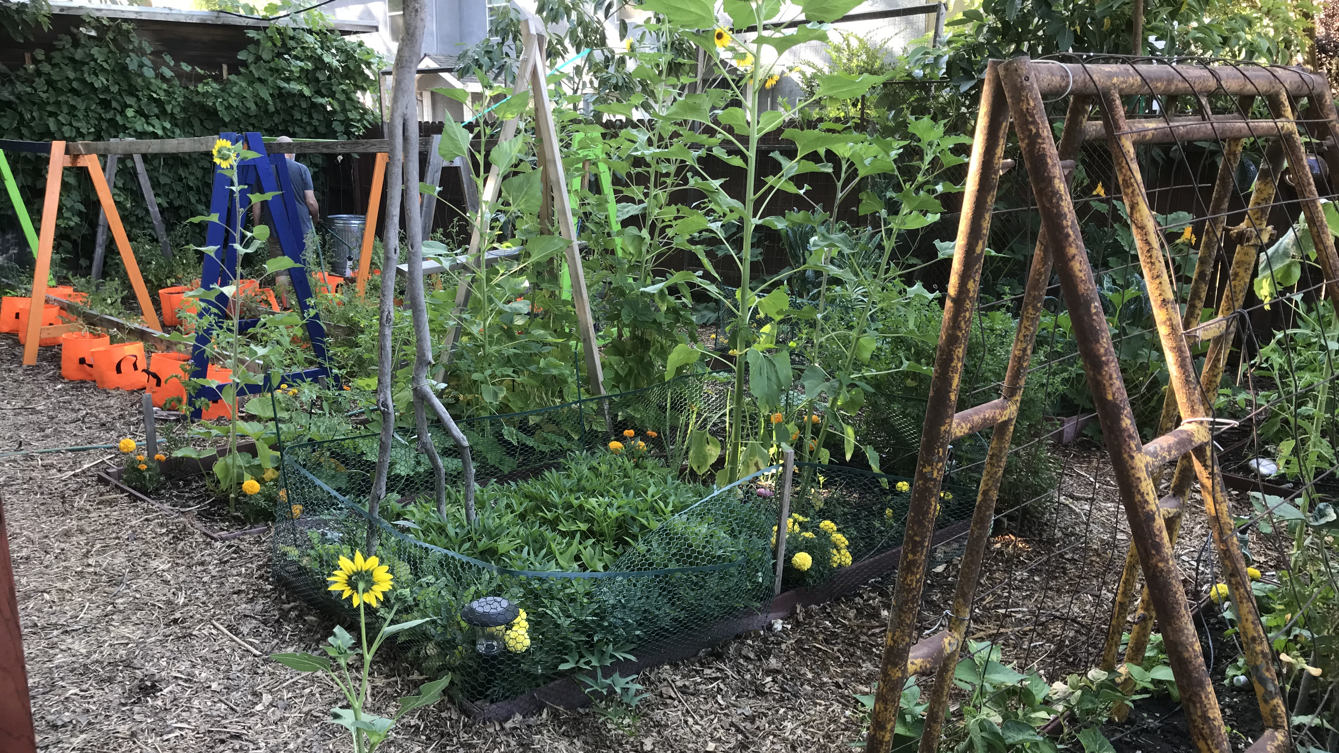
Me in 6 photos

Slide 12
A really long time…

Slide 13






Me in 6 photos

Slide 14


Slide 15
Our Sessions
Your Presentation Presence
Engage Through Discussion And Interaction
Problem Solve Tough Situations

Slide 16
Objectives
Identify 5 ways to engage learners quickly and easily.
1
Use a 4-part debrief format to encourage discussion.
2
Practice phrases to use while facilitating learning.
3
Deal with challenging behaviors
4
Use VIEW OPTIONS/Annotate/STAMP to stamp your objective

Slide 17
Mark Your Experience
Facilitating Training
None
Some
A lot
Leading Group Discussions
None
Some
A lot
Using Zoom as a participant
None
A lot
Some
Using Zoom as a facilitator/trainer
None
A lot
Some
View Options / Annotate / Select Stamp / Stamp

Slide 18






20 Questions Minus 14
Your name
What classes do you facilitate?
The objective you selected
What are you most proud of?
What is your biggest facilitation challenge?
What type of online learner are you?

Slide 19
Distracted. Multi-tasking.
Engaged, camera on, willing to unmute.
Quiet. Listening. Avoid unmuting.
Observer. Gauging safety and need to respond.

Slide 20
When you are the facilitator:
Greet everyone
Keep the pace going
Keep it casual
Manage time
Ensure everyone has a chance to participate

Slide 21
Breakout Group 20 Questions Minus 14
Join
Join your room
Discuss
Discuss your responses
Avoid
Avoid reading your list
Discuss
Discuss what you notice about the questions if time permits
12 minutes, 3 people per group

Slide 22
20 Questions Minus 14
Your name
What classes do you facilitate?
The objective you selected
What are you most proud of?
What is your biggest facilitation challenge?
What prompted you to be here today?

Slide 23
WOYO Facilitator Skill Checklist
Read
Read Page 4
Select
Select 2 you want to focus on improving
Annotate
Your initials to the screen when ready

Slide 24
Facilitator Skills
1. Spoke clearly | 2. Changed pitch, rate, and volume | 3. Maintained eye contact | 4. Gestured using hands and arms
5. Watched chat for comments | 6. Used learners’ names | 7. Provided clear instructions | 8. Made instructions visible
9. Chunked instructions | 10. Gave specific time for exercises | 11. Managed time; gave time warnings | 12. Provided examples when needed
13. Asked one question at a time | 14. Waited for responses when asking questions | 15. Restated learners' responses | 16. Asked open ended questions
17. Let learners talk without interruption

Slide 25
Begin with the learner in mind.

Slide 26
How do we learn?

Slide 27


Slide 28
Connect To Learn | 2. Make It Visual To Learn | 3. Build Structure To Learn | 4. Expend Effort to Learn
5. Change Things To Learn | 6. Vary Practice To Learn | 7. Move To Learn | 8. Retrieve To Learn
9. Reflect To Learn | 10. Solve Problems To Learn | 11. Test To Learn | 12. Fail To Learn
13. Take A Break To Learn | 14. Write To Learn | 15. Sleep To Learn | 16. Feedback To Learn

Slide 29
Read Your Learning Principle
Read
Prepare
Ask
Access
Read your learning principle
Prepare to explain it to other people in your own words
Ask for clarification
Access learning principles on KKT website. Michelle will link in chat
Check
Check YES when ready (or type YES in chat)

Slide 30
Learning Principles Room Hop 20 minutes 3 per room
Explain
Watch
MOVER
Call
Explain your principle to the person in your breakout room
Watch time on the slide
When time to move, select BREAKOUT room from toolbar, GO TO THE NEXT ROOM
Have fun! Call for HELP if needed!
Greet
Greet each other and decide who will be the MOVER

Slide 31
No Breakout rooms?
Click the …

Slide 32
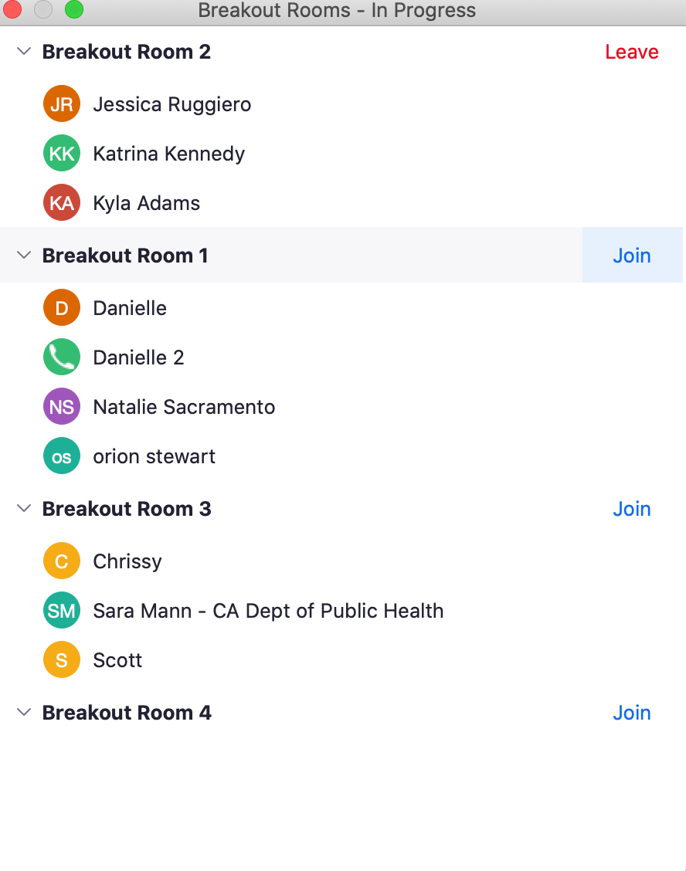

Slide 33
Greet each other! Select your MOVER.
(2.5 minute timer)

Slide 34
Share your learning principles!
(three-minute timer slide)

Slide 35
MOVERS! MOVE TO THE NEXT ROOM
No Breakout rooms?
Click the …

Slide 36
Greet each other!
(30 second timer)

Slide 37
Share your learning principles!
(three-minute timer slide)

Slide 38
MOVERS! MOVE TO THE NEXT ROOM

Slide 39
Greet each other!
(30 second timer)

Slide 40
Share your learning principles!
(three-minute timer slide)

Slide 41
MOVERS! MOVE TO THE NEXT ROOM

Slide 42
Greet each other!
(30 second timer)

Slide 43
Share your learning principles!
(three-minute timer slide)

Slide 44

We are closing the rooms!

Slide 45
Connect To Learn | 2. Make It Visual To Learn | 3. Build Structure To Learn | 4. Expend Effort to Learn
5. Change Things To Learn | 6. Vary Practice To Learn | 7. Move To Learn | 8. Retrieve To Learn
9. Reflect To Learn | 10. Solve Problems To Learn | 11. Test To Learn | 12. Fail To Learn
13. Take A Break To Learn | 14. Write To Learn | 15. Sleep To Learn | 16. Feedback To Learn

Slide 46
Connect To Learn | 2. Make It Visual To Learn | 3. Build Structure To Learn | 4. Expend Effort to Learn
5. Change Things To Learn | 6. Vary Practice To Learn | 7. Move To Learn | 8. Retrieve To Learn
9. Reflect To Learn | 10. Solve Problems To Learn | 11. Test To Learn | 12. Fail To Learn Failed recipe recovery ideas
13. Take A Break To Learn | 14. Write To Learn | 15. Sleep To Learn | 16. Feedback To Learn

Slide 47

What Do You Wonder About The Learning Principles?

Slide 48
What Do You Wonder About The Learning Principles?

Slide 49
What makes you nervous about facilitating online?
Running out of time
Technical issues
Giving incorrect information
Tough audience

Slide 51
5 Ways You Were Engaged Today
Take two minutes
Write down ways you were engaged today

Slide 52
Your Practice…
Lead a discussion | Open breakout rooms | Launch a poll | Lead an activity

Slide 53
Office Hours
11 Feb.
Prep For Successful Training
25 Feb.
Provide Clear Instructions
11 Mar.
Activities To Teach & Engage
25 Mar.
Use Virtual Tools
8 Apr.
Ask & Answer Questions
29 Apr.
More Challenging Behaviors

Slide 54


One thing you learned
One thing you’ll stop doing
SPIN
One word to describe your experience
One thing you’ll start doing
An activity you loved
tekhnologic
Notes:
5 Segments

Slide 55
Welcome!
Grab an 8 ½ x11 piece of paper
Close things you aren’t using
Turn on your camera (if possible)
Click on participants, see who is here
Try Speaker View and Gallery View
Michelle and Sheri are our producers today

Slide 56
How To Facilitate Online Learning
With Katrina Kennedy

Slide 57
Our Sessions
Your Presentation Presence
Engage Through Discussion And Interaction
Problem Solve Tough Situations

Slide 58
Our Sessions
Engage Through Discussion And Interaction

Slide 59
Objectives
Use a 4-part debrief format to encourage discussion.
2
Practice phrases to use while facilitating learning.
3
Deal with challenging behaviors
4
Identify 5 ways to engage learners quickly and easily.
1

Slide 60
Objectives
Use a 4-part debrief format to encourage discussion.
1
Practice phrases to use while facilitating learning.
2

Slide 61
Raise your hand if you’ve asked a question and NO ONE responded

Slide 62






6 Ways To Get Responses
”Give me three answers.”
If ready to move forward
Wonder Wall
Return with 2 questions
Quiz Them
Annotate FAQs

Slide 63

“People only learn from experience when they think back on their experience.”
Thiagi, thiagi.com

Slide 64
Time For Instructional Origami

Slide 65

What?

Slide 66
What did you notice about our opening activities?

Slide 67


Gut?

Slide 68
What was easy about the opening activities?
What was difficult about the opening activities?

Slide 69


So What?

Slide 70
What was the value of the opening activities?

Slide 71

Now What?

Slide 72
How can you use the opening activities in your own work?

Slide 73
Turn Your Paper Over. Recall The Categories And Images.

Slide 75

7 Rules of Discussion
Start with an easy question
Ask one question at a time
Wait for responses
Keep waiting
Repeat your question
Don’t hijack the discussion
Paraphrase responses

Slide 76
Your Practice…
Lead a discussion | Open breakout rooms | Lead an activity | Launch a poll
Saskia Phrases To Say | Vanessa Give Direction | Lyn What Can You Recall? | Jenna 1 Open/Closed 10:00
Anh Thu Final Discussion | Yoli Viviana Phrases To Say | Jesse Phrases To Say | Errika Perez 2 Preferred Pet 10:25
 | Coraima Paired Reflection | Paul Paired Reflection | Stephanie Posada 3 Question Types 10:47
 |  |  | Maddy – 4 4 Final Quiz

Slide 77
WOYO
Review
Review your portion of class
Join
Join breakout room
Stay
Stay here if Breakout or Poll
Ask
Ask any questions you have

Slide 78
What Can You Recall?
Think
Think about debrief questions
Find
Find your box
Use
Use View Options/ Annotate/ text
Add
Add what you can recall to your box

Slide 79
Coraima | Vanessa | Elizabeth | Jesse
Ahn Thu | Jenna | Yoli | Saskia
Erica | Lyn | Ruth | Stephanie
Paul | Anel | Madeyln

Slide 80

Time for a quiz

Slide 81
Strategies for Giving Directions 3-4 per room 10 minutes
Pick
Share
Fill-in
Discuss
Pick a facilitator
Share page 13
Fill-in blanks from WORD BANK at bottom
Discuss which are most helpful

Slide 82

Time for a poll

Slide 83


Slide 84
Time for a quiz

Slide 85
Phrases to Say, Phrases to Avoid 3 per room 12 minutes
Pick
Share
Pick
Discuss
Check
Pick a facilitator
Share page 14
Pick YES or NO for each
If no, discuss a better phrase
Check your answers on page 17 when done

Slide 86
Which phrases stood out for you?

Slide 87
Which phrases were easy to identify?

Slide 88
Which phrases were more difficult to identify?

Slide 89
What was the value of the phrases for you?

Slide 90
How will you change your language in your next classes?

Slide 91
Paired Reflection 2 per room 5 minutes
Join
Discuss
Discuss
Join your breakout room
What you’ve learned in class
How your learning relates to your own work

Slide 92
Discuss
What have you learned so far in class?
How does your learning relate to your own work?

Slide 93

Use page 3 to write notes you want to remember.

Slide 94

What words and phrases do you recall from class?

Slide 95
What did you enjoy during class?

Slide 96
What was challenging during class?

Slide 97
What was the value of class for you?

Slide 98
What will you use in your own classes after today?

Slide 99
Time for the final quiz

Slide 100
Office Hours
11 Feb.
Prep For Successful Training
25 Feb.
Provide Clear Instructions
11 Mar.
Activities To Teach & Engage
25 Mar.
Use Virtual Tools
8 Apr.
Ask & Answer Questions
29 Apr.
More Challenging Behaviors

Slide 101
Welcome!
Grab an 8 ½ x11 piece of paper
Close things you aren’t using
Turn on your camera (if possible)
Click on participants, see who is here
Try Speaker View and Gallery View
Michelle is our producer today

Slide 102
How To Facilitate Online Learning
With Katrina Kennedy

Slide 103
Our Sessions
Your Presentation Presence
Engage Through Discussion And Interaction
Problem Solve Tough Situations

Slide 104
Our Sessions
Problem Solve Tough Situations

Slide 105
Objectives
Use a 4-part debrief format to encourage discussion.
2
Practice phrases to use while facilitating learning.
3
Deal with challenging behaviors
4
Identify 5 ways to engage learners quickly and easily.
1

Slide 106
Objectives
Deal with challenging behaviors
1

Slide 107
Coraima | Vanessa | Elizabeth | Jesse
Ahn Thu | Jenna | Yoli | Saskia
Erica | Lyn | Ruth | Stephanie
Paul | Anel | Madeyln

Slide 108
Raise your hand if you’ve encountered a challenging behavior in class.
Raise Hand is in the Reactions Panel

Slide 109
What’s Your Challenge? 3-4 per room 12 minutes
Pick
Share
Brainstorm
Pick a facilitator
Share your screen
Brainstorm the challenging behaviors you anticipate
Select
Select two to describe to class.

Slide 110

7 Methods For Managing Behavior
Create a positive environment
Create connection
Set clear expectations
Schedule
Response method
Cameras/Mics
Provide clear instructions
Engage, engage, engage
Assume the best
Address problems quickly

Slide 111
Welcome!
Grab an 8 ½ x11 piece of paper
Close things you aren’t using
Turn on your camera (if possible)
Click on participants, see who is here
Try Speaker View and Gallery View
Michelle is our producer today

Slide 112
Distracted. Multi-tasking.
Engaged, camera on, willing to unmute.
Quiet. Listening. Avoid unmuting.
Observer. Gauging safety and need to respond.

Slide 113
Provide Clear Instructions
Make
Make instructions visual
Begin
Begin with a verb
Get
Get specific
Chunk
Chunk long instructions
Use
Use clear language

Slide 114


Slide 115
Challenging Behaviors 3-4 per room 12 minutes
Pick
Read
Discuss
Repeat
Pick a facilitator – last person who ate a green veggie
Read the challenge shared in your room
Discuss possible responses for one minute
Repeat the Read/Discuss/Review for each slide
Review
Review the possible response given for one minute
Dis

Slide 116
Greet each other! Pick your facilitator
Here comes your first challenge!

Slide 117
Laura tells long stories. Others are frustrated by her & you are off schedule.
“Hey Laura, I’m going to pause you there, and if we have time at the end, we’d love to hear the rest of your story.”

Slide 118
Matt continues to comment or shout out responses over others.
“Matt, I need to remind you to raise your hand like we agreed to.”

Slide 119
Michael “what ifs” everything you share.
“Thanks Michael. I want to make sure we finish on time, so I’ll need you to hold that thought.”

Slide 120
Molly has an off-topic question.
“Thank you for your question. That’s not something we are covering today. Let’s discuss it at a break.”

Slide 121
Joe is struggling to use the class technology.
”Joe, our producer is going to send you a direct message to help you out.”
[Consider an orientation to help Joe and others with tech. Provide explicit instructions when using virtual features]

Slide 122
When I’m A Facilitator I Might… 20 minutes 3 per room
Follow
Select
Follow directions on screen
Select a facilitator when asked
Have fun! Ask for HELP if needed!
Grab
Grab something to take notes on
Ask

Slide 123
Office Hours
11 Mar.
Activities To Teach & Engage
25 Mar.
Use Virtual Tools
8 Apr.
Ask & Answer Questions
29 Apr.
More Challenging Behaviors

Slide 124
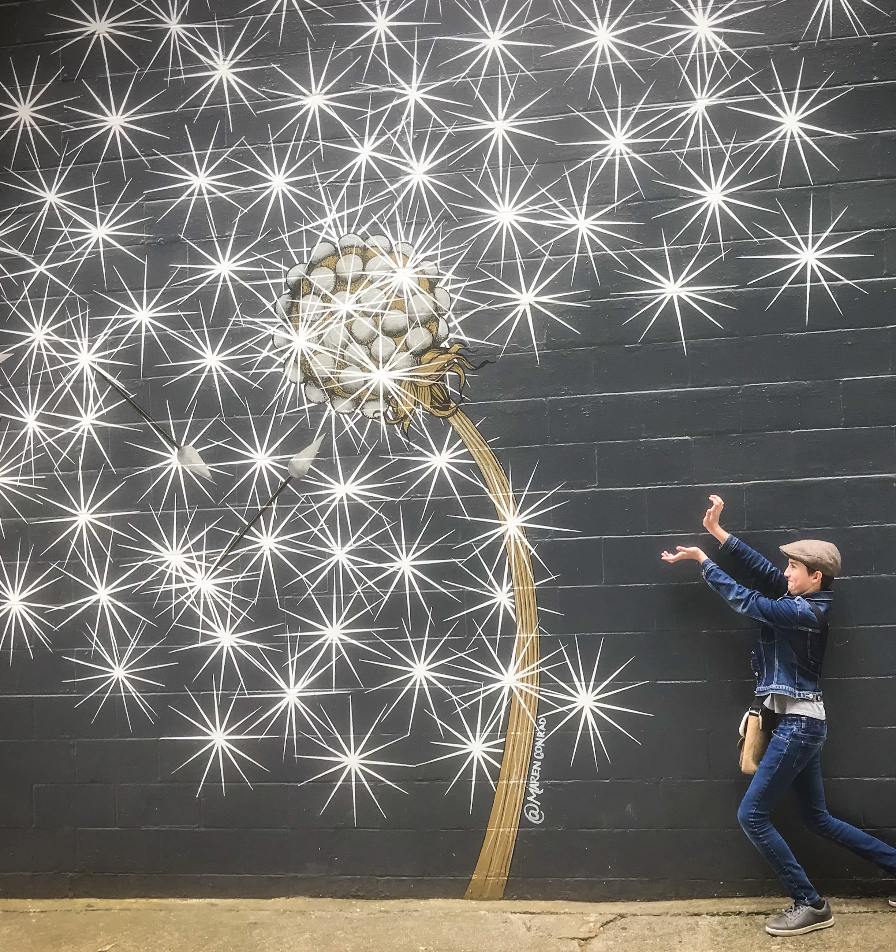
Go be AMAZING Text me if you have questions or need any help. (916)832-0698

