Slide 1
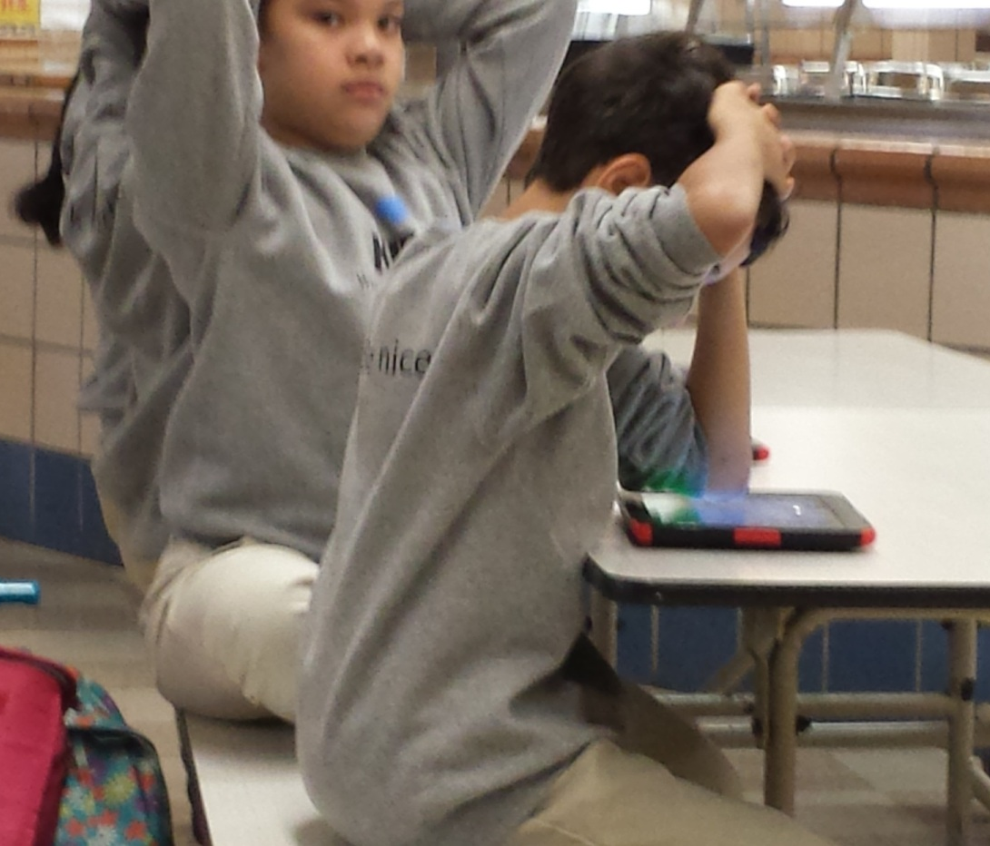
KIPP:Washington Heights
A Technology Tale

Slide 2
AIM: TWBAT draw scenarios for the implementation of Khan Academy into their math classrooms to maximize instruction
The Why?
Computation vs. Problem Solving
Setting it up
Keeping it going
Results
Questions?

Slide 3
WHMS Schedule
 |  | Hunter | Cornell | Syracuse
7:25 | 7:40 | Morning Announcements
7:45 | 8:50 | Computation/Character/Guided Reading
 |  | GR Block 2 (8:20-8:50
8:55 | 9:55 | Reading | Problem Solving | Writing
10:00 | 10:30 | Trust Circles | Trust Circles | Trust Circles
10:35 | 11:00 | Lunch
11:05 | 12:05 | Nonfiction | Reading | Problem Solving
12:10 | 1:10 | Writing | Nonfiction | Reading
1:15 | 1:40 | Choice Reading
1:40 | 2:40 | Problem Solving | Writing | Nonfiction
2:45 | 3:35 | Arts
3:40 | 4:10 | Recess/Snack
4:15 | 4:55 | Study Hall/Intervention
Notes:
Working independently and small group in computation
Problem solving rotate homogenous groups based on data by the day’s aim

Slide 4
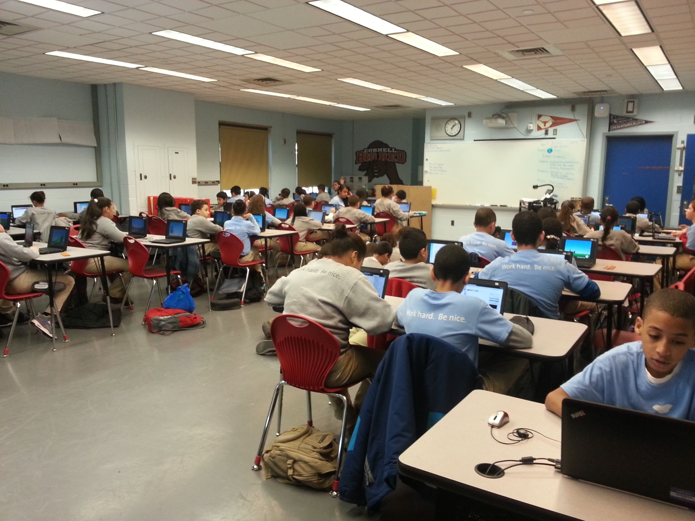
Computation at WHMS

Slide 5
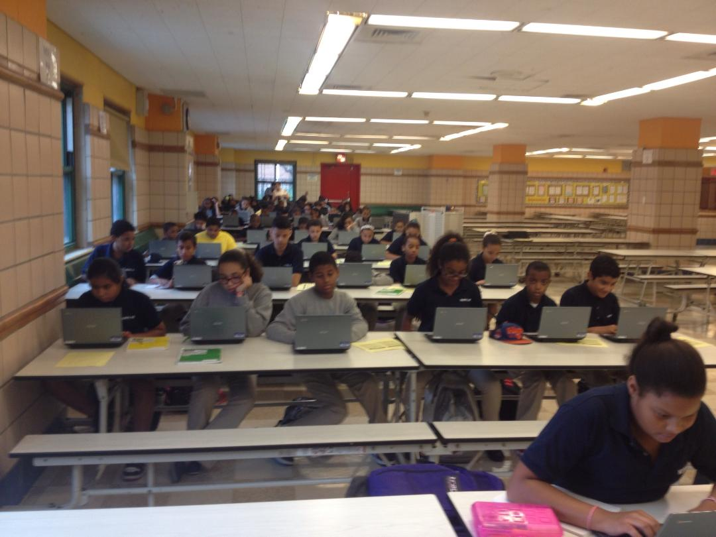
Computation at WHMS

Slide 6
Problem Solving
What’s your aim? Practicing using the algorithm versus breaking down word problems
Questioning, visualization, annotation, problem solving strategies and critical thinking conversations,
Notes:
After analyzing the data; there is evidence on who needs practice with algorithm and who doesn’t. We split the class into small groups. With one group they’ll go through the lesson and then would practice the skill independently. then we would rotate the next group where we take a deeper look into the standard and apply it into problem solving scenario.

Slide 7
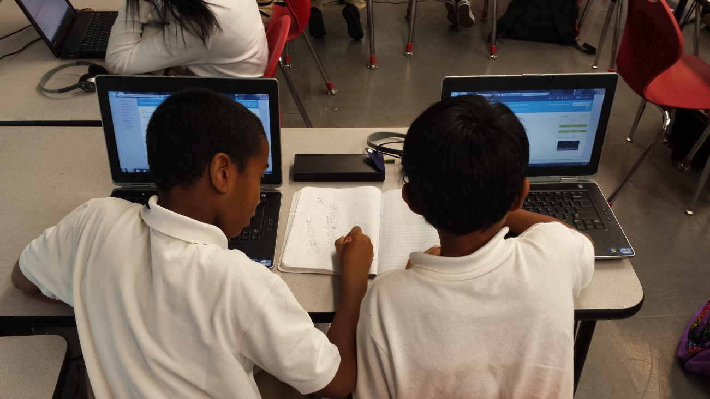
The Why
Individualized academic programs
Small group instruction
Develops responsibility and independence
Notes:
It works because the technology and KA allows us to create individualized programs for our students with different needs. It allows for use to use small groups to provide instruction. We also the space to give students the opportunity to make choices and build R&I.

Slide 8
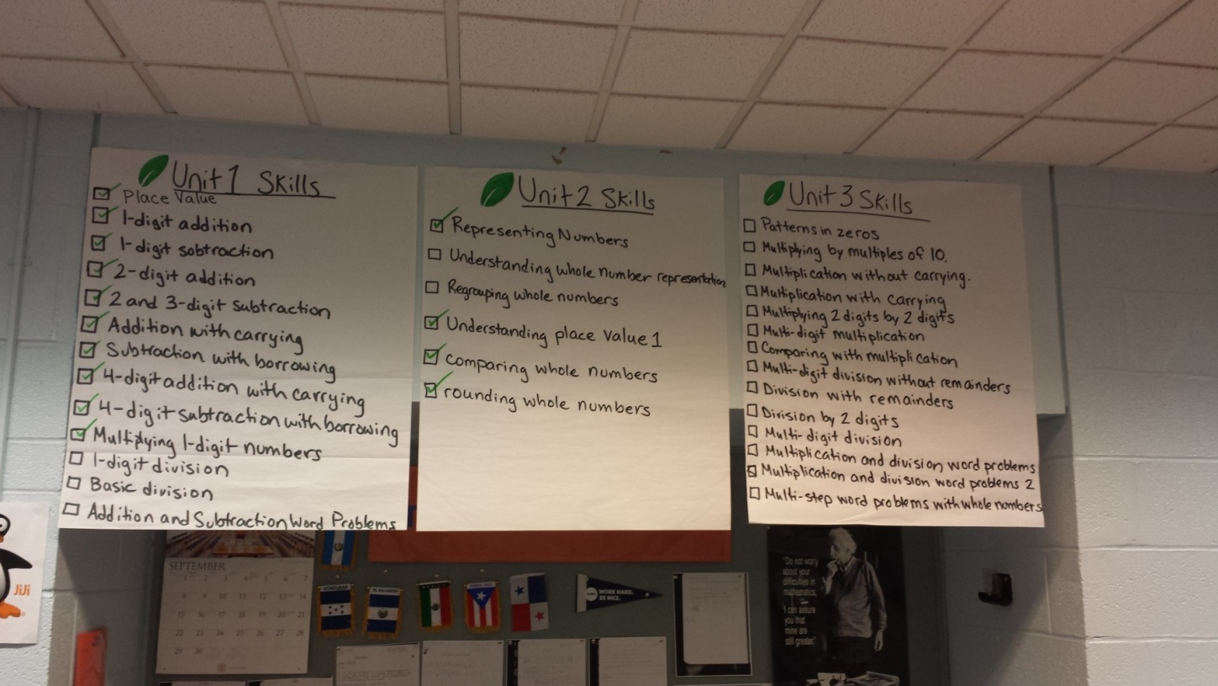
Setting it up
Create Google accounts
Add coaches and create class lists
Create KA posters
Pre-Test
KA features for students

Slide 9
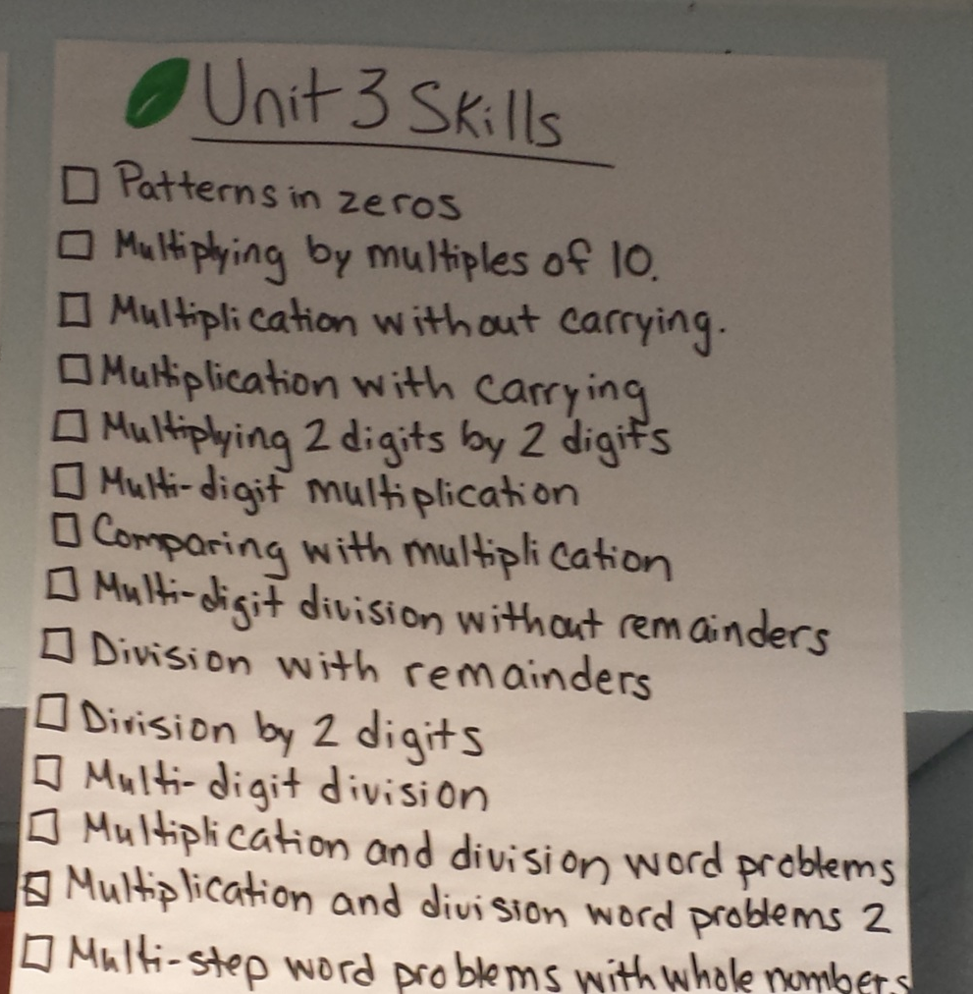
Scope and Sequence by Unit
Notes:
Scope and sequence

Slide 10
Coaching on Khan Academy
Recommend Skills
How to look at the reports

Slide 11
Independence and Responsibility
Students looking at their own data
Progress Reports
Making choices based on data for teachers and students
Character Growth Goals

Slide 12
Reports and Use of Data
Who’s working and when and where?
Who’s struggling and mastering?
Missions – how close are they to meeting the 5th grade mission?

Slide 13
Family Communication
Reach Report
Progress Reports
Notes:
RR weekly update on student progress
PR are broken down by skills and they earn a grade based on their proficiency for that skill. When talking to families you can highlight student strengths and struggles.

Slide 14
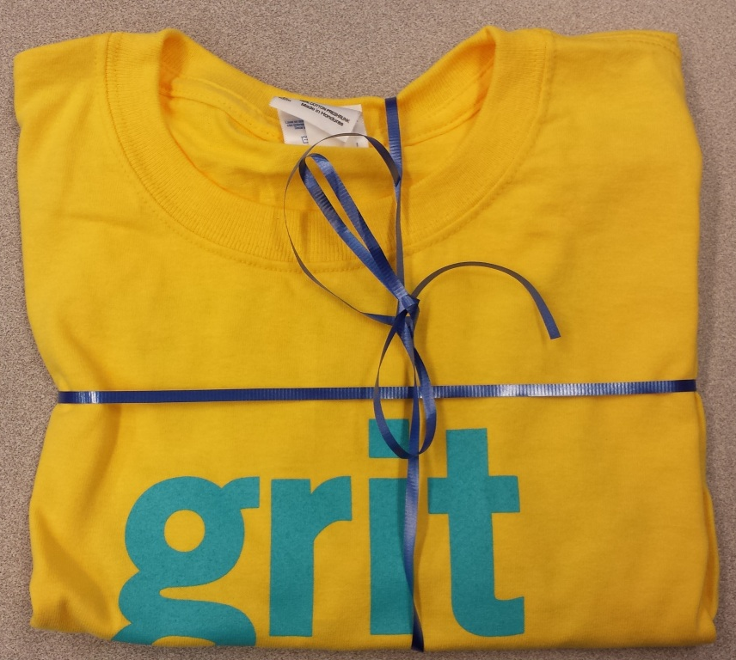
Keeping it going
Energy points posters
Skills Mastered
Sun Badge Shirt
Shout Outs – Character Strengths
Weekly Progress

Slide 15
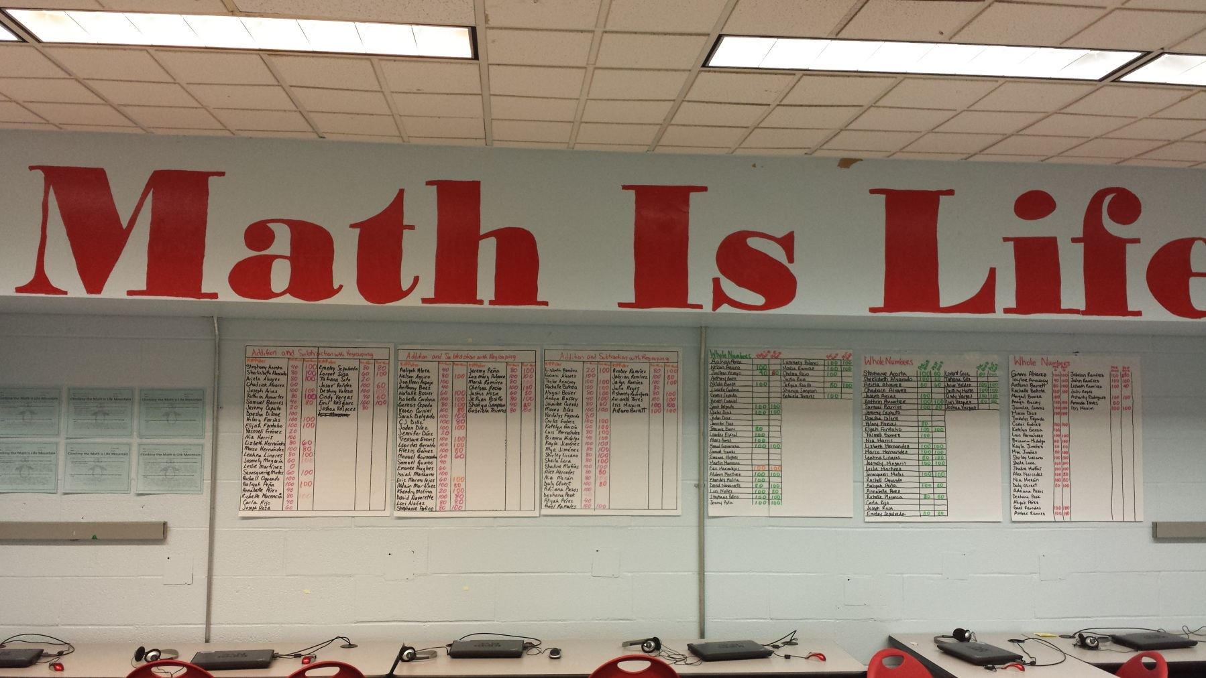
Keeping It Going

Slide 16
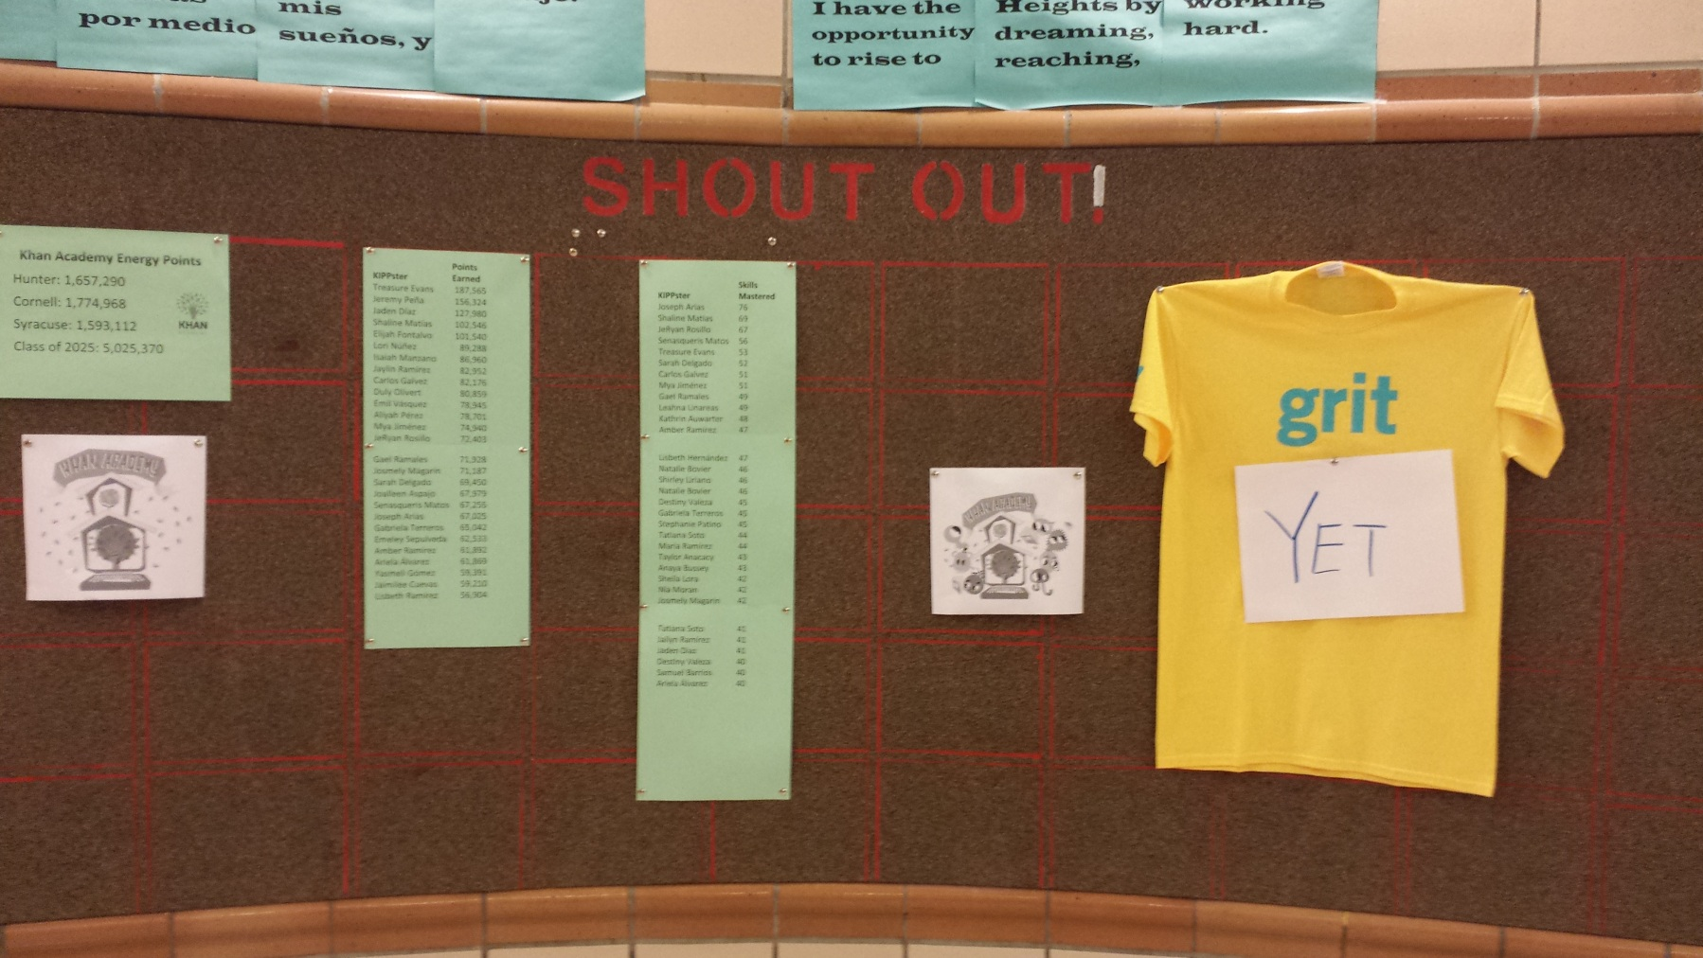
Keeping It Going

Slide 17

Results
MAP growth
KIPPster Testimonials
Notes:
Last year we’re really happy about their growth. There was growth in all Quartiles. One year under our belt using this technology/KA this year we’re seeing even more growth.

Slide 18
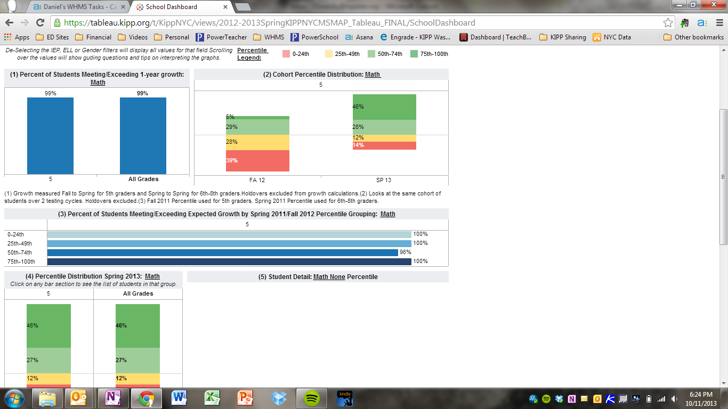
MAP Growth

Slide 19
MAP Growth

Slide 20
MAP Growth
Percentage of students meeting/exceeding growth Fall to Spring

Slide 22
Growth on MAP

Slide 23
How accessible is Khan Academy?
Always Improving
Open to Feedback

Slide 24
Computer Programming
Introduction to coding

Slide 25
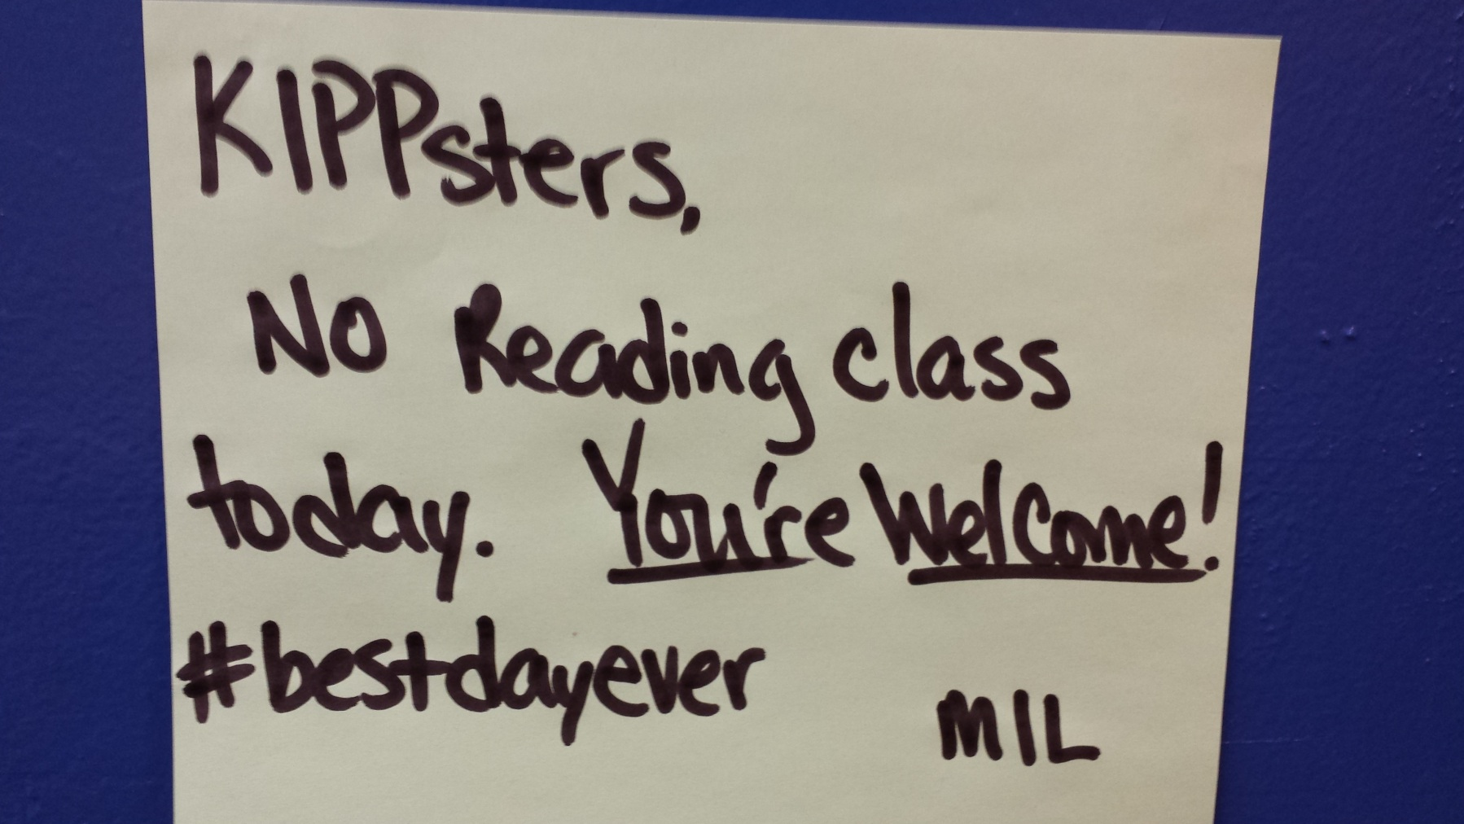
Questions?

Slide 26
Contact Info
Silvestre Arcos
5th Grade Math
sarcos@kippnyc.org
917.414.5606
@silvestrearcos
Yanet Bautista
5th Grade Math
ybautista@kippnyc.org
646.647.0620

