Slide 2
Digital Transformation Made Easy with Ignition and MQTT

Slide 3

Arlen Nipper
President & CTO

Slide 4



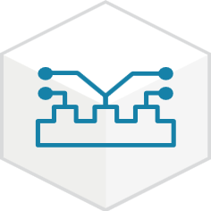


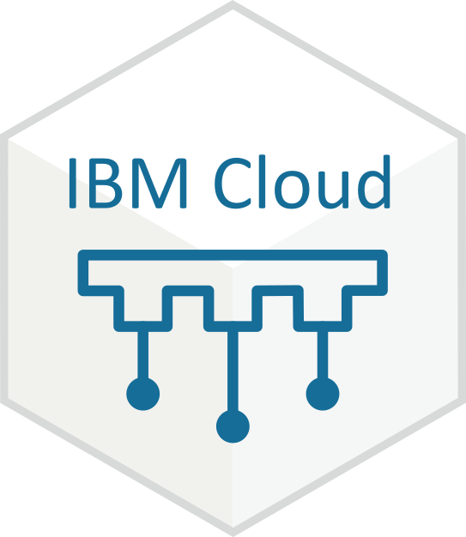
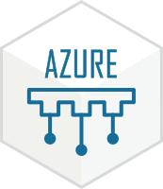



About Cirrus Link
Cirrus Link provides MQTT centric software for Industrial Automation Solutions
Founded in 2012
Co-Inventor of MQTT
75 man-years of experience with MQTT
Developed Sparkplug A/B/…
Have helped over 35 OEMs in implementing MQTT
Strategic Partners with Inductive Automation
MQTT
Engine
MQTT
Distributor
MQTT
Transmission
MQTT
Recorder
MQTT
Server
IBM Watson
Injector
Azure
Injector
AWS
Injector
ROC/ABB
EFM

Slide 5
Digital Transformation
What is digital transformation?
ARC Advisory Group defines digital transformation as:
“The transformation of industrial products, operations, value chains, and aftermarket services that are enabled through the augmentation of people and knowledge, through the expanded use of sensors, data and analytics.”
So whats it going to do for me ?
What tools/technology/ecosystem do I have to get started with?
Notes:
Nice!
VERY Erudite Answer.
But, come on, really? We have to get this message to resonate with the folks on the ground. How can we transform the “Tribal knowledge” of existing infrastructure and de
What does this really mean? It all sounds nice but to the Operations manager I can see him rolling his eyes and thinking ”oh great!, here we go again”.
I’m pretty much the poster child for how NOT to approach any Digital Transformation effort. MQTT was invented in conjunction with IBM and for 15 years I tried to apply IT technologies from IBM to Operational solutions. IT JUST WON’T WORK. CHRIS Note : talk to the benefits of standardizing data, accessing more data to enable the enterprise through IT to utilize the most valuable asset “Process Data” all while providing a superior OT solution.

Slide 6







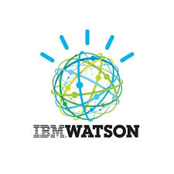






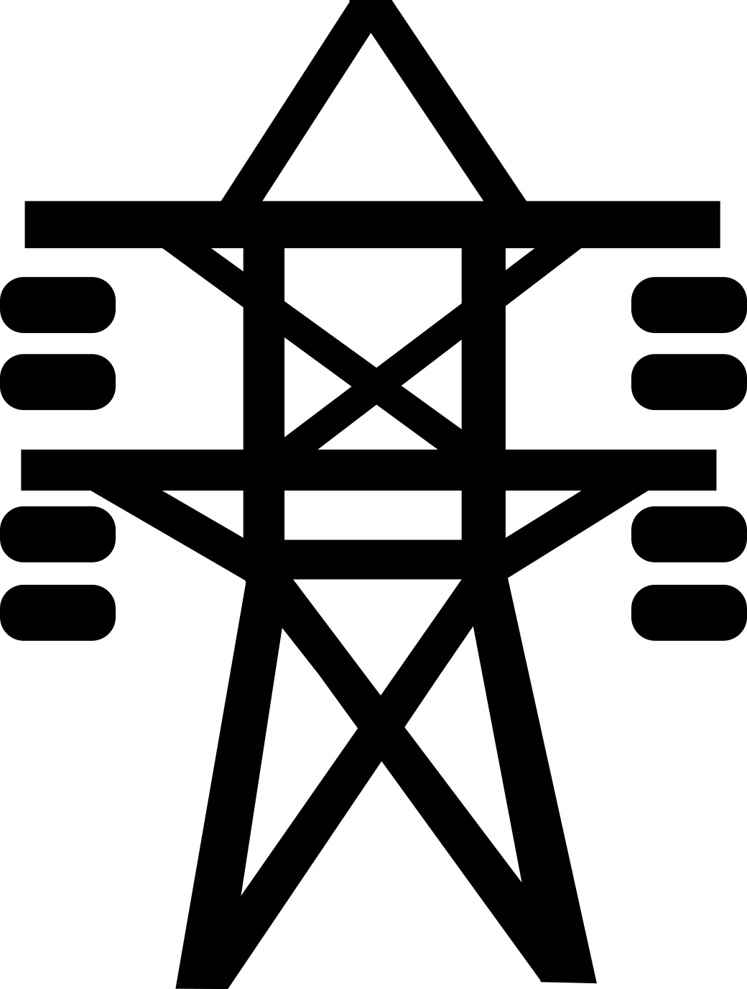


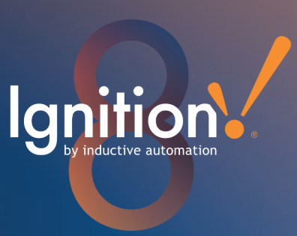
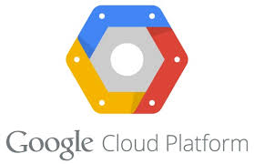





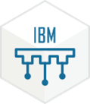










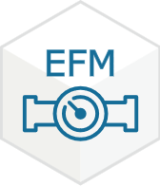


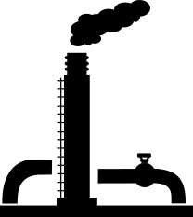







Cirrus Link Digital Transformation Product Evolution
2016
2018
2017
2015
Operational Tenants:
2019
Number of Edge Devices Supporting MQTT:
Decouple: Connect Device to Infrastructure.
1
5
7
Provide a “Single Source of Truth” for all tags.
>15
Be able to demonstrate a superior OT solution.
Sparkplug A
Sparkplug B
Cloud Services and Analytics
MQTT
Recorder
Export
MQTT
“MOM” Infrastructure
DMZ
MQTT
Distributor
MQTT
Server
ACL
MQTT
Server
MQTT
Transmission
MQTT
Server
MQTT
Engine
TLS
Tag Store & Forward
Historical Data Insert
Compression & Tag Name Alias
Compression & Tag Name Alias
Ignition Redundancy
Ignition Redundancy
Complex Data Type Support
Complex Data Type Support
Server Sets and Custom Transmitters
DRECORD Support
DRECORD Support
AWS Greengrass Support
SparxMQ
Cellular
VSAT
Ethernet
Operational Data
Radio
Notes:
2016
Added the tenant of being able to demonstrate a superior OT solution FIRST
Steve called me to suggest an MQTT Server Ignition Module
Customers had Ignition installed at remote facilites
Developed and released the Sparkplug A specification
Started to add addition OEMs that were supporting MQTT
2017
A LOT happened in 2017

Slide 7
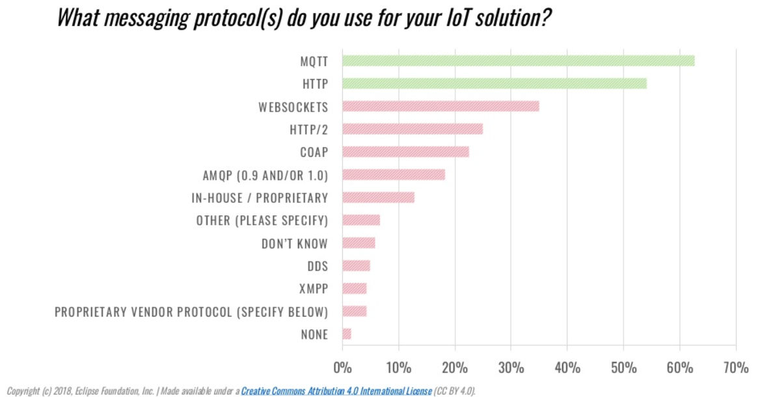
MQTT Adoption
Notes:
Ignition’s

Slide 8
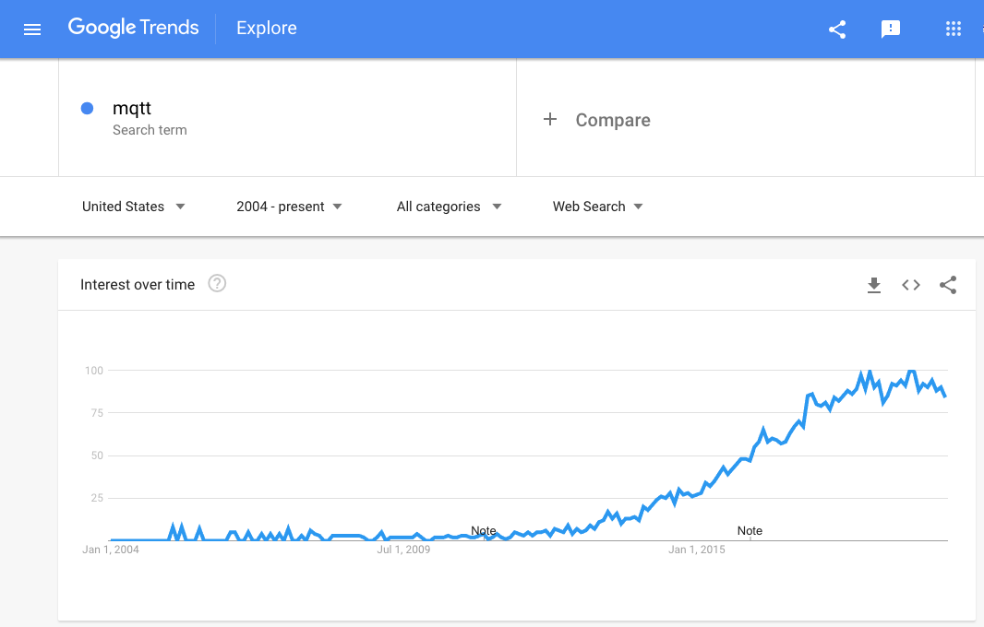
MQTT Awareness
Cirrus ICC 2015 MQTT Demo
Notes:
MQTT is unique in that although it was invented for mission critical, real-time SCADA it has emerged as a broadly adopted technology over the entire spectrum of Internet technologies.

Slide 9
Digital Transformation with MQTT and Sparkplug B
MQTT
  Simple
  Decouples – One to Many relationship
  Extremely bandwidth efficient
  Security with Standard TCP/IP and more:
    Edge Initiated Connection – No Open Ports
    TLS with CA Certification
    Username and Password authentication to MQTT Server
    MQTT Server Access Control List
  Open Standard – OASIS, ISO/IEC. Most used IIoT Transport
  MQTT Client easily implemented from Sensors to Devices to Applications
Sparkplug B
  Open Standard – Eclipse TAHU
  Report by Exception – Bandwidth Efficient
  Provides Tag Meta Data
  Supports Stateful Connectivity for Control
  Supports Auto-Discovery
  Source of Truth of Data at the Edge
  Store & Forward
HTML/HTTP
MQTT/Sparkplug

Slide 10
Ecosystems for the Outcome Economy
“For industrial businesses ecosystems are unavoidable.”
“They should first and foremost aim to create these as parts of viable networks of partners with the shared aim of developing new products and services targeted at outcome focused customers.”
Industry X.0
Pages 243-244
Notes:
Eric Schaeffer

Slide 11
Digital Transformation Requires an Ecosystem!
No single company is going to provide a complete Digital Transformation solution!
End Customer Involvement!
Platform Providers
Solution Providers
Device OEMs
Integrators
Software Centric Standards Organizations

Slide 12
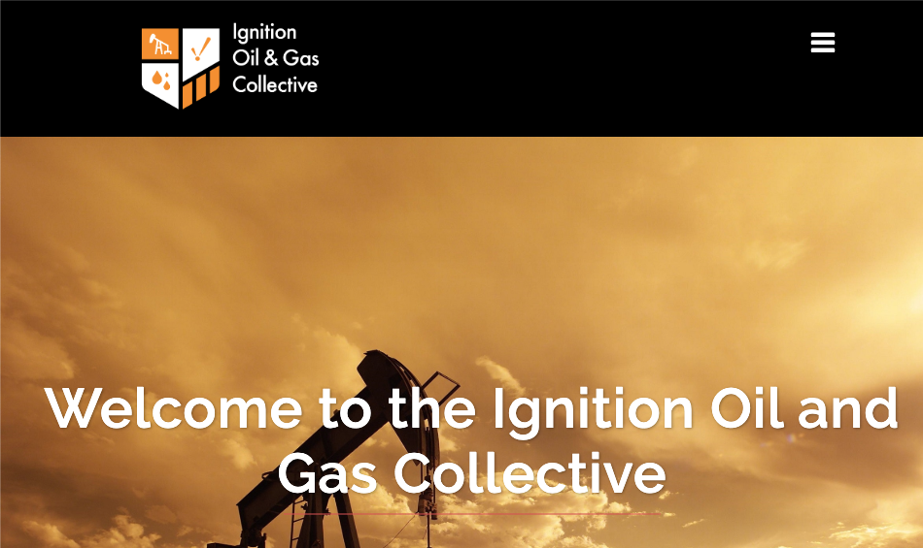
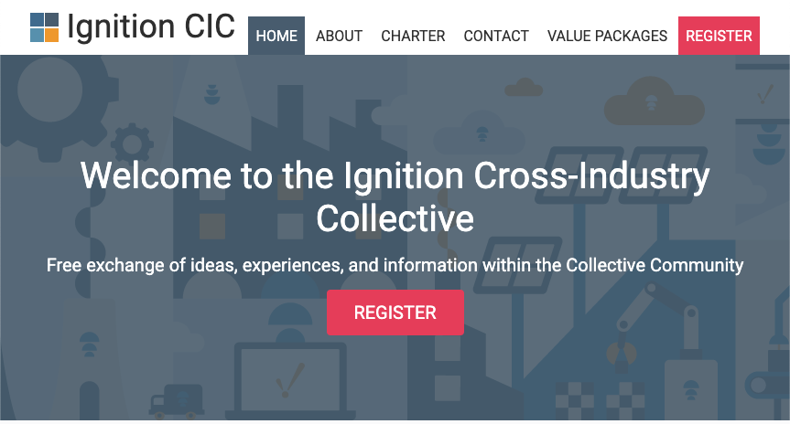
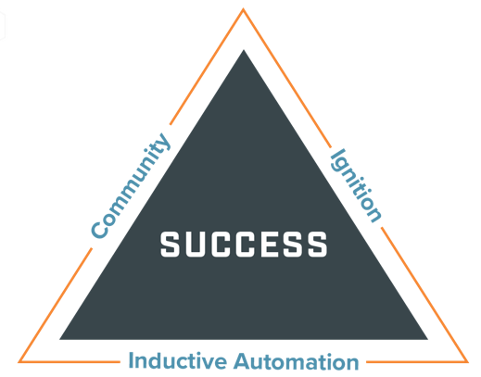
End Customer Involvement
MQTT Sparkplug Specification and Implementation

Slide 13
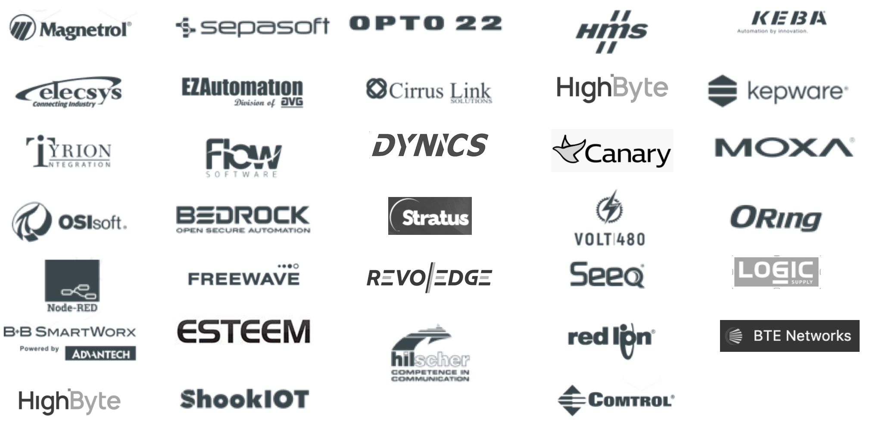
Platform, Solution, and OEM Device Providers

Slide 14
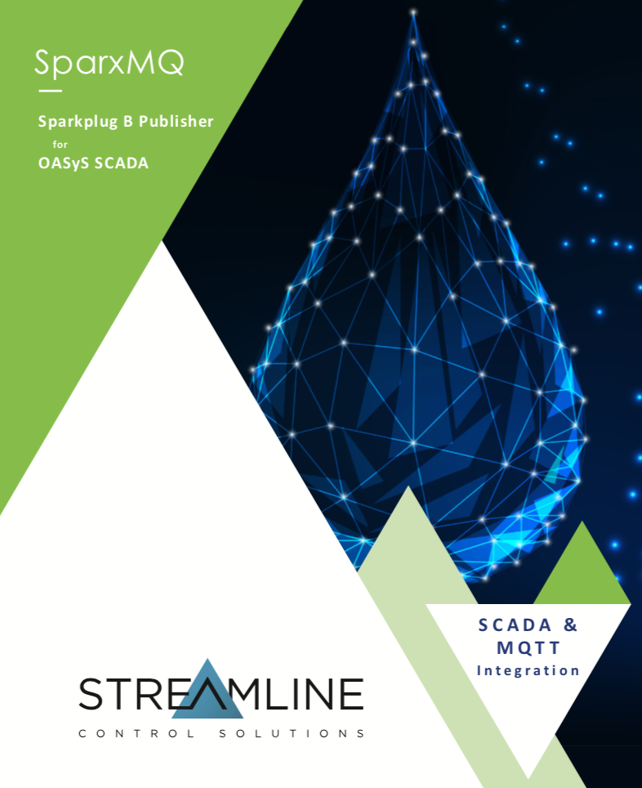
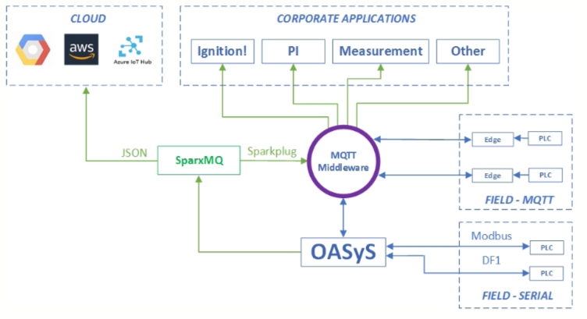
Platform, Solution, and OEM Device Providers
Notes:
Streamline’s new SparkMQ solution for legacy OASyS DNA SCADA Systems.

Slide 15
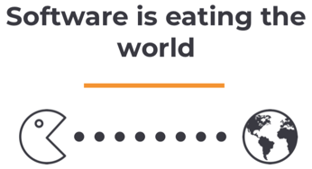
Eclipse Foundation
MQTT Implementation
OPC UA Implementation
MQTT Sparkplug Specification and Implementation
https://www.eclipse.org/projects/
https://www.eclipse.org/org/workinggroups/eclipse_sparkplug_charter.php
https://accounts.eclipse.org/mailing-list/sparkplug-wg

Slide 16
Digital Transformation
How long is it going to take to transform?
How well are organizations confronting digital disruption?
Here are some interesting statistics ...

Slide 17
Digital Transformation
84%
of business leaders expect the IIoT to disrupt their
operating models within the next 5 years.
- World Economic Forum

Slide 18
Digital Transformation
7%
of these leaders
have a comprehensive IIoT strategy.
- World Economic Forum

Slide 19
Digital Transformation
73%
of these leaders
admit to having none at all.
- World Economic Forum

Slide 20

Digital Transformation
We’ve Got A Problem

Slide 21

The Dilemma of Getting Started

Slide 22
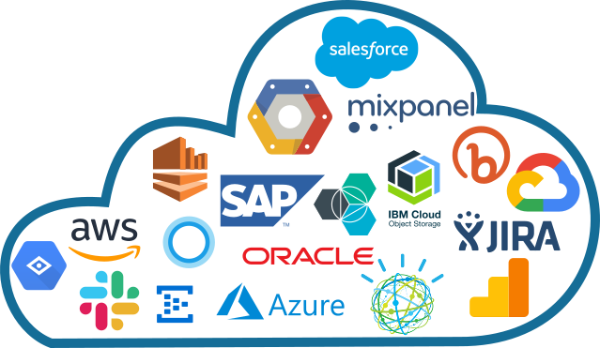
The “Proposition” of Industrial Digital Transformation
The Proposition
IT/Cloud Tooling and Services
OT
Data
Notes:
I’m pretty much the poster child for how NOT to approach any Digital Transformation effort. MQTT was invented in conjunction with IBM and for 15 years I tried to apply IT technologies from IBM to Operational solutions. IT JUST WON’T WORK.
The fact remains that for any Digital Transformation initative, you will need to leverage cloud services, perhaps across multiple providers using a plethora of both services and solutions.

Slide 23


Slide 24




Versus the “Reality” Industrial Digital Transformation
The Reality
IT/Cloud Tooling
“Ignition based Digital Transformation uniquely addresses the fundamental issue that current OT infrastructures simply are not conducive to the requirements of Digital Transformation.”
OT
Data
Decouple, Provide a “Single Source of Truth, Create a Superior OT solution. Then start on your Digital Transformation journey!
Notes:
Provide OT with the Tools and technology to provide the base of your Digital Transformation strategy.
OT has to be enabled to create infrastructures that are “enabled” to participate once a superior OT solution has been created.

Slide 25
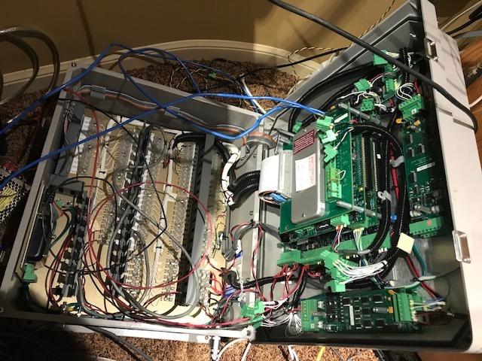
Digital Transformation meets The Brownfield World
Brownfield Data Producer
The majority of Digital Transformation will be with the Brownfield World for a decade or more
Connecting to Legacy Protocols
Register Based Data using Poll/Response Protocols
Data will have little context
OT Data is not easily IT Consumable and must be addressed holistically. Most try custom software at the edge increasing the costs and complexity of and eroding any ROI. Requires cost effective tools on platforms not custom code.
Modbus Address 40,027 = 1256
What does 1256 represent?
Is it a raw value or scaled?
What are the engineering units?
What is the engineering range?
What Tag Name does 40,027 represent?

Slide 26
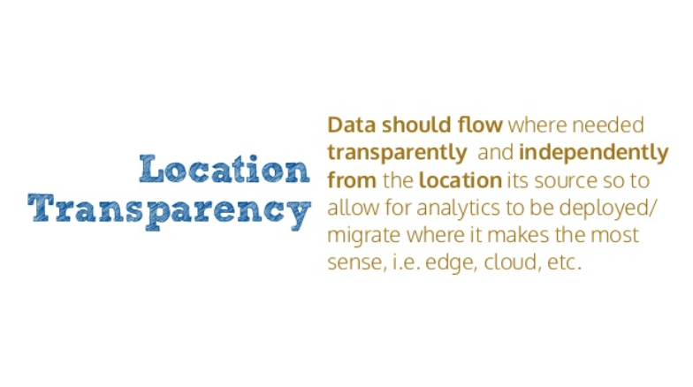
Edge Computing – Why/Where/When?
Notes:
40 years from now this won’t be a notion. But with 40 years of existing infrastructure and devices it IS an issue in any Digital Transformation strategy.

Slide 27
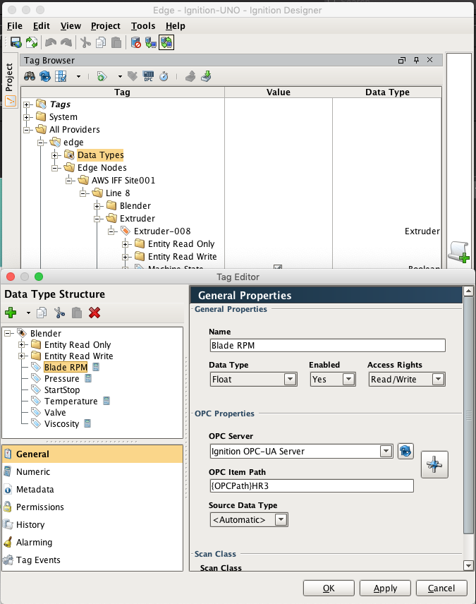
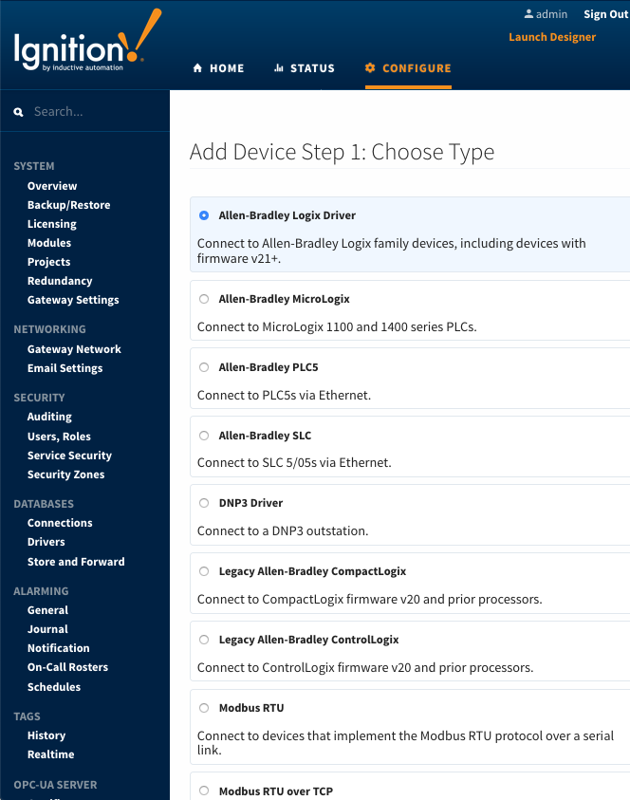

OT Edge vs. IT Edge
OT Edge and IT Edge
IT/Cloud Tooling
APIs
C
C#
Python
Java
JavaScript
Google Go
”Pythonic/SQL-ish”
OT
Data
?
IT Edge requires:
“Coding on Operating Systems”
OT Edge provides:
“Tools on Platforms”
Notes:
Shout out to Timothy Triplett!!!
Manually coding tags? What is a tag?
Manually coding OPC UA
Manually coding MQTT
Per the Eclipse Foundation slide, a majority of the IT Edge MQTT and OPC UA APIs were derived directly from the Paho and Milo projects!
At the ARC event in Orlando this year Hugh Roddy from Chabani called Ignition his “OT Operating System”
The Ignition Platform “MAKES IT SIMPLE”
Single source of truth (tag standardization)
Tag naming
Time stamp
Real value
Engineering units / range
Data type
Custom properties
Quick-and-simple configuration
Using tools, rather than coding, for configuration
Cost efficient
Data sent on change
Time series efficiency
Scalable

Slide 28


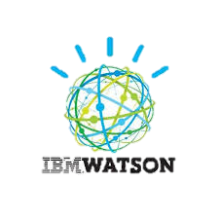
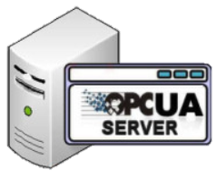




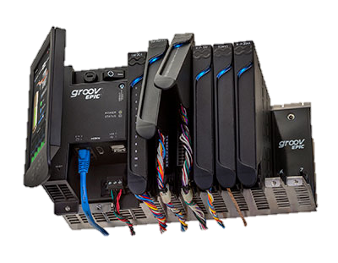
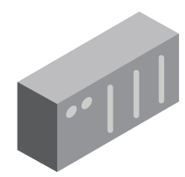
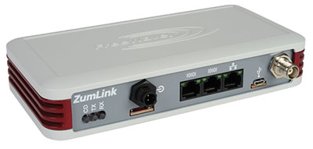
Solution Architectures – Hub & Spoke
Enterprise Service Bus (ESB
Factory/SCADA
Factory/SCADA
MQTT Server
Infrastructure
OPC-UA Server
Cloud
Injectors
MQTT
Engine
Existing SCADA
MQTT Transmission
SparkMQ
PLCs/RTUs
PLCs/RTUs

Slide 29
Solution Architectures - Edge
Ignition Edge
OPC-UA Server
PLCs/RTUs
Existing SCADA
Factory Floor / SCADA

Slide 30

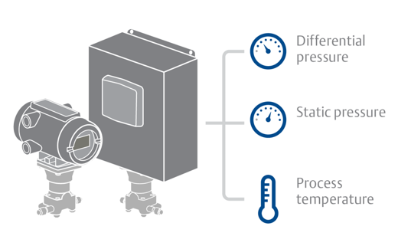




EFM Solution Topology
Real Time
Tags
Tag
Provider
Or
Alarms
Events
Electronic Flow Meters
History
Alarms
SQL Database
Config
Events
History
Real Time
Tags
MQTT Transmission
MQTT Server
Config
MQTT Recorder
Ignition Tag Historian
MQTT Engine
Alarms
Events
History
Config
Transaction Queue
Export
Flow Measurement

Slide 31
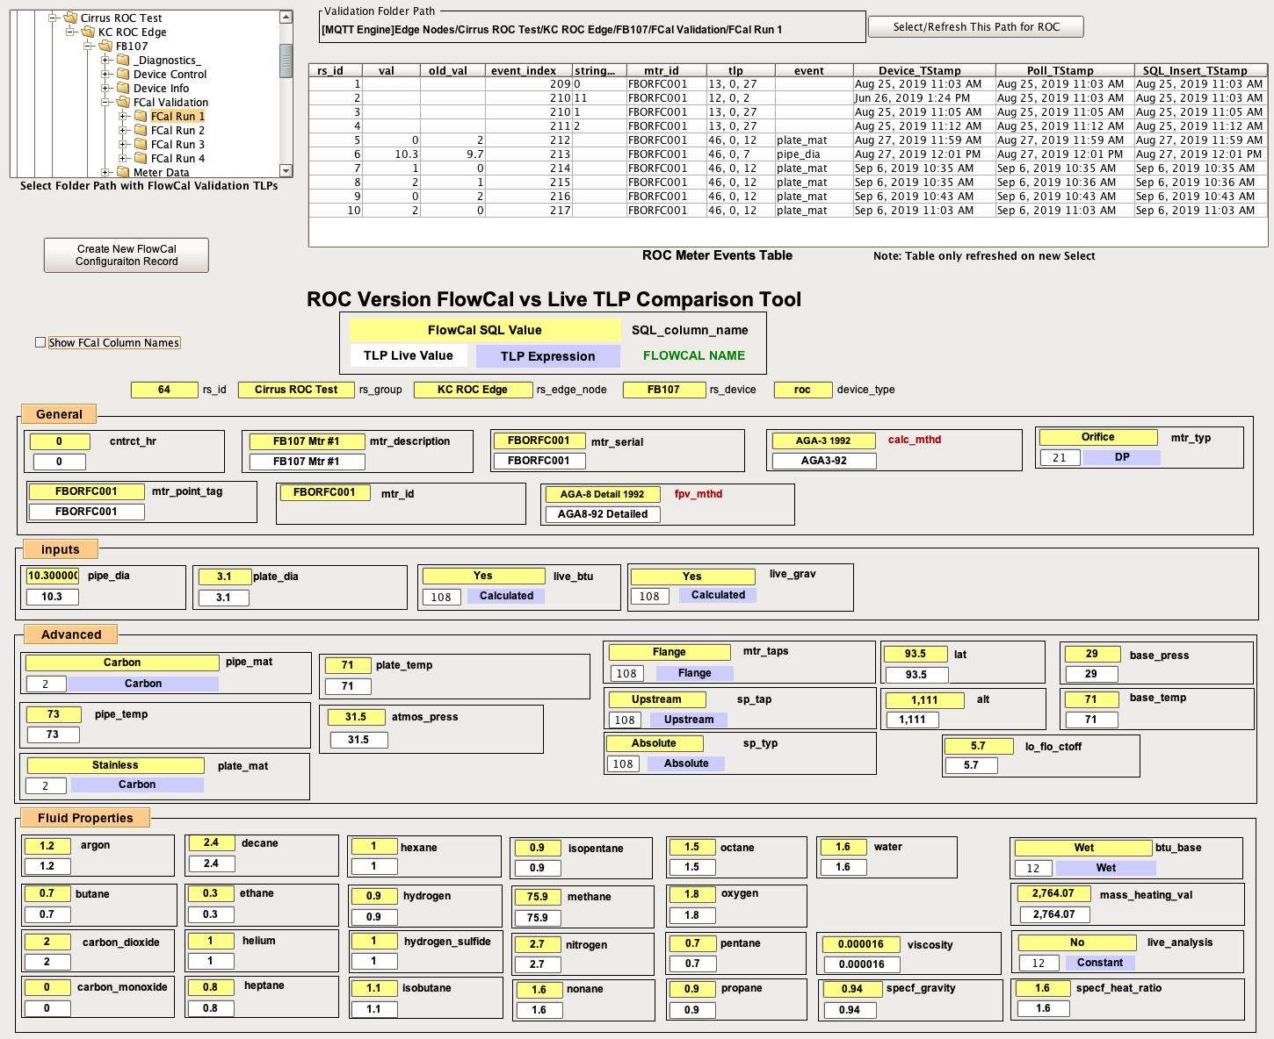
Transparent Access to Data
Notes:
Look at other industry examples.
Pharma Railroad

Slide 32
Digital Transformation
“Inductive Automation provides the tools, technology and ecosystem required to modernize existing OT infrastructures, resulting in not only superior OT solutions, but in an infrastructure that is now ready to address your Digital Transformation requirements, whatever they may be now or in the future"
Notes:
Start your digital transformation by addressing your OT infrastructure first.
Don’t try to eat the elephant all at once. Identify

Slide 33
BTW - This all works for Greenfield as well!
Don’t miss the excellent projects from ARB Midstream and Streamline Chemicals around how they utilized Ignition EDGE, MQTT, and the Ignition Platform for some amazing Greenfield projects!

Slide 37
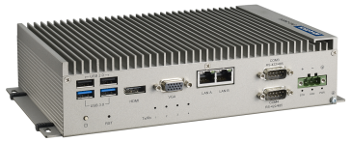
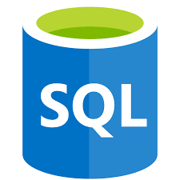
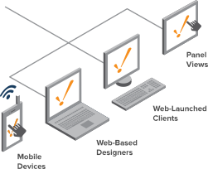









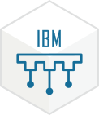

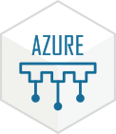

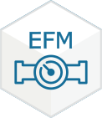
Cloud Services and Analytics
Store /
Forward
Standalone MQTT Server
MQTT
Engine
MQTT
Distributor
MQTT
Transmission
MQTT
Recorder
IBM Watson
Injector
Google Cloud
Injector
Azure
Injector
AWS
Injector
ROC/ABB
EFM

