Slide 1

Fatal
Flaws:
Your Active
Shooter Response

Slide 2


Slide 3


Slide 4


Slide 5
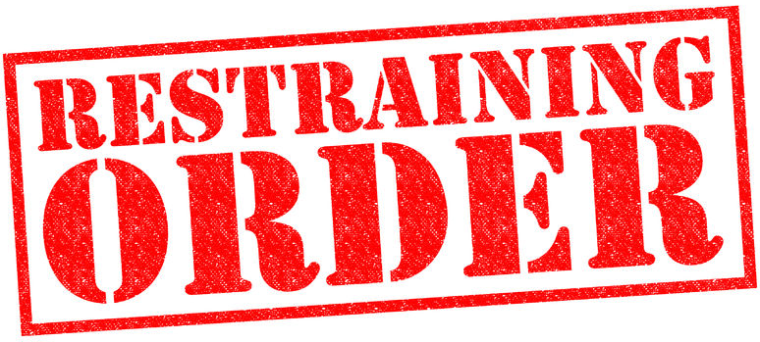
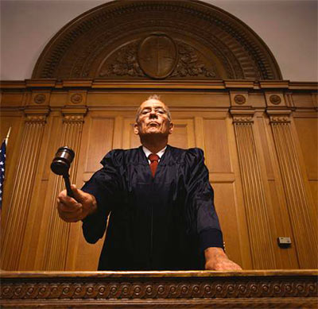

Slide 7

Ohhh

Slide 8
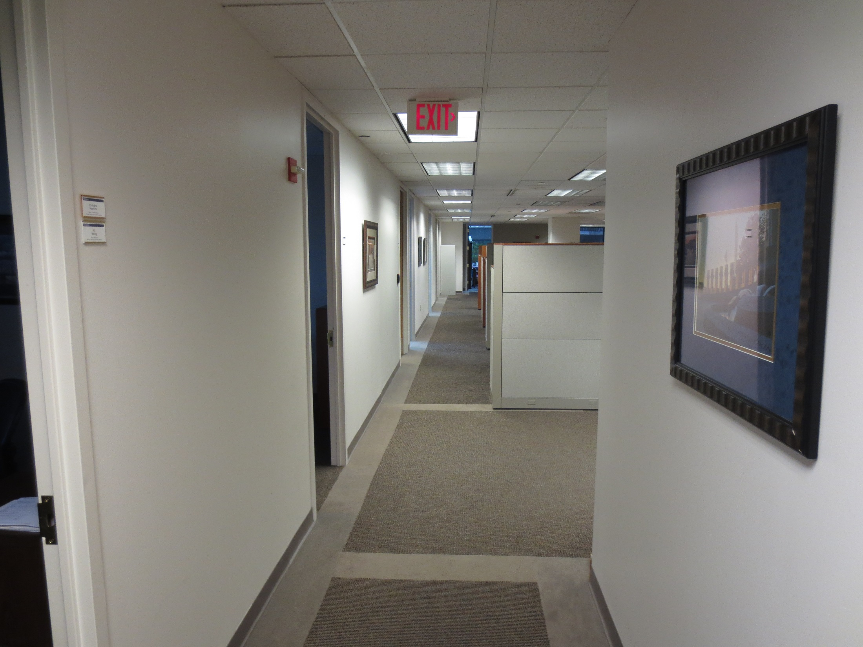

Slide 9


Slide 10


Slide 11
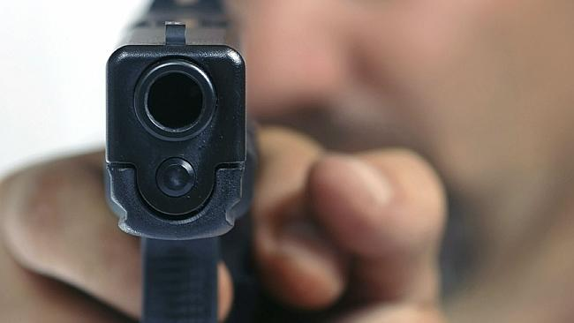

Slide 12
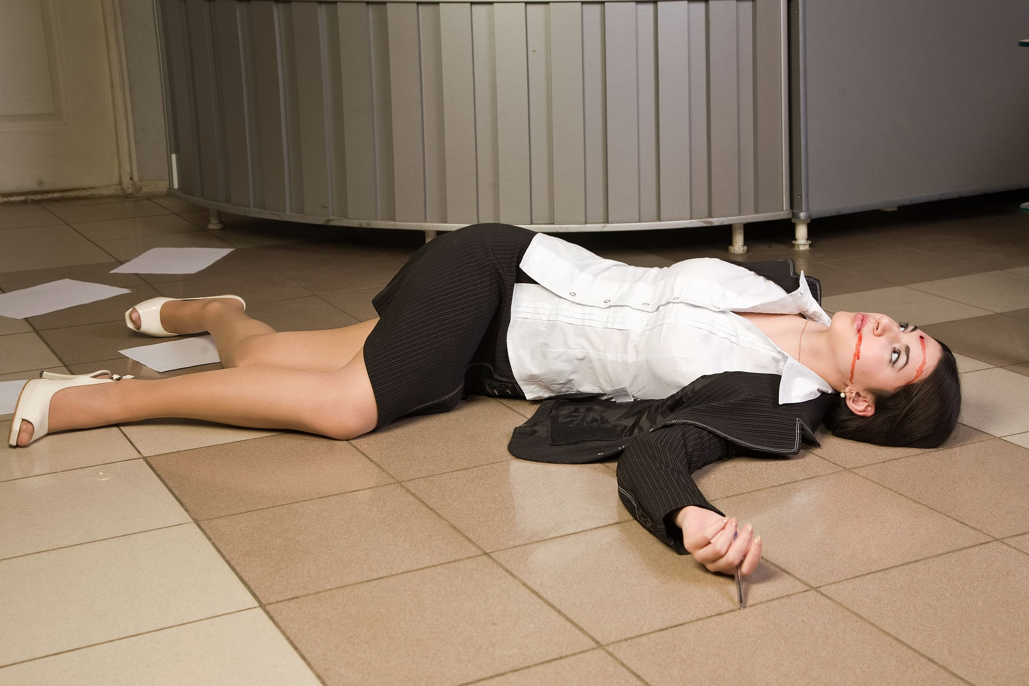

Slide 13
What Do YOU Do
Right NOW

Slide 14
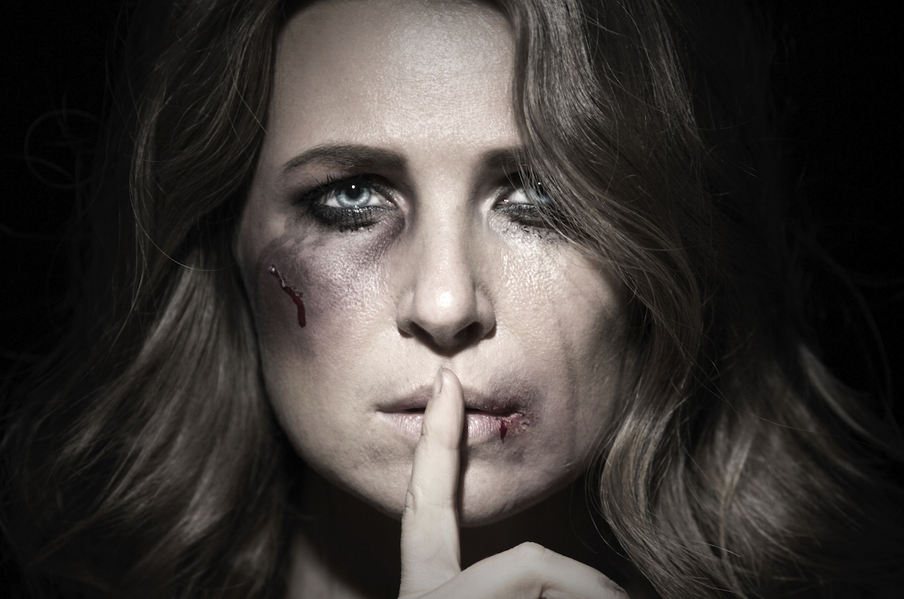

Intimate Partner Violence

Slide 15
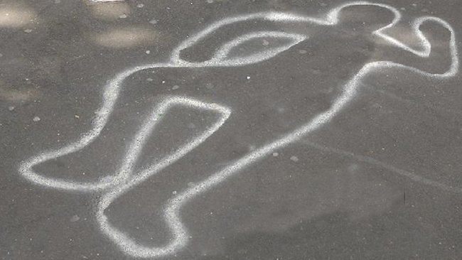

Intimate Partner
Violence Kills
1,300 Every Year

Slide 16
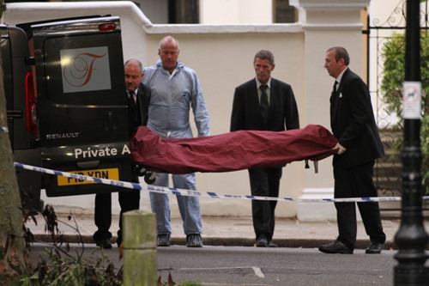
2 Workplace Homicides Every Day

Slide 17
What Do YOU Do
Right NOW

Slide 18



Fatal Flaw: Your EAP
Majority over in
4-5
minutes

Slide 19
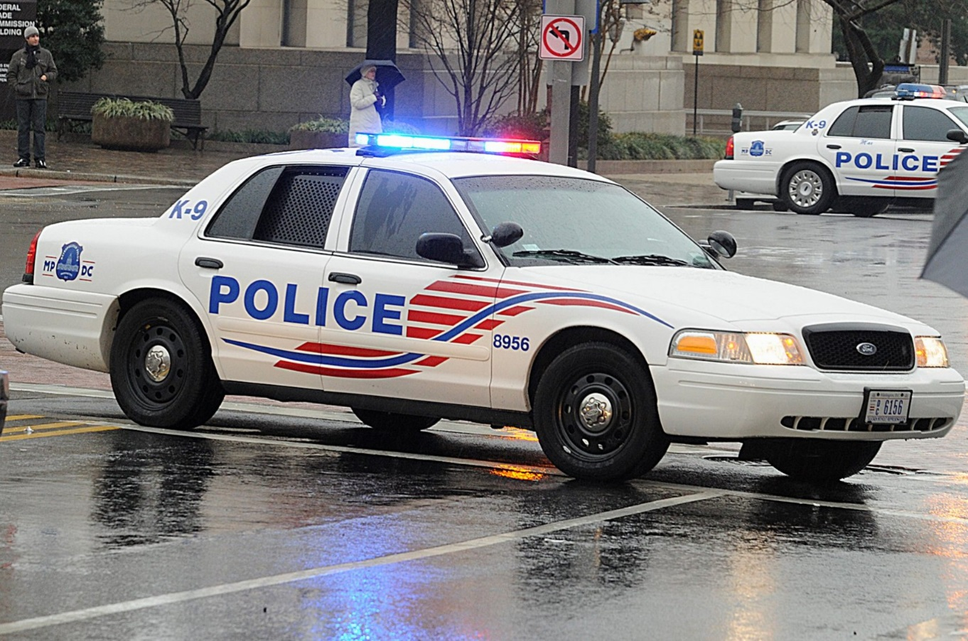
Police
probably
Can’t
deploy
in time

Slide 20


PD + FD Not 1st Responders

Slide 21
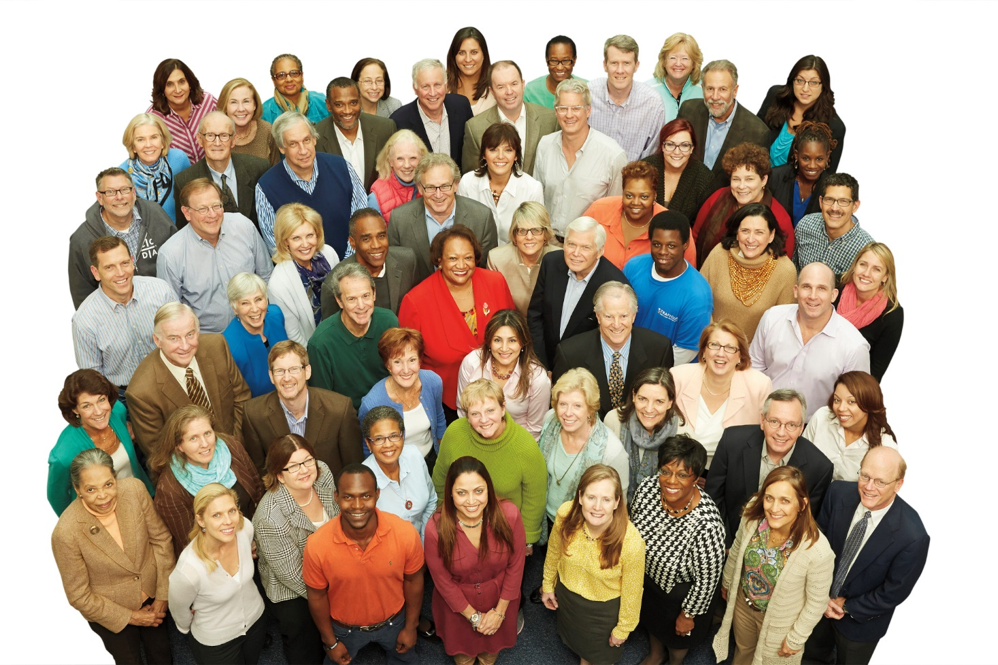
Employees = 1st Responders

Slide 22
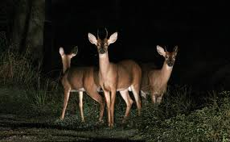

Slide 23
  Bo Mitchell
  911 Consulting
  Founder/President

Slide 24


Slide 25
  Bo Mitchell
  911 Consulting
  President
  Police Commissioner (Ret.)
Certified Emergency Manager
CEM, CPP, CHS-V, CBCP, CSI-ML, HSEEP, CNTA, IAC, MOAB, CHSP, CHEP, CSHM, CESCO, CHCM, CFC, CSSM, CSC, CAS, TFCT3, CERT, CHSEMR, CMC

Slide 26
Expert Consultant
Landmark Legal Cases
Expected Settlements:
$1 Billion Each
“Failure to Plan”
“Failure to Train”

Slide 27
911 Consulting Clients
    GE HQ
    H&R Block HQ
    Hyatt HQ
    MasterCard HQ
    Rolls Royce HQ
    Subway HQ

Slide 28
911 Consulting Clients
26 K-12
5 Colleges + Universities

Slide 29
Speaker
ASSP
NFPA
FEMA
SHRM
OSHA
RIMS

Slide 30
What Do YOU Do
Right NOW

Slide 31

Workplace
Violence

Slide 32

18x
More Likely to Have
Violence than a Fire
at Work
DOJ & NFPA

Slide 33
2 Workplace Homicides Every Day

Slide 34
Threats
2 People Murdered
Every Day:
26 Rapes
Every Hour
DOJ

Slide 35
Facts: WPV
2 people murdered/day!
Every hour:
      26 rapes
      44 robberies
      207 aggravated assaults
      938 simple assaults
      3,125 threats.

Slide 36

Active
Shooter

Slide 37
B4 Sandy Hook:

Slide 38
1X/Mo

Slide 39
1/WK

Slide 40
What Do YOU Do
Right NOW

Slide 42
What’s
Missing
Here???

Slide 43
Your EAP
FATAL FLAW
Almost All Active Shooter Incidents Over 8 Mins

Slide 44
Fatal Flaw: Your EAP
Majority over in
4-5
minutes

Slide 45

Chaotic + Kinetic
Combat Situation

Slide 46
Police
probably
Can’t
deploy
in time

Slide 47
PD + FD Not 1st Responders

Slide 48
Employees = 1st Responders

Slide 49
Your Planning + Training
Built for Police Response
Not Your Personnel’s Response
4-8 Minutes

Slide 50
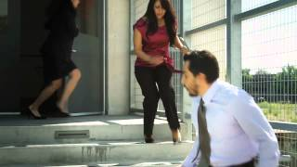


Slide 51
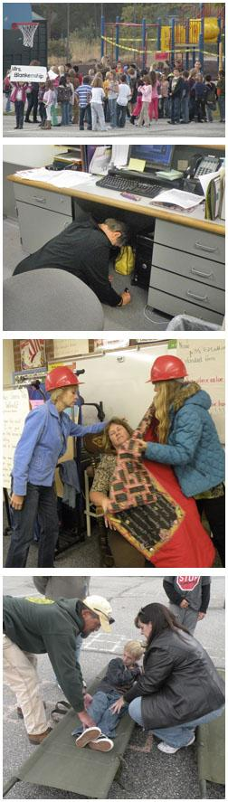

Slide 52
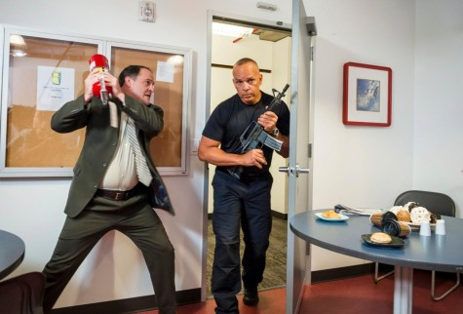

Slide 54
Where Do Active Shooters Come From?

Slide 55
Active Shooter is
Workplace
Violence

Slide 56
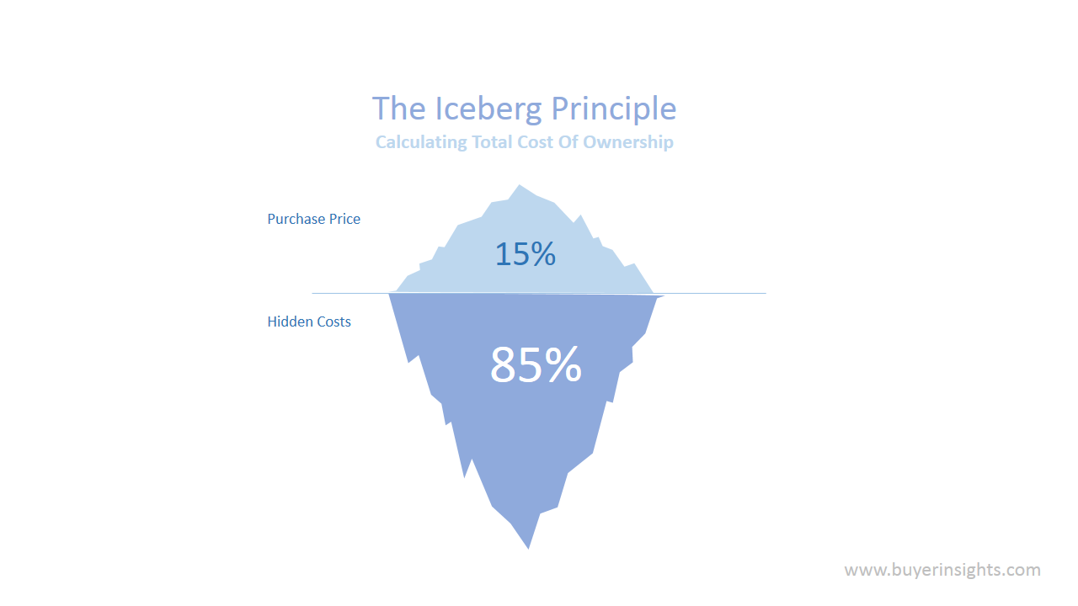
Iceberg Principle

Slide 57

Active Shooter
Active Shooter

Slide 58
Active Shooter
Active Shooter
Daily
Workplace
Violence

Slide 59
Research
Insights

Slide 60
Intimate Partner Violence

Slide 61
Spousal Abuse Is Epidemic
CDC

Slide 62
Intimate Partner Violence
IPV: Men & Women are Victims
1/3 Female Homicides/Yr
5.3MM Incident/Yr
2MM injuries. 1,300 Deaths
555M Req Medical Attention
18.5 MM Mental Health Visits/Yr

Slide 63
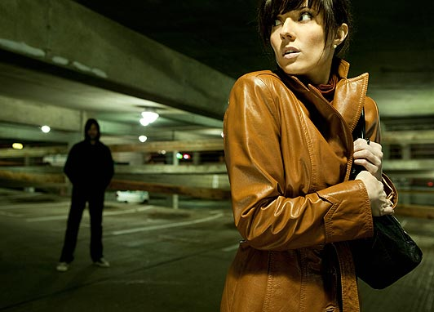
Stalking @ Workplace

Slide 64
Stalking @ Workplace
3.4 MM Victims/Yr
46%: 1 Unwanted Contact/Wk
11%: Stalked 5+ Yrs
Hi Risk: Divorced or Separated
Women at Greater Risk: Stalking
Men+Women: Harassment
¼ Report Cyber stalking

Slide 65
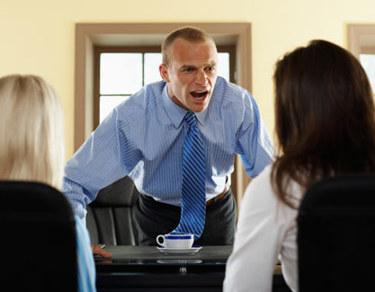
Workplace Bullying

Slide 66
Workplace Bullying
37% Report WPB: 54MM
Add’l 12% Witness
72% Bullies: Supervisors. 60% Male.
Equal: M to M; M to F; F to F; 2/3 Less: F to M;
57% Targets: Women

Slide 67
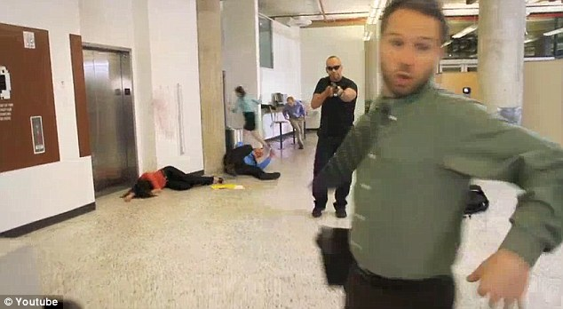
Every A.S. Has Been Bullied: ✓School
✓Work ✓Neighborhood

Slide 68
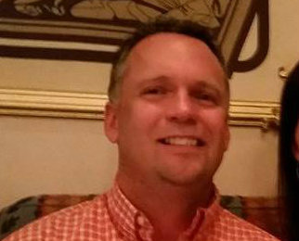
UPS
Birmingham
3
Dead

Slide 69
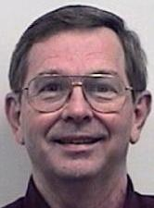
NASA
Houston
2
Dead

Slide 70
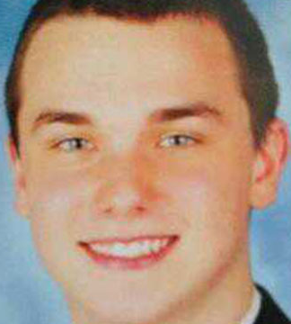
FedEx
GA Apr ’14
1
Dead
6 Wounded

Slide 72
Where Do Active Shooters Come From?

Slide 73
Active Shooter
Active Shooter
Daily
Workplace
Violence

Slide 75
Profile?

Slide 76
NYPD: Active Shooter Analysis
Male: 96%
Alone: 98%

Slide 77
NYPD: Active Shooter Analysis
Deaths: 3.0 Ave
Injured: 3.6 Ave

Slide 78
NYPD: Active Shooter Analysis
Campuses:
Other Workplaces:

Slide 79
NYPD: Active Shooter Analysis
Campuses: 29%
Other Workplaces:

Slide 80
NYPD: Active Shooter Analysis
Campuses: 29%
Other Wrkplaces:
71%

Slide 81
NYPD: Active Shooter Analysis
Force: 46%
Suicide: 40%
Arrested: 14%

Slide 83
What Do YOU Do
Right NOW

Slide 84
Chaotic + Kinetic
Combat Situation

Slide 85
Employees = 1st Responders

Slide 86
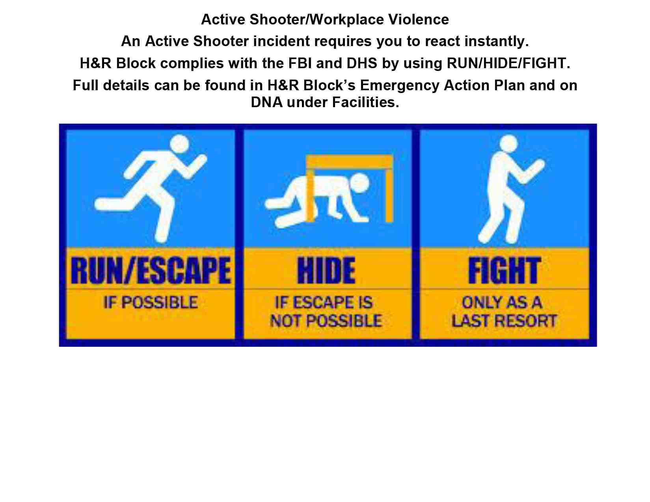

Slide 87
ALERT

Slide 88
Life Safety Code®

Slide 89
ALERT

Slide 90
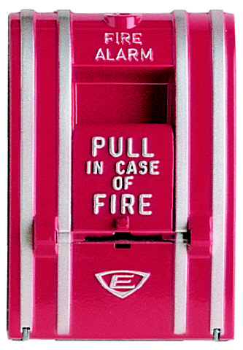

Slide 91
FAST Way: Alert ALL
PA
Cell Calls
Paging
ENS
Email

Slide 92
FAST Way: Alert ALL
PA
Cell Calls
Paging
ENS
Email
Texts
Panic Alarms
2-Way Radios
Lock Computer Screens

Slide 93
FAST Way: Alert ALL
Duplicative?
PA
Cell Calls
Paging
ENS
Email
Texts
Panic Alarms
2-Way Radios
Lock Computer Screens

Slide 94
Redundancy Is a Beautiful Thing

Slide 95
Redundancy Is a Beautiful Thing
Redundancy Is a Beautiful Thing

Slide 96
Redundancy Is a Beautiful Thing
Redundancy Is a Beautiful Thing
Redundancy Is a Beautiful Thing

Slide 97
Active
Shooter
Protocol

Slide 98
Active Shooter Protocol
Go Into Your Bldg

Slide 99
Active Shooter Protocol
Go Into Your Bldg
Find Guy w Gun

Slide 100
Active Shooter Protocol
Go Into Your Bldg
Find Guy w Gun
Kill Him

Slide 101
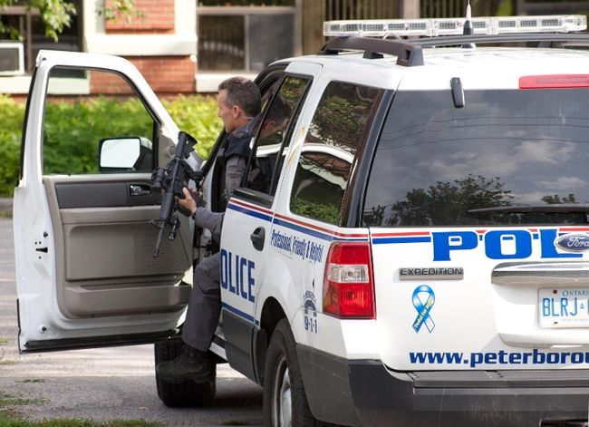

Slide 102
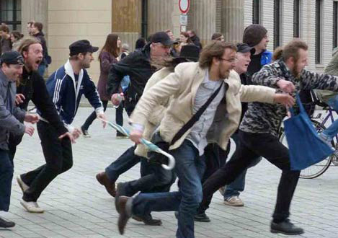

Slide 103
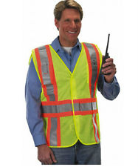
Your Emergency
Commander
Guardian
Deputy
Emergency
Commander

Slide 104
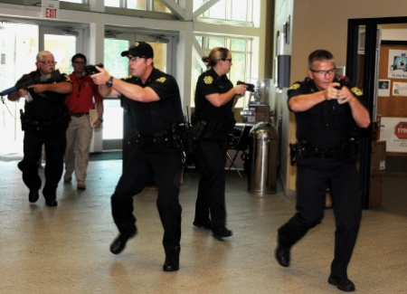

Slide 105
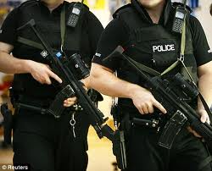

Slide 106
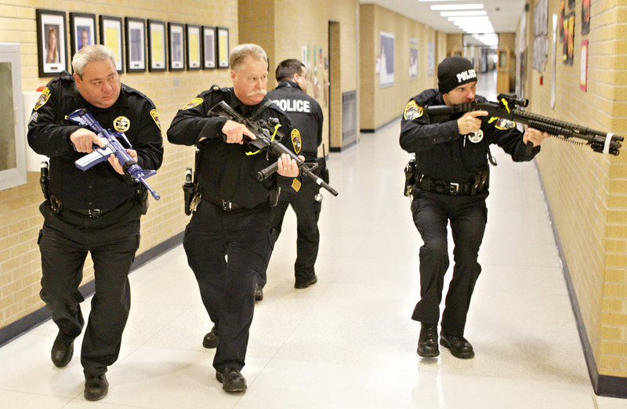

Slide 107
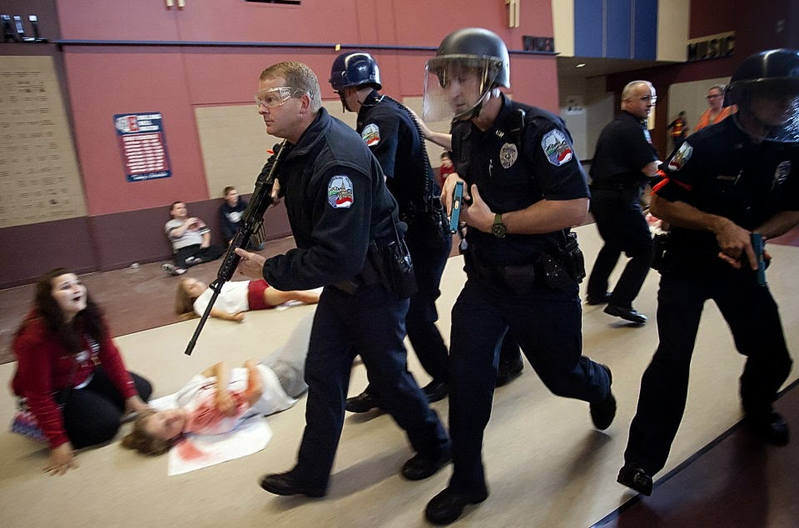

Slide 108
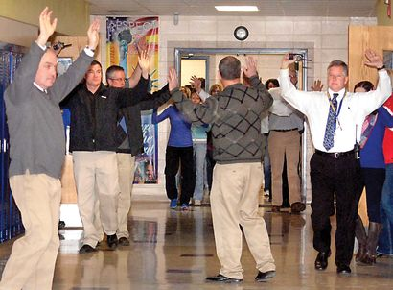

Slide 109
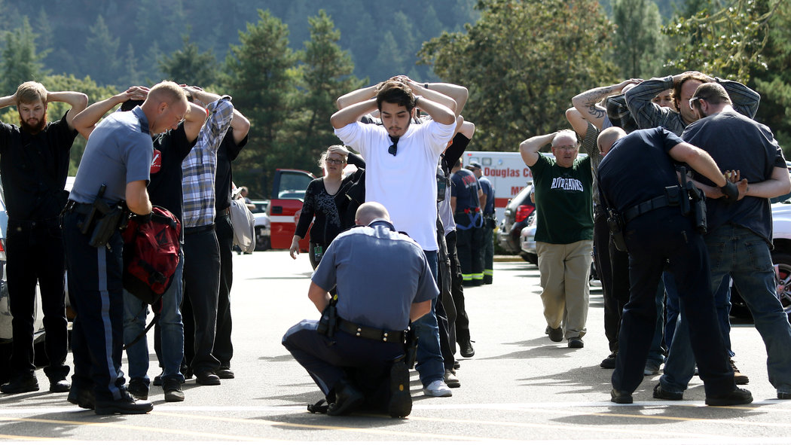

Slide 110
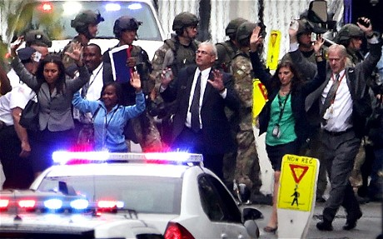

Slide 111
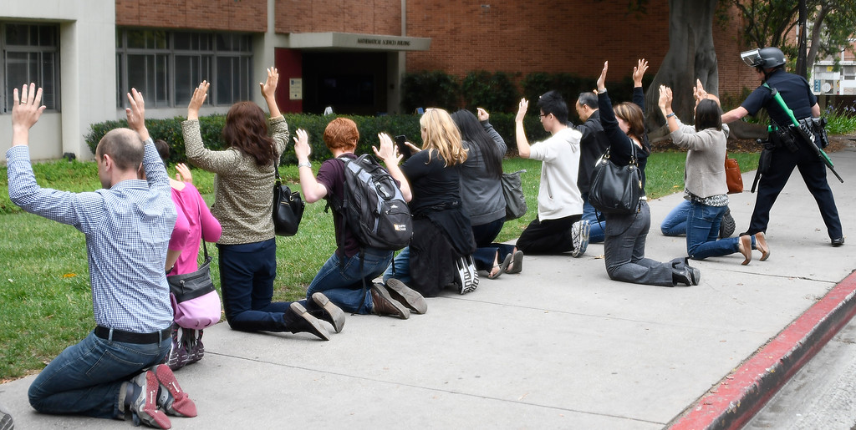

Slide 112
Put Your Hands Up

Slide 113
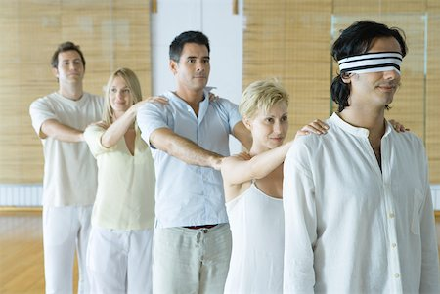
Your Workplace: Active Shooter Response

Slide 114
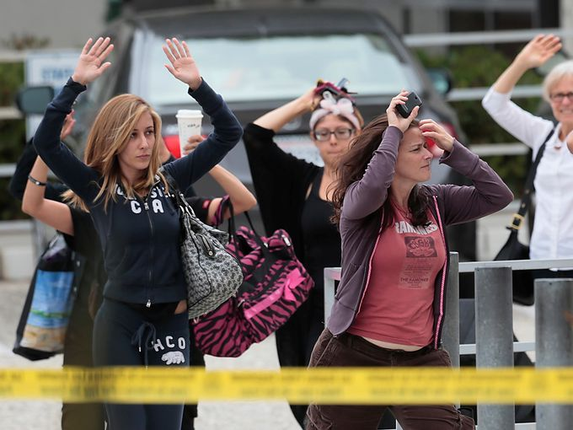

Slide 118
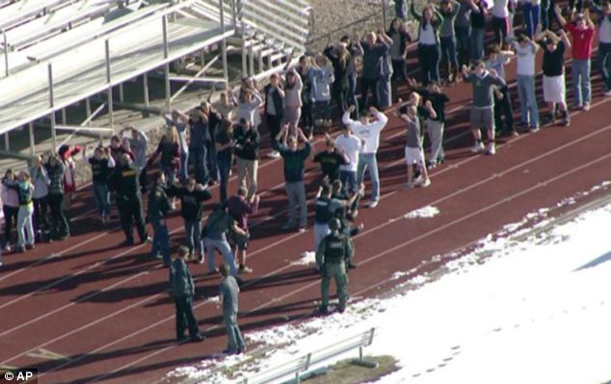

Slide 125
Run Hide Fight
Training
Training
Training

Slide 126
We Don’t Rise to the Occasion…

Slide 127


Slide 128
We Don’t Rise to the Occasion.
We Sink to Our Level of Our Training

Slide 131
For Every Complex Problem…

Slide 132
For Every Complex Problem, There’s a Simple Solution

Slide 133
For Every Complex Problem, There’s a Simple Solution
That’s Always Wrong

Slide 134
Generalities = Dangerous

Slide 135
Make Site Specific for
Your People

Slide 136
Active Shooter
Alert
Run
Hide
Fight

Slide 138
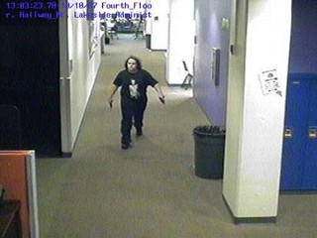

Slide 139
Active Shooter
Alert
Run
Hide
Fight

Slide 141
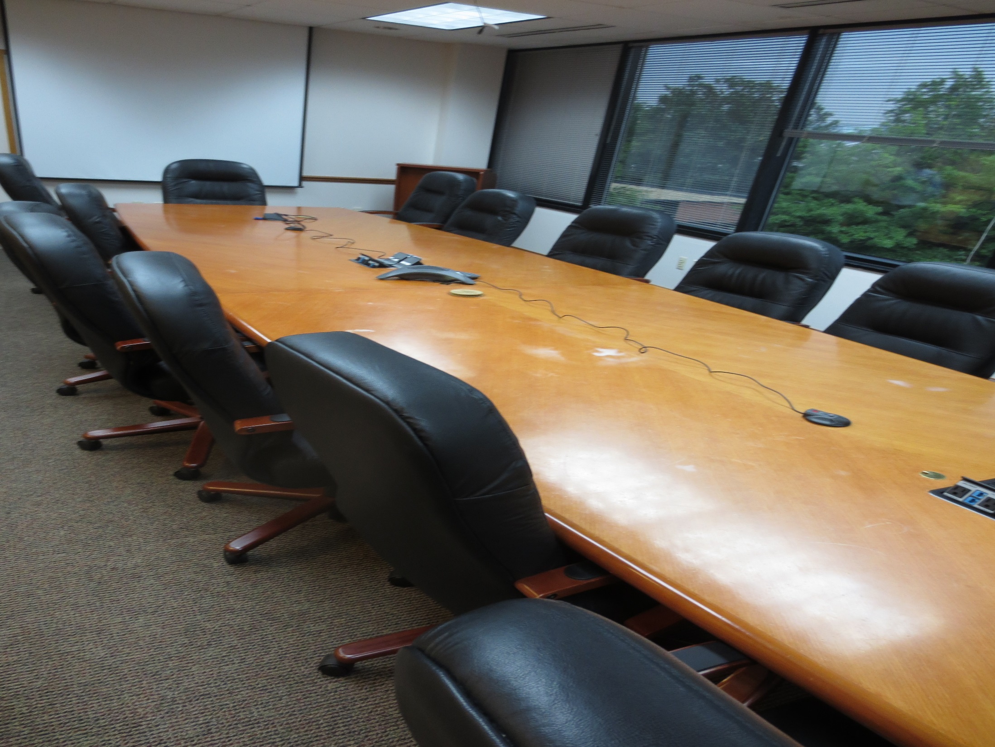

Slide 142
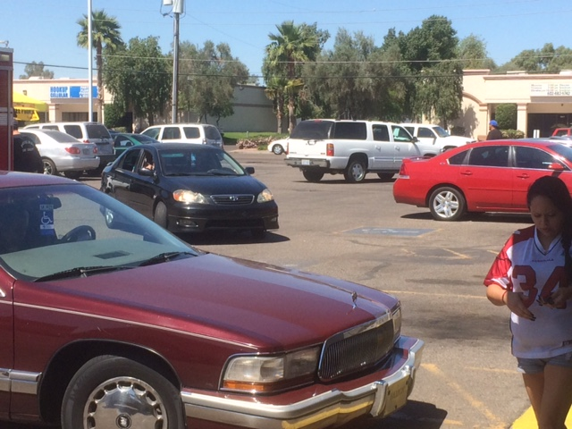

Slide 143
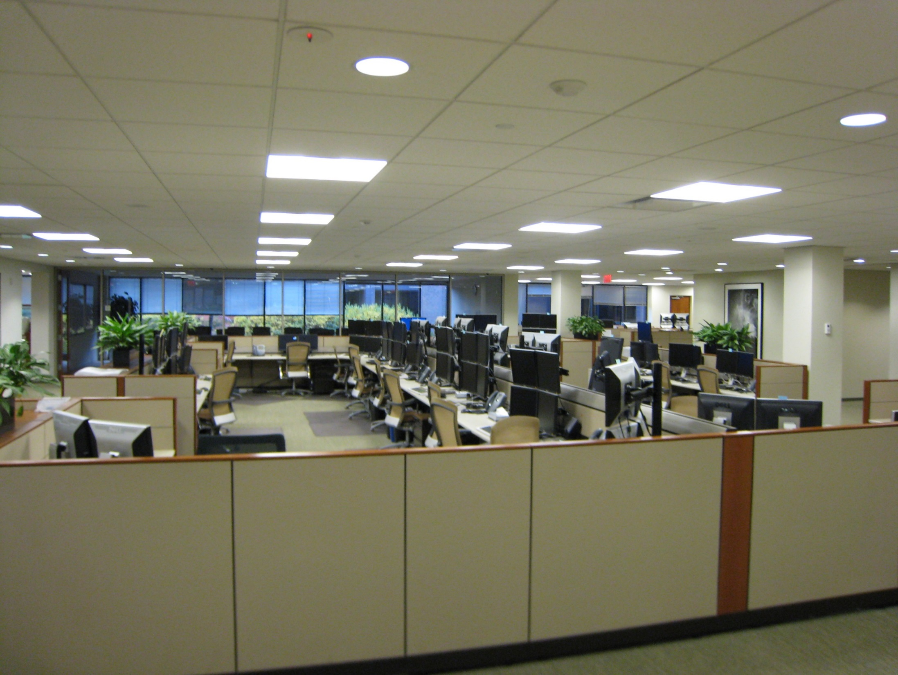

Slide 144
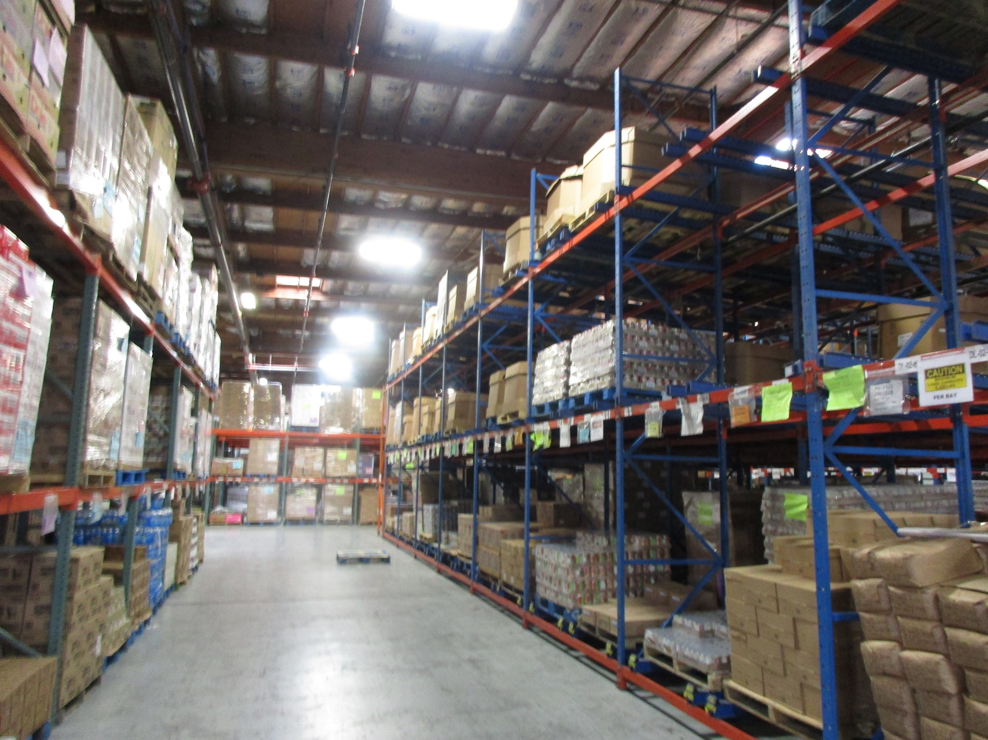

Slide 145


Slide 146
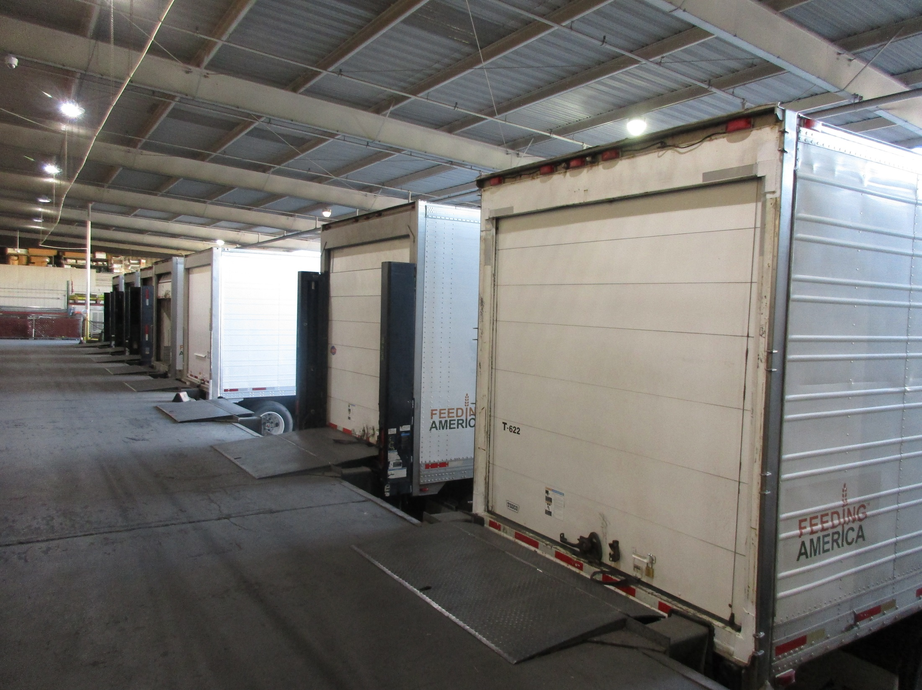

Slide 147
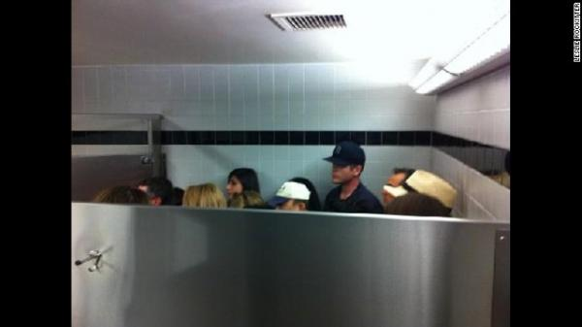

Slide 148
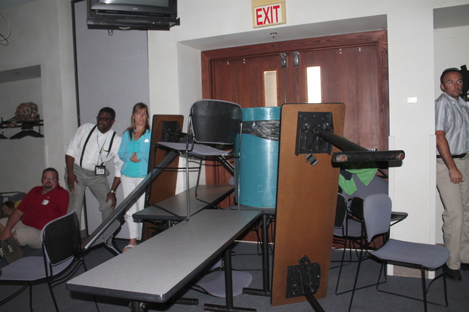

Slide 149
Active Shooter
Alert
Run
Hide
Fight

Slide 150
1/WK

Slide 151
Fight
Last Resort

Slide 153
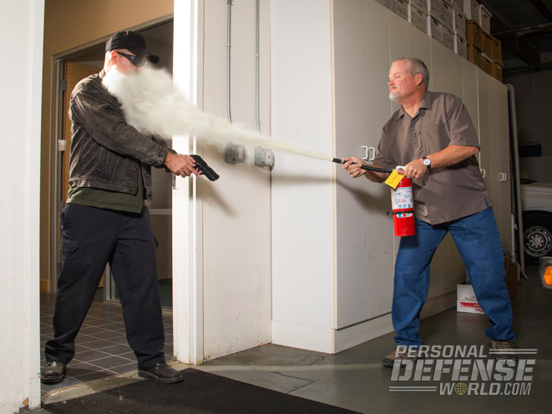

Slide 154
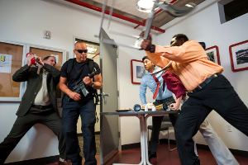

Slide 155
How Do We Fix
Fatal Flaw?

Slide 156
Biggest
Threat?

Slide 157
Denial

Slide 158
Tell Me What’s Required by Law

Slide 159
Duty of
Care

Slide 160
Everything
Is Always
Your Fault

Slide 161

General Duty Clause
“each employer shall furnish …a place of employment …free from recognized hazards that are causing or are likely to cause death or serious physical harm to employees.”

Slide 162
Standards

Slide 163
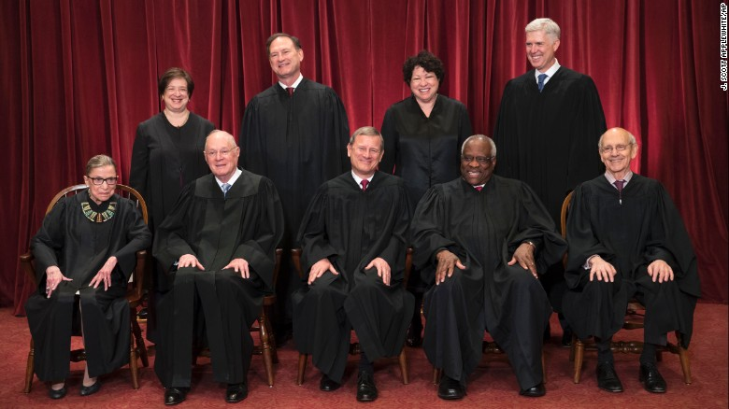

SCOTUS

Slide 164

SCOTUS
Only Courts Can Set/Adopt the Standards that Juries Use to Judge YOU.

Slide 166
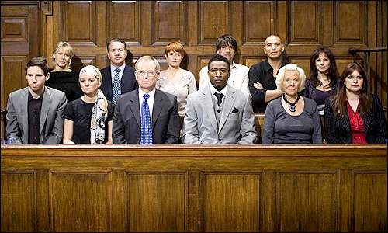
Jury = Employees

Slide 167
Your Employees
Sanctuary
Of
Safety

Slide 168

KENOSHA?
OSHKOSH?
Wisconsin

Slide 169
+ WPV

Slide 170
OSHA + WPV
OSHA Does NOT Have Regs on WPV

Slide 171
But…
OSHA Does NOT Have Regs on WPV

Slide 172
29 CFR
1910.34

Slide 173
“Sections 1910.34 through 1910.39 apply to workplaces in general industry except mobile workplaces such as vehicles or vessels”

Slide 174
29 CFR 1910.38
Emergency Action Plan

Slide 175
General
Duty
Clause

Slide 176
General Duty Clause
“each employer shall furnish …a place of employment …free from recognized hazards that are causing or are likely to cause death or serious physical harm to employees.”

Slide 177
WPV Enforcement
Guidelines
2011

Slide 179
1600

Slide 180
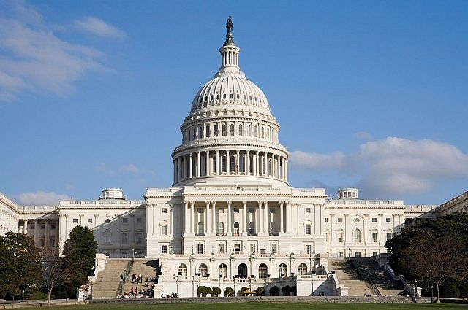

Slide 181


Slide 182
59,000,000

Slide 183


Slide 184
1600

Slide 186
1600

Slide 187


Slide 188
Resiliency

Slide 189
1600

Slide 190


Slide 191

Shall Create + Train Plans
All
Hazards
1600

Slide 192
Shall Create + Train Plans
All
Hazards
1600

Slide 193



Slide 194
All-Hazards Plan: Shall
Emergency Team
Chain of Command
Visitors
Contractors
Civil Disturbance
Disabled
Headcounts
Evacuation
In-Building Relo
AAs
Fire
Bomb Threat
Medical Em
Security
Active Shooter
Hostage
Lockout
Suicide
Bullying
Perimeter Access
Security Aft Hours
Chemical Spill: In
Chemical Spill: Out
Shelter in Place
Suspicious Pkg
Suspicious Person
Explosion
Structural Failure
Severe Weather
Elevator Em
Power Outage
Water/Phone Out
Lockdown
Air Quality
Em Shutdown
Earthquake
Flooding
Pipe Burst
CBRNE
Terrorism
Use of FEs
Training
Drills
Exercises
Search-Seizure
Weapons
Evac Maps
Em Contacts
1600

Slide 195
500 +
Plans Reviewed

Slide 196

Compliant?

Slide 197
Compliant?
1

Slide 198

3
Things Guaranteed
in Life

Slide 199
3 Things in Life Guaranteed
Death

Slide 200
3 Things in Life Guaranteed
Death
Taxes

Slide 201
3 Things in Life Guaranteed
Death
Taxes
You Do Not Have: EAP Complies w
1600

Slide 202
FUBAR

Slide 203
Fair
Warning

Slide 204
I Will Be
Candid
★    

Slide 205


Slide 206


Slide 207
ASIS Standards + Guidelines
Risk Assessment
Security Mgmt
Physical Security

Slide 208
ASIS Standards + Guidelines
Risk Assessmt
Security Mgmt
Physical Security
Bground ✓s
C.S.O./S.O.
WPV
Investigations

Slide 209
What Do YOU Do
Right NOW

Slide 211

Credible
Peer Reviewed
Authoritative
Long-Standing
Comprehensive

Slide 212
Training
Mandatory

Slide 213
Training
Mandatory:
Train All Personnel

Slide 214
Training
Mandatory:
Train All Personnel
In Classroom

Slide 215
Training
Mandatory:
Train All Personnel
In Classroom
Annually & At Hire

Slide 216
Training
Mandatory:
Train All Personnel
In Classroom
Annually & At Hire
“Qualified” Trainer (by Exp, Trng)

Slide 217


Slide 218

On-Screen Training Can Supplement

Slide 219
On-Screen Training Can NEVER Substitute

Slide 220
Employees = 1st Responders

Slide 221
Responsible
Officer?

Slide 222
Responsible Party?
CEO

Slide 223
CEO: Responsible Party
Civilly

Slide 224
CEO: Responsible Party
Civilly
Personally

Slide 225
CEO: Responsible Party
Civilly
Personally
Criminally

Slide 226


Slide 227
Responsible Parties
CEO
Directors
Sr. Ops Personnel

Slide 228


Slide 229
Exaggeration?

Slide 230
2015-16-17 Criminal
11 CEOs Indicted.
9 CEOs Convicted

Slide 231
CEOs: 2015-16-17
CA: 3 Convicted. Prison

Slide 232
CEOs: 2015-16-17
CA: 3 Convicted, Prison
PA: 2 Convicted, Prison

Slide 233
CEOs: 2015-16-17
CA: 3 Indicted, Prison
PA: 2 Convicted, Prison
W. VA.: 2 Convicted, Prison

Slide 234
CEOs: 2015-16-17
CA: 3 Indicted, Prison
PA: 2 Convicted, Prison
W. VA.: 2 Convicted, Prison
NYC: 4 Indicted 2 Convicted, Prison

Slide 235
CEOs: 2015-16-17
CA: 3 Convicted
PA: 2 Convicted
W. VA.: 2 Convicted
NYC: 4 Indicted,
2 Convicted

Slide 236

Alfonso Prestia
5Aug15
The
New York Times

Slide 237
March 2017: Wisconsin
Company Indicted
3 Sr. Managers Indicted Criminally
No Dead: “Willful”

Slide 238
March 2017: Wisconsin
Company Indicted
3 Sr. Managers Indicted
Corporate Safety & Environmental Director
Safety Coordinator
Operations Manager

Slide 239
March 2017: Wisconsin
Safety officials with the company tried to cover up the exposure, sending emails including one that speculates the company would be hit with a $70,000 federal fine and concluded with the order, "KEEP THIS INFORMATION UNDER RAP (sic) until we can hammer out our final plans of dealing with this issue," according to the indictment.

Slide 240
March 2017: Wisconsin
If convicted, the three face maximum sentences ranging from 11 to 41 years in prison. They also face hundreds of thousands in fines. The corporation faces millions in criminal penalties.

Slide 241
May 2017: Ohio
Supervisor
Mgr Environmental Enterprises

Slide 242
May 2017: Ohio
Supervisor
Mgr Environmental Enterprises
Involuntary Manslaughter
Reckless Homicide

Slide 243
May 2017: Ohio
Supervisor
Mgr Environmental Enterprises
Involuntary Manslaughter
Reckless Homicide
Tampering: Records
Tampering: Evidence

Slide 244
2015-16-17 Criminal
11 CEOs Indicted.
9 CEOs Convicted
6 Sr. Ops Indicted

Slide 245
Companies: Guilty Criminally
PG&E, CA: Guilty 2016
Behr Co., Ill: Guilty 2016

Slide 246
2015-16-17 Criminal
CEO Indicted
Every
78 Days
11 CEOs Indicted.
8 CEOs Convicted
3 Sr. Ops Indicted

Slide 249
New MOU Dec 2015
Enhance DOJ’s Cases
Juries: Emotion
Obstruction of Justice: Subpoena

Slide 250
18 U.S.C. §1505
Obstruction of Justice

Slide 251


Slide 252


Slide 253
No
Exaggeration

Slide 254
No
Exaggeration

Slide 255
No
Exaggeration

Slide 256
CEO = Resp Officer
Do Your CEOs Know This?

Slide 257
CEO = Resp Officer
Do Your CEOs Know This?
Shouldn’t They?

Slide 258
CEO = Resp Officer
Do Your CEOs Know This?
Shouldn’t They?
Wouldn’t You?

Slide 259
Denial

Slide 260

Your
Boss

Slide 261

Mitchell’s
6 Phases of Denial

Slide 262

6 Phases of Denial
It Won’t Happen
to ME

Slide 263

6 Phases of Denial
It Won’t Happen to ME
It Won’t
Happen
HERE

Slide 264
6 Phases of Denial
It Won’t Happen to ME
It Won’t Happen HERE
It Won’t
Happen
NOW

Slide 265

6 Phases of Denial
It Won’t Happen to ME
It Won’t Happen HERE
It Won’t Happen NOW
If It Does
Happen, It
Won’t Be that BAD

Slide 266
6 Phases of Denial
It Won’t Happen to ME
It Won’t Happen HERE
It Won’t Happen NOW
If it does Happen, it Won’t Be that BAD
If it is that
Bad, my Ins.
Co. Will pay for It.

Slide 267

6 Phases of Denial
It Won’t Happen to ME
It Won’t Happen HERE
It Won’t Happen NOW
If it does Happen, it Won’t Be that BAD
If it is that Bad, my Insurance Co. Will Take Care of It.
OMG, Why
Didn’t We
Plan for THIS

Slide 268
6 Phases of Denial
Lockdown?
Touchdown?

Slide 269
Meeting
With
Your
Boss

Slide 270
HDWSI
How Do We Sell It?

Slide 271
HDWSI
Planning
Training
Drills
Exercises

Slide 272
Protecting Your:
People
Property
Productivity
Posterior

Slide 273


Slide 274
ROI
If We’re Never Hit, our ROI is Zero…

Slide 275
ROI
If We’re Never Hit, our ROI is Zero…Thank
God!

Slide 276
ROI
If We’re Never Hit, our ROI is Zero…Thank God!
If We Are Hit, Our ROI Is Measured in the 10s of Millions of $$$!

Slide 277
ROI
Protect Brand

Slide 278
ROI
Protect Brand
Protect People

Slide 279
ROI
Protect Brand
Protect People
Protect CEO’s Posterior

Slide 280
ROI
Protect Brand
Protect People
Protect CEO’s Posterior
Protect Productivity

Slide 281
ROI
Protect Brand
Protect People
Protect CEO’s Posterior
Protect Productivity
Protect $$$

Slide 282
ROI
Protect Brand
Protect People
Protect CEO’s Posterior
Protect Productivity
Protect $$$
85% ID Safety

Slide 283
ROI
Protect Brand
Protect People
Protect CEO’s Posterior
Protect Productivity
Protect $$$
85% ID Safety
98.5% Confident

Slide 284
ROI
Protect Brand
Protect People
Protect CEO’s Posterior
Protect Productivity
Protect $$$
85% ID Safety
98.5 Confident
Bond Emps into Safety Culture

Slide 285
ROI
Protect Brand
Protect People
Protect CEO’s Posterior
Protect Productivity
Protect $$$
85% ID Safety
98.5 Confident
Bond Emps into Safety Culture
Build Emp Awareness

Slide 286
ROI
Protect Brand
Protect People
Protect CEO’s Posterior
Protect Productivity
Protect $$$
85% ID Safety
98.5 Confident
Bond Emps into Safety Culture
Build Emp Awareness
Knock Down Silos

Slide 287
ROI
Protect Brand
Protect People
Protect CEO’s Posterior
Protect Productivity
Protect $$$
85% ID Safety
98.5 Confident
Bond Emps into Safety Culture
Build Emp Awareness
Knock Down Silos
Integrate Safety: Their Jobs

Slide 288
ROI
Bond Emps into Safety Culture
Build Emp Awareness
Knock Down Silos
Integrate Safety: Their Jobs
Instill Sense of Responsibility
Protect Brand
Protect People
Protect CEO’s Posterior
Protect Productivity
Protect $$$
85% ID Safety
98.5 Confident

Slide 289
ROI
Bond Emps into Safety Culture
Build Emp Awareness
Knock Down Silos
Integrate Safety: Their Jobs
Instill Sense of Responsibility
Incr Emp Ownership
Protect Brand
Protect People
Protect CEO’s Posterior
Protect Productivity
Protect $$$
85% ID Safety
98.5 Confident

Slide 290
ROI
Protect Brand
Protect People
Protect CEO’s Posterior
Protect Productivity
Protect $$$
85% ID Safety
98.5 Confident
Bond Emps into Safety Culture
Build Emp Awareness
Knock Down Silos
Integrate Safety: Their Jobs
Instill Sense of Responsibility
Incr Emp Ownership

Slide 291
Getting It Done Is Tough!

Slide 292

Scariest Word

Slide 293
NOT:
“Cost” or
“Price” or
“Budget” or
“Headcount”

Slide 294
Change!

Slide 295
Change Occurs Because of

Slide 296

Blunt Force Trauma from the Outside

Slide 297

…Never by Inspired Leadership from the Inside

Slide 298
Denial

Slide 300
Cultural
Earthquake

Slide 301
HDWSI
About
Denial

Slide 302


Slide 303
“Jaws”: Cultural Earthquake
“Won’t Close the Beaches” =
$$$

Slide 304
“Jaws”: Cultural Earthquake
“Won’t Close the Beaches” = $$$
“Can’t Hire More Lifeguards” = $$$

Slide 305
“Jaws”: Cultural Earthquake
“Won’t Close the Beaches” = $$$
“Can’t Hire More Lifeguards” =$$$
“I’ve Never Seen this Shark”

Slide 306
“Jaws”: Cultural Earthquake
“Won’t Close the Beaches” = $$$
“Can’t Hire More Lifeguards” =$$$
“I’ve Never Seen this Shark”
“Are You Sure We Have a Problem?”

Slide 307
We Never See the Monster in the 1st 60 Minutes
★    

Slide 308


Slide 309
“We Need a Bigger Boat!”

Slide 310


Slide 311


Slide 312
Where Do We Start?

Slide 313
Here’s Where
You Start

Slide 314
What Do You Need to
Believe?

Slide 315
What Do You Need to Believe?
Real Threats: You

Slide 316
What Do You Need to Believe?
Real Threats: You
Penalties: Don’t Do Right Thing

Slide 317
What Do You Need to Believe?
Real Threats: You
Penalties: Don’t Do Right Thing
You’re the Responsible Party

Slide 318
What Do You Need to Believe?
Real Threats: You
Penalties: Don’t Do Right Thing
You’re the Responsible Party
Duty of Care

Slide 319
What Do You Need to Believe?
Real Threats: You
Penalties: Don’t Do Right Thing
You’re the Responsible Party
Duty of Care
Emps Want /Appreciate This. Won’t Feel Penalized

Slide 320
What Do You Need to Believe?
You Will Lead

Slide 321
What Do You Need to Believe?
You Will Lead
You Will Be a Hero

Slide 322
What Do You Need to Believe?
You Will Lead
You Will Be a Hero
You Will Not Look Stupid. This Is Not Your Fault.

Slide 323
What Do You Need to Believe?
You Can Report to Stakeholders: Leadership, Compliance, Due Diligence to Protect Them

Slide 324
Action
Plan

Slide 325


Slide 326
Action Plan
Threat Assessment of Your Org’s Current Emergency Planning + Training

Slide 327
Action Plan
Threat Assessment of Your Org’s Current Emergency Planning + Training
Just Like Your Financial Audits

Slide 328
Action Plan
Assessment of Your Org’s Current Emergency Planning + Training
Just Like Your Financial Audits
Outside, Independent

Slide 329
Outside/Independent Assessment
You Don’t Have Expertise

Slide 330
Outside/Independent Assessment
You Don’t Have Expertise
Inside Audits: Politics + Command Influence

Slide 331
Outside/Independent Assessment
You Don’t Have Expertise
Inside Audits: Politics + Command Influence
Inside: Always Dismissed: Court, Any 3rd Party

Slide 332
Help for You
Right Now

Slide 333
Copy
of This Presentation

Slide 334

10
Commandments
Planning

Slide 335
10
Commandments
Training

Slide 336

Send Me Everything!

Slide 337
“We Need a Bigger Boat!”

Slide 338


Slide 339

⬆ ⬆ ⬆ ⬆ ⬆ Survey

Slide 341
“We Need a Bigger Boat!”

Slide 342
Fatal
Flaws:
Your Active
Shooter Response

