Slide 1

17
Gaps
Emergency Plans:
How to Fill Them

Slide 2


Slide 3


Slide 4


Slide 5
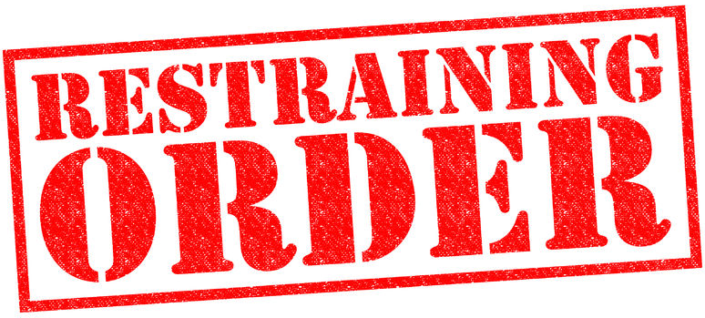
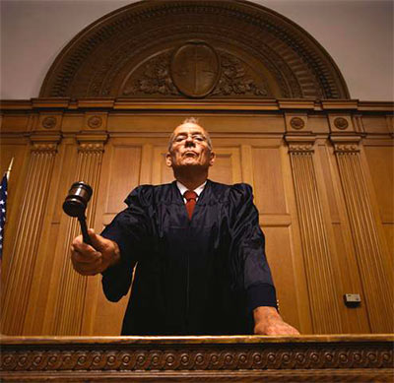

Slide 7

Ohhh

Slide 8


Slide 9


Slide 10
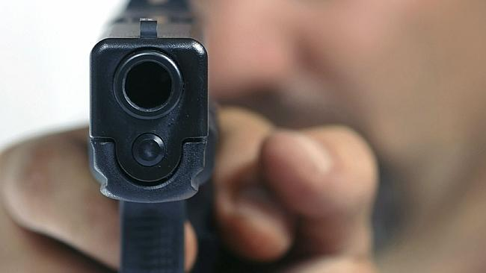

Slide 11
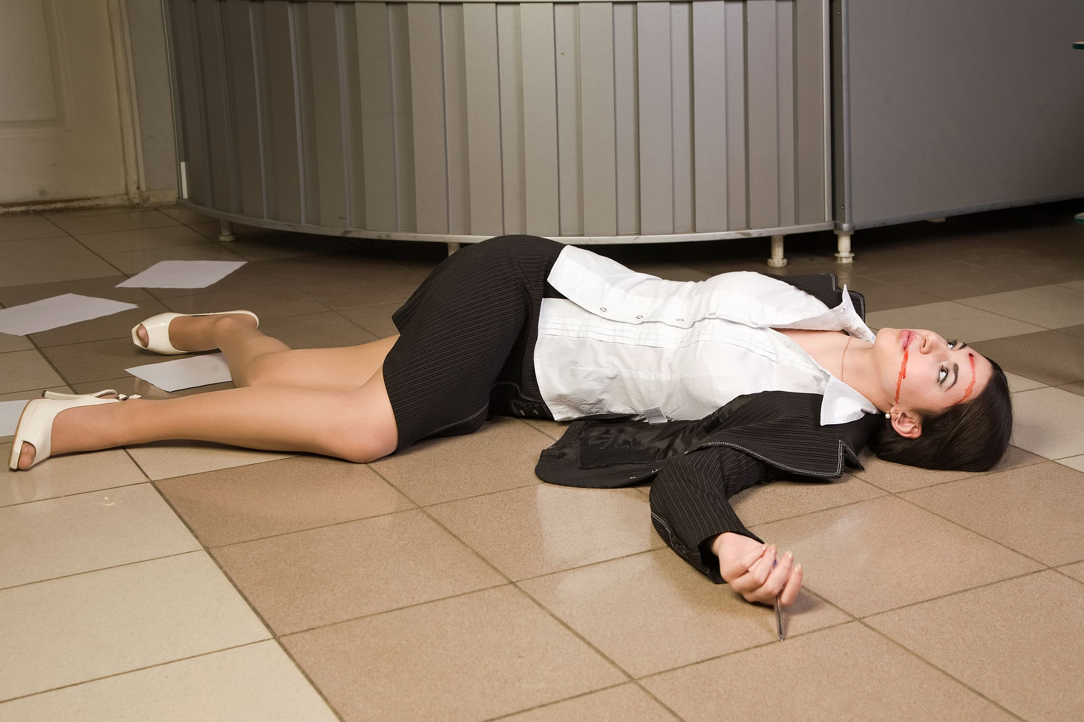

Slide 12
What Do YOU Do
Right NOW

Slide 13


Intimate Partner Violence

Slide 14


Intimate Partner
Violence Kills
1,300 Every Year

Slide 15
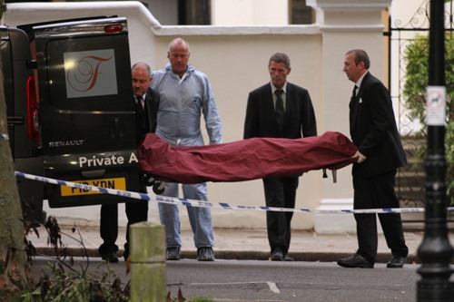
2 Workplace Homicides Every Day

Slide 16
What Do YOU Do
Right NOW

Slide 17



Fatal Flaw: Your EAP
Majority over in
4-5
minutes

Slide 18
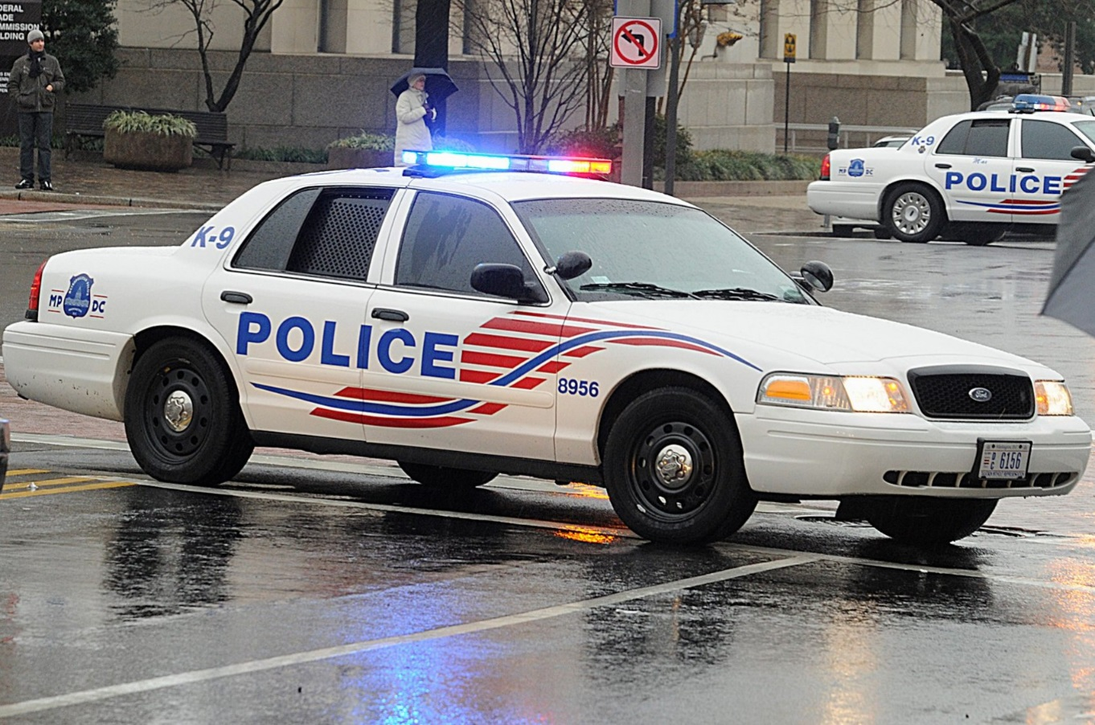
Police
probably
Can’t
deploy
in time

Slide 19


PD + FD Not 1st Responders

Slide 20

Employees = 1st Responders

Slide 21
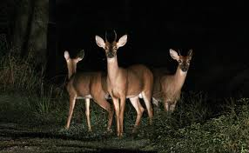

Slide 22
  Bo Mitchell
  911 Consulting
  President

Slide 23


Slide 24
  Bo Mitchell
  911 Consulting
  President
  Police Commissioner (Ret.)
Certified Emergency Manager
CEM, CPP, CHS-V, CBCP, CSI-ML, HSEEP, CNTA, IAC, MOAB, CHSP, CHEP, CSHM, CESCO, CHCM, CFC, CSSM, CSC, CAS, TFCT3, CERT, CHSEMR, CMC

Slide 25
Speaker
ASSP
NFPA
FEMA
SHRM
OSHA
RIMS

Slide 26
911 Consulting Clients
    GE HQ
    H&R Block HQ
    Hyatt HQ
    MasterCard HQ
    Rolls Royce HQ
    Subway HQ

Slide 27
911 Consulting Clients
26 K-12
5 Colleges + Universities

Slide 28
17
Gaps
Emergency Plans:
How to Fill Them

Slide 29

Why?

Slide 30
Duty of Care

Slide 31
Affirmative
Duty of Care

Slide 32
“Everything Is Always My Fault”

Slide 33

General Duty Clause
“each employer shall furnish …a place of employment …free from recognized hazards that are causing or are likely to cause death or serious physical harm to employees.”

Slide 34
Core
Management
Responsibility

Slide 35
Emergency Planning in US
30%-80%
SAY they Have an Emergency Plan

Slide 36

5.4 Million Employers
155Million Employees

Slide 37
Emergency Planning in US
30%-80%
SAY they Have an Emergency Plan

Slide 38
Emergency Plan?
DR or BC Plan
All About Data
Not Called EAP
Not All Hazards
Not Trained Annually
Not ALL Emps
Not OSHA Compliant

Slide 39
500 +
Plans Reviewed

Slide 40
Compliant?

Slide 41
Compliant?
1

Slide 42
Tell Me:
What’s Required by Law?

Slide 43
Emergency Planning
Authorities
Who Is Covered
Responsible Party

Slide 44

KENOSHA?
OSHKOSH?
Wisconsin

Slide 45

Required by Federal Law

Slide 46
OSHA
29 CFR
1910.34

Slide 47
“Sections 1910.34 through 1910.39 apply to workplaces in general industry except mobile workplaces such as vehicles or vessels”

Slide 48
Mandatory
    29 CFR 1910.38/.39
      Emergency Action Plan
      Fire Prevention Plan

Slide 50
Standards

Slide 51
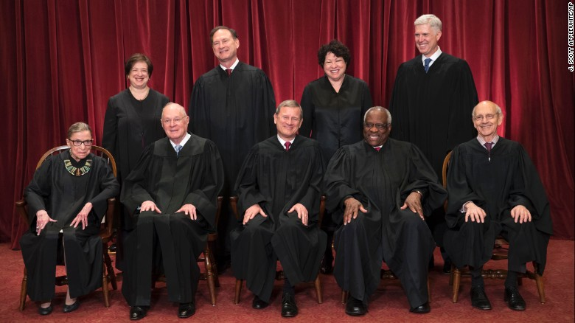

SCOTUS

Slide 52

SCOTUS
Only Courts Can Set/Adopt the Standards that Juries Use to Judge YOU.

Slide 54
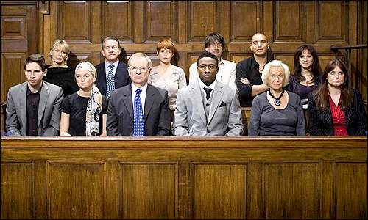
Jury = Employees

Slide 55


Slide 56
1600

Slide 57
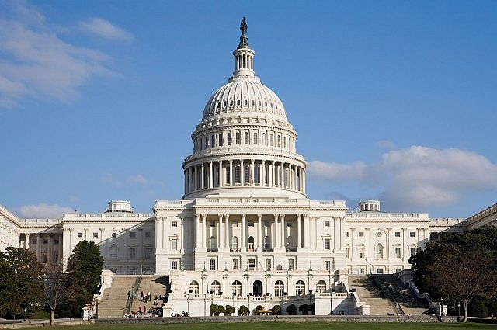

Slide 58
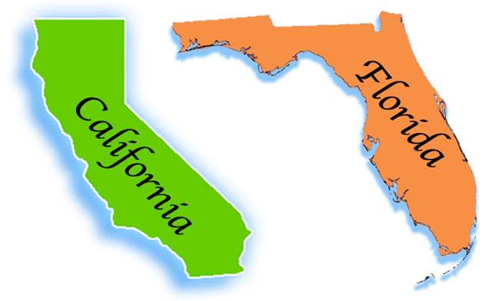

CT

Slide 59
59,000,000

Slide 60


Slide 61
1600

Slide 62


Slide 63
1600

Slide 64


Slide 65
Resiliency

Slide 66
1600

Slide 67


Slide 68

Shall Create + Train Plans
All
Hazards
1600

Slide 69
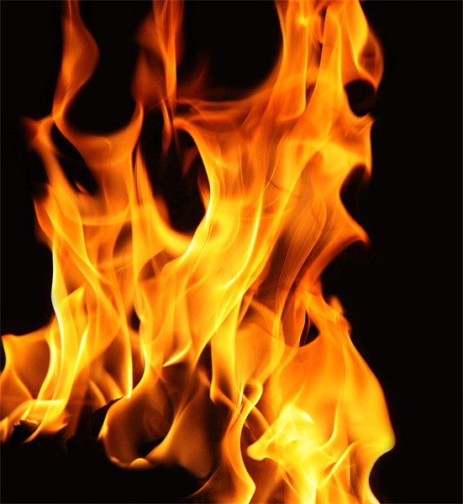
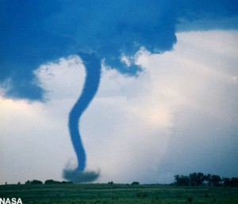

Slide 70
All-Hazards Plan: Shall
Emergency Team
Chain of Command
Visitors
Contractors
Civil Disturbance
Disabled
Headcounts
Evacuation
In-Building Relo
AAs
Fire
Bomb Threat
Medical Em
Security
Active Shooter
Hostage
Lockout
Suicide
Bullying
Perimeter Access
Security Aft Hours
Chemical Spill: In
Chemical Spill: Out
Shelter in Place
Suspicious Pkg
Suspicious Person
Explosion
Structural Failure
Severe Weather
Elevator Em
Power Outage
Water/Phone Out
Lockdown
Air Quality
Em Shutdown
Earthquake
Flooding
Pipe Burst
CBRNE
Terrorism
Use of FEs
Training
Drills
Exercises
Search-Seizure
Weapons
Evac Maps
Em Contacts

Slide 71
Your Plan???
Fire
Evacuation
Headcounts
Bomb
Chem Spill
Drills
Weather
Sus Pkg
Sus Pers
Pwr Out

Slide 72
All-Hazards Plan: Shall
Emergency Team
Chain of Command
Visitors
Contractors
Civil Disturbance
Disabled
Headcounts
Evacuation
In-Building Relo
AAs
Fire
Bomb Threat
Medical Em
Security
Active Shooter
Hostage
Lockout
Suicide
Bullying
Perimeter Access
Security Aft Hours
Chemical Spill: In
Chemical Spill: Out
Shelter in Place
Suspicious Pkg
Suspicious Person
Explosion
Structural Failure
Severe Weather
Elevator Em
Power Outage
Water/Phone Out
Lockdown
Air Quality
Em Shutdown
Earthquake
Flooding
Pipe Burst
CBRNE
Terrorism
Use of FEs
Training
Drills
Exercises
Search-Seizure
Weapons
Evac Maps
Em Contacts

Slide 73

All Hazards: Mandatory
Special Needs Personnel
Visitors
Contractors
Headcounts
Training

Slide 74
?

Slide 75

3
Things Guaranteed
in Life

Slide 76
3 Things in Life Guaranteed
Death

Slide 77
3 Things in Life Guaranteed
Death
Taxes

Slide 78
3 Things in Life Guaranteed
Death
Taxes
You Do Not Have: EAP Complies w
1600

Slide 79
Tenant

Slide 80
Landlord Has No Obligation re Your Requirements: Emergency Planning or Training in Federal, State or Local Law.

Slide 81
Landlords
So Evil at Em Planning…

Slide 82
Landlords
So Evil at This That Cable TV Has Dedicated a Whole Week to Landlords.

Slide 83
Landlord Week!
on the Discovery Channel

Slide 84
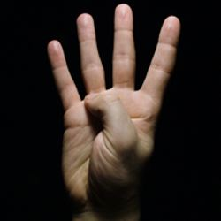
4
Things Guaranteed in Life

Slide 85
4 Things in Life Guaranteed
Death

Slide 86
4 Things in Life Guaranteed
Death
Taxes

Slide 87
3 Things in Life Guaranteed
Death
Taxes
You Do Not Have: EAP Complies w
1600

Slide 88
4 Things in Life Guaranteed
Death
Taxes
You Don’t Have: EAP
Your Landlord Does NOT Have: EAP Complies w
1600

Slide 89

4 Things in Life Guaranteed
Death
Taxes
You Don’t Have: EAP
Your Landlord Does NOT Have
for Himself…
1600

Slide 90
4 Things in Life Guaranteed
Death
Taxes
You Don’t Have: EAP
Your Landlord Does NOT Have an
Himself…
or for You.
1600

Slide 91
FUBAR

Slide 92
For Every Complex Problem…

Slide 93
For Every Complex Problem, There’s a Simple Solution

Slide 94
For Every Complex Problem, There’s a Simple Solution
That’s Always Wrong

Slide 95
Fair
Warning

Slide 96
I Will Be
Candid
★    

Slide 97
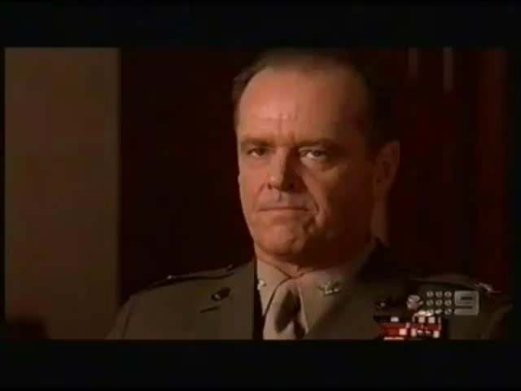

Slide 98
Who is
Covered?

Slide 99
Who Is Covered?
Employees (OSHA)
All Occupants (Fire Code)
Contractors (OSHA)
Special Needs (ADA+)
Visitors (Prem Liability/FC)

Slide 100
Responsible
Officer?

Slide 101
Responsible Party?
CEO

Slide 102
CEO: Responsible Party
Civilly

Slide 103
CEO: Responsible Party
Civilly
Personally

Slide 104
CEO: Responsible Party
Civilly
Personally
Criminally

Slide 105
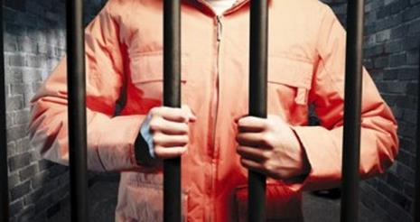

Slide 106
Responsible Parties
CEO
Directors
Sr. Ops Personnel

Slide 107
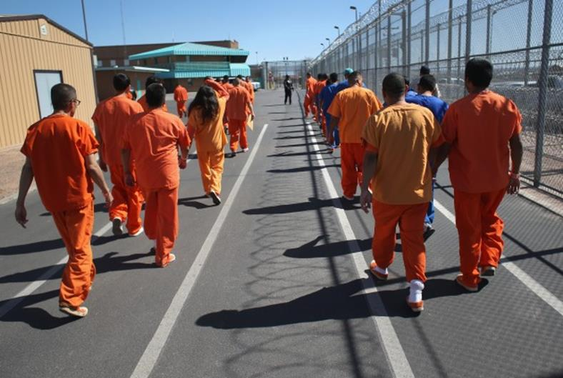

Slide 108
Exaggeration?

Slide 109
“Failure to Plan”
“Failure to Train”

Slide 110
2015-16-17 Criminal
11 CEOs Indicted.
9 CEOs Convicted

Slide 111
CEOs: 2015-16-17
CA: 3 Convicted. Prison

Slide 112
CEOs: 2015-16-17
CA: 3 Convicted, Prison
PA: 2 Convicted, Prison

Slide 113
CEOs: 2015-16-17
CA: 3 Indicted, Prison
PA: 2 Convicted, Prison
W. VA.: 2 Convicted, Prison

Slide 114
CEOs: 2015-16-17
CA: 3 Indicted, Prison
PA: 2 Convicted, Prison
W. VA.: 2 Convicted, Prison
NYC: 4 Indicted 2 Convicted, Prison

Slide 115
CEOs: 2015-16-17
CA: 3 Convicted
PA: 2 Convicted
W. VA.: 2 Convicted
NYC: 4 Indicted,
2 Convicted

Slide 116
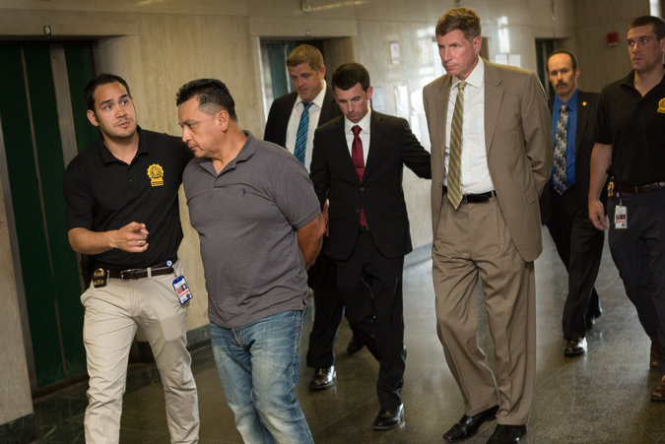
Alfonso Prestia
5Aug15
The
New York Times

Slide 117
March 2017: Wisconsin
Company Indicted
3 Sr. Managers Indicted Criminally
No Dead: “Willful”

Slide 118
March 2017: Wisconsin
Company Indicted
3 Sr. Managers Indicted
Corporate Safety & Environmental Director
Safety Coordinator
Operations Manager

Slide 119
March 2017: Wisconsin
Safety officials with the company tried to cover up the exposure, sending emails including one that speculates the company would be hit with a $70,000 federal fine and concluded with the order, "KEEP THIS INFORMATION UNDER RAP (sic) until we can hammer out our final plans of dealing with this issue," according to the indictment.

Slide 120
March 2017: Wisconsin
If convicted, the three face maximum sentences ranging from 11 to 41 years in prison. They also face hundreds of thousands in fines. The corporation faces millions in criminal penalties.

Slide 121
May 2017: Ohio
Supervisor
Mgr Environmental Enterprises

Slide 122
May 2017: Ohio
Supervisor
Mgr Environmental Enterprises
Involuntary Manslaughter
Reckless Homicide

Slide 123
May 2017: Ohio
Supervisor
Mgr Environmental Enterprises
Involuntary Manslaughter
Reckless Homicide
Tampering: Records
Tampering: Evidence

Slide 124
2015-16-17 Criminal
11 CEOs Indicted.
9 CEOs Convicted
6 Sr. Ops Indicted

Slide 125
Companies: Guilty Criminally
PG&E, CA: Guilty 2016
Behr Co., Ill: Guilty 2016

Slide 126
2015-16-17 Criminal
CEO Indicted
Every
78 Days
11 CEOs Indicted.
8 CEOs Convicted
3 Sr. Ops Indicted

Slide 129
New MOU Dec 2015
Enhance DOJ’s Cases
Juries: Emotion
Obstruction of Justice: Subpoena

Slide 130
18 U.S.C. §1505
Obstruction of Justice

Slide 131

My Dog
Brando

Slide 132
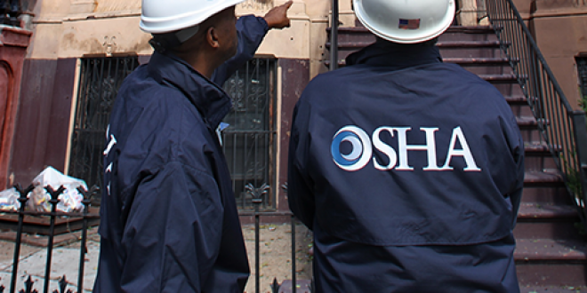

Slide 133
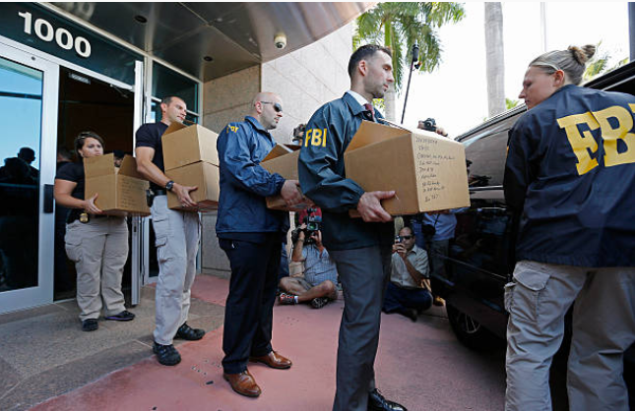

Slide 134
No
Exaggeration

Slide 135
No
Exaggeration

Slide 136
No
Exaggeration

Slide 137
CEO = Resp Officer
Do Your CEOs Know This?

Slide 138
CEO = Resp Officer
Do Your CEOs Know This?
Shouldn’t They?

Slide 139
CEO = Resp Officer
Do Your CEOs Know This?
Shouldn’t They?
Wouldn’t You?

Slide 140
“Failure to Plan”
“Failure to Train”

Slide 141
Why?

Slide 142
Why Plan?
U.S.: Justice Measured in $$$

Slide 143
Why Plan?
U.S.: Justice Measured in $$$
More Justice? More $$$

Slide 144
Why Plan?
U.S.: Justice Measured in $$$
More Justice? More $$$
Juries Armed:
Commas & Zeros

Slide 145
Jury = Employees

Slide 146
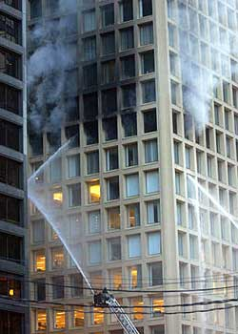
Cook
County
Fire
(Chi)

Slide 147
Cook Co. Fire
6 Dead
$4-5 Billion

Slide 148
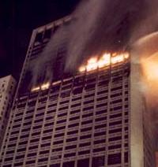
One
Meridian
Plaza
(Phila)

Slide 149
1 Meridian Plaza
3 Dead
$4 Billion

Slide 150
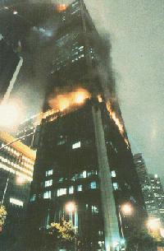
First Interstate Bank
(LA)

Slide 151
1st Interstate
1 Dead
$2 Billion

Slide 152
“Everything Is Always My Fault”

Slide 153
Why?

Slide 154
Risk
Never
Sleeps
★    

Slide 155
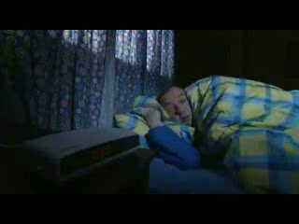

Slide 156
Risk Always Multiplies

Slide 157
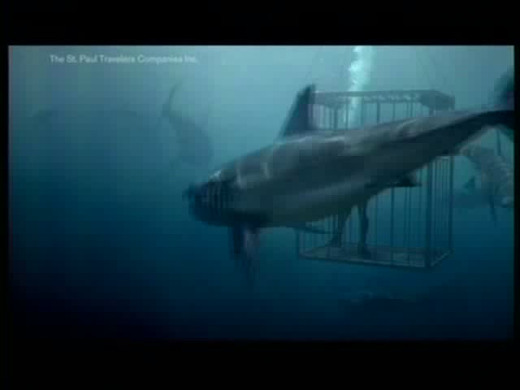

Slide 158
17
Gaps
Emergency Plans:
How to Fill Them

Slide 159
Threats
4.1 MM
Workplace Injuries
Annually
DOJ

Slide 160
Threats
349,500
HazMat
Spills
NFPA

Slide 161


Threats
HazMat Spills
800,000 Shpmnts Daily
60,000 Spills Yearly
Train-on-Vehicle Collision:
Every 90 minutes
DOT & EPA
U.S. DOT

Slide 162
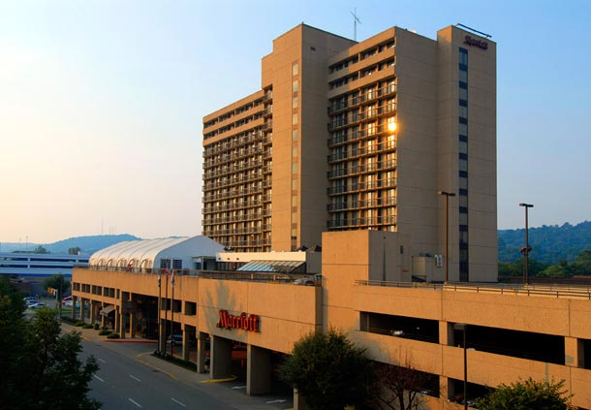
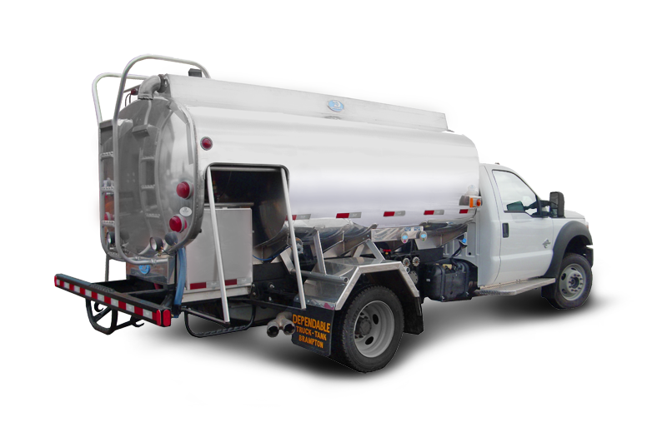
Chlorine

Slide 163
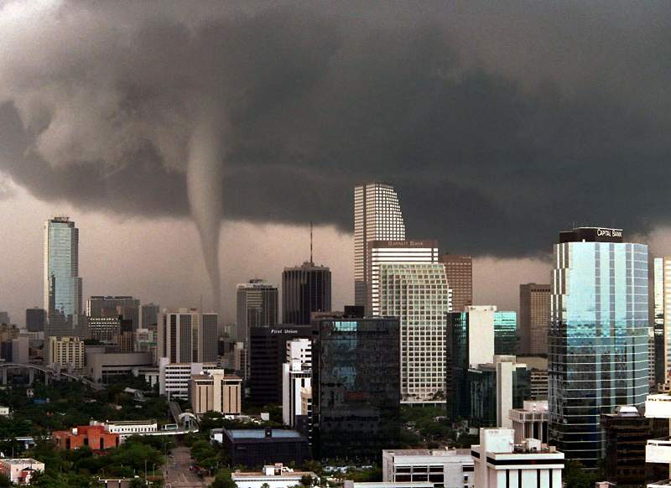

Slide 164

Workplace Bullying

Slide 165

Stalking @ Workplace

Slide 166


Slide 167
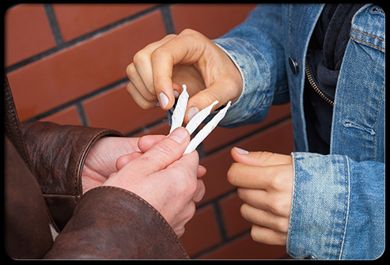

Slide 168


Slide 169


Slide 170
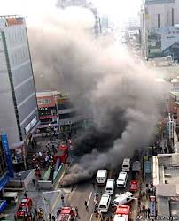

Slide 171


Slide 172
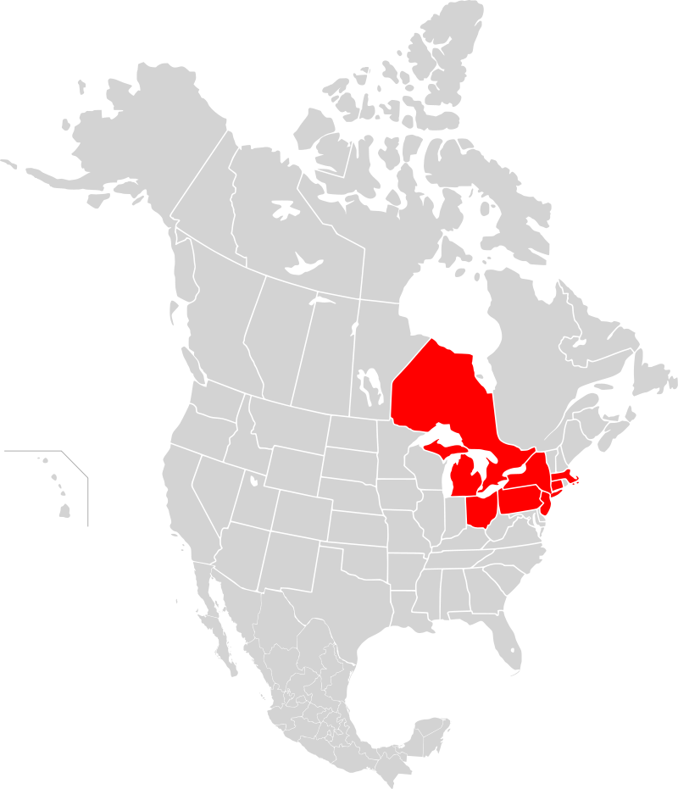
14 Aug 2003

Slide 173
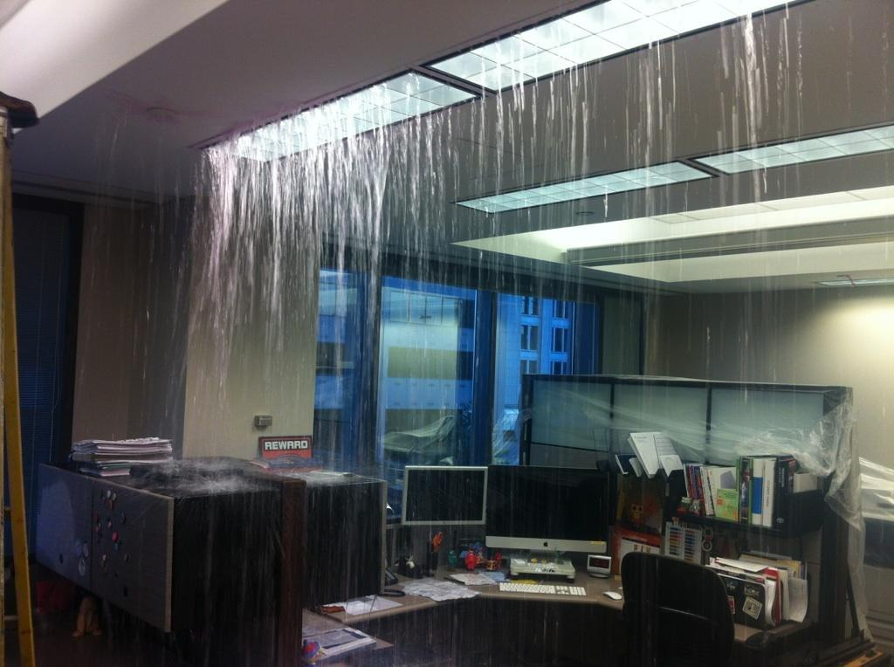

Slide 174
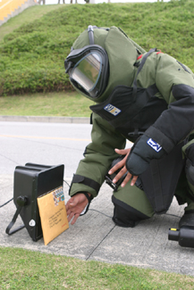

Slide 175
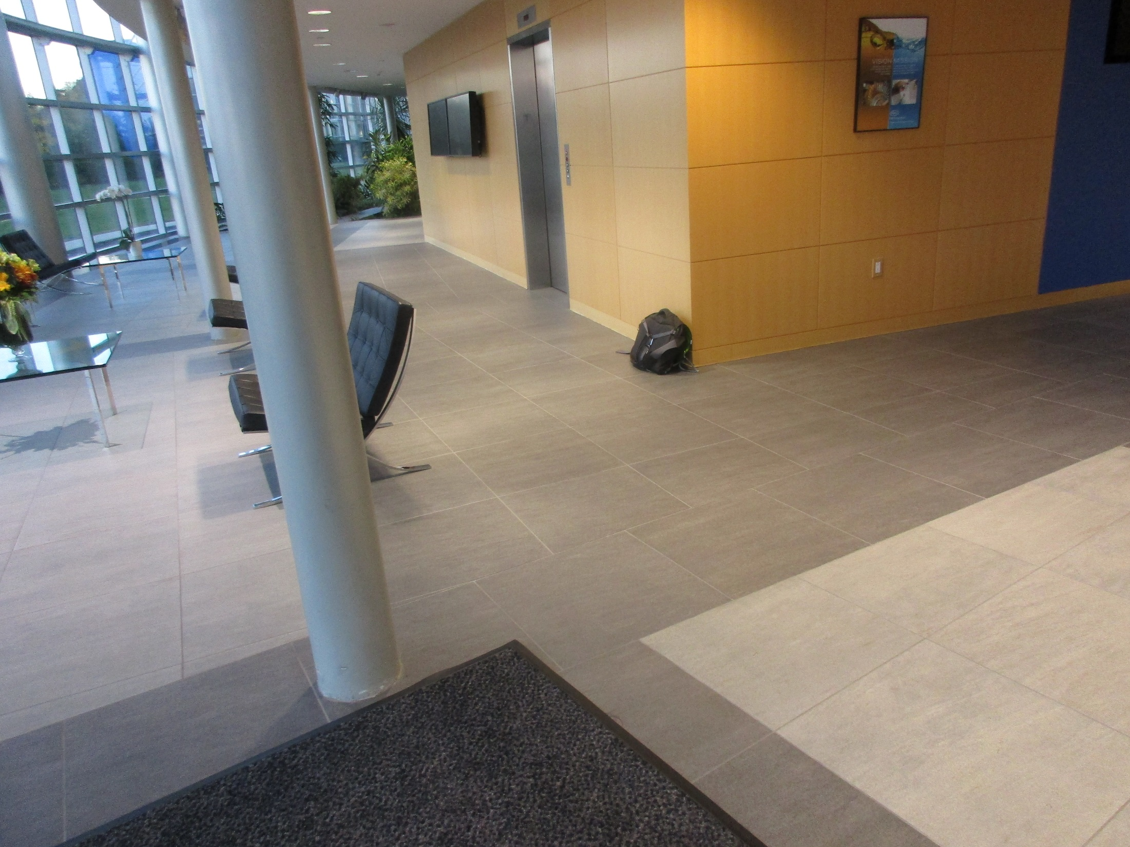

Slide 176
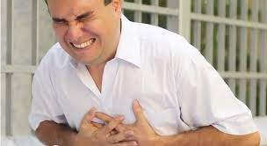

10,000: Work

Slide 177
Heart Attacks At Work
50%: Women
13% of All Workplace Deaths

Slide 178
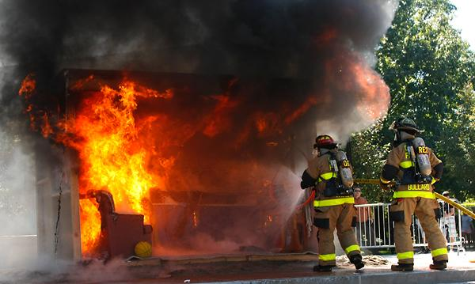
111,500 Structural Fires at Work:

Slide 179
Threats
5,100
Workplace
Deaths
OSHA

Slide 180

Threats
1 Million
Calls to
911 Every Day

Slide 181

Threats
78%
Orgs Out of Biz
In 2 Years
Agility Recovery Solutions

Slide 182
Threats
90%
Can’t Resume: 5 Days Out of Biz: 1 Year
Agility Recovery Solutions

Slide 183
Denial

Slide 184

Customers & Contractors
Least Likely to Know Our Procedures; Most Likely to Panic, Freeze, Not Coop—And then Sue!

Slide 185
Emergency
Team

Slide 186
Command
Control
Communications

Slide 187
Command & Control
Not Enough Commanders
No Chain of Command

Slide 188
Em Team Size
Too Few Team Members

Slide 189




NRF

Slide 190
Emergency Team
1:5!

Slide 191
1:5
Employees
Visitors
Customers
Contractors

Slide 192
All-Hazards Plan: Shall
Emergency Team
Chain of Command
Visitors
Contractors
Civil Disturbance
Disabled
Headcounts
Evacuation
In-Building Relo
AAs
Fire
Bomb Threat
Medical Em
Security
Active Shooter
Hostage
Lockout
Suicide
Bullying
Perimeter Access
Security Aft Hours
Chemical Spill: In
Chemical Spill: Out
Shelter in Place
Suspicious Pkg
Suspicious Person
Explosion
Structural Failure
Severe Weather
Elevator Em
Power Outage
Water/Phone Out
Lockdown
Air Quality
Em Shutdown
Earthquake
Flooding
Pipe Burst
CBRNE
Terrorism
Use of FEs
Training
Drills
Exercises
Search-Seizure
Weapons
Evac Maps
Em Contacts

Slide 193
All-Hazards Plan: Shall
Emergency Team
Chain of Command
Visitors
Contractors
Civil Disturbance
Disabled
Headcounts
Evacuation
In-Building Relo
AAs
Fire
Bomb Threat
Medical Em
Security
Active Shooter
Hostage
Lockout
Suicide
Bullying
Perimeter Access
Security Aft Hours
Chemical Spill: In
Chemical Spill: Out
Shelter in Place
Suspicious Pkg
Suspicious Person
Explosion
Structural Failure
Severe Weather
Elevator Em
Power Outage
Water/Phone Out
Lockdown
Air Quality
Em Shutdown
Earthquake
Flooding
Pipe Burst
CBRNE
Terrorism
Use of FEs
Training
Drills
Exercises
Search-Seizure
Weapons
Evac Maps
Em Contacts
Yikes!

Slide 194
Yikes!
Many Threats & Many Procedures:

Slide 195
Yikes!
Many Threats & Many Procedures:
One Team!

Slide 197
Command
Control
Communications
★    

Slide 198
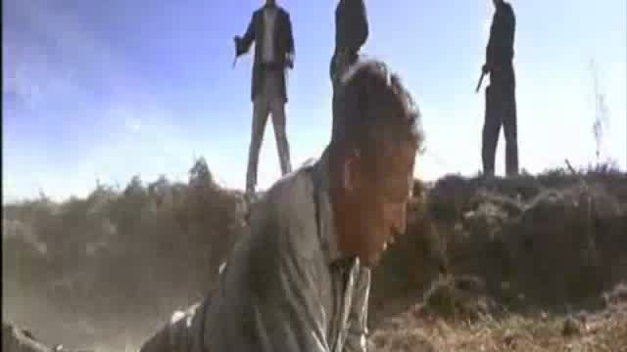

Slide 199
If You Can’t Communicate, You Can’t Respond

Slide 200
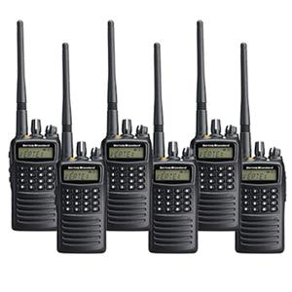

Slide 201


Slide 203
Emergency Comms: Cells
Won’t Work All Time, All Sites

Slide 204
Emergency Comms: Cells
Won’t Work All Time, All Sites
Can Be Shut Down by PD, FD

Slide 205
Emergency Comms: Cells
Won’t Work All Time, All Site
Can Be Shut Down by PD, FD
Not a Broadcast Tool

Slide 206
Emergency Comms: Cells
Won’t Work All Time, All Site
Can Be Shut Down by PD, FD
Not a Broadcast Tool
Batteries Will Die

Slide 207
Alert: Your People
Cell
PA
Panic
All Call
ENS
2-Way Radios

Slide 208
Alert: Your People
Duplicative?
Cell
PA
Panic
All Call
ENS
2-Way Radios

Slide 209
Calling For Help: Many Ways
Redundancy Is A Beautiful Thing

Slide 210
Calling For Help: Many Ways
Redundancy Is A Beautiful Thing
Redundancy Is A Beautiful Thing

Slide 211
Calling For Help: Many Ways
Redundancy Is A Beautiful Thing
Redundancy Is A Beautiful Thing
Redundancy Is A Beautiful Thing

Slide 212
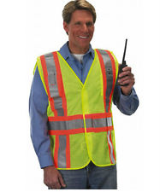
Your
Emergency
Commander

Slide 213
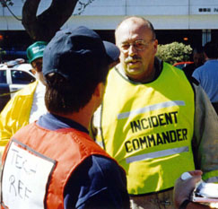

Slide 214
Security

Slide 215
Security
“You Can’t Stop Crazy”
“We have met the enemy; it is us.”

Slide 216
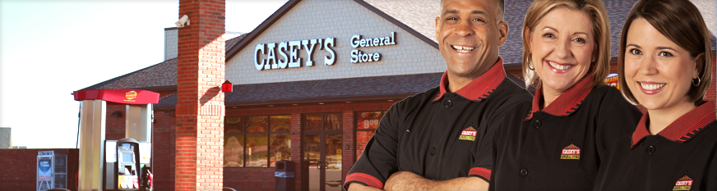
Your Employees

Slide 217
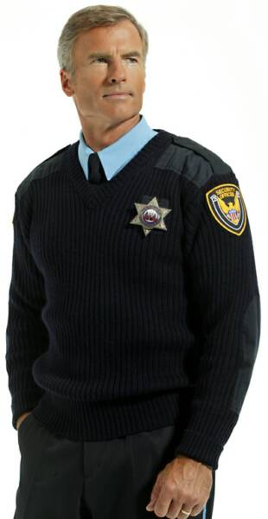
Security Officers

Slide 218
Truly Integrated: Ops?
Security Monitor 

Slide 219
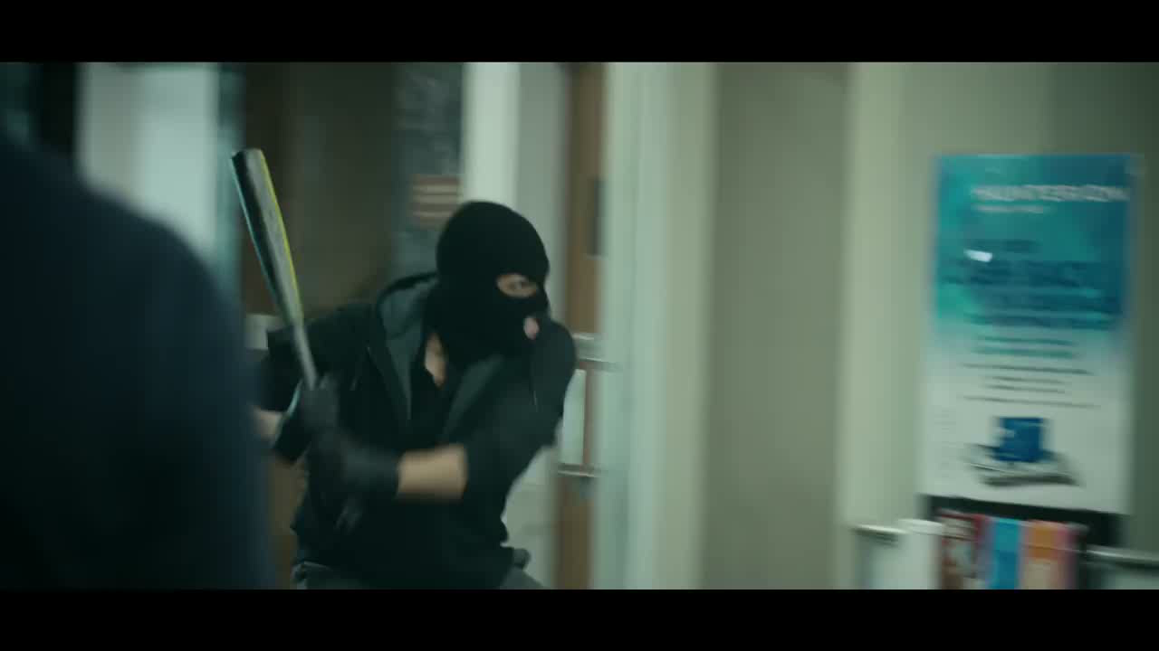

Slide 220
Truly Integrated: Ops?
Post Orders: Site Specific?

Slide 221
Truly Integrated: Ops?
Post Orders: Site Specific?
General Orders: Site Specific?

Slide 222
Truly Integrated: Ops?
Post Orders: Site Specific?
General Orders: Site Specific?
Challenge?

Slide 223
Truly Integrated: Ops?
Post Orders: Site Specific?
General Orders: Site Specific?
Challenge?
Custodial Arrest?
Truly Integrated: Your ERT?

Slide 224
Truly Integrated: Ops?
Post Orders: Site Specific?
General Orders: Site Specific?
Challenge?
Custodial Arrest?
Truly Integrated: Your ERT?
Trained/Coord:
PD/FD/EMS?

Slide 225
Truly Integrated: Ops?
Post Orders: Site Specific?
General Orders: Site Specific?
Challenge?
Custodial Arrest?
Truly Integrated: Your ERT?
Trained/Coordinated w PD/FD/EMS?
Armed?

Slide 226
Common Gaps
No
Headcounts

Slide 227
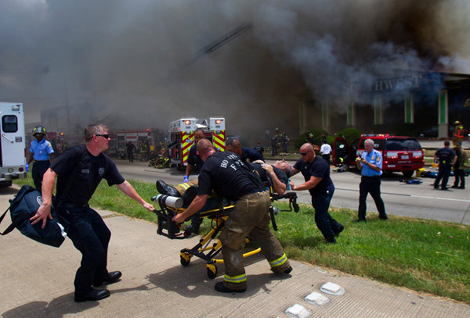
Four Fire Fighters who died were caught in roof collapse searching for people who had already escaped (31May13)

Slide 228
Common Gaps
Evacuation Maps
Required by Law
Must be for Every Employee from Any/All Parts
of Every Building

Slide 230
Evacuation Maps
OSHA
29 CFR 1910.38
29 CFR 1910.36
29 CFR 1910.37

Slide 231
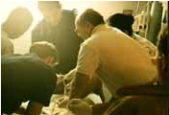
Medical
Emergency

Slide 232
Medical
Emergency

Slide 233
Medical Emergency
Standard
Of Care

Slide 234
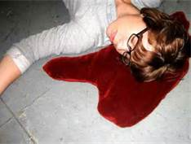

Slide 235
Medical Emergency
1st Aid:
29 CFR 1910.151
Bloodborne Pathogens:
29 CFR 1910.1030

Slide 236
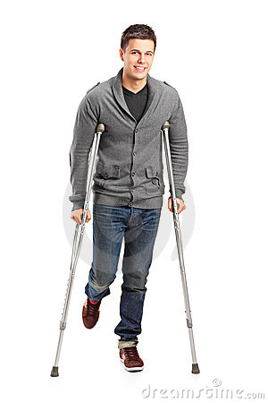
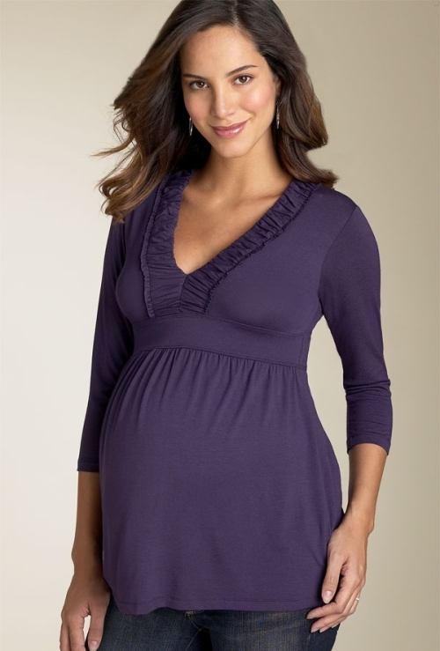
Special
Needs
Persons

Slide 237
Common Gaps
Special Needs
Required by St. & Fed Law

Slide 238
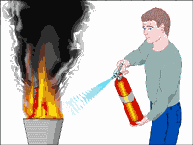

Slide 239
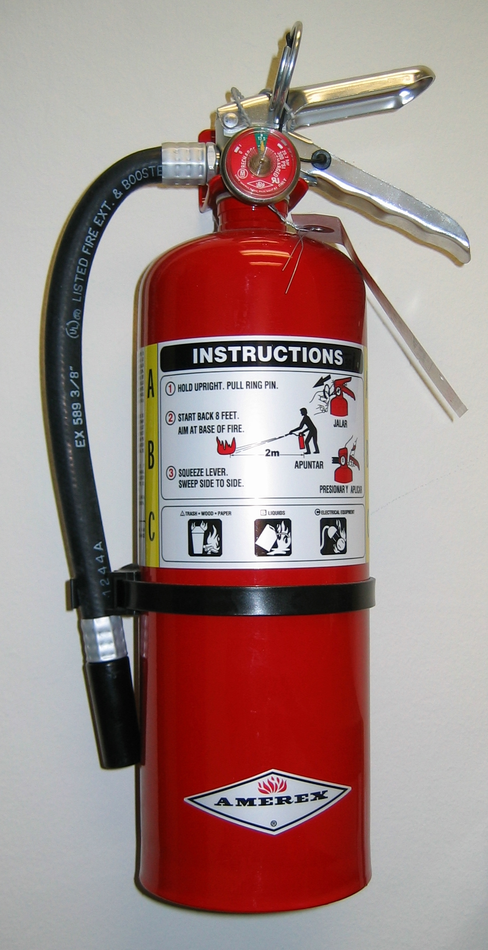
FE Training Illegal
Use or Don’t Use Policy

Slide 240
Employees: Use Fire Extinguishers
Shall
  Conference Room

Slide 241
Employees: Use Fire Extinguishers
Shall
  Conf Rm
  Certified Trainer

Slide 242
Employees: Use Fire Extinguishers
Shall
  Conf Rm
  Certified Trainer
  Authorized Video

Slide 243
Employees: Use Fire Extinguishers
Shall
  Conf Rm
  Certified Trainer
  Authorized Video
  Put Out a Fire (Live Burn)

Slide 244


Slide 245
Annually

Slide 246

Plagiarism

Slide 247
All Emergency Plans
Shall Be
Site
Specific

Slide 248
Plagiarism
HQ Plan
Buddy
Cut & Paste

Slide 249
Out
of
Date
2014

Slide 250
Why We Plan & Train
Great plans are a smart thing…

Slide 251
Why We Plan & Train
Great plans are a smart thing…
Training is
everything

Slide 252


Slide 253



Slide 254
Training is Everything
737 Canada Fiery Crash Evacuation No Deaths
737 Greek Fiery Crash
55/137 Dead

Slide 255


Slide 256
Training is Everything
Difference?
Non-Fatal Crash: 75% were frequent business flyers
55 Fatalities: Almost 100% were 1st-time flyers

Slide 257
Why Train?
It is the result of
training.

Slide 258
Training
Mandatory

Slide 259
Training
Mandatory:
Train All Personnel

Slide 260
Training
Mandatory:
Train All Personnel
In Classroom

Slide 261
Training
Mandatory:
Train All Personnel
In Classroom
Annually & At Hire

Slide 262
Training
Mandatory:
Train All Personnel
In Classroom
Annually & At Hire
“Qualified” Trainer (by Exp, Trng)

Slide 263
Training: The Law
Mandatory
Train All Employees
In Classroom
Annually & At Hire
“Qualified” Trainer
(by Experience, Training)

Slide 264


Slide 265

On-Screen Training Can Supplement

Slide 266
On-Screen Training Can NEVER Substitute

Slide 267
We Don’t Rise to the Occasion…

Slide 268


Slide 269
We Don’t Rise to the Occasion.
We Sink to Our Level of Our Training

Slide 270
911 Consulting Training Promise
You Give Me
Your Emps 2hrs Annually

Slide 271
911 Consulting Training Promise
I’ll Give You Back Your Emps Confident

Slide 272
National Research
85%
Safety:
MOST Important
Issue at Work

Slide 273
National Research
85%
Safety: MOST Important Issue at Work
More Imp than:
        Wages
        Leave
        Sick Days
        Overtime
        Union

Slide 274
Training
Trained 33,000 Employees

Slide 275
Training
Trained 33,000 Employees
98.5%
Confident

Slide 276
98.5% Confident
Made It All About THEM

Slide 277
98.5% Confident
Took “Scary” out of Discussion

Slide 278
98.5% Confident
Made Everyone Comfortable

Slide 279
98.5% Confident
Empowered All

Slide 280
Getting Employees to Training

Slide 281
Like
Herding
Cats
★    

Slide 282


Slide 283
What Do YOU Do
Right NOW

Slide 284

Workplace
Violence

Slide 285
18x
More Likely to Have
Violence than a Fire
at Work
DOJ & NFPA

Slide 286
Threats
2 million
Workplace Violence
Annually
DOJ

Slide 287
Threats
2 People Murdered
Every Day:
26 Rapes
Every Hour
DOJ

Slide 288
Facts: WPV
2 people murdered/day!
Every hour:
      26 rapes
      44 robberies
      207 aggravated assaults
      938 simple assaults
      3,125 threats.

Slide 289


Slide 290

Active
Shooter

Slide 291
B4 Sandy Hook:

Slide 292
1X/Mo

Slide 293
1/WK

Slide 294
What’s
Missing
Here???

Slide 295
Fatal Flaw: Your EAP
Majority over in
4-5
minutes

Slide 296
Police
probably
Can’t
deploy
in time

Slide 297
PD + FD Not 1st Responders

Slide 298
Employees = 1st Responders

Slide 299


Slide 300


Slide 301


Slide 302

Alert

Slide 303
Active Shooter: Your Plan
No Procedures
No Reporting
No Awareness
No Training

Slide 304

4
Min
Rule

Slide 305

Chlorine

Slide 307
Workplace Bullying

Slide 308
Stalking @ Workplace

Slide 315
14 Aug 2003

Slide 318
10,000: Work

Slide 319
“No One Cares”

Slide 320
Common Gaps
“No One Cares”
Common Belief
200,000 Calls:
Costs: Fines +Sr.Time +Lawyers

Slide 321


Slide 322

You Can’t Survive that OSHA Audit Today

Slide 323
“Failure to Plan”
“Failure to Train”

Slide 324
Common Gaps
“We’ve Had No Incidents”
“We’re a Family”
“We’ve Been Lucky”

Slide 325


Slide 326

17 Gaps
Emergency Plans:
How to Fill Them

Slide 327
1.

Slide 328
: All-
Hazards

Slide 329
All-Hazards Plan: Shall
Emergency Team
Chain of Command
Visitors
Contractors
Civil Disturbance
Disabled
Headcounts
Evacuation
In-Building Relo
AAs
Fire
Bomb Threat
Medical Em
Security
Active Shooter
Hostage
Lockout
Suicide
Bullying
Perimeter Access
Security Aft Hours
Chemical Spill: In
Chemical Spill: Out
Shelter in Place
Suspicious Pkg
Suspicious Person
Explosion
Structural Failure
Severe Weather
Elevator Em
Power Outage
Water/Phone Out
Lockdown
Air Quality
Em Shutdown
Earthquake
Flooding
Pipe Burst
CBRNE
Terrorism
Use of FEs
Training
Drills
Exercises
Search-Seizure
Weapons
Evac Maps
Em Contacts

Slide 330
Alfonso Preia
5Aug15
The
New York Times

Slide 331
2.
Yo! It’s Landlord Week! on the Discovery Channel

Slide 332

Police, Fire,
EMTs are not the first responders

Slide 333
Employees =
1st Responders
3.

Slide 334
4. Special
Needs
Persons

Slide 335

5.
Ignore Critical Personnel
Visitors
Contractors
Customers

Slide 336
Four Fire Fighters who died were caught in roof collapse searching for people who had already escaped (31May13)
6.
Head-
counts

Slide 337

7.
Training
    Emergency Team
    All Employees

Slide 338
On-Screen Training Can NEVER Substitute

Slide 339

8. Emergency Team:
    Not Big Enough
Your
Emergency
Commander
Your
Deputy
Emergency
Commander

Slide 340
Emergency Team
1:5!

Slide 341
9.
Your
Emergency
Commander
Not Enough Commanders
No Chain
of
Command
Your
Deputy
Emergency
Commander

Slide 342
10.
Communications
Cells/PTT/Land
Lines
Won’t Work
2-Way Radios
Mandatory
Your
Emergency
Commander

Slide 343
11.

Slide 344
12.
Medical
Standard
of Care

Slide 345
13.
Security
Not
Integrated

Slide 346
14.
FE
Training Illegal

Slide 347
15.
Plagiarism

Slide 348
16.
Out
of
Date
2014

Slide 349
17.
Run
Can’t
Hide

Slide 350
You Can’t Survive that OSHA Audit Today

Slide 351
18.

Slide 352
19.
Luck
Is Not A
Strategy

Slide 353

20.
No Independent Audit

Slide 354
How Do We Sell It?

Slide 355
ROI?

Slide 356


Slide 357
ROI
If We’re Never Hit, our ROI is Zero…

Slide 358
ROI
If We’re Never Hit, our ROI is Zero…Thank
God!

Slide 359
ROI
If We’re Never Hit, our ROI is Zero…Thank God!
If We Are Hit, Our ROI Is Measured in the 10s of Millions of $$$!

Slide 360
ROI
Protect Brand

Slide 361
ROI
Protect Brand
Protect People

Slide 362
ROI
Protect Brand
Protect People
Protect CEO’s Posterior

Slide 363
ROI
Protect Brand
Protect People
Protect CEO’s Posterior
Protect Productivity

Slide 364
ROI
Protect Brand
Protect People
Protect CEO’s Posterior
Protect Productivity
Protect $$$

Slide 365
ROI
Protect Brand
Protect People
Protect CEO’s Posterior
Protect Productivity
Protect $$$
85% ID Safety

Slide 366
ROI
Protect Brand
Protect People
Protect CEO’s Posterior
Protect Productivity
Protect $$$
85% ID Safety
98.5% Confident

Slide 367
ROI
Protect Brand
Protect People
Protect CEO’s Posterior
Protect Productivity
Protect $$$
85% ID Safety
98.5 Confident
Bond Emps into Safety Culture

Slide 368
ROI
Protect Brand
Protect People
Protect CEO’s Posterior
Protect Productivity
Protect $$$
85% ID Safety
98.5 Confident
Bond Emps into Safety Culture
Build Emp Awareness

Slide 369
ROI
Protect Brand
Protect People
Protect CEO’s Posterior
Protect Productivity
Protect $$$
85% ID Safety
98.5 Confident
Bond Emps into Safety Culture
Build Emp Awareness
Knock Down Silos

Slide 370
We Don’t Have Silos!

Slide 371
We Don’t Have Silos!
We Have
Cylinders of Excellence

Slide 372
ROI
Protect Brand
Protect People
Protect CEO’s Posterior
Protect Productivity
Protect $$$
85% ID Safety
98.5 Confident
Bond Emps into Safety Culture
Build Emp Awareness
Knock Down Silos
Integrate Safety: Their Jobs

Slide 373
ROI
Bond Emps into Safety Culture
Build Emp Awareness
Knock Down Silos
Integrate Safety: Their Jobs
Instill Sense of Responsibility
Protect Brand
Protect People
Protect CEO’s Posterior
Protect Productivity
Protect $$$
85% ID Safety
98.5 Confident

Slide 374
ROI
Bond Emps into Safety Culture
Build Emp Awareness
Knock Down Silos
Integrate Safety: Their Jobs
Instill Sense of Responsibility
Incr Emp Ownership
Protect Brand
Protect People
Protect CEO’s Posterior
Protect Productivity
Protect $$$
85% ID Safety
98.5 Confident

Slide 375
ROI
Protect Brand
Protect People
Protect CEO’s Posterior
Protect Productivity
Protect $$$
85% ID Safety
98.5 Confident
Bond Emps into Safety Culture
Build Emp Awareness
Knock Down Silos
Integrate Safety: Their Jobs
Instill Sense of Responsibility
Incr Emp Ownership

Slide 376


Slide 377
R
I
S
K

Slide 378
S
E
CU
I
T
Y
R
I
S
K

Slide 379
S
E
CU
I
T
Y
S
A
F
E
T
Y
R
I
S
K

Slide 380
S
E
CU
I
T
Y
FACILITIES
S
A
F
E
T
Y
R
I
S
K

Slide 381
S
E
CU
I
T
Y
FACILITIES
S
A
F
E
T
Y
R
I
S
K
HR

Slide 382
S
E
CU
I
T
Y
FACILITIES
S
A
F
E
T
Y
BC
★
DR
R
I
S
K
HR

Slide 383
Silos
Kill

Slide 384
Denial

Slide 385
HDWSI
How Do We Sell It?

Slide 386
HDWSI
Planning
Training
Drills
Exercises

Slide 387
Protecting Your:
People
Property
Productivity
Posterior

Slide 388
Getting It Done Is Tough!

Slide 389

Scariest Word

Slide 390
NOT:
“Cost” or
“Price” or
“Budget” or
“Headcount”

Slide 391
Change!

Slide 392
Change Occurs Because of

Slide 393

Blunt Force Trauma from the Outside

Slide 394

…Never by Inspired Leadership from the Inside

Slide 396
Cultural
Earthquake

Slide 397
HDWSI
About
Denial

Slide 398


Slide 399
“Jaws”: Cultural Earthquake
“Won’t Close the Beaches” =
$$$

Slide 400
“Jaws”: Cultural Earthquake
“Won’t Close the Beaches” = $$$
“Can’t Hire More Lifeguards” = $$$

Slide 401
“Jaws”: Cultural Earthquake
“Won’t Close the Beaches” = $$$
“Can’t Hire More Lifeguards” =$$$
“I’ve Never Seen this Shark”

Slide 402
“Jaws”: Cultural Earthquake
“Won’t Close the Beaches” = $$$
“Can’t Hire More Lifeguards” =$$$
“I’ve Never Seen this Shark”
“Are You Sure We Have a Problem?”

Slide 403
We Never See the Monster in the 1st 60 Minutes
★    

Slide 404


Slide 405
“We Need a Bigger Boat!”

Slide 406


Slide 407


Slide 408
Where Do We Start?

Slide 409
Biggest
Obstacle:

Slide 410


Slide 411
Here’s Where
You Start

Slide 412
Here’s Where You Start
This Is Not Your Fault

Slide 413
Your Role
You Didn’t Know

Slide 414
Your Role
You Didn’t Know
You Are the 99%

Slide 415
Your Role
You Didn’t Know
You Are the 99%
Champion

Slide 416
Your Role
You Didn’t Know
You Are the 99%
Champion
Rare + Heroic

Slide 417
Your Role
Protect Your “Family”

Slide 418
Your Role
Protect Your “Family”
Responsible Thing To Do

Slide 419
Your Role
Protect Your “Family”
Responsible Thing To Do
Protect Stakeholders

Slide 420
What Do You Need to
Believe?

Slide 421
What Do You Need to Believe?
Real Threats: You

Slide 422
What Do You Need to Believe?
Real Threats: You
Penalties: Don’t Do Right Thing

Slide 423
What Do You Need to Believe?
Real Threats: You
Penalties: Don’t Do Right Thing
You’re the Responsible Party

Slide 424
What Do You Need to Believe?
Real Threats: You
Penalties: Don’t Do Right Thing
You’re the Responsible Party
Duty of Care

Slide 425
What Do You Need to Believe?
Real Threats: You
Penalties: Don’t Do Right Thing
You’re the Responsible Party
Duty of Care
Emps Want /Appreciate This. Won’t Feel Penalized

Slide 426
What Do You Need to Believe?
You Will Lead

Slide 427
What Do You Need to Believe?
You Will Lead
You Will Be a Hero

Slide 428
What Do You Need to Believe?
You Will Lead
You Will Be a Hero
You Will Not Look Stupid. This Is Not Your Fault.

Slide 429
What Do You Need to Believe?
You Can Report to Stakeholders: Leadership, Compliance, Due Diligence to Protect Them

Slide 430
ROI
Protect Brand
Protect People
Protect CEO’s Posterior
Protect Productivity
Protect $$$
85% ID Safety
98.5 Confident
Bond Emps into Safety Culture
Build Emp Awareness
Knock Down Silos
Integrate Safety: Their Jobs
Instill Sense of Responsibility
Incr Emp Ownership

Slide 431
Action
Plan

Slide 432
Action Plan
Threat Assessment of Your Org’s Current Emergency Planning + Training

Slide 433
Action Plan
Threat Assessment of Your Org’s Current Emergency Planning + Training
Just Like Your Financial Audits

Slide 434
Action Plan
Assessment of Your Org’s Current Emergency Planning + Training
Just Like Your Financial Audits
Outside, Independent

Slide 435
Outside/Independent Assessment
You Don’t Have Expertise

Slide 436
Outside/Independent Assessment
You Don’t Have Expertise
Inside Audits: Politics + Command Influence

Slide 437
Outside/Independent Assessment
You Don’t Have Expertise
Inside Audits: Politics + Command Influence
Inside: Always Dismissed: Court, Any 3rd Party

Slide 438


Slide 439
Help for You
Right Now

Slide 440
Copy: This
Presentation

Slide 441

10
Commandments
Planning

Slide 442
10
Commandments
Training

Slide 443

Send Me Everything!

Slide 444
“We Need a Bigger Boat!”

Slide 445


Slide 446

⬆ ⬆ ⬆ ⬆ ⬆ Survey

Slide 448
“We Need a Bigger Boat!”

Slide 449
17
Gaps
Emergency Plans:
How to Fill Them

