Slide 1


Your logo here
Weight Loss Surgery
Presented by:
The ASMBS Public Education Committee
Notes:
Welcome. We are glad you have decided to learn more about what weight loss surgery is and how it can impact the health of many people with obesity and obesity-related medical conditions.

Slide 2

Today’s Goals
Understand the Risks of Obesity
Understand the Surgical Options for Weight Loss
Understand the Risks of Weight Loss Surgery
Understand the Benefits of Weight Loss Surgery
Understand How to Go Forward From Today
Notes:
The goal of this session is to help you understand the risks of obesity and how it impacts a person’s life. We also want to review the options to consider for surgery and the risks and benefits of each of those options. And to conclude, we certainly hope that you will feel empowered with this knowledge to go forward and make an informed decision on your journey to health and wellness.

Slide 3

The Biology
of Fat
Stores excess energy
CALORIES
Communicates with the brain & body
HORMONES
These hormones control hunger
Burn Calories
Excess fat → Obesity
→ Chronic Disease
Notes:
Let’s start by talking about fat. Many of us think of fat as being bad, but it is actually an important and sophisticated organ that releases many hormones, or chemicals, to communicate with our brain and body. These hormones are important in controlling our hunger and regulates how our body handles and burns calories. Excess fat can lead to obesity and, over time, lead to chronic disease.

Slide 4



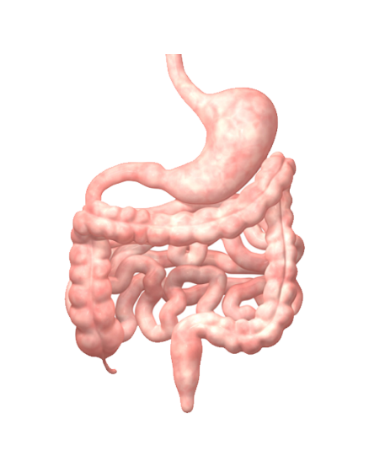
The Brain Defends our Set Point Weight
High Set Point
Brain
Hormones
Hunger
Metabolism
Obesity
Chronic Disease
Gut
Notes:
Our brains are set up to control how much we weigh and there is a particular weight, known as the set point weight, where our brain wants us to stay. Our brain and gut communicate using hormones that control our hunger and metabolism, or how we use the things we eat and drink for energy. If the set point weight is high, then obesity can develop and lead to more medical problems and chronic disease.

Slide 5
Why Do We Care?
Obesity
Chronic Disease
Death
Morbid Obesity decreases
life span 5-15 years
Notes:
Why do we care? There is clear evidence that obesity and the chronic diseases related to obesity can lead to death and they decrease our life span by several years.

Slide 6

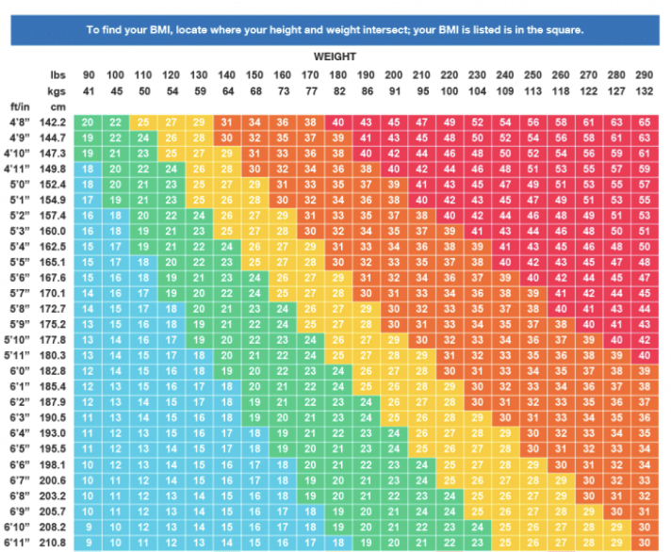
What is Your
Body Mass
Index?
Healthy Weight | 20-25
Overweight | 25-30
Obesity | 30-35
Severe Obesity | 35-40
Morbid Obesity | 40+
Body Mass Index (BMI) = Weight (Kg)/Height (m)²
Notes:
An important measurement we use to define various levels of obesity is called BMI, which stands for Body Mass Index. It is an equation that takes into account our weight and height. In this chart, we see that weight increases as we go left to right and height increases as we go from top to bottom. As BMI increases from blue to red, so does our risk for medical problems.

Slide 7
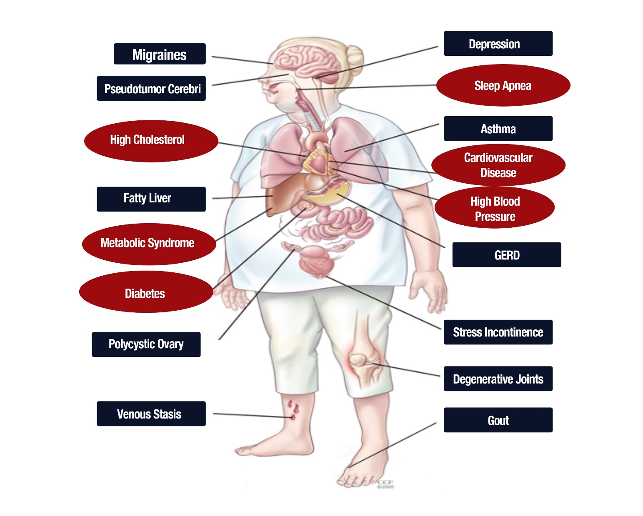
Health
consequences
of obesity
“Overweight and obesity are major risk factors for a number of chronic diseases, including type 2 diabetes, cardiovascular diseases and cancer.”
World Health Organization (WHO)
Notes:
Some of the chronic diseases related to obesity are illustrated in this diagram. Essentially every organ system is affected by obesity. Conditions such as high cholesterol, sleep apnea, diabetes, high blood pressure, and heart disease are commonly seen. Also other conditions you may not have thought are related to obesity such as gout, migraines, reflux, depression, and cancer.

Slide 8




How Does
Weight
Affect
Your Life?
Ability to do what you want
Amusement park rides
Playing with children
Social Gatherings
Travel
Notes:
How does weight affect our personal lives? Our weight can often dictate the ability to do the things we want such as riding amusement park rides, playing with children, attending social gatherings, and also how we travel.

Slide 9
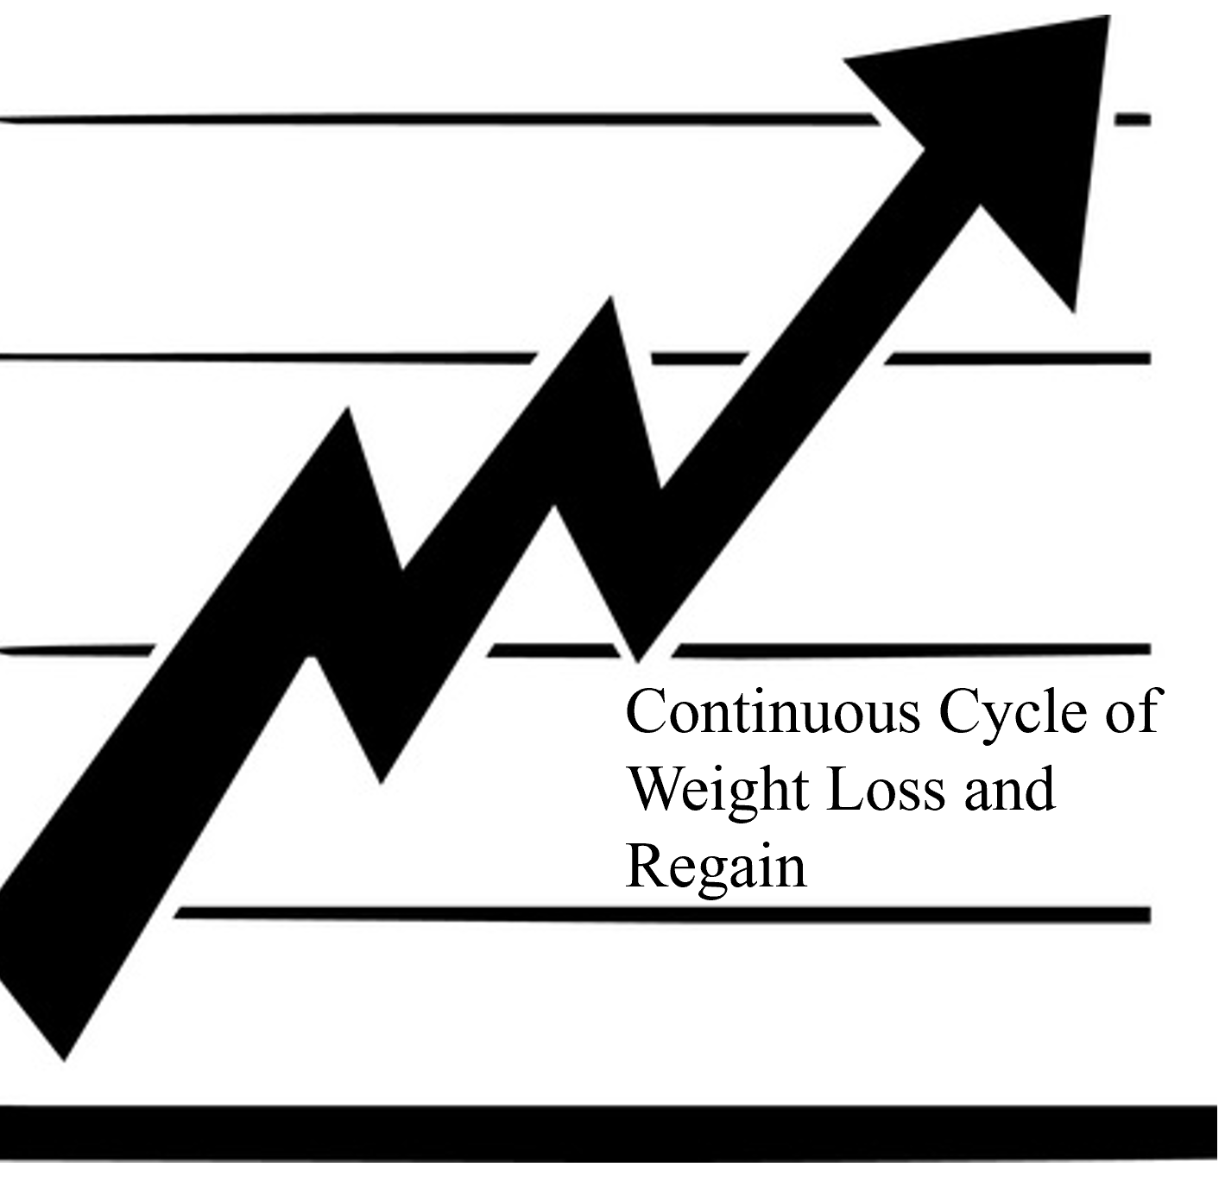
Diet &
Exercise
Alone
Genetics & hormones prevent diet and exercise from working by themselves.
Notes:
Diet and exercise are important factors in determining our weight, but they are not the only factors to consider. Our genetics and hormones play an important role and may prevent our diet and exercise efforts from working the way we want them to.

Slide 10

Weight
Loss
Exercise
More
Eat Less
Now We Know…
Hormones
Genetics
Old Theory
Diet + Exercise
Notes:
As we’ve studied obesity, we have learned that this old theory of eat less and exercise more is outdated and can often cause people to feel ashamed when efforts to lose weight do not work or last. Now we know better. Genetics and hormones play an important part in losing weight just as diet and exercise do.

Slide 11



Surgery
Lowers
Set point
Brain
Hunger
Calorie Use
Obesity
Hormones
Gut
Notes:
Surgery is an important tool that can impact our weight loss. Weight loss surgery interacts with the hormone signals between our brain, gut, and the rest of our body and can alter how hungry we are and the way our body burns calories. These changes that surgery brings about can actually lower the set point and positively impact obesity.

Slide 12
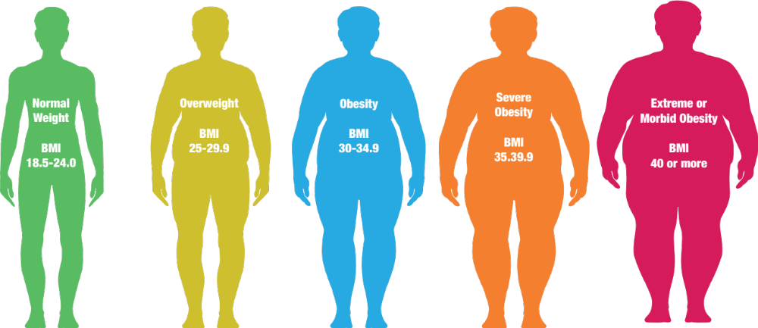
NIH Recommendations for Treating Obesity
Life Style
Modification
Life Style
Modification
Life Style
Modification
Life Style
Modification
Life Style
Modification
Medical
Management
Medical
Management
Medical
Management
Medical
Management
Medical
Management
Consider
Surgery
Surgery
Surgery
Notes:
The National Institute of Health recommends that healthy lifestyle changes and medical therapy be used to help prevent or treat obesity. However, as our BMI increases, surgery should be considered because of the overwhelming evidence that it can reverse or alter many chronic diseases related to obesity and help reverse the course of obesity itself.

Slide 13

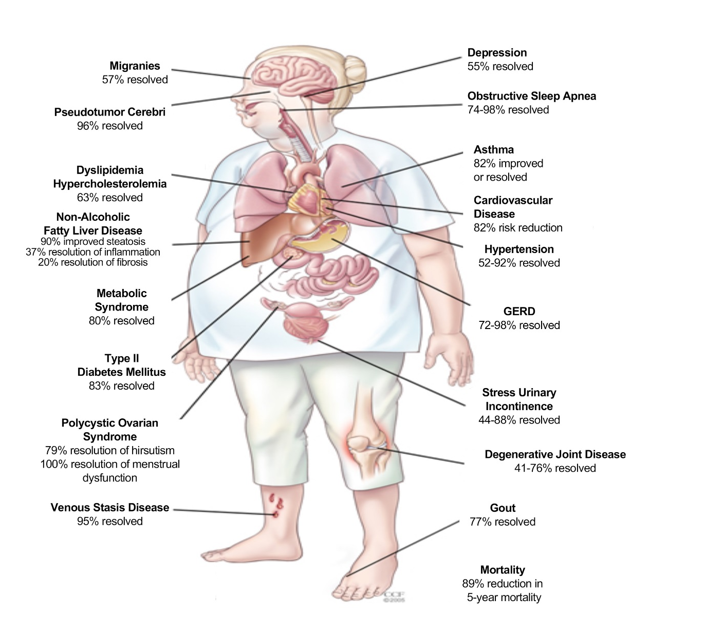
Benefits of weight
loss after surgery!!
Quality of Life= 95% Improved!!
Mortality Reduced= 89% at 5 years
Notes:
Going back to the illustration of how obesity affects every organ system in our body, we know that weight loss surgery can also impact those areas. High cholesterol, sleep apnea, diabetes, high blood pressure, heart disease, and more can significantly improve after weight loss surgery. The majority of patients who choose weight loss surgery will note an improved quality of life and research shows that our risk of death is reduced long-term.

Slide 14
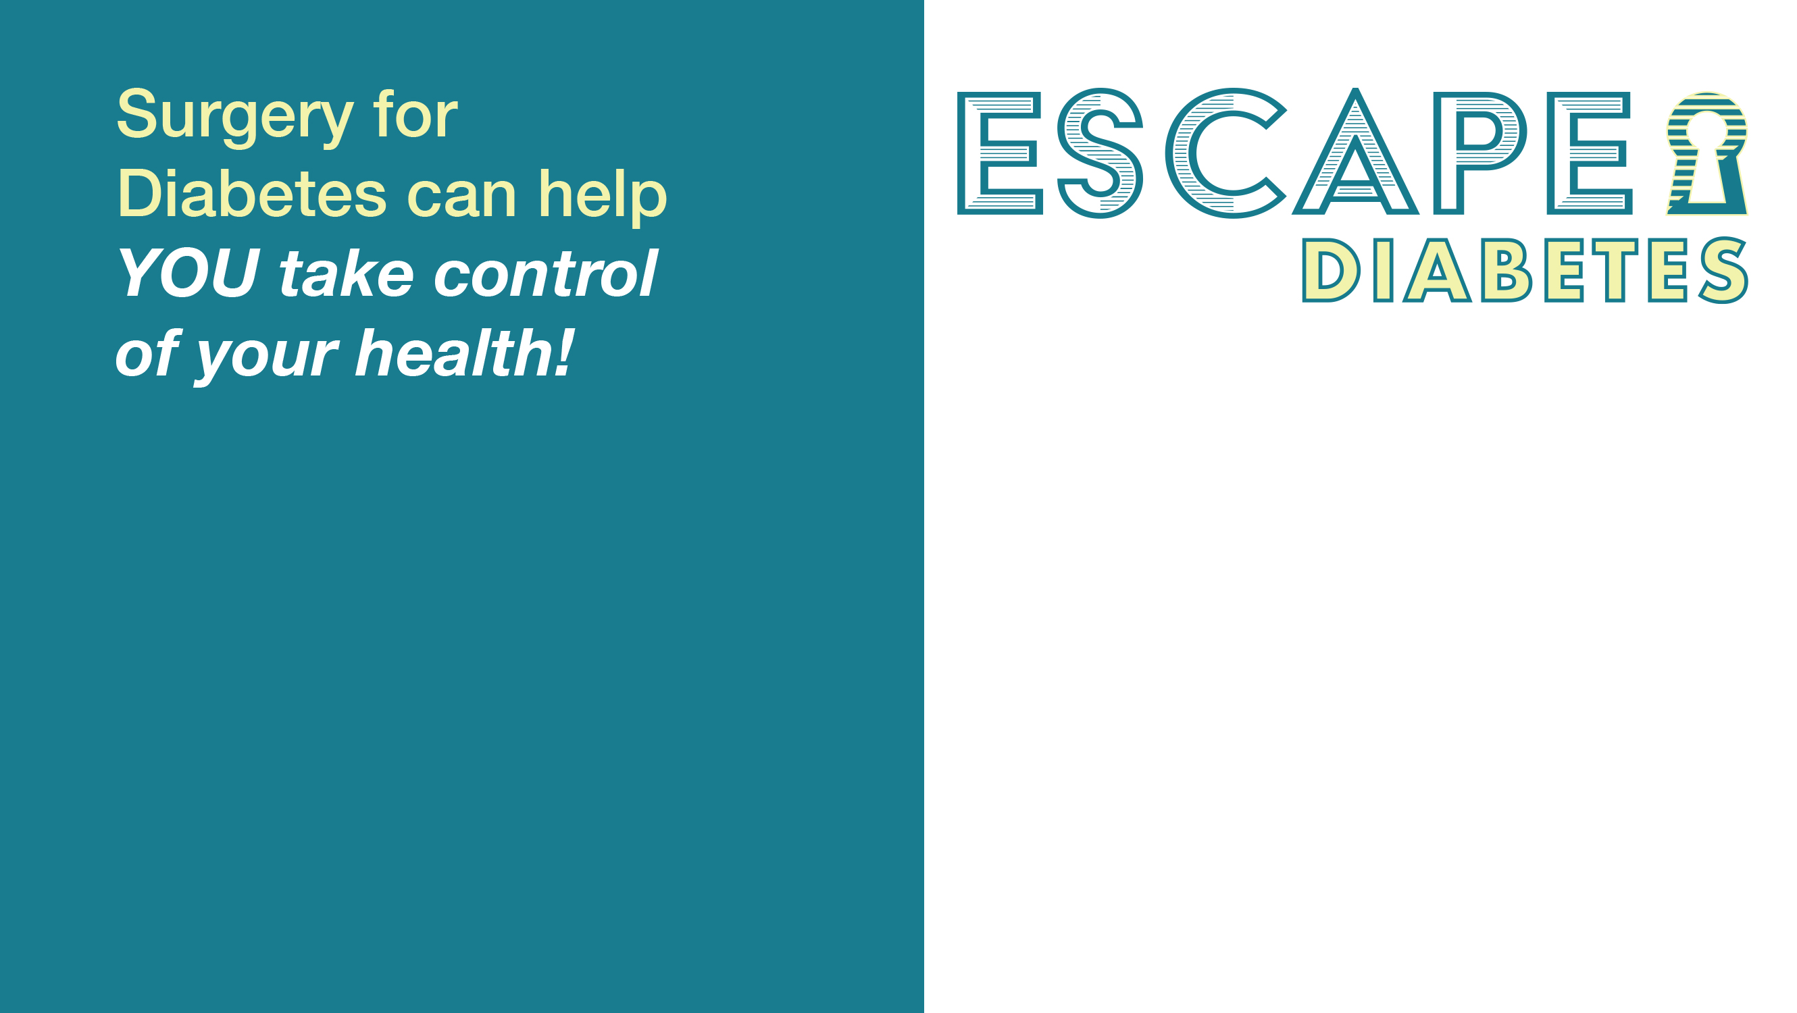
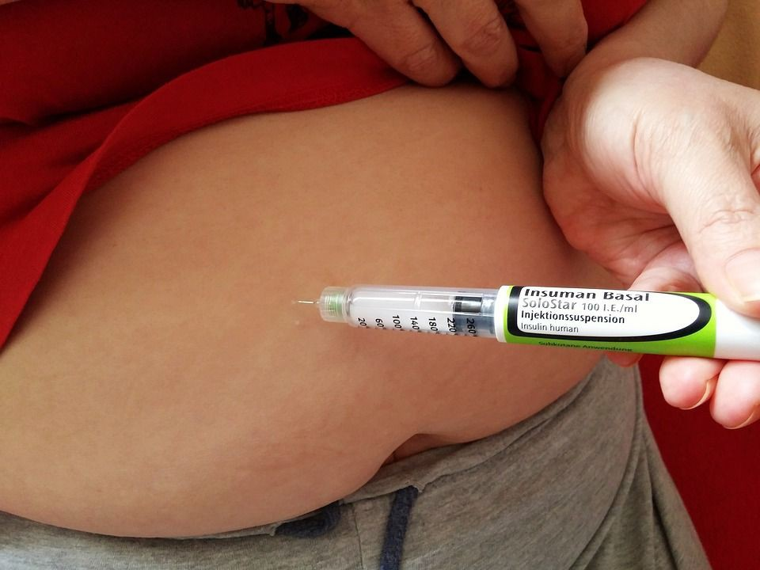
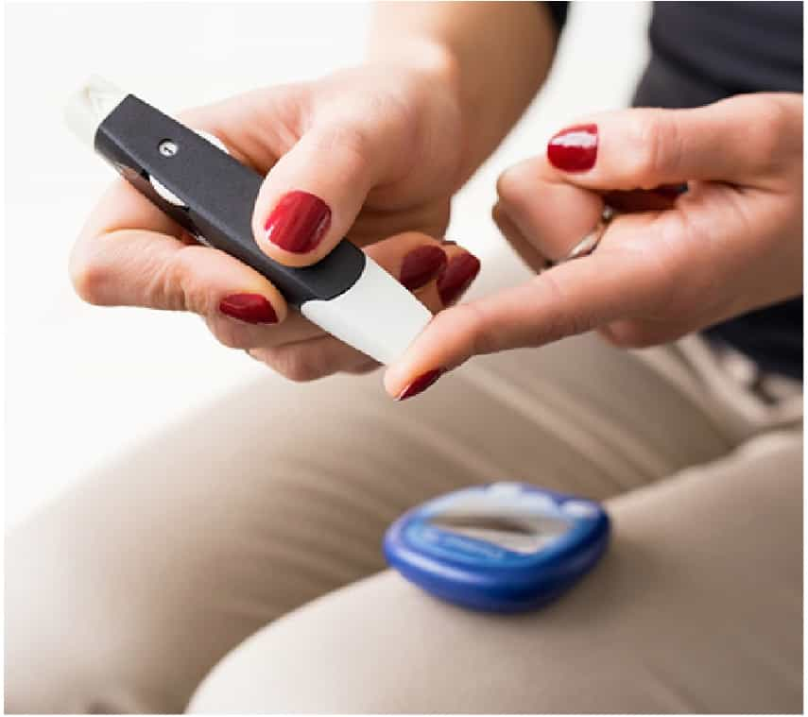
BETTER improvement and resolution compared to:
  Diabetic medications
  Non-surgical weight loss interventions!
Metabolic surgery is the only treatment that leads to remission of type 2 diabetes.
EscapeDiabetes.org
Notes:
Diabetes is a very important medical problem that has a serious impact on our quality of life and can cause significant damage to other organs in our body. Weight loss surgery helps patients take control of their diabetes. Compared to non-surgical methods of weight loss as well as diabetic medications, surgery may be superior in helping improve diabetes. This means you could come off your diabetes medications or no longer have diabetes. This disease, however, could return over time. A great resource to use is the Escape Diabetes webpage located at escapediabetes.org. Here you can calculate your risk of complications from diabetes, including death, over the next 10 years with and without weight loss surgery. The results are meant to be specialized to you based on specific information that you enter and can help you make an informed decision about weight loss surgery as it relates to diabetes.

Slide 15

Who is a
Candidate for Surgery?
What is my BMI?
What are my medical conditions?
Am I safe for surgery?
Notes:
So who is a candidate for surgery? Three questions to ask are: What is my BMI? What are my medical conditions? And, am I safe for surgery? Your answers to these questions and discussion with a weight loss surgeon can help you decide if you are a good candidate for weight loss surgery.

Slide 16
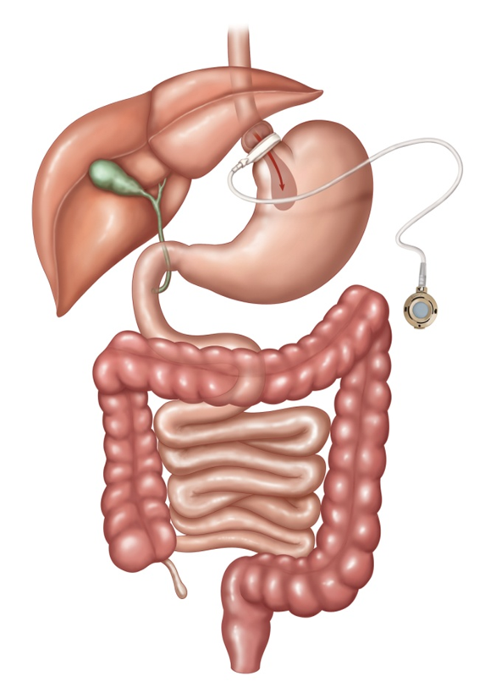
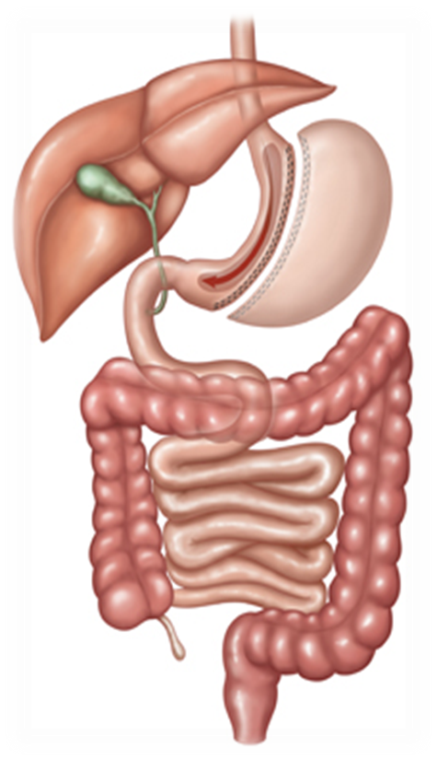
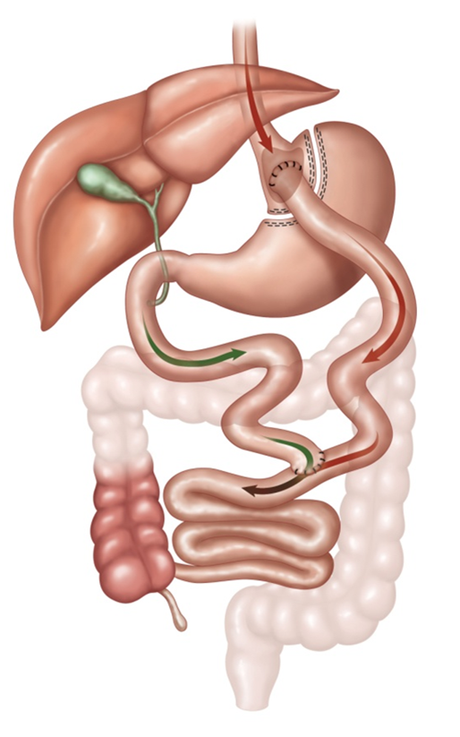
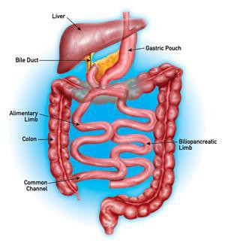
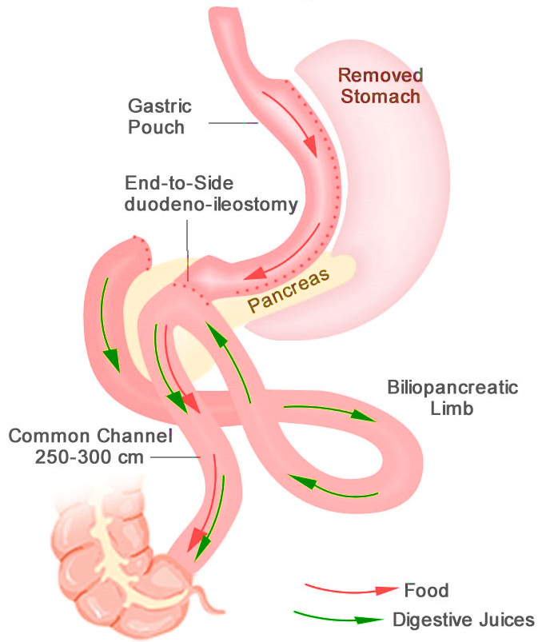
Laparoscopic Surgery Options
Adjustable Gastric Banding
(AGB)
Sleeve Gastrectomy
(SG)
Roux-en-Y Gastric Bypass
(RYGB)
Bilio-pancreatic Diversion with Duodenal Switch
(BPD-DS)
Single Anastomosis Duodeno-ileal Bypass w/ Sleeve Gastrectomy
(SADI-S)
Notes:
These pictures show the five surgical procedures which are endorsed by the ASMBS to treat Obesity in the United States. In the next several slides, we will review these procedures, and how you and your surgeon will choose which procedure will be best for you.

Slide 17
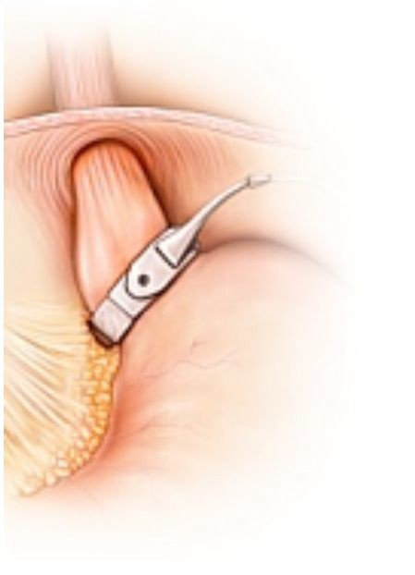
Laparoscopic Adjustable Gastric Banding
Placed around top of stomach; port under skin
Requires fluid adjustments in port
No bowel connections or staple lines
Weight loss 10-20% total body weight*
  (30-50% excess body weight loss)
Removal is possible
High chance of removal (50% at 10 years)
*MBSAQIP 2016-2020
Notes:
Laparoscopic adjustable gastric banding, or the “LAP BAND” involves placement of a silicone band around the top part of the stomach. This can be filled with fluid and tightened through a reservoir placed under the skin of the abdomen. This procedure has a lower chance of complications within the first month of the procedure than any other bariatric surgery. However, the chances of requiring surgery to remove the band are quite high.

Slide 18
Laparoscopic Adjustable Gastric Banding
Pros:
  No stapling
  No involvement of small intestine
  Decreases hunger
Cons:
  Involves a ”foreign body”
  Requires adjustments through port injections
  Can cause swallowing difficulties
  Poor tolerance and slippage may lead to removal
  No change on metabolism
Ideal for:
  Absorption of vitamins, critical medication
  Extensive surgical history
  Steroid dependence
  Low BMI without metabolic disease
  High risk (medical and psychiatric)
Notes:
The advantages for the band include safety early on when compared to procedures that involve stapling the stomach and intestines. It can be, therefore, used for patients with more risks related to their surgical history or preexisting medical problems.

Slide 19
Laparoscopic Sleeve Gastrectomy
About 3/4th of the stomach is removed
No bowel connections
Metabolic effects and possible type 2 diabetes remission
Can potentially worsen GERD/esophagitis
*MBSAQIP 2016-2020
Notes:
The laparoscopic sleeve gastrectomy, otherwise known as a vertical sleeve gastrectomy, or simply a “sleeve,” involves placing a tube into the stomach to avoid making the sleeve too big or too small, stapling along side that tube, and then removing the tube. This turns the stomach into the size and shape of a banana, and removes 3/4ths of the stomach, or almost all of the stomach that produces the “hunger hormone.” It also helps with other hormones that fight diabetes and obesity. This is a simpler procedure than the bypass or the duodenal switch, both of which require new intestinal connections. While this achieves a great amount of weight loss for most patients, it can worsen gastroesophageal reflux or heartburn disease, or less common, it can cause the disease in a patient that doesn’t have it to begin with.

Slide 20
Laparoscopic Sleeve Gastrectomy
Weight Loss at 1 year
  25.6% Total weight loss
    Interquartile range [19.5 - 31.8%]
  59.7% Excess body weight loss
    Interquartile range [44.4 - 76.8%]
Weight Loss at 3 year
  20.9% Total weight loss
    Interquartile range [13.4 - 28.8%]
  49.1 % Excess body weight loss
    Interquartile range [31.1 - 68.9%]
*MBSAQIP 2015-2018
Notes:
To give more detail regarding weight loss after the sleeve, at 1 year total weight loss is 25.6% and excess weight loss averages close to 60%. At 3 years, most people will have lost approximately 21% of their total body weight and 49% of their excess body weight. Each of these values represents an average, and patients fall into a range as indicated by the numbers in brackets after the interquartile range. These numbers have been verified by MBSAQIP, the national accreditation program for bariatric surgery.

Slide 21
Laparoscopic Sleeve Gastrectomy
Pros:
  No involvement of small intestine
  Decreases hunger
  Improves metabolism
Cons:
  May cause or worsen reflux
  Possible risk of Barrett’s esophagus
Ideal for:
  Absorption of vitamins, minerals, critical medications
  Extensive surgical history
  Steroid dependence (auto-immune conditions)
  NSAID dependent patients
  High risk (medical, psych, super morbid obesity)
Notes:
The advantages of the sleeve gastrectomy involve its simplicity and its effects on hunger and metabolism. If a patient already has heartburn symptoms, having a sleeve gastrectomy can worsen reflux, or at least not change the symptoms. In a smaller percentage of patients, the sleeve can cause GERD that wasn’t present before surgery. Your surgeon will evaluate you for heartburn symptoms before surgery. Some patients have conditions that make the sleeve a better choice because of its lack of intestinal connections. Patients who already have problems with absorption, abdominal scar tissue or large abdominal hernias, conditions requiring chronic steroid or nonsteroidal antiinflammatory medication use, or who are higher cardiovascular risk may be better served with a sleeve gastrectomy.

Slide 22
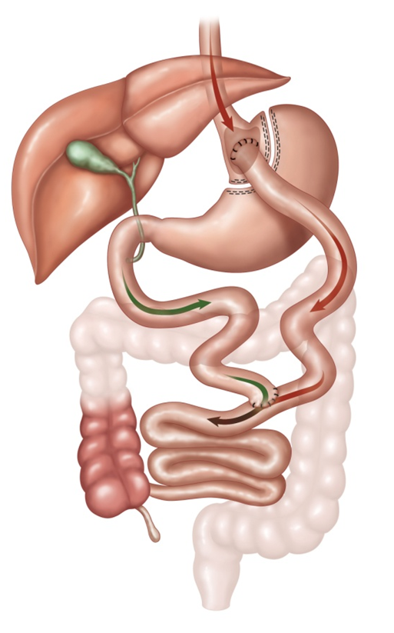
Laparoscopic
Roux-en-Y Gastric Bypass
Gastric pouch 30-40cc
“Roux limb”
Procedure with a long track record
Very effective against type 2 diabetes
Most effective anti-reflux operation
Weight loss 25-35% total body weight*
  (60-75% excess body weight loss)
Potential for ulcers with tobacco/NSAIDs
Risk of bowel obstruction
* MBSAQIP 2016-2020
Notes:
The laparoscopic Roux-en-Y gastric bypass is the “gold standard” operation for obesity. It has been performed successfully since the 1960’s, and laparoscopically since the 1990’s. It is very effective against diabetes, and is the best operation for treating reflux. Patients who undergo a gastric bypass must stop smoking and never smoke again. Patients who take NSAIDs for joint and other pain will need to stop these as well and abstain from these for life. Both of these recommendations are due to the increased risks of ulcers at the connection between the gastric pouch and the small intestine. Because of the lower connection in the small intestine, there is a risk of bowel obstruction requiring emergency surgery in the future.

Slide 23
Laparoscopic
Roux-en-Y Gastric Bypass
Gastric pouch 30-40cc
“Roux limb”
Weight Loss at 1 year
  31.1% Total weight loss
    Interquartile range [25.2 - 36.9%]
  70.6% Excess body weight loss
    Interquartile range [55.6 - 86.9%]
Weight Loss at 3 year
  28.7% Total weight loss
    Interquartile range [21.2 - 36.2%]
  66.0% Excess body weight loss
    Interquartile range [47.9 - 84.4%]
* MBSAQIP 2015-2018
Notes:
To look closer at the weight loss you may expect after the bypass, at 1 year, you may lose 31% of your total body weight and 71% of excess body weight. At 3 years, you may expect to have lost close to 29% of your total body weight and 66% of your excess body weight. Again, these are estimates according to the MBSAQIP’s national database.

Slide 24
Laparoscopic
Roux-en-Y Gastric Bypass
Pros:
  Long track record
  Decreases hunger
  Improves metabolism
  Great impact on
    Type 2 diabetes mellitus
    Metabolic syndrome
Cons:
  Possibility of internal hernia / bowel obstruction
  Potential for development of “marginal ulcers”
  Decreased absorption of vitamins / nutrients
  Involves 2 bowel connections
  No NSAIDS
Ideal for:
  Patient with type 2 diabetes
  Patients with obesity and reflux (GERD)
Notes:
The gastric bypass has the same or better effects on hunger, metabolism and diabetes as the sleeve, and is the best surgery for reflux. Since it is a more complex operation with two new bowel connections, it does have higher risks for complications and future nutritional deficiencies.

Slide 25
Bilio-pancreatic Diversion with Duodenal Switch
Similar to a gastric bypass but with
  Sleeve-like pouch
  Longer bypassed intestinal segment
A more complex technical and longer surgery
Excellent sustainable weight loss results
  45-50% total body weight loss
  (80-90% excess body weight loss)
Highly effective in resolution of type 2 diabetes and other medical problems
Risk of vitamin, nutrient deficiencies
Notes:
The biliopancreatic diversion with duodenal switch, or the BPD/DS, or simply “the switch,” is an operation that involves a sleeve gastrectomy, and then two new bowel connections, like with the gastric bypass. The difference here is that the “upper connection” is between the duodenum (or the first part of the small intestine which starts after the stomach) and the ileum (the last part of the small intestine before the colon). This is more complex than the bypass to perform, and there are fewer surgeons who perform this than there are that perform the bypass and sleeve. This procedure has the best results for weight loss, and is often therefore used for patients with a very high BMI. It has a very good rate of improvement or resolution of multiple medical problems. It also has a higher risk for nutritional deficiencies and these patients need to be monitored very closely in follow-up visits.

Slide 26
Bilio-pancreatic Diversion with Duodenal Switch
Pros:
  Excellent impact on
    Type 2 diabetes mellitus
    Metabolic syndrome
  Excellent sustainable weight loss
  Tolerant of NSAIDs
Cons:
  More technically complex, longer surgery
  Decreased absorption of vitamins, nutrients
  Possibility of internal hernia, bowel obstruction
  Increased number of bowel movements
Ideal for:
  May be performed after Sleeve Gastrectomy
  Seconds stage in patients with super morbid obesity
Notes:
The duodenal switch has the best results of any bariatric procedure on diabetes and several other diseases. Because there is no connection between the stomach and intestine, there is less of a problem with NSAIDs than with the bypass. The weight loss is better than the other procedures as well. But the duodenal switch is the most complex bariatric operation to perform and therefore takes longer, has more associated possible complications, and there are fewer surgeons performing this operation. Because of the two connections, this has a risk of bowel obstruction like the gastric bypass. This also has a higher chance of vitamin and nutrient deficiencies, and more frequent loose bowel movements.

Slide 27
Single Anastomosis Duodeno-ileal Bypass with Sleeve Gastrectomy
Highly effective for type 2 diabetes, comorbid conditions
Less risk for future bowel obstructions and hernias
NSAID use tolerated
May be performed after a sleeve gastrectomy
Weight loss 80-90% excess body weight
Notes:
The Single-Anastomosis Duodenal-ileal Bypass with Sleeve Gastrectomy, or SADI-S, or simply, the “loop DS,” is the most recent approved procedure for weight loss. This is similar to a duodenal switch but without a second connection. This is very good for obesity and diabetes, and has a better risk profile than the “full” DS. This is a procedure that can be done after a sleeve gastrectomy to treat obesity and/or diabetes that have not fully resolved with a sleeve.

Slide 28
Single Anastomosis Duodeno-ileal Bypass with Sleeve Gastrectomy
Pros:
  Excellent impact on
    Type 2 diabetes mellitus
    Metabolic syndrome
  Excellent weight loss
  Better tolerance of NSAIDs
Cons:
  Newer procedure
  Decreased absorption of vitamins, nutrients
  Bowel connection
  Increased number of bowel movements
Ideal for:
  May be performed after Sleeve Gastrectomy
  Patients with super morbid obesity (2-stage)
Notes:
The advantages of the SADI-S are its excellent outcomes when compared to the sleeve and its slightly lower risks than the full DS. This still involves bowel connections, malabsorption, and also has a risk of more frequent bowel movements.

Slide 29
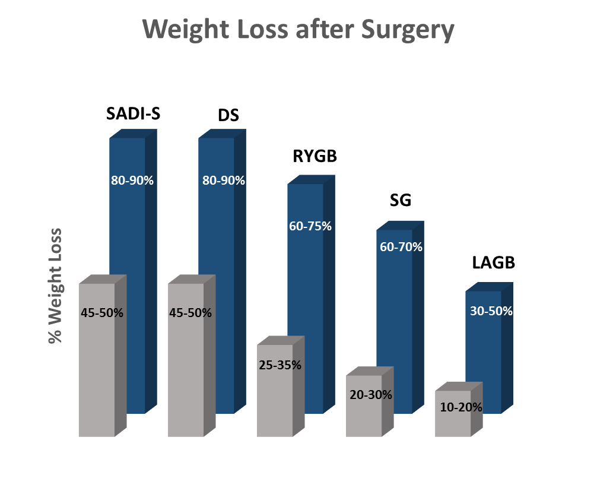
Excess
Total
Notes:
This graph illustrates the amount of weight you may lose after the different types of weight loss procedures. From left to right, the weight loss goes from highest to lowest. The blue bars indicate excess body weight loss and the gray bars indicate total body weight loss. As you can see, both the SADI-S and duodenal switch procedures result in the highest amount of weight lost on average. The bypass is slightly below that followed by the sleeve and then the gastric band. While weight loss is an important outcome of surgery, each procedure has its own risks. It is important to review these risks with your weight loss surgery team, because procedures that offer the most weight loss are often more complex and carry a greater risk of nutritional complications.

Slide 30

Are You
Safe for
Surgery?
Low risk of complications
(some procedures are as safe as gallbladder removal)
Discuss with your Surgeon
Notes:
The next question to discuss with your surgeon is: am I safe for surgery? The laparoscopic gastric bypass and the laparoscopic sleeve gastrectomy have been shown to be as safe as gallbladder removal in terms of risks of death and major complications.

Slide 31
Am I
Safe for
Surgery?
Factors specific to you
Medical Conditions
Mobility
Mental Health Issues
Social Support
Program and follow up
May need additional testing or preparation to determine this step
Notes:
Your surgeon can discuss your medical problems and whether you are higher risk due to cardiac, liver or kidney disease, and if you qualify for surgery. You will also have to have appropriate social support for recovery from surgery, and will need to go through your program’s pathway to surgery, which will include an evaluation of all your medical conditions and whether you have any mental health issues that may complicate your recovery from surgery.

Slide 32
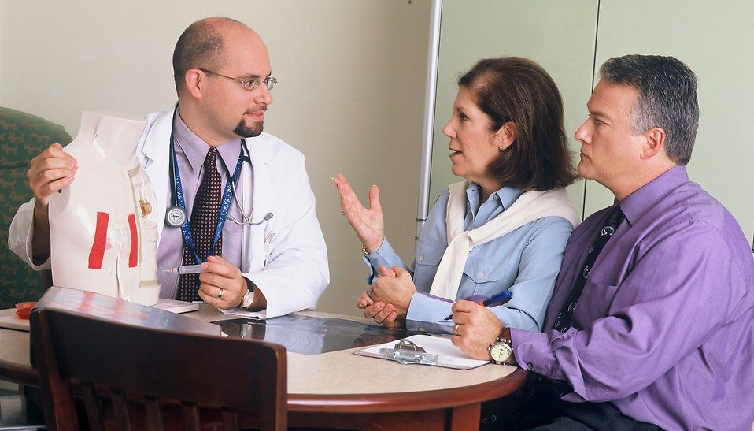
Expectations for
Surgery
Preparing takes 1-3 months
Insurance may require more time
Most go home in 1-2 days and some same day
Back to work in 1-3 weeks
Individual results may vary
Notes:
Once you start the pathway with your bariatric surgery program, this may take several months, depending on your individual program’s requirements, as well as your insurance company’s requirements. After surgery, most patients go home after a 1-2 night hospital stay, and are back to work within a couple of weeks.

Slide 33
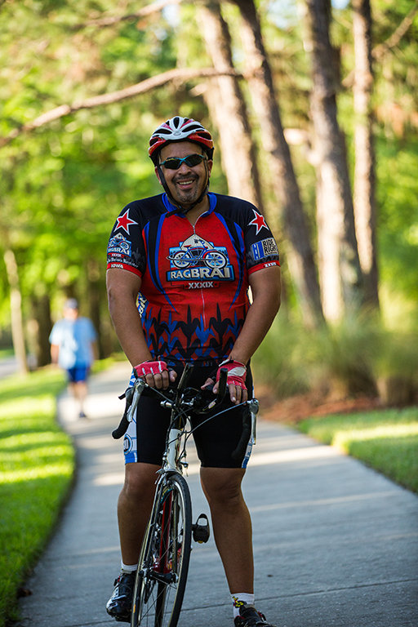
After Surgery
Physical activity
  Improve success!!
  Before and after surgery
Diet
  High protein
  Low carbohydrate
Notes:
Before and after surgery, physical activity is important to improve success. Given the changes to your gastrointestinal system, you will need to eat foods high in protein and low in carbohydrates.

Slide 34


The
Surgery
Team
Benefits of Accreditation
Meets national bariatric standards
All patients enrolled into national database
Continuous quality improvement
Program reviewed regularly
Bariatric specific training for staff
Support Groups, Special Equipment and Furniture
Lifelong care and follow up
All of these lead to Best Outcomes!
Notes:
Bariatric surgery programs which are certified by the ASMBS through the MBSAQIP are continuously evaluated for quality and measure their surgical outcomes against national standards on a regular basis. They frequently reassess and retrain to maintain high standards, and therefore this certification is a sign of excellence.

Slide 35
The
Surgery
Team
Multidisciplinary Approach
Surgeon
Nurse
Dietitian
Behavioral Health
Obesity Medicine
Other specialists
  Cardiology
  Pulmonology
  Sleep medicine
Notes:
Bariatric surgery centers use a multidisciplinary approach to obesity care. Yours will involve a surgeon or surgeons, nurses, dietitians, behavioral health specialists, and some also will have obesity medicine specialists, as well as specialists in cardiac, pulmonary, and sleep medicine.

Slide 36
Program Progression
Initial Seminar & Initial Surgeon Evaluation
Supervised Weight Loss & Support Group
Nutrition & Psych Workup
Surgeon Evaluation & Pre-Op
Testing
Surgery
Notes:
Most programs will follow a pathway similar to this one. After initial evaluation, there will be a period of supervised weight loss with a dietitian and visits with a psychologist. There will be some preoperative medical evaluation and some imaging studies and/or endoscopy. Your surgeon will decide what studies are appropriate for you. Once all this is completed, a final visit before surgery will ensure all of the medical issues have been addressed and surgery will be scheduled.

Slide 37

Long Term
Outcomes
Obesity
  Disease of metabolism
  Chronic and progressive
  Shortens life expectancy
Weight Loss Surgery
  Best treatment of obesity
  Most effective treatment for type 2 diabetes
  Durable long term
  Safe
Life
Changing!
Notes:
In conclusion, obesity is a disorder of metabolism, and is NOT just a lack of diet or exercise. Obesity is a chronic disease that can be difficult to treat, and if left untreated, it can shorten life span. Surgery is often the best treatment for obesity and associated conditions, such as diabetes. While some patients will gain some weight after losing it, the vast majority of patients lose a substantial amount of weight and keep it off. The surgeries we’ve discussed are safe, especially when compared to the risks of the disease of obesity without surgery.

Slide 38
Are You Ready?
Notes:
So, the final question is: Are You Ready?

