Slide 1


Slide 2

Notes:
At Tongal, we’ve seen, time and time again, that great ideas and brilliant video content comes from people just like you – from every walk of life, every age group, every longitude and latitude.
Whether you’re an idea-person, writer, or film maker – you can be successful with Tongal.

Slide 3
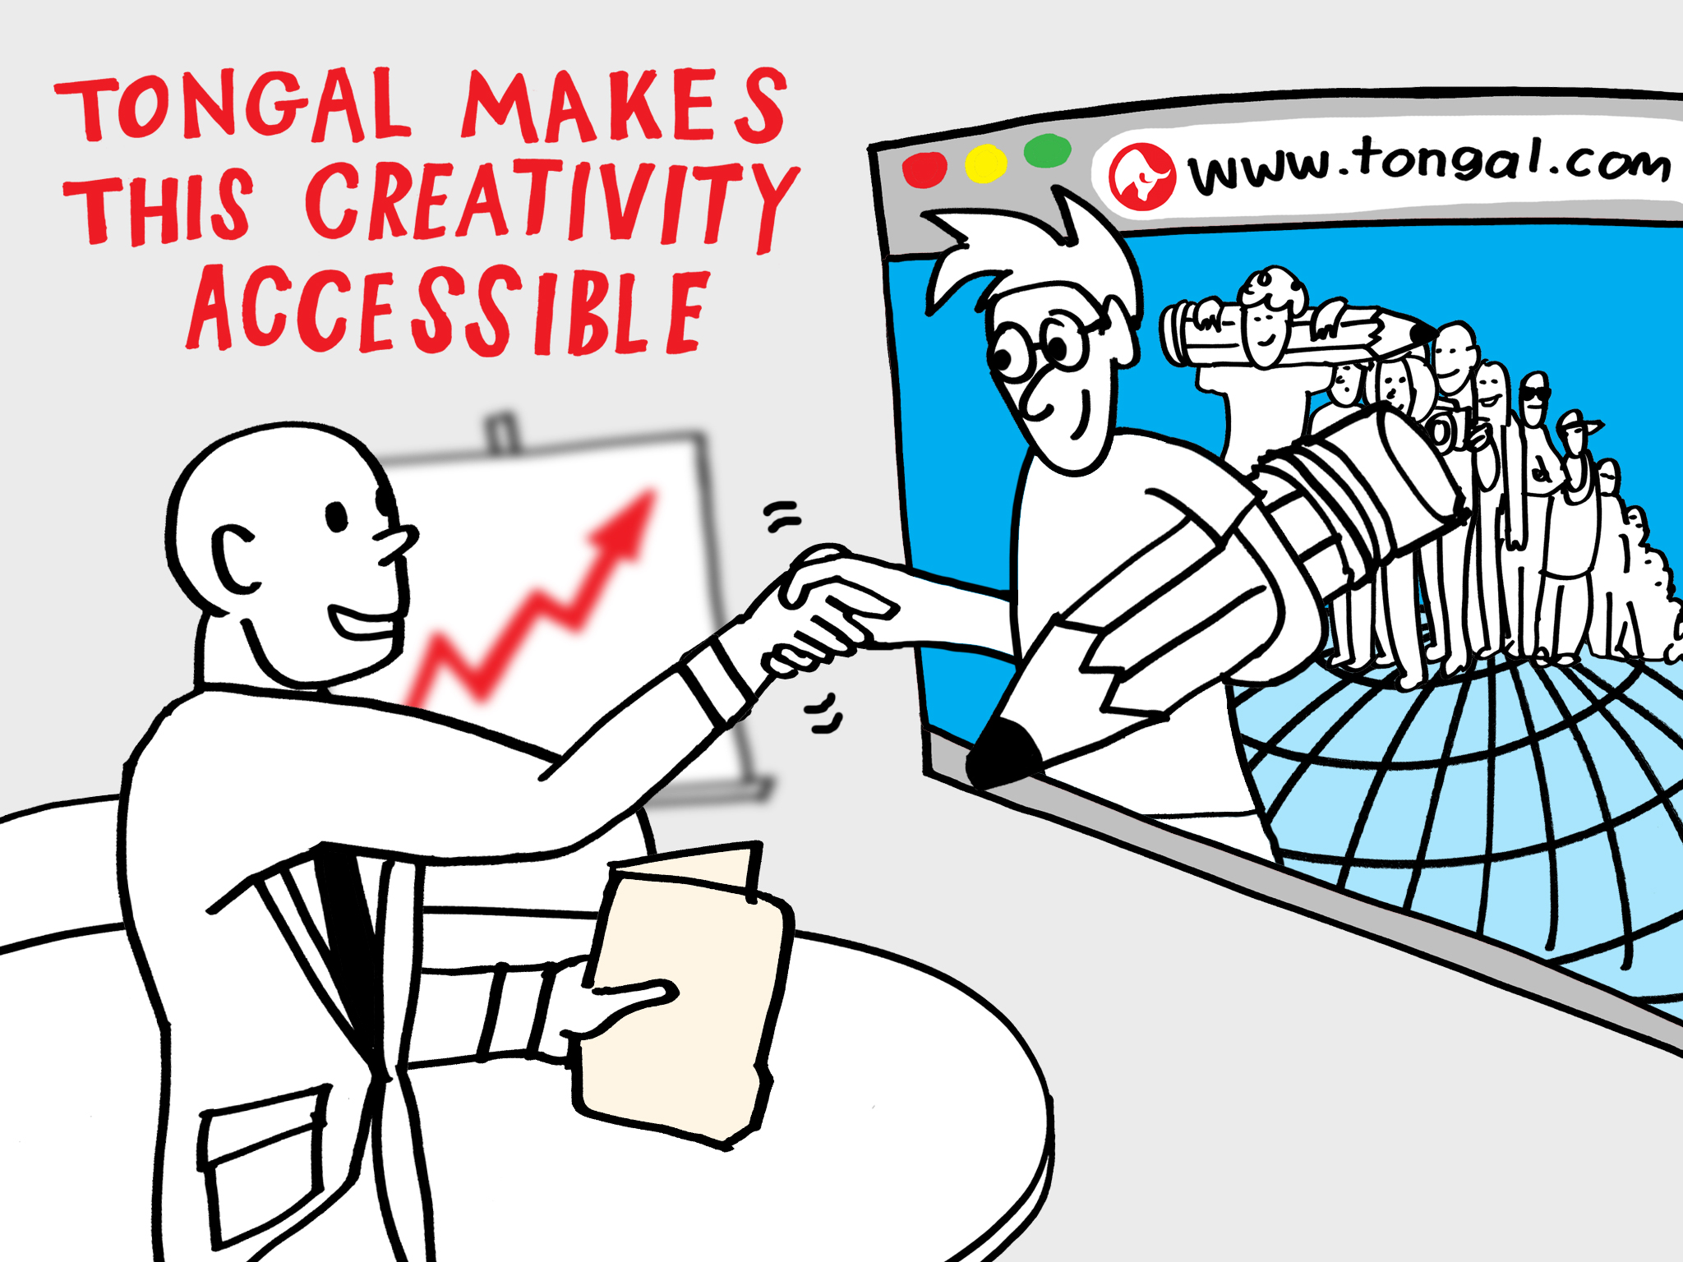
Notes:
We connect our community (that’s you!) with some of the world’s best-known brands, so you can earn money and be recognized for helping to develop or produce great video content.
With Tongal, it’s creative work pure and simple: no office, no dress-code, no commute. Nothing but rewarding challenges for your best thinking and your best work.
Here’s how it works:

