Slide 1
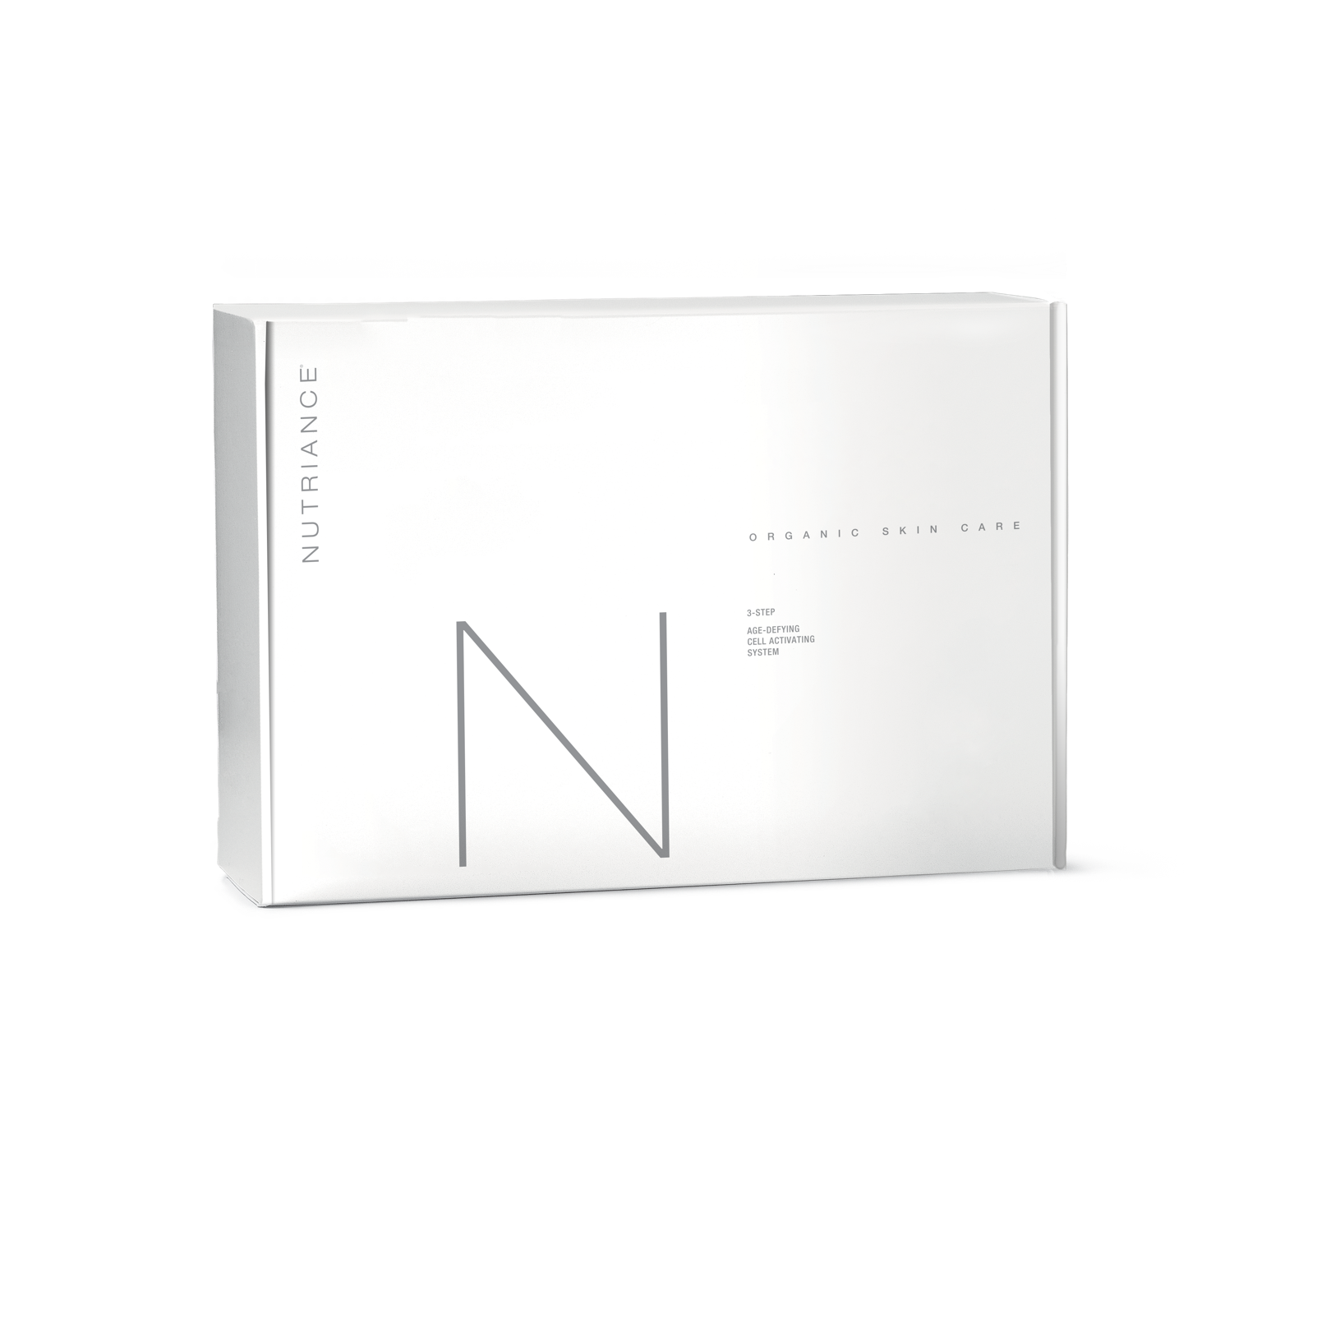
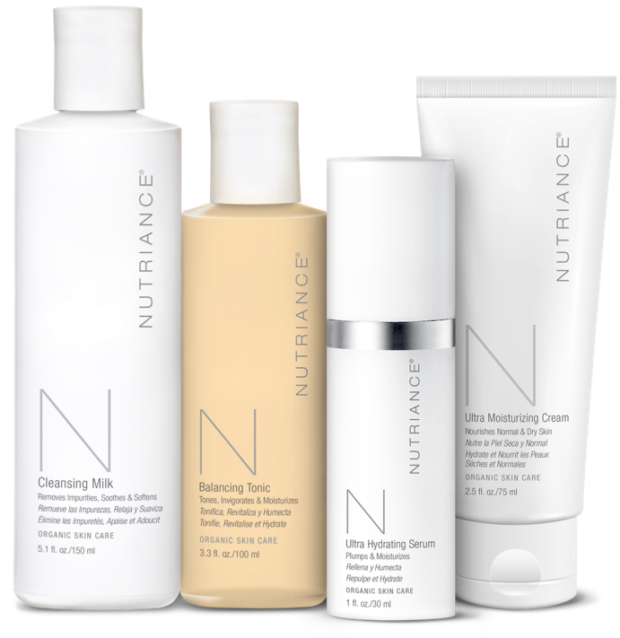

AGE-DEFYING
CELL ACTIVATING
SYSTEM
Notes:
Presenter Speaks:
I am one of a select group of Promoters who belong to the Nutriance Organic Pre-Launch team. The presentation you just saw is really just a sneak peak into a line that isn’t officially on the market yet. But the company was so excited to spread the news about this breakthrough new line, that they produced small batches of these exclusive formulas to be released in limited quantities prior to the official launch coming in April, 2018.
I jumped at the opportunity to partner with NeoLife for this launch because of two major reasons. First, the quality of these products is incredible. It’s the perfect addition to supercharge our grassroots movement to end the trend. And second, I just couldn’t pass up the chance to take advantage of this ground floor opportunity and get in early before it explodes.
I want to share a special pre-launch perk that will be ending before April. Whether you decide to join as a Club Member and be a customer, or as a Promoter and earn an income, the company is offering some really exciting deals.

Slide 2
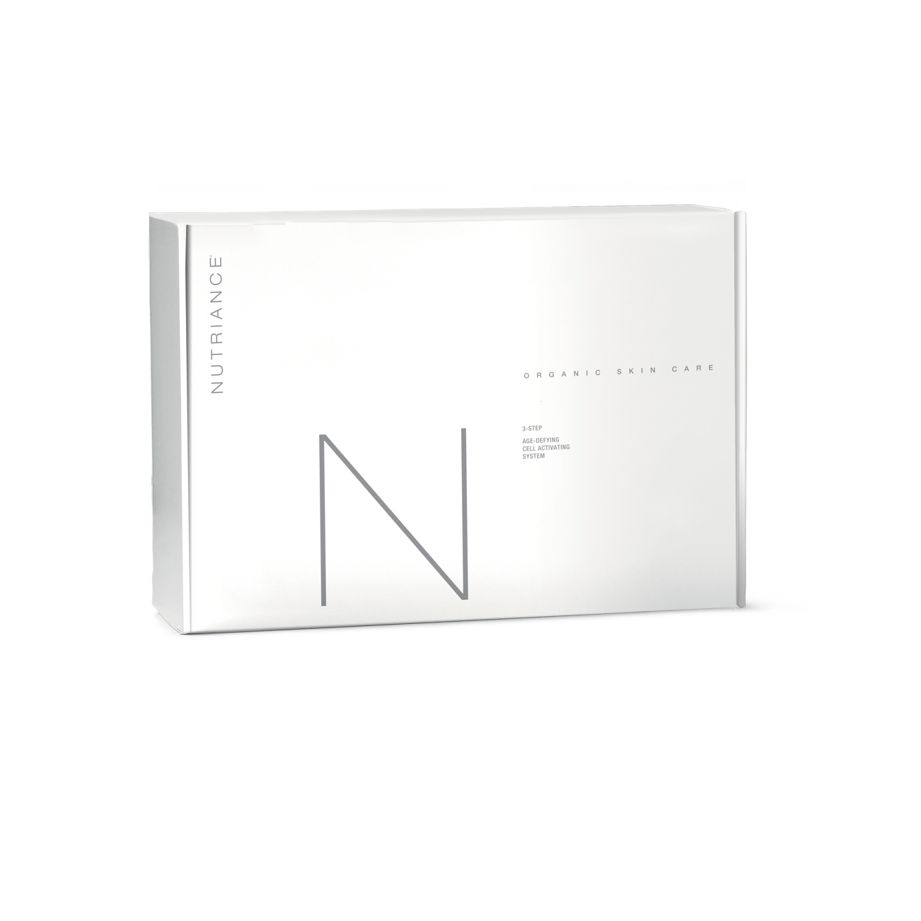

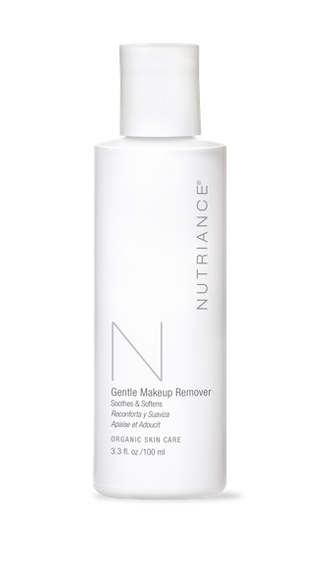
SPECIAL PRE-ORDER OFFERS!
PRE-ORDER
3-STEP SYSTEM
BUY ONE 3-Step System
&
GET FREE
Gentle Makeup Remover
Notes:
Presenter Speaks:
Pre-Order 3-step: get a free gentle makeup remover with the pre-order of every 3-step system. You’ll get this before everyone else… first shipments go out on March 1. (then the next window is April 1)

Slide 3
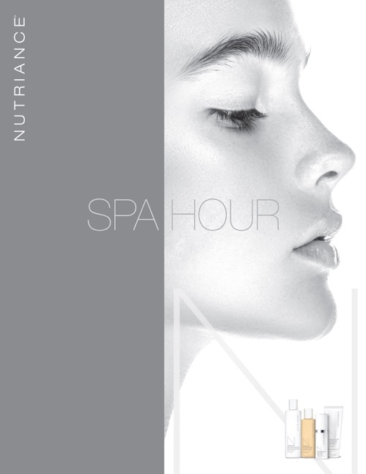
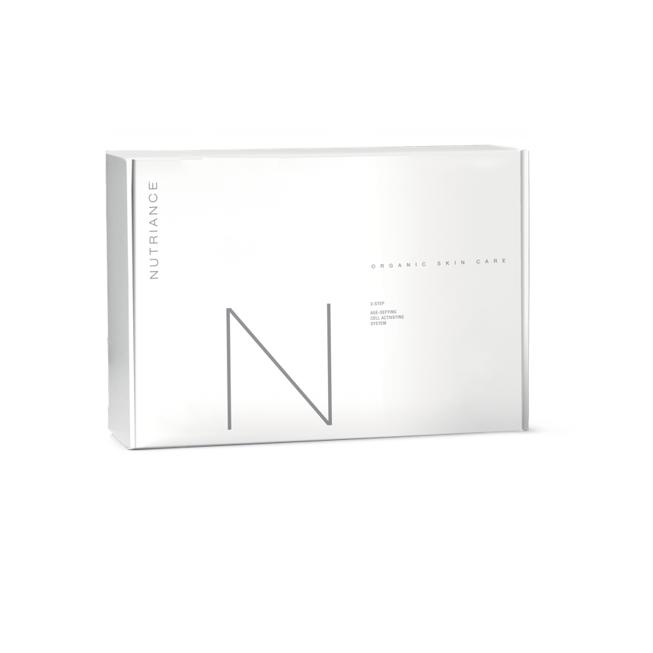
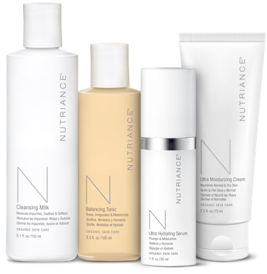
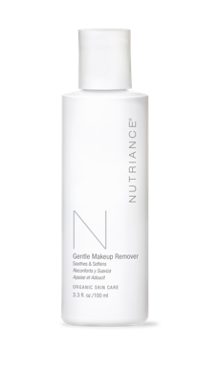
SPECIAL PRE-ORDER OFFERS!
LAUNCH PARTNER PACK
BUY FOUR 3-Step Systems
&
GET FREE
(2) Gentle Makeup Remover
(1) Spa Hour Guide
Notes:
Presenter Speaks:
Launch Partner Pack: for promoters who want to be a part of the pre-Launch. get a free spa our guide and two free gentle makeup removers with the purchase of four 3-step systems. Shipments go out Feb.1. (after Feb. 1 orders are processed like normal, right away).

