Slide 1
Chapter 8: Thinking and Language
Case Study: Can Animals Talk to Us?
Section 1: Understanding Thinking
Section 2: Problem Solving
Section 3: Reasoning and Decision Making
Section 4: Language
Lab: Applying What You’ve Learned

Slide 2
Section 1 at a Glance
Understanding Thinking
Thinking is the mental activity that allows us to understand, process, and communicate information.
The basic units of thought include symbols, concepts, and prototypes.
There are three kinds of thinking: convergent, divergent, and metacognition.

Slide 3
Basic Elements of Thinking
Thinking is the mental activity that is involved in the understanding, processing, and communicating of information.
Thinking is made possible through units of thought that include symbols, concepts, and prototypes.
Symbols
Concepts
A symbol is an object or an act that stands for something else.
Letters and words are symbols.
Mental images are symbols.
Symbols help us think about things that are not present.
A concept is a mental structure used to categorize objects, people, or events that share similar characteristics.
People organize concepts into hierarchies.
People learn concepts through experience.
Notes:
–

Slide 4
Prototypes
A prototype is an example of a concept that best exemplifies the characteristics of that concept.
Prototypes help us categorize the world and process information about it.
Without prototypes, people might have to examine unfamiliar elements as if they were totally new.

Slide 5
Three Kinds of Thinking
In general people think in three ways: convergent, divergent, and metacognitive.
Convergent
Divergent
Convergent thinking is thought limited to facts.
We use convergent thinking to find one solution for a problem or task.
Developing rules and following them is one example of convergent thinking.
Convergent thinking is not particularly creative.
Divergent thinking allows the mind to associate more freely to various elements of a problem.
Divergent thinking is at the base of creativity.
Divergent thinking typically results in multiple solutions.
Notes:
–

Slide 6
Metacognition
Metacognition consists of planning, evaluating, and monitoring mental activities.
It is thinking about thinking.
It has two different aspects: metacognitive knowledge and metacognitive experiences.

Slide 7
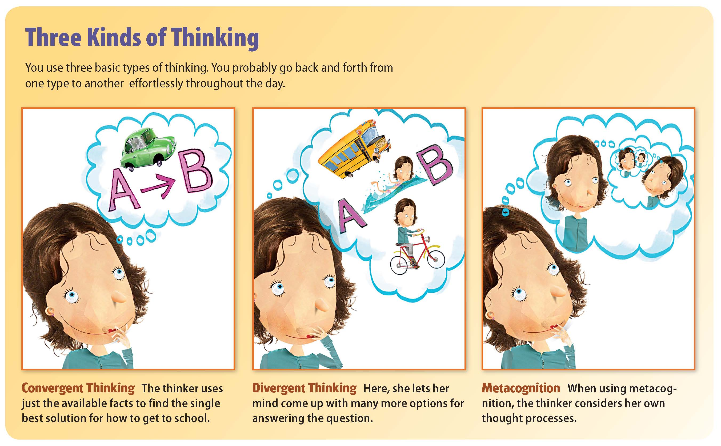

Slide 8
Section 2 at a Glance
Problem Solving
Problem solving involves a series of processes, including analyzing the problem, breaking it into component parts, and establishing goals.
Algorithms and heuristics are general approaches to problem solving.
There are specific methods of problem solving, including systematic searching, trial and error, difference reduction, means-end analysis, working backward, and use of analogy.

Slide 9
Approaches to Problem Solving
Algorithms
An algorithm is a specific procedure that, when used properly and in the right circumstances, will always lead to the solution of a problem.
Mathematical formulas are examples of algorithms.
One kind of complex algorithm is a systematic search.
Heuristics
Algorithms are guaranteed to work, but they are not always practical.
This is why people use heuristics for many types of problems.
Heuristics are rules of thumb that often, but not always, help us solve problems.
They are shortcuts that are faster than algorithms, but they are not always reliable.

Slide 10
Problem-Solving Methods
Trial and Error
Somewhat similar to systematic searching, but more haphazard and less reliable.
Difference Reduction
Difference reduction is a problem-solving method in which we identify our goal, where we are in relation to it, and the direction we must go to move closer to it.
The aim is to reduce the difference between a present situation in which a problem is unsolved to a desired situation in which the problem is solved.
Not always a reliable method.

Slide 11
Means-End Analysis
Means-end analysis is a heuristic problem-solving technique.
In means-end analysis, certain things we do (means) will have certain results (ends).
Focus on the knowledge that a particular action will have a particular result.
Working Backward
Involves breaking a problem down into parts and dealing with each part individually.
Starts by examining the final goal, then works back to determine the best course of action.
Very useful when the goal is known but the way to achieve it is not.

Slide 12
Analogies
An analogy is a similarity between two or more items, events, or situations.
When people have successfully solved one problem, they may try to use the same approach in solving another problem if it is similar enough to the first one.

Slide 13
Obstacles to Problem Solving
Mental Sets
The tendency to respond to a new problem with an approach that was successfully used with similar problems is called mental set.
Mental set can get in the way of problem-solving.
Functional Fixedness
Another obstacle to problem solving is called functional fixedness, which is the tendency to think of an object as being useful only for the function that the object is usually used for.
Functional fixedness can interfere with finding a solution to a problem.

Slide 14
Problem Solving and Creativity
Flexibility
Flexibility is the ability to adapt to new, different, or changing situations.
Flexibility leads to original thinking.
Recombination
Recombination is the mental rearrangement of elements of a problem.

Slide 15
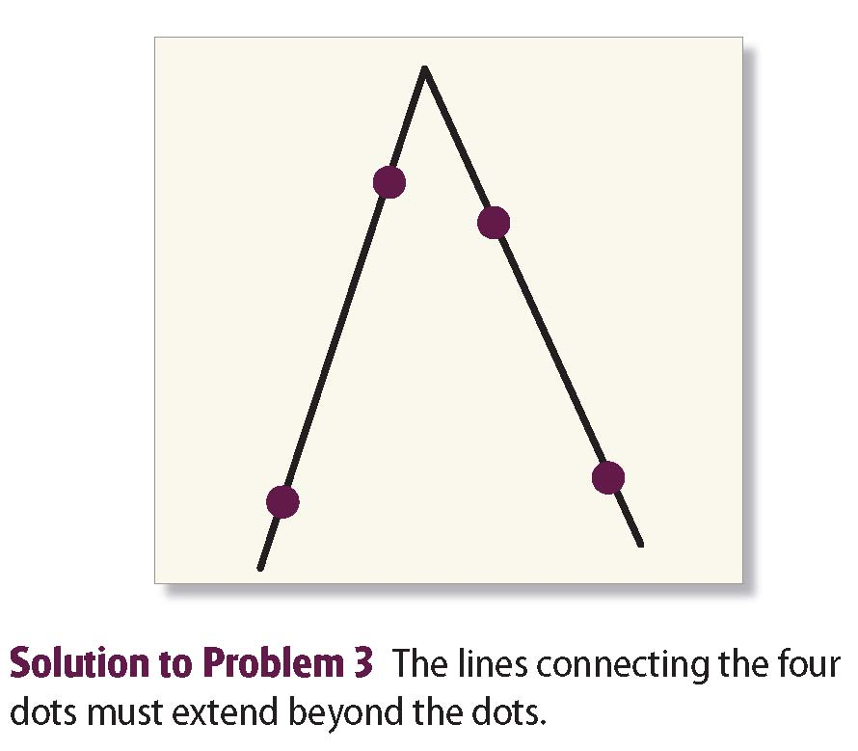
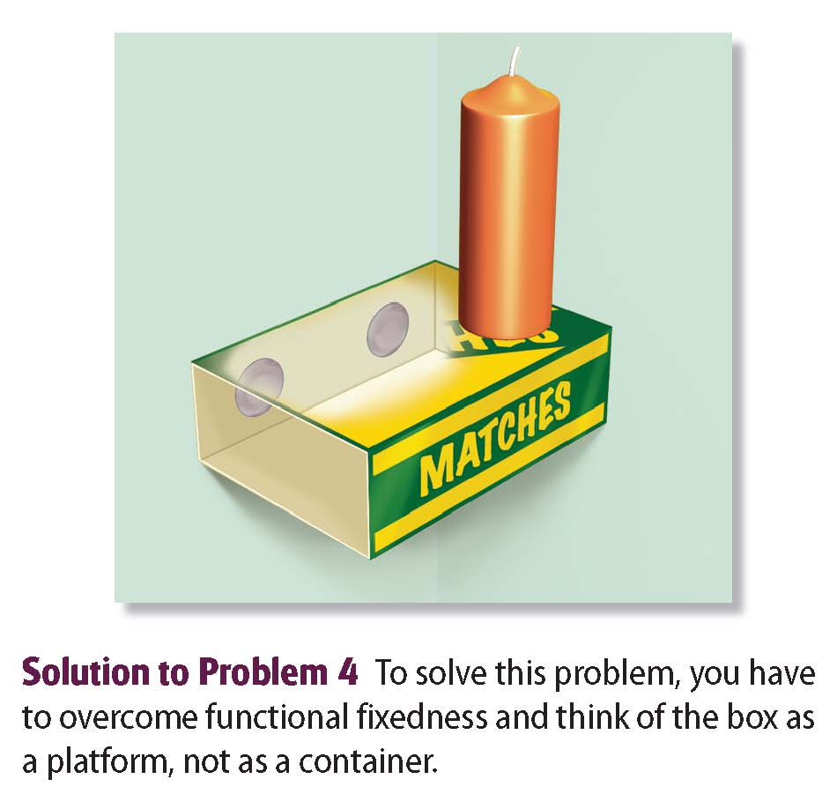
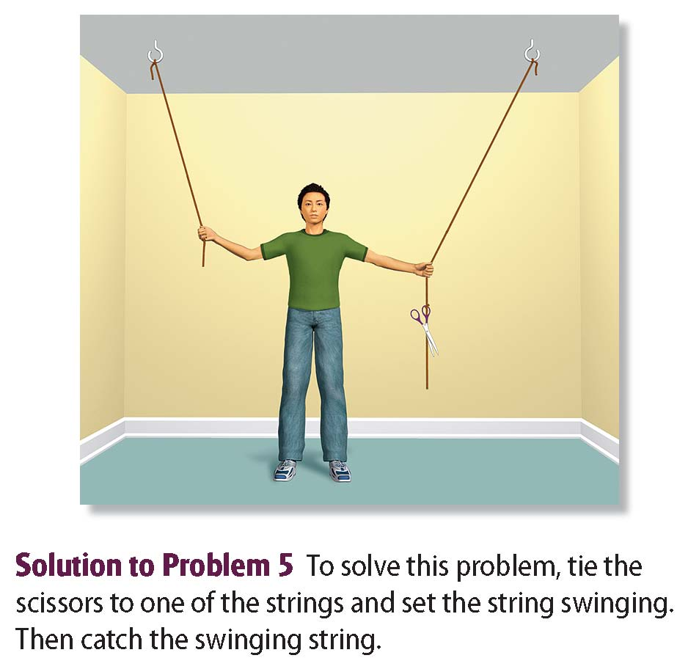

Slide 16
Insight and Incubation
Insight gives us sudden understanding of a problem.
The incubation effect is the tendency to arrive at a solution after a period of time away from the problem.

Slide 17
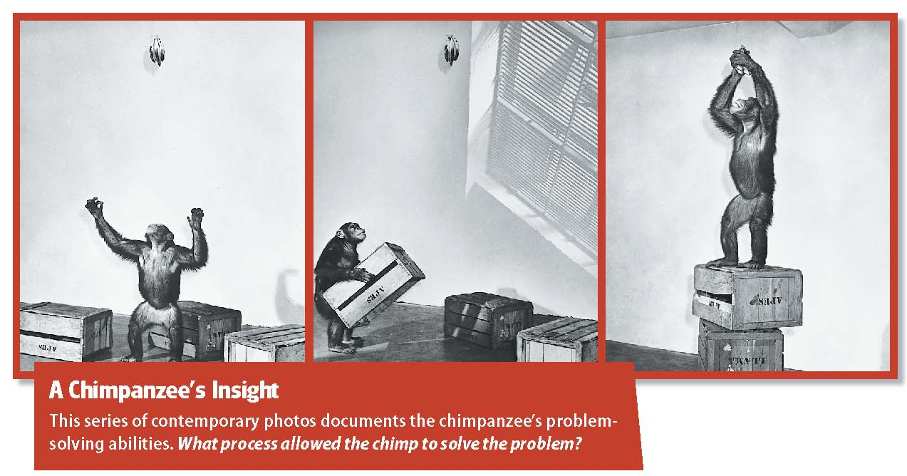

Slide 18
Section 3 at a Glance
Reasoning and Decision Making
Reasoning is the use of information to reach conclusions. There are two main types of reasoning: deductive and inductive.
People use a variety of methods to make decisions, including using a balance sheet and some types of heuristics.

Slide 19
Deductive Reasoning
Reasoning is the use of information to reach conclusions. There are two main types of reasoning: deductive reasoning and inductive reasoning.
In deductive reasoning, the conclusion is true if the premises are true.
A premise is an idea or statement that provides the basic information that allows us to draw conclusions.

Slide 20
Inductive Reasoning
In deductive reasoning, we usually start out with a general statement or principle and reason down to specifics that fit that statement or principle.
In inductive reasoning, we reason from individual cases or particular facts to reach a general conclusion.
In inductive reasoning, the conclusion is sometimes wrong, even when the premises are correct.
Even though inductive reasoning does not allow us to be certain that our assumptions are correct, we use inductive reasoning all the time.
Most sciences, including psychology, rely on inductive reasoning.

Slide 21
Weighing Costs and Benefits
Making decisions means choosing among goals or courses of action to reach goals.
When we make decisions, we weigh the pluses and minuses of each possible course of action.
Making a balance sheet can help ensure that all available information has been considered.
A balance sheet can also be helpful when a person is making a decision between two or more alternatives.

Slide 22
Shortcuts in Decision Making
The Availability Heuristic
The availability heuristic can help people make decisions on the basis of available information in their immediate consciousness.
The Representativeness Heuristic
Based on the representativeness heuristic, people make decisions about a sample according to the population that the sample appears to represent.
The representativeness heuristic can be misleading.

Slide 23
The Anchoring Heuristic
The anchoring heuristic is the process of making decisions based on certain ideas or standards held by the decision maker.
Family traditions, political beliefs, religion, and ways of life are common anchors.

Slide 24
Section 4 at a Glance
Language
Language is the communication of ideas through symbols that are arranged according to rules of grammar.
Language contains three basic elements: phonemes, morphemes, and syntax.
Children everywhere learn language in the same sequence of steps. Heredity and environment both affect language learning.
Bilingualism is the ability to understand and speak two languages.

Slide 25
Basic Concepts of Language
Language is the communication of ideas through symbols that are arranged according to the rules of grammar.
Language makes it possible for people to share knowledge.
The psychology of language is called psycholinguistics.
Hereditary Influences
Environmental Influences
The natural tendency to acquire language can be called a language acquisition device (LAD).
The LAD enables the brain to understand and use grammar and to turn ideas into sentences.
Most people are capable of acquiring language from about 18 months of age to puberty.
Children learn language partly by observing and imitating other people.
Children acquire the languages of their parents and then pass them down to their children.
In this manner, languages pass, with small changes, from generation to generation.
Notes:
–

Slide 26
The Basic Elements of Language
Phonemes
Phonemes are the basic sounds of language.
English uses about 43 phonemes, including some that are not found in other languages.
Morphemes
The units of meaning in a language are called morphemes.
Morphemes are made up of phonemes.
Syntax
The way in which words are arranged to make phrases and sentences is syntax.
The rules for word order are the grammar of a language.
Semantics
The study of meaning in language is called semantics.
Semantics involves the relationship between language and the objects depicted in the language.

Slide 27
The Stages of Language Development
Crying, Cooing, and Babbling
Crying is an effective form of verbal expression for infants.
Infants begin to coo during their second month of age.
Infants begin to babble at about six months of age.
Crying, cooing, and babbling are basic human abilities.
Babies understand much of what other people are saying before they learn to talk.
Words, Words, Words
The learning of words is the start of true language development.
Most early words are nouns.
Research indicates that reading to children increases their vocabulary.

Slide 28
Development of Grammar
The first things children say are usually brief, but they have a grammar.
Most children who are nearing two years old will begin to use two-word sentences.
Two-word sentences usually show understanding of grammar.
Children make language errors because of overregularization.

Slide 29
Bilingualism
To speak two languages fluently is to be bilingual.
In general, learning a second language during childhood is easier than learning it later in life.
The bilingual population of the United States is growing.
Many people in other countries speak two or more languages.
Most psychologists believe that bilingualism is good for children’s cognitive development.

Slide 30
Cultural Diversity and Psychology
Disappearing Languages
By the year 2100 about half of the world’s 7,000 or so languages are likely to have disappeared. As a result, information about cultures, their history, the environment, and the different ways that people think will also disappear.
Languages die as the few remaining people who speak them die.
Languages are disappearing most rapidly in five regions.
Two of the regions are the upper Pacific Coast and the Southwest.
One reason languages die out is because of the influence of “predator” languages.
When a language is lost, so is an entire culture.
Different ways of thinking and different ways of using language are also lost.
Many countries are working to save or revive dying languages.
Notes:
–

