Slide 1

Oregon Essential Health Benefits Workgroup
Bruce M. Wolfe, MD, FASMBS

Slide 2
Disclosures
EnteroMedics – research contract
  Role: Investigator

Slide 3

ACA EHB Requires:
Ambulatory patient services
2. Emergency services
3. Hospitalization
4. Maternity and newborn care
5. Mental health and substance use disorder services, including behavioral health treatment

Slide 4
ACA EHB Requires:
Prescription drugs
Rehabilitative and habilitative services and devices
Laboratory services
Preventive and wellness services and chronic disease management
10. Pediatric services, including oral and vision care

Slide 5
12/11 HHS: State Selects Benchmark
the largest plan by enrollment in any of the three largest small group insurance products in the State’s small group market;
any of the largest three State employee health benefit plans by enrollment;
any of the largest three national FEHBP plan options by enrollment; or
the largest insured commercial non-Medicaid Health Maintenance Organization (HMO) operating in the State.

Slide 6
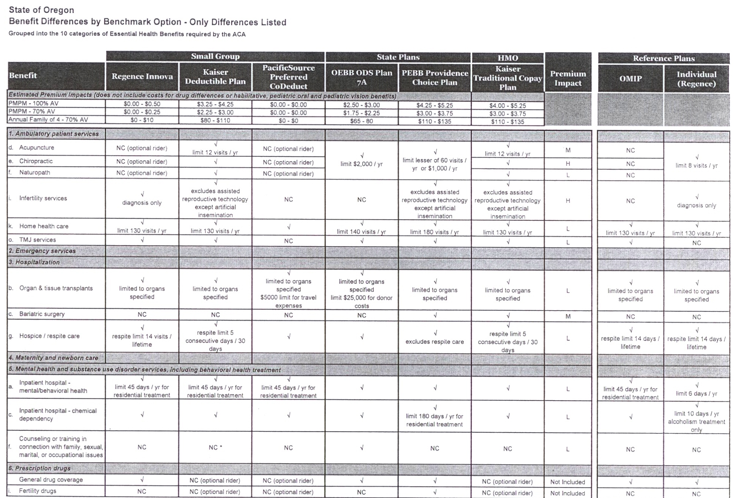

Slide 7
OR: EHB Workgroup
 | Excludes bariatric surgery coverage | Includes bariatric surgery coverage
Pacific Source Small Group Plan | X
Regence Small Group Plan | X
OEBB State Plan (effective 12/31/11) | X
Kaiser Small Group Plan | X
HMO (Kaiser) |  | X
PEBB (Providence Choice) |  | X

Slide 8
WA: Milliman Recommendation
Select most prevalent small group/plan as benchmark
Will accommodate state mandates
Complies with need to reflect “typical employer plan”
Lean benefits but affordable
  Uniform Medical Plan, PEBB not as affordable
FEHBP
  State mandates not considered
  Selection back to federal government

Slide 9
WA: Milliman Observations
Benchmark defines EHB, not cost sharing
States need to accommodate mandates
States may not adjust benefits of Benchmark Plan but must comply with the 10 mandates
Insurers will have flexibility

