Slide 1
Text Perspectives on
English Reading Achievement
Tim Klasson & Trilby Berger, MetaMetrics

Slide 2
The Lexile® measure: a scientific way to match readers with text
Uses a common scale for measuring individual readers and texts
Enables accurate matching of reader ability with text complexity to enhance learning
Allows us to look at text demands in different contexts and monitor progress over time

Slide 3

Lexile measures for readers and text
A student has a
Lexile measure
that describes her
reading ability
A book has a
Lexile measure
that describes its reading demand
850L
850L
  A Lexile measure is a number
  followed by an “L”

Slide 4
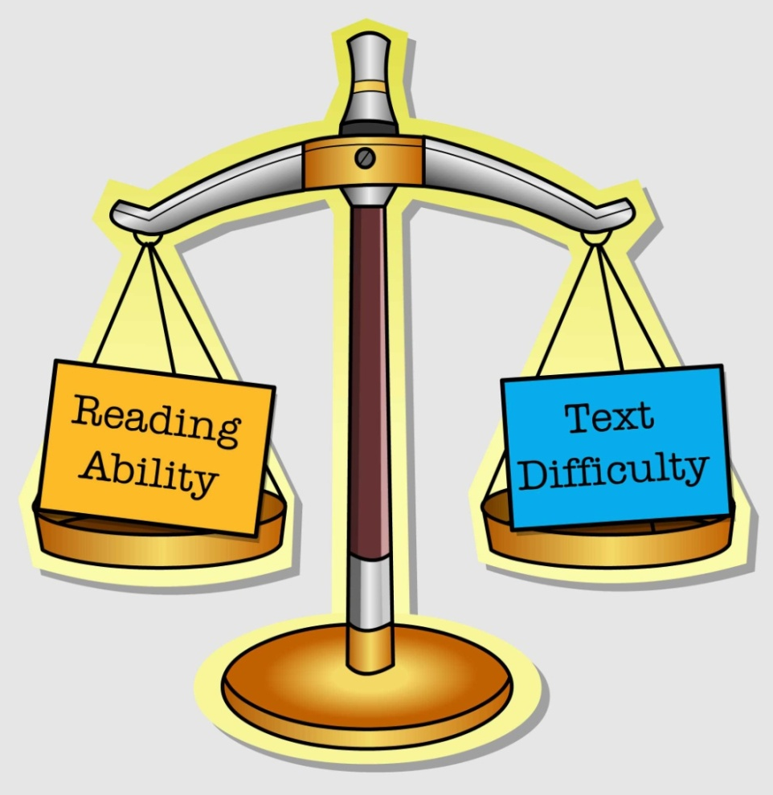
A common scale for reading
When they match,
learning improves.
850L
850L

Slide 5
The Lexile scale
Lexile measures are developmental.
Advanced-level readers and texts
have higher measures
Beginner-level readers and texts
have lower measures
2000L
Advanced
1500L
A Lexile measure is given as a number followed by an “L”
1000L
500L
0L
Beginner

Slide 6

What can you do with a reading test score?
Compare reader abilities on a given test
Track growth if using
the same test

Slide 7
What can you do with a reading test score that also reports a Lexile® measure?
Connect to real-world reading demands
  Elementary/Secondary Schools
  University
  Workplace
  Military
  Citizenship
Target practice for optimal learning

Slide 8
How are readers measured?
A reading test determines the Lexile measure of an individual.
A test that utilizes the Lexile scale for Reading
or
A test that has been linked with Lexile measures

Slide 9
How are texts measured?
The Lexile Analyzer evaluates the complexity of a text to determine the Lexile measure.
Difficulty of the sentence structures
  Longer sentences are more difficult.
Difficulty of the vocabulary
  Less familiar words are more difficult.

Slide 10
Sample text: 1080L
Robert Louis Stevenson is often and fondly attributed to saying: “Wine is bottled poetry.”
Indeed, nothing quite matches the true feeling of relaxation that arises as you uncork the bottle; the evocative colors splashing into the glass as the liquid is poured; and that exquisite first sip—all but confirming that wine truly is the drink of the gods.
This, of course, makes it all the worse when you discover, by smell and taste if not before, that the plentiful crimson nectar that you purchased in good faith is faulty.

Slide 11
Sample text: 1350L
After a final month-long halt in Grytviken, South Georgia, Endurance departed for the Antarctic on 5 December. Two days later Shackleton was disconcerted to encounter pack ice as far north as 57 degrees 26’S [South], forcing the ship to maneuver. During the following days there were more tussles with the pack, which on 14 December was thick enough to halt the ship for 24 hours. Three days later the ship was stopped again. Shackleton commented: “I had been prepared for evil conditions in the Weddell Sea, but had hoped that the pack would be loose. What we were encountering was fairly dense pack of a very obstinate character”.

Slide 12
Matching reader and text
The best fit for learning typically ranges from 100L below to 50L above the reader’s measure.
For example, a 900L reader is usually matched with books that range from 800L to 950L.
This match results in 75% comprehension, an optimal level for learning.

Slide 13
Tests providing Lexile measures in Japan
TOEFL, TOEFL Junior, and TOEIC tests
published by ETS
Engaging English™ service for targeted practice
published by MetaMetrics®

Slide 14
What we’ve learned about authentic text demands of English reading.
Regardless of native language, Lexiles are measuring the same construct; reading comprehension.
Appropriate standards can be developed by country.

Slide 15
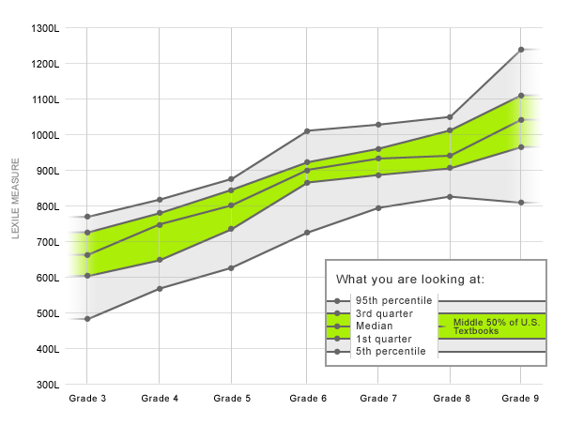
Typical text demands by U.S. grade levels

Slide 16
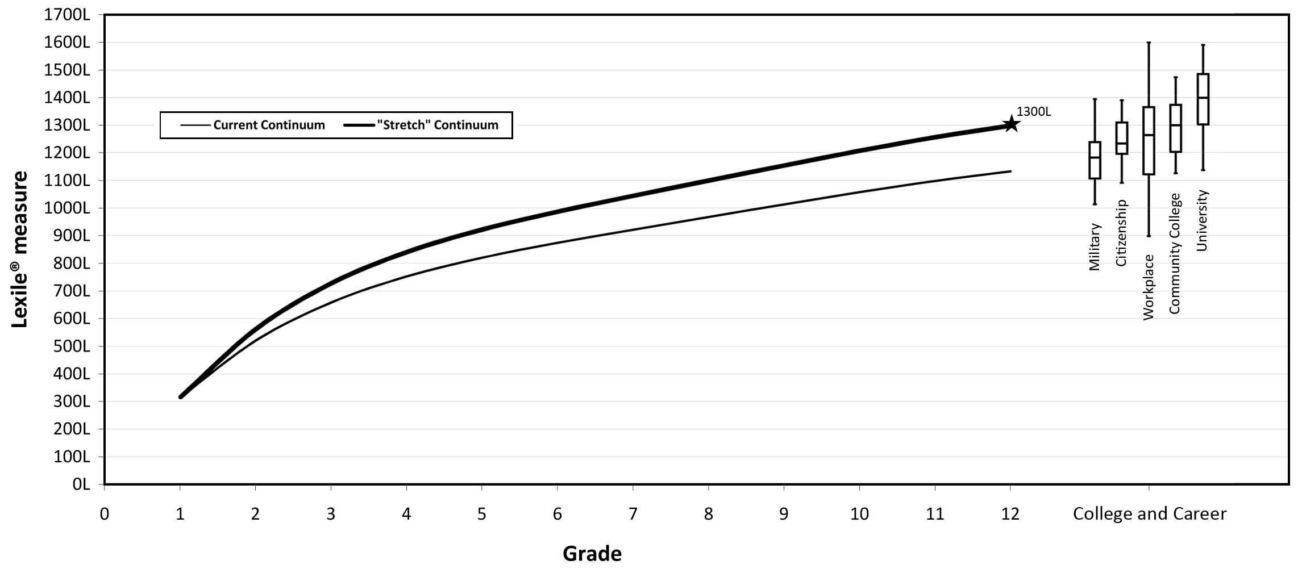
The stretch continuum

Slide 17
U.S. Common Core State Standards
Analysis of text collections led to the use
of the Lexile® scale to:
  Define text complexity by grade in the U.S. Common Core State Standards
  Set the goal for college- and career-readiness (CCR)

Slide 18
U.S. Common Core State Standards
The Standards provide Lexile bands for reading comprehension development by grade levels
U.S. Grade Levels | Lexile® Band
K–1 | N/A
2–3 | 450L–790L
4–5 | 770L–980L
6–8 | 955L–1155L
9–10 | 1080L–1305L
11–CCR | 1215L–1355L

Slide 19
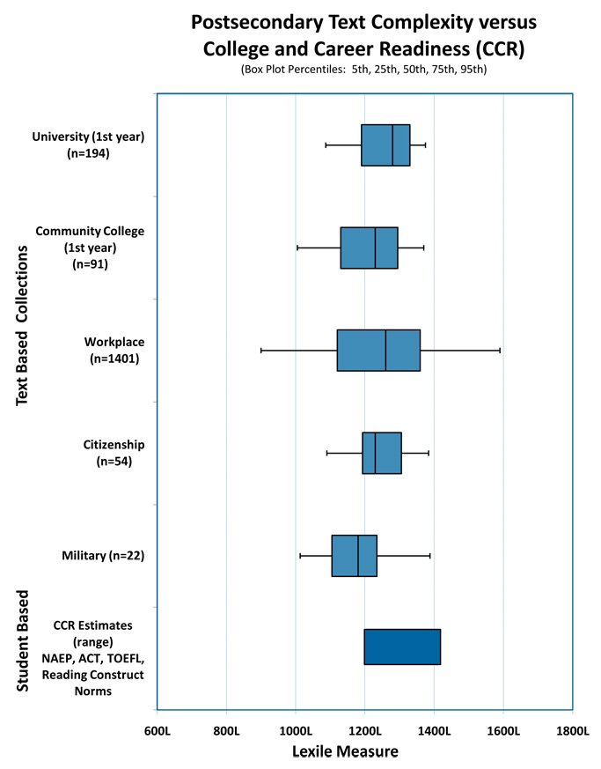
College and Career
Readiness
The CCR standard has been set at 1300L
Adapted from Williamson, G. L. (2008).
A text readability continuum for postsecondary readiness. Journal of Advanced Academics, 19(4), 602-632.

Slide 20
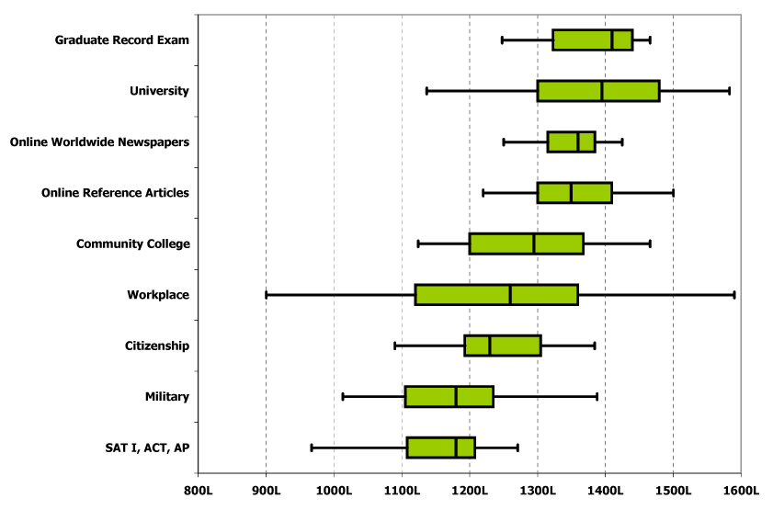
College and career readiness
A text-based perspective using Lexile measures

Slide 21
Real-world text demands
English-language online newspapers
1340L Times of India
1350L Japan Times
1360L Chosun Ilbo (Korea)
1370L Arab News (Saudi Arabia)
1380L Santiago Times (Chile)
1400L China Daily
1400L The Moscow Times (Russia)

Slide 22
Lexile measures and the workplace
•
scientist
15
•
accountant
14
•
teacher
13
•
executive
12
•
nurse
11
•
supervisor
10
•
sales
9
•
8
secretary
7
•
foreman
Job Level
6
•
5
•
clerk
4
craftsman
•
construction
3
•
2
service
1
•
labor
0
700L
900L
1100L
1300L
1500L
Reader measure (Lexile measure)
Data: National Adult Literacy Study (1992)

Slide 23
On the Job Lexile Requirements
1500L
1400L
1300L
1200L
1100L
1000L
900L
800L
National Adult Literacy Study 1992
International Center for Leadership in Education 2006
Construction
Craftsman
Nurse
Sales
Secretary

Slide 24
Text demands in the workplace
Career Clusters | Lexile® Measures
Agriculture/Nat.Resources | 1270L – 1510L
Architecture/Construction | 1210L – 1340L
Business and Administration | 1210L – 1310L
Hospitality and Tourism | 1230L – 1260L
Law and Public Safety | 1420L – 1740L
Manufacturing | 1200L – 1310L

Slide 25
Text demands in the workplace
Text demand of jobs can be measured to set reading requirements of the worker.
Document | Lexile® Measure
Business Ethics | 1460L
Code of Conduct | 1270L
Bonus Program | 1240L
Safe Practices | 1250L

Slide 26
Lexile Calculator
Forecasted comprehension rates:
  Reader measure – text measure = 0 75%
  Reader measure – text measure = -250 50%
  Reader measure – text measure = +250 90%
  Example:
  Reader 1000L – Text 750L = 90% comprehension

Slide 27
Lexile study findings: TOEFL Junior
TOEFL Junior Reading Score | Lexile Measure | Reading Level (US)
280 - 300 | 1000L – 1160L | 7th 8th and 9th Grade
250 - 275 | 795L – 950L | 5th and 6th Grade
210 - 245 | 590L – 775L | 3rd and 4th Grade
Notes:
Grade ranges describe US readers, not text

Slide 28
Lexile Study Findings: TOEFL
TOEFL Reading Performance Level | TOEFL Reading Score | Lexile Measure | Reading Level (US)
High | 27 – 30 | 1490L – 1595L+ | Graduate School
High | 22 – 26 | 1315L – 1435L | College Jr/ Sr Yrs
Intermediate | 18 – 21 | 1215L – 1295L | 12th Grade
Intermediate | 15 – 17 | 1135L – 1190L | 10th Grade
Low | 9 – 14 | 1025L – 1110L | 8th Grade
Low | 0 – 8 | 855L – 1010L | 6th Grade
Notes:
Grade ranges describe US readers, not text

Slide 29
Lexile Study Findings: TOEIC (Japan)
TOEIC Reading Score | Lexile Measure | Reading Level (US)
455-495 | 1290L-1400L | College
355-450 | 1040L-1280L | High School
255-350 | 885L-1035L | 7th and 8th Grade
155-250 | 720L-875L | 5th and 6th Grade
60-150 | 510L-710L | 3rd and 4th Grade
Notes:
Grade ranges describe US readers, not text

Slide 30
Websites for using Lexile measures
All Users of Lexile Measures—
  http://www.lexile.com/fab/
TOEFL Junior users—
  http://toefljunior.lexile.com/en
TOEIC users—
  http://lerg.lexile.com/
TOEFL users—
  http://www.lexile.com/toefl/

Slide 31
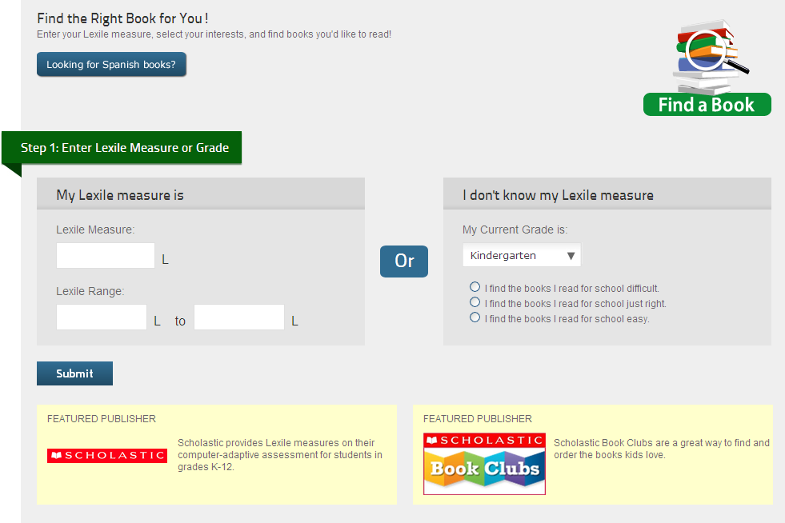

Slide 32
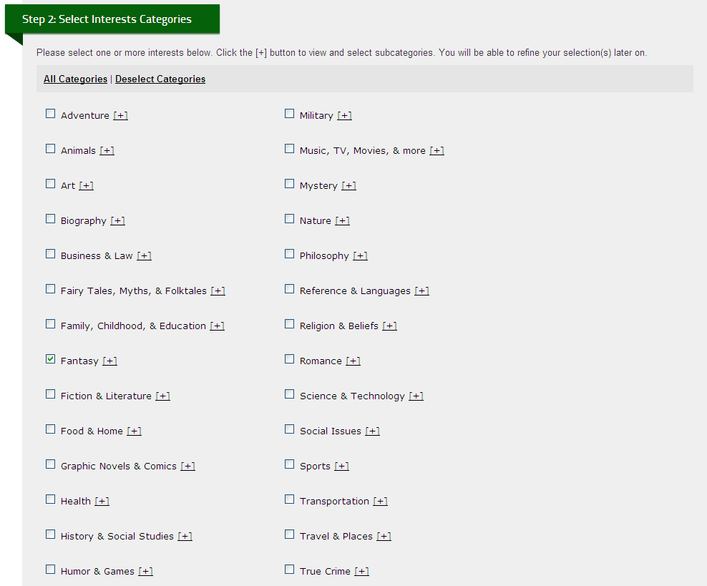

Slide 33
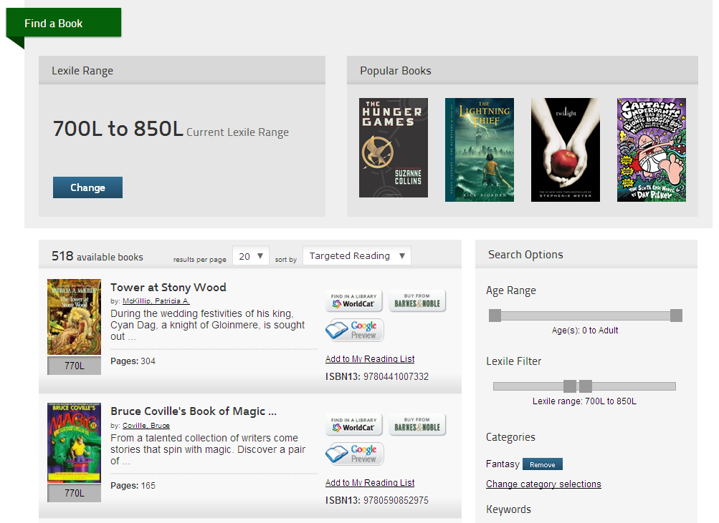

Slide 34
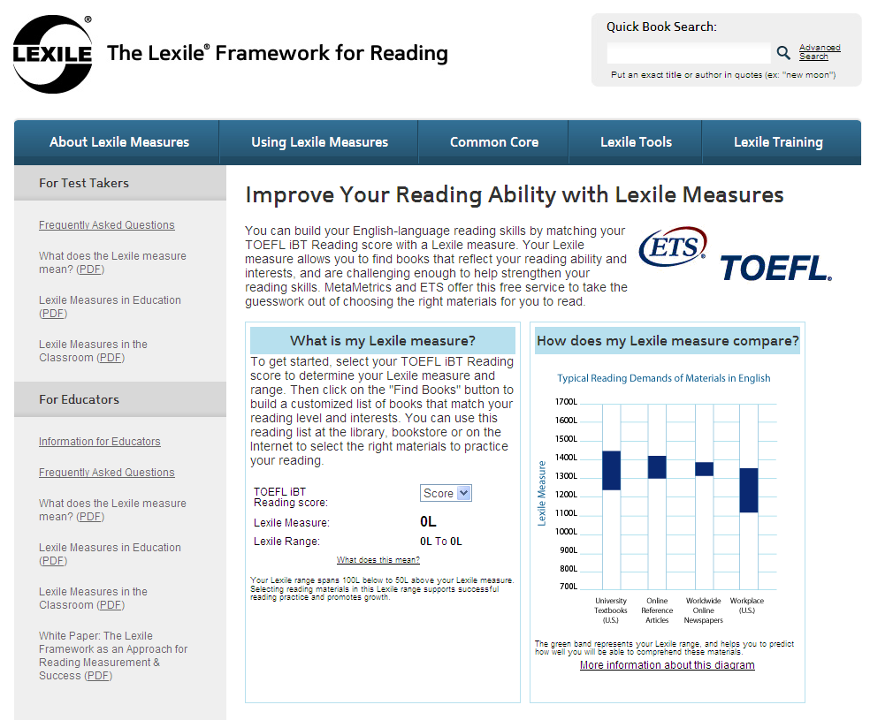
Tools for Building English Reading Skills
TOEFL test takers:
Match a TOEFL iBT Reading score with a Lexile® measure and then use the free “Find a Book” search utility to build custom English reading lists.
www.lexile.com/ TOEFL

Slide 35
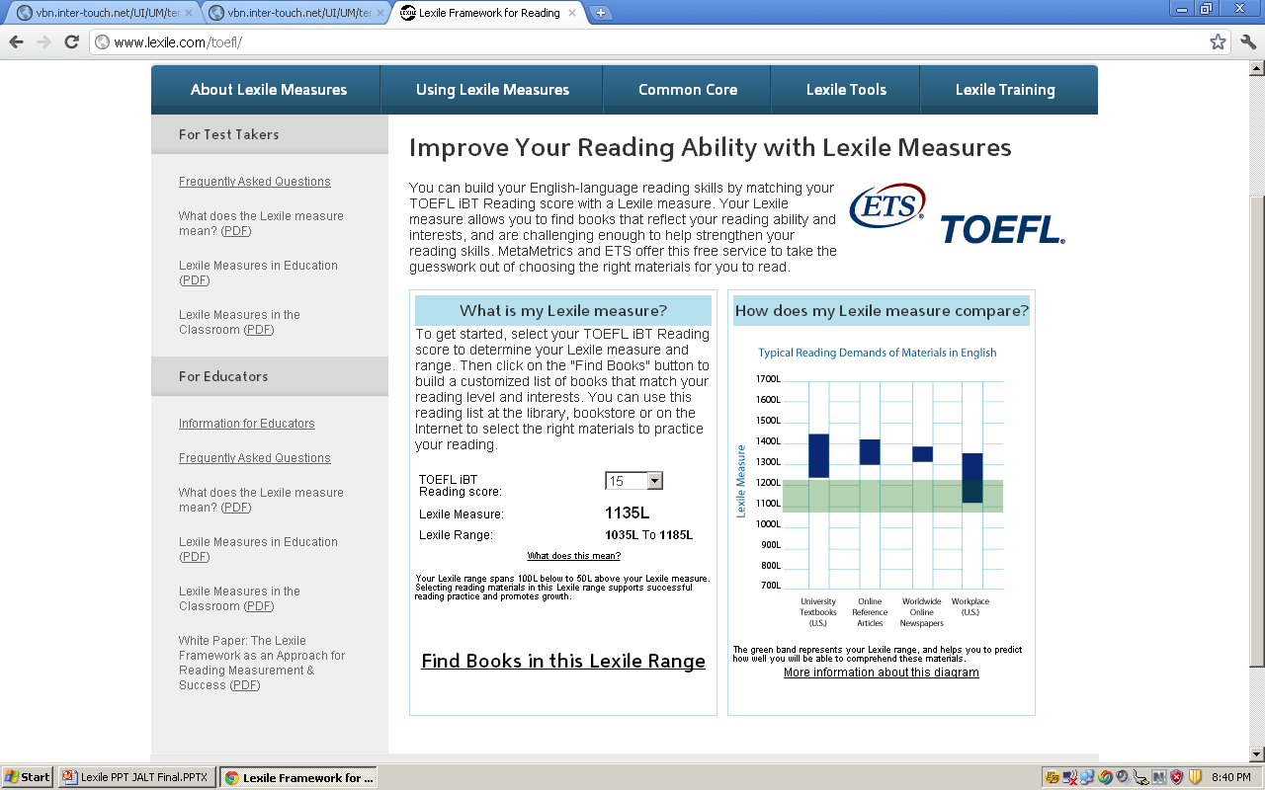

Slide 36
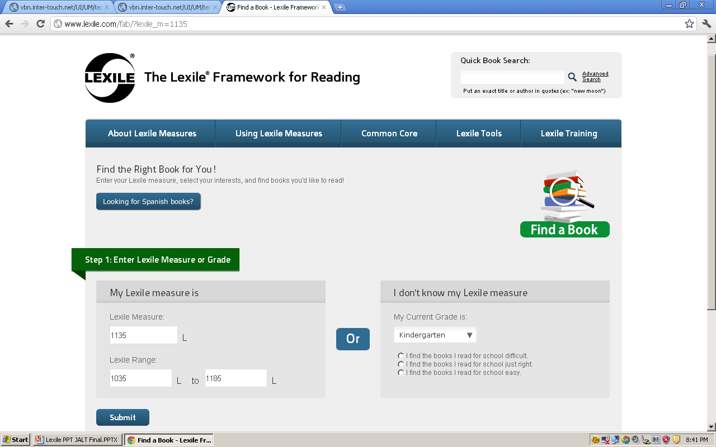

Slide 37
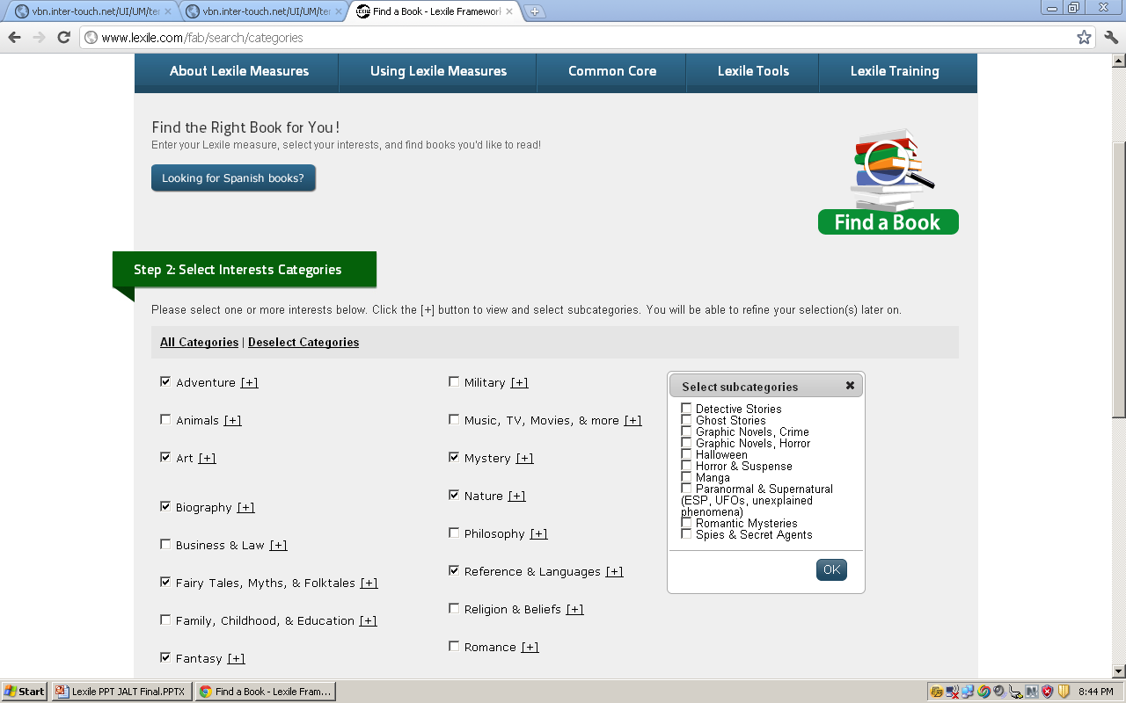

Slide 38
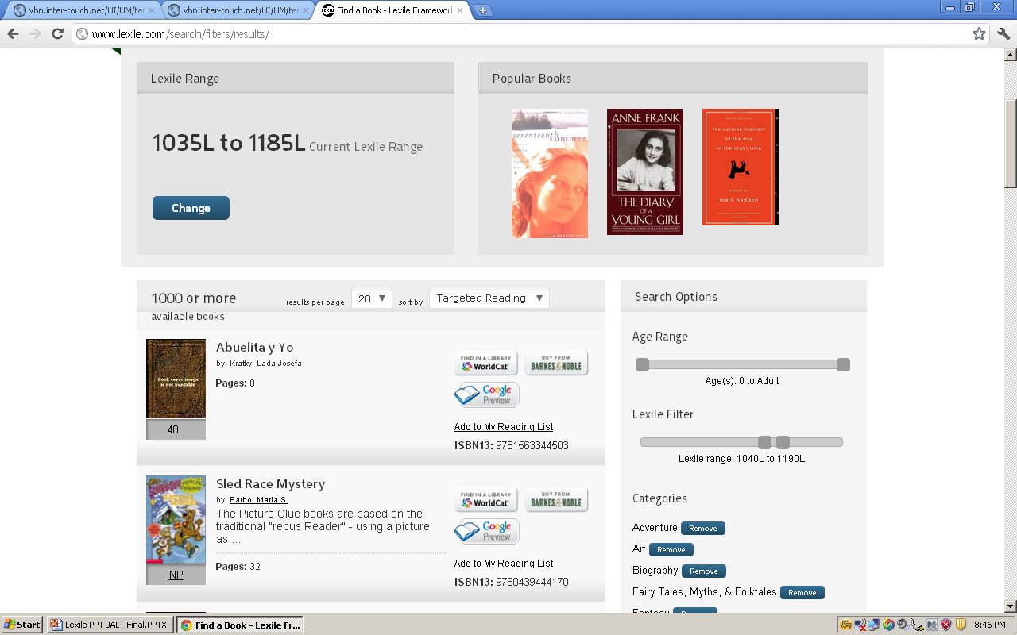

Slide 39
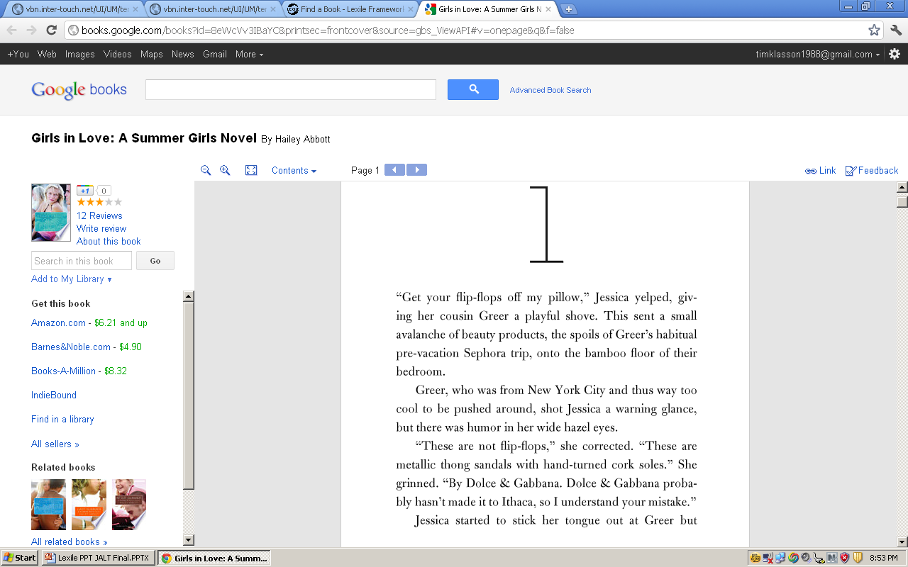

Slide 40
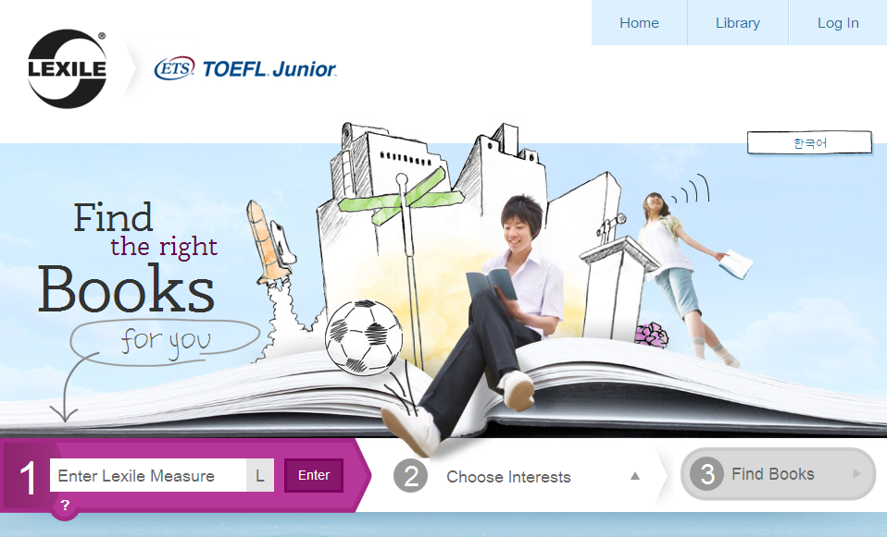
Tools for Building English Reading Skills
TOEFL Junior test takers:
Use the Lexile® measure provided
on the TOEFL Junior score report to find English books at the right level and on topics of interest.
http://toefljunior.lexile.com

Slide 41
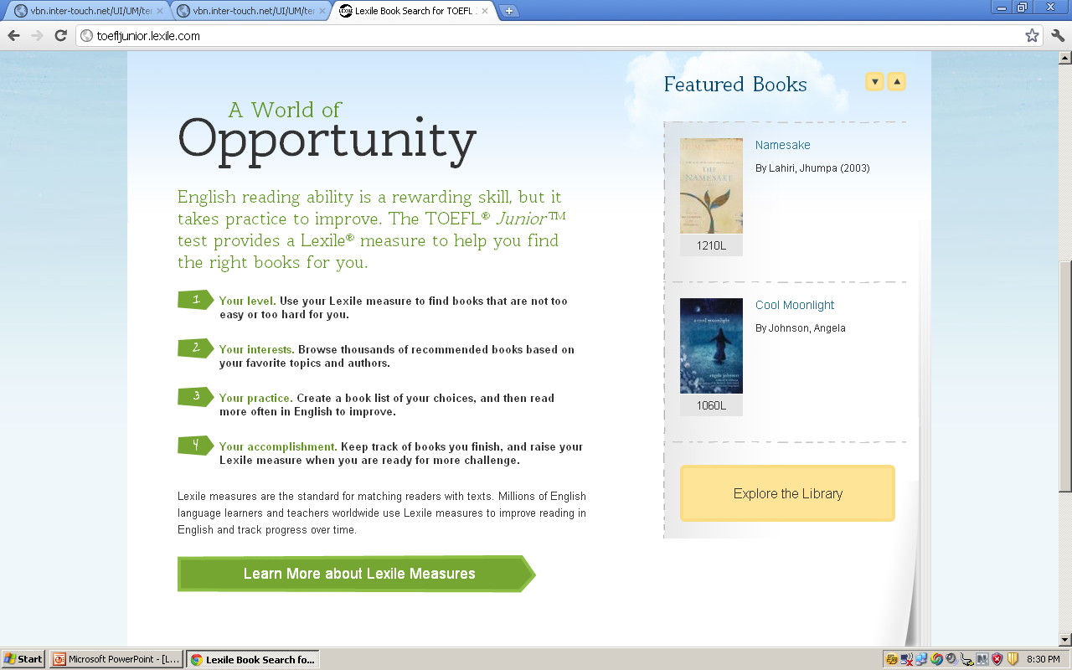

Slide 42
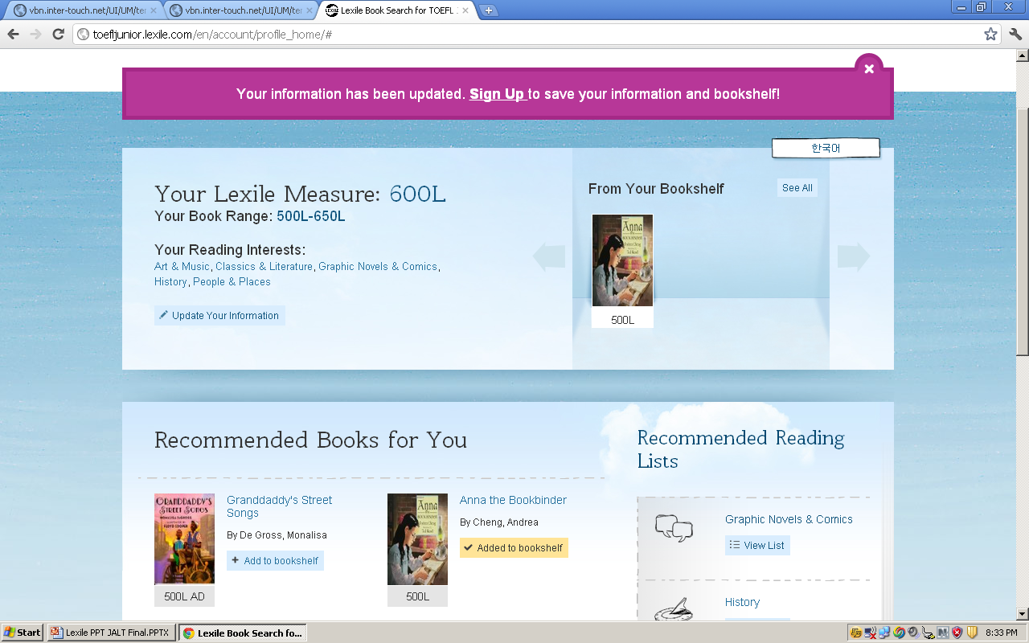

Slide 43
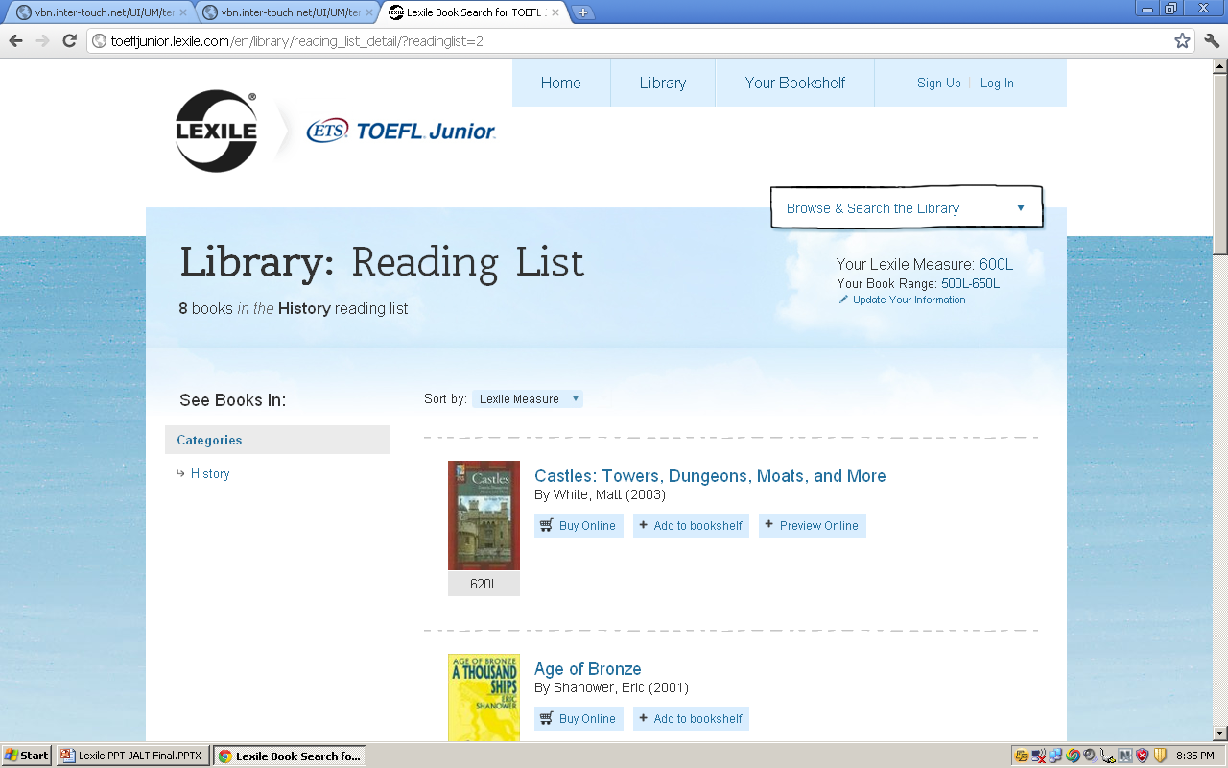

Slide 44
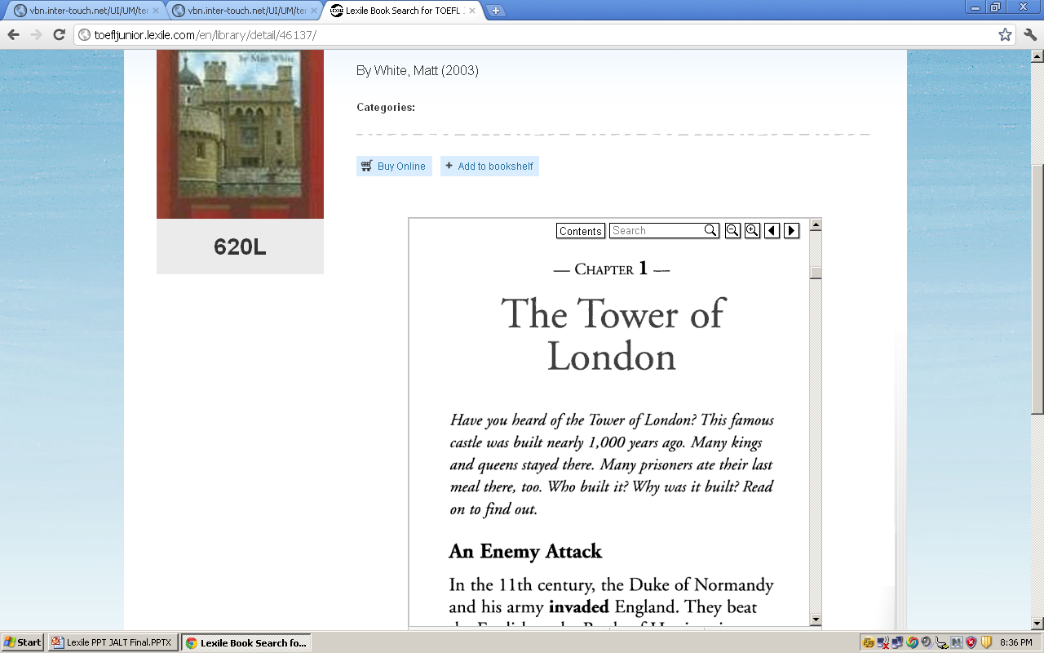

Slide 45


Slide 46
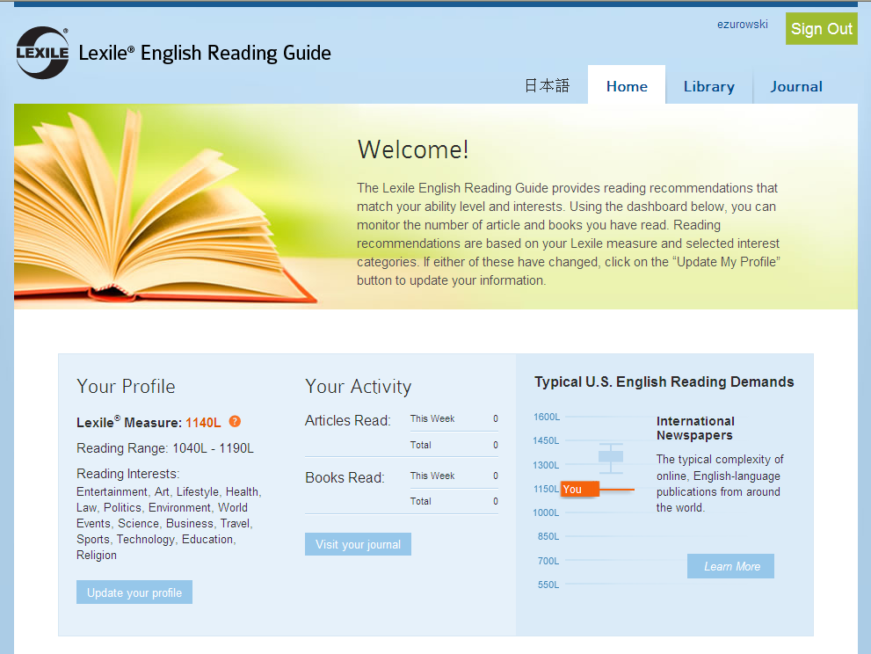
Tools for Building English Reading Skills
TOEIC test takers
(in Japan only through IIBC’s TOEIC Internet Services):
Use the Lexile® English Reading Guide to match a TOEIC Reading score with a Lexile measure and then receive daily book and article recommendations to support English reading practice.
http://lerg.lexile.com

Slide 47
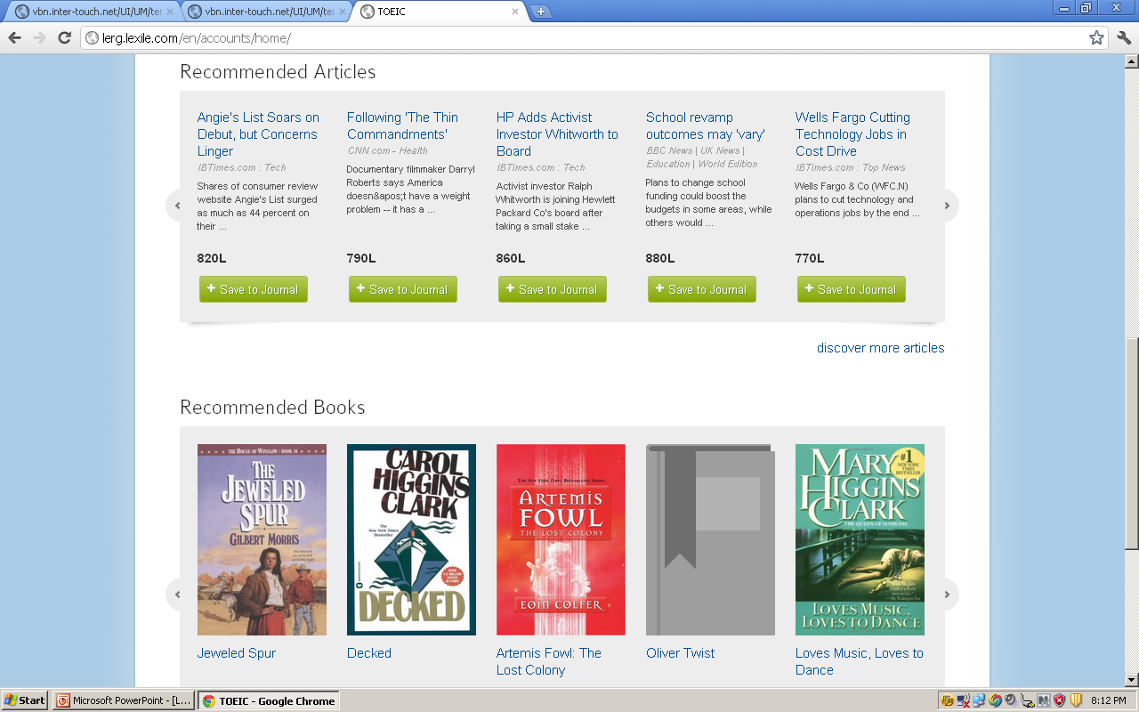

Slide 48
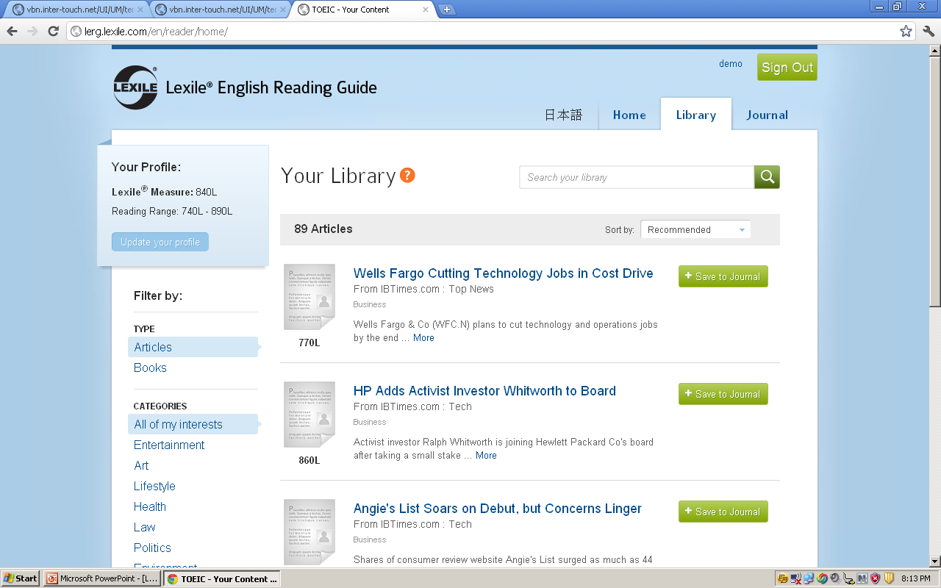

Slide 49
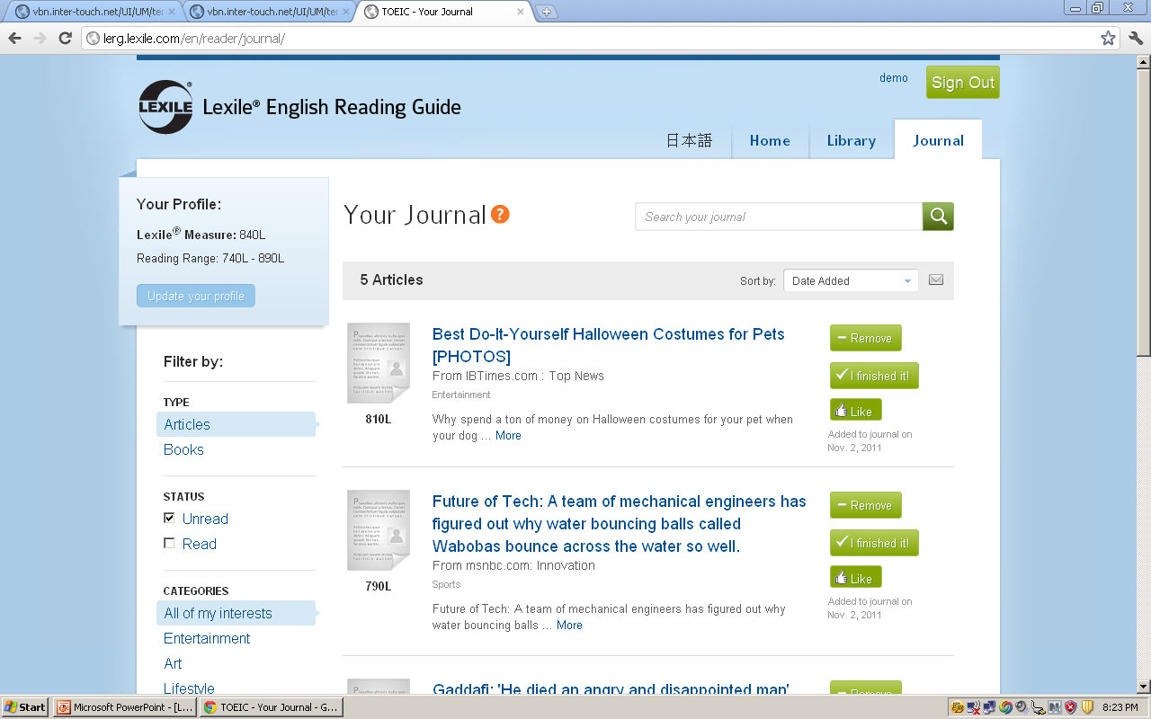

Slide 50
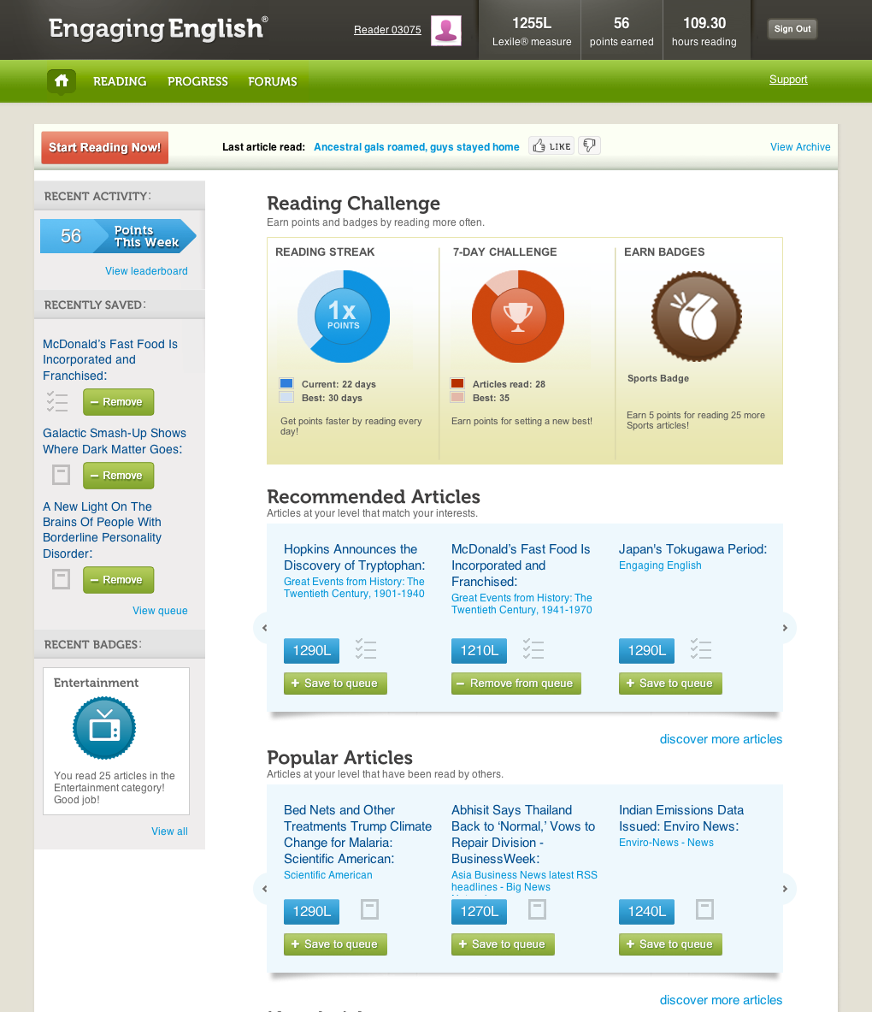
Tools for Building English Reading Skills
All Language Learners:
Engaging English® provides unlimited access to high-interest Web articles at the right level and monitors English reading growth
in real time to help language learners achieve their goals.
www.EngagingEnglish.com

Slide 51
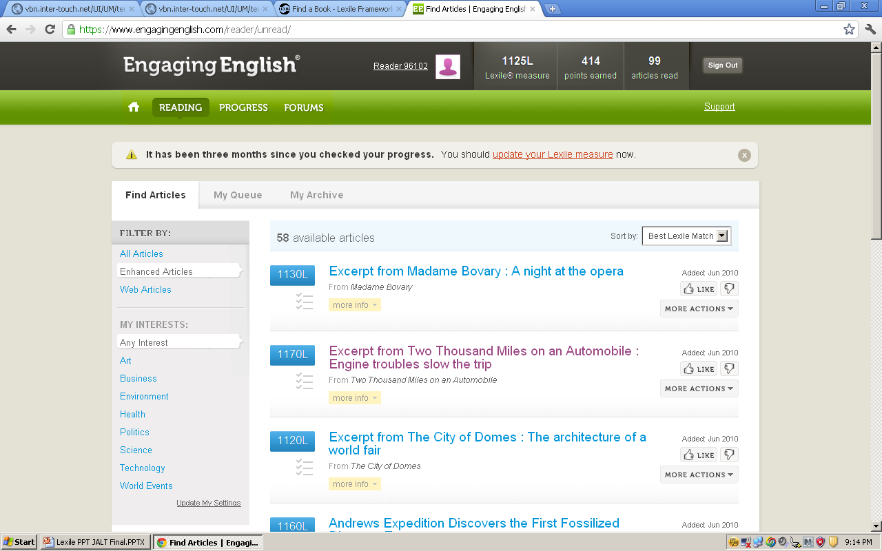

Slide 52
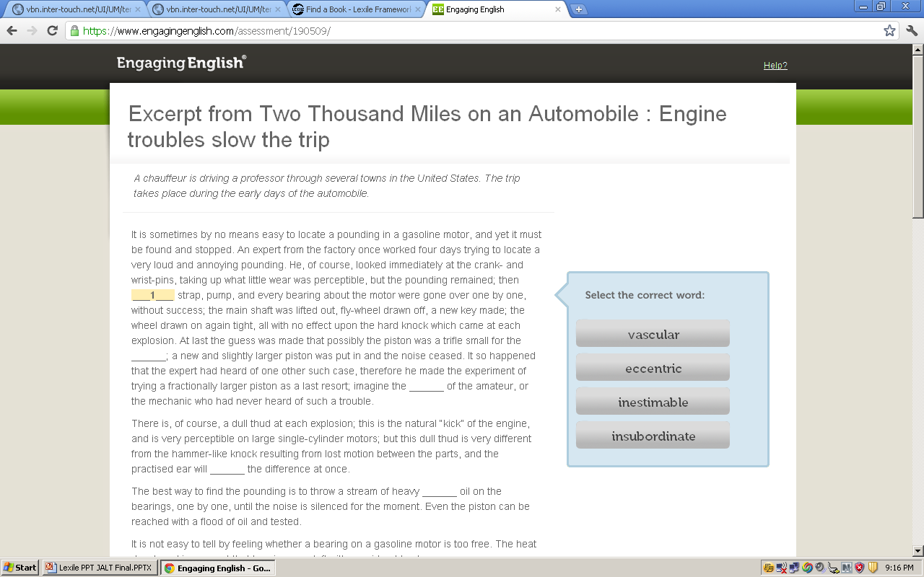

Slide 53
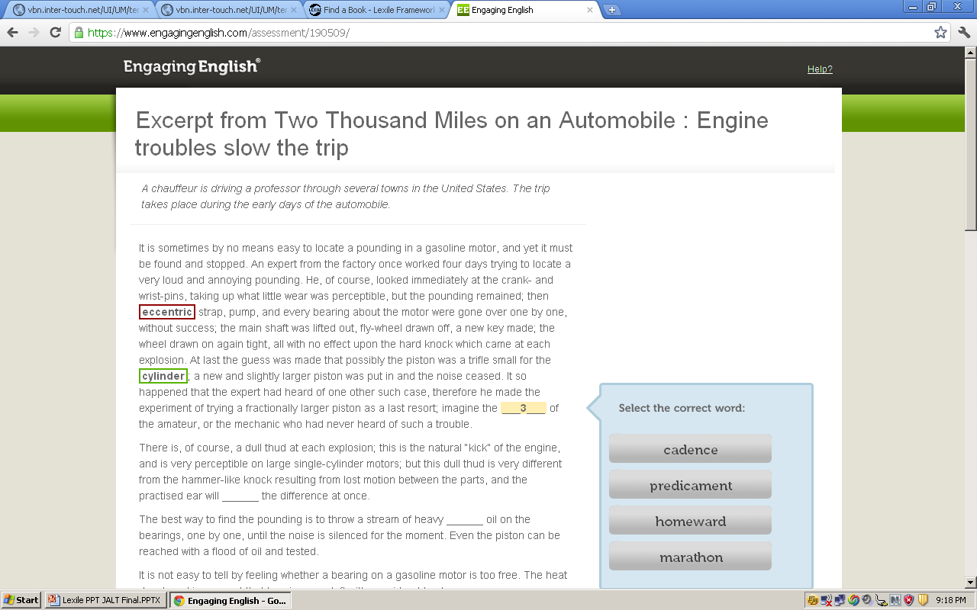

Slide 54
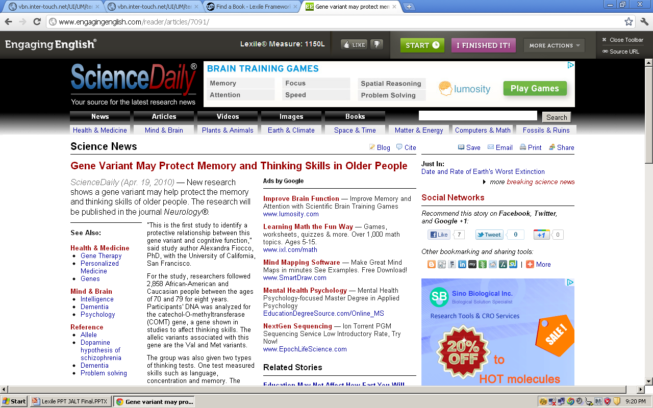

Slide 55
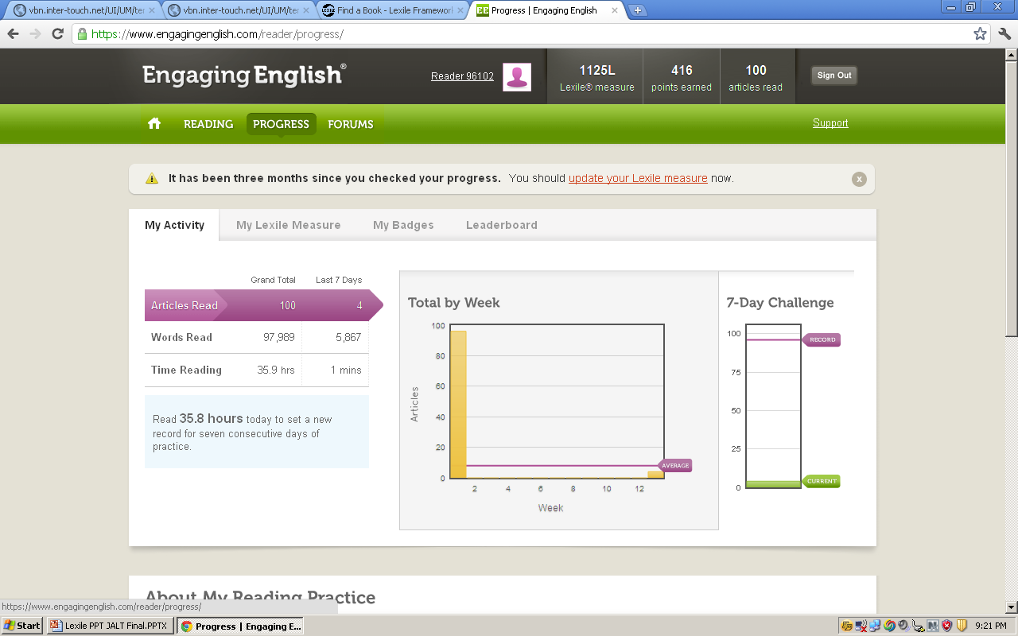

Slide 56
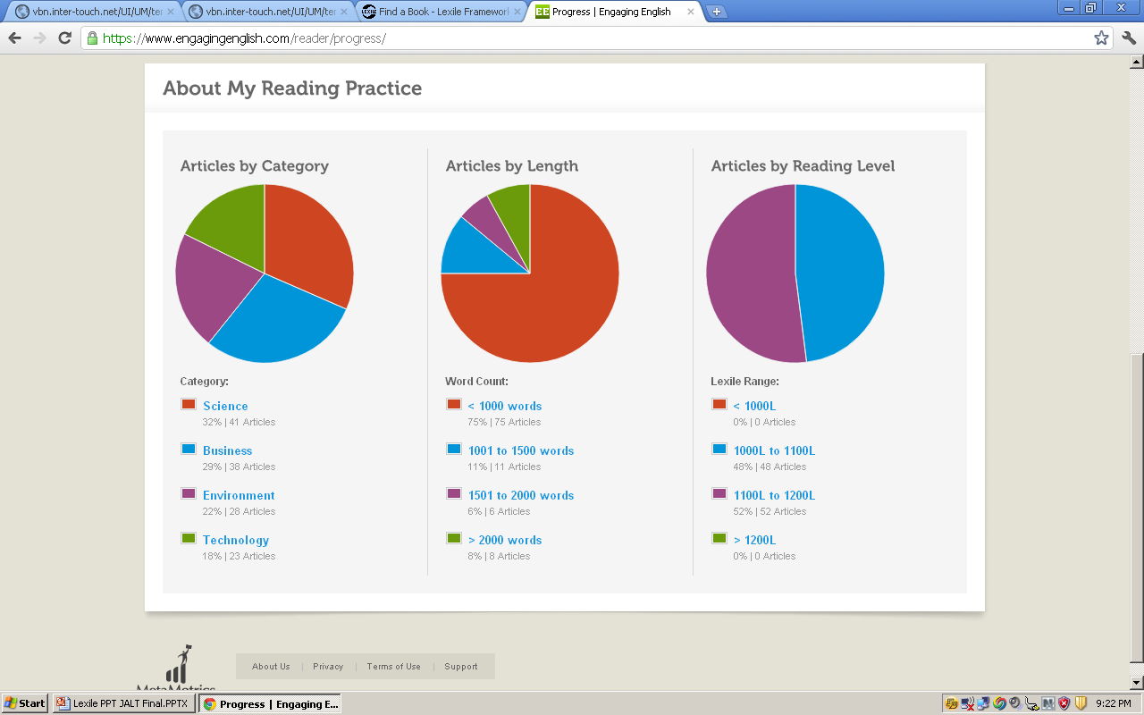

Slide 57
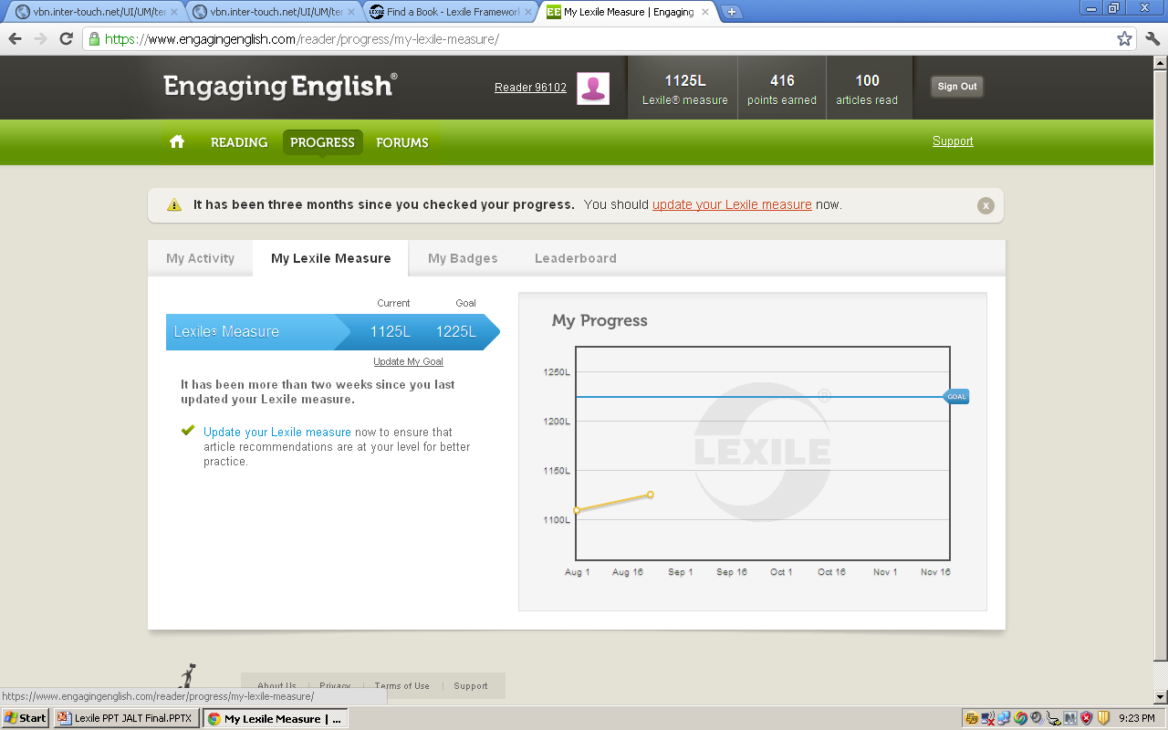

Slide 58
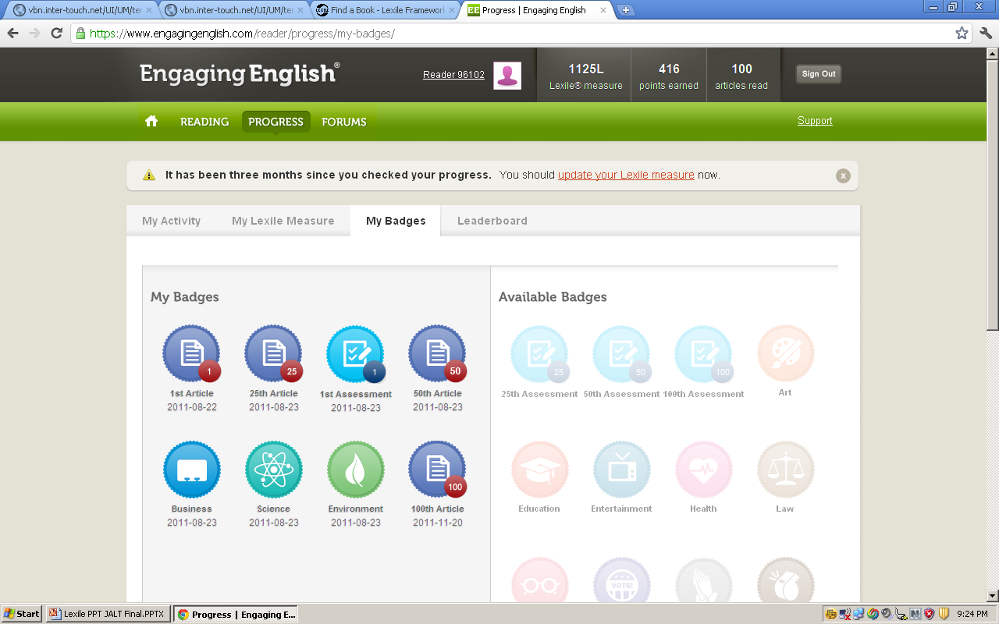

Slide 59
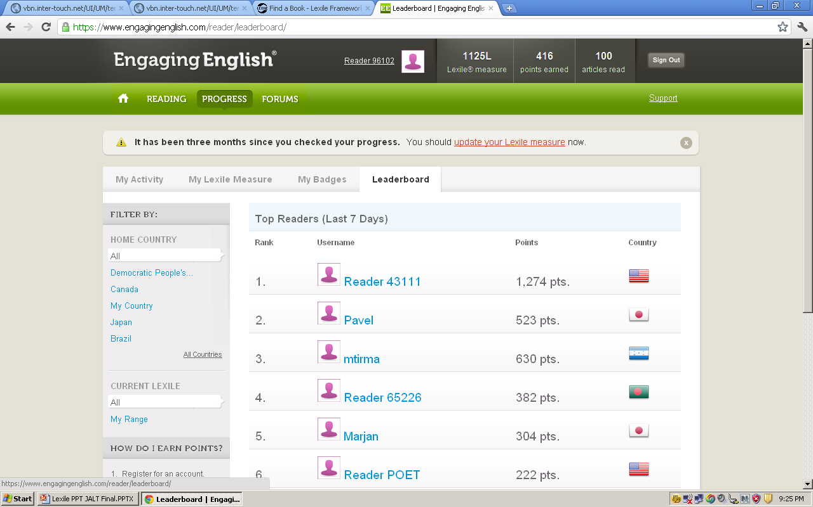

Slide 60
Research¹ suggests that a novice develops into an expert through an intricate process that includes:
Targeted practice in developmentally appropriate activities
Real-time corrective feedback based on performance
Intensive practice daily basis to monitor ability
Distributed practice over 5–10 years
Self-directed practice when a teacher is not available
¹Glaser, 1996; Kellogg, 2006; Shea & Paull, 1996; Wagner & Stanovich, 1996
Notes:
60
60

Slide 61
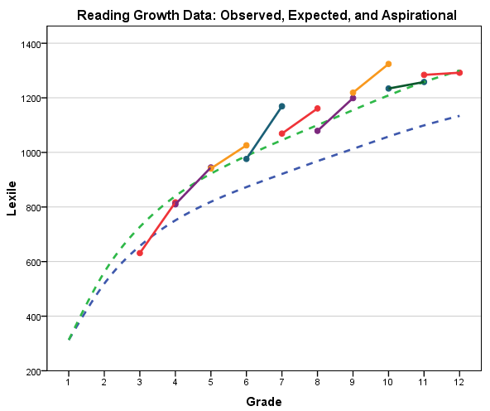
Expected
Aspirational
Observed by Cohort
Notes:
61

Slide 62
Summary
The text studies have shown a gap between secondary and postsecondary reading demands, leading to the U.S. Common Core State Standards.
Knowing the text demands of a domain can inform authentic goal setting and promote English reading achievement.
Using Lexile measures to match reader and text optimizes learning.

Slide 63
Contact Us
For more information. . .
Online:
Visit www.lexile.com/feedback to submit
your questions to MetaMetrics
Email:
Tim Klasson: tklasson@Lexile.com
Trilby Berger: tberger@Lexile.com

