Slide 1
Promoting College and Career Readiness for All Students
Malbert Smith III, Ph.D.
President, MetaMetrics
Research Professor, UNC School of Education

Slide 2
Agenda
The Goal
The Problem
Bridging the Readiness Gap
Bending the Curve: Eliminating Summer Loss

Slide 3
“If we can dramatically increase high school graduation rates, if we can dramatically increase the number of graduates who are college and career ready, that’s what this is about. Everything’s a means to that end. That’s the Holy Grail here. Are our students being prepared to be successful?” – Arne Duncan
Education Week, December 9, 2009.

Slide 4
Quick Facts
Each year, approximately 1.2 million students fail to graduate from high school, more than half of whom are from minority groups.
Percent of freshmen that enroll in at least one remedial course
Community College | Four-Year Institution
42% | 20%
Alliance for Excellent Education, February 2009 edition.

Slide 5
Students Obtaining Bachelor’s Degree
in Eight Years
Students who enroll in
a remedial reading
course are 41 percent
more likely to drop
out of college.
(NCES, 2004a)
Alliance for Excellent Education, February 2009 edition.

Slide 6
“High school completion does not equal college readiness.”
– Education Week
Gewertz, Catherine. “College-Readiness Program Hard to Gauge." Education Week 30.18 (2011): 1+. Print

Slide 7
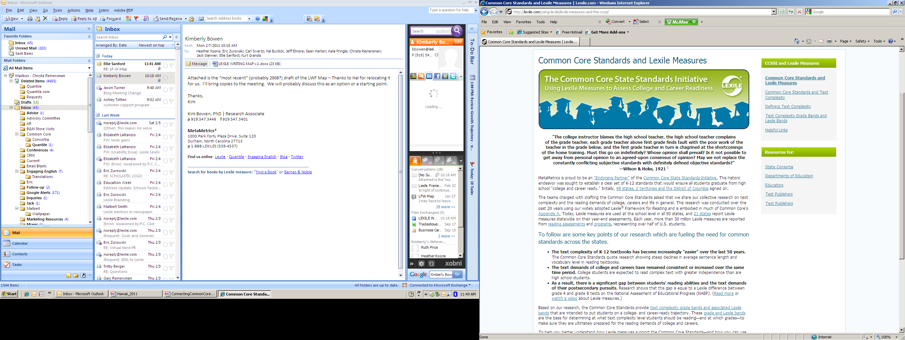

Slide 8
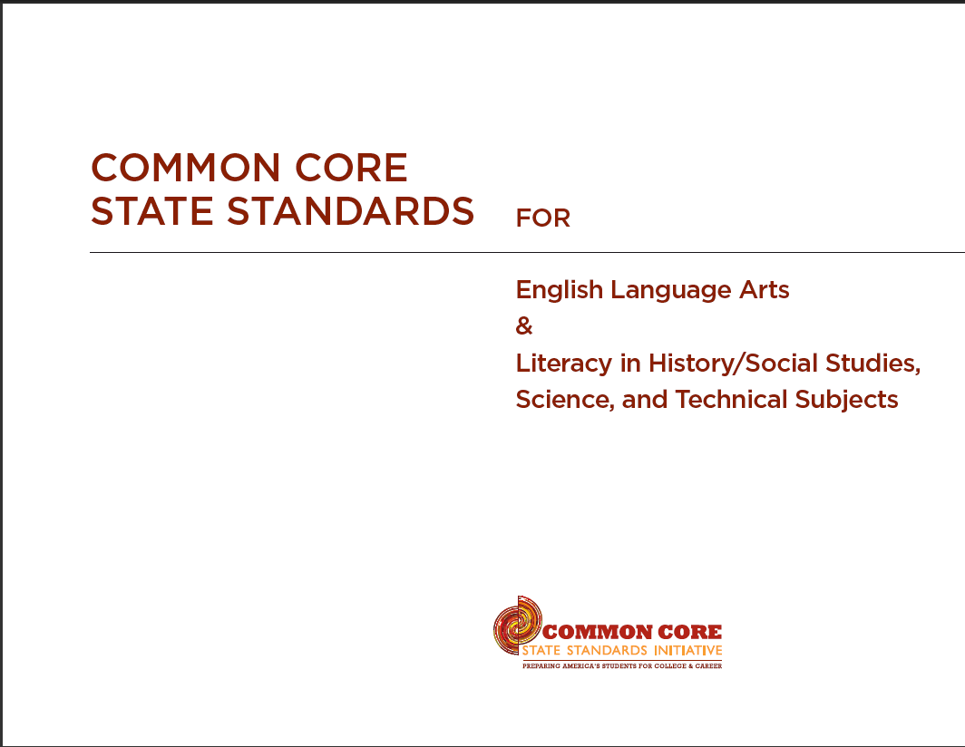

Slide 9
Common Core Standards for English Language Arts and Literacy in History/Social Studies & Science
Appendix A: Findings
Students who fall short of ACT's college readiness benchmarks have the greatest difficulty with the test items involving the most complex text.
K-12 reading assignments have become much less demanding in the last half-century, with an especially large drop-off in high school expectations.
Weston, S. P. (2010). “The giant text complexity challenge inside the new literacy standards.” The Prichard Committee for Academic Excellence

Slide 10
Common Core Standards for English Language Arts and Literacy in History/Social Studies & Science
Appendix A: Findings
College reading assignments have moved in the opposite direction, becoming a bit harder over the same fifty years.
High school teachers commonly give students many kinds of support and coaching to help them figure out the material, but college teachers expect students to pull the knowledge from the text on their own, making the gap in practical ability even wider than the gap in the texts themselves.

Slide 11
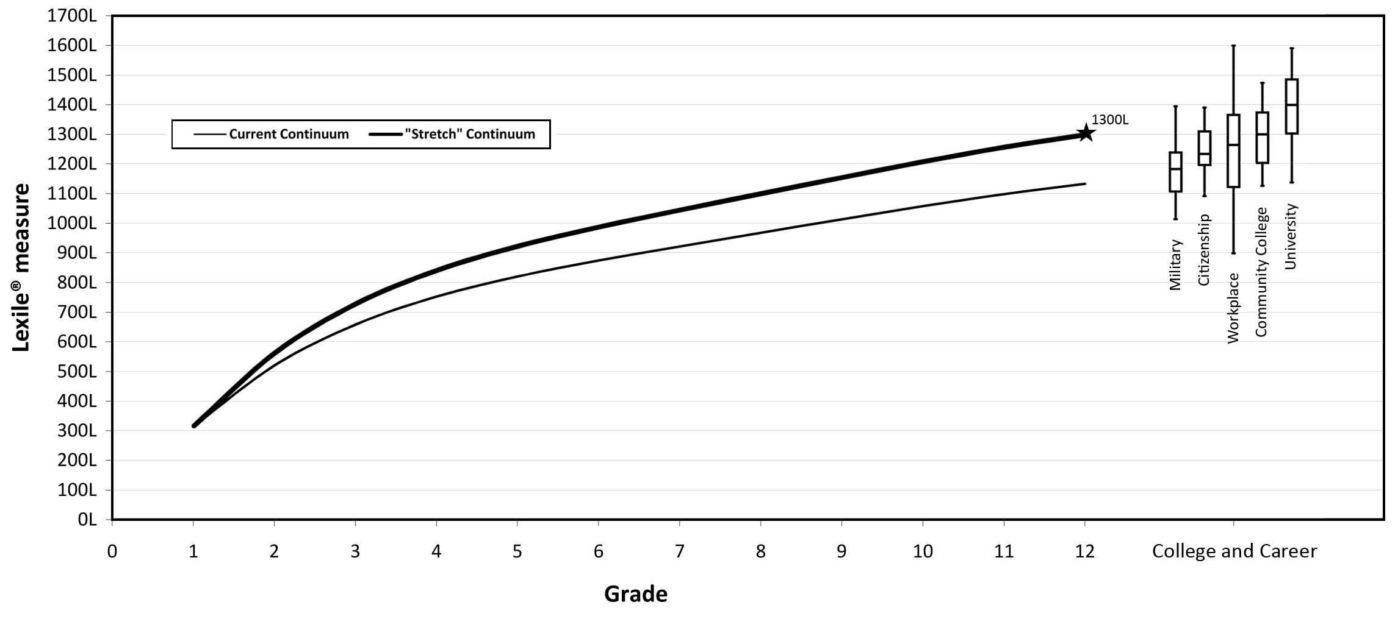
Text Gap

Slide 12
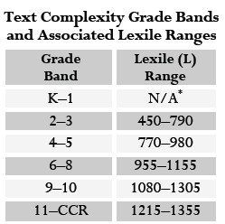
Common Core Appendix A

Slide 13
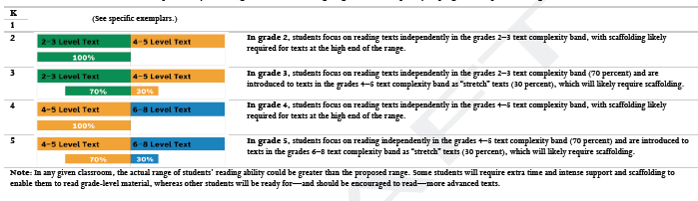
Common Core Standards
The Lexile measure helps determine
  What text is appropriate for each grade band.
  What is “stretch text?”

Slide 14
Ensuring Students Are College and Career Ready
Mitigate summer loss
Increase the diet of non-fiction text
Utilize instructional tools and resources that promote differentiated instruction and deliberate practice

Slide 15
Estimated Cumulative Differences in Language Experience by 4 Years of Age
Professional Family
50_
40_
Working-Class Family
Estimated Cumulative Words
Addressed to Child
(in millions)
30_
20_
Welfare Family
10_
12
24
36
48
Age of Child in Months

Slide 16
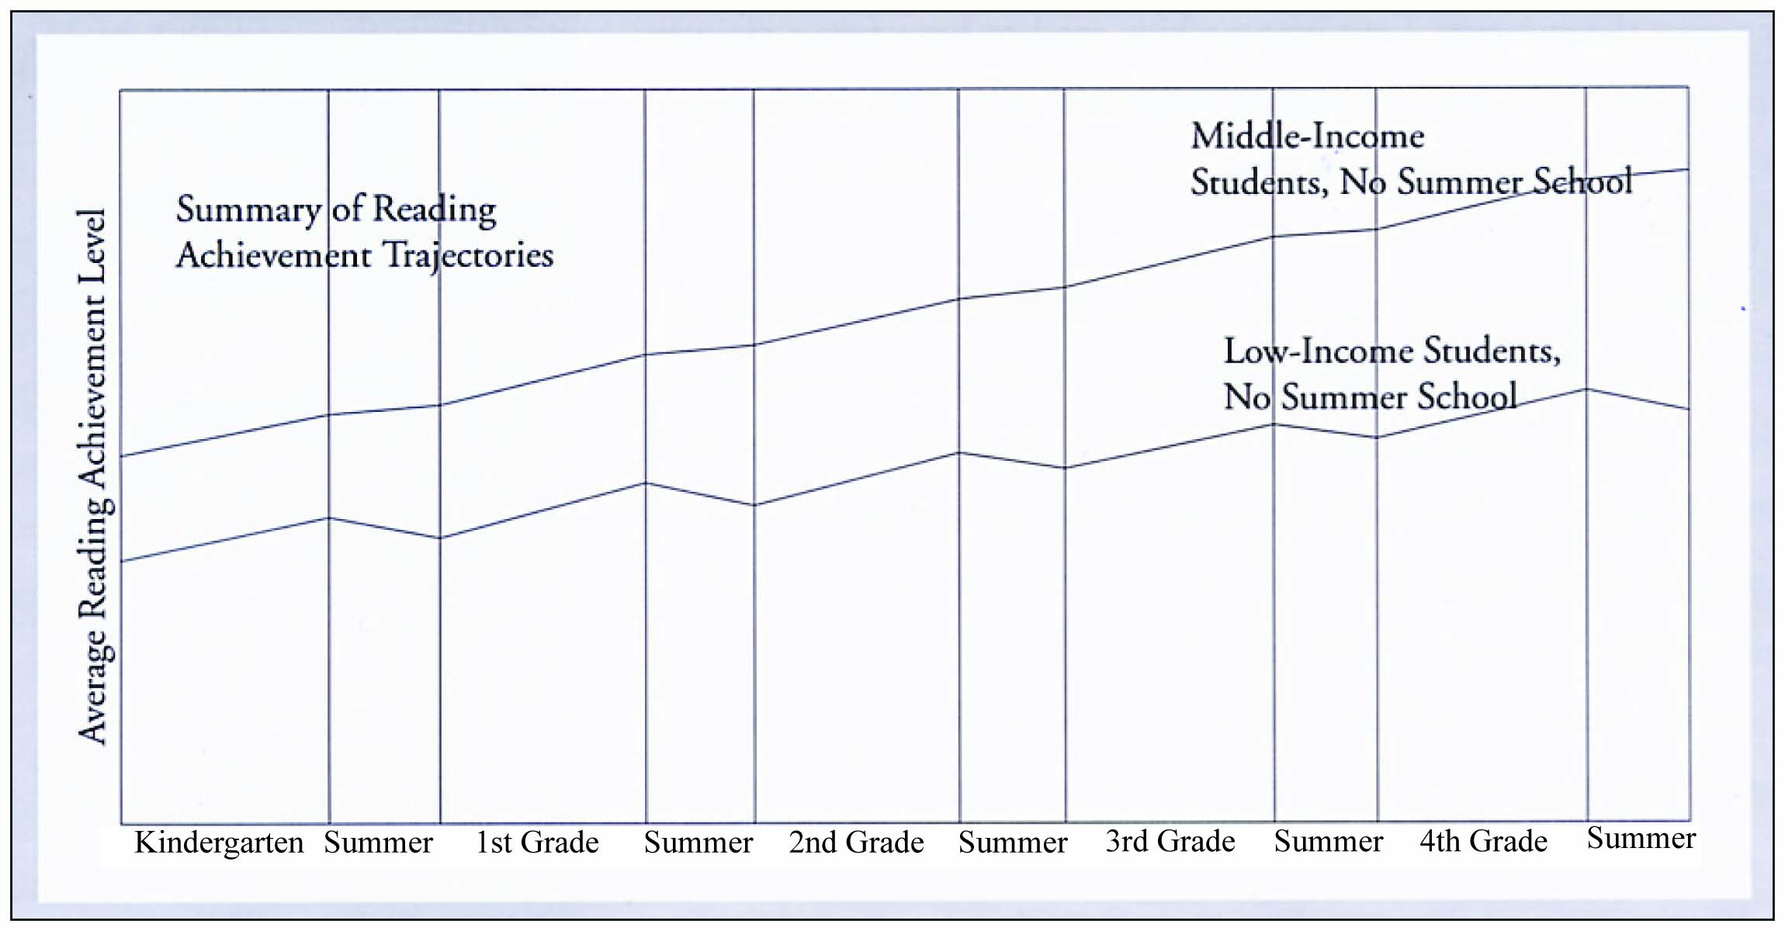
Mitigate Summer Learning Loss
Fairchild, R. McLaughlin, B. & Brady, J. (2006). Making the Most of Summer: A Handbook on Effective Summer Programming and Thematic Learning. Baltimore, MD: Center for Summer Learning.

Slide 17
Mitigate Summer Learning Loss
Cumulative Effect of Summer Loss
Summer Loss Research by Dr. James Kim
“Find a Book”

Slide 18
Effects of a Voluntary Summer Reading
Intervention on Reading Achievement
Results From a Randomized Field Trial
Key Points
Eight books at:
  Interest Category
  Lexile Level
Kim, J.S. (2005). Project READS (Reading Enhances Achievement During Summer): Results from a Randomized Field Trial of a Voluntary Summer Reading Intervention.

Slide 19
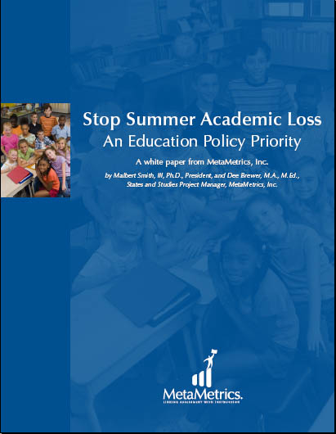
White Paper: Stop Summer Academic Loss

Slide 20

“Find a Book”
Search for books by Lexile measure, title, author, ISBN, or keyword.

Slide 21
“Find a Book”
Search for books by Lexile measure, title, author, ISBN, or keyword.
Students who do not have a Lexile measure can use a quick and simple
utility within “Find a Book” to estimate their Lexile range.

Slide 22
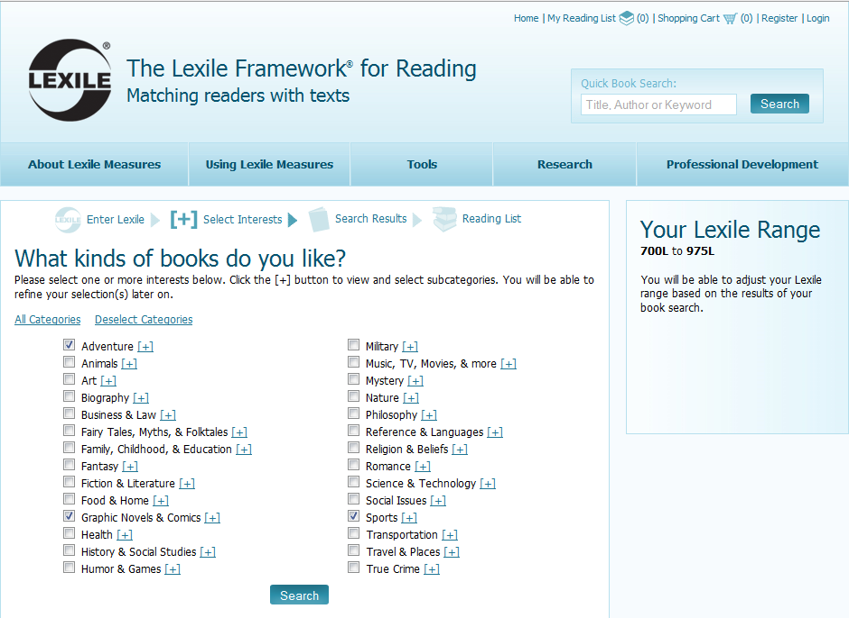

Slide 23
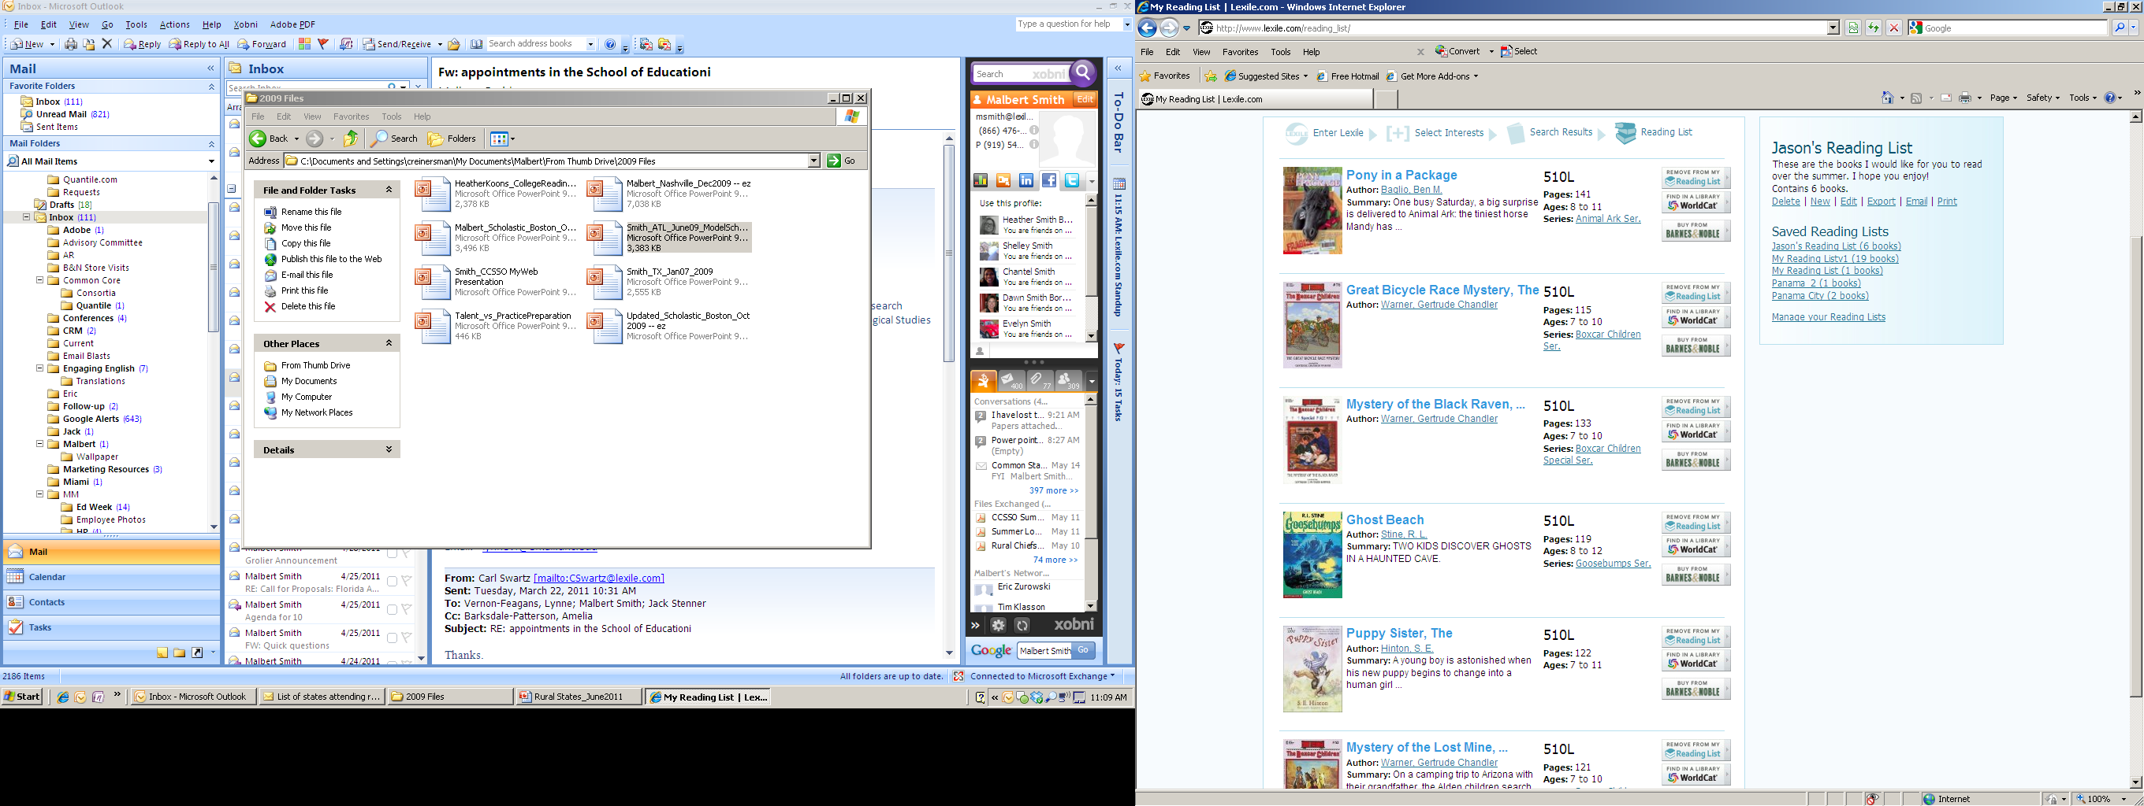
“Find a Book”
Search for books by Lexile measure, title, author, ISBN, or keyword.

Slide 24


Slide 25


Slide 26
Increase the Diet of Non-Fiction Text
Duke, Nell K. “The Real-World Reading and Writing U.S. Children Need.” Phi Delta Kappan 91, no. 5 (February 2010): 68-71.
PIRLS 2001 International Report: IEA’s Study of Reading Literacy Achievement in Primary Schools, Mullis, I.V.S., Martin, M.O., Gonzalez, E.J., & Kennedy, A.M. (2003), Chestnut Hill, MA: Boston College.

Slide 27
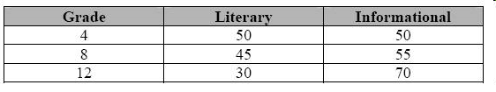
Percentage distribution of literary and informational passages
National Assessment Governing Board. Reading Framework for the 2009 National Assessment of Educational Progress. Washington, D.C.: American Institutes for Research, 2007.

Slide 28
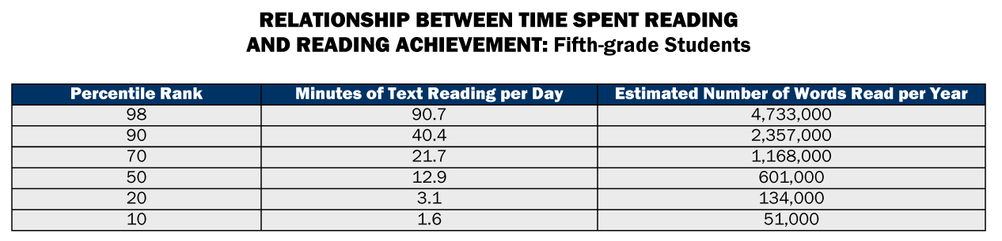
How can we do better?
Anderson et al., 1988, Table 3, N=155

Slide 29
Estimating the Impact of Family and Home on Student Achievement
Single-Parent Families
Parents Reading to Children Every Day
Hours Spent Watching Television
Frequency of School Absences
Educational Testing Service (www.ets.org)

Slide 30
Percentage of Children in Single-Parent Families,
by State, 2004
Alaska 30% Delaware 35% Idaho 23% Iowa 24% Kansas 24% Minnesota 24% Montana 27% Nebraska 23% New Mexico 38% North Dakota 24% South Dakota 27% Vermont 26% West Virginia 29% Wyoming 27%
Courtesy of: Educational Testing Service (www.ets.org)
* All states were listed. A sample of states were taken for this slide.

Slide 31
Percentage of Children Who Were Read to Every Day in the Past Week, 2003
Alaska 50% Delaware 53% Idaho 49% Iowa 53% Kansas 51% Minnesota 57% Montana 51% Nebraska 49% New Mexico 43% North Dakota 47% South Dakota 47% Vermont 68% West Virginia 54% Wyoming 53%
Courtesy of: Educational Testing Service (www.ets.org)
* All states were listed. A sample of states were taken for this slide.

Slide 32
Percentage of Eighth-Graders Watching Four or More Hours of Television per School Day, 2000
Idaho 13% Kansas 13% Minnesota 10% Montana 8% Nebraska 14% New Mexico 18% North Dakota 10% Vermont 11% West Virginia 22% Wyoming 12%
Courtesy of: Educational Testing Service (www.ets.org)
* All states that took the NAEP were listed. A sample of states were taken for this slide.

Slide 33
Percentage of Eight-Graders Who Are Absent Three Days of More per Month, by State, 2005
Delaware 24% Idaho 20% Iowa 18% Kansas 19% Minnesota 21% Montana 25% Nebraska 20% New Mexico 25% North Dakota 19% South Dakota 19% Vermont 19% West Virginia 22% Wyoming 27%
Courtesy of: Educational Testing Service (www.ets.org)
* All states were listed. A sample of states were taken for this slide.

Slide 34
Parent-Teacher Meetings, School Websites, School Bulletins, etc.
Emphasize the Importance of:
  Attendance
  Restricting TV
  Reading / Writing at home

Slide 35
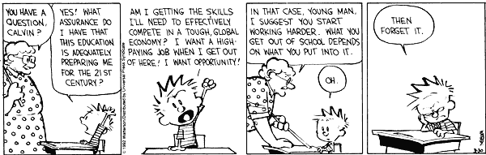
Courtesy of: http://picayune.uclick.com/comics/ch/1992/ch920330.gif

Slide 36
Contact Info:
Malbert Smith III, Ph.D.
President, MetaMetrics
Research Professor, UNC School of Education
msmith@Lexile.com

