Slide 1
Individual Centered Growth
PCRC
San Diego, California
February, 2012
A. Jackson Stenner
Chairman & CEO, MetaMetrics
Research Professor
University of North Carolina, Chapel Hill
jstenner@Lexile.com

Slide 2
A Paradigm Shift
“Most analysis efforts in learning and development still focus on data averaged across subjects. There is a growing realization of the limitations of this time-honored approach.” Molenaar and Newell, 2010.
“Nevertheless, in the social sciences researchers often discuss and interpret findings on the basis of population- or group-level variance, as if they applied to explaining causal processes at the individual level.” Loken, 2010.
“There is an exciting convergence occurring in the social sciences with increasing interest in single-subject designs and self-experimentation, awareness of the necessity for single-subject data to support the logic of scientific inference regarding the dynamics of change, and the availability of methods for the collection of continuous individual-level data.” Loken, 2010.

Slide 3
Reading and writing research seems to be almost exclusively focused on models that aggregate data across people. Evidence for effective instructional programs is typically focused on what is advantageous on average for a population. The issue is not whether such a strategy can ever uncover individual centered causal processes it is rather that it is rarely acknowledged that it may not. Stenner, 2012

Slide 4
What is Ergodicity?
Three assumptions must be met if findings based on between-person analyses can be applied to inferences about within person processes: (1) the same attribute is being measured at all time points for all persons, (2) there are no trends or cycles in the longitudinal data, and (3) a single function form for the growth trajectory (e.g. quadratic) is applicable for all persons.
Notes:
We will check whether these three assumptions are met when we turn up the power of the microscope when examining individual centered growth for a single reader.

Slide 5
What if the developmental process for reading is non-ergotic?
Then we error when we use models of between person variation to support inferences about within person developmental processes.
Notes:
Five year growth trajectories on 1000’s of persons suggest that:
The same reading construct is being measured across readers and across time.
There are different trends and cycles within some persons trajectories.
Different function forms are needed for different persons.

Slide 6
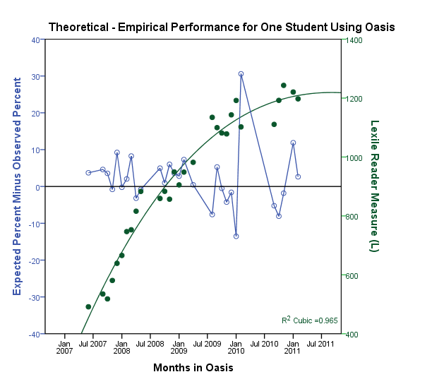
Student 1528
7th Grade
Male
Hispanic
Paid Lunch
May 2007 – April 2011
347 Encounters
138,695 Words
3,342 Items
983 Minutes
Text Demands for
College and Career
1600
1400
Expected: 73.5%
Observed: 71.7%
1200
1000
May 2016
(12th Grade)
Notes:
This is a real student
He read a Harry Potter length novels worth of informational text - 140,000 words over 30 months.
This is a completely individual centered picture – no data on any other student is needed to make this graphic
Note the college and career context. This is a text based description of our K-12 objective in reading. Explain in more detail if time permits.
The growth trajectory shows good fit
The projected HS graduation Lexile measure approaching1400L.
The monthly fit statistics (expected – observed) are within acceptable bounds. The learning system is in control
Ergodicity
Same construct assumption: expected-observed different is satisfactory 73.5%-71.7% = 1.8% off (Es = .08)
No trends or cycles: There is a summer fade cycle not easily seen on this graph. But note that data points following summer are regularly lower than the overall trajectory
Same function form assumption: Here a cubic, others are quadratic

Slide 7
Measurement Error
What is Known? | Individual Standard Error of Measurement
Student is in the District (grade unknown) | 400L
Only grade is known | 220L
One fifty item reading test score is known | 110L
3 ½ years of learning Oasis data Growth trajectory is known | 11L

Slide 8
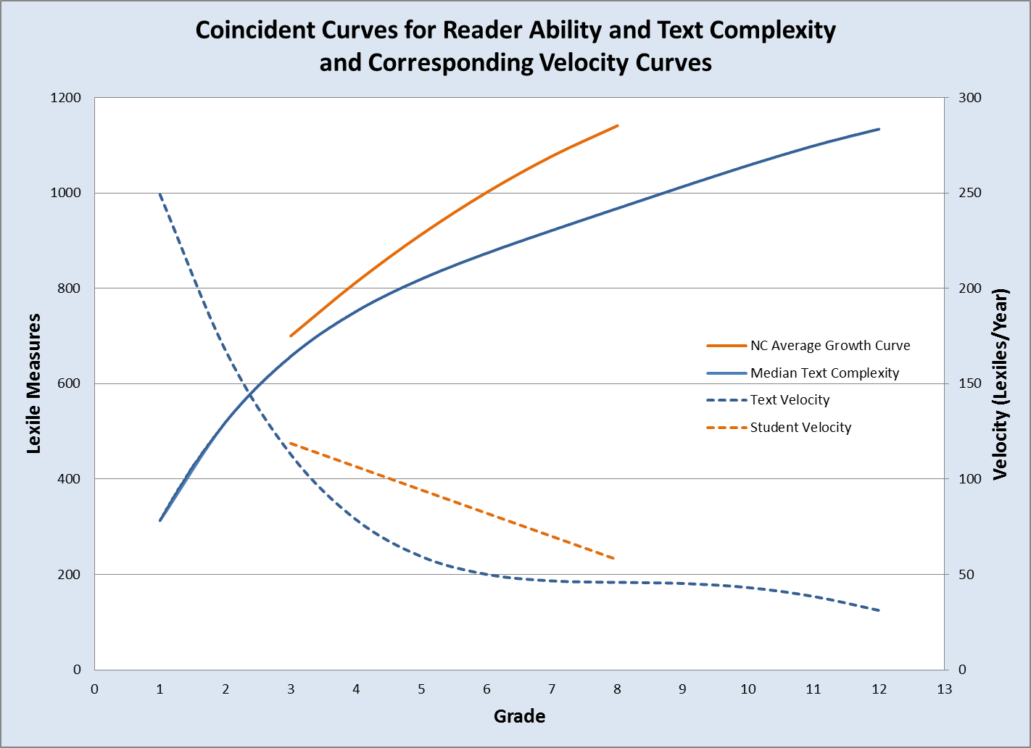

Slide 9
Contact Info:
A. Jackson Stenner.
Chairman & CEO, MetaMetrics
Research Professor, UNC, Chapel Hill
jstenner@Lexile.com

