Slide 1
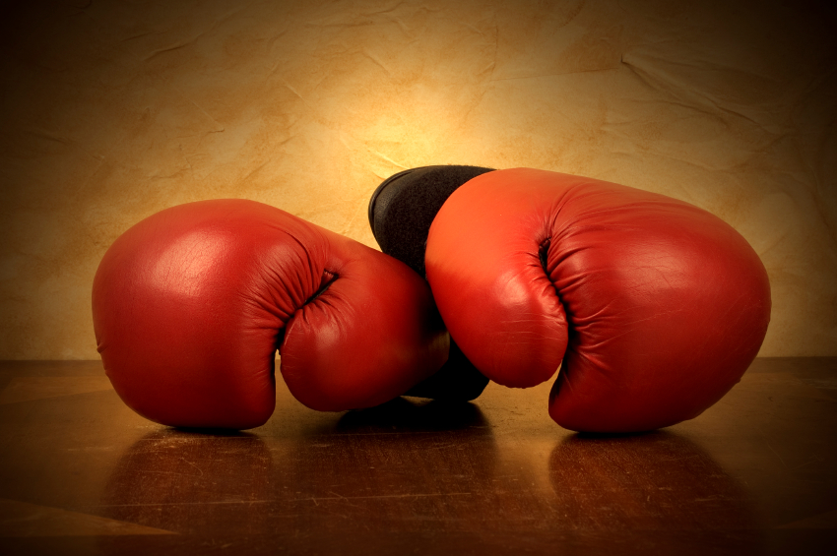

Legendary Marketing
Showdown

Slide 2
Presenters
Kipp Bodnar
Inbound Marketing Manager, HubSpot
Author of The B2B Social Media Book.
Dan Zarrella

Slide 3
#Showdown

Slide 4
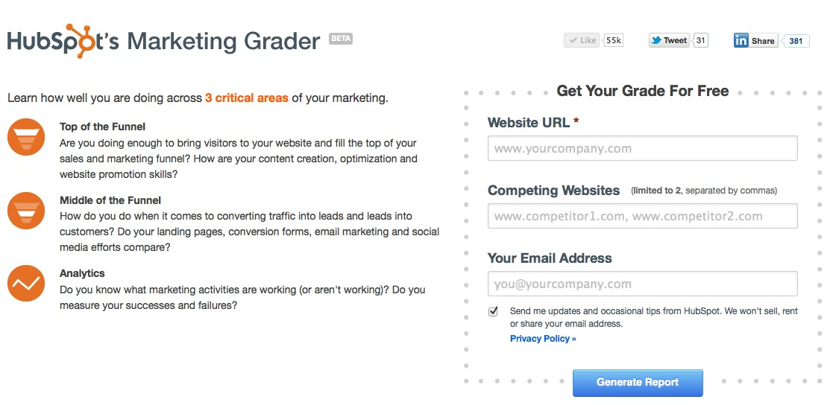
Marketing.Grader.com

Slide 5
SHOWDOWN #1
PEPSI VS COKE

Slide 6
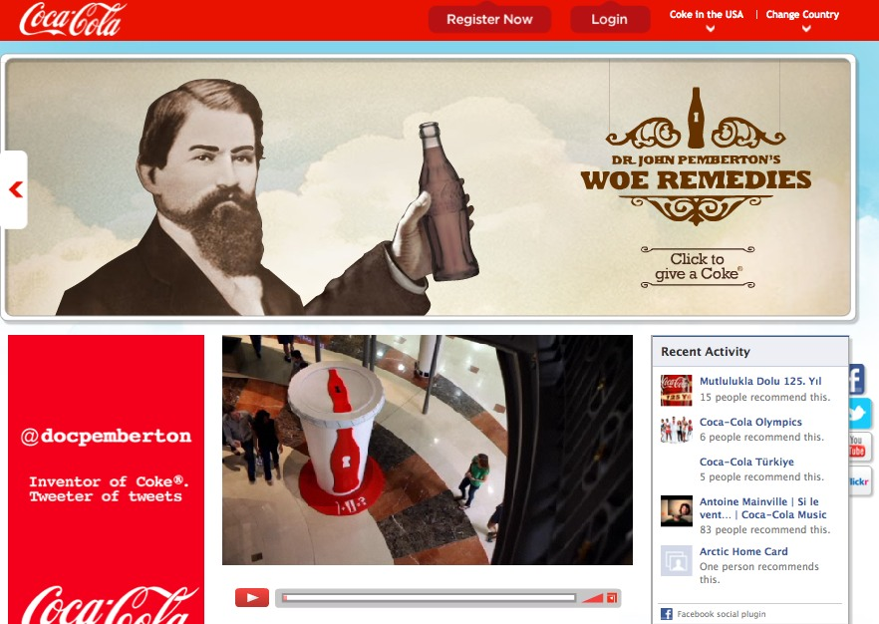

Slide 7
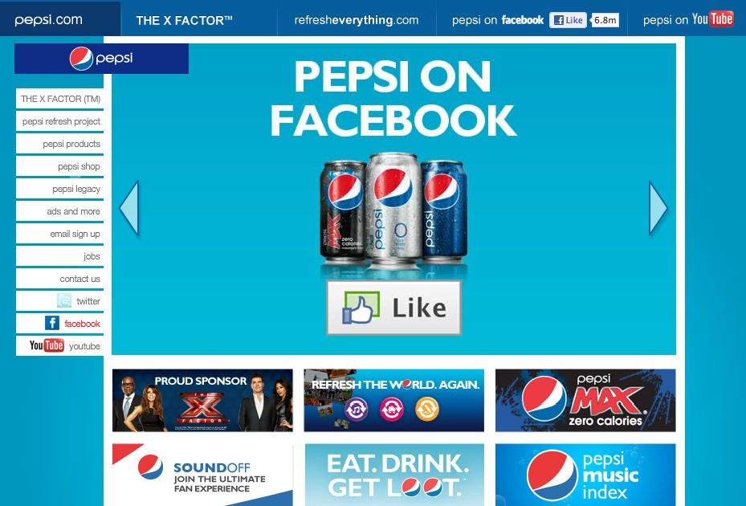

Slide 8
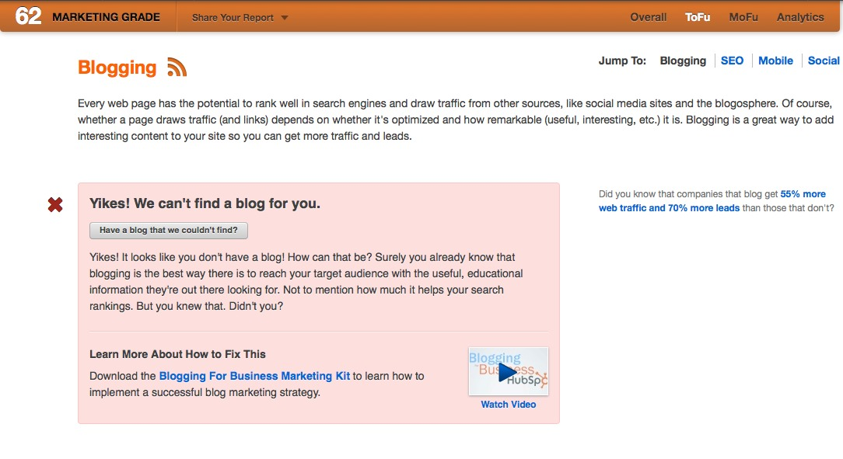

Slide 9
A great
brand
knows
itself.
Absence of
email.

Slide 10
WINNER:
PEPSI

Slide 11
SHOWDOWN #2
APPLE VS MICROSOFT

Slide 12
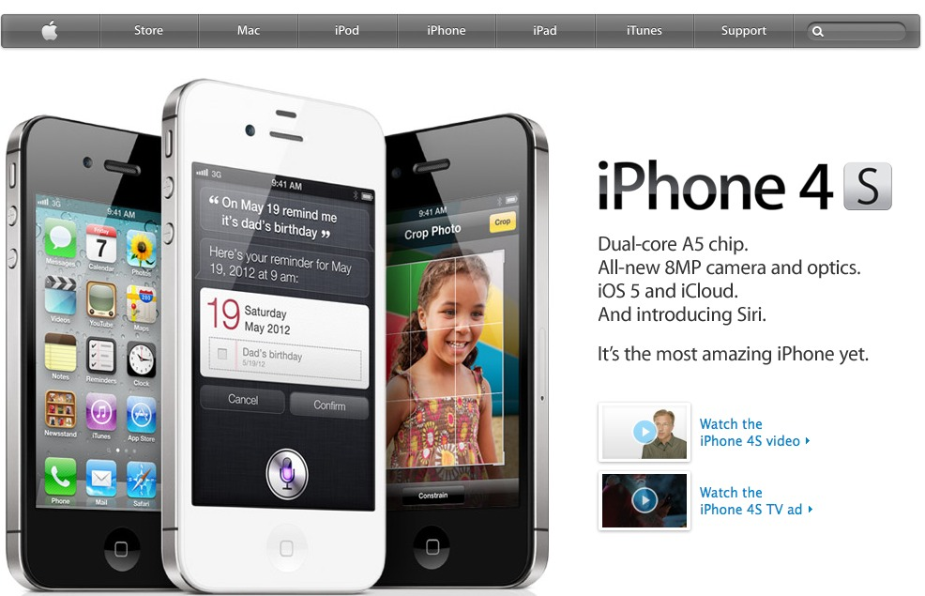

Slide 13
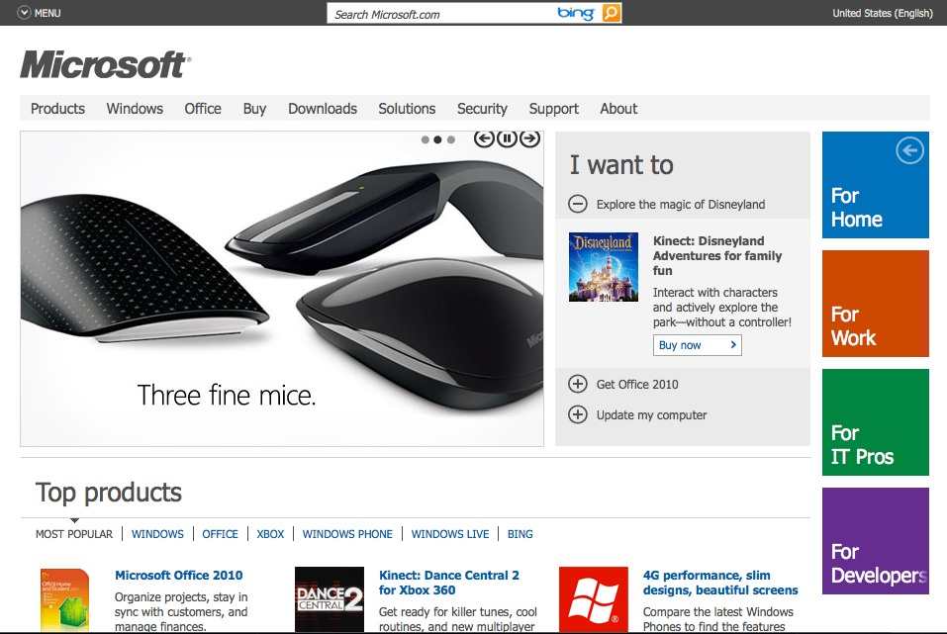

Slide 14
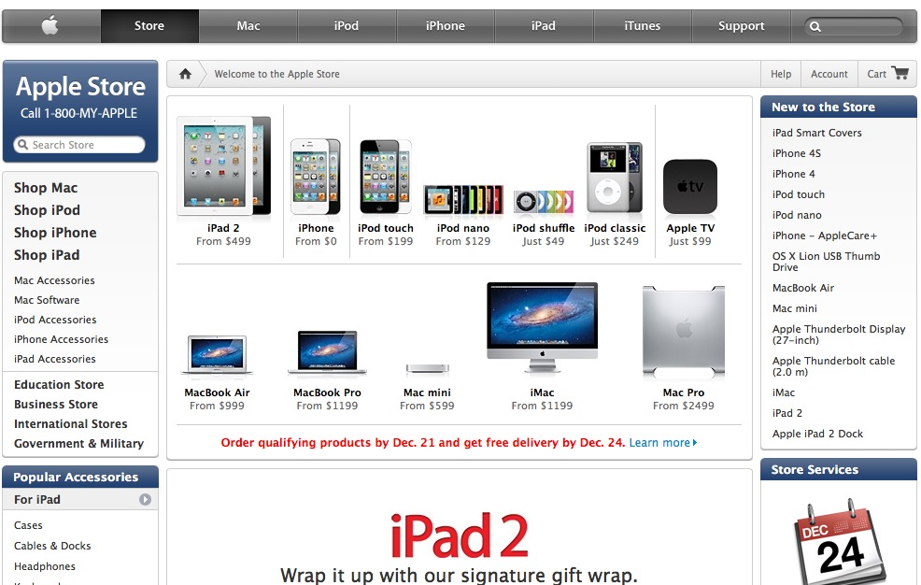
A great
brand
knows
itself.
Conversion Focused

Slide 15
WINNER:
APPLE

Slide 16
SHOWDOWN #3
RED SOX VS YANKEES

Slide 17
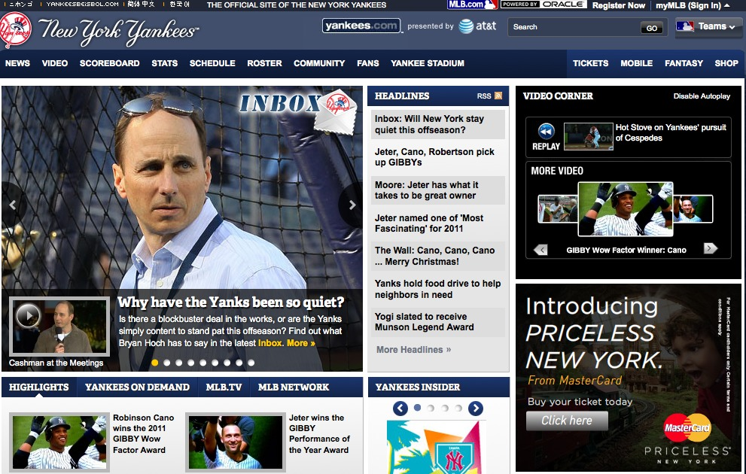

Slide 18
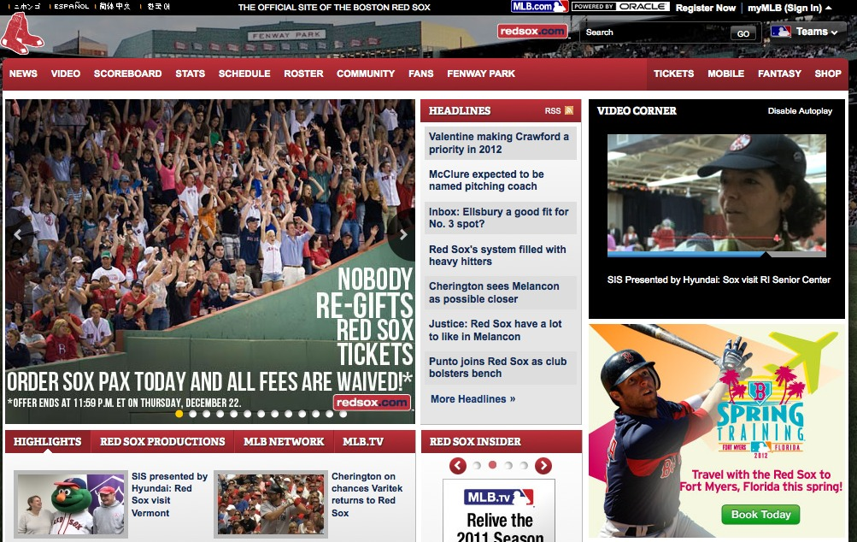

Slide 19
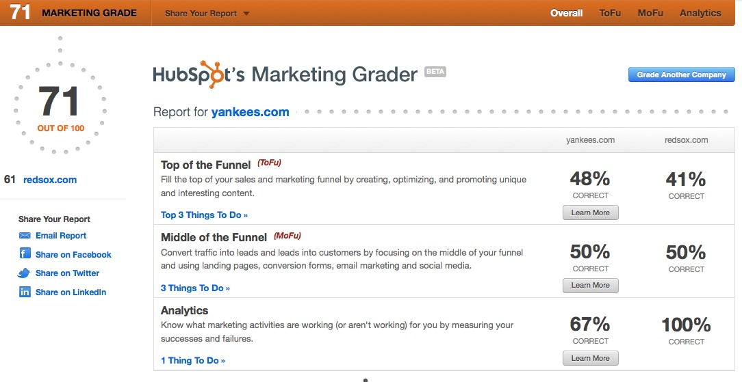

Slide 20
WINNER: YANKEES

Slide 21
SHOWDOWN #4
MCDONALDS VS BURGER KING

Slide 22
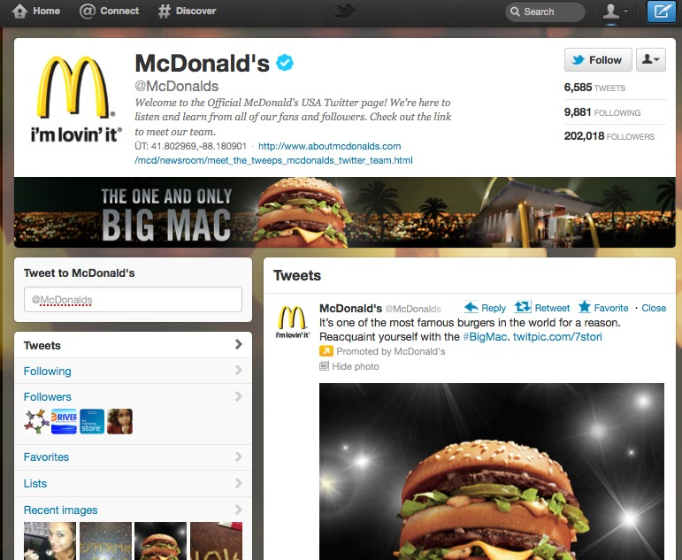

Slide 23
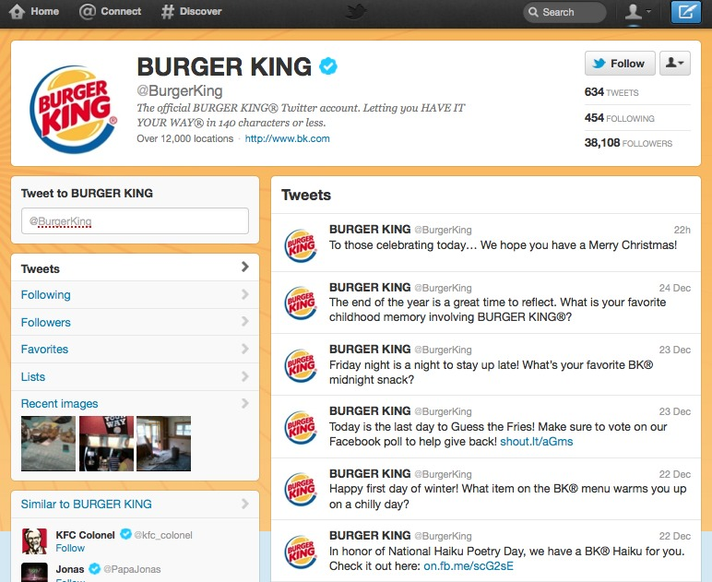

Slide 24
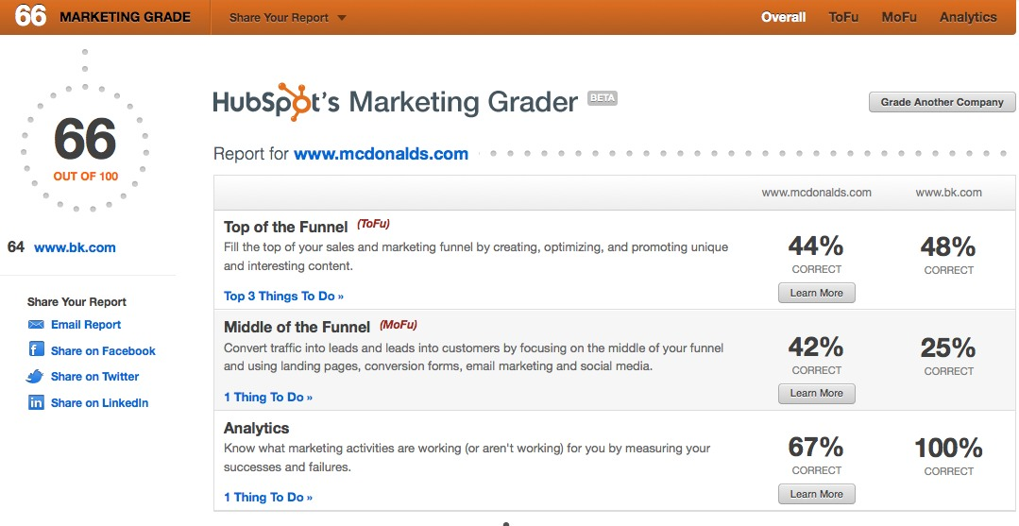

Slide 25
WINNER:
MCDONALDS

Slide 26
SHOWDOWN #5
TARGET VS WALMART

Slide 27
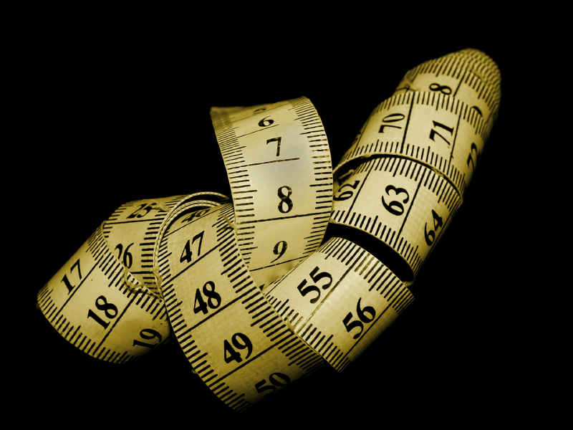

Slide 28
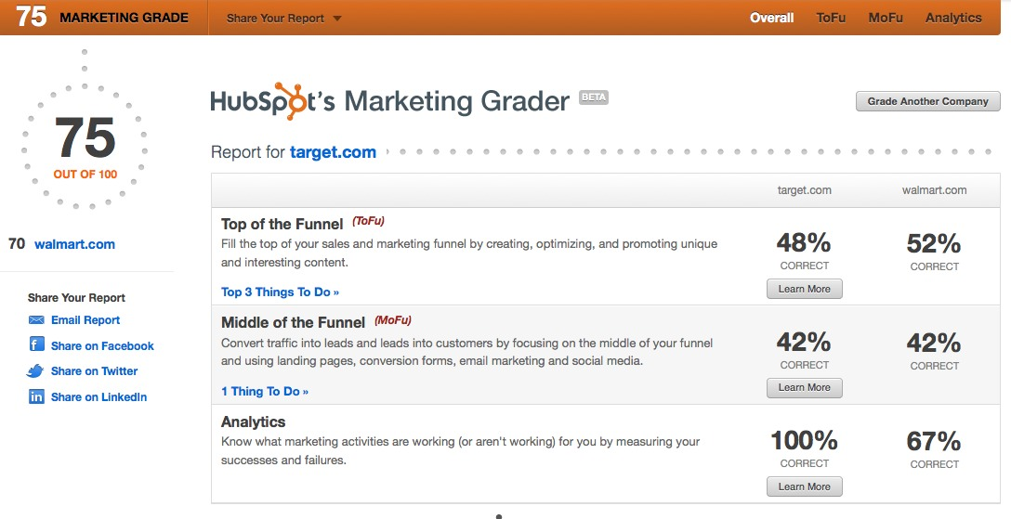

Slide 29
WINNER:
TARGET

Slide 30
Marketing.Grader.com

Slide 31
THANK
YOU.

