Slide 1
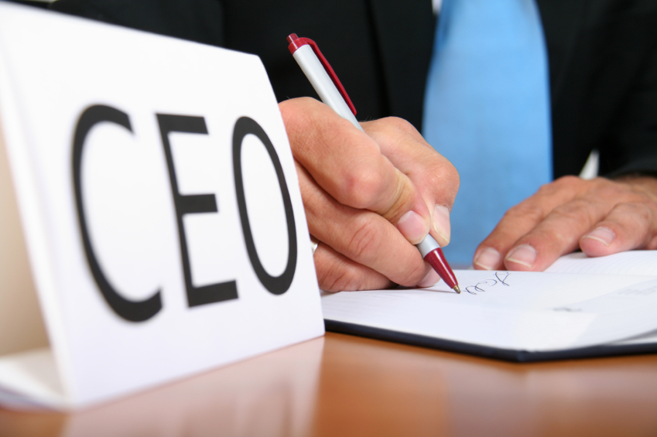
Mastering B2B
Social Media

Slide 2
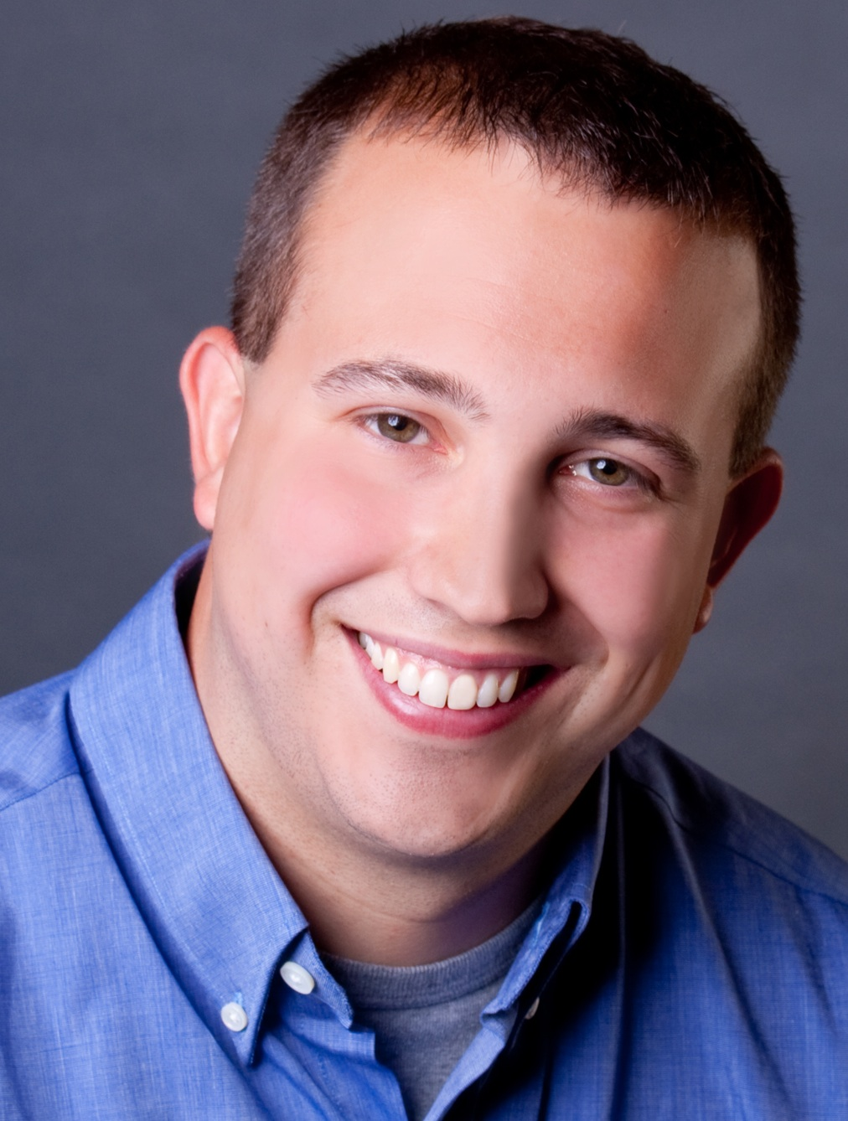
I’m Brian Halligan.
Nice to meet you.
I’m Kipp Bodnar.
Nice to meet you.
@KippBodnar

Slide 3
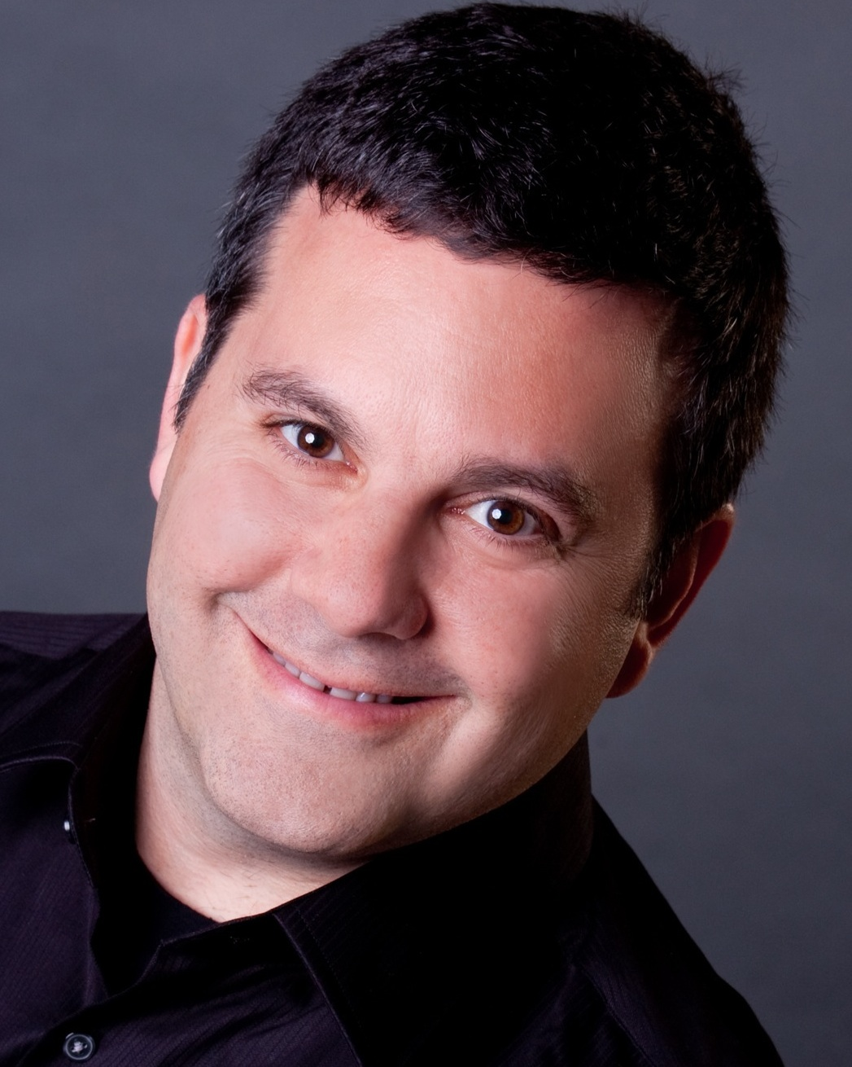
I’m Brian Halligan.
Nice to meet you.
I’m Jeff Cohen.
Nice to meet you.
@JeffreyLCohen

Slide 4
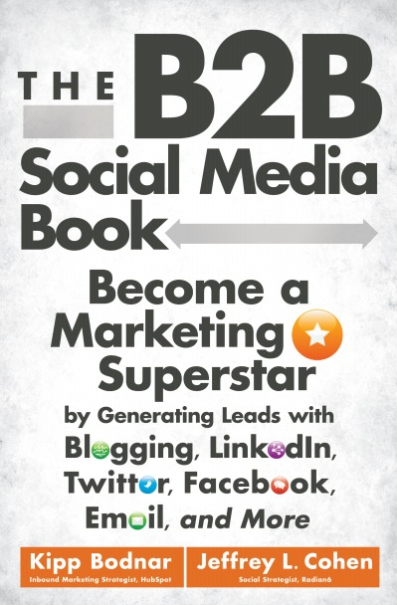
I’m Brian Halligan.
Nice to meet you.
We wrote The B2B Social Media Book.
amzn.to/b2bsm2

Slide 5
#SXB2BSM

Slide 6

We’re dorks.

Slide 7

We’ve got a a Problem.

Slide 8
73%
of CEOs
don’t believe
marketers drive revenue.
91
Fournaise Marketing Group: bit.ly/peNScq

Slide 9

Your opportunity, to shine.

Slide 10

Leads fix
the problem.

Slide 11
LEADS ARE
A PROXY
FOR SALES.

Slide 12

“
Your goal shouldn't be to buy leads. Your goal should be to buy customers.
”
@KippBodnar
Tweet This!
#SXB2BSM

Slide 13


Slide 14
How Social Media Leads Happen
1
Tweet
Landing Page
Form
Lead
Like
Blog Post
CTA
Landing Page
+1
Product Page
CTA
Landing Page

Slide 15
3 MUST-HAVES FOR
SOCIAL MEDIA
LEAD
GENERATION:

Slide 16
1
Get people to connect with you.
2
Get people to share your stuff.
3
Place calls-to-action everywhere.

Slide 17
“
Prospects don’t want to hear about your products. They want solutions to their problems.
”
@JeffreyLCohen
Tweet This!
#SXB2BSM

Slide 18
60%
of the sales cycle is over – before a buyer talks to your salesperson.
91
CORPORATE EXECUTIVE BOARD: bit.ly/zub2I7

Slide 19
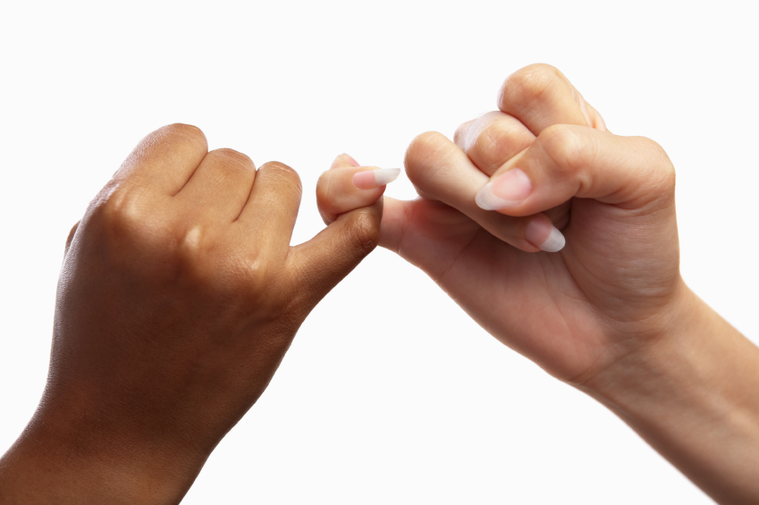
People to People

Slide 20
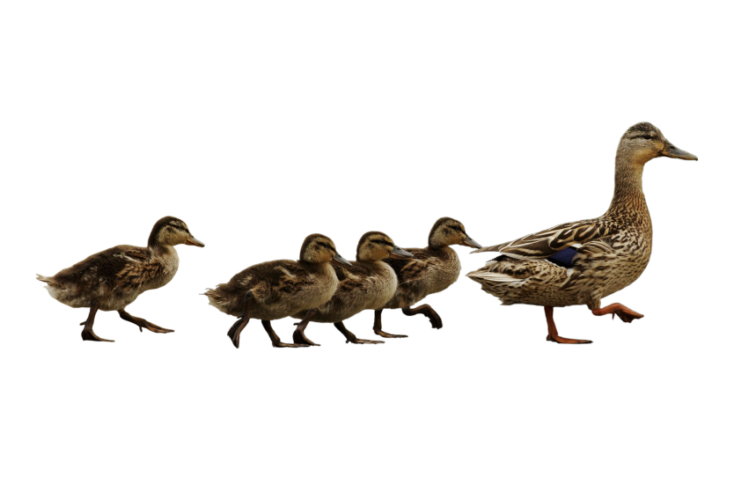
Follow. Friend. Connect. With People.

Slide 21

BITLY, 9/2011
The shelf life of a social media link is 3 hours.
Notes:
Connect to milk and pour glass

Slide 22
THE
Links to company blog posts
10-4-1
Links to third-party articles
Link to a company landing page
RULE

Slide 23
“
Publishing and sharing content online is the single biggest lever to increase lead generation.
”
@JeffreyLCohen
Tweet This!
#SXB2BSM

Slide 24
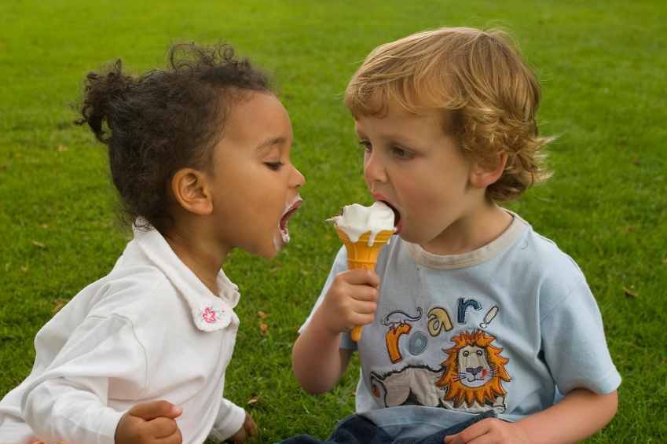
Get people to share your stuff.

Slide 25


Slide 26
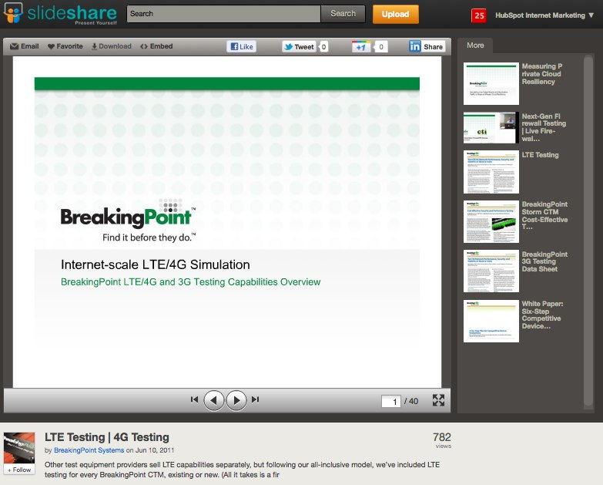

Slide 27
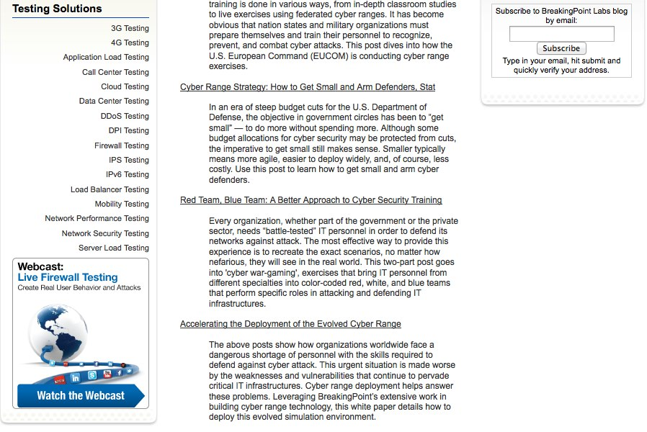

Slide 28


Slide 29
Closed Millions In Sales From Online Leads
ROI – 2800%!

Slide 30
“
Maximize content discovery by producing awesome content and reducing the friction around sharing it.
”
@KippBodnar
Tweet This!
#SXB2BSM

Slide 31
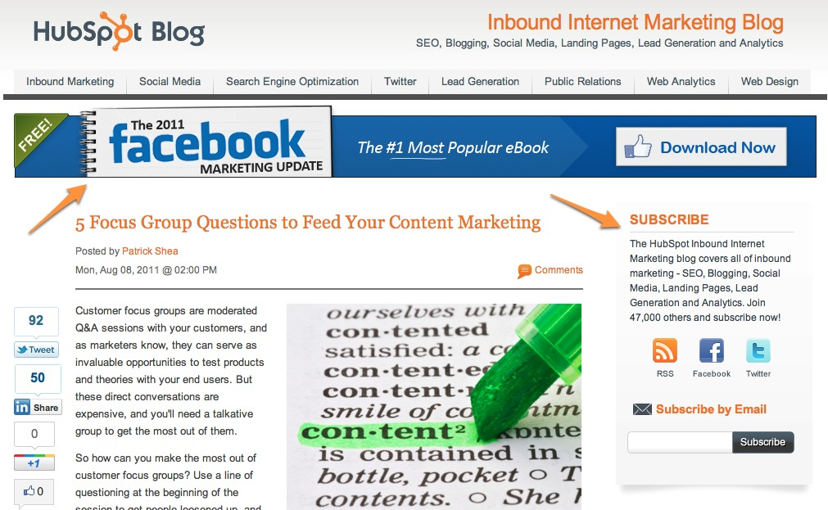
Place CTAs Everywhere.

Slide 32
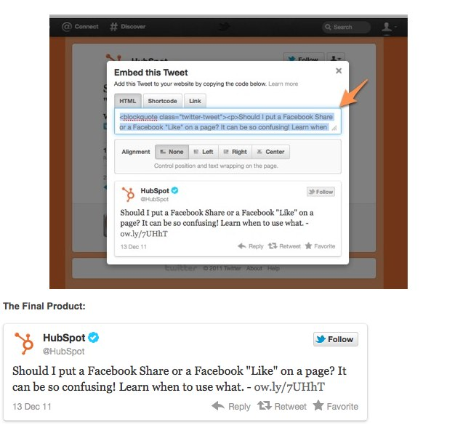
Embed Tweets

Slide 33

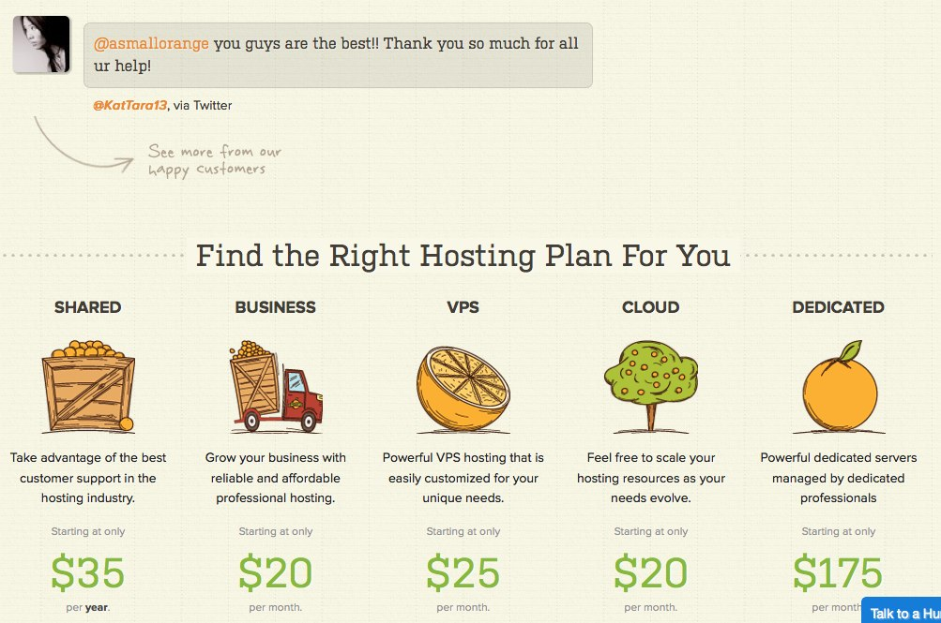

Slide 34
1
Get people to connect with you.
2
Get people to share your stuff.
3
Place calls-to-action everywhere.

Slide 35
Prove the
CEO
Wrong

Slide 36
You’re the Star

Slide 37
THANK
YOU

Slide 38
I’m Brian Halligan.
Nice to meet you.
We wrote The B2B Social Media Book.
amzn.to/b2bsm2

