Slide 1

The Power of Retweeting

Slide 2
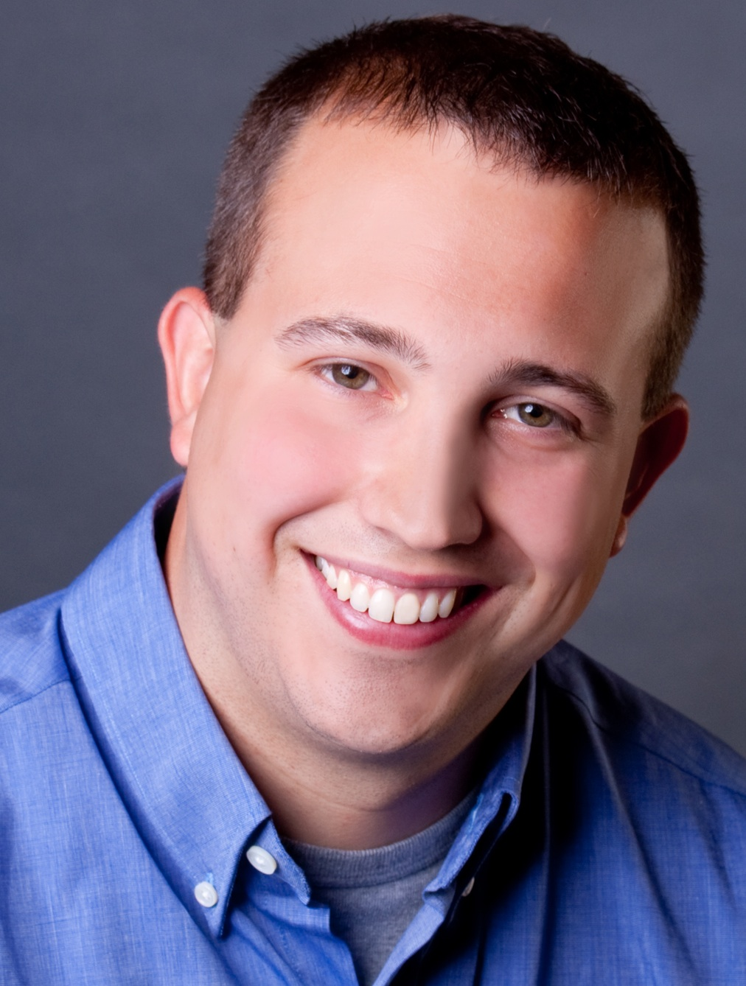
I’m Brian Halligan.
Nice to meet you.
I’m Kipp Bodnar.
Nice to meet you.
@KippBodnar

Slide 3
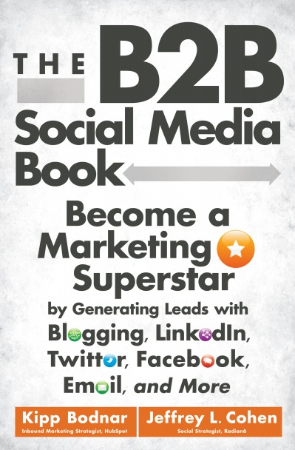
I’m Brian Halligan.
Nice to meet you.
I wrote The B2B Social Media Book.
amzn.to/b2bsm2
Notes:
Mention book signing

Slide 4
#ReTweeting

Slide 5

I’m a dork.

Slide 6

We’ve got a a Problem.

Slide 7
73%
of CEOs
don’t believe
marketers drive revenue.
91
Fournaise Marketing Group: bit.ly/peNScq
Notes:
Stat
Measuring the wrong things

Slide 8

Your opportunity, to shine.
Notes:
Glass half full

Slide 9

Leads fix
the problem.

Slide 10
How Leads Happen On Twitter
1
Tweet
Landing Page
Form
Lead
Blog Post
CTA
Landing Page
ReTweet
Bio Link
Product Page
CTA
Landing Page

Slide 11
3 MUST-HAVES FOR TWITTER MARKETING
SUCCESS

Slide 12
1
Tweeting: Get people to connect with you.
2
ReTweeting: Get people to share your stuff.
3
Integration: Twitter as part of your overall marketing plan.

Slide 13
60%
of the sales cycle is over – before a buyer talks to your salesperson.
91
CORPORATE EXECUTIVE BOARD: bit.ly/zub2I7
Notes:
Say the stat
Customer in power not Sales
Social Media is a critical tool for educating the buyer early in the process

Slide 14
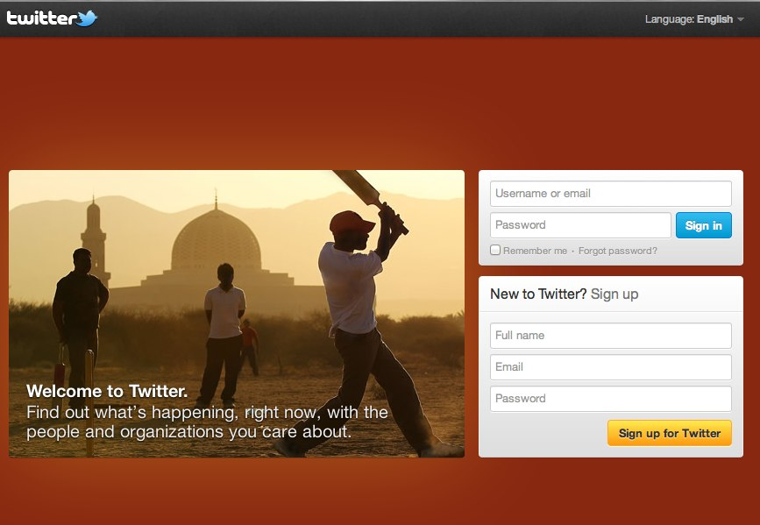
Twitter Account = Company Name

Slide 15
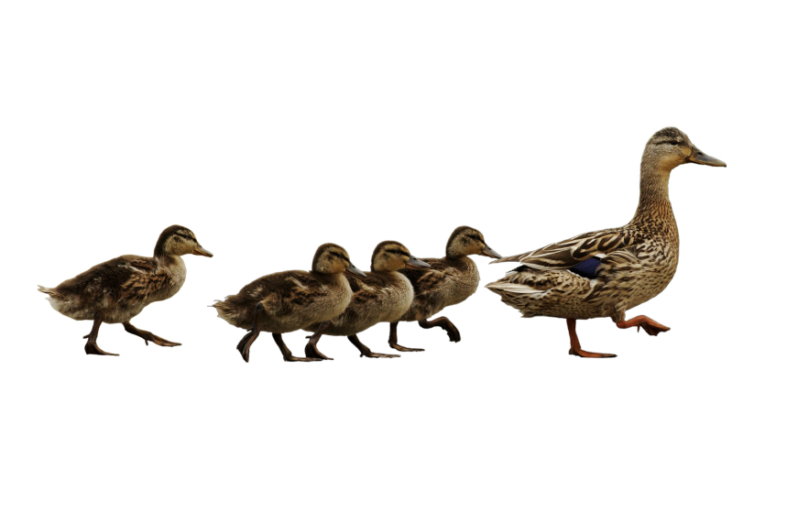
Follow. Friend. Connect. With People.
Notes:
To build your reach you have to take action
Follow friend connect
It won’t happen by magic

Slide 16
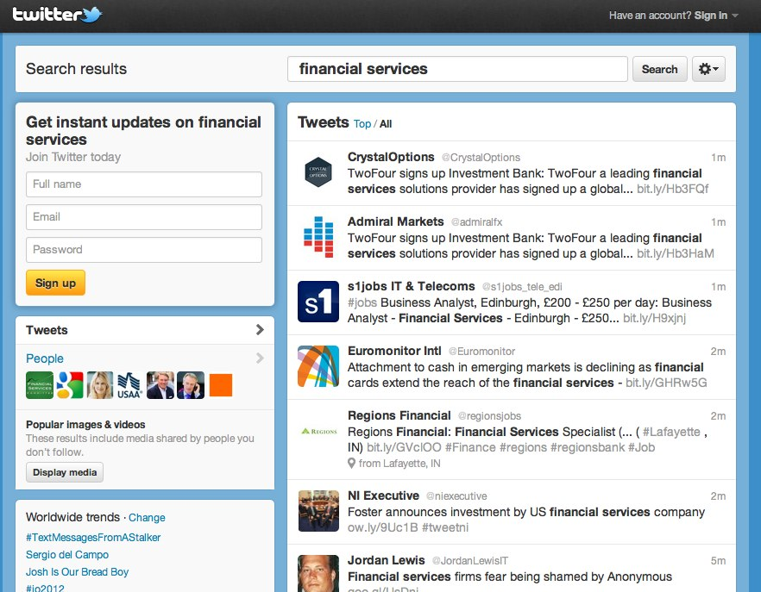
Twitter.com/Search

Slide 17
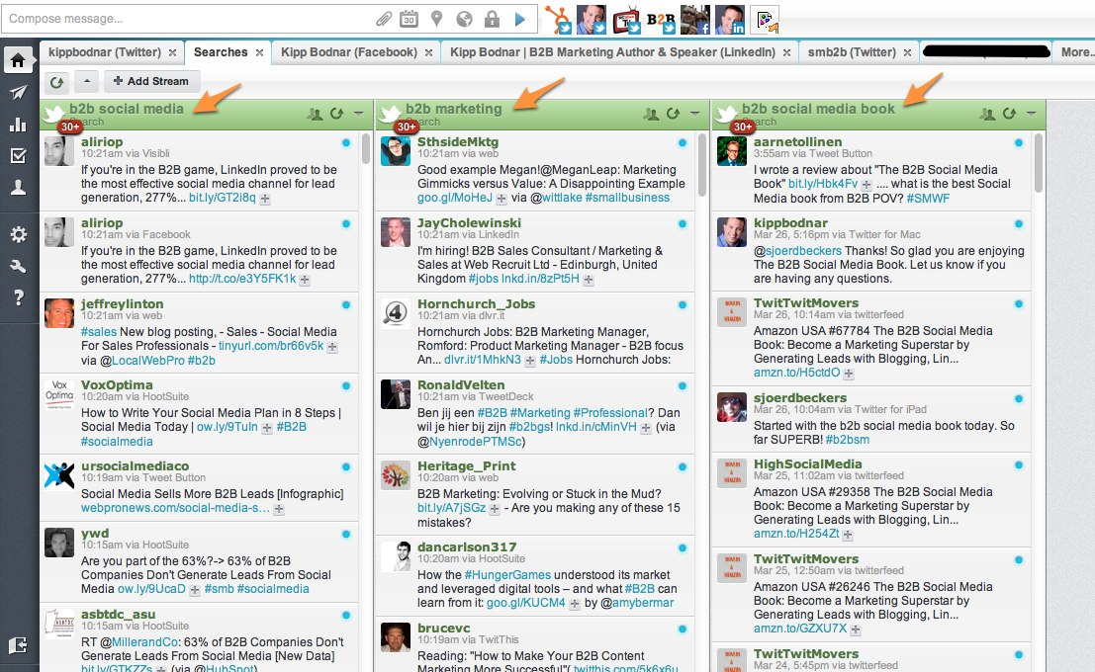
Hootsuite.com

Slide 18
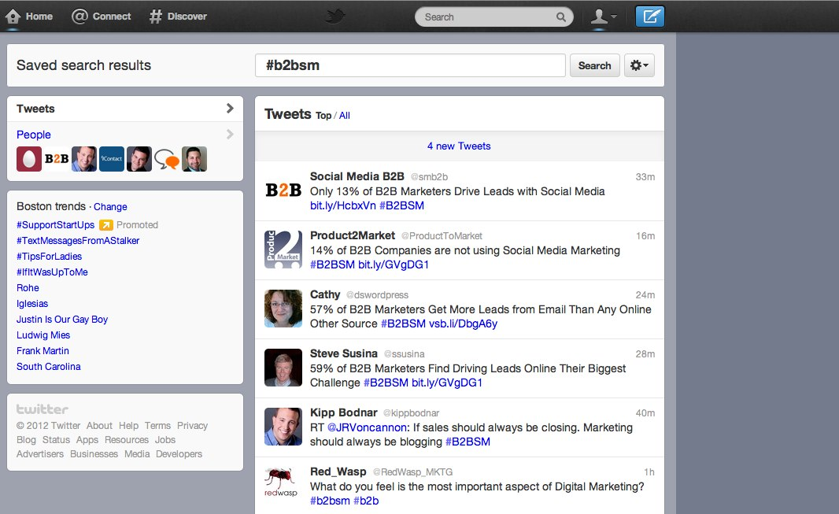
Hashtags Explained

Slide 19

“
Prospects don’t care about your products. They want solutions to their problems.
”
@KippBodnar
Tweet This!
#ReTweeting
Notes:
Read Tweet
B2B Marketing broken
Me, Me, Me

Slide 20

BITLY, 9/2011
The shelf life of a social media link is 3 hours.
Notes:
Stat
Milk analogy
That means after 3 hours your link is essentially dead.

Slide 21
“
Publishing and sharing content on Twitter is the single biggest lever to increase lead generation.
”
@KippBodnar
Tweet This!
#ReTweeting
Notes:
Executives have to make it easy for marketing to do this

Slide 22
THE
Links to company blog posts
10-4-1
Links to third-party articles
Link to a company landing page
RULE
Notes:
So you need to share lots of links and here is how
“here’s my press release”

Slide 23
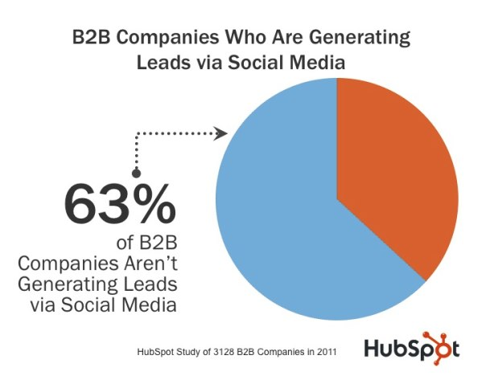

Slide 24

Get people to share your stuff.

Slide 25
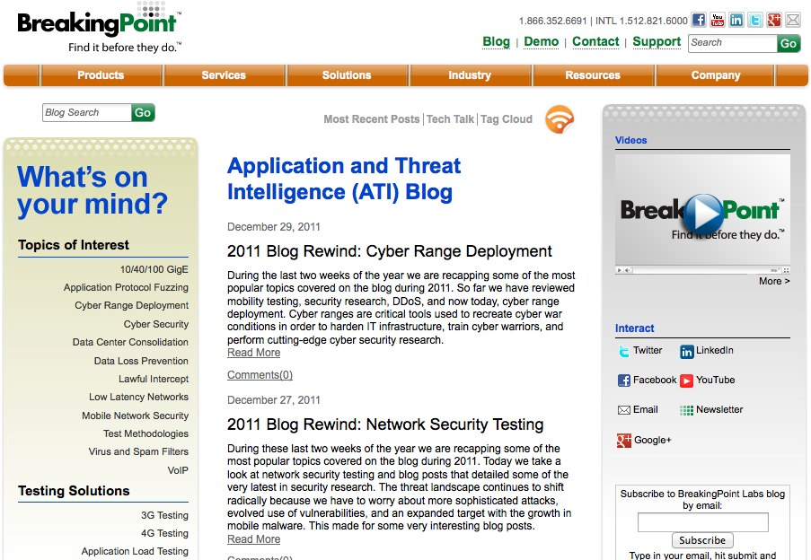

Slide 26
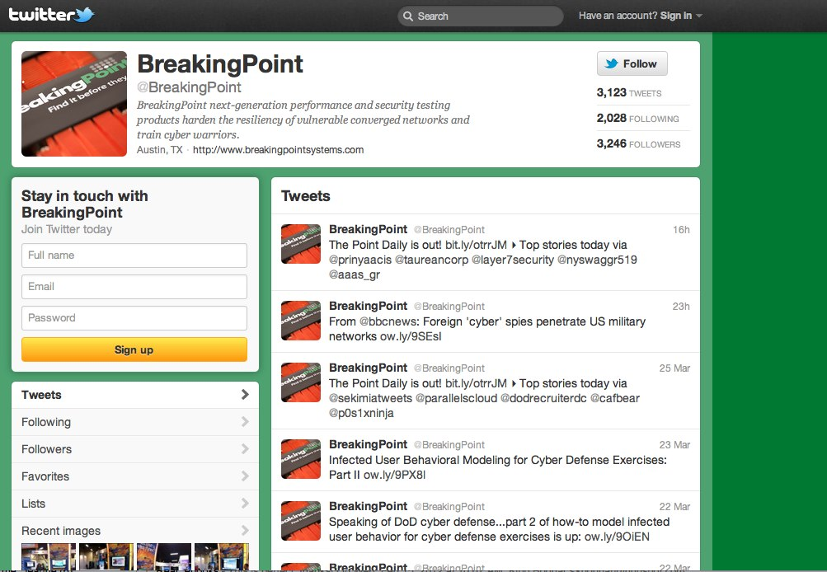

Slide 27
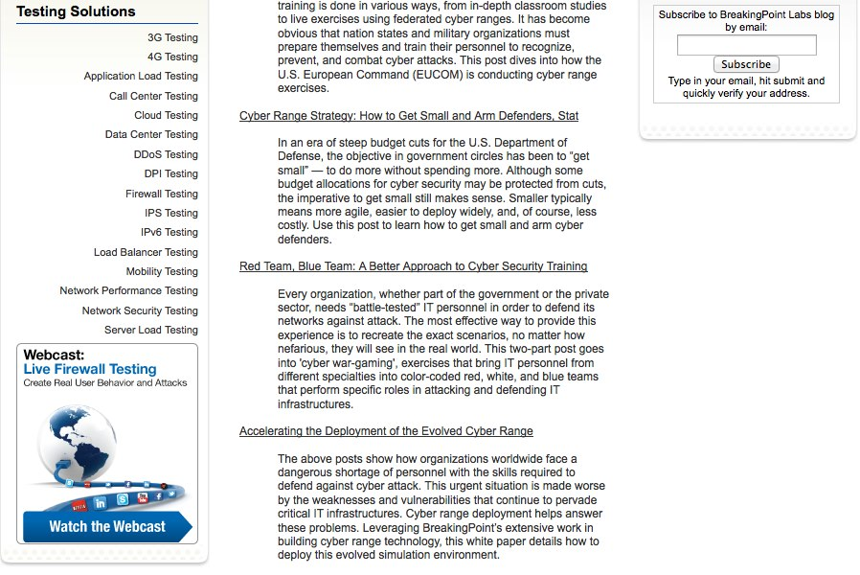

Slide 28
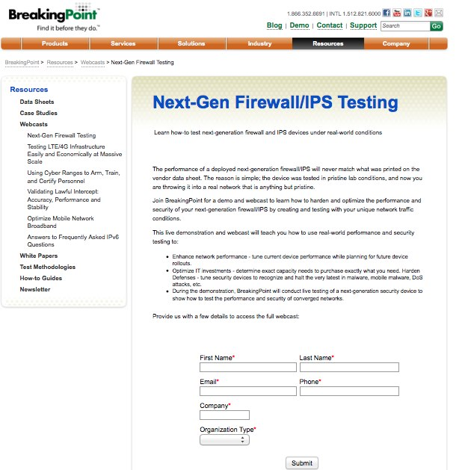

Slide 29
Closed Millions In Sales From Online Leads
ROI – 2800%!

Slide 30
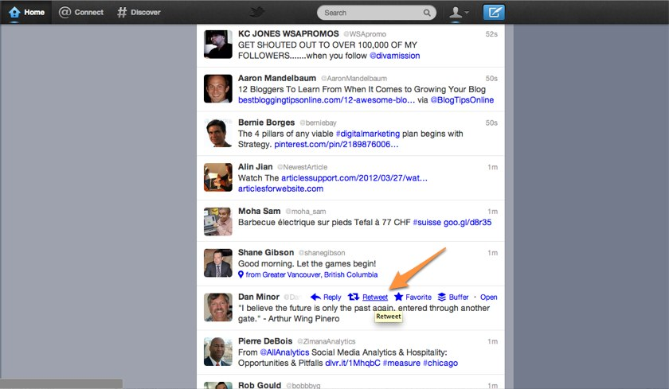

Slide 31
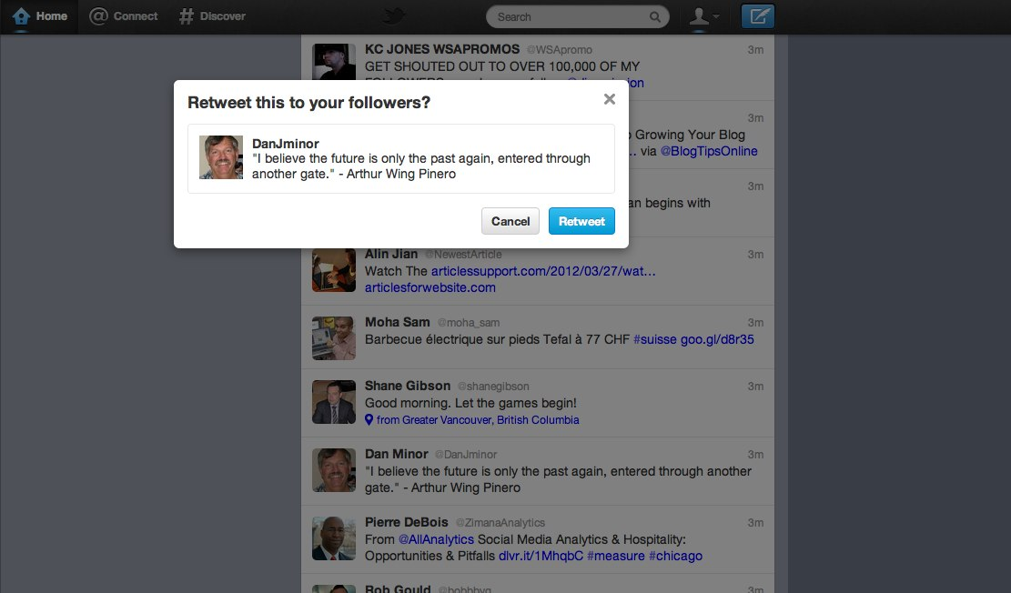

Slide 32
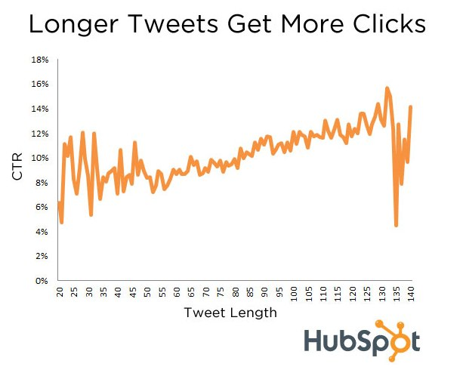

Slide 33
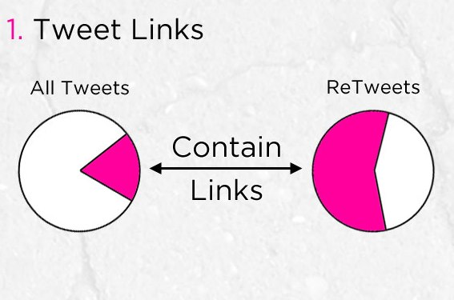
How to Get More Retweets
Source: Dan Zarrella

Slide 34
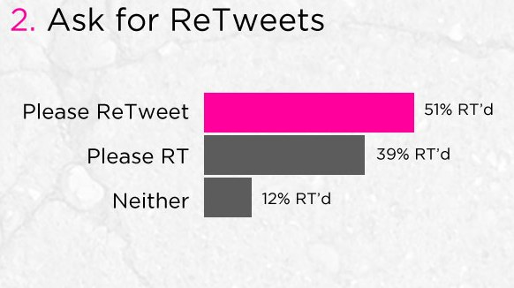
How to Get More Retweets
Source: Dan Zarrella

Slide 35
“
Create awesome content and reduce the friction around sharing it.
”
@KippBodnar
Tweet This!
#SXB2BSM

Slide 36

Integrating Twitter.
Notes:
1. You have to have CTAs to generate leads and revenue from Social Media
2. Too many marketers don’t convert
3. Many different types of CTAS
4. You need to have CTAs on all online properties

Slide 37
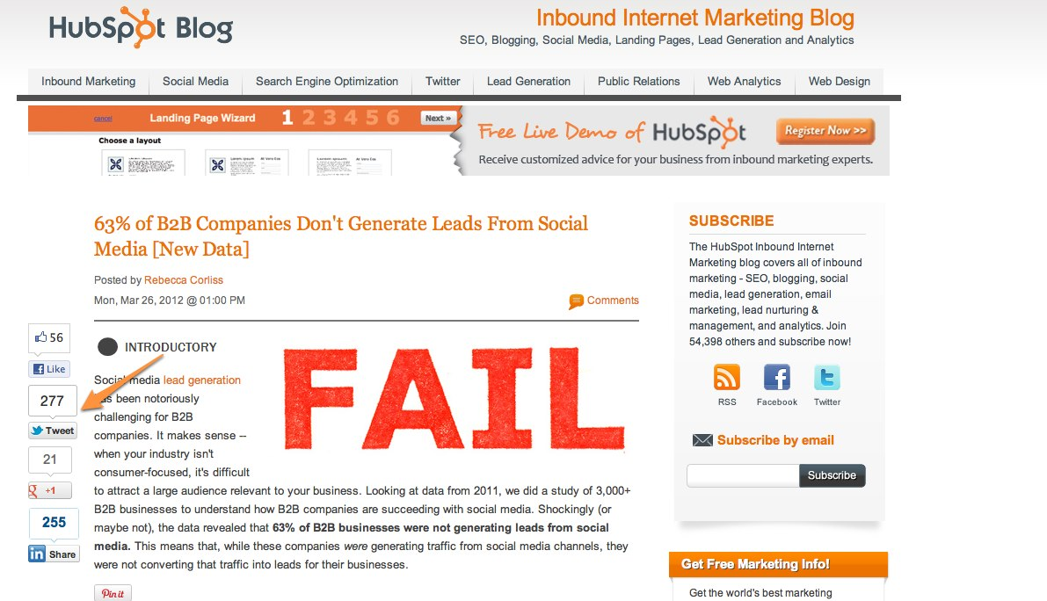
Twitter Sharing
Button

Slide 38
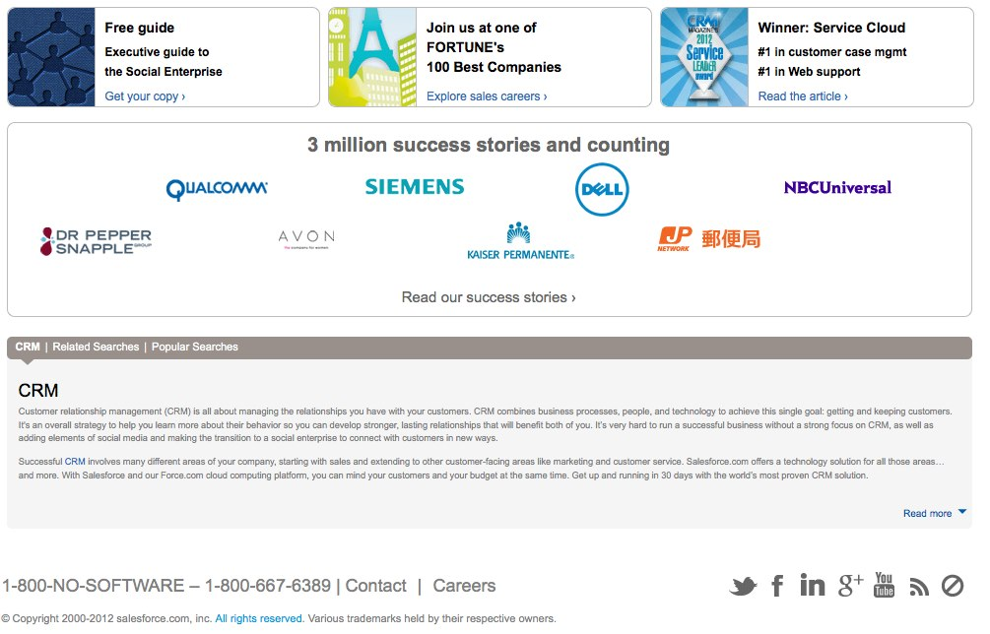
Twitter Follow Button

Slide 39
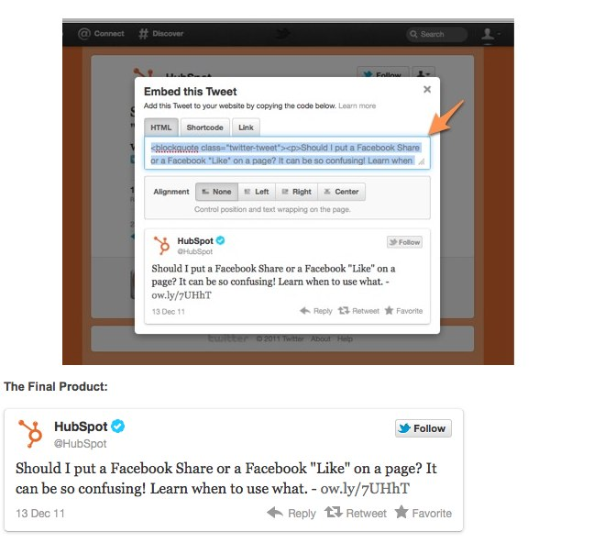
Embed Tweets
Notes:
Sometimes CTAs aren’t what you think
Testimonials written by robots
For example you can use embedded tweets to impact conversion
Twitter makes it easy now to embed a tweet.

Slide 40

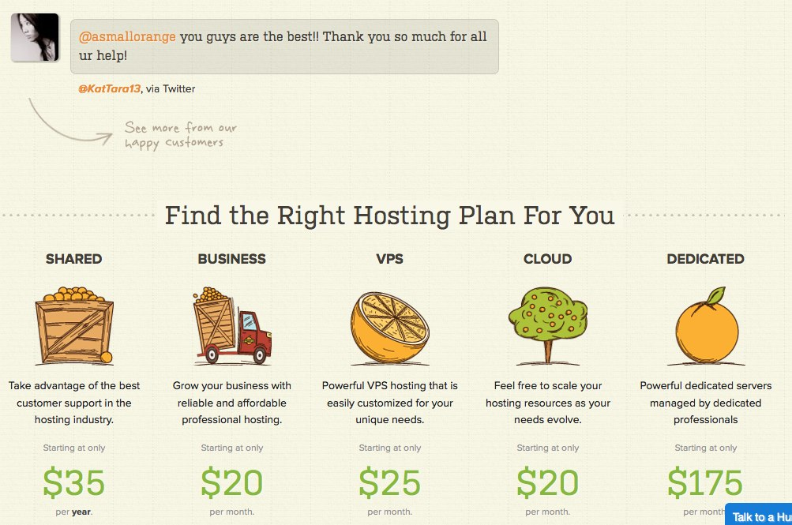
Notes:
Lets look at an example of embedded tweets for conversion
Small orange test
Reults

Slide 41
1
Tweeting: Get people to connect with you.
2
ReTweeting: Get people to share your stuff.
3
Integration: Twitter as part of your overall marketing plan.

Slide 42

Prove the
CEO
Wrong

Slide 43
You’re the Star

Slide 44
THANK
YOU

Slide 45
I’m Brian Halligan.
Nice to meet you.
We wrote The B2B Social Media Book.
amzn.to/b2bsm2

