Slide 1


Kipp Bodnar
@Kipp Bodnar
Go Inbound!

Slide 2

I’m Brian Halligan.
Nice to meet you.
I’m Kipp Bodnar.
Nice to meet you.
@KippBodnar

Slide 3
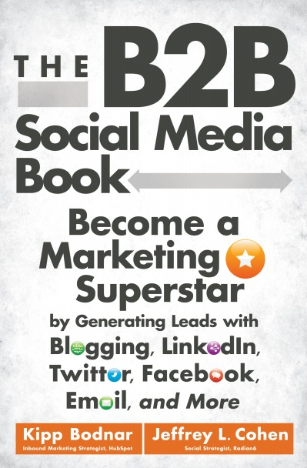
I’m Brian Halligan.
Nice to meet you.
I wrote The B2B Social Media Book.
amzn.to/b2bsm2

Slide 4
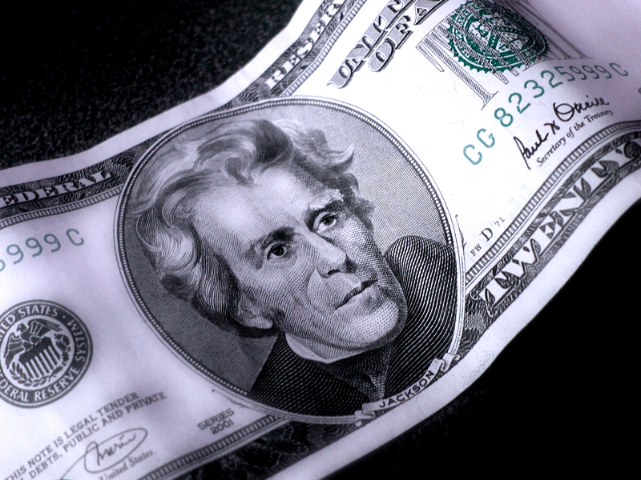

Slide 5
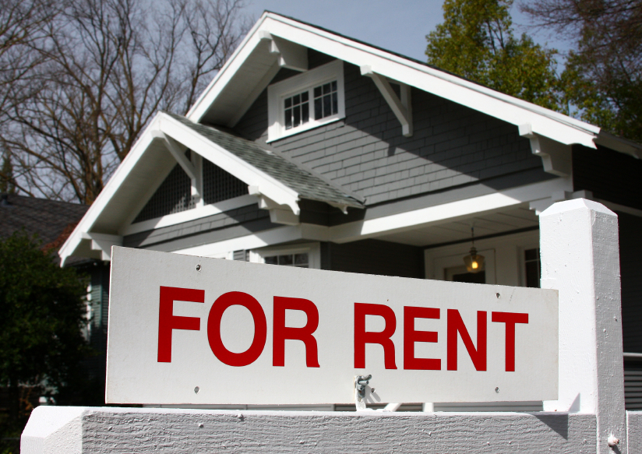

Slide 6


Slide 7

Why is renting ok in your marketing?

Slide 8
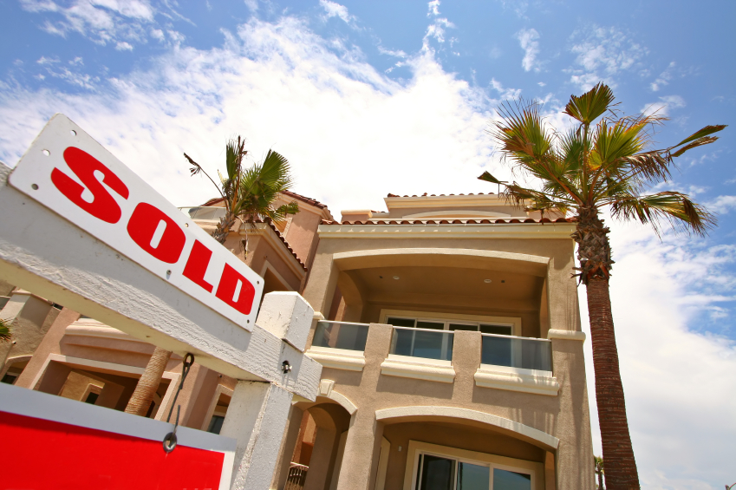

Slide 9

“
Marketing is an asset NOT an expense.
”
@KippBodnar
Tweet This!

Slide 10

People don’t want to be interrupted.

Slide 11
INBOUND
MARKETING IS ABOUT ATTRACTING AND CONVERTING NOT INTERUPPTING

Slide 12
1
1
Inbound Marketing
SEO
Blogging
Analytics
Lead Nurturing
Social Media
Email Marketing
Landing Pages

Slide 13

Don’t take my word for it.

Slide 14
10
Mind-blowing Inbound Marketing statistics

Slide 15
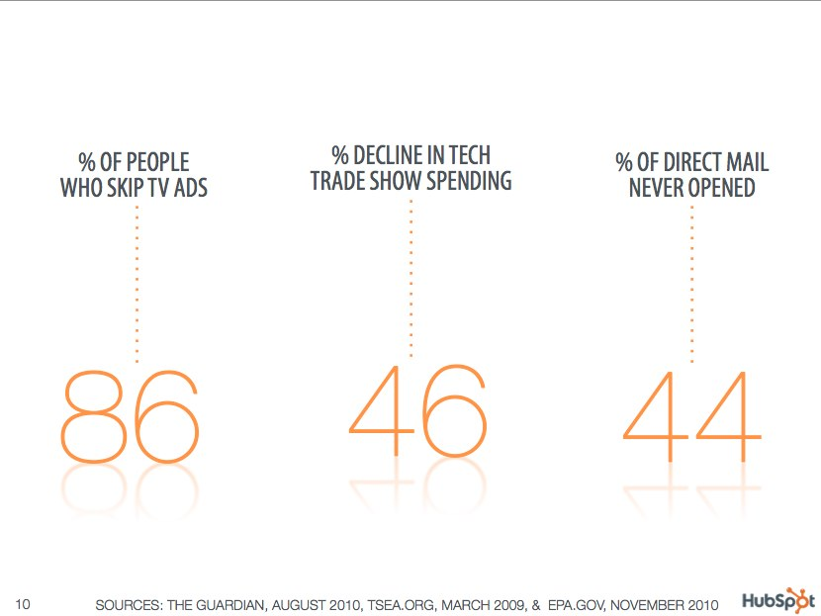

Slide 16

DATA SOURCE, MONTH & YEAR
78%
of Internet users conduct product research online.

Slide 17
Mobile Dominating Web Browsing
Web Browsing
72 Minutes
94 Minutes
Mobile App
Usage
Source: Comscore
Notes:
http://moneywatch.bnet.com/economic-news/article/super-bowl-2011-adding-up-the-numbers/6190270/

Slide 18
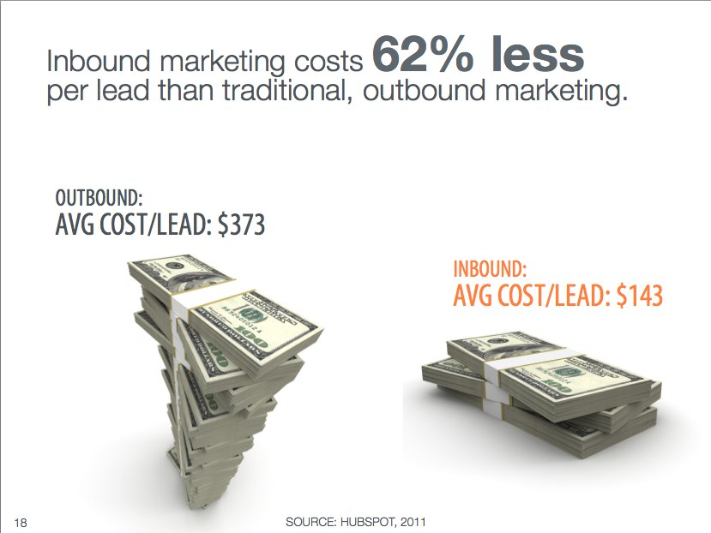

Slide 19
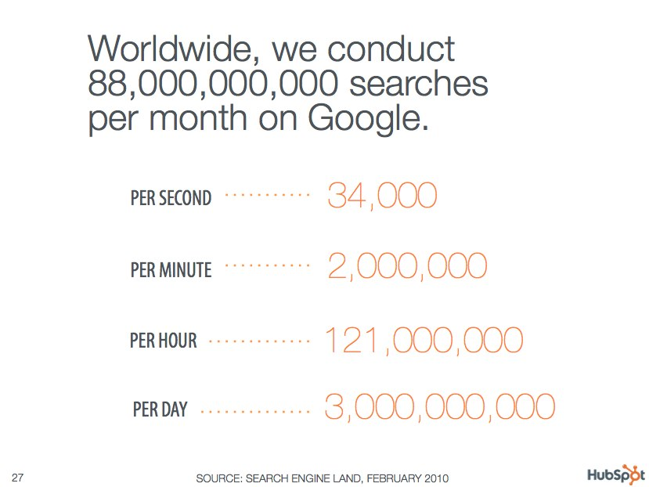

Slide 20
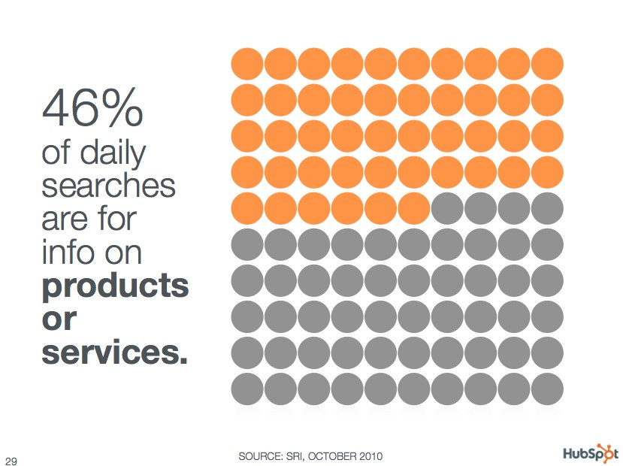

Slide 21
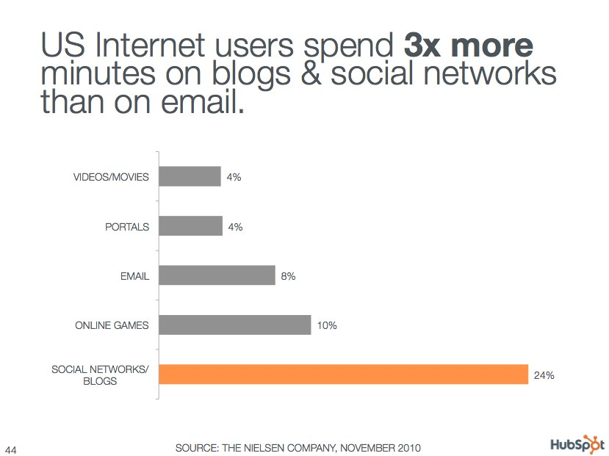

Slide 22
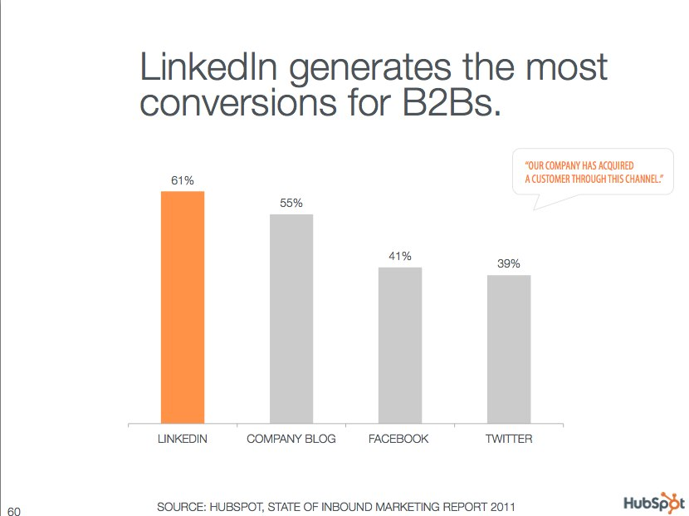

Slide 23
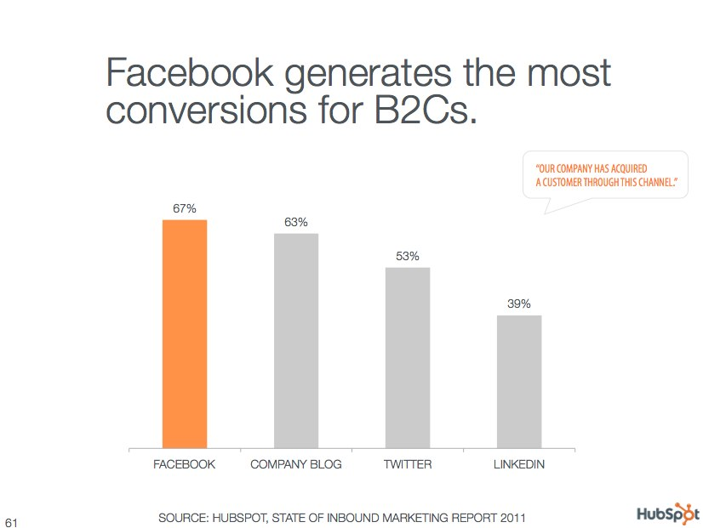

Slide 24
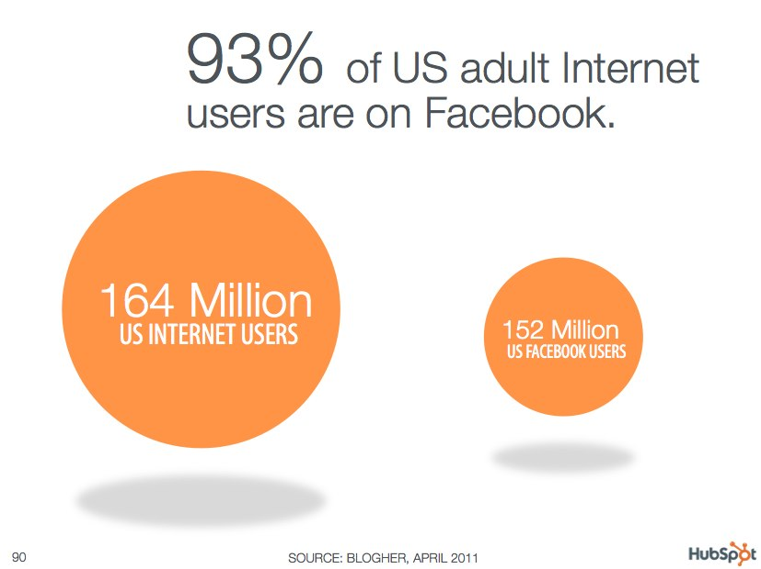

Slide 25

Changing Affinity Marketing

Slide 26
Traditional Affinity Marketing
Big Bank
Supermarket Chain
AAA

Slide 27

Affinity Marketing Online

Slide 28

Affinity online
is niche and diverse

Slide 29
Online Affinity Marketing
Niche network
Forum
Blogger
Forum
Blogger
Business Owner
Niche network
Forum
Forum
Blogger
Niche network
Business Owner
Niche network
Forum
Blogger

Slide 30

Affiliate Marketing

Slide 31
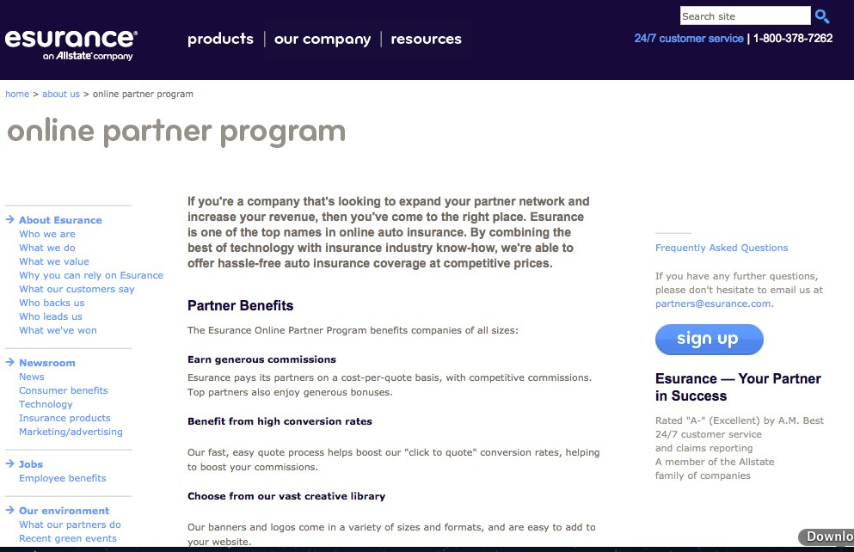

Slide 32
“
Affiliate Marketing is results-based attention renting
”
@KippBodnar
Tweet This!

Slide 33
Owning the attention.

Slide 34
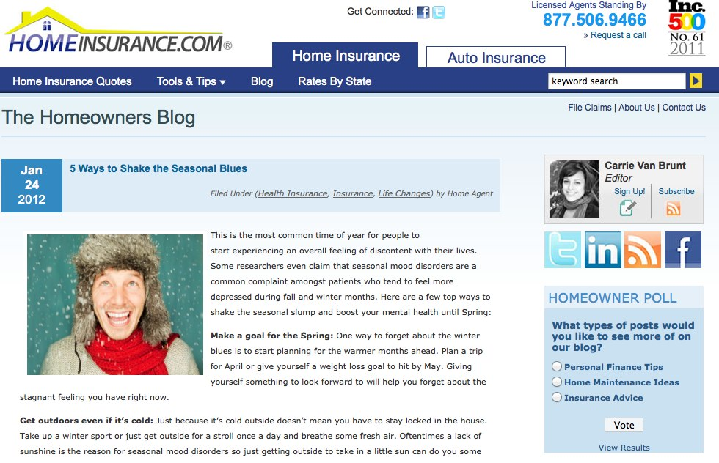

Slide 35
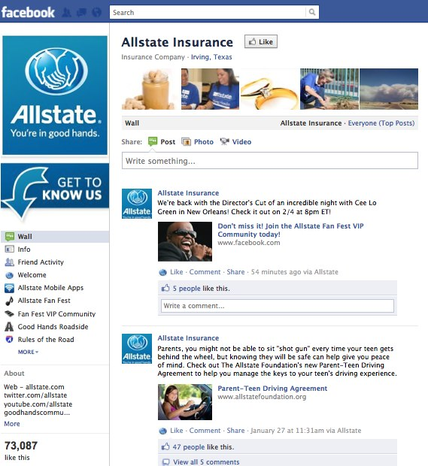

Slide 36
STOP RENTING…
START OWNING…

Slide 37


Slide 39
THANK
YOU

Slide 40
I’m Brian Halligan.
Nice to meet you.
I wrote The B2B Social Media Book.
amzn.to/b2bsm2

