Slide 1
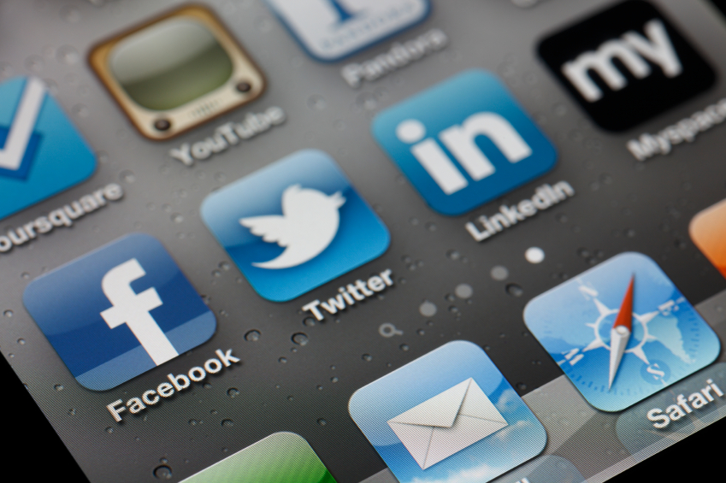

Smart
Mobile Marketing
Kipp Bodnar
@KippBodnar

Slide 2

I’m Brian Halligan.
Nice to meet you.
I’m Kipp Bodnar.
Nice to meet you.
@KippBodnar

Slide 3

I wrote The B2B Social Media Book.
I’m Brian Halligan.
Nice to meet you.
Book Link

Slide 4

I’m a dork.

Slide 5
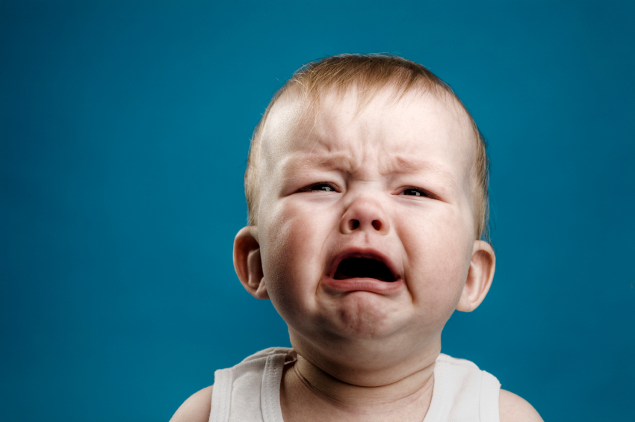
We’ve got a a Problem.

Slide 6
73%
of CEOs
don’t believe
marketers drive revenue.
91
Fournaise Marketing Group: bit.ly/peNScq

Slide 7
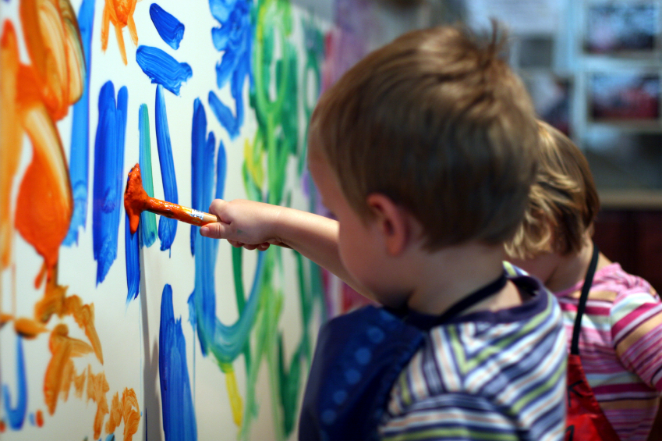
Marketing isn’t
Arts and Crafts.

Slide 8

We’re creative.

Slide 9
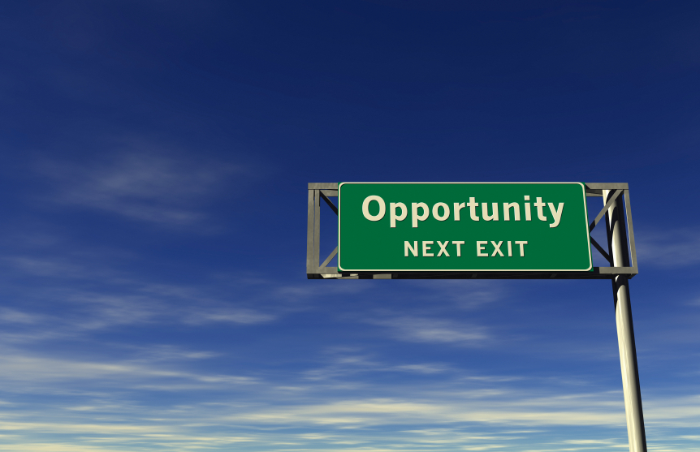
An opportunity, not a problem.

Slide 10

Your opportunity, to shine.

Slide 11
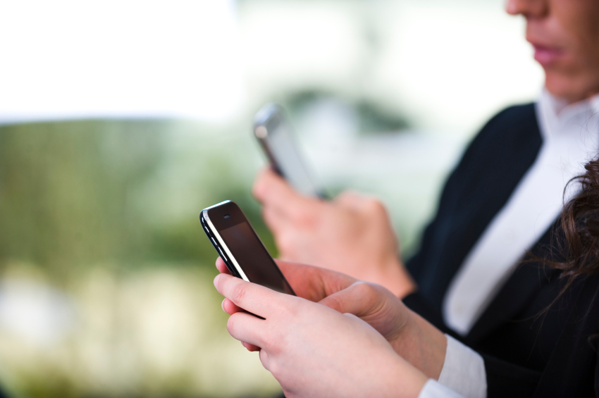
Mobile can
help!

Slide 12
SMART PHONES WILL EXCEED
PCs BY 2013.

Slide 13

82% OF
EXECUTIVES HAVE
SMART PHONES.

Slide 14
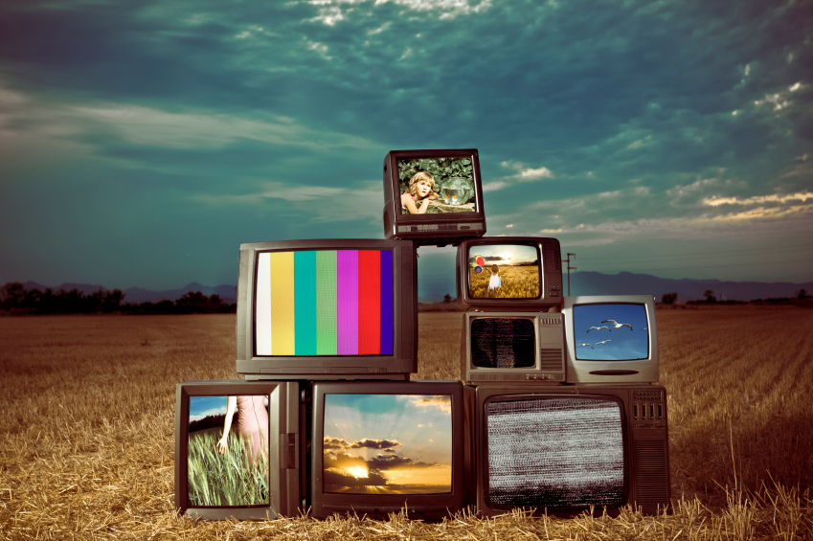

Notes:
Customers behind secure firewalls

Slide 15
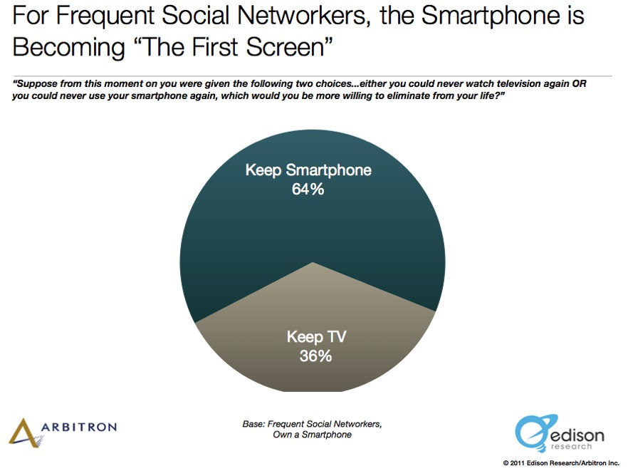
Notes:
Customers behind secure firewalls

Slide 16
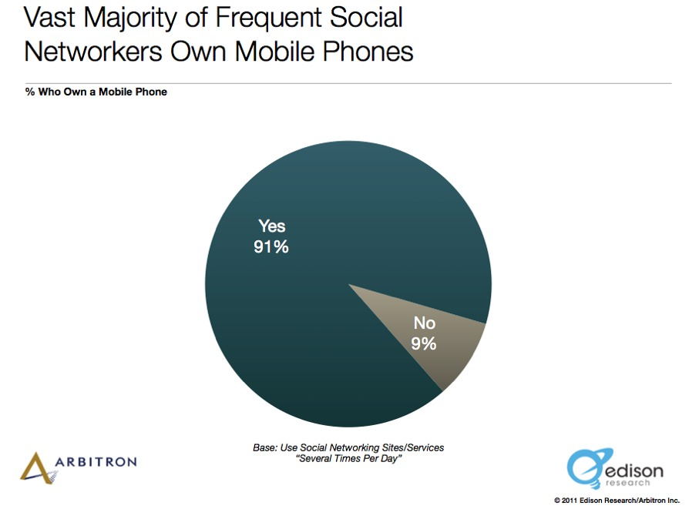
Notes:
Customers behind secure firewalls

Slide 17
4 KEYS TO GREAT MOBILE MARKETING
1
A Mobile Optimized Experience
2
A Great App Experience
3
Being Social in a Mobile World
4
Master Mobile Content

Slide 18
1
Mobile Optimized Experience

Slide 19
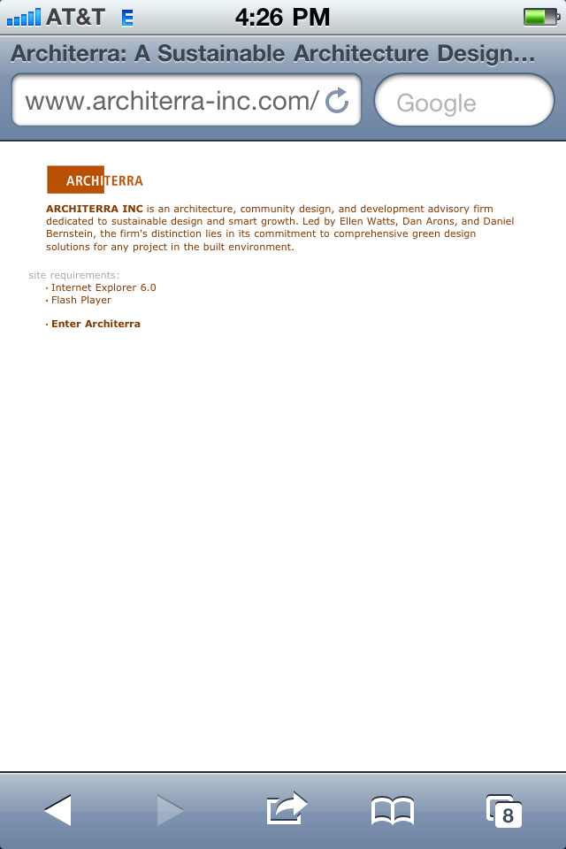

Slide 20
Two Options For Mobile Optimization
Mobile Stylesheet
Mobile Website
OR
Notes:
DPS: Lets find another brand image. This one kind of has low contrast and the text sits funny on top of the bow. (The reason I’m being a tad picky, even though this is an internal document is that it’s possible that this deck is something we share externally at some point. It’s important).

Slide 21
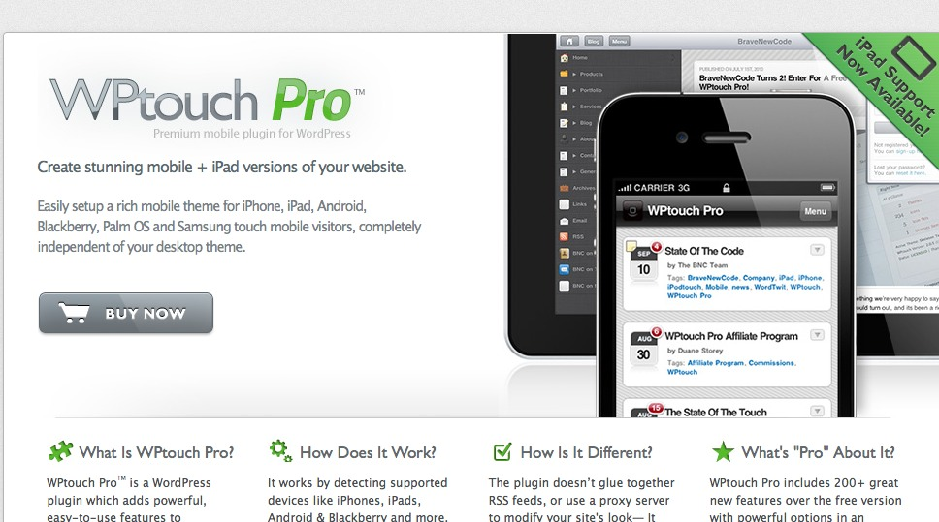

Slide 22

Mobile Optimized Email

Slide 23
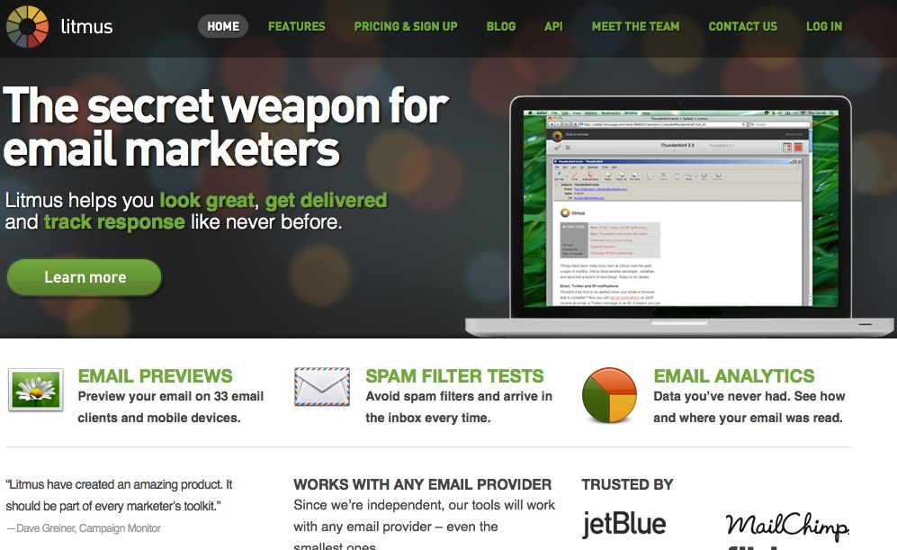

Slide 24
2
A Great App Experience

Slide 25
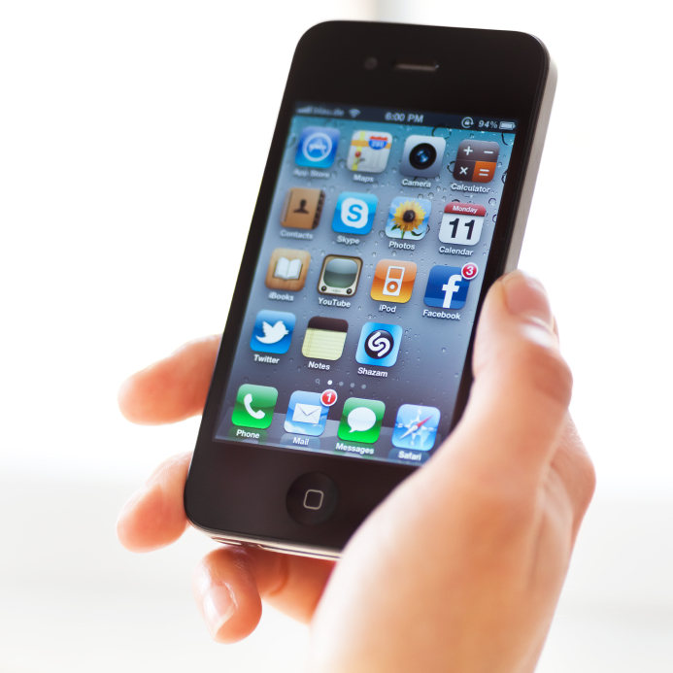
The average iPhone user has
applications.
48

Slide 26
Two Types of Mobile Applications
Native Application
HTML5
OR
Notes:
DPS: Lets find another brand image. This one kind of has low contrast and the text sits funny on top of the bow. (The reason I’m being a tad picky, even though this is an internal document is that it’s possible that this deck is something we share externally at some point. It’s important).

Slide 27
Native apps are designed for
ONLY one
operating system.

Slide 28

Native Apps Provide Depth

Slide 29

HTML5 provides flexibility

Slide 30
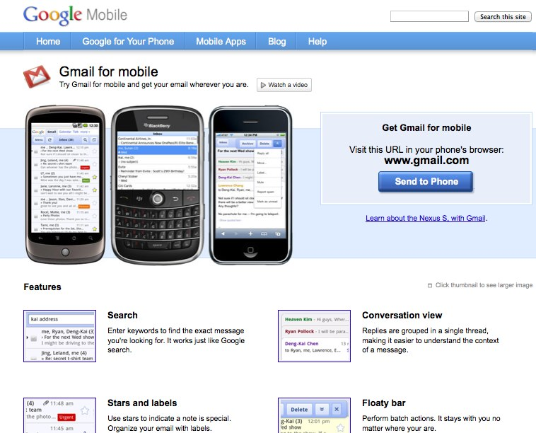
HTML5 Example Gmail.com

Slide 31
A GREAT APP FOCUSES ON
UTILITY NOT TECHNOLOGY.

Slide 32
4 QUESTIONS TO JUDGE MOBILE APP UTILITY
1
What user needs are different in a mobile experience?
2
What mobile features (location, SMS, etc) provide a better experience?
3
What is the business value of creating a mobile app?
4
Are any features or marketing efforts improved by building a native app?

Slide 33
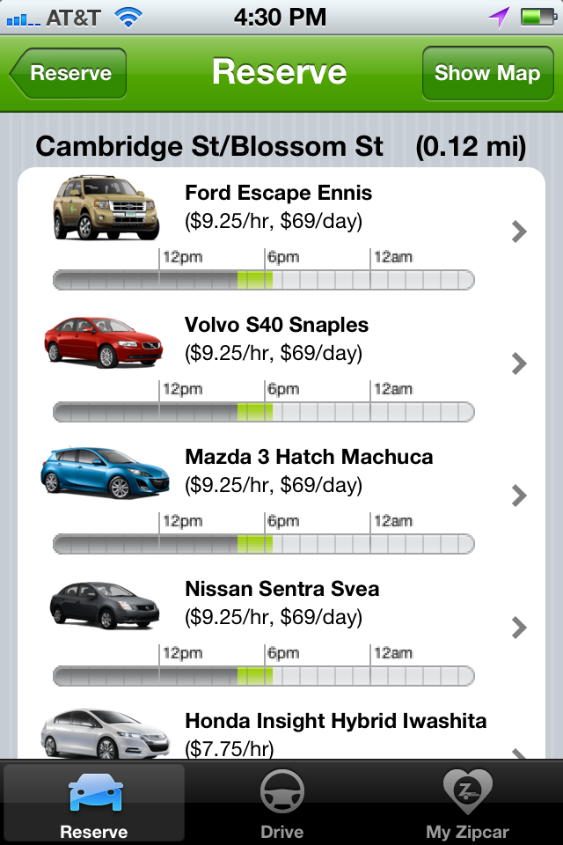
Example: Zipcar
- Leverages Location
- Contextual
- Improves Desktop Experience
- Offers Depth

Slide 34
3
Being Social in a Mobile World

Slide 35
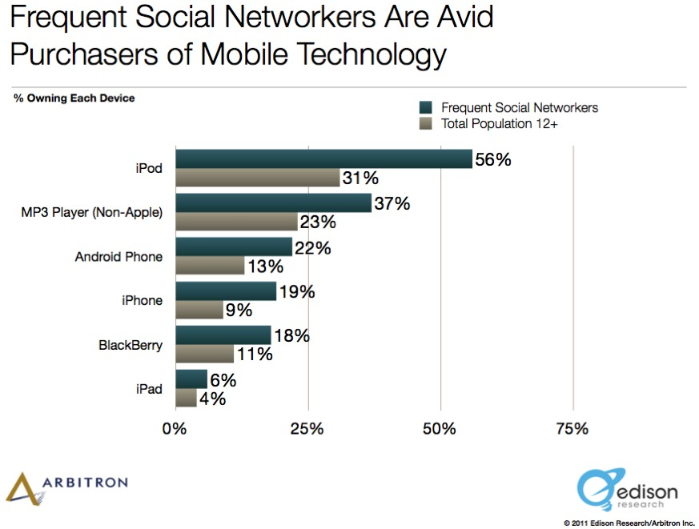

Slide 36
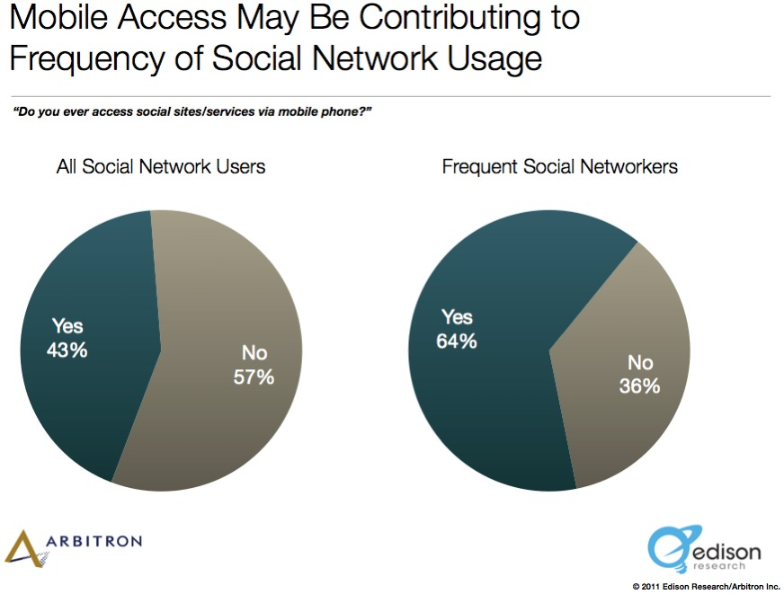

Slide 37
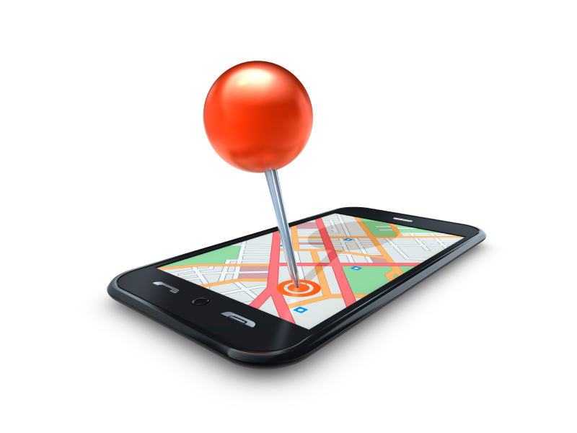
Location is over-hyped.

Slide 38
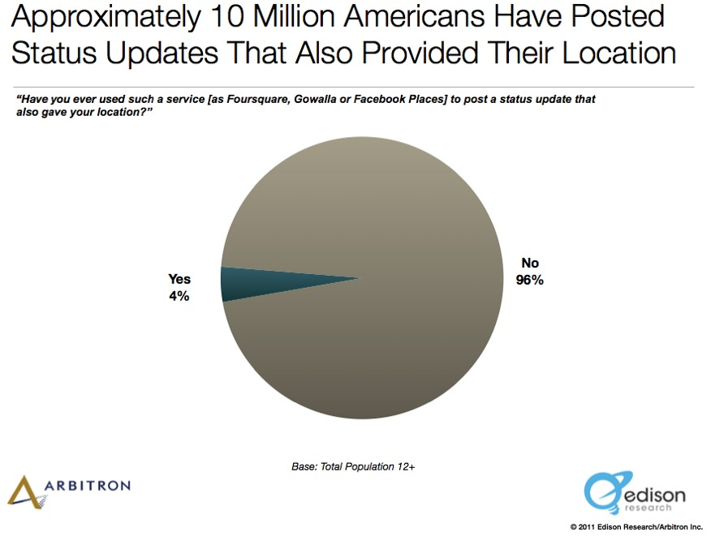

Slide 39
Foursquare
Facebook
800 Million
10 Million

Slide 40
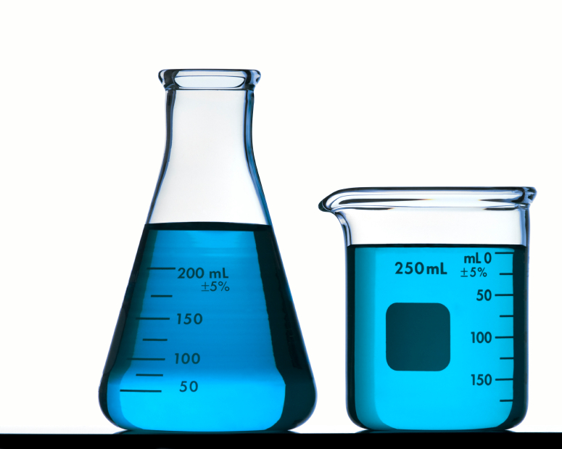
Experiment but don’t be stupid.

Slide 41
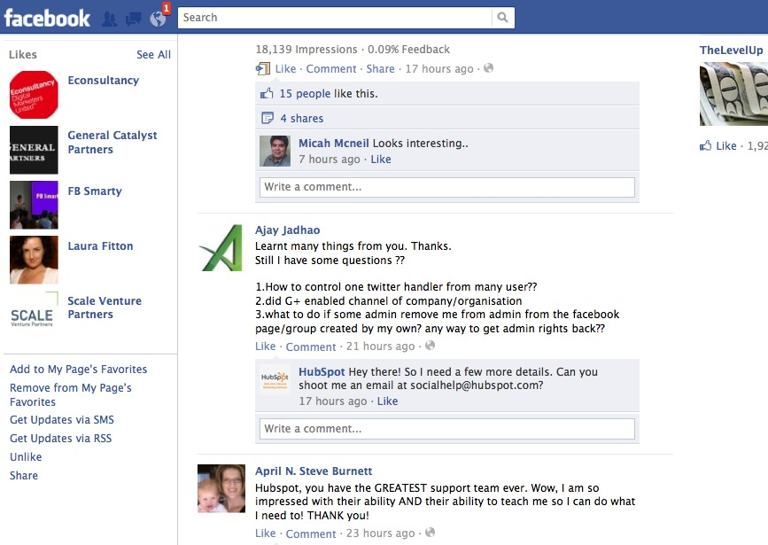
Leverage SMS

Slide 42
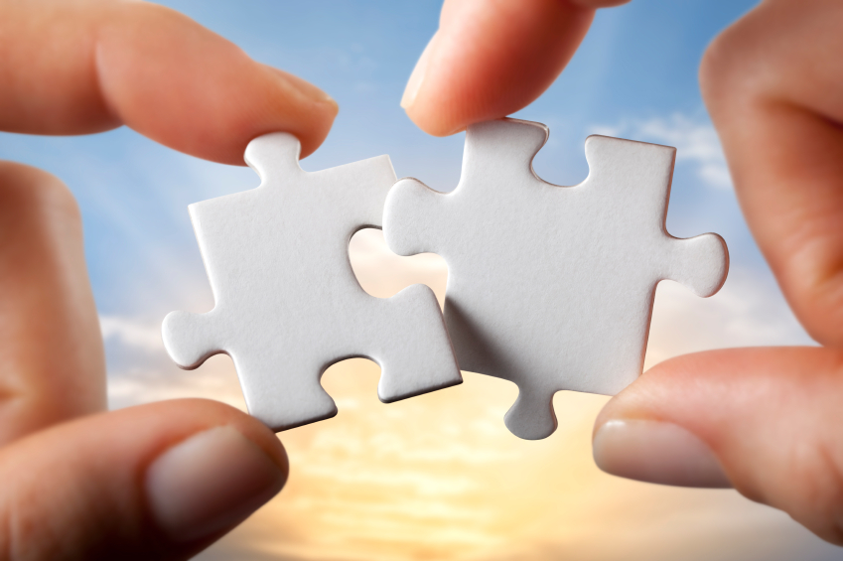
Connect Offline & Online

Slide 43
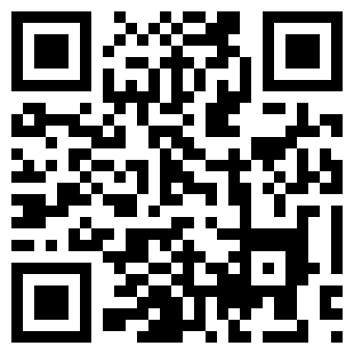
QR Codes

Slide 44
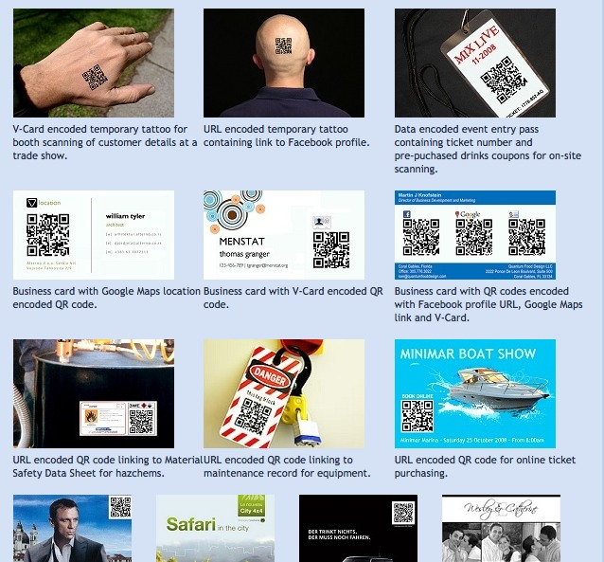

Slide 45
QR Codes Store Information:
1
URL
2
Text
3
SMS
4
Phone Number

Slide 46
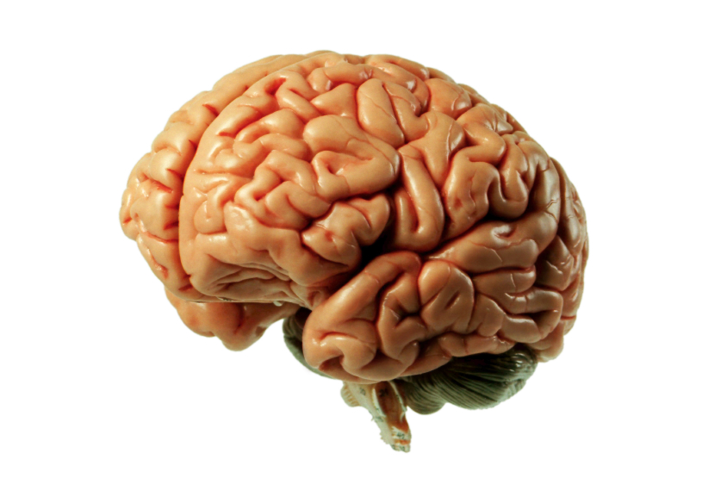
Think about the total experience.

Slide 47
PRETTY PLEASE! STOP USING
QR CODES ONLINE

Slide 48
4
Master Mobile Content

Slide 49

Create Mobile Social Content

Slide 50
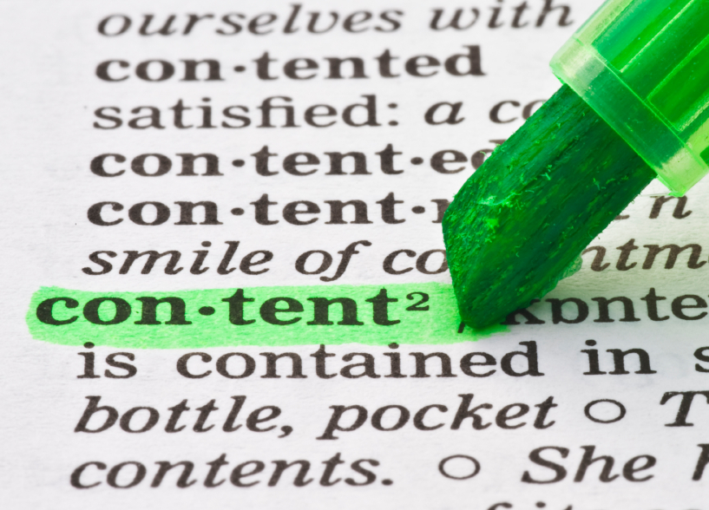
Keep It Short

Slide 51
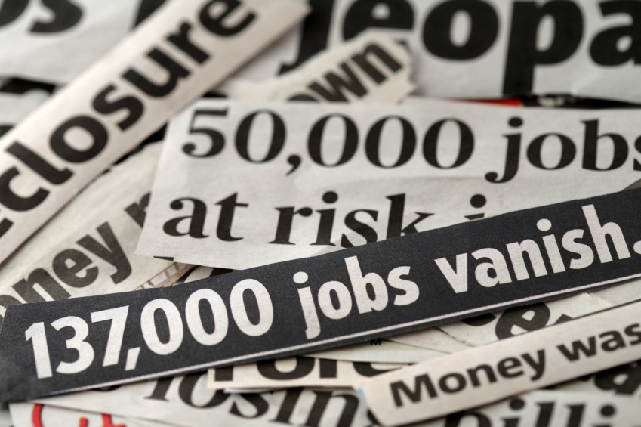
Focus on Headlines

Slide 52

Use Calls-to-Action

Slide 53
Mobile Friendly Transaction Experience

Slide 54
4 KEYS TO GREAT MOBILE MARKETING
1
A Mobile Optimized Experience
2
A Great App Experience
3
Being Social in a Mobile World
4
Master Mobile Content

Slide 55

Mastered the Mystery.

Slide 56

Prove the CEO Wrong.

Slide 57
You’re the Star.

Slide 58
THANK
YOU.

