Slide 1
All About Mary

Slide 2
Mary Loves Sexy
The Design Focused Mary

Slide 3
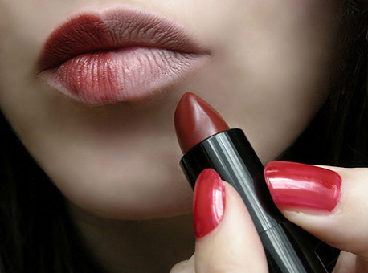
Mary Wants To Impress
Notes:
Mary wants to impress her boss and one of the ways that she does this is by providing things that are sexy. After all she is a marketer and it’s her job to make an OK product sound like something that is wonderful. It is in her DNA to make things more sexy than they are! Because of this she wants things that help her pass along things that are sexy.

Slide 4

Why Does She Care About WordPress?

Slide 5
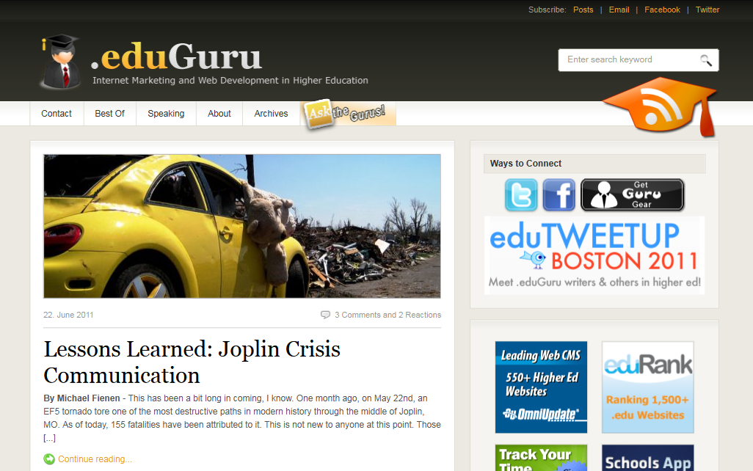
WordPress Themes are Sexy
Notes:
Mary loves the ability to make a WordPress website look sexy and how easy it is to do it.

Slide 6
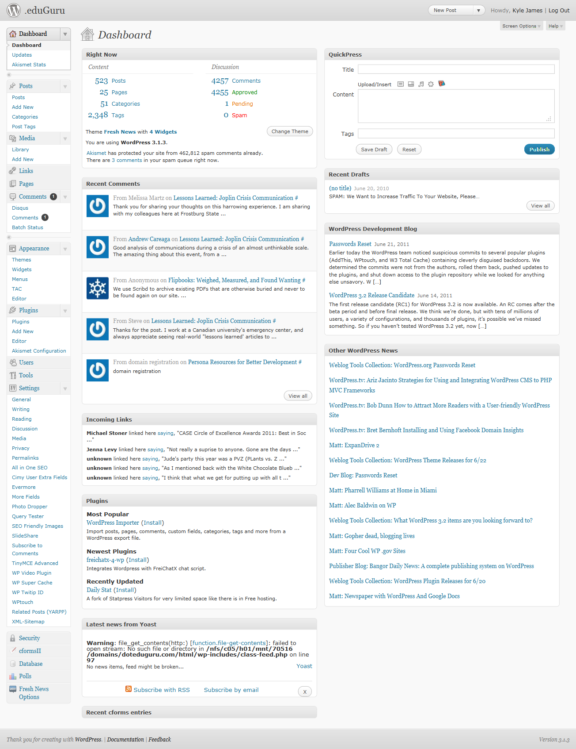
My WordPress Backend
Notes:
Mary doesn’t want to have to figure out the backend of this mess. It’s true that I don’t need all the plugins and things to make that site look that sexy but there are a whole lot of them that go into it. There is like a MILLION options in the backend of WP once you have it really tweaked out right. At this point she’s more confused than if she just took her HS blog.

Slide 7
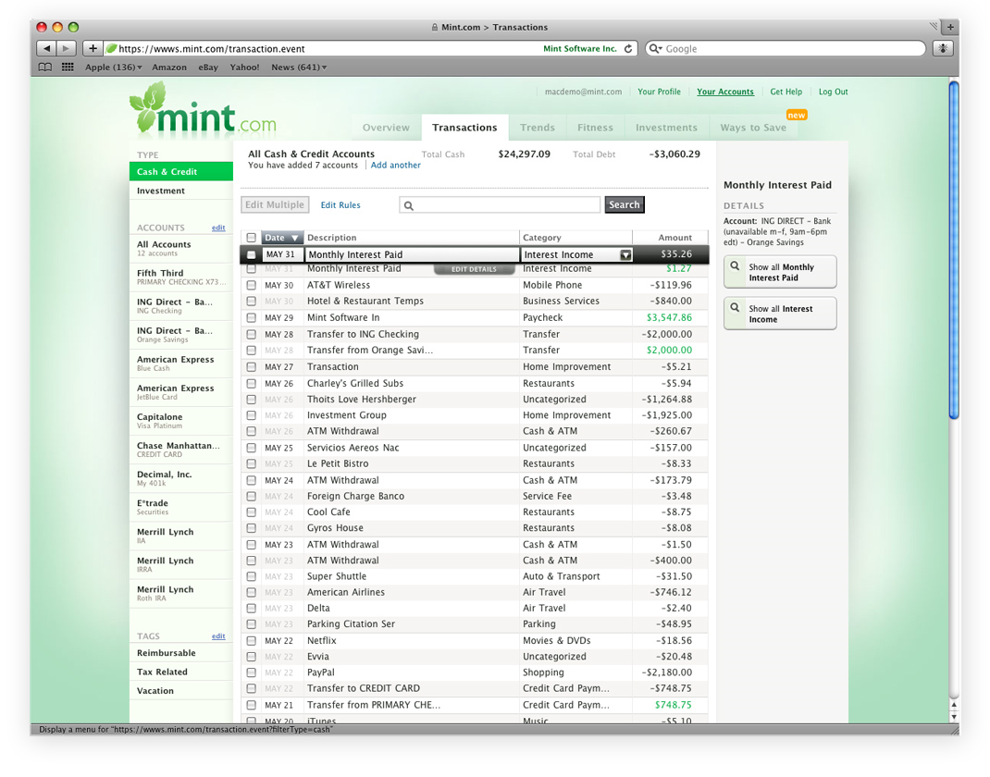
Sexy Makes Data Look Better
Notes:
Mint is actually having major problems keeping up with banks and it looks like they have no intention to continue the service. KJ has actually quit using it in favor of USAA which now brings in all his external accounts.
SEXY MAKES MARY IGNORE BUGS!

Slide 8
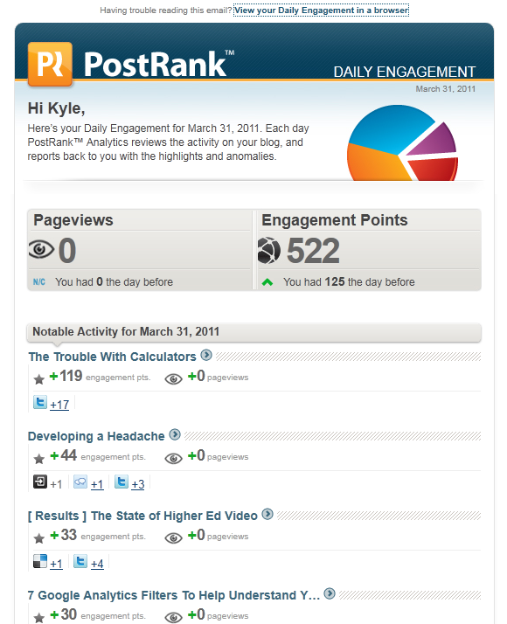
Sexy Make Data Matter
Notes:
What does all this mean? What is Engagement Points? Who cares because it looks sexy! Do I really care about every detail of who tweeted, delcious, reddit, etc my article?

Slide 9
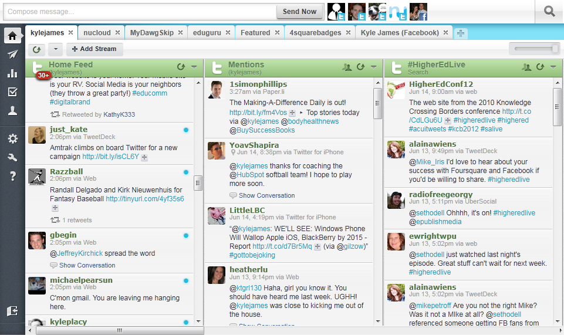
Sexy Organizes Better
Notes:
Nice clean UI helps me organize the data and I want to look at it longer. She thinks there is a magical ability to help me find the needle in a haystack

Slide 10
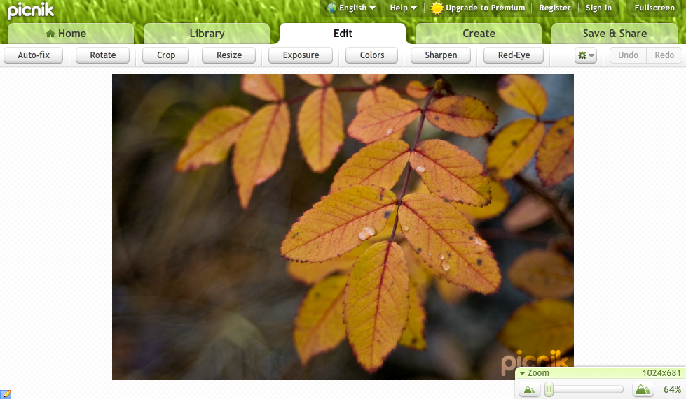
Sexy Makes It Fun

Slide 11
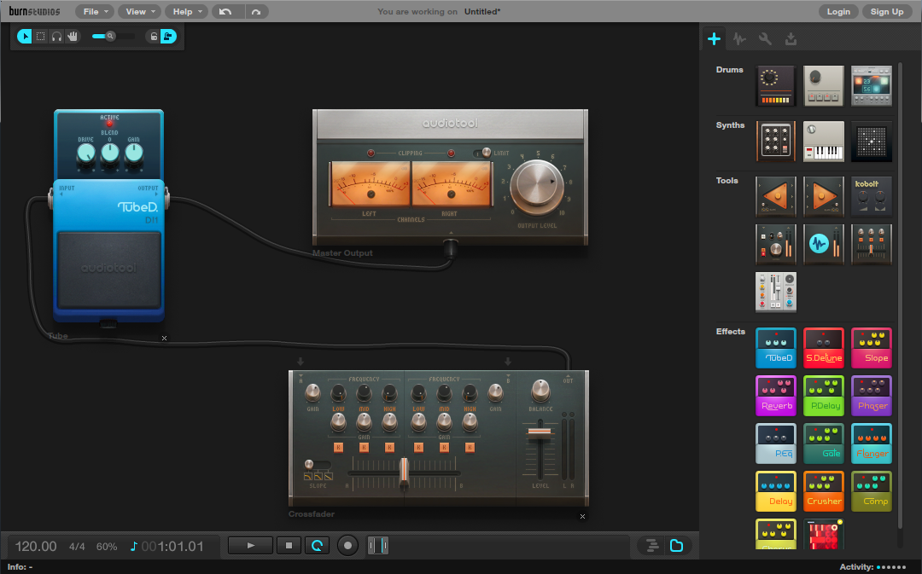
Sexy Makes It Work Better
Notes:
Do you know anything about mixing audio? Probably not… but something that looks sexy is a lot more likely to get Mary to want to try and use it.

Slide 12
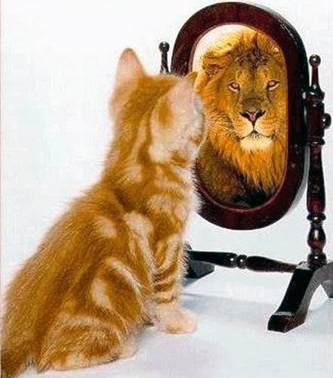
To Design Mary - Perception Is Reality
Notes:
It’s Mary’s job to sell a dream that she hands off to sales people to close. To her perception is everything. If something is perceived as valuable then she has done her job.

Slide 13
Meet Mollie

Slide 14
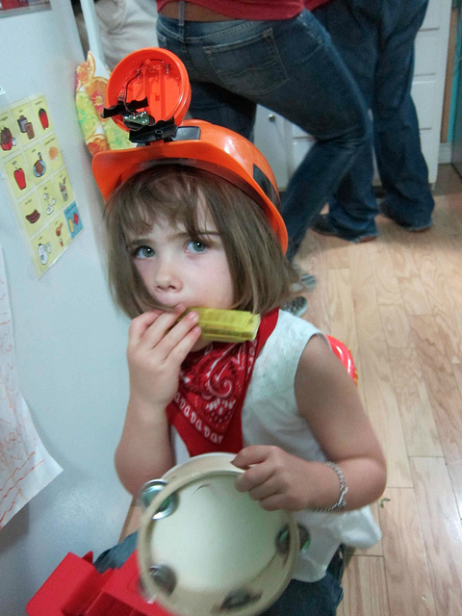
a
one-woman show
Flickr photo credit: betsssssy
Notes:
http://www.flickr.com/photos/betsssssy/5052901015/
Mollie is a one-person marketing team. She typically works at a smaller business and owns everything related to marketing, from lead gen to PR to product marketing.
To get this job, and to keep this job, she must be a jack-of-all-trades, someone who can do a little bit of everything.
In that sense, she’s like an Ollie with a lot to do, short on time/budget/resources, but understands how marketing works and has used a bunch of tools to get that job done.

Slide 15

intersection of the business
Flickr photo credit: revivaling
Notes:
http://www.flickr.com/photos/revivaling/5728158227/in/photostream/
What’s really interesting about Mollie’s job is that she works at the intersection of every part of the business. I believe this is true about marketing in general, but when you get into larger organization with a larger marketing team, you have marketers who specialize in different areas. With Mollie being a one-person team, she gets to see how marketing fits into the larger organization.
Marketing is at the cross-roads of all the other departments – from sales to finance to product development.

Slide 16
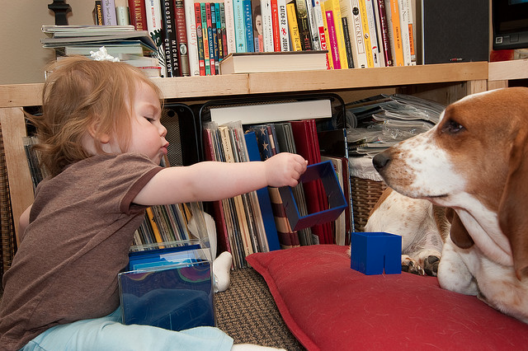
play nice
Flickr photo credit: walakazoo
Notes:
http://www.flickr.com/photos/walakazoo/3467719202/in/photostream/
Because of this, Mollie has to work well with all the other execs or depts in the company. She needs to be able to communicate well with them and to understand what’s important to them. For sales, it might be “how many awesome leads are you generating for me today?” For product development, it might be, “what are our potential customers’ goals and challenges?” For finance, it might be, “how can you cut your budget?” ☺ Mollie needs to be able to answer each of these questions.

Slide 17
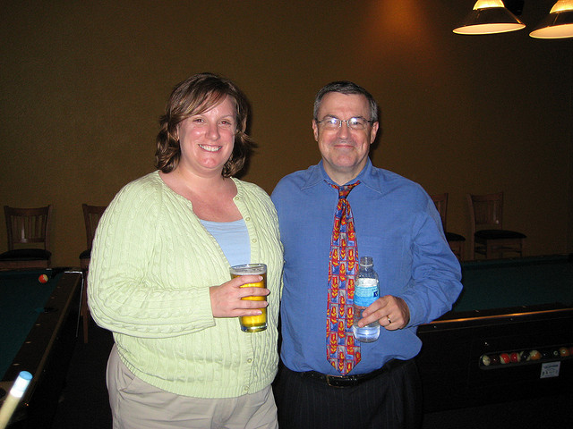
Notes:
Example: sitting next to Heidi when I started
-get the feedback
-have the conversation about what’s important and what’s not

Slide 18

Trash vs. Keep
Flickr photo credit: epsos
Notes:
http://www.flickr.com/photos/epsos/5693012875/in/photostream/
Mollie’s a busy person with limited time and budget. She needs to make the most of what’s available to her, so she needs to be ready to cut what’s not valuable. To do that, she needs to know what is or is not valuable. She’ll spend a fair amount of time evaluating different marketing programs – even as broad as PR vs. lead gen – and making a call as to which to spend her time on today.

Slide 19

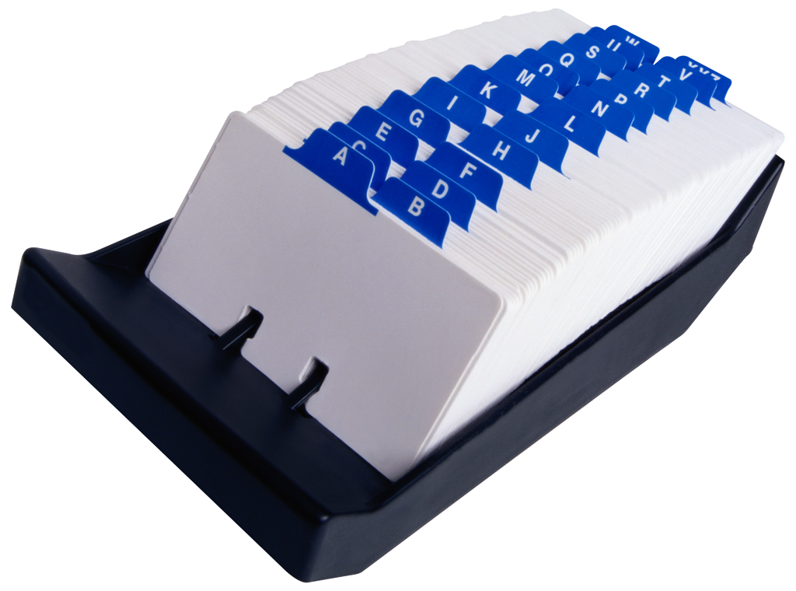
vs.
Notes:
Example: focusing on IMS 2008 sponsors vs. new lead gen

Slide 20
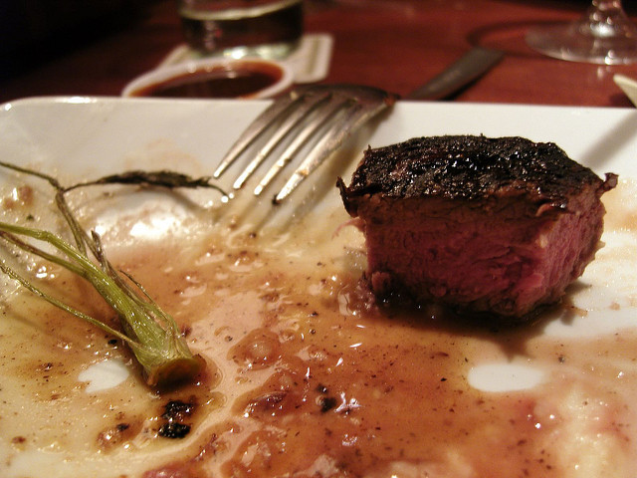
more steak than sizzle
Flickr photo credit: basheertome
Notes:
http://www.flickr.com/photos/basheertome/2113908770/in/photostream/
And so, Mollie needs to make decisions and see results – she’ll experiment with new tools or techniques, but this thing just needs to work.

Slide 21










Notes:
Example: webinar providers
Oh, we were willing to try new ones. But one after another, they didn’t work.

Slide 22

How easily can we
get there?
Notes:
Mollie already has an overly packed schedule, with not a lot of time to try things out for fun or make a lot of effort just to try something that she’s skeptical of.
Case in point: I don’t really use trials. Because of the set up involved, I’m either going to commit and go full-force or not bother.
Anything that leverages what she’s already got going on – processes, systems, etc. helps. Integration definitely helps here.
Back to the webinar example – test events/trials didn’t mean anything to me, let’s just jump in and get there.

Slide 23

Low on budget…
I mean, scrappy.
Flickr photo credit:31274030@N08
Notes:
http://www.flickr.com/photos/31274030@N08/4520904259/in/photostream/
Mollie typically doesn’t have a lot of money to spend. She’s willing to put in some extra time or pain to get something to work on the cheap.
That also means Mollie is somewhat tech-savvy, or willing to try to figure things out on her own.

Slide 24
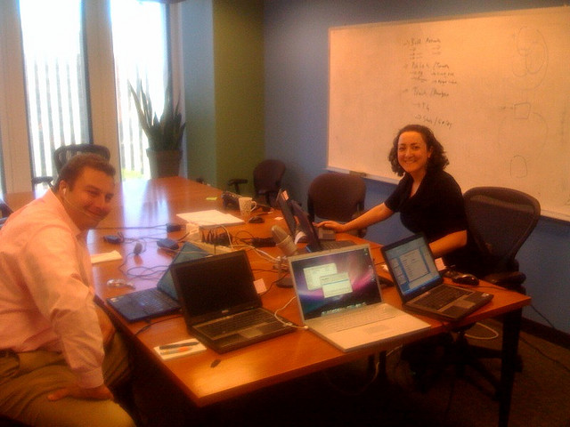
Flickr photo credit: Rick Burnes
Notes:
http://www.flickr.com/photos/93363727@N00/2929736774/in/photostream/
Example: the webinar disaster of 2008
3 people, 6 computers, 2 gotowebinars

Slide 25

lonely
Flickr photo credit: 62446298@N00
Notes:
http://www.flickr.com/photos/62446298@N00/2838339289/in/photostream/

Slide 26

the whole picture

Slide 27
Sales Focused Mary

Slide 28


Slide 29






Slide 30
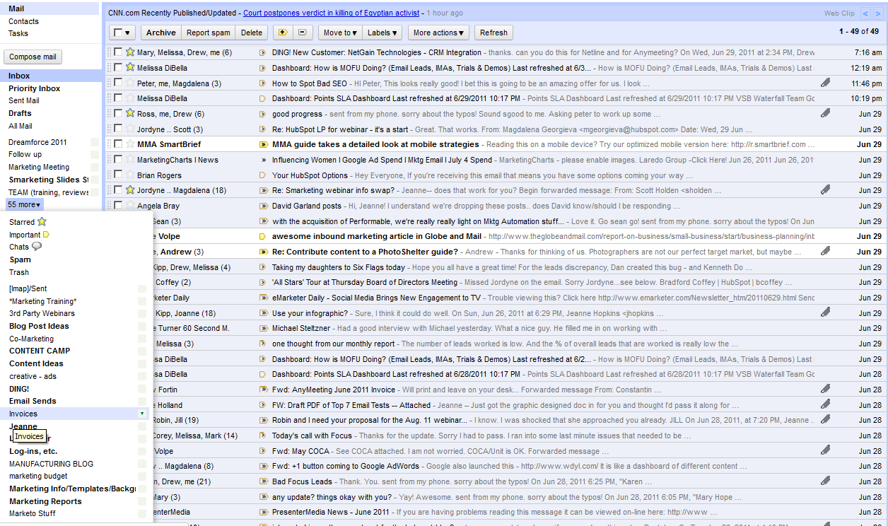

Slide 31
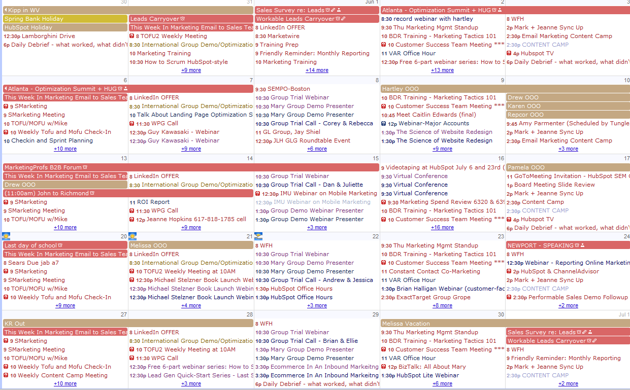

Slide 32
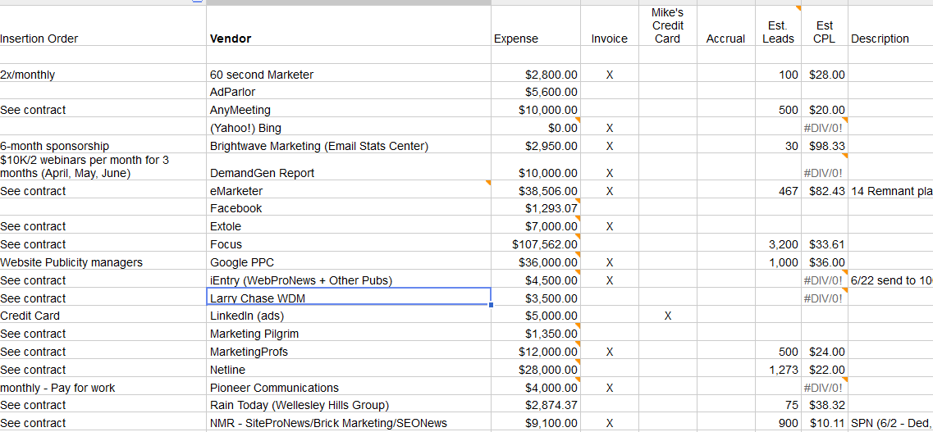
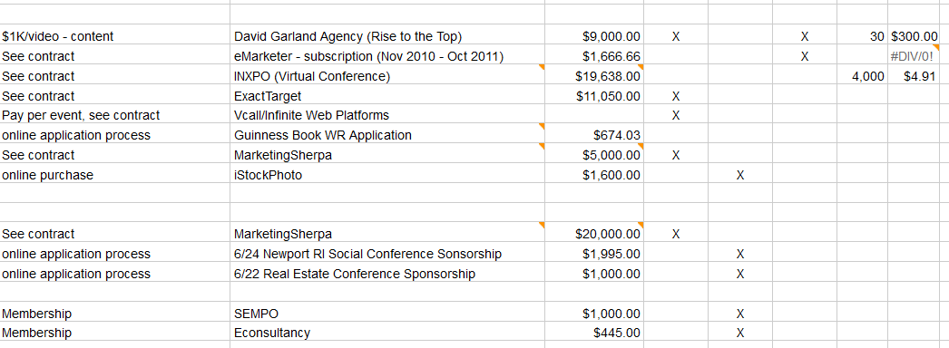

Slide 33

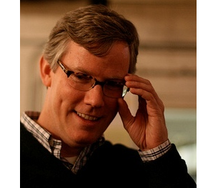



Slide 35

“Curse of Knowledge”

Slide 36
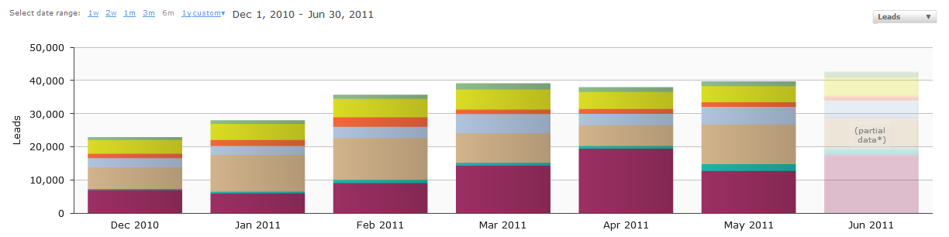
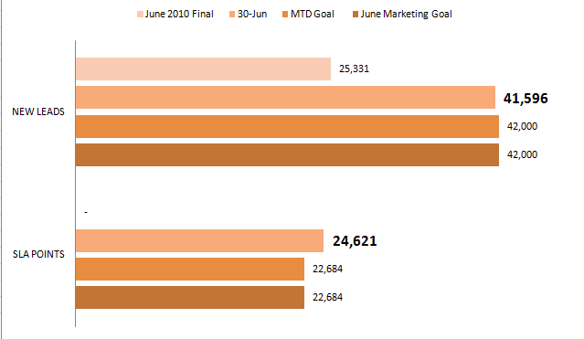

Slide 37







Slide 38
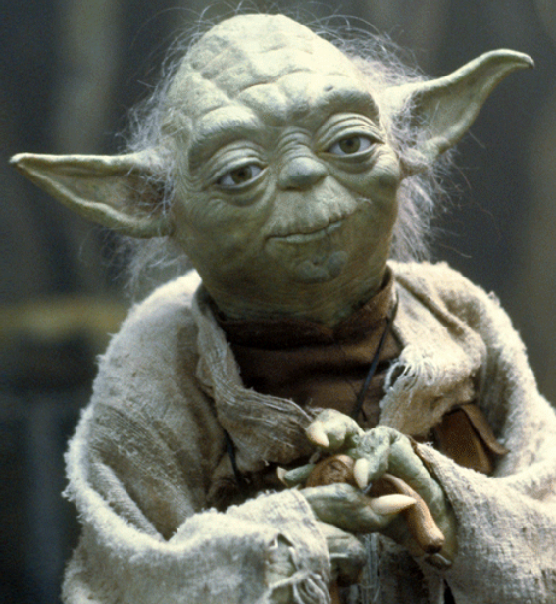

Slide 40
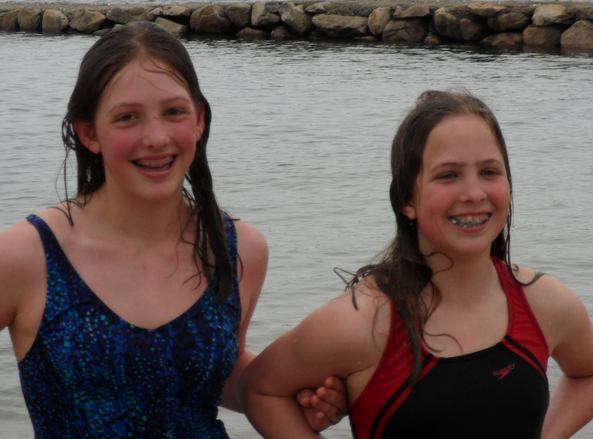

Slide 41
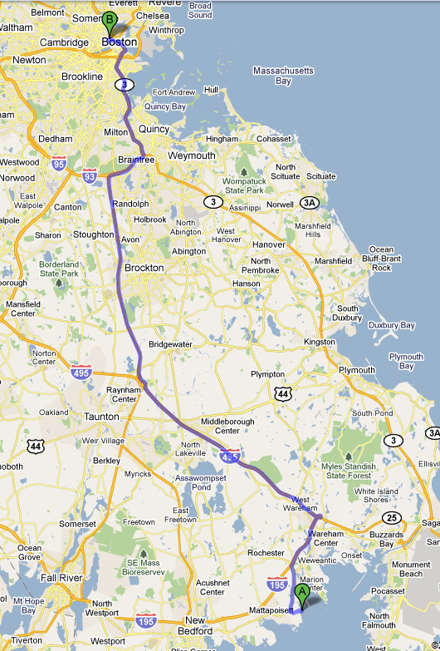

Slide 42


Slide 43
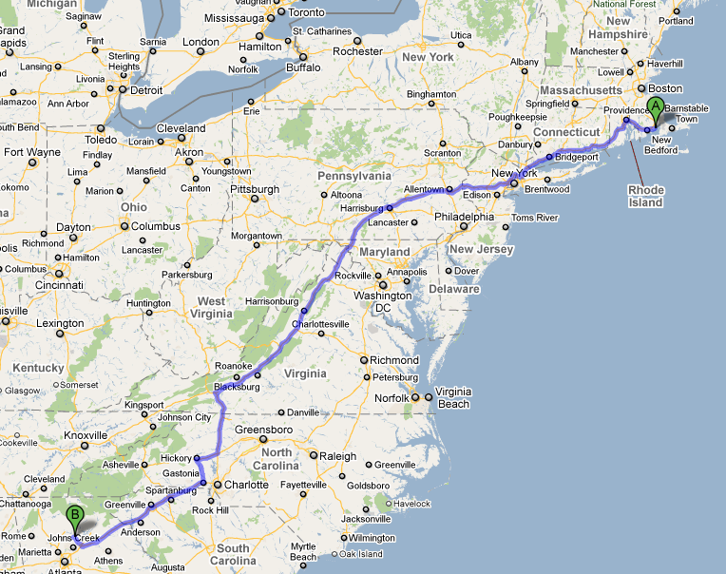

Slide 45


Slide 46
