Slide 1

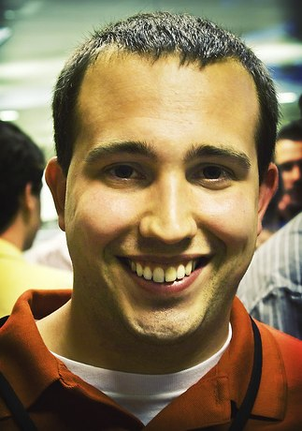

Workshop: B2B Social Media
Building and Socializing Your B2B Marketing Strategy
Kipp Bodnar
Inbound Marketing Manager

Slide 2


Slide 3

B2B > B2C

Slide 4

What is a lead?

Slide 5
Goals
15 minutes

Slide 6

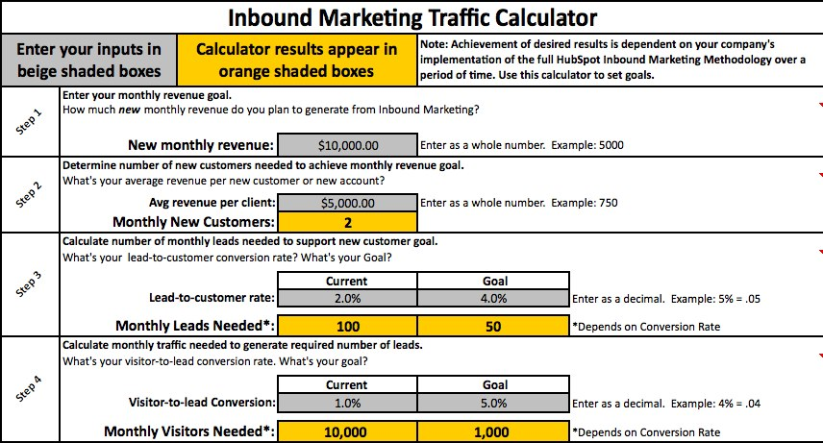
Download: http://bit.ly/LeadsCalc

Slide 7

Content

Slide 8
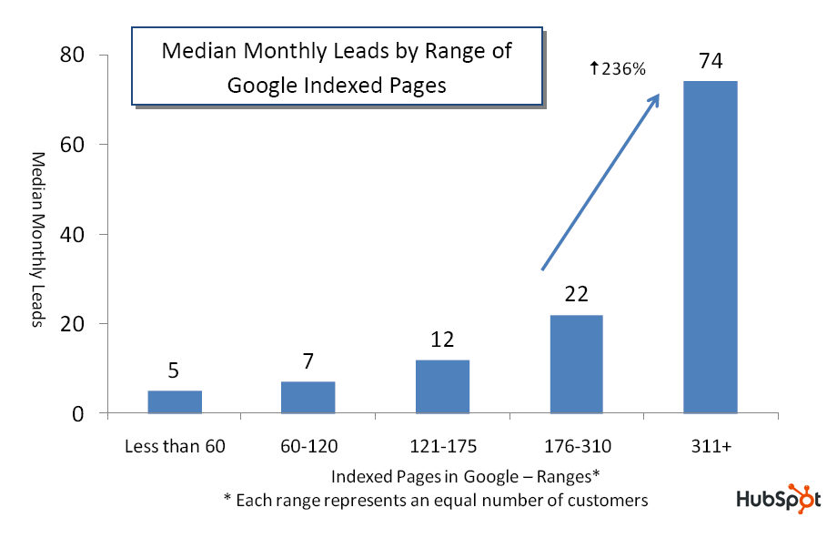
Source: State of Inbound Marketing Lead Generation Report - http://bit.ly/cVMpkn

Slide 9
Content Audit
15 Minutes
Notes:
Offers, Customer Questions, 10 Blog Post Headlines

Slide 10
3 Offers

Slide 11
5 Customer Questions

Slide 12
10 Blog Post Titles

Slide 13

Blogging

Slide 14
Blog Outline
20 Minutes
Notes:
Offers, Customer Questions, 10 Blog Post Headlines

Slide 15
Determine Blog URL

Slide 16
Determine Bloggers

Slide 17
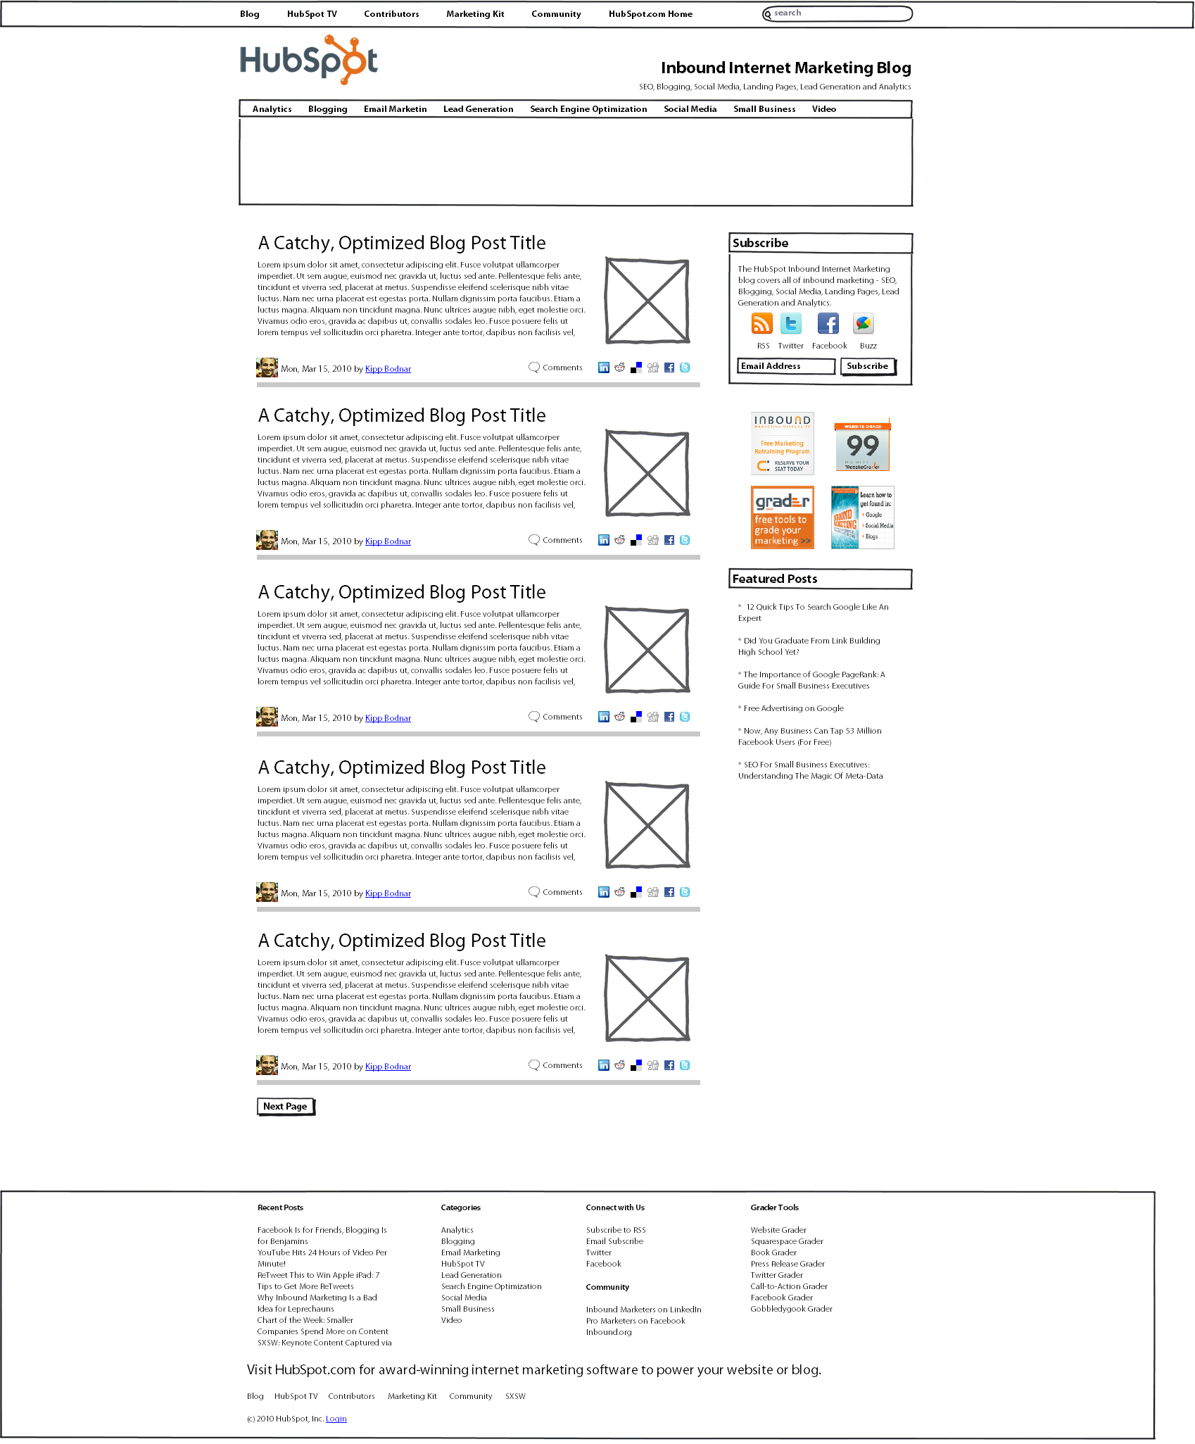
Blog Wire Frame

Slide 18
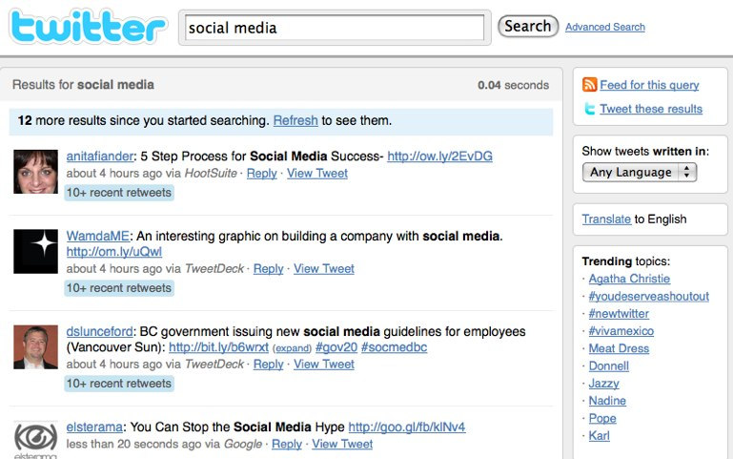
Social Media

Slide 19
Channel Research
15 Minutes
Notes:
Offers, Customer Questions, 10 Blog Post Headlines

Slide 20
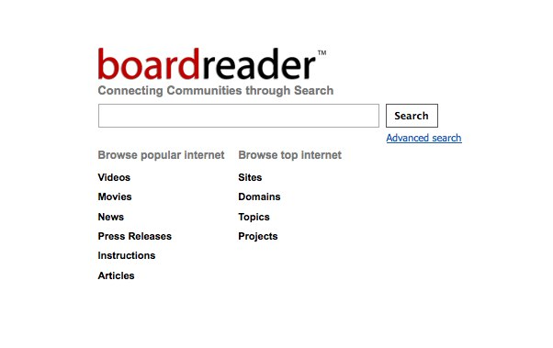
BoardReader.com

Slide 21
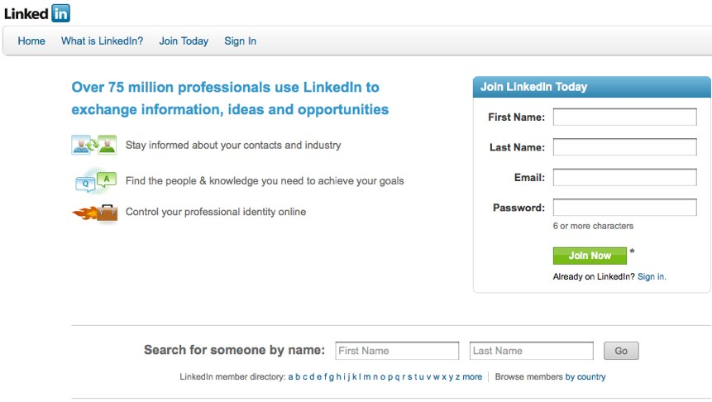
LinkedIn Groups

Slide 22
Twitter #Chats
http://bit.ly/TwitterChatDoc

Slide 23

Tracking

Slide 24
Tracking Setup
20 Minutes
Notes:
Offers, Customer Questions, 10 Blog Post Headlines

Slide 25
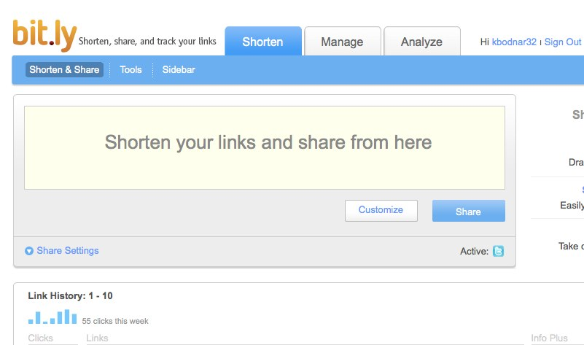
Set Up Bit.ly

Slide 26
Map Channel Tracking

Slide 27
?’s
@Kbodnar32
Blog.Hubspot.com

