Slide 1

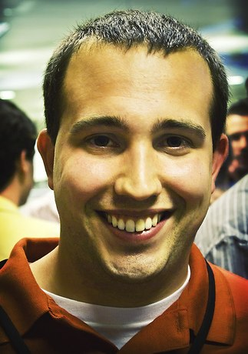

B2B Social Media
Driving and Measuring Conversations, Leads and Sales
Kipp Bodnar
Inbound Marketing Manager

Slide 2


Slide 3
Please Tweet questions and comments to @Kbodnar32
The Hashtag is #B2BLeads.

Slide 4

B2B > B2C

Slide 5

Focus
Notes:
B2B Companies Have Focus that B2C could only hope to have.

Slide 6

Expertise

Slide 7


Slide 8

Customers<
Notes:
B2B Social Media Doesn’t Work If

Slide 9

Blocked
Notes:
Customers behind secure firewalls

Slide 10

Advocate
Notes:
Don’t have management support from at least one member

Slide 11

Velocity & Volume
Notes:
Lots of sales fast.

Slide 12

Resources

Slide 13
Leads

Slide 14

What is a lead?

Slide 15
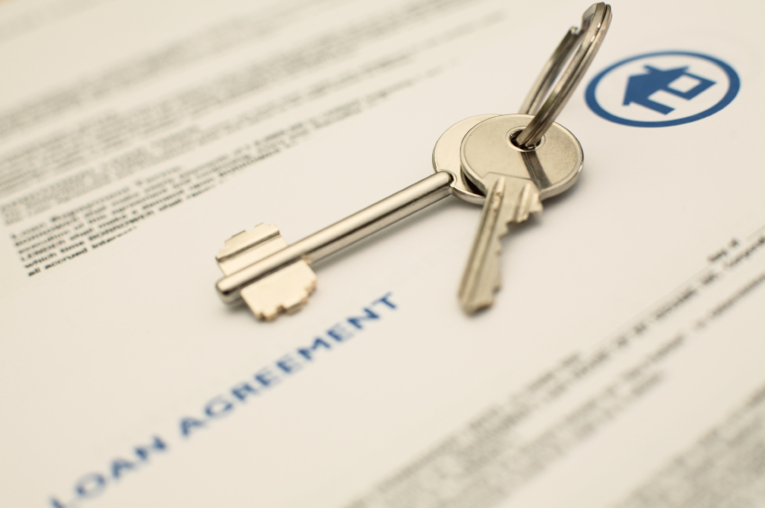
Service Level Agreement

Slide 16
Top Of The Funnel

Slide 17

Basics
Notes:
Having a clean goal focused site

Slide 18

Landing Pages

Slide 19
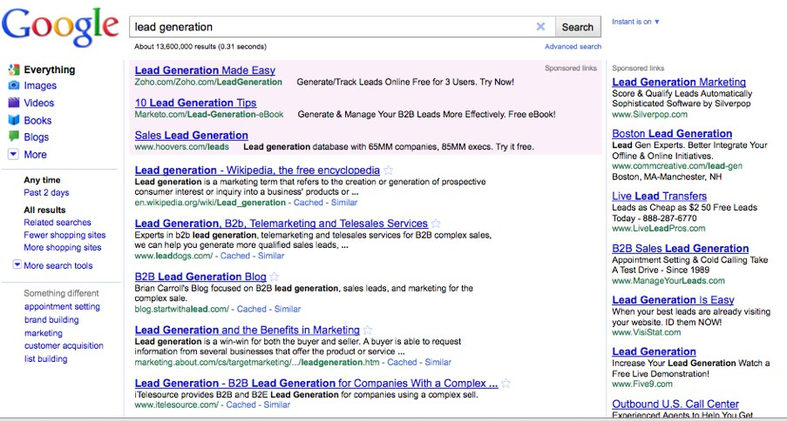
Keywords

Slide 20

Content

Slide 21

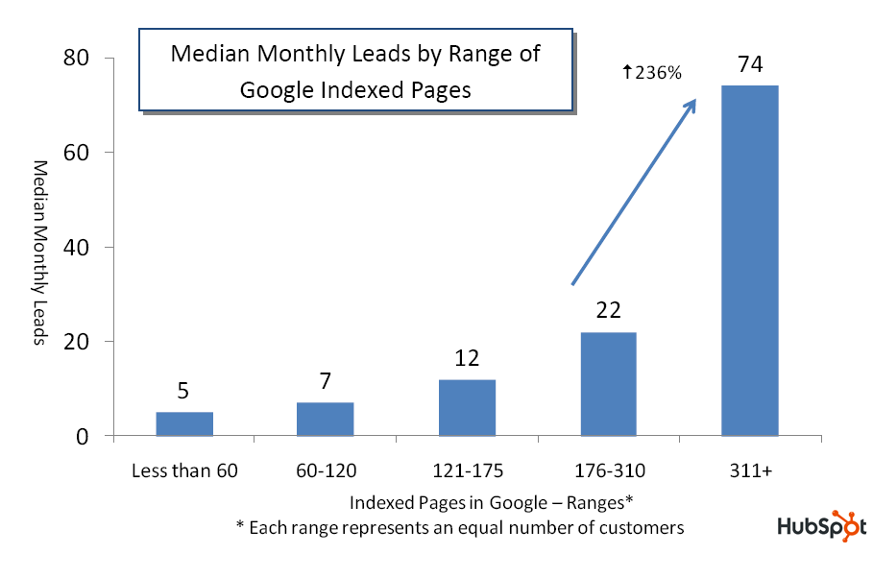
Source: State of Inbound Marketing Lead Generation Report - http://bit.ly/cVMpkn

Slide 22
Takeaway:
Content creation correlates to organic lead growth.

Slide 23

Conversion= Content+CTAs

Slide 24
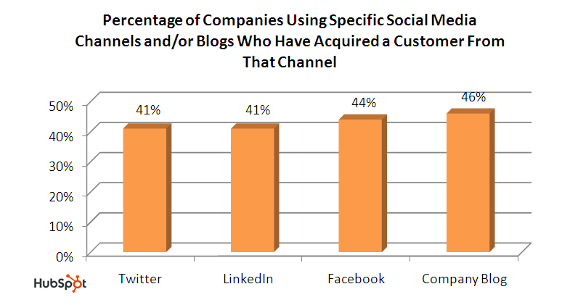
Source: State of Inbound Marketing Report - http://bit.ly/aewfHr

Slide 25
Takeaway:
Leads come from multiple social channels depending on industry and strategy.

Slide 26
Engagement Is Not A Goal

Slide 27

Blogging

Slide 28
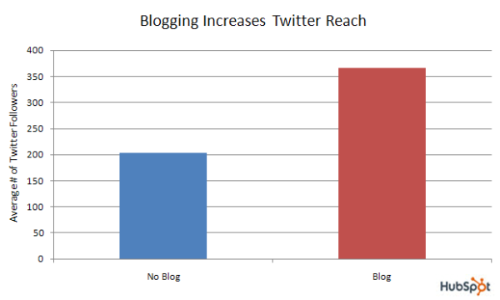
Source: Data from over 2,000 businesses - http://bit.ly/a6SrWh

Slide 29

Headlines Win

Slide 30

Segment

Slide 31

Optimized

Slide 32
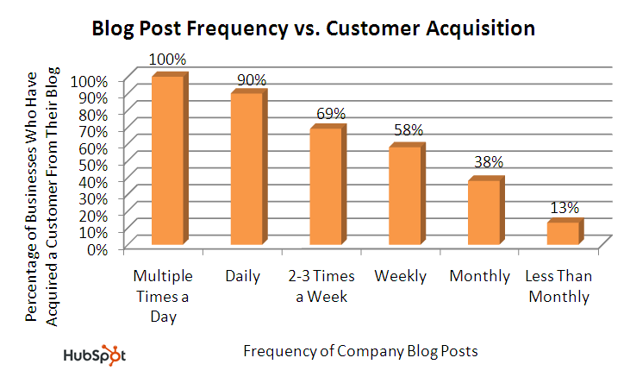
Source: State of Inbound Marketing Report - http://bit.ly/aewfHr

Slide 33
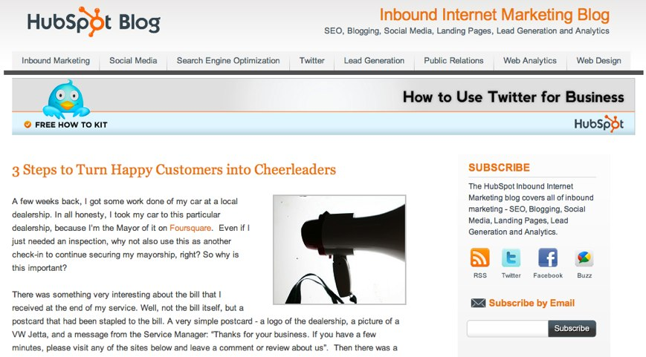
CTAs

Slide 34
Leverage for SEO

Slide 35

Customers>You

Slide 36

Everyone

Slide 37
Takeaway:
Business blogging drives leads and provides a hub for search and social media visitors.

Slide 38
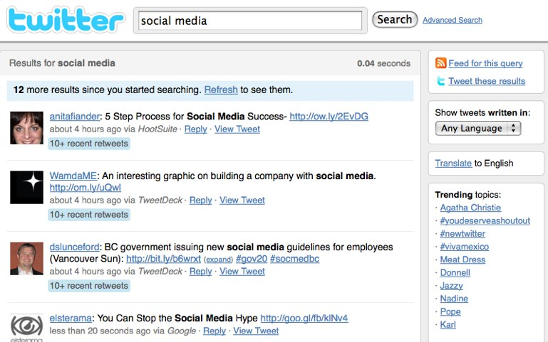
Social Media

Slide 39
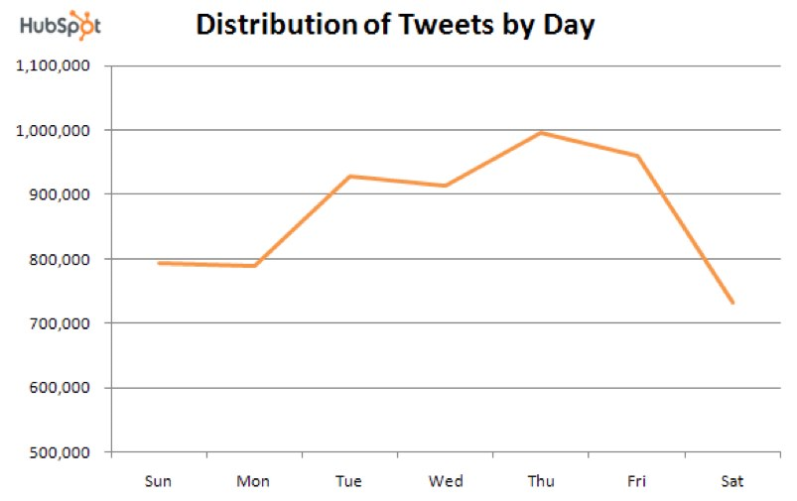
Source: State of the Twittersphere Report - http://bit.ly/5RXUDu

Slide 40
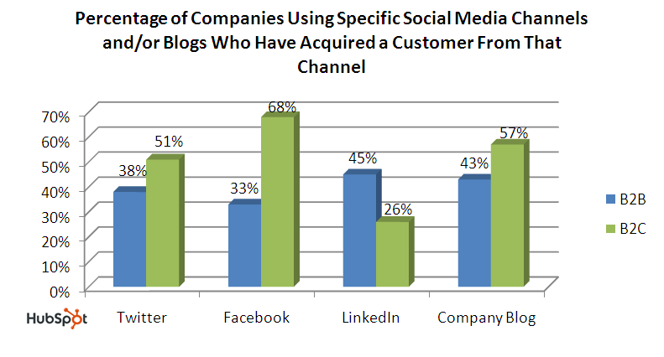
Source: State of Inbound Marketing Report - http://bit.ly/aewfHr

Slide 41

Email

Slide 42
Email+Search+ Social

Slide 43
Testing Ground

Slide 44
Middle of The Funnel

Slide 45

Tracking

Slide 46
URLs = Meta Data

Slide 47

Content
Templates

Slide 48

Lead Source

Slide 49
Takeaway:
Have analytics in place to measure and provide insight around lead sources.

Slide 50
Social + CRM = ROI

Slide 51
Bottom of the Funnel

Slide 52
Measure: Visit to Customer

Slide 53
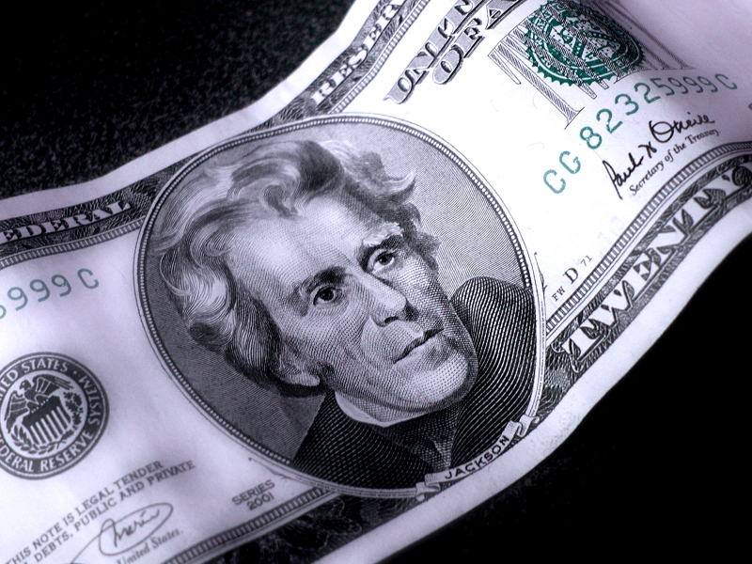
COCA

Slide 54
TLV

Slide 55
Takeaway:
Social Media = More Engaged, Lower Cost Customers

Slide 56
?’s
@Kbodnar32
Blog.Hubspot.com

