Slide 1

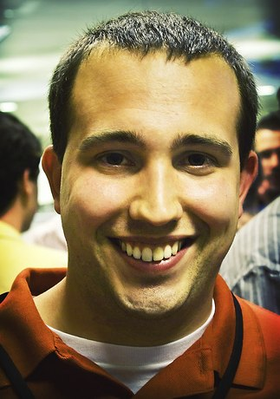

Inbound Marketing
How to Leverage Content Creation and Ditch Outbound
Kipp Bodnar
Inbound Marketing Manager

Slide 2


Notes:
Customers behind secure firewalls

Slide 3
Please Tweet questions and comments to @Kbodnar32
The Hashtag is #CEInbound.

Slide 4


Slide 5
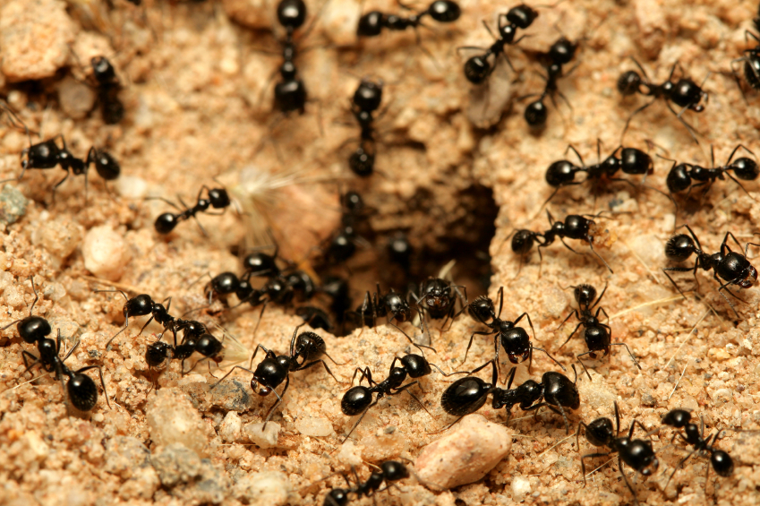
Inbound VS Outbound

Slide 6

Outbound

Slide 7

TV Ads

Slide 8

Cold Calling

Slide 9

Print Ads

Slide 10

Tradeshows

Slide 11
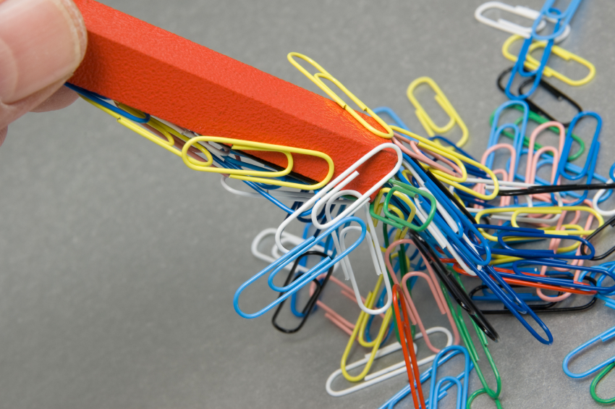
Inbound

Slide 12

Blogging

Slide 13

Organic Search

Slide 14
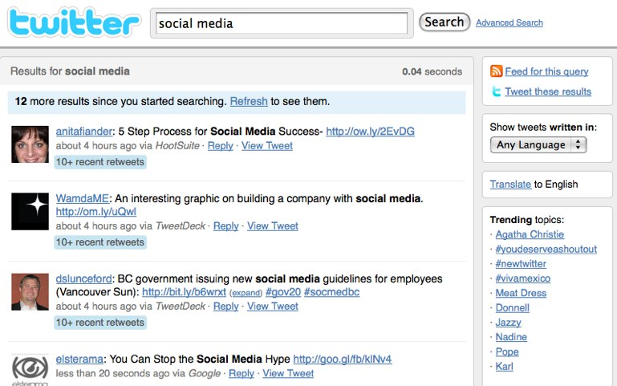
Social Media

Slide 15

Landing Pages

Slide 16
Get Found

Slide 17

Content

Slide 18


Slide 19
Static. Lifeless. Generic.

Slide 21
1,654

Slide 23
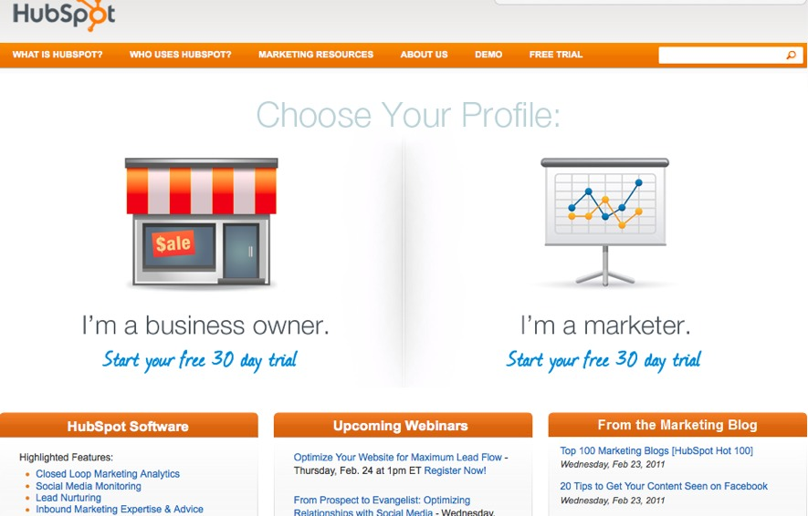

Slide 24
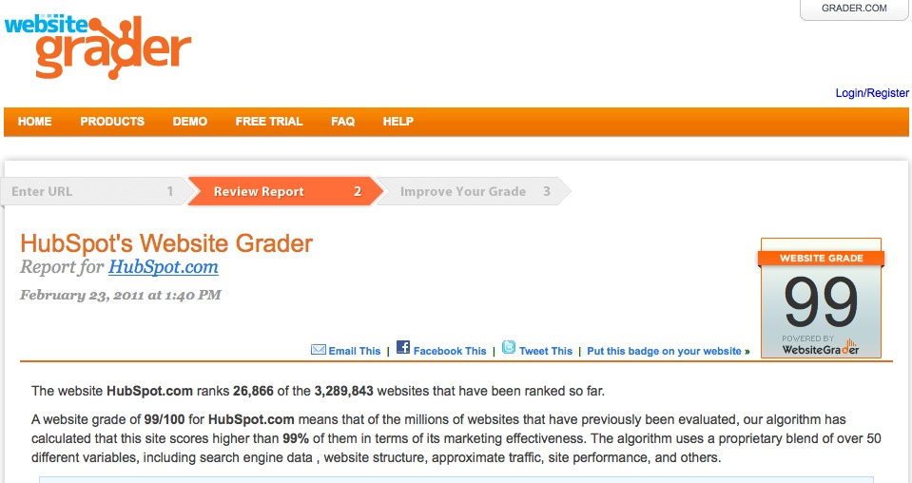

Slide 25
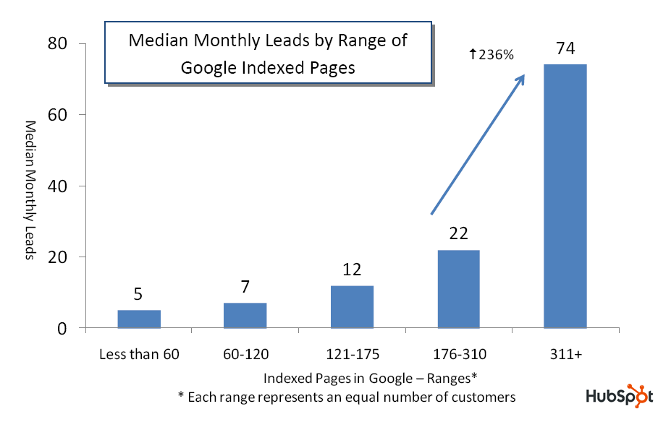
Source: State of Inbound Marketing Lead Generation Report - http://bit.ly/cVMpkn

Slide 26


Slide 27
Blogging

Slide 28
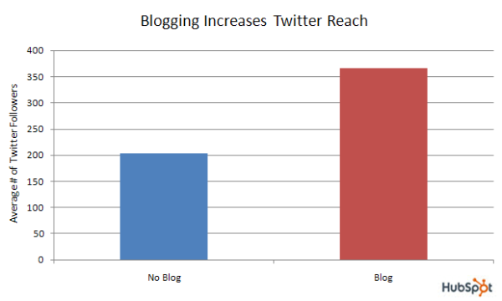
Source: Data from over 2,000 businesses - http://bit.ly/a6SrWh

Slide 29

Headlines Win

Slide 30
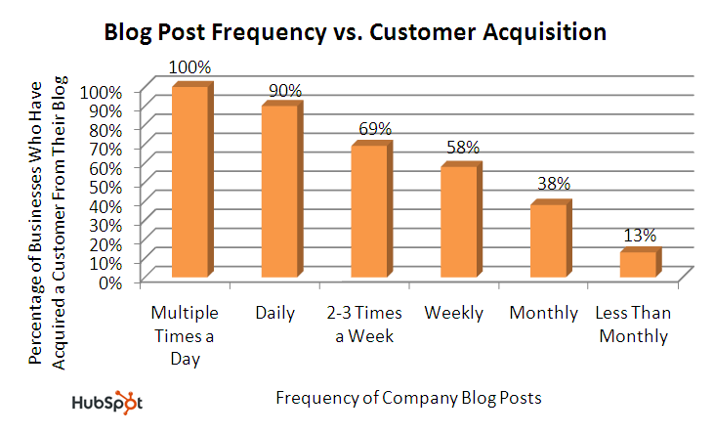
Source: State of Inbound Marketing Report - http://bit.ly/aewfHr

Slide 31
Social Media

Slide 32


Slide 33
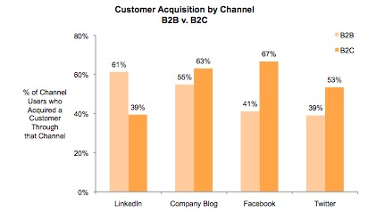
Source: State of Inbound Marketing Report - http://bit.ly/aewfHr

Slide 34
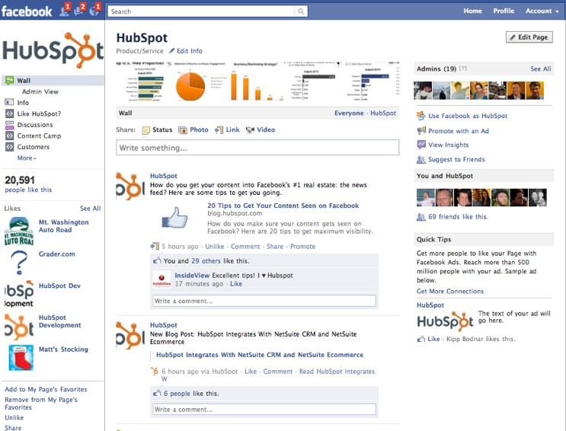

Slide 35
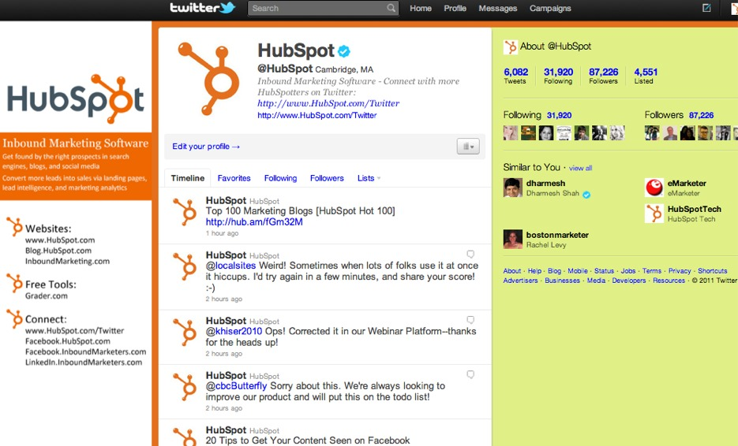

Slide 36
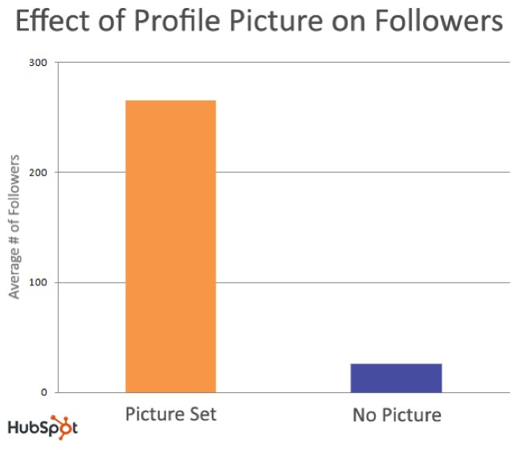
Source: Science of Twitter - http://bit.ly/dVkqDd

Slide 37
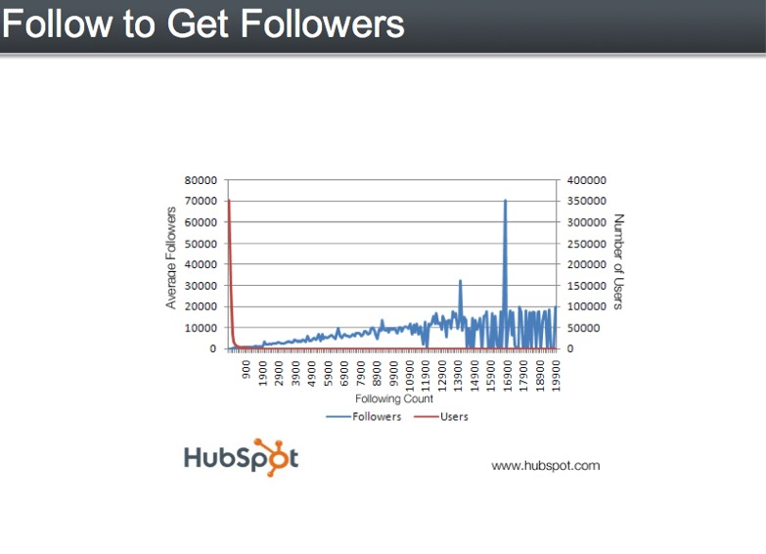
Source: Science of Twitter - http://bit.ly/dVkqDd

Slide 38
Convert

Slide 39


Slide 40


Slide 41

Conversion= Content+CTAs

Slide 42
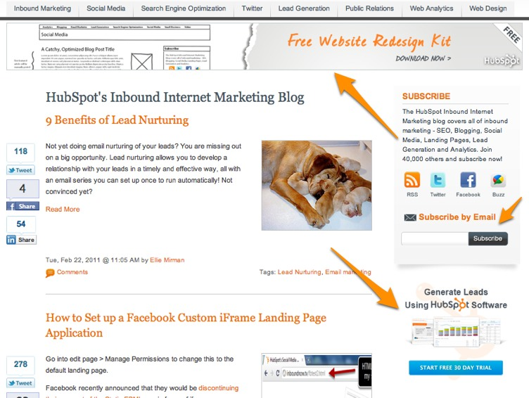

Slide 43
Landing Pages

Slide 44
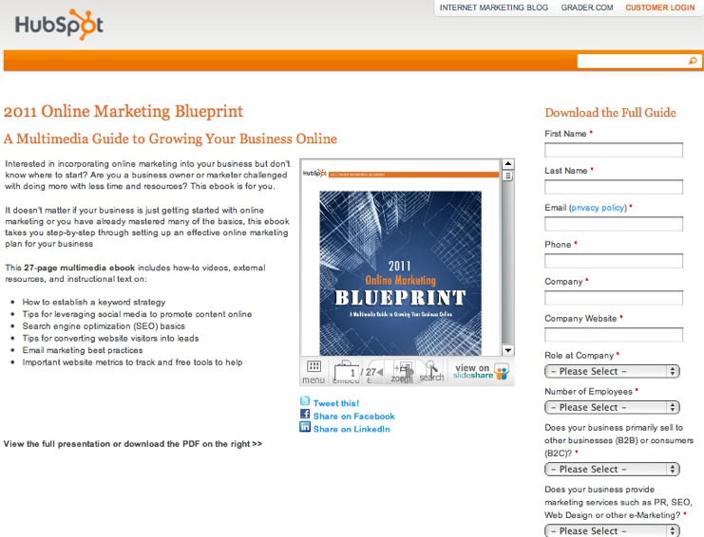

Slide 45

Content
Templates

Slide 46
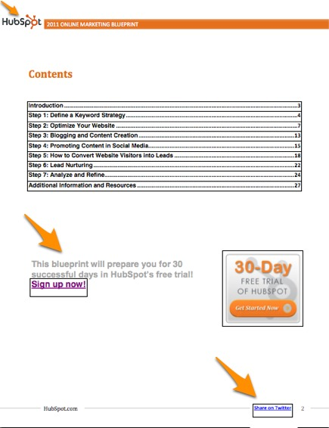

Slide 47
Optimize

Slide 48


Slide 49
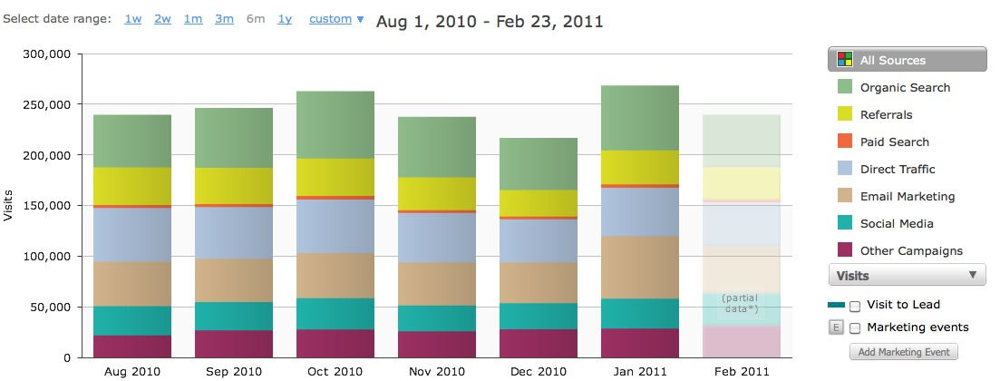
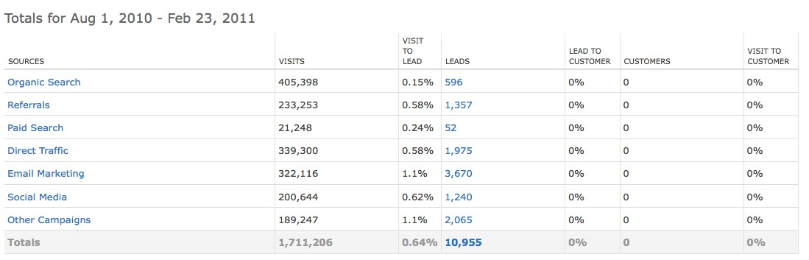

Slide 50


Slide 51


Slide 52
?’s
@Kbodnar32
Blog.Hubspot.com

