Slide 1

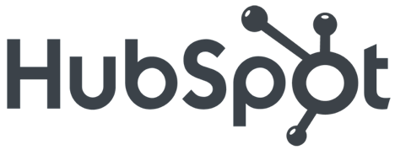
Social Media
Lead Generation
Kipp Bodnar
@KippBodnar

Slide 2

I’m Brian Halligan.
Nice to meet you.
I’m Kipp Bodnar.
Nice to meet you.
@KippBodnar

Slide 3

I’m Brian Halligan.
Nice to meet you.
I wrote The B2B Social Media Book.
amzn.to/b2bsm2

Slide 4
#SMLeads

Slide 5

I’m a dork.

Slide 6

We’ve got a a Problem.

Slide 7
73%
of CEOs
don’t believe
marketers drive revenue.
91
Fournaise Marketing Group: bit.ly/peNScq

Slide 8

Marketing isn’t
Arts and Crafts.

Slide 9

We’re creative.

Slide 10
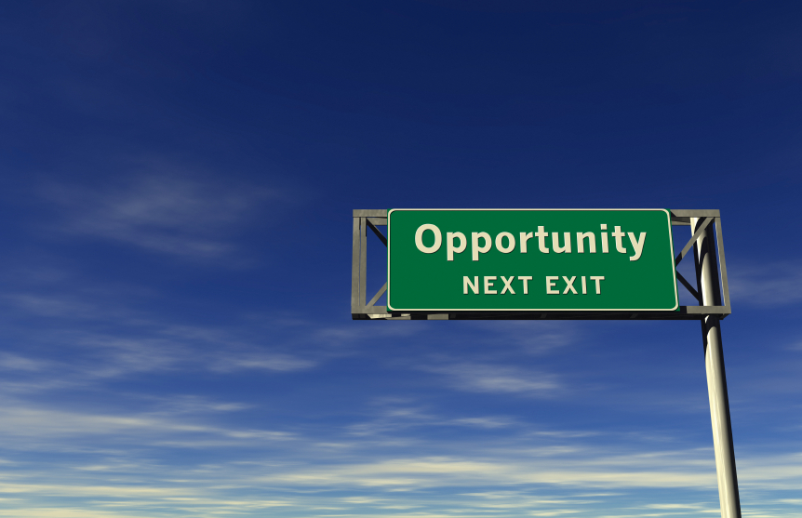
An opportunity, not a problem.

Slide 11

Your opportunity, to shine.

Slide 12

Leads fix
the problem.

Slide 13
What is a
Lead?

Slide 14
LEADS ARE
A PROXY
FOR SALES.

Slide 15
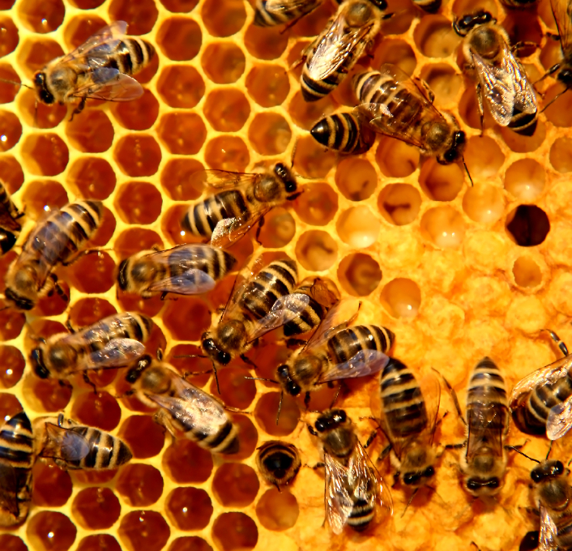
Social Media
is the buzz word.

Slide 16
What is a
Social Media?

Slide 17

Social Media isn’t hugging customers.

Slide 18
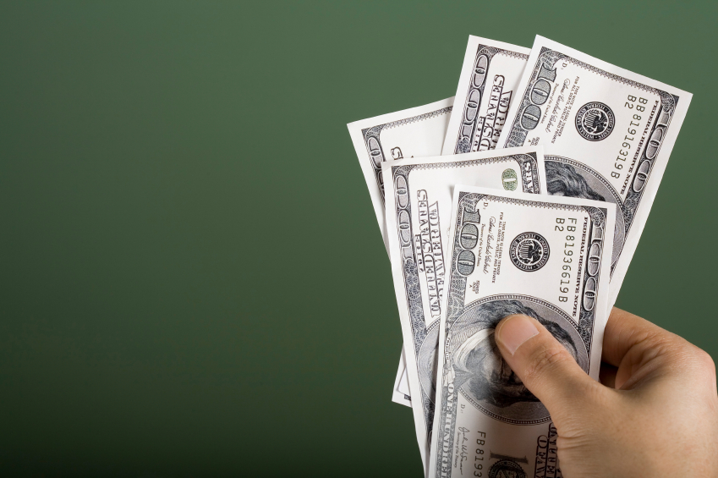
Social Media
that doesn’t
drive revenue doesn’t last.

Slide 19
How Social Media Leads Happen
1
Tweet
Landing Page
Form
Lead
Like
Blog Post
CTA
Landing Page
+1
Product Page
CTA
Landing Page

Slide 20
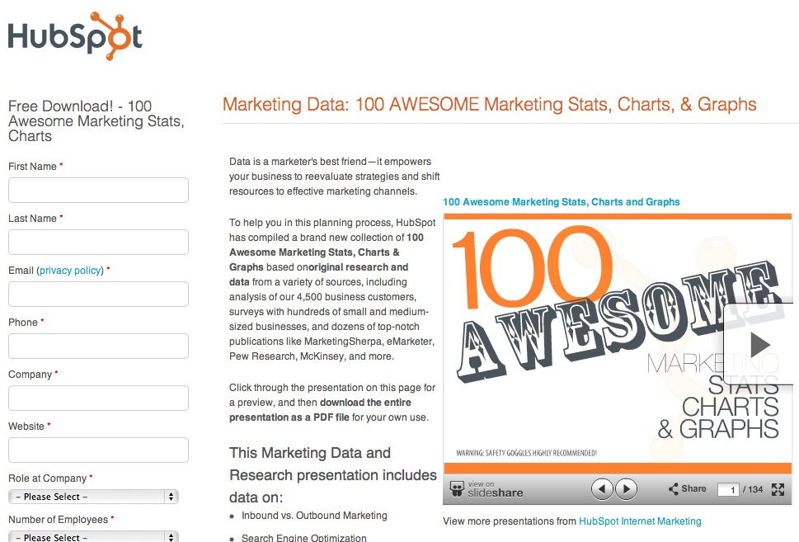
Information Transactions

Slide 21
5 STEPS TO SOCIAL MEDIA
LEAD
GENERATION:

Slide 22
1
Get The Basics Right
2
Maximize Content Discovery
3
Create Conversion Ubiquity
4
Test and Fail Fast
5
Optimize for Maximum Leads

Slide 23
1
Get The Basics Right
2
Maximize Content Discovery
3
Create Conversion Ubiquity
4
Test and Fail Fast
5
Optimize for Maximum Leads

Slide 24

Build
Social Media Reach.

Slide 25
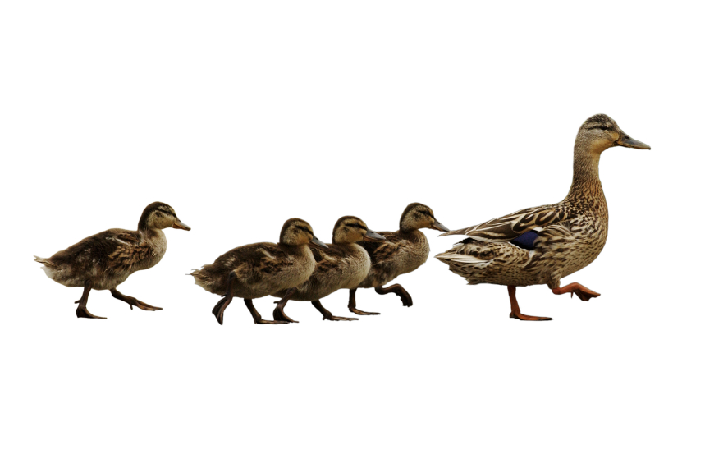
Follow. Friend. Connect.

Slide 26

Share lots of links.

Slide 27

BITLY, 9/2011
The self life of a social media link is 3 hours.
Notes:
Connect to milk and pour glass

Slide 28

Automatic Sharing

Slide 29
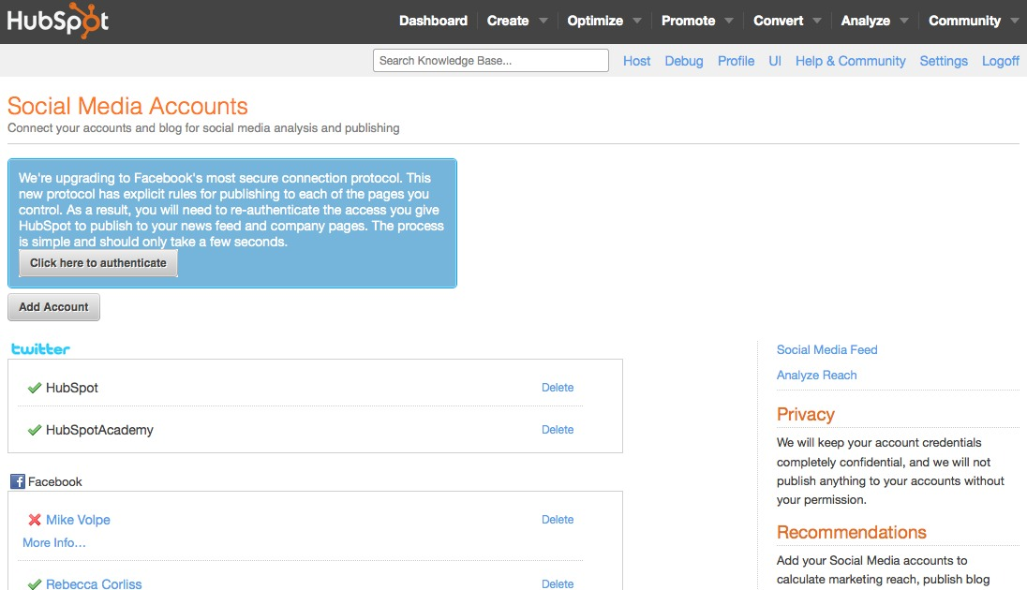
Set up
sharing.

Slide 30

Leverage existing contacts.

Slide 31
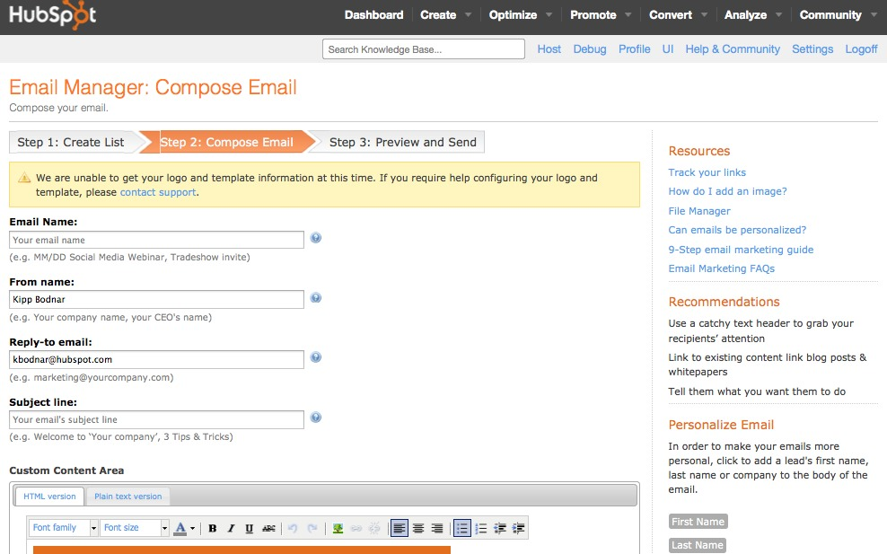
Use email for reach building.

Slide 32


Slide 33
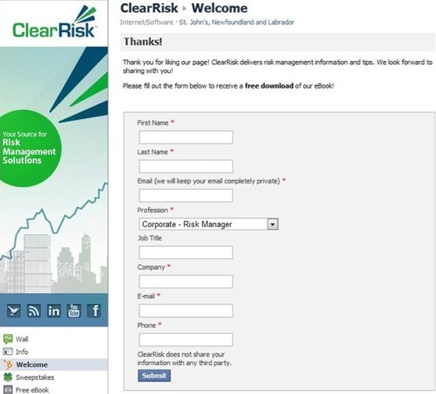

Slide 34
1
Get The Basics Right
2
Maximize Content Discovery
3
Create Conversion Ubiquity
4
Test and Fail Fast
5
Optimize for Maximum Leads

Slide 35
Framework: Content Discovery for Lead Generation
Regular
Content
Dedicated Monitoring
1
2
3
4
Consistent Sharing
Prioritized Engagement

Slide 36
1
Regular Content

Slide 37

Content Calendar.

Slide 38
2
Consistent Sharing

Slide 39

Build social thank you pages.

Slide 40
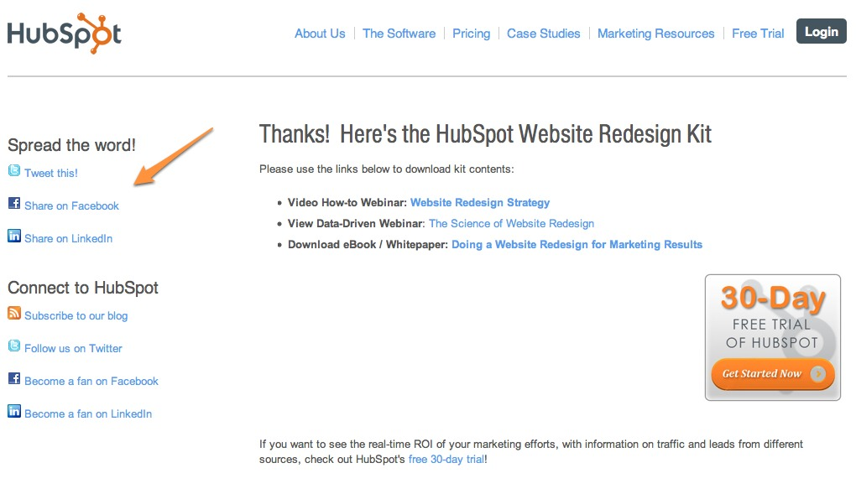
Notes:
People need stuff to share too

Slide 41
3
Dedicated Monitoring

Slide 42

15 Minutes
a Day.

Slide 43
1
5 Minutes Twitter/Facebook
2
5 LinkedIn Answers/Groups
3
5 Minutes Google Alerts

Slide 44
4
Prioritized Engagement

Slide 45
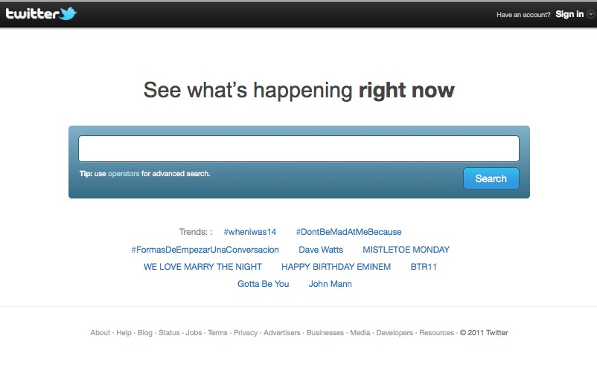
Twitter.com/Search
Notes:
While instead but

Slide 46
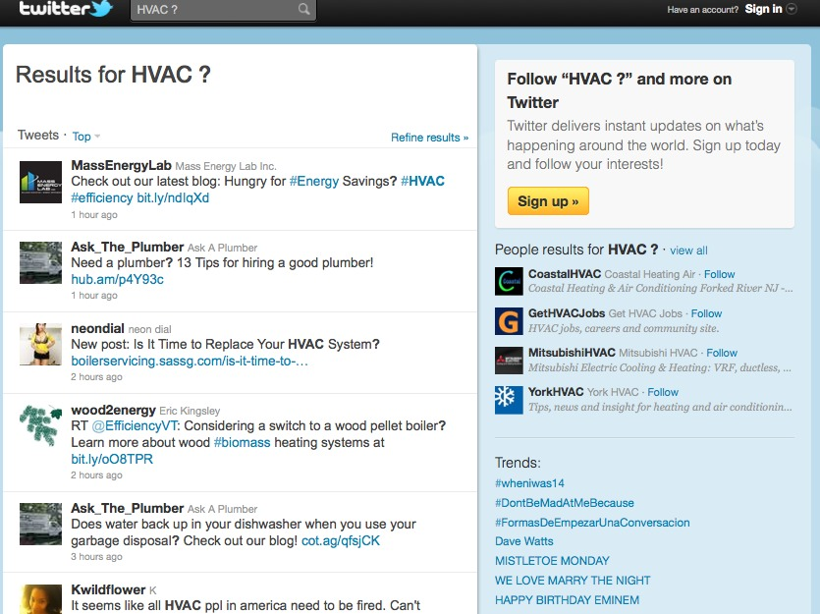
Notes:
While instead but

Slide 47
1
Get The Basics Right
2
Maximize Content Discovery
3
Create Conversion Ubiquity
4
Test and Fail Fast
5
Optimize for Maximum Leads

Slide 48

Marketing is math.
Notes:
Conversion Rates

Slide 49
What is a
Call-to-Action?

Slide 50

Place CTAs Everywhere.

Slide 51
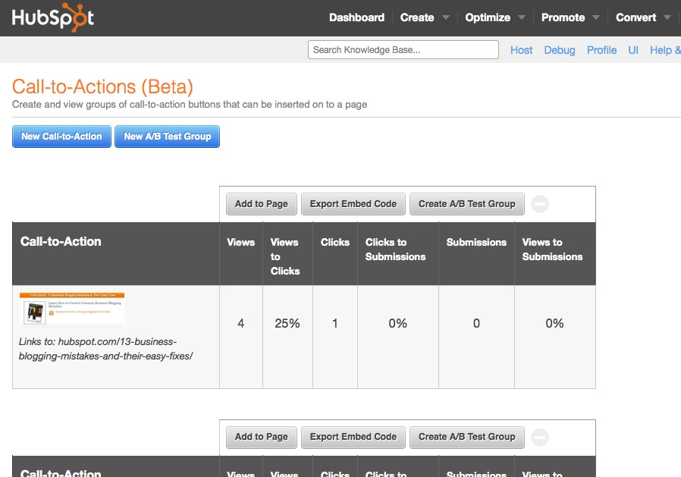

Slide 52
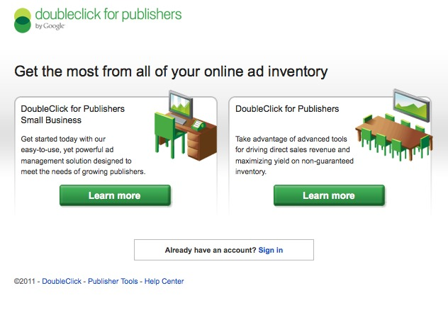
Google.com/DFP

Slide 53
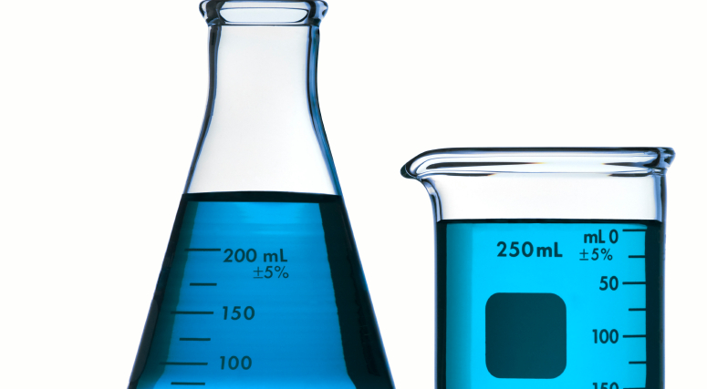
Testing
CTAs
aid testing.

Slide 54
1
Get The Basics Right
2
Maximize Content Discovery
3
Create Conversion Ubiquity
4
Test and Fail Fast
5
Optimize for Maximum Leads

Slide 55

Failure sucks.

Slide 56

Improve
and Iterate

Slide 57
Framework: Social Media Lead Generation Testing
4
Set action items following the experiment.
3
Conduct an experiment retrospective.
2
Set methodology for gathering data for success criteria.
1
Set a clear qualitative objective.

Slide 58

What can you stop doing ?

Slide 59
1
Get The Basics Right
2
Maximize Content Discovery
3
Create Conversion Ubiquity
4
Test and Fail Fast
5
Optimize for Maximum Leads

Slide 60
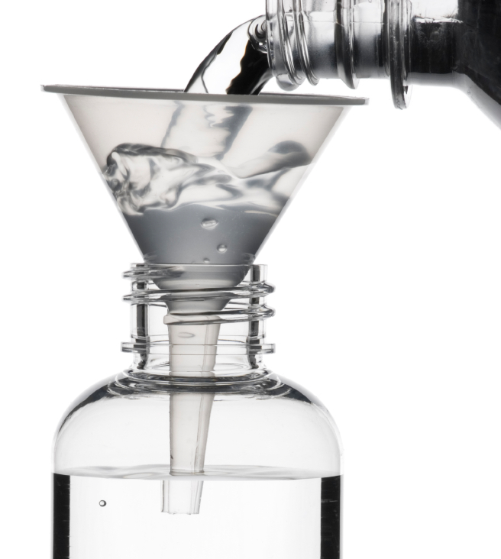
Traffic and Conversion Rates

Slide 61
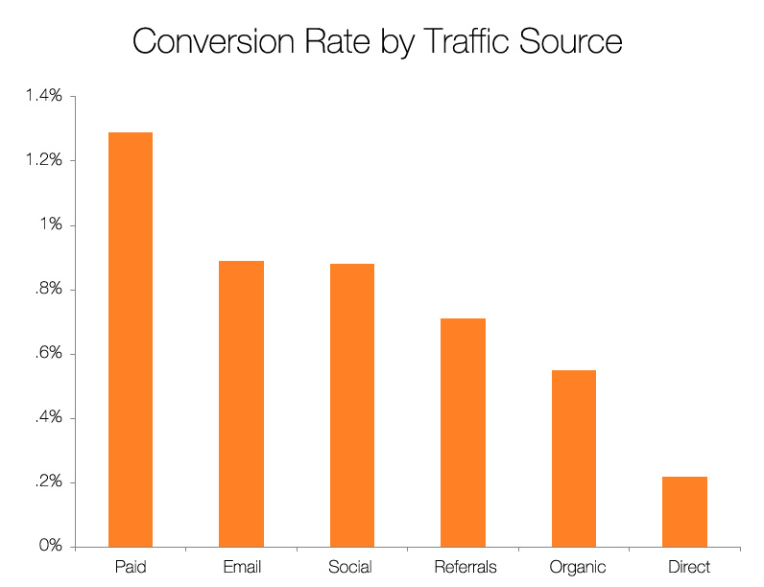
Source: Science of Lead Generation

Slide 62
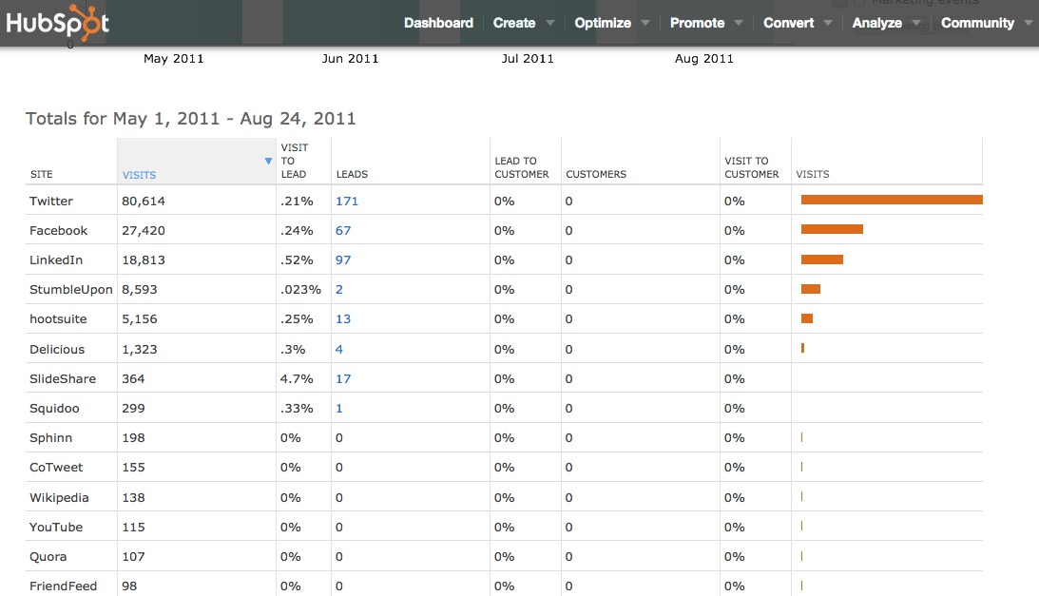
Visit-to-Lead

Slide 63
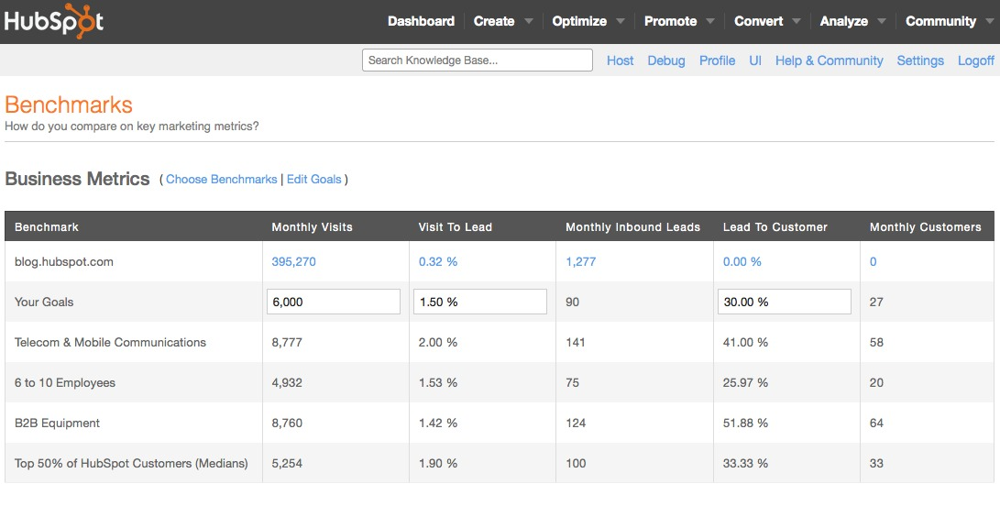
Benchmarks App

Slide 64

Conduct
radical tests.

Slide 65
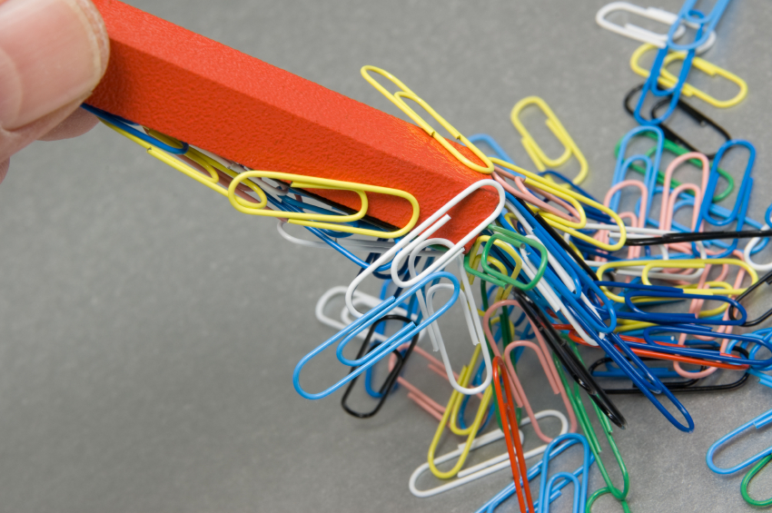
Increase Content Volume.

Slide 66
1
Get The Basics Right
2
Maximize Content Discovery
3
Create Conversion Ubiquity
4
Test and Fail Fast
5
Optimize for Maximum Leads
Notes:
Consistent not hard

Slide 67

Mastered the Mystery.

Slide 68

Prove the CEO Wrong.

Slide 69
You’re the Star.

Slide 70
GET A DEMO OF HUBSPOT:
HubSpot.com/Demo

Slide 71
THANK
YOU.

