Slide 1

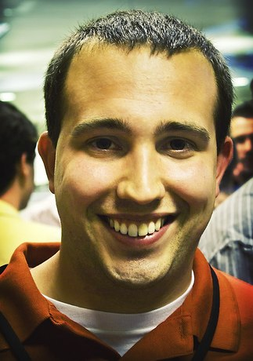

Epic Blogging
Kipp Bodnar - @KBodnar32
Inbound Marketing Manager

Slide 2


Slide 3
3 Million

Slide 4

3 Epic Blogging Commandments

Slide 5
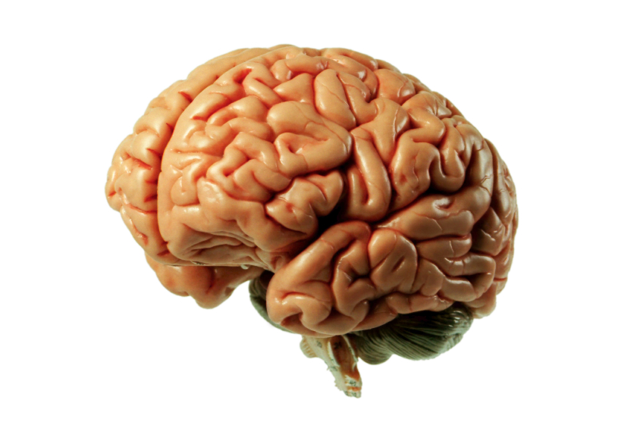
1. Epic Idea

Slide 6
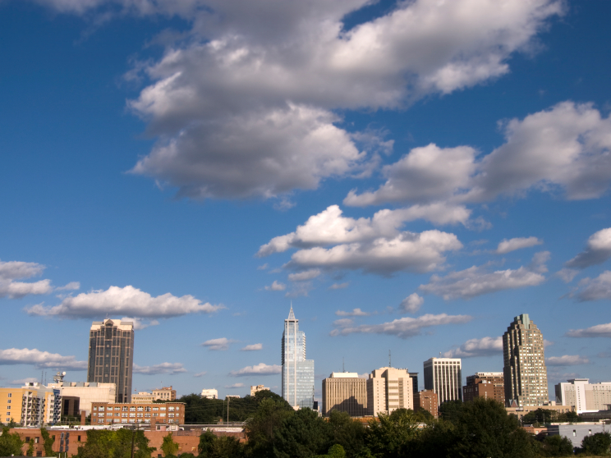
No Fluff

Slide 7
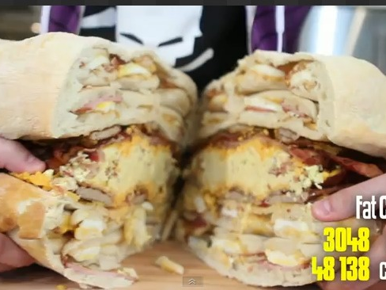
Combined Relevance

Slide 8
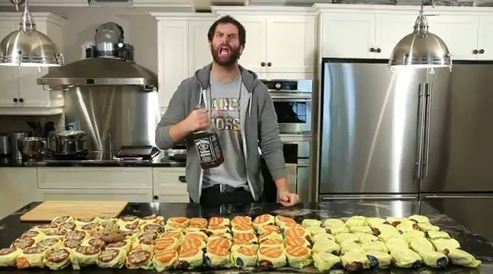
Be Awesomer

Slide 9

Polarize

Slide 10

Timely

Slide 11
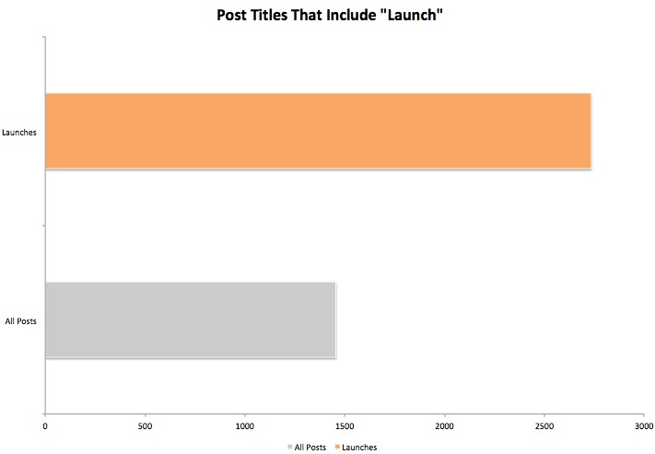

Slide 12
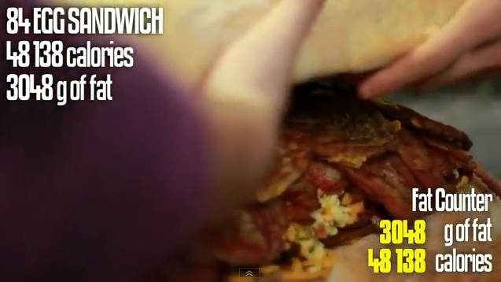
Have Data

Slide 13

New Ideas

Slide 14
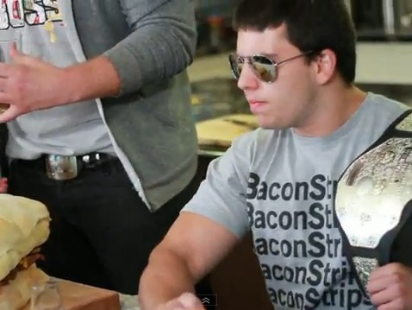
Hero and Villain

Slide 15

2. Epic Title

Slide 16
Clear

Slide 17
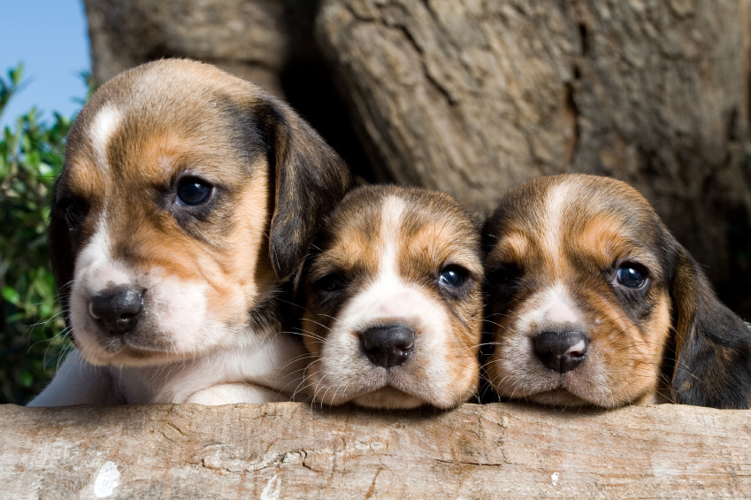
Hype

Slide 18
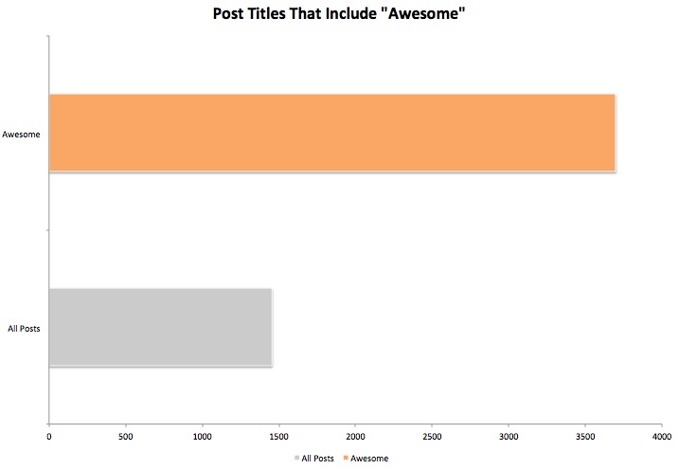

Slide 19
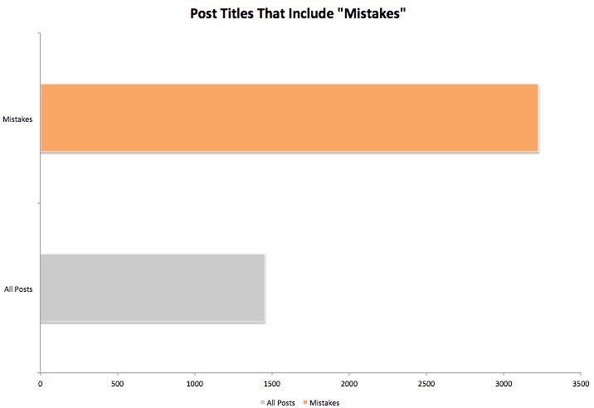

Slide 20

Active

Slide 21

Data

Slide 22

3. Epic Composition

Slide 23
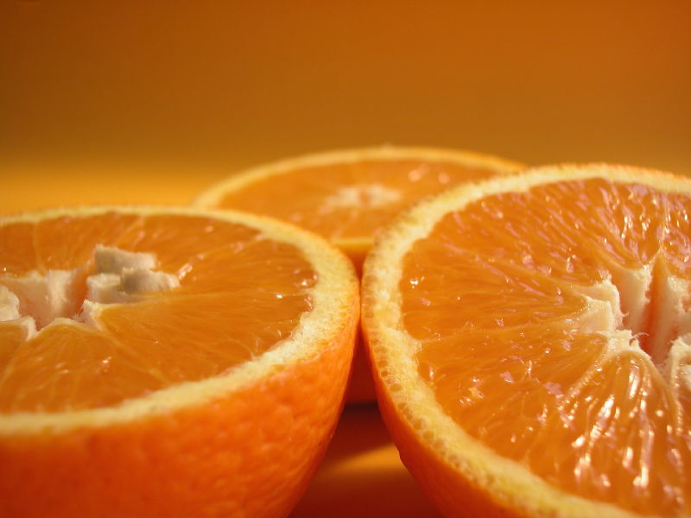
Segment

Slide 24

Multimedia

Slide 25

Long Enough

Slide 26
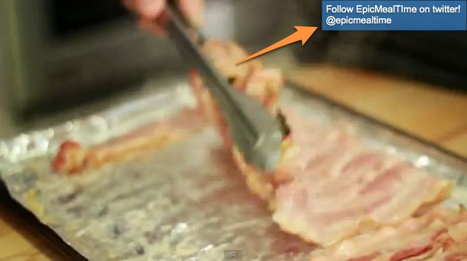
Links

Slide 27

Polish

Slide 28
1. Epic Idea
2. Epic Title
3. Epic Composition

Slide 29

Free Lunch

