Slide 1



Social Media Lead Generation Builds Marketing Superstars
Kipp Bodnar - @KBodnar32
Inbound Marketing Manager

Slide 2

Define: Lead

Slide 3
Please Tweet questions and comments to @KBodnar32
The Hashtag is #SMLead.

Slide 4
Lead
Generation

Slide 5


Notes:
Customers behind secure firewalls

Slide 6
Social
Media

Slide 7

Notes:
Customers behind secure firewalls

Slide 8

Notes:
Customers behind secure firewalls

Slide 9
Misconceptions
End Today

Slide 10

Problem

Slide 11
Problem: Generating More Leads With Less

Slide 12

5 Steps

Slide 13
WARNING:
Steps Assume Understanding of Online Marketing and Content Strategy.

Slide 14

Step 1: Get The Basics Right

Slide 15

Landing Page Tips

Slide 16

Offers That Rock

Slide 17

Think Like Publisher

Slide 18

Step 2: Maximize Content Discovery

Slide 19
Abstract Concepts
Framework: Maximizing Content Discovery for
Lead Generation With Social Media
Regular Content Creation
Dedicated Monitoring
1
2
3
4
Consistent Sharing
Prioritized Engagement

Slide 20

Step 3: Create Conversion Ubiquity

Slide 21
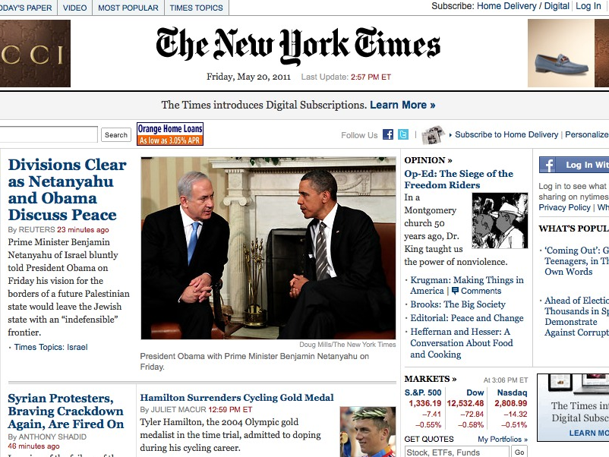
The New York Times Is The Competition

Slide 22

Tweeting Landing Pages Doesn’t Kill Puppies

Slide 23

Step 4: Test and Fail Fast

Slide 24
Abstract Concepts
Framework: How to Test Social Media Lead Generation Strategies
4
Set action items following the experiment.
3
Conduct an experiment retrospective.
2
Set methodology for gathering data for success criteria.
1
Set a clear qualitative objective.

Slide 25
Objective:
Generate 100 Leads From Facebook in 90 Days

Slide 26
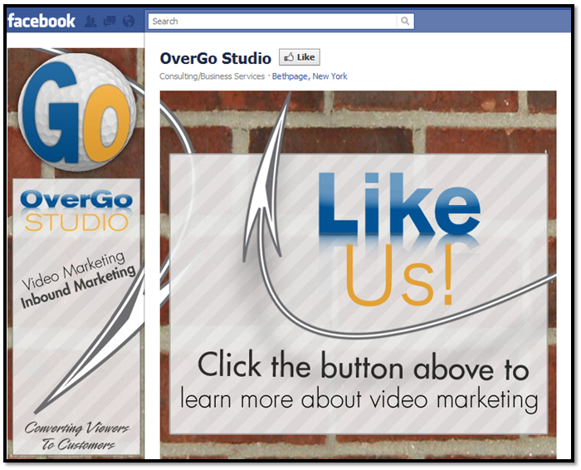

Slide 27
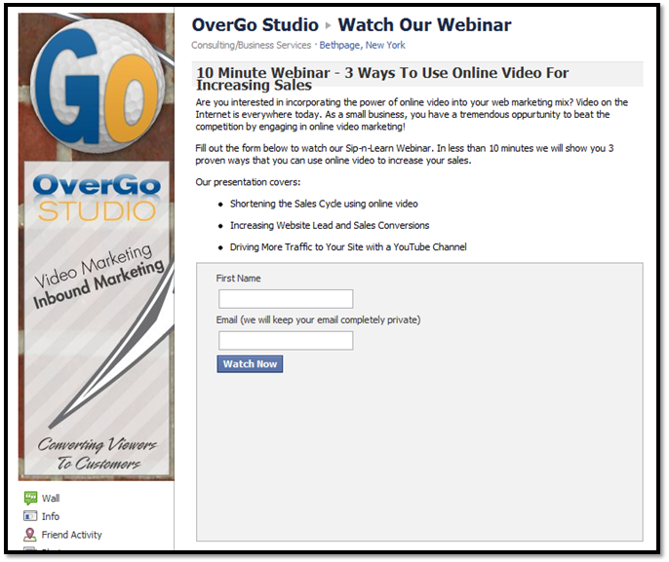

Slide 28
Data Gathering:
Use Web Analytics or CRM

Slide 29
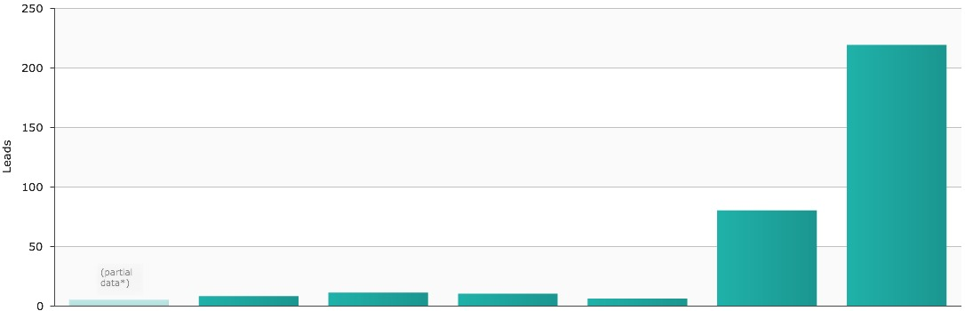
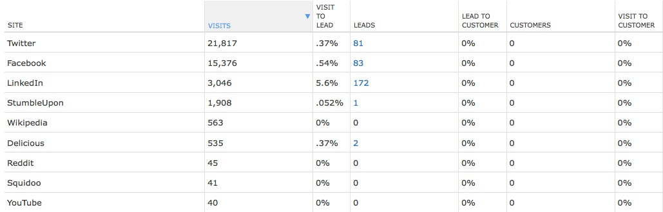
Data Gathering:
Use Web Analytics or CRM

Slide 30
Retrospective:
Honest Reflection of Execution

Slide 31
Action Items:
Stop or Double Down

Slide 32

Step 5: Optimize For Maximum Lead Flow

Slide 33
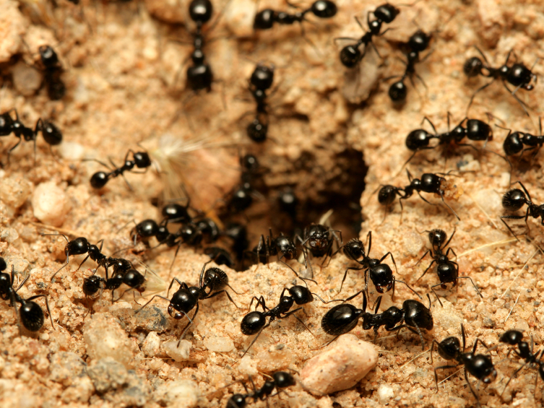
Conversion Rates
Vs. Traffic

Slide 34
Don’t Believe Me

Slide 35
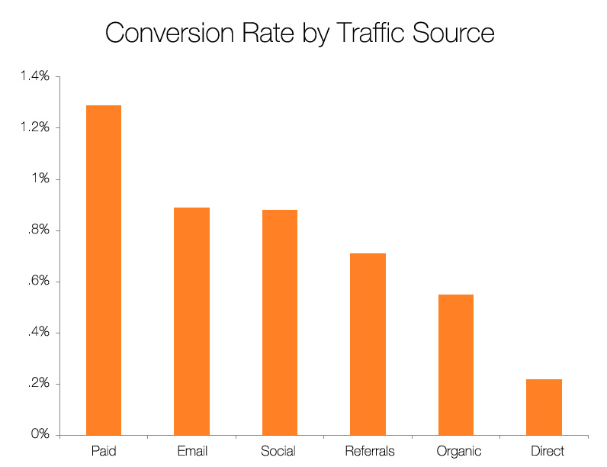
Source: Science of Lead Generation

Slide 36
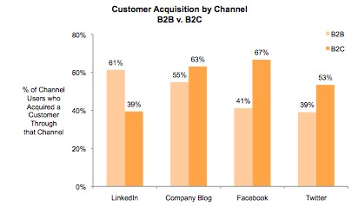
Source: State of Inbound Marketing Report - http://bit.ly/aewfHr

Slide 37
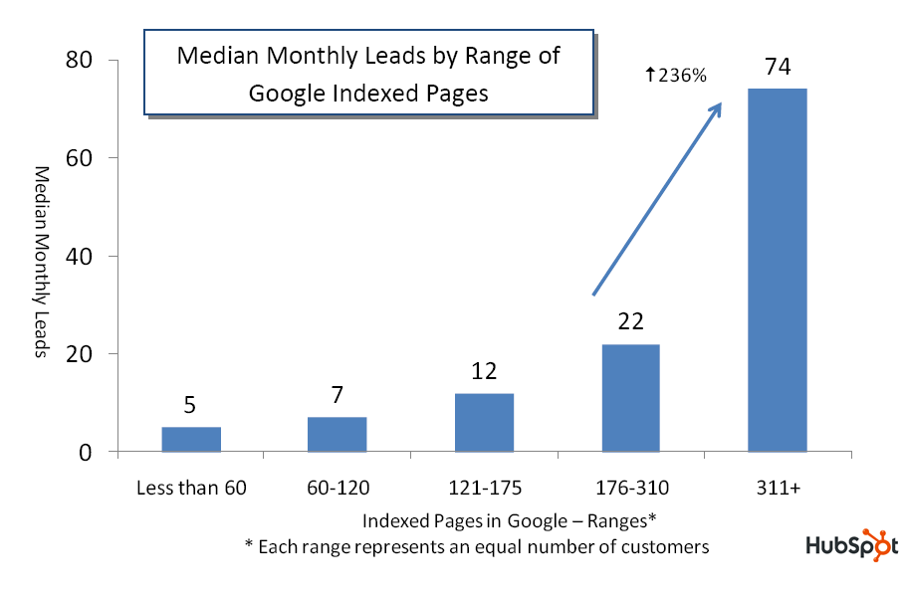
Source: State of Inbound Marketing Lead Generation Report - http://bit.ly/cVMpkn

Slide 38
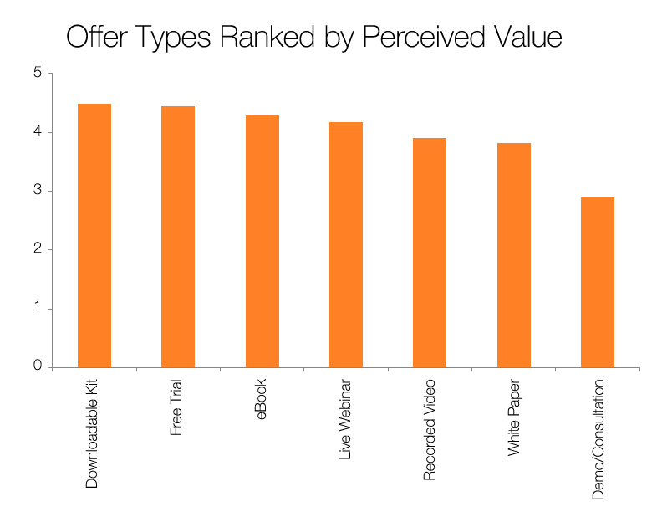
Source: Science of Lead Generation

Slide 39
The 5 Steps of Social Media Lead Generation
Step 1: Get The Basics Right
Step 2: Maximize Content Discovery
Step 3: Create Conversion Ubiquity
Step 4: Test and Fail Fast
Step 5: Optimize For Maximum Lead Flow

Slide 40

You’re The Star

Slide 41

Don’t Wait

Slide 42
End This Today

Slide 43
?’s
@Kbodnar32
Blog.Hubspot.com

