Slide 1

Social Media
Lead Generation

Slide 2

I’m Brian Halligan.
Nice to meet you.
I’m Kipp Bodnar.
Nice to meet you.
@KippBodnar

Slide 3
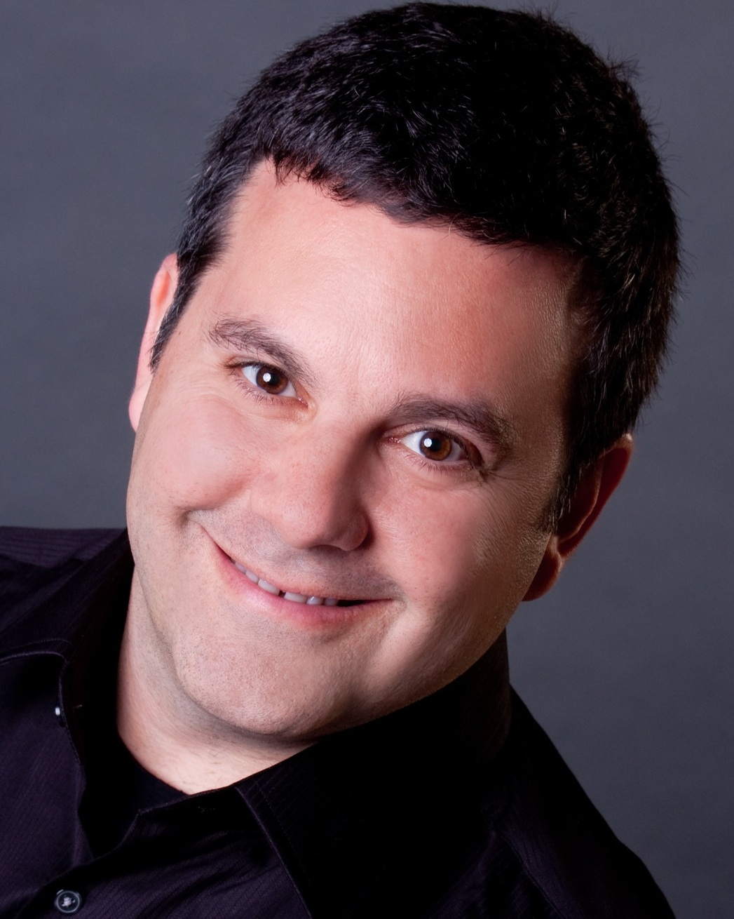
I’m Brian Halligan.
Nice to meet you.
I’m Jeff Cohen.
Nice to meet you.
@JeffreyLCohen

Slide 4

I’m Brian Halligan.
Nice to meet you.
We wrote The B2B Social Media Book.
amzn.to/b2bsm2

Slide 5
#B2BSM

Slide 6

We are dorks.

Slide 7

We’ve got a a Problem.

Slide 8
73%
of CEOs
don’t believe
marketers drive revenue.
91
Fournaise Marketing Group: bit.ly/peNScq

Slide 9

Marketing isn’t
Arts and Crafts.

Slide 10

We’re creative.

Slide 11
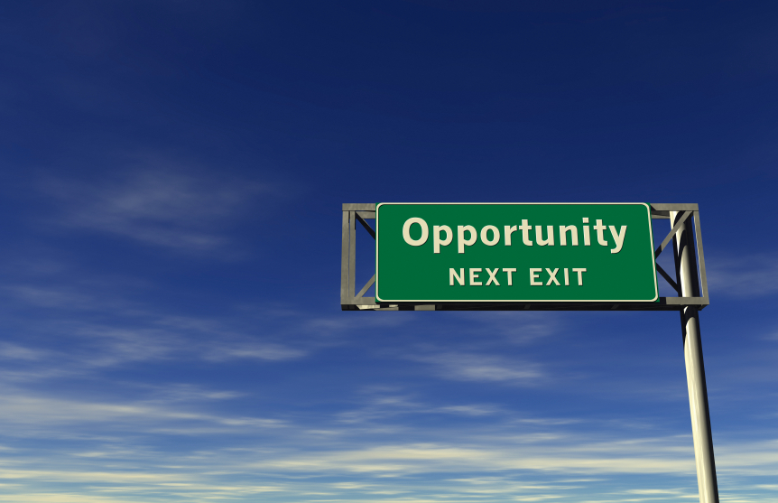
An opportunity, not a problem.

Slide 12

Your opportunity, to shine.

Slide 13

Leads fix
the problem.

Slide 14
What is a
Lead?

Slide 15
LEADS ARE
A PROXY
FOR SALES.

Slide 16
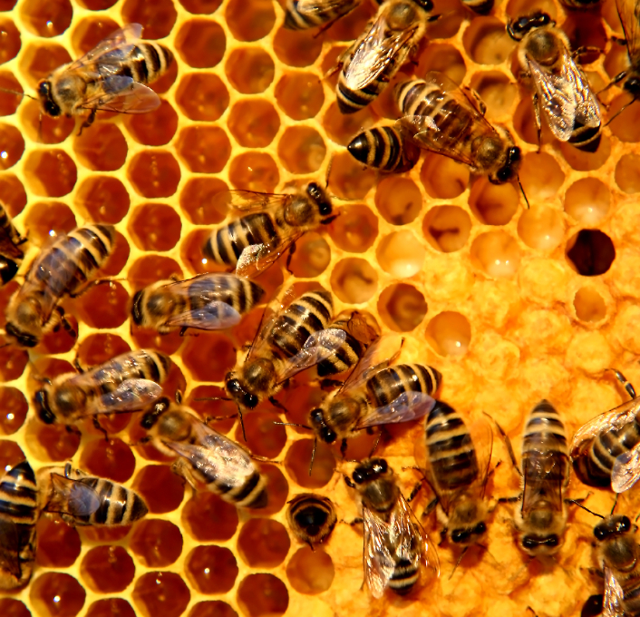
Social Media
is the buzz word.

Slide 17
What is a
Social Media?

Slide 18

Social Media isn’t hugging customers.

Slide 19
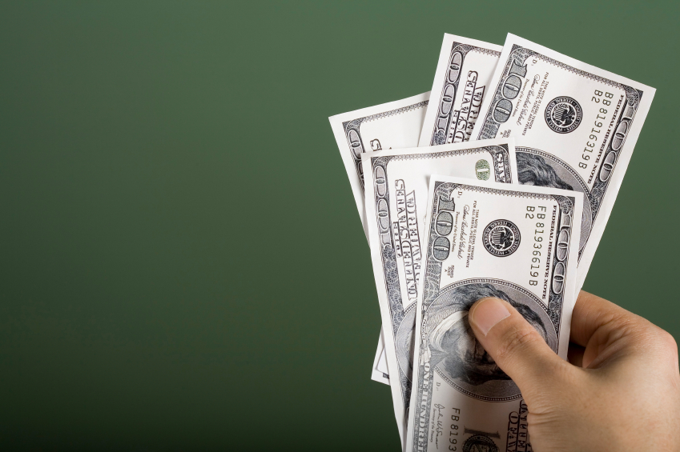
Social Media
that doesn’t
drive revenue doesn’t last.

Slide 20
How Social Media Leads Happen
1
Tweet
Landing Page
Form
Lead
Like
Blog Post
CTA
Landing Page
+1
Product Page
CTA
Landing Page

Slide 21
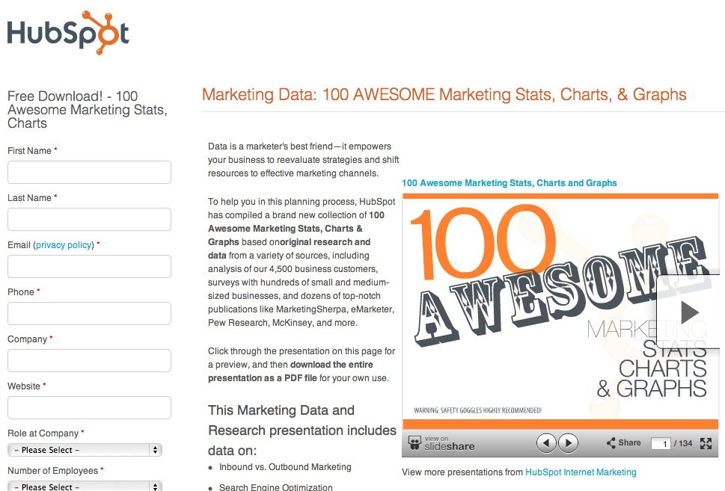
Information Transactions

Slide 22
5 STEPS TO SOCIAL MEDIA
LEAD
GENERATION:

Slide 23
1
Get The Basics Right
2
Maximize Content Discovery
3
Create Conversion Ubiquity
4
Test and Fail Fast
5
Optimize for Maximum Leads

Slide 24
1
Get The Basics Right
2
Maximize Content Discovery
3
Create Conversion Ubiquity
4
Test and Fail Fast
5
Optimize for Maximum Leads

Slide 25

Build
Social Media Reach.

Slide 26
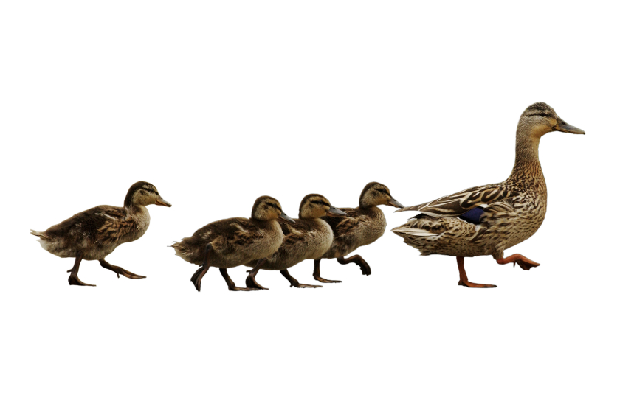
Follow. Friend. Connect.

Slide 27

Share lots of links.

Slide 28

BITLY, 9/2011
The self life of a social media link is 3 hours.
Notes:
Connect to milk and pour glass

Slide 29

Automatic Sharing

Slide 30

Leverage existing contacts.

Slide 31
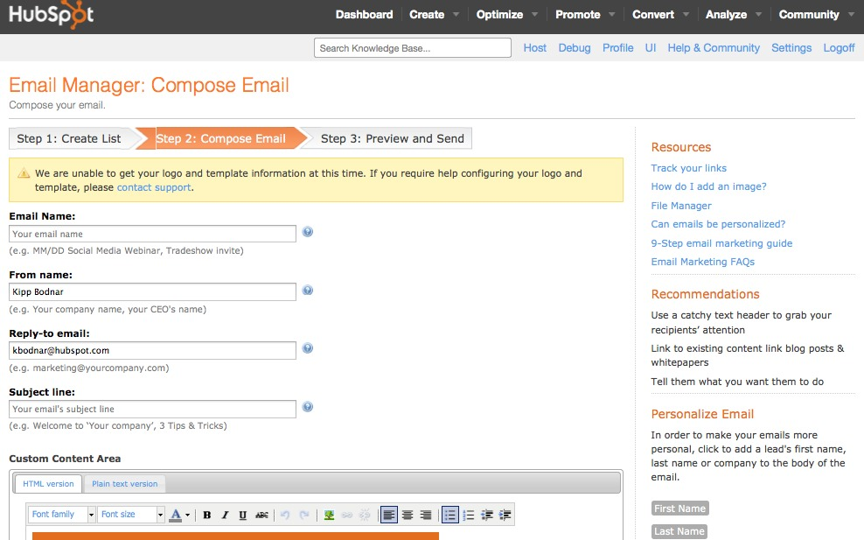
Use email for reach building.

Slide 32


Slide 33
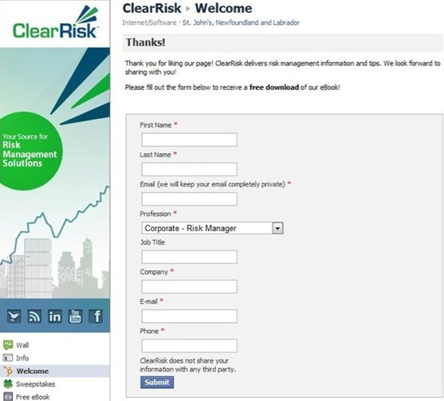

Slide 34
1
Get The Basics Right
2
Maximize Content Discovery
3
Create Conversion Ubiquity
4
Test and Fail Fast
5
Optimize for Maximum Leads

Slide 35
Framework: Content Discovery for Lead Generation
Regular
Content
Dedicated Monitoring
1
2
3
4
Consistent Sharing
Prioritized Engagement

Slide 36
1
Regular Content

Slide 37

Content Calendar.

Slide 38
2
Consistent Sharing

Slide 39

Build social thank you pages.

Slide 40
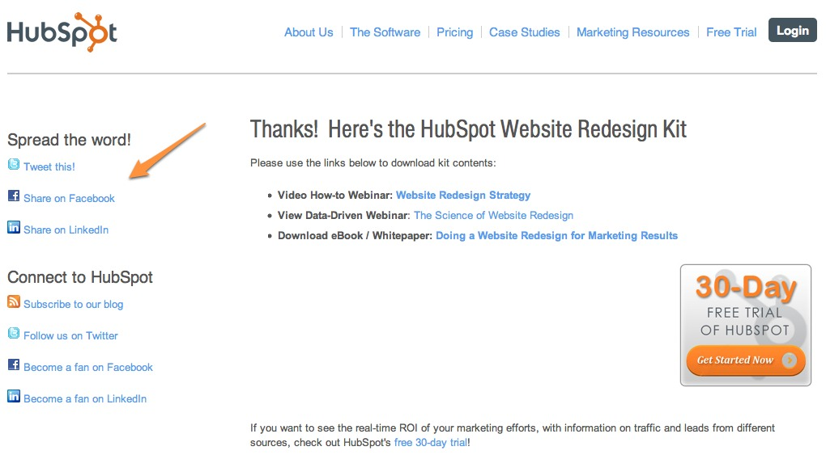
Notes:
People need stuff to share too

Slide 41
3
Dedicated Monitoring

Slide 42

15 Minutes
a Day.

Slide 43
1
5 Minutes Twitter/Facebook
2
5 LinkedIn Answers/Groups
3
5 Minutes Google Alerts

Slide 44
4
Prioritized Engagement

Slide 45
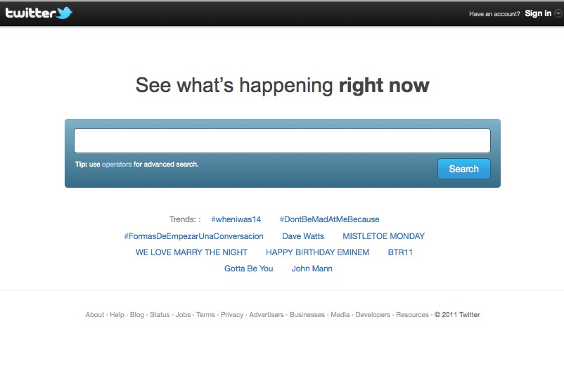
Twitter.com/Search
Notes:
While instead but

Slide 46
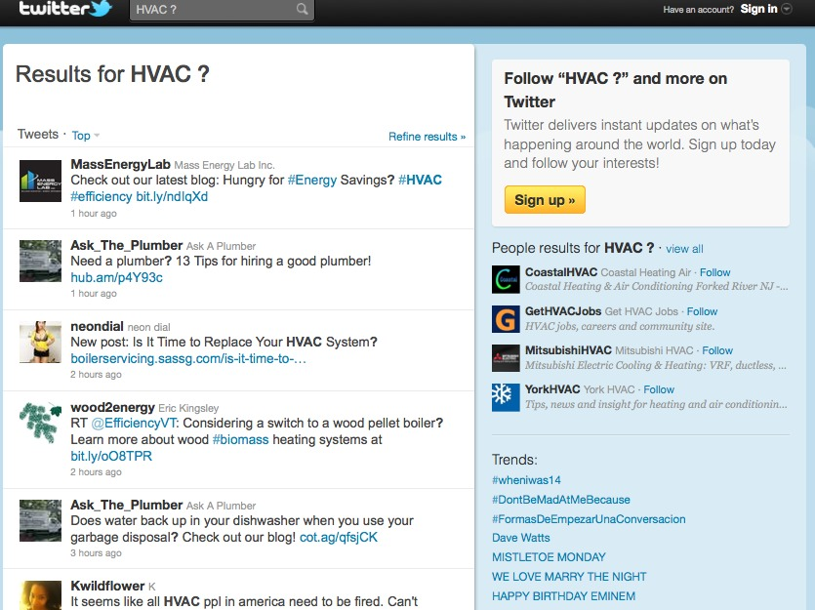
Notes:
While instead but

Slide 47
1
Get The Basics Right
2
Maximize Content Discovery
3
Create Conversion Ubiquity
4
Test and Fail Fast
5
Optimize for Maximum Leads

Slide 48

Marketing is math.
Notes:
Conversion Rates

Slide 49
What is a
Call-to-Action?

Slide 50

Place CTAs Everywhere.

Slide 51
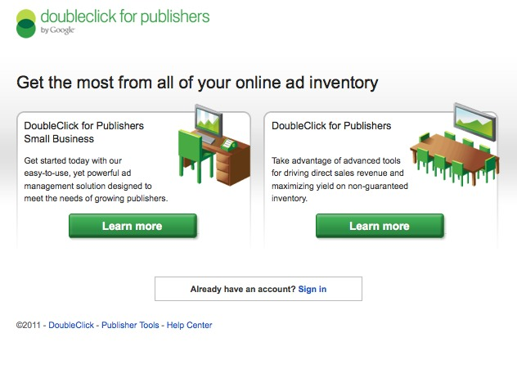
Google.com/DFP

Slide 52
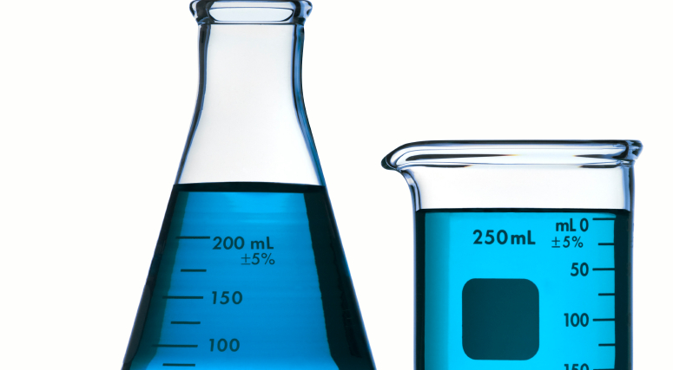
Testing
CTAs
aid testing.

Slide 53
1
Get The Basics Right
2
Maximize Content Discovery
3
Create Conversion Ubiquity
4
Test and Fail Fast
5
Optimize for Maximum Leads

Slide 54

Failure sucks.

Slide 55

Improve
and Iterate

Slide 56
Framework: Social Media Lead Generation Testing
4
Set action items following the experiment.
3
Conduct an experiment retrospective.
2
Set methodology for gathering data for success criteria.
1
Set a clear qualitative objective.

Slide 57

What can you stop doing ?

Slide 58
1
Get The Basics Right
2
Maximize Content Discovery
3
Create Conversion Ubiquity
4
Test and Fail Fast
5
Optimize for Maximum Leads

Slide 59
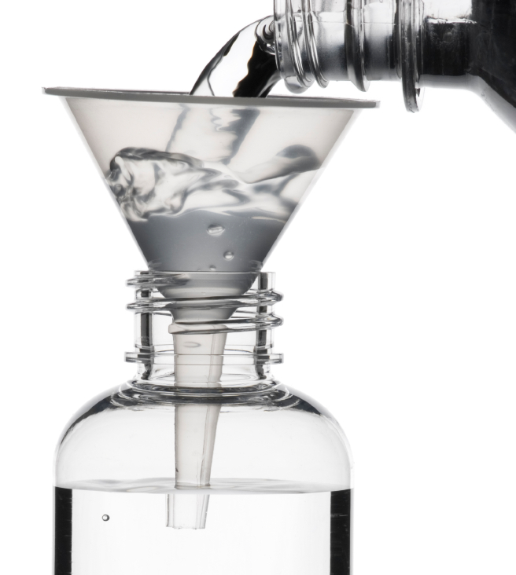
Traffic and Conversion Rates

Slide 60
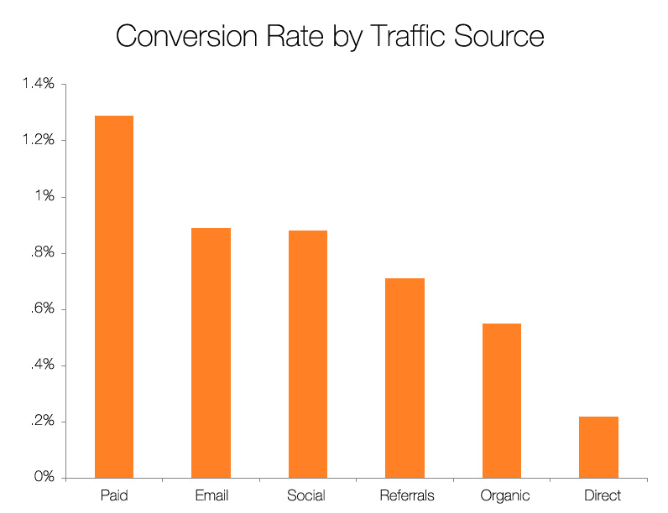
Source: Science of Lead Generation

Slide 61

Conduct
radical tests.

Slide 62

Increase Content Volume.

Slide 63
1
Get The Basics Right
2
Maximize Content Discovery
3
Create Conversion Ubiquity
4
Test and Fail Fast
5
Optimize for Maximum Leads
Notes:
Consistent not hard

Slide 64

Mastered the Mystery.

Slide 65

Prove the CEO Wrong.

Slide 66
You’re the Star.

Slide 67
THANK
YOU.

