Slide 1

Social Media
Lead Generation

Slide 2

I’m Brian Halligan.
Nice to meet you.
I’m Kipp Bodnar.
Nice to meet you.
@KippBodnar

Slide 3

I’m Brian Halligan.
Nice to meet you.
I wrote The B2B Social Media Book.
amzn.to/b2bsm2

Slide 4
#B2BSM

Slide 5

I am a dork.

Slide 6
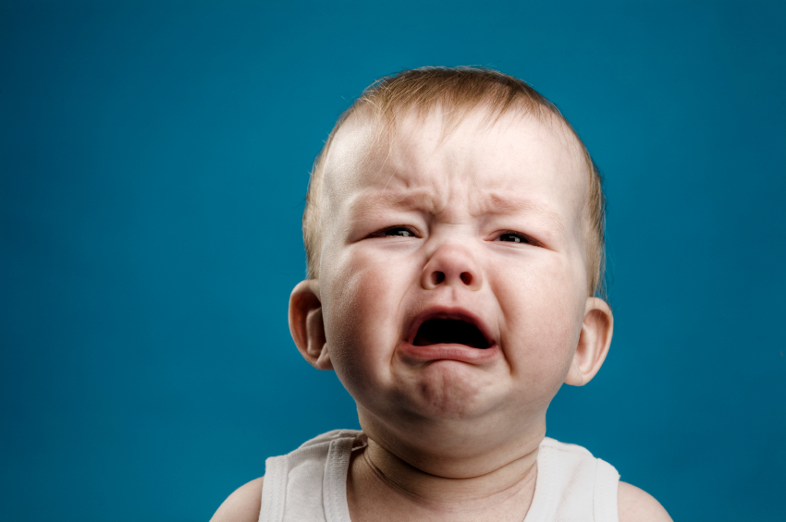
We’ve got a a Problem.

Slide 7
73%
of CEOs
don’t believe
marketers drive revenue.
91
Fournaise Marketing Group: bit.ly/peNScq

Slide 8

Marketing isn’t
Arts and Crafts.

Slide 9

We’re creative.

Slide 10
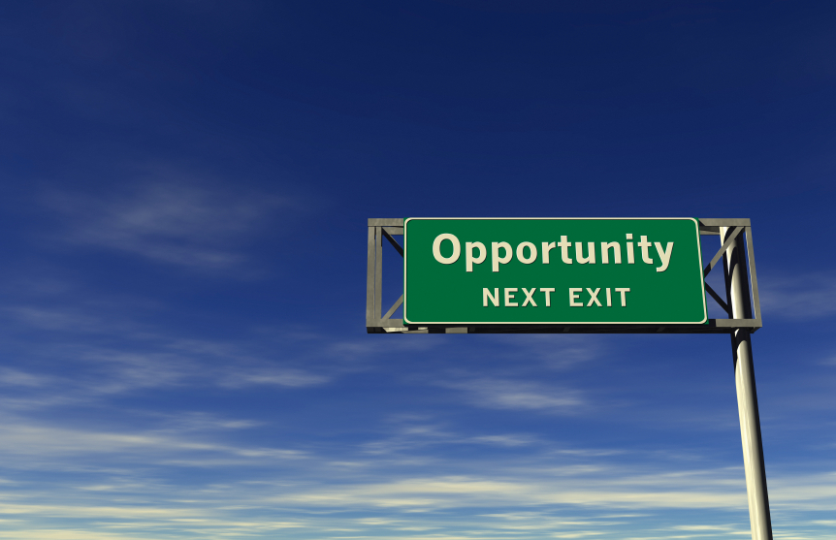
An opportunity, not a problem.

Slide 11

Your opportunity, to shine.

Slide 12

Leads fix
the problem.

Slide 13
What is a
Lead?

Slide 14
LEADS ARE
A PROXY
FOR SALES.

Slide 15

“
Your goal shouldn't be to buy leads. Your goal should be to buy customers.
”
@KippBodnar
Tweet This!
#B2BSM

Slide 16
What is
Social Media?

Slide 17
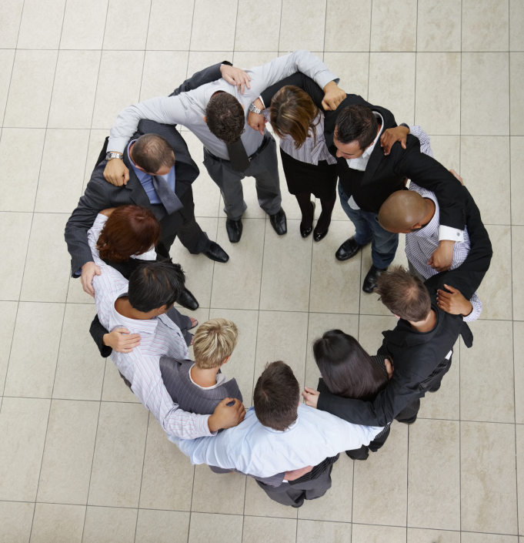
Social Media isn’t hugging customers.

Slide 18
“
Social Media that doesn’t drive revenue is destined for failure.
”
@KippBodnar
Tweet This!
#B2BSM

Slide 19
How Social Media Leads Happen
1
Tweet
Landing Page
Form
Lead
Like
Blog Post
CTA
Landing Page
+1
Product Page
CTA
Landing Page

Slide 20
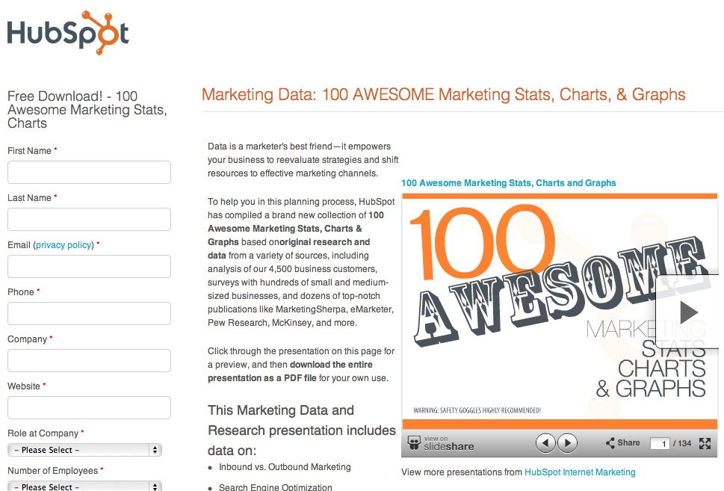
Information Transactions

Slide 21
3 MUST-HAVES FOR
SOCIAL MEDIA
LEAD
GENERATION:

Slide 22
1
Build Social Media Reach
2
Maximize Content Discovery
3
Conversion Ubiquity

Slide 23
1
Build
Social Media Reach

Slide 24

Build
Social Media Reach.

Slide 25
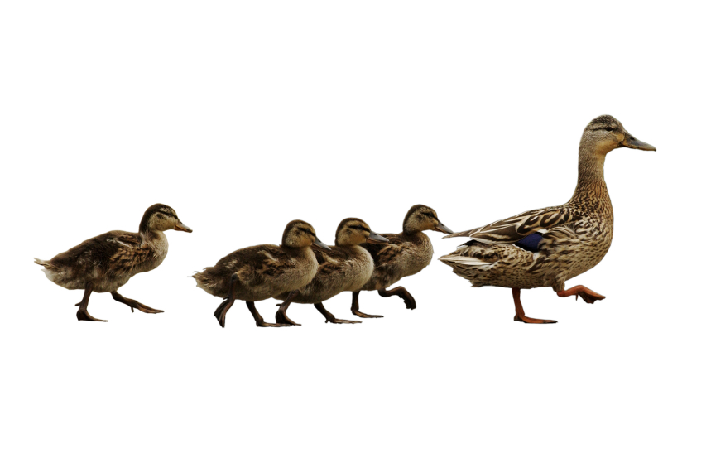
Follow. Friend. Connect.

Slide 26
60%
of the sales cycle is over – before a buyer talks to your salesperson.
91
CORPORATE EXECUTIVE BOARD: bit.ly/zub2I7

Slide 27

Share lots of links.

Slide 28

BITLY, 9/2011
The shelf life of a social media link is 3 hours.
Notes:
Connect to milk and pour glass

Slide 29
THE
Links to company blog posts
10-4-1
Links to third-party articles
Link to a company landing page
RULE

Slide 30

Automatic Sharing

Slide 31

Leverage existing contacts.

Slide 32
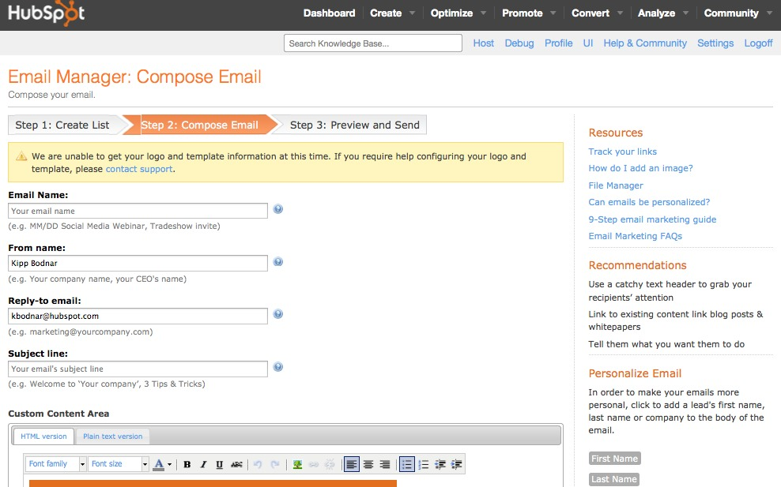
Use email for reach building.

Slide 33


Slide 34
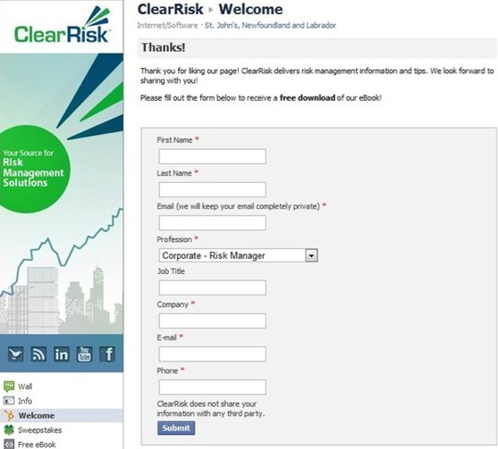

Slide 35
2
Maximize Content Discovery

Slide 36
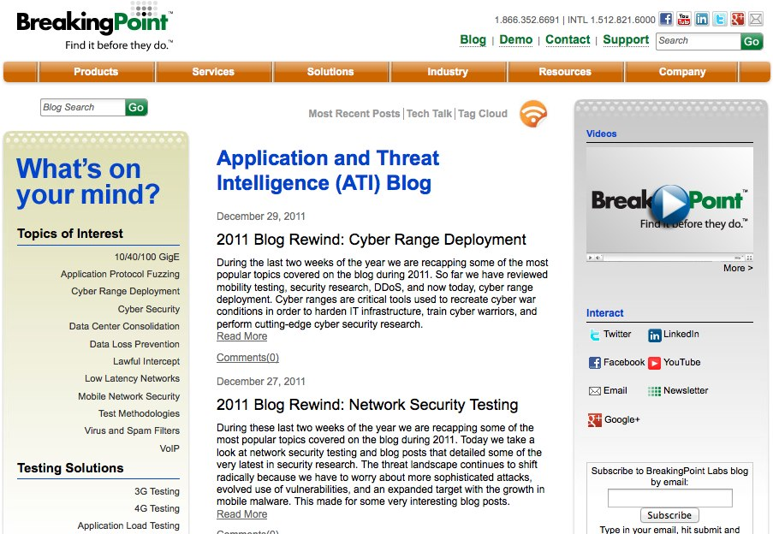

Slide 37
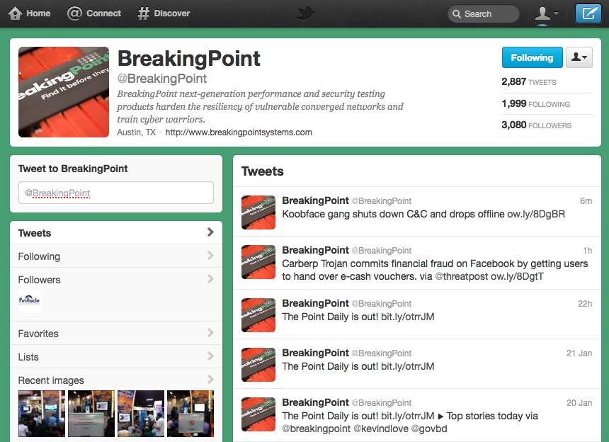

Slide 38
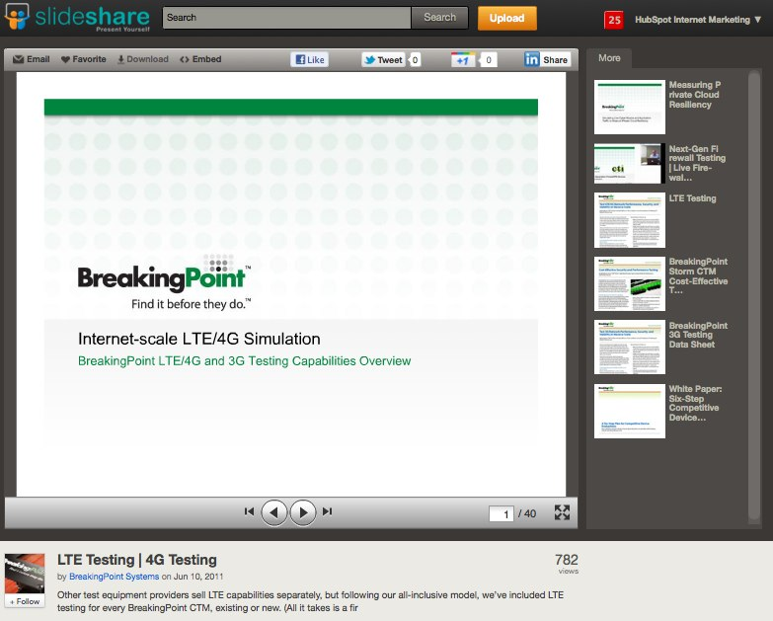

Slide 39


Slide 40
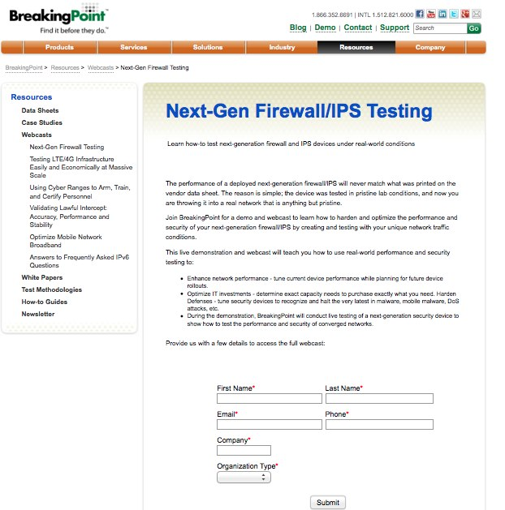

Slide 41
Closed Millions In Sales From Online Leads
ROI – 2800%!

Slide 42

Content Calendar.

Slide 43

Build social thank you pages.

Slide 44
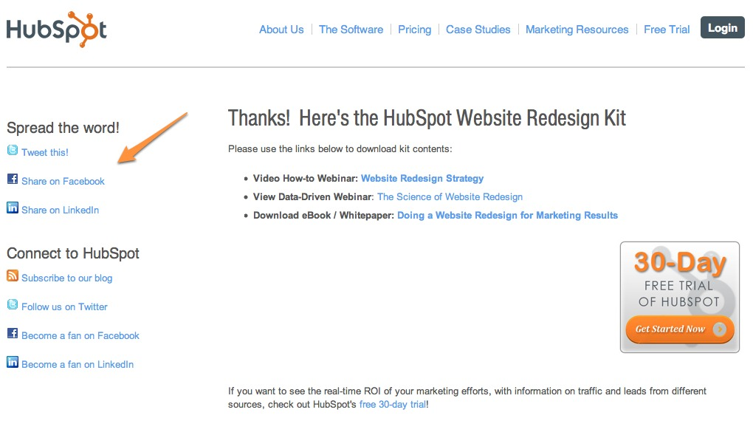
Notes:
People need stuff to share too

Slide 45

Tailored Content

Slide 46
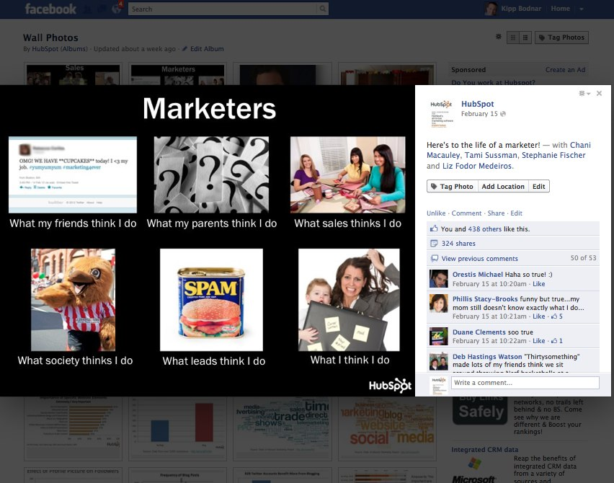

Slide 47
3
Conversion Ubiquity

Slide 48
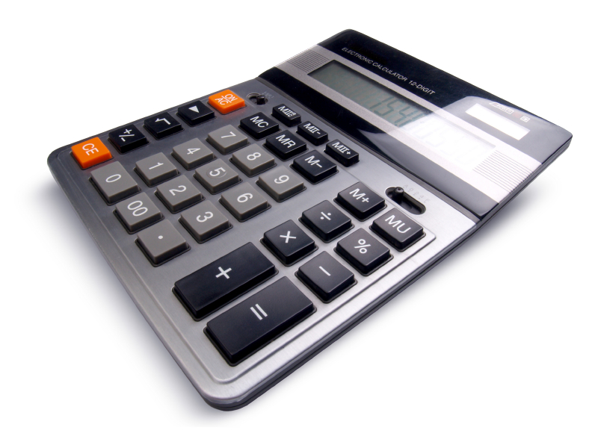
Marketing is math.
Notes:
Conversion Rates

Slide 49
What is a
Call-to-Action?

Slide 50

Place CTAs Everywhere.

Slide 51
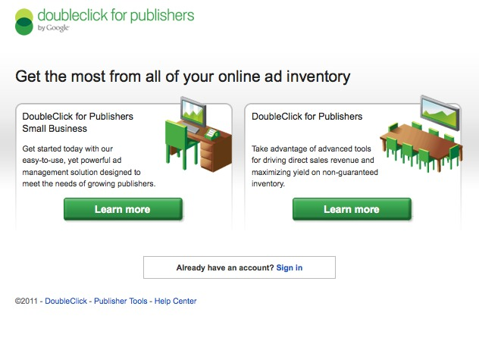
Google.com/DFP

Slide 52
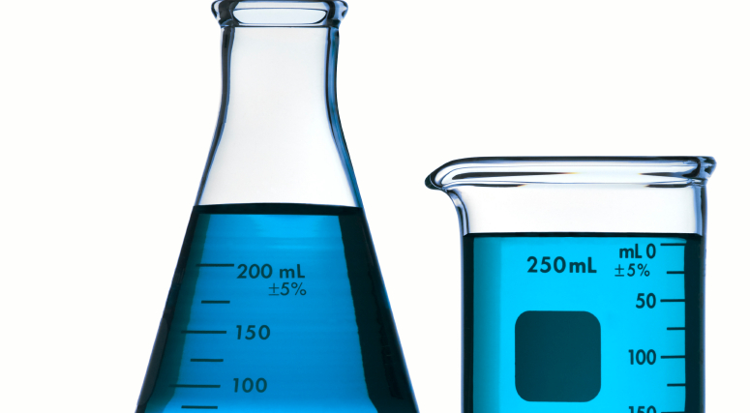
Testing
CTAs
aid testing.

Slide 53

What can you stop doing ?

Slide 54
1
Build Social Media Reach
2
Maximize Content Discovery
3
Conversion Ubiquity

Slide 55
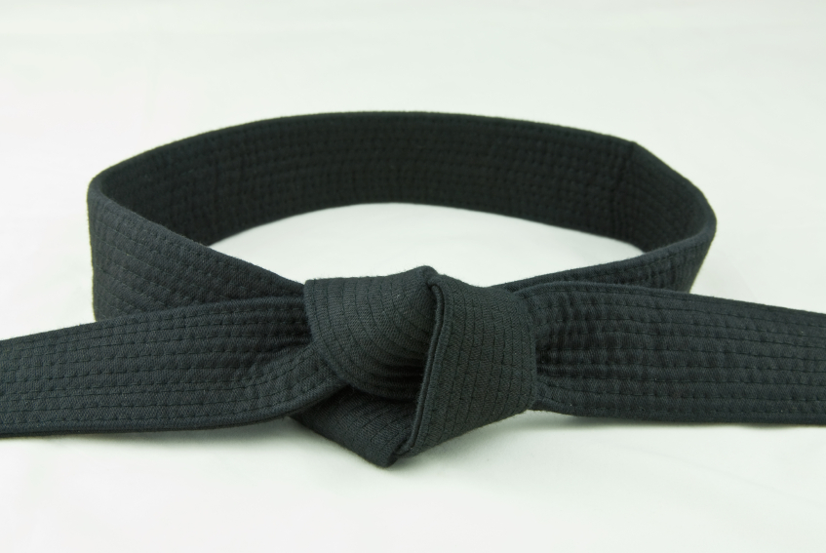
5 Social Media Lead Generation Master Tips.

Slide 56
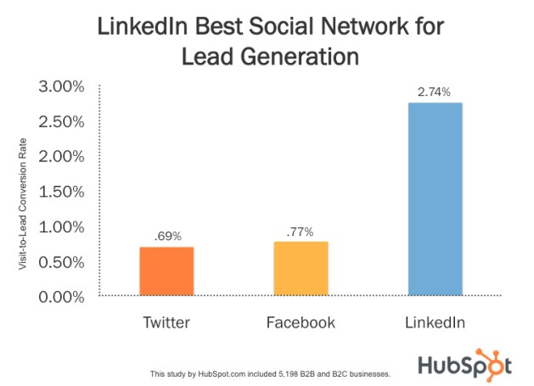

Slide 57
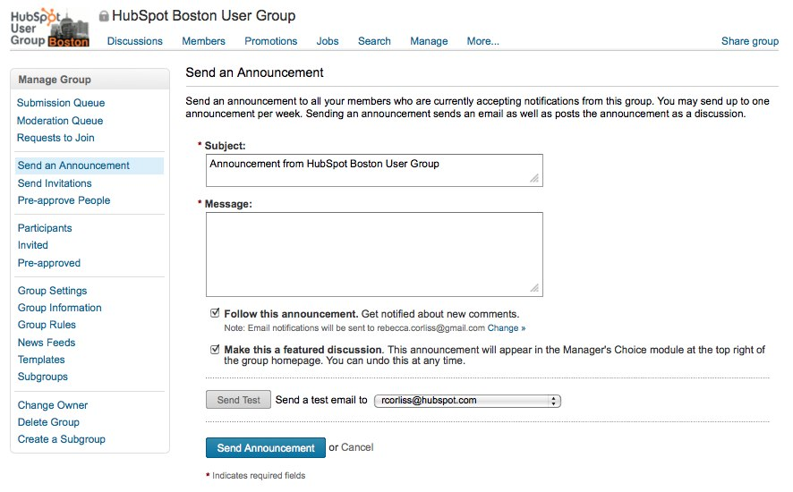
Weekly LinkedIn Group Messages

Slide 58
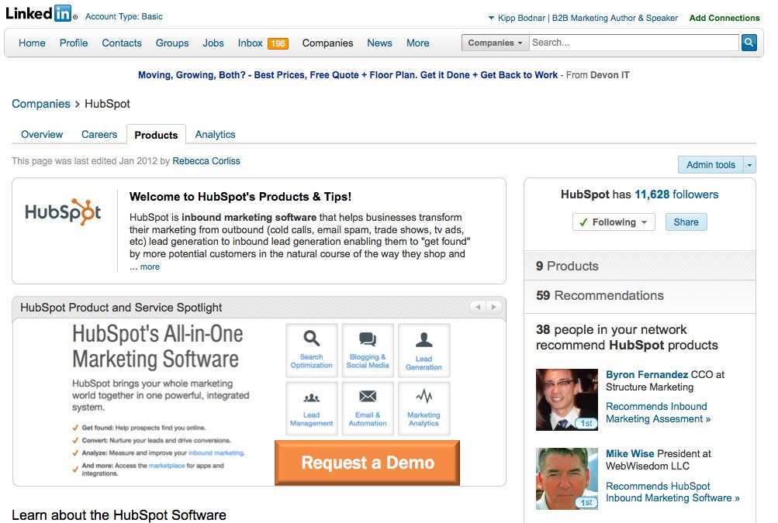
Overhaul your LinkedIn company page.
Weekly LinkedIn Group Messages

Slide 59
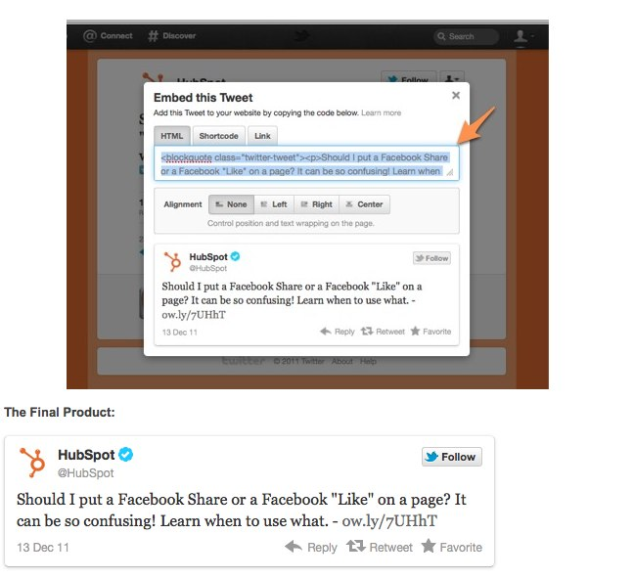
Embed Tweets

Slide 60
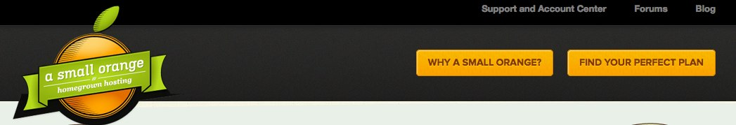
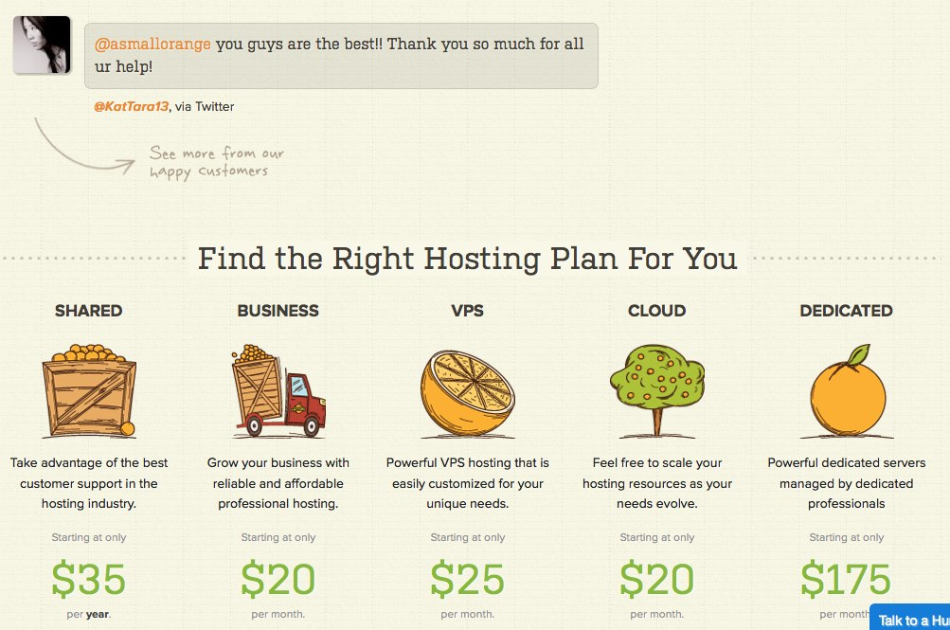

Slide 61
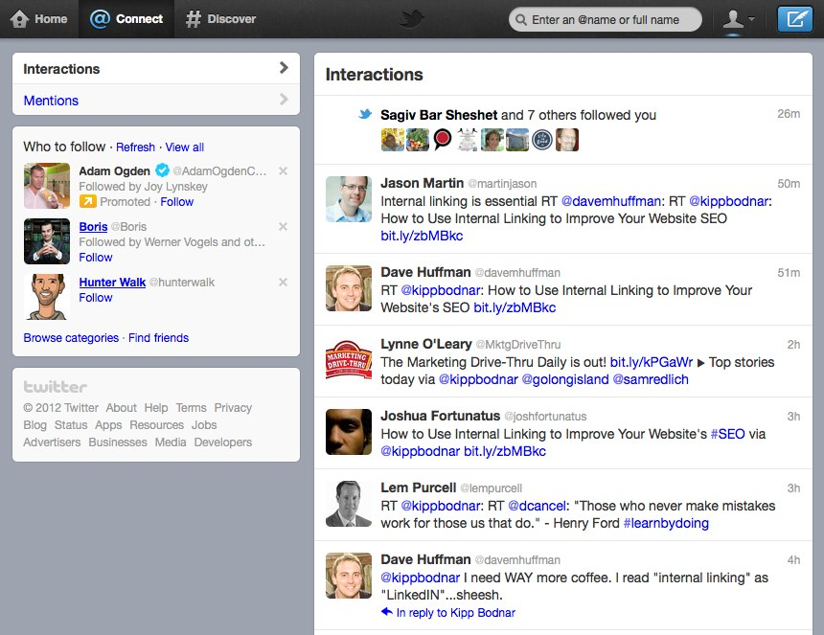
Buy Social Reach

Slide 62
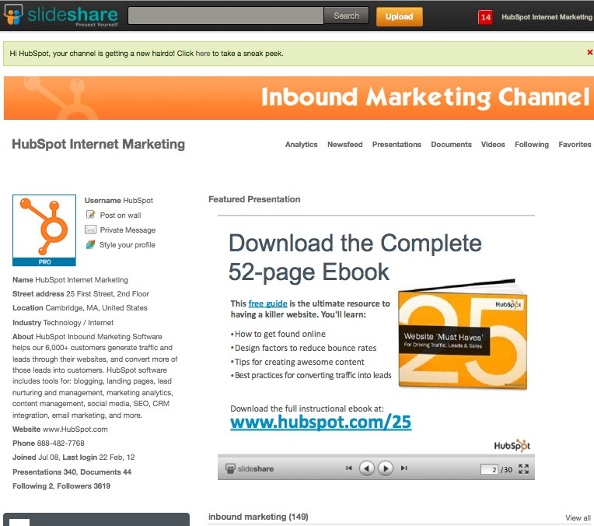
Insert Custom CTA Slides

Slide 63
1
Build Social Media Reach
2
Maximize Content Discovery
3
Conversion Ubiquity

Slide 64

Proved the CEO Wrong.

Slide 65
You’re the Star.

Slide 66
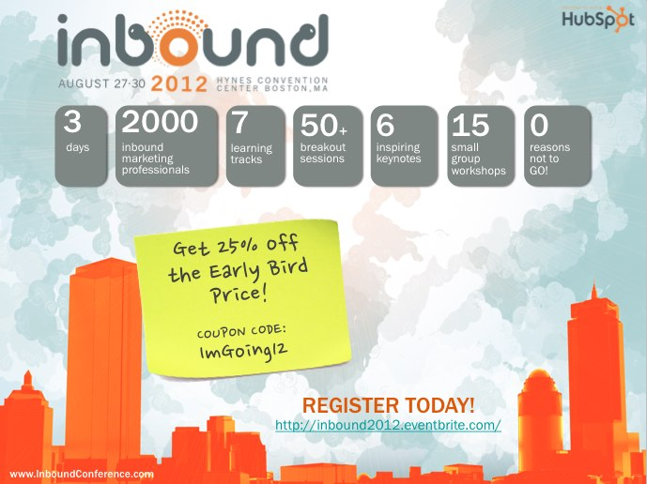
www.InboundConference.com
AUGUST 27-30, 2012
EVENT SNAPSHOT

Slide 67
THANK
YOU.

