Slide 1

Social Media
Lead Generation

Slide 2

I’m Brian Halligan.
Nice to meet you.
I’m Kipp Bodnar.
Nice to meet you.
@KippBodnar

Slide 3

I’m Brian Halligan.
Nice to meet you.
I wrote The B2B Social Media Book.
amzn.to/b2bsm2

Slide 4
#B2BSM

Slide 5

I am a dork.

Slide 6

We’ve got a a Problem.

Slide 7
73%
of CEOs
don’t believe
marketers drive revenue.
91
Fournaise Marketing Group: bit.ly/peNScq

Slide 8

Your opportunity, to shine.

Slide 9

Leads fix
the problem.

Slide 10
3 SOCIAL MEDIA
OPPTIMIZATION OPPORTUNITIES

Slide 11
1
Mastering Facebook Conversion Opportunities
2
Ruling Embeddable Media
3
Generating the Most From LinkedIn

Slide 12
1
Mastering Facebook Conversion Opportunities

Slide 13

Build
Social Media Reach.

Slide 14
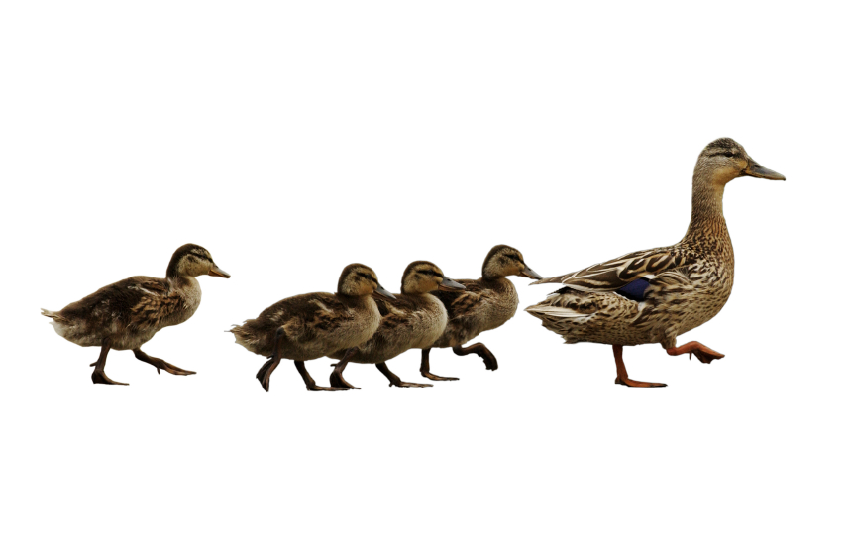
Follow. Friend. Connect.

Slide 15
60%
of the sales cycle is over – before a buyer talks to your salesperson.
91
CORPORATE EXECUTIVE BOARD: bit.ly/zub2I7

Slide 16

Share lots of links.

Slide 17

BITLY, 9/2011
The shelf life of a social media link is 3 hours.
Notes:
Connect to milk and pour glass

Slide 18
THE
Links to company blog posts
10-4-1
Links to third-party articles
Link to a company landing page
RULE

Slide 19

Automatic Sharing

Slide 20

Leverage existing contacts.

Slide 21
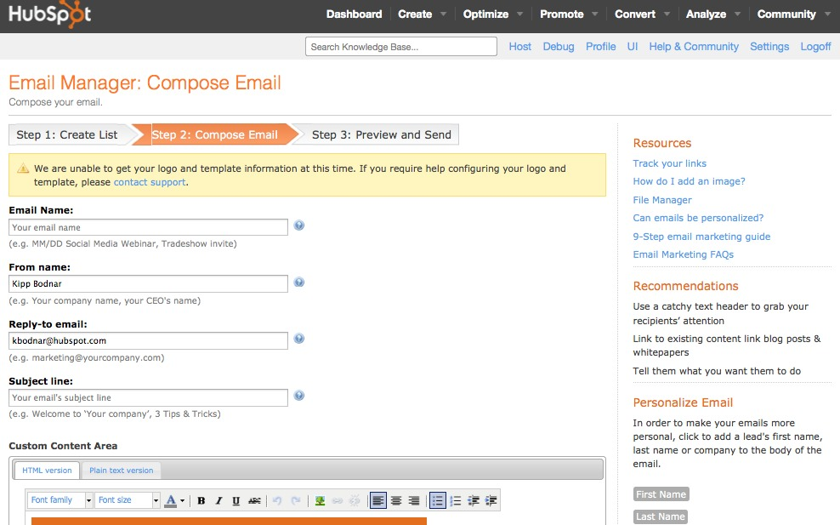
Use email for reach building.

Slide 22


Slide 23
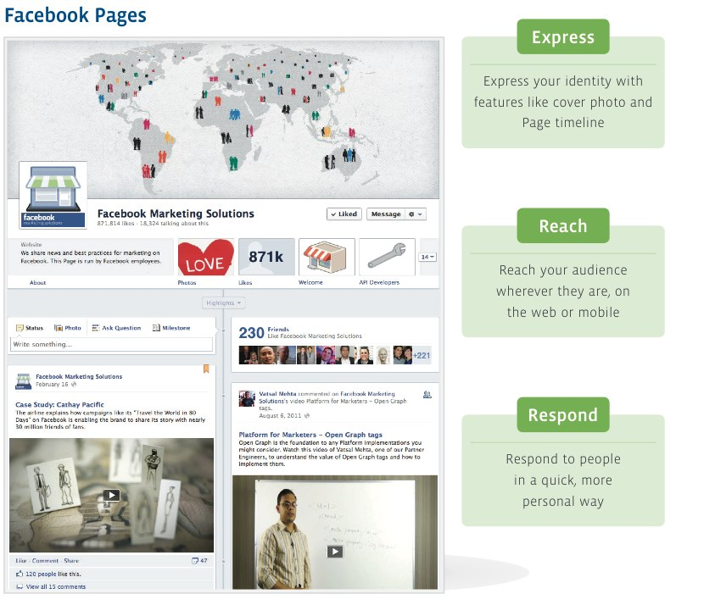

Slide 24
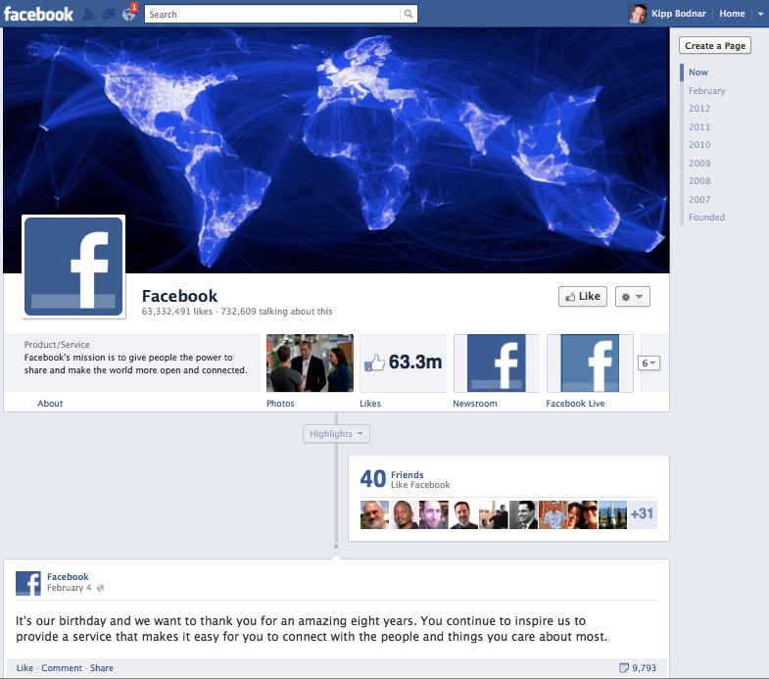

Slide 25
5 Things You Cover Image CAN’T Include
Price or purchase information.
2. Contact information such as a website address, email, mailing address.
3. References to Facebook features or actions, such as “Like” or “Share” or an arrow pointing from the cover photo to any of these features.
4. Calls-to-action, such as “Get it now” or “Tell your friends.”
5. Covers must not be false, deceptive or misleading.

Slide 26
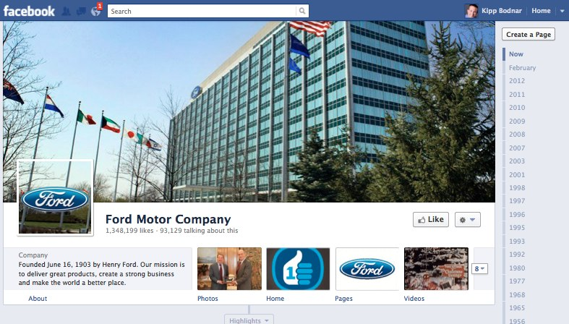
Highlight CTA Tabs

Slide 27
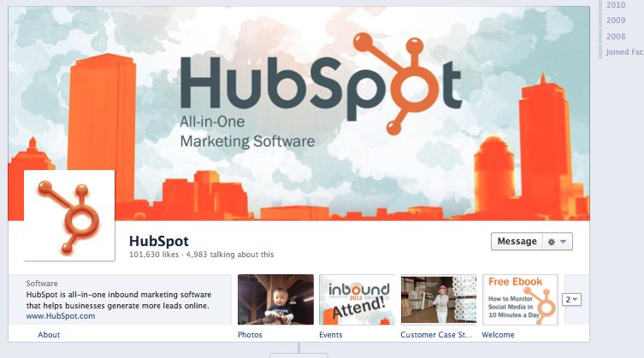
Highlight CTA Tabs

Slide 28
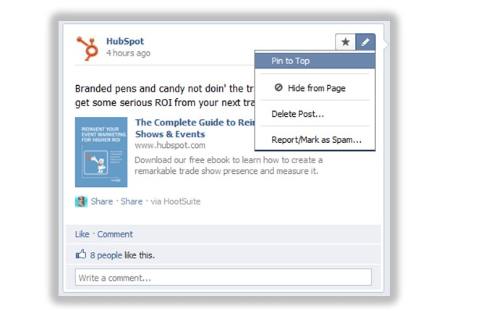
Pin CTA Posts Every 7 Days

Slide 29
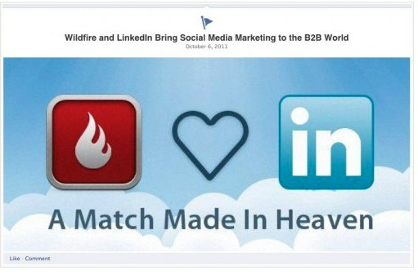
Star CTA Posts

Slide 30
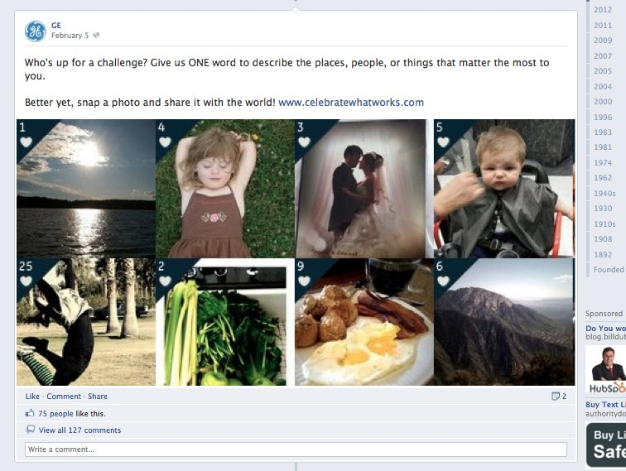
Photography Focused CTAs.

Slide 31
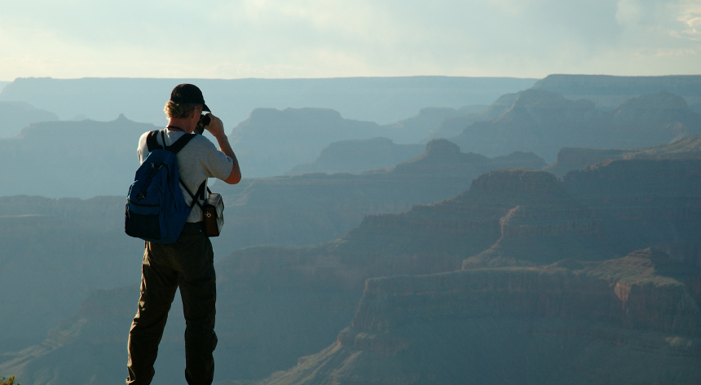
Facebook Timeline success depends on great visuals.

Slide 32
2
Ruling Embeddable Media

Slide 33
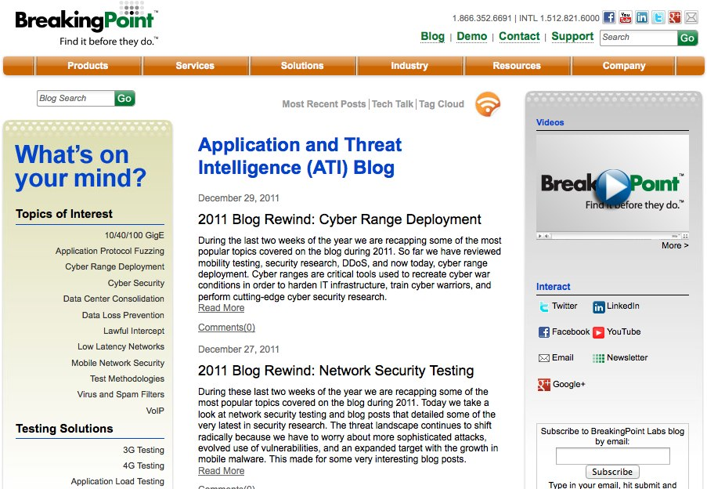

Slide 34
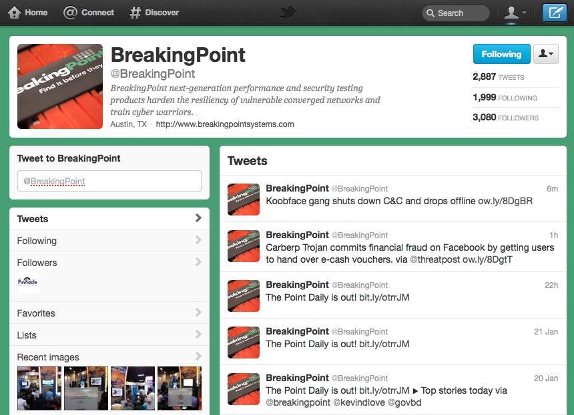

Slide 35
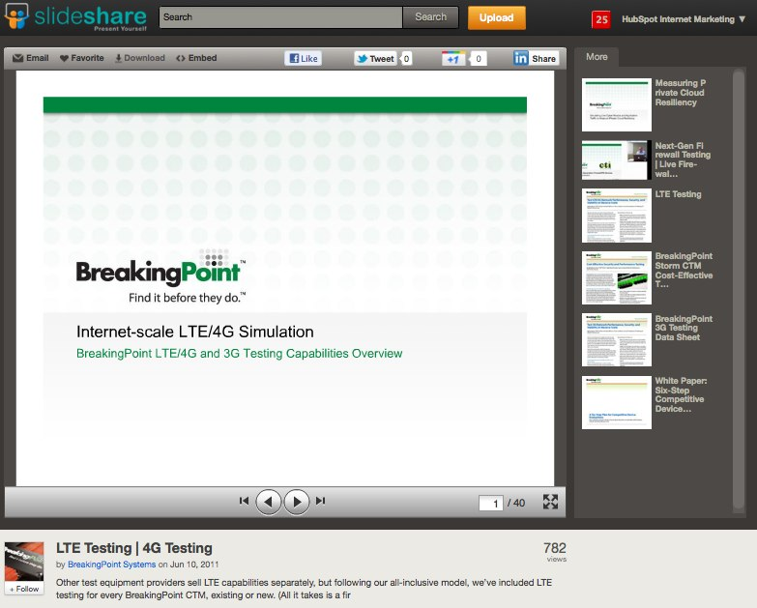

Slide 36


Slide 37
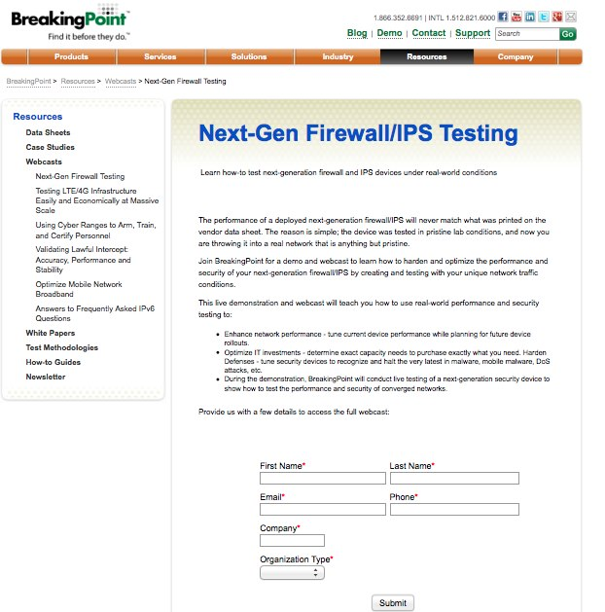

Slide 38
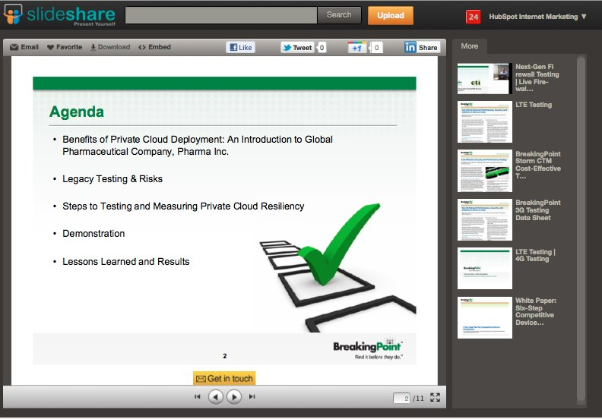

Slide 39
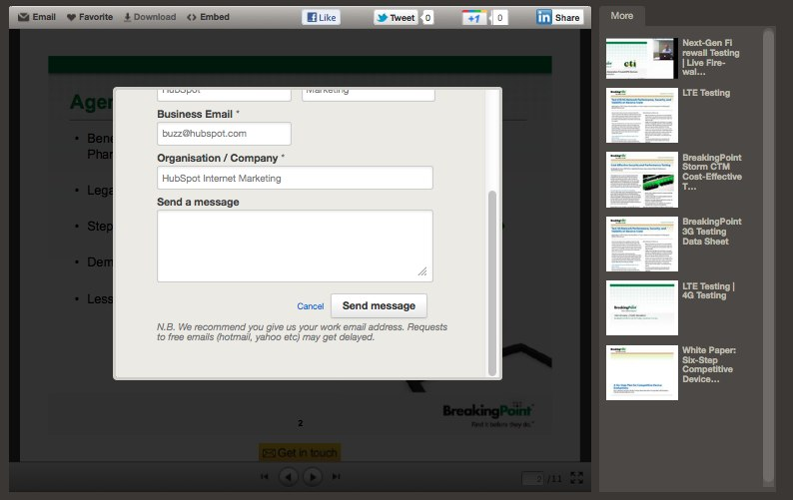

Slide 40
Closed Millions In Sales From Online Leads
ROI – 2800%!

Slide 41
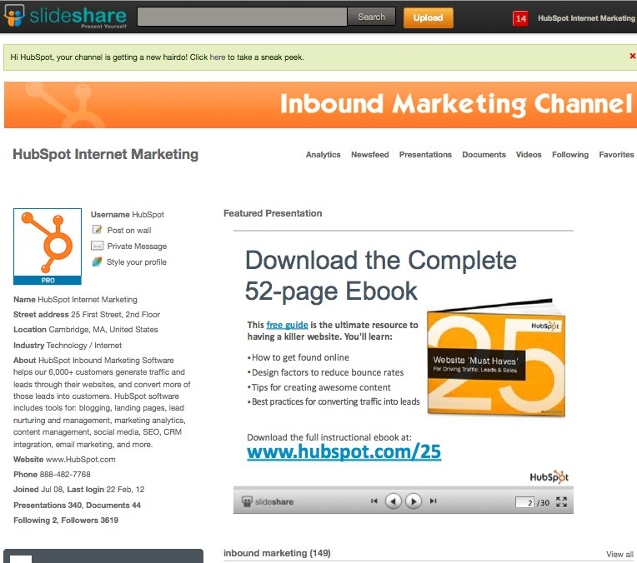
Insert Custom CTA Slides

Slide 42
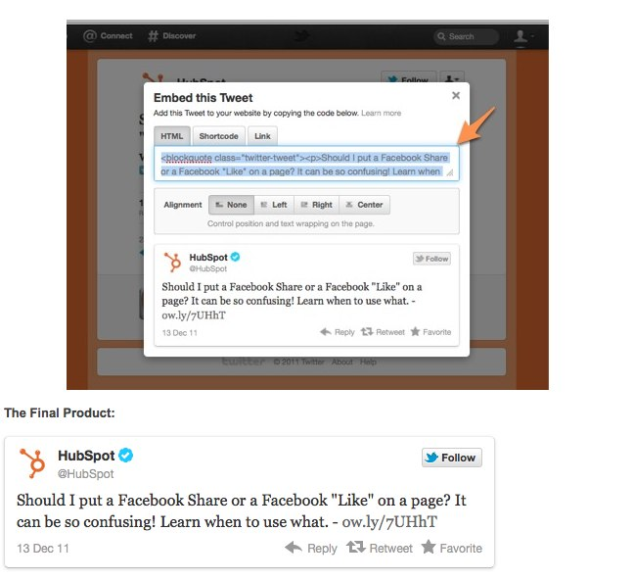
Embed Tweets

Slide 43
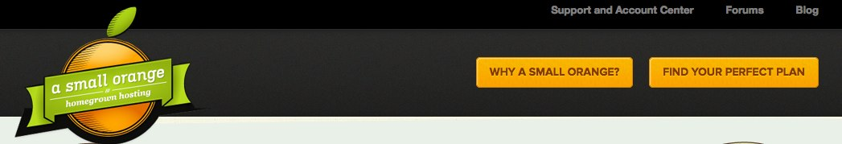
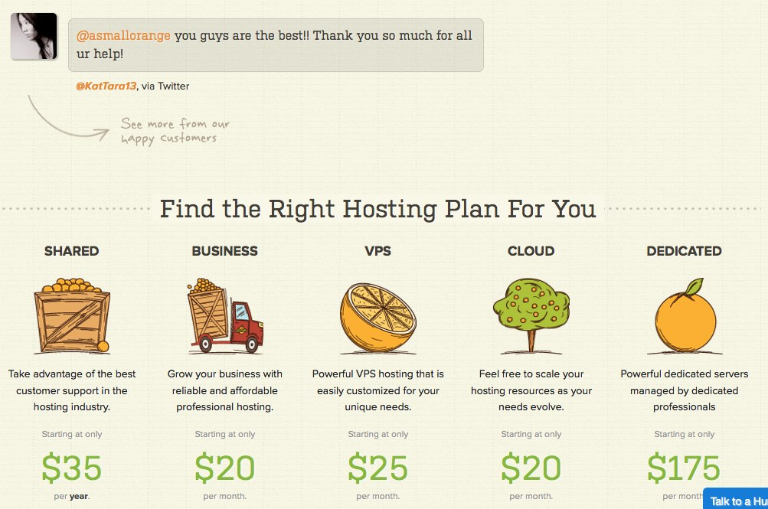

Slide 44
3
Building an Awesome LinkedIn Company Page

Slide 45
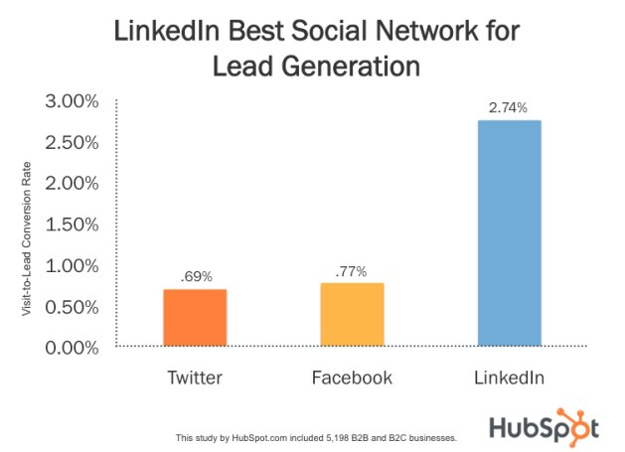

Slide 46
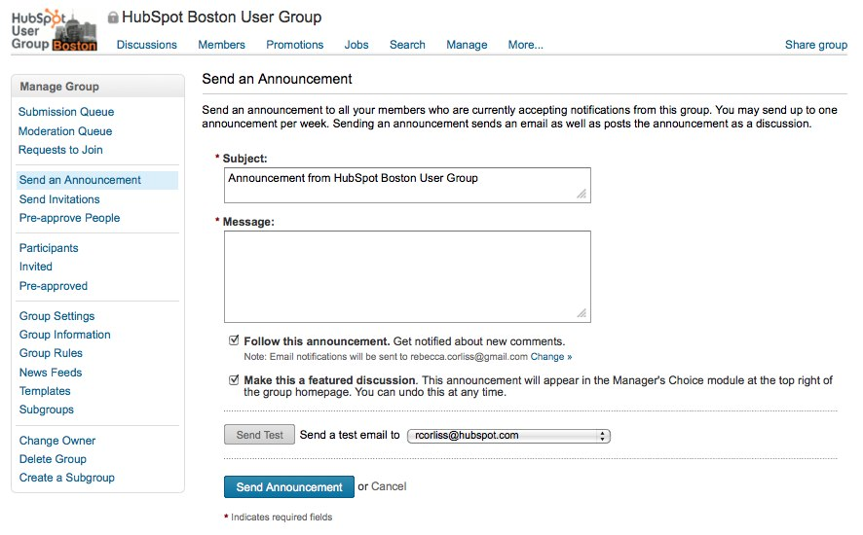
Weekly LinkedIn Group Messages

Slide 47
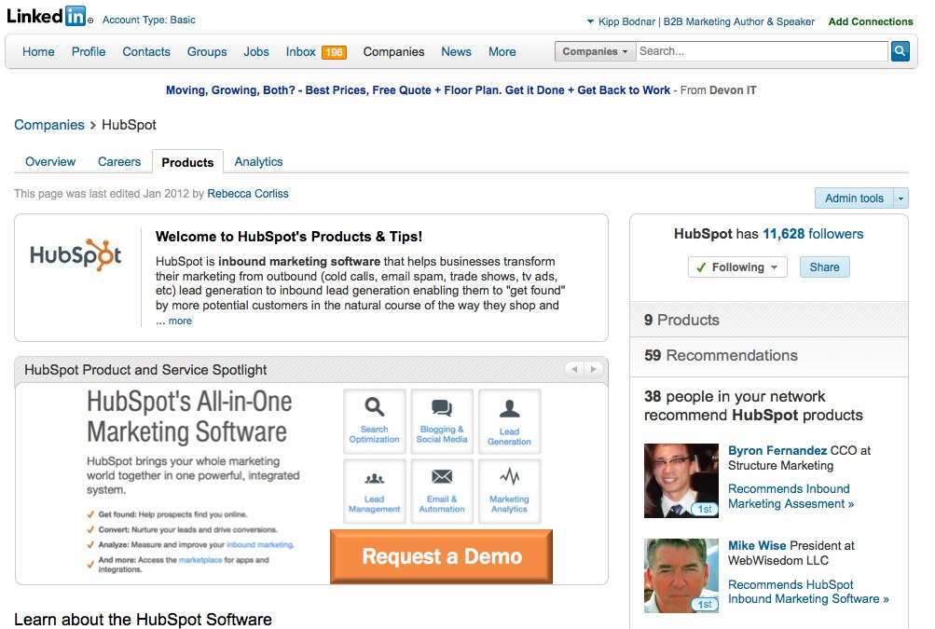
Overhaul your LinkedIn company page.
Weekly LinkedIn Group Messages

Slide 48
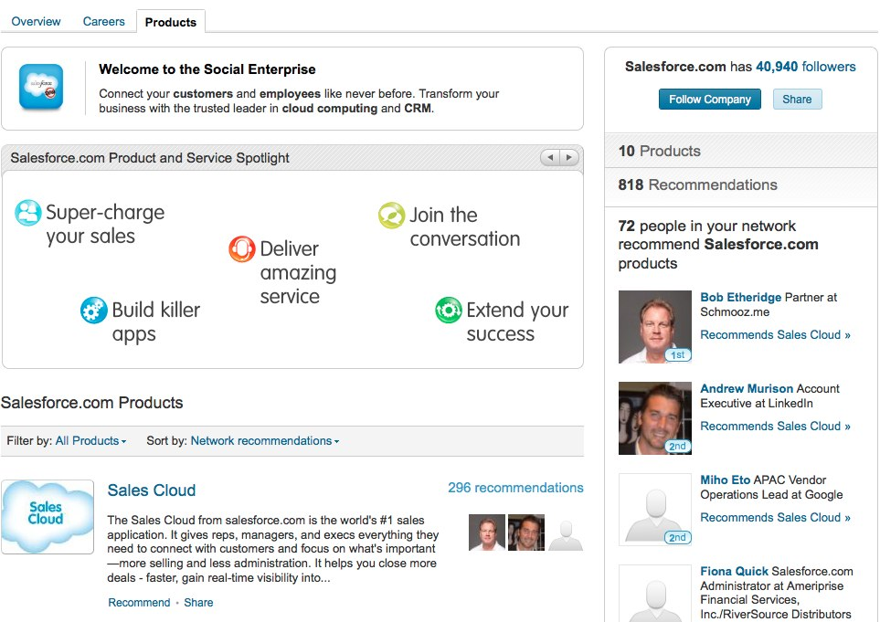

Slide 49
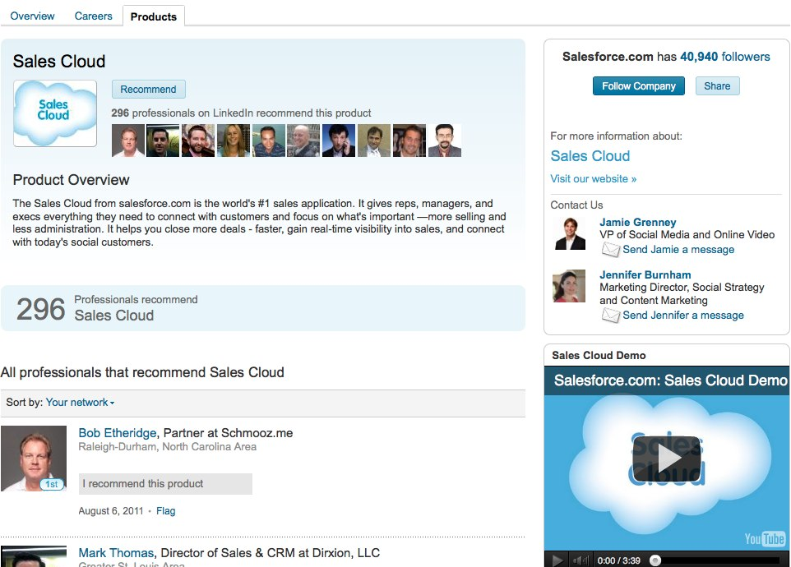

Slide 50
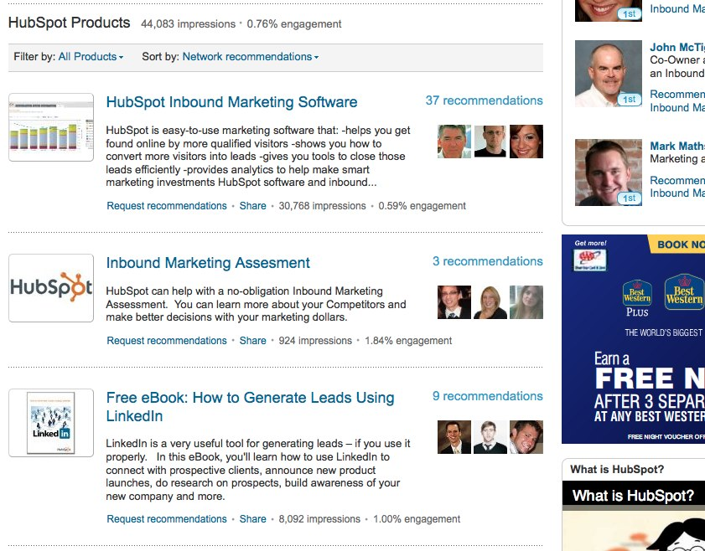
List Offers as Products

Slide 51
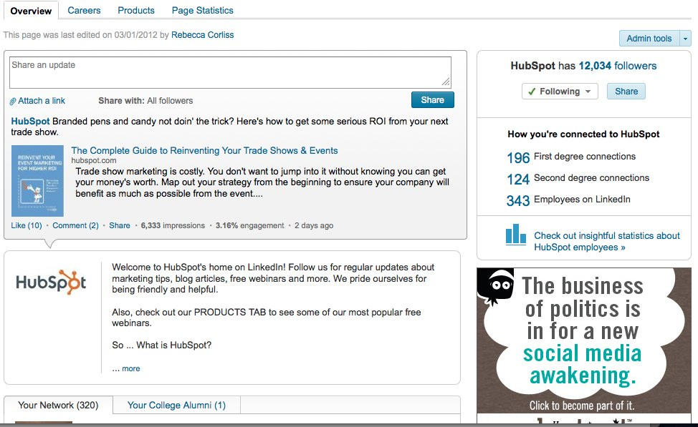
CTAS as Updates

Slide 52
LinkedIn leads are driven by company follows and group updates.

Slide 53
1
Mastering Facebook Conversion Opportunities
2
Ruling Embeddable Media
3
Generating the Most From LinkedIn

Slide 54

Proved the CEO Wrong.

Slide 55
You’re the Star.

Slide 56
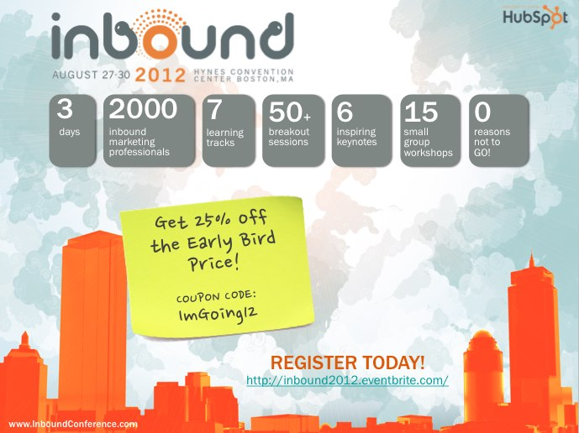
www.InboundConference.com
AUGUST 27-30, 2012
EVENT SNAPSHOT

Slide 57
THANK
YOU.

