Slide 1

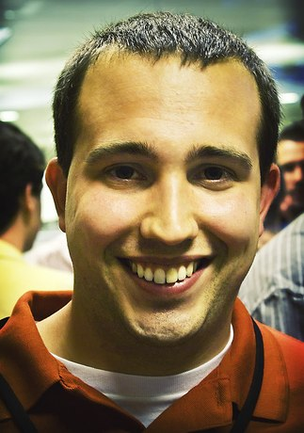

Content Is King
How to Leverage Content Creation and Ditch Outbound
Kipp Bodnar
Inbound Marketing Manager

Slide 2
Please Tweet questions and comments to @Kbodnar32
The Hashtag is #ContentKing.

Slide 3


Notes:
Customers behind secure firewalls

Slide 4
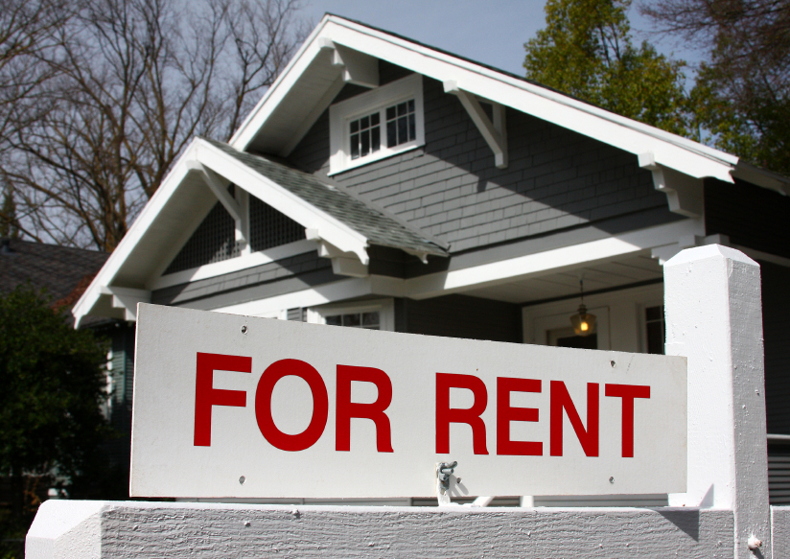
Notes:
Customers behind secure firewalls

Slide 5

TV Ads

Slide 6

Print Ads

Slide 7

Notes:
Customers behind secure firewalls

Slide 8

Content

Slide 9


Slide 10
Static. Lifeless. Generic.

Slide 12
1,654

Slide 13
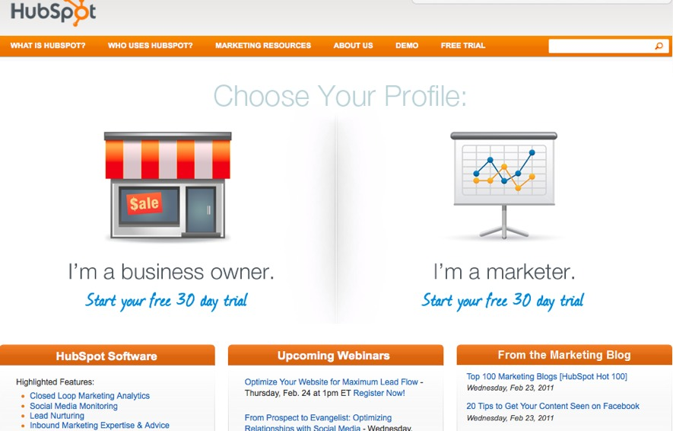

Slide 14
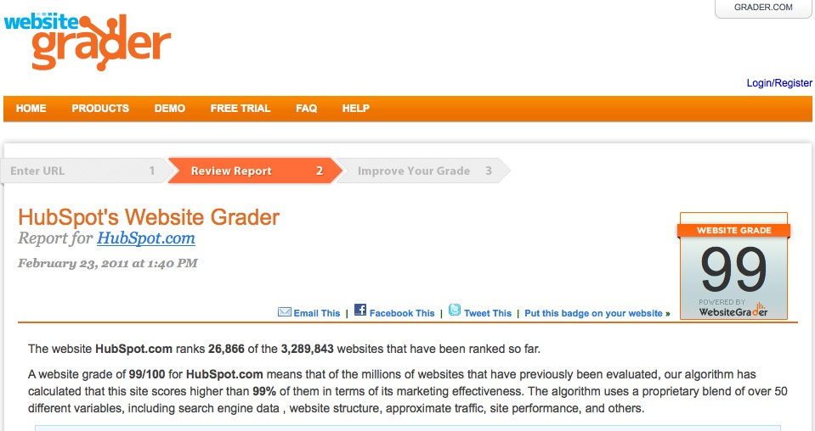

Slide 15
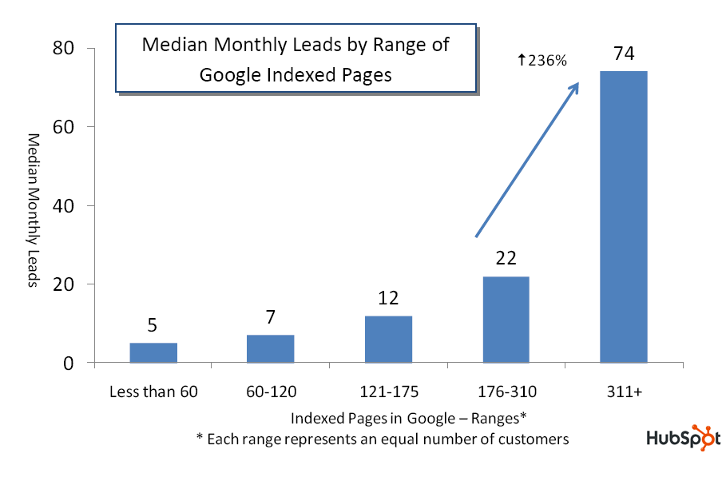
Source: State of Inbound Marketing Lead Generation Report - http://bit.ly/cVMpkn

Slide 16

Blogging

Slide 17
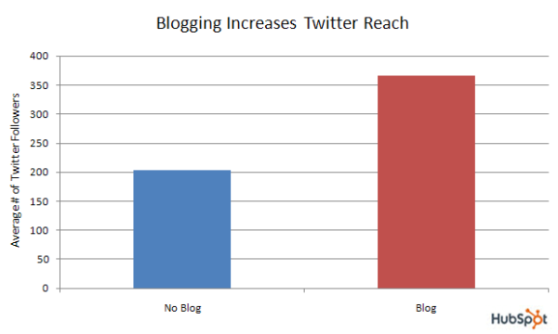
Source: Data from over 2,000 businesses - http://bit.ly/a6SrWh

Slide 18

Headlines Win

Slide 19
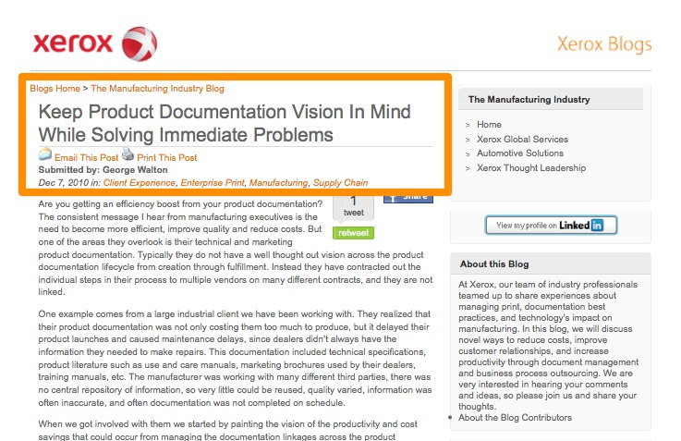

Slide 20
9 Words

Slide 21

Segment

Slide 22
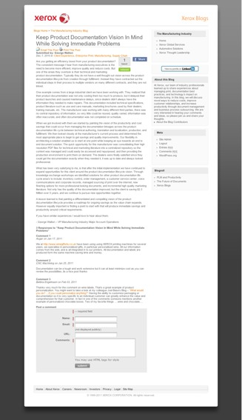

Slide 23
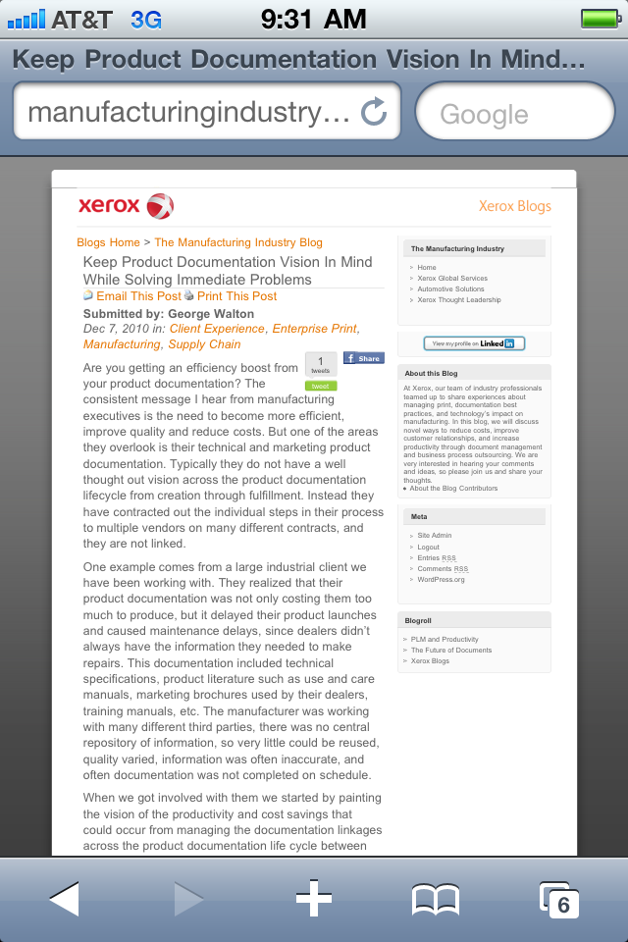

Slide 24
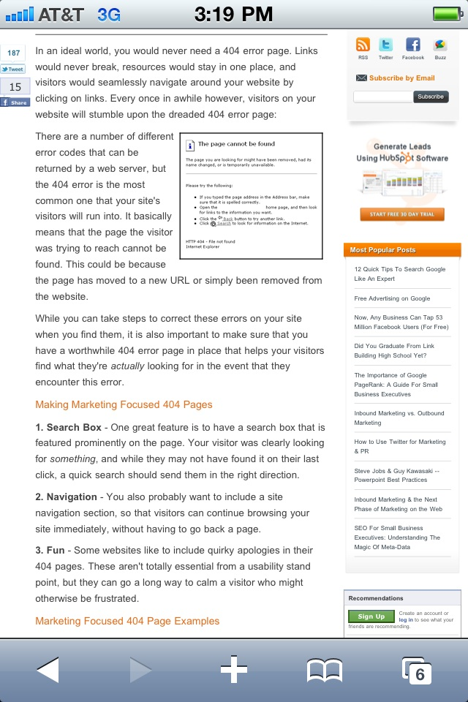

Slide 26

Pictures

Slide 27
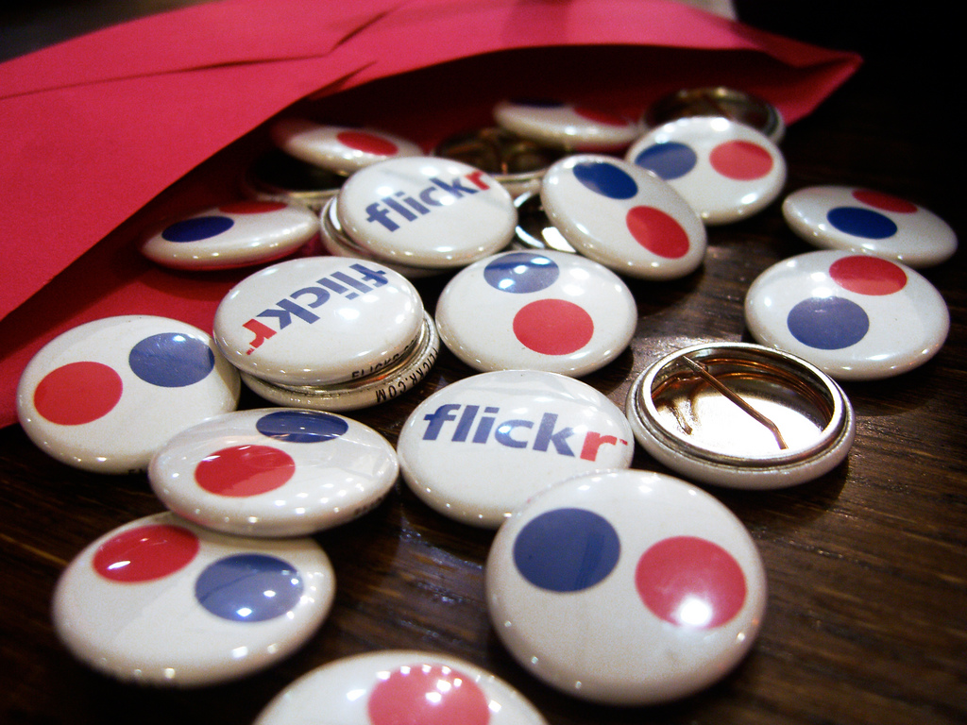
Flickr

Slide 28
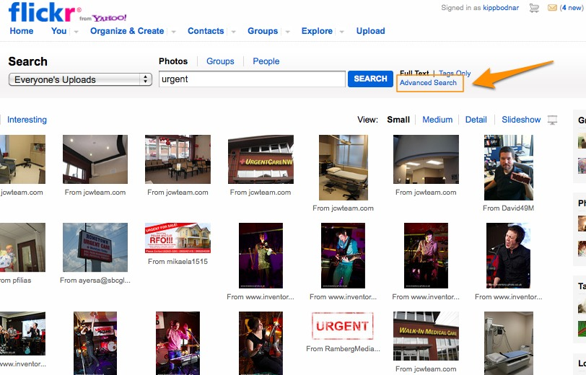

Slide 29
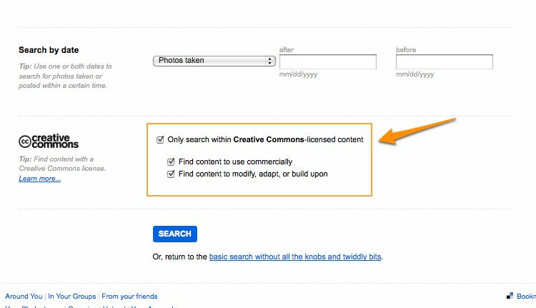

Slide 30
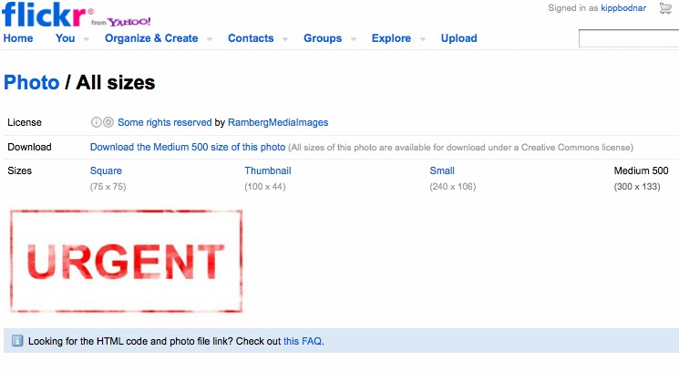

Slide 31

Don’t Preach

Slide 32
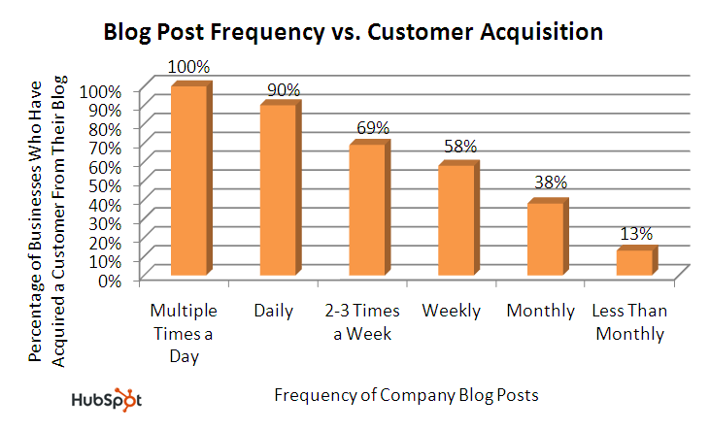
Source: State of Inbound Marketing Report - http://bit.ly/aewfHr

Slide 33

Pick Fights

Slide 34
Break News

Slide 35
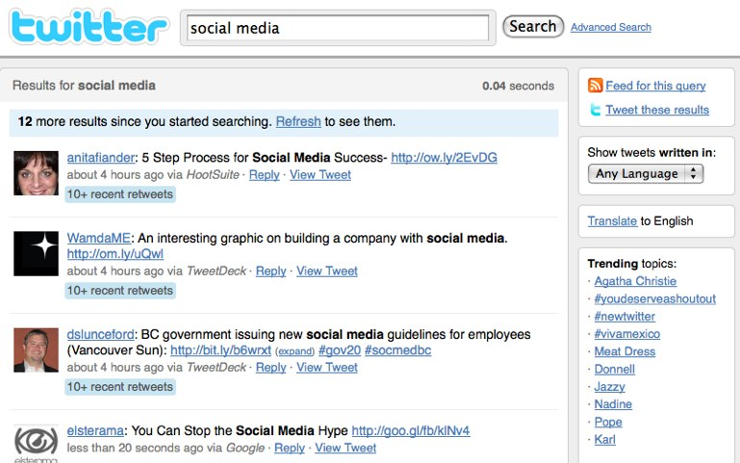
Social Media

Slide 36
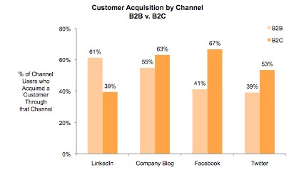
Source: State of Inbound Marketing Report - http://bit.ly/aewfHr

Slide 37
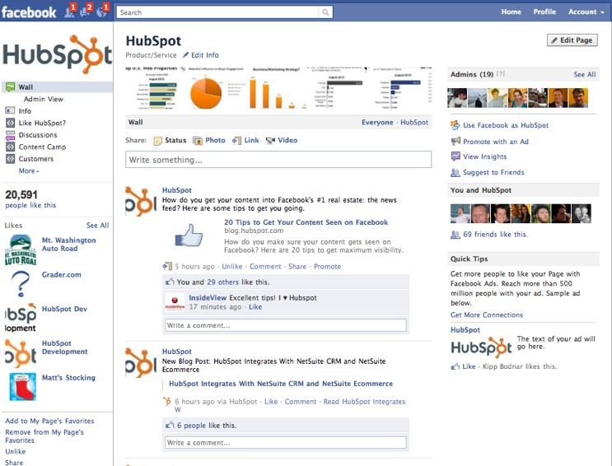

Slide 38
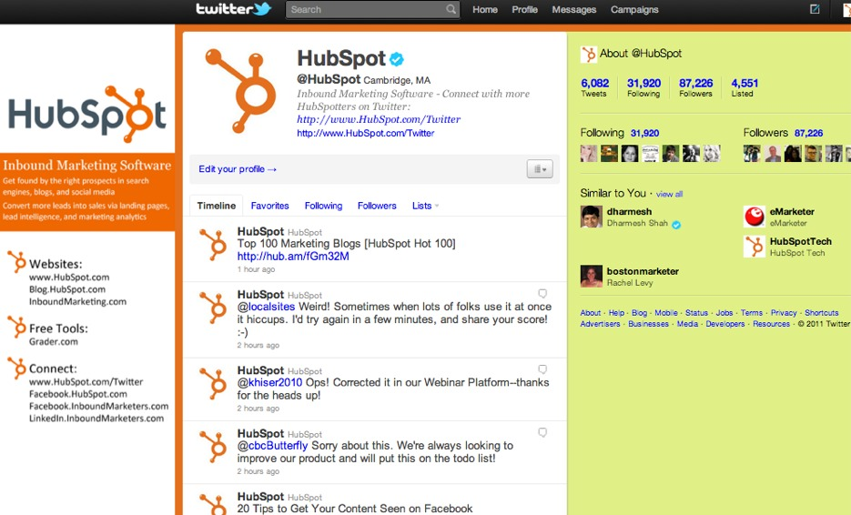

Slide 39
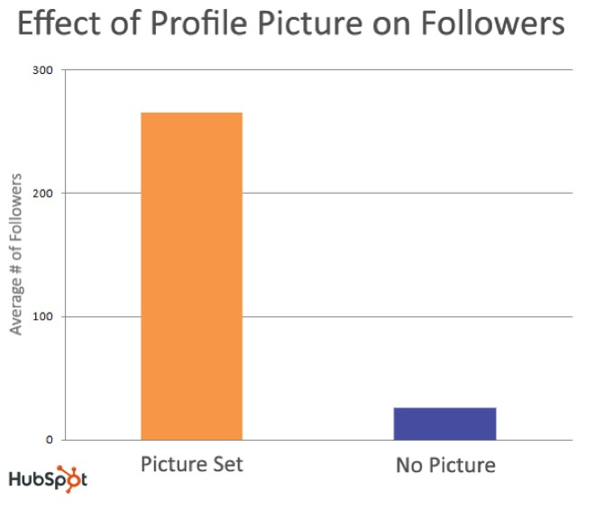
Source: Science of Twitter - http://bit.ly/dVkqDd

Slide 40

Conversion= Content+CTAs

Slide 41
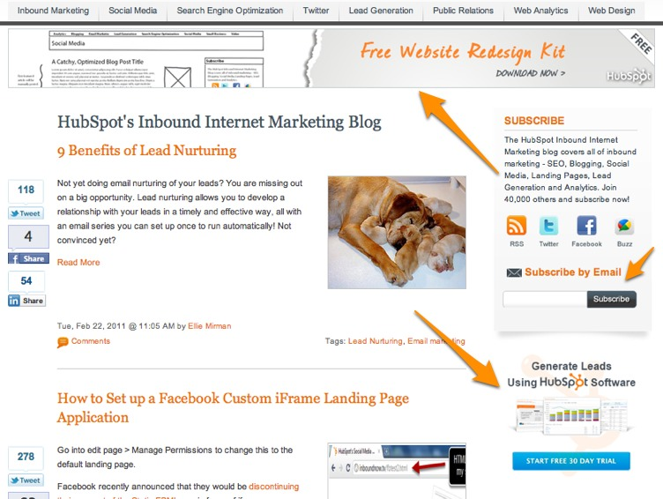

Slide 42

Landing Pages

Slide 43
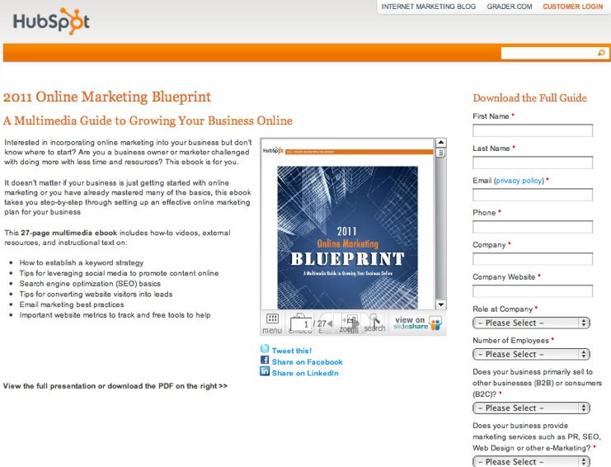

Slide 44

Content
Templates

Slide 45
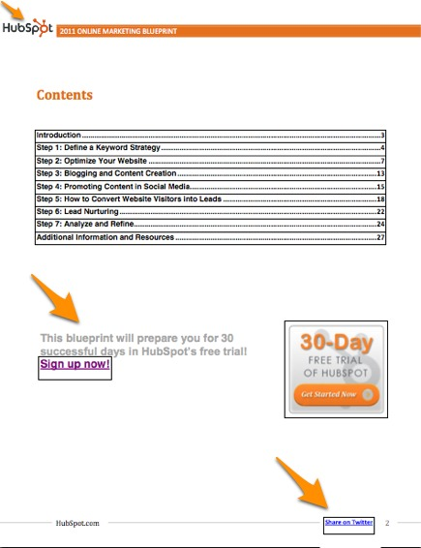

Slide 47


Slide 48
?’s
@Kbodnar32
Blog.Hubspot.com

