Slide 1

Mastering B2B
Social Media

Slide 2

I’m Brian Halligan.
Nice to meet you.
I’m Kipp Bodnar.
Nice to meet you.
@KippBodnar

Slide 3

I’m Brian Halligan.
Nice to meet you.
I wrote The B2B Social Media Book.
amzn.to/b2bsm2

Slide 4
#B2BSM

Slide 5
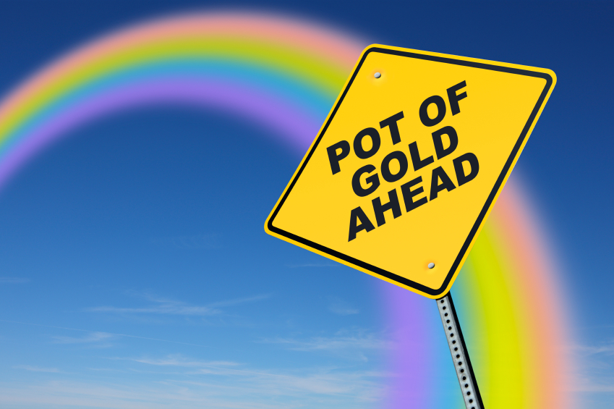

Slide 6

Your opportunity to shine

Slide 7
60%
of the sales cycle is over – before a buyer talks to your salesperson.
91
CORPORATE EXECUTIVE BOARD: bit.ly/zub2I7

Slide 8
B2B>B2C

Slide 9
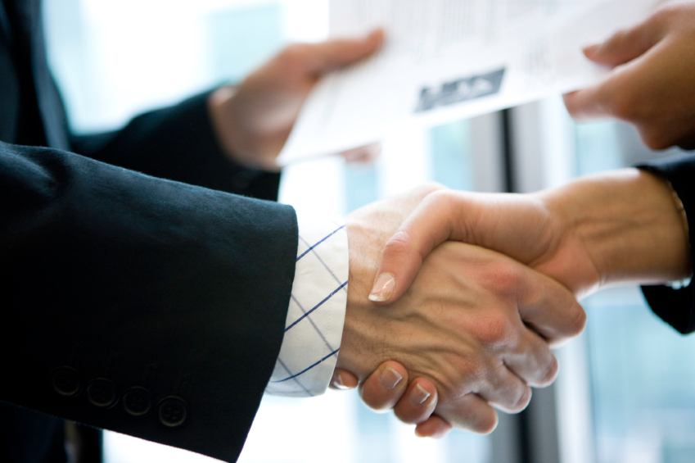
Relationship based sales

Slide 10
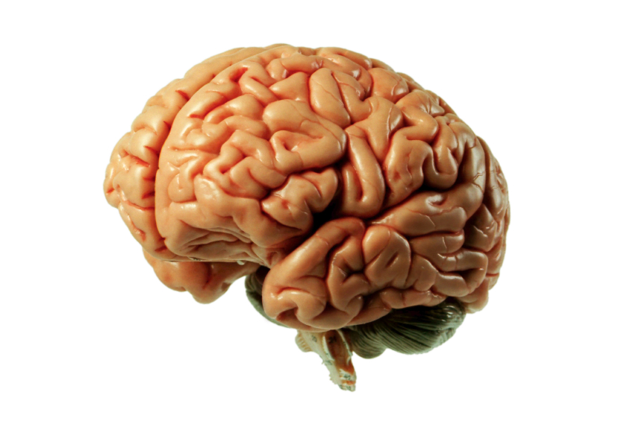
Already have
the expertise

Slide 11
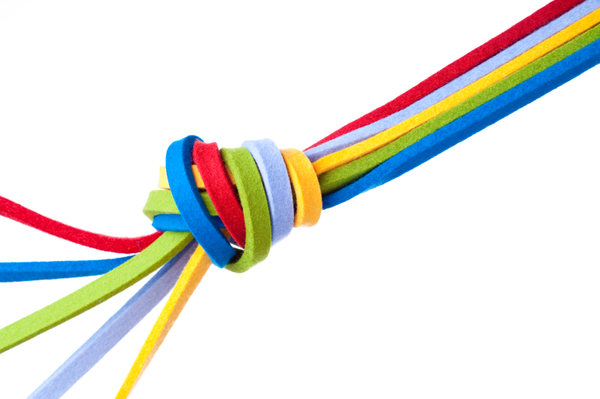
Clear customer Personas

Slide 12
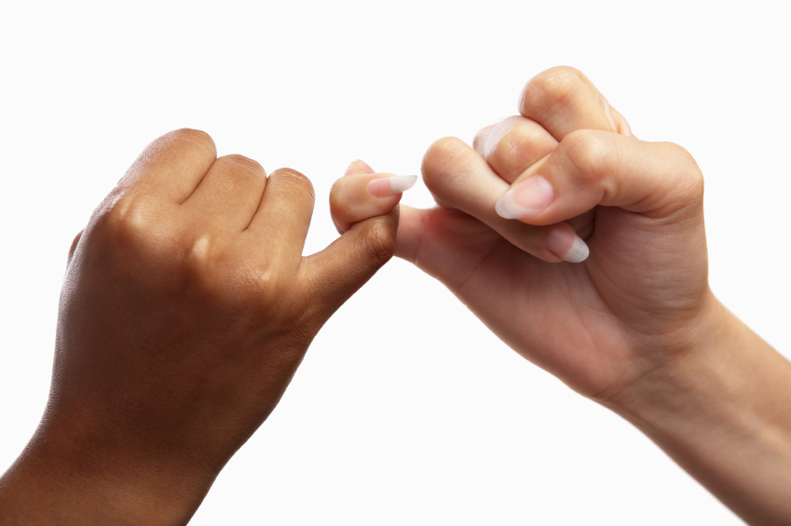
People to People

Slide 13
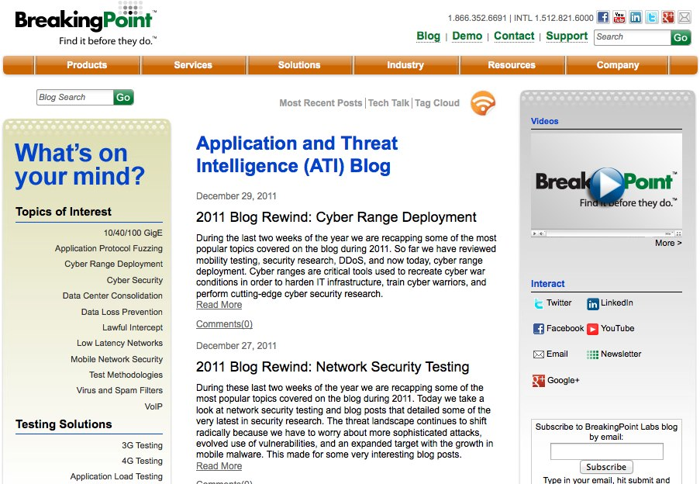

Slide 14
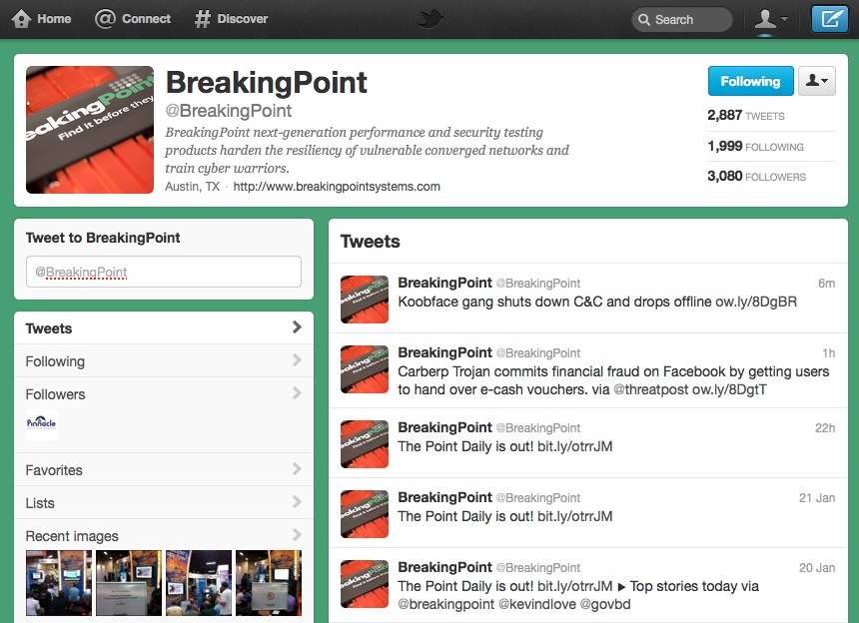

Slide 15
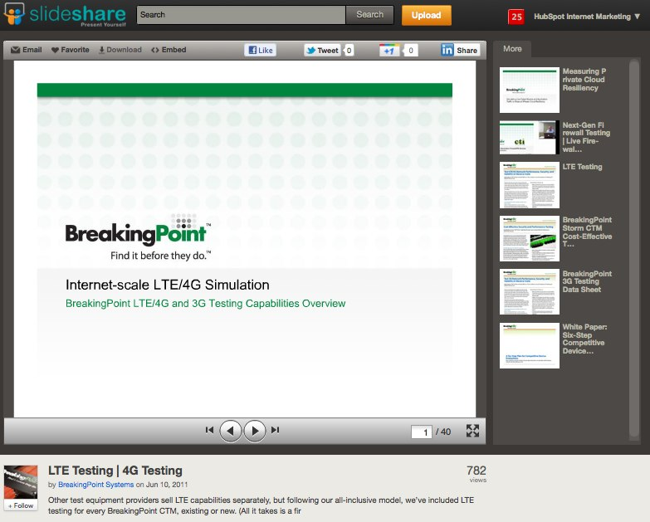

Slide 16


Slide 17
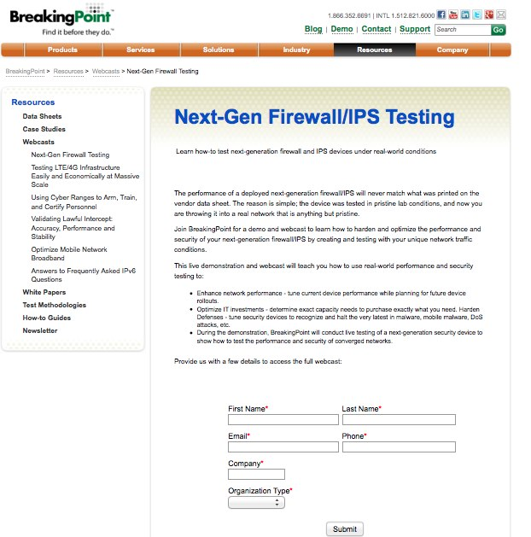

Slide 18
Closed Millions In Sales From Online Leads
ROI – 2800%!

Slide 19
#B2BSM

Slide 20


Slide 21
B2B Myths Busted

Slide 22

“
Marketing is an asset NOT an expense.
”
@KippBodnar
Tweet This!
#B2BSM

Slide 23
B2B SOCIAL MEDIA IS
ABOUT REACH BUILDING

Slide 24

The Social Web Rewards Reach

Slide 25
“
B2B companies should obsess about building reach as much or MORE than B2C companies.
”
@KippBodnar
Tweet This!
#B2BSM

Slide 26
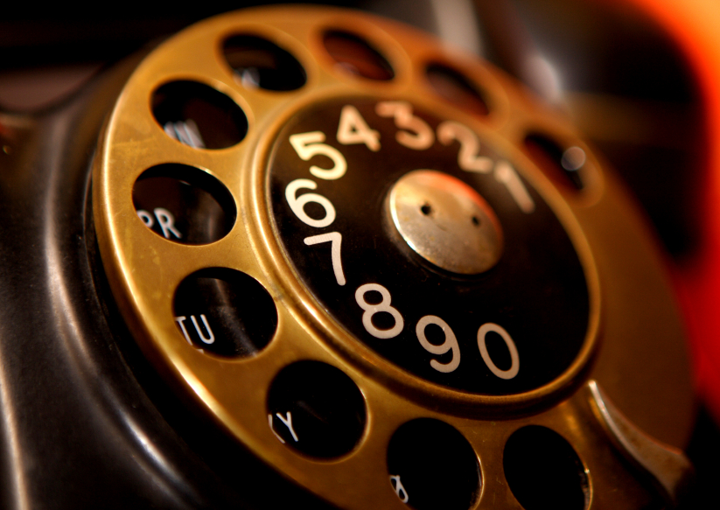
Social reach is the new
word-of-mouth referral engine

Slide 27

Share lots of links

Slide 28

BITLY, 9/2011
The shelf life of a social media link is 3 hours.
Notes:
Connect to milk and pour glass

Slide 29
THE
Links to company blog posts
10-4-1
Links to third-party articles
Link to a company landing page
RULE

Slide 30
B2B SOCIAL MEDIA IS
ABOUT SELLING

Slide 31
“
Your goal shouldn't be to buy leads. Your goal should be to buy customers.
”
@KippBodnar
Tweet This!
#B2BSM

Slide 32
73%
of CEOs
don’t believe
marketers drive revenue.
91
Fournaise Marketing Group: bit.ly/peNScq

Slide 33

Leads fix
the problem

Slide 34
How Social Media Leads Happen
1
Tweet
Landing Page
Form
Lead
Like
Blog Post
CTA
Landing Page
+1
Product Page
CTA
Landing Page

Slide 35

Place CTAs Everywhere

Slide 36
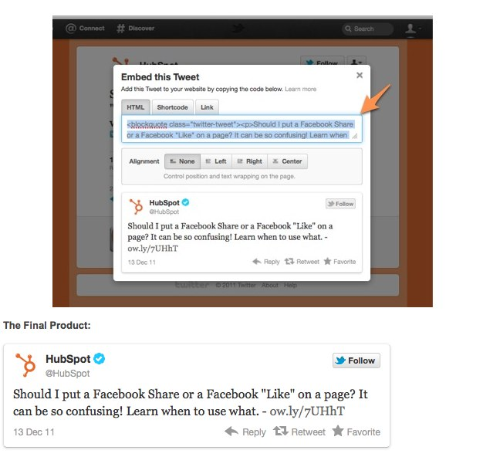
Embed Tweets
Notes:
Sometimes CTAs aren’t what you think
Testimonials written by robots
For example you can use embedded tweets to impact conversion
Twitter makes it easy now to embed a tweet.

Slide 37
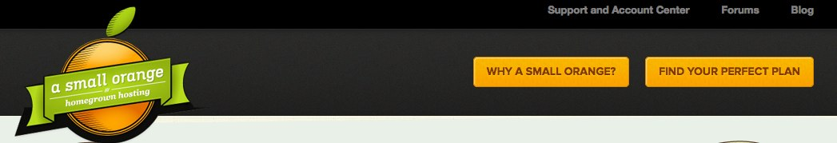
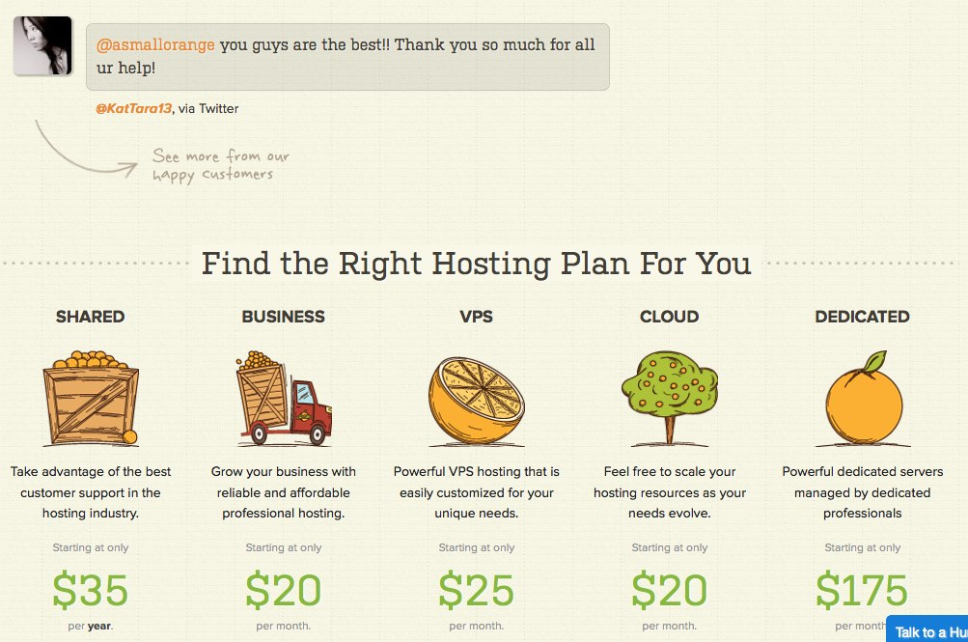
Notes:
Lets look at an example of embedded tweets for conversion
Small orange test
Reults

Slide 38

Improve
and Iterate

Slide 39
#B2BSM

Slide 40
B2B SOCIAL MEDIA HAS
CLEAR ROI

Slide 41
“
If you can’t count it, why do it?
”
@KippBodnar
Tweet This!
#B2BSM

Slide 42

Math Ahead

Slide 43
TLV-COCA
=
ROI (%)
COCA

Slide 44
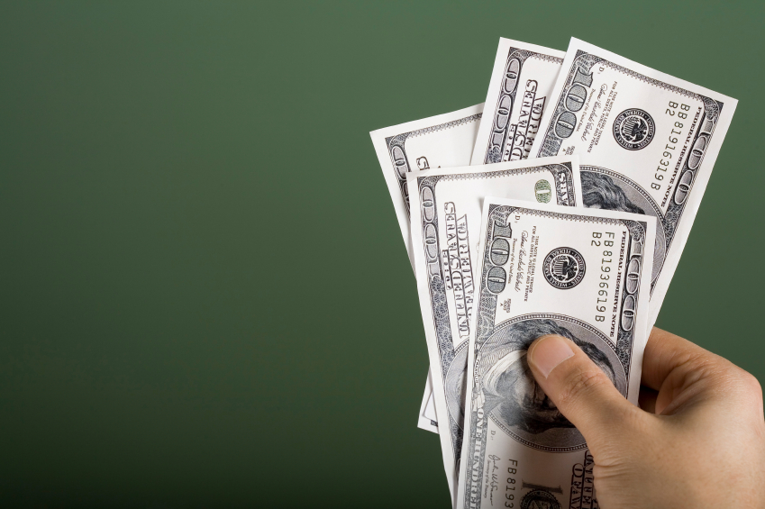
Total Lifetime Value

Slide 45
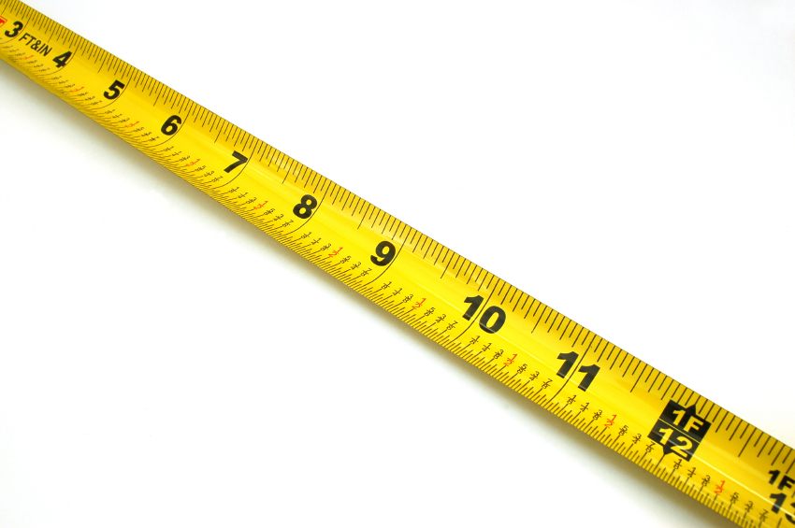
Cost of Customer Acquisition

Slide 46
First- Vs. Last-Action Attribution
Last-Action Attribution: Clicks on a PPC Ad
Attends Sales Call
Buys Product
Looks at Product Page
First-Action Attribution: User Clicks Link on Twitter
Signs Up For Webinar
Reads Blog Post

Slide 47

10K-3K
=
233%
3K

Slide 48
B2B SOCIAL MEDIA IS
ONLY ONE PIECE

Slide 49
“
Social media amplifies the effectiveness of offline marketing.
It doesn’t replace it.
”
@KippBodnar
Tweet This!
#B2BSM

Slide 50

Trade shows
are social too

Slide 51
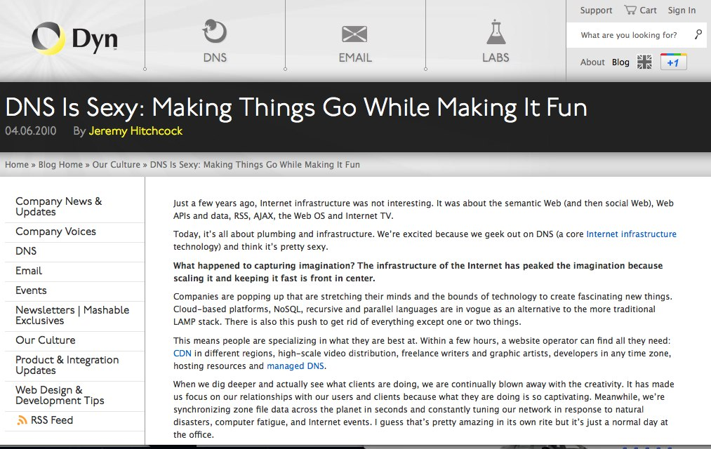

Slide 52
GOAL:
Use Social Media To Promote Offline Events

Slide 53
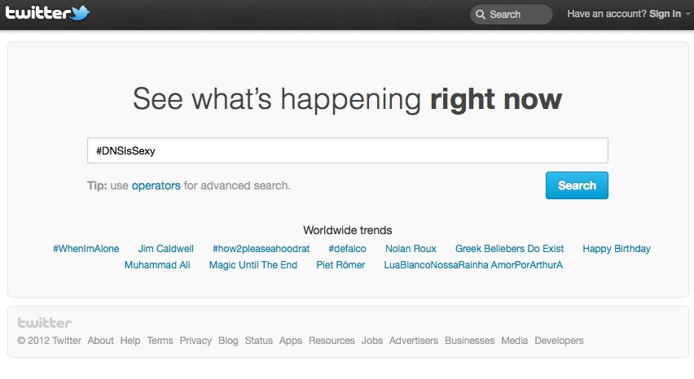

Slide 54
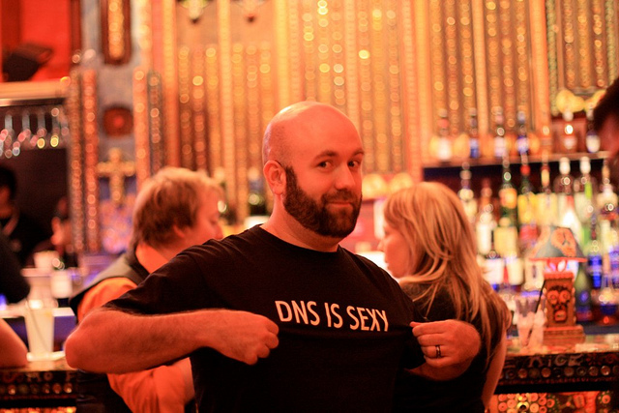
5,000 T-Shirts

Slide 55
RESULT:
235% Increase in event tickets distributed and 95% redeemed

Slide 56
THE BEST
TIME EVER FOR MARKETERS

Slide 57
“
Master B2B Social Media with reach, lead gen, data and integration with offline activities.
”
@KippBodnar
Tweet This!
#B2BSM

Slide 58
Prove the
CEO
Wrong

Slide 59
You’re the Star

Slide 60
THANK
YOU

Slide 61
I’m Brian Halligan.
Nice to meet you.
We wrote The B2B Social Media Book.
amzn.to/b2bsm2

