Slide 1
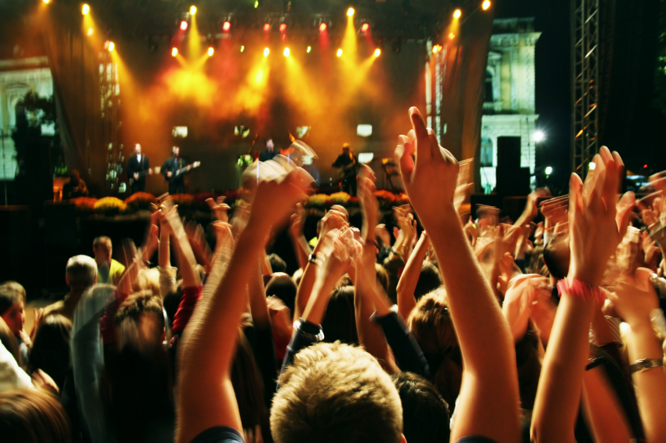
Social Media
Lead Generation

Slide 2

I’m Brian Halligan.
Nice to meet you.
I’m Kipp Bodnar.
Nice to meet you.
@KippBodnar

Slide 3
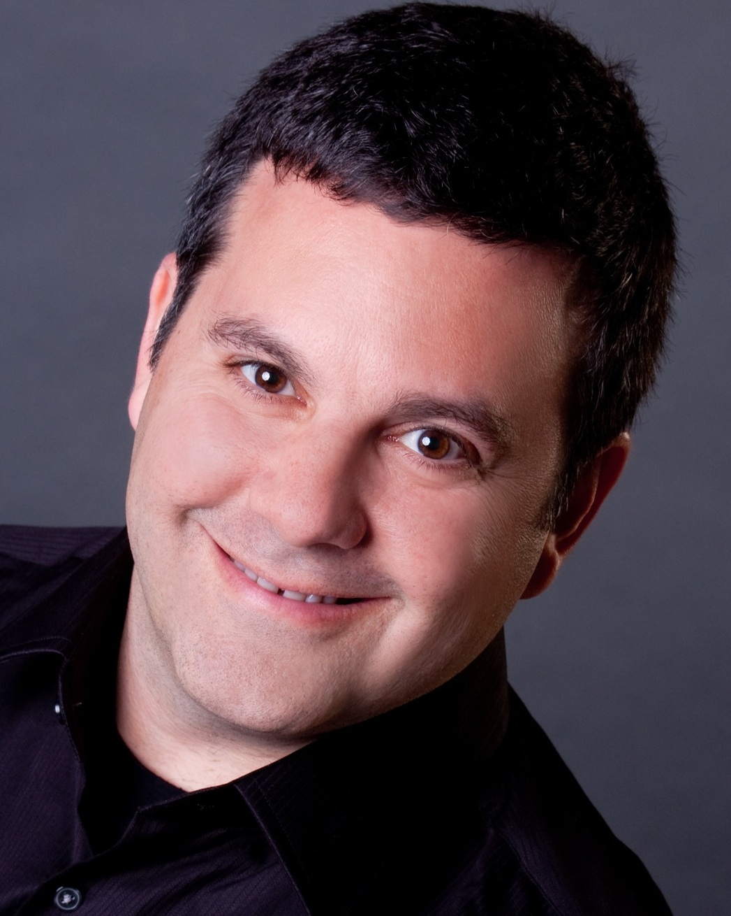
I’m Brian Halligan.
Nice to meet you.
I’m Jeff Cohen.
Nice to meet you.
@JeffreyLCohen

Slide 4

I’m Brian Halligan.
Nice to meet you.
We wrote The B2B Social Media Book.
amzn.to/b2bsm2

Slide 5
#B2BSM

Slide 6
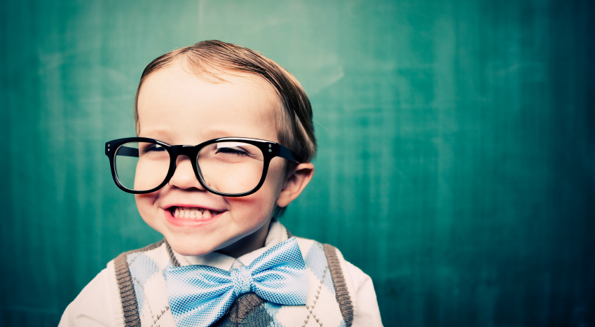
We’re dorks.

Slide 7
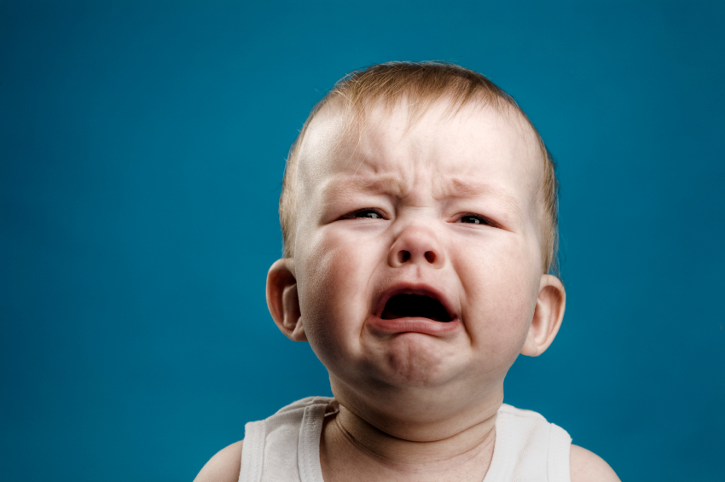
We’ve got a a Problem.

Slide 8
73%
of CEOs
don’t believe
marketers drive revenue.
91
Fournaise Marketing Group: bit.ly/peNScq

Slide 9

Your opportunity, to shine.

Slide 10

Leads fix
the problem.

Slide 11
LEADS ARE
A PROXY
FOR SALES.

Slide 12

“
Your goal shouldn't be to buy leads. Your goal should be to buy customers.
”
@KippBodnar
Tweet This!
#SXB2BSM

Slide 13
1
Traditional Lead Gen Campaign
List
Mailer
Track
ROI

Slide 14
How Social Media Leads Happen
1
Like
+1
Tweet
Form
Blog Post
Product Page
Blog Post
Landing Page
Lead

Slide 15
3 KEYS FOR
SOCIAL MEDIA
LEAD
GENERATION SUCCESS:

Slide 16
1
Build a Network of Strong Ties
2
Influence Connections For Content Sharing
3
Master Social Conversion

Slide 17
1
Build a Network of Strong Ties
2
Influence Connections For Content Sharing
3
Master Social Conversion

Slide 18
60%
of the sales cycle is over – before a buyer talks to your salesperson.
91
CORPORATE EXECUTIVE BOARD: bit.ly/zub2I7
Notes:
Say the stat
Customer in power not Sales
Social Media is a critical tool for educating the buyer early in the process

Slide 19
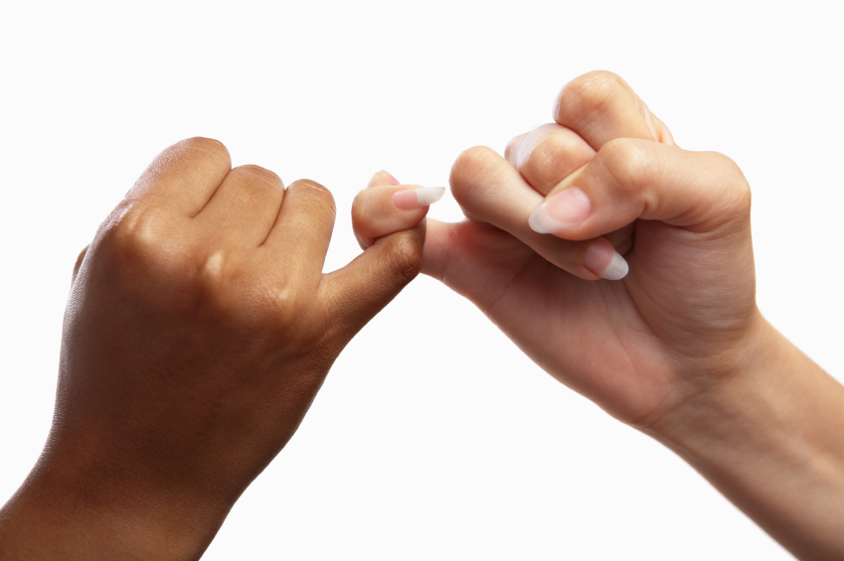
People to People
Notes:
Not B2B its People to People
Social Media and relationship selling

Slide 20
“
Prospects don’t care about your products. They want solutions to their problems.
”
@JeffreyLCohen
Tweet This!
#B2BSM
Notes:
WHY

Slide 21
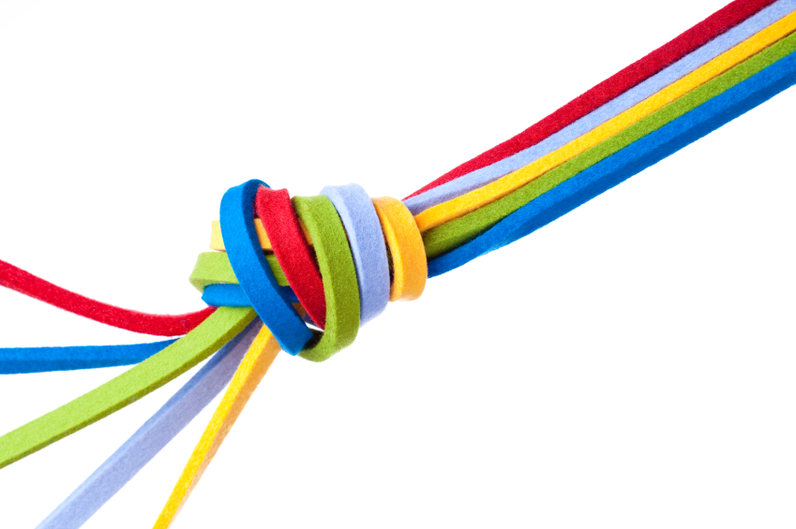
Build Strong Ties
Notes:
http://en.wikipedia.org/wiki/Interpersonal_ties

Slide 22
Interaction, Affection
and Time
Build Strong Ties
Notes:
http://en.wikipedia.org/wiki/Interpersonal_ties

Slide 23
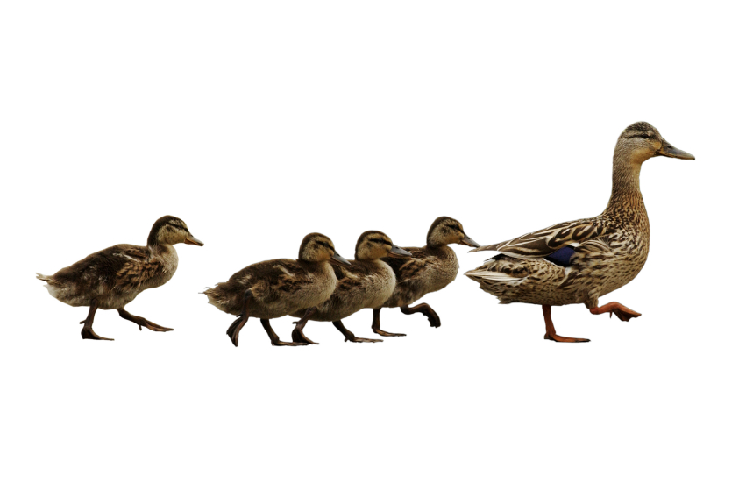
Follow. Friend. Connect. With People.
Notes:
To build your reach you have to take action
Follow friend connect
The magic of the internets won’t bring people to you.
INTERACTION

Slide 24

BITLY, 9/2011
The half-life of a social media link is 3 hours.
Notes:
Stat
Milk analogy
That means after 3 hours your link is essentially dead.
Interaction

Slide 25
THE
10-4-1
RULE

Slide 26
THE
10-4-1
Links to third-party articles
RULE

Slide 27
THE
Links to company blog posts
10-4-1
RULE

Slide 28
THE
10-4-1
Link to a company landing page
RULE

Slide 29
Engagement = Affection

Slide 30
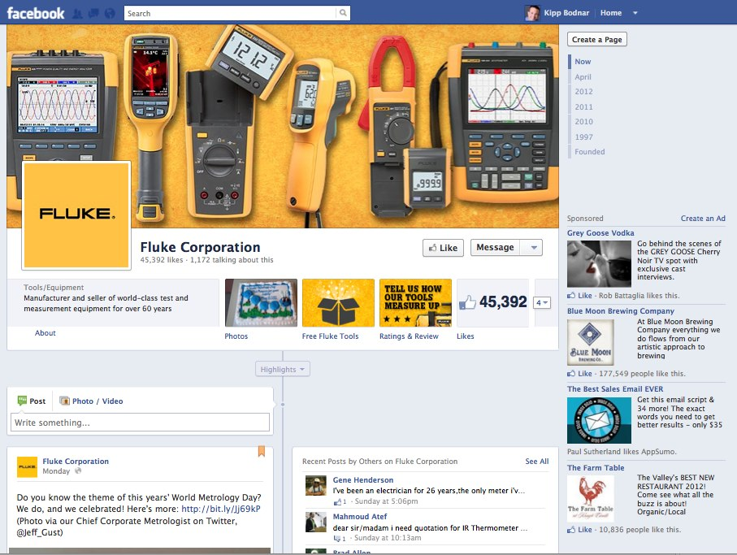

Slide 31
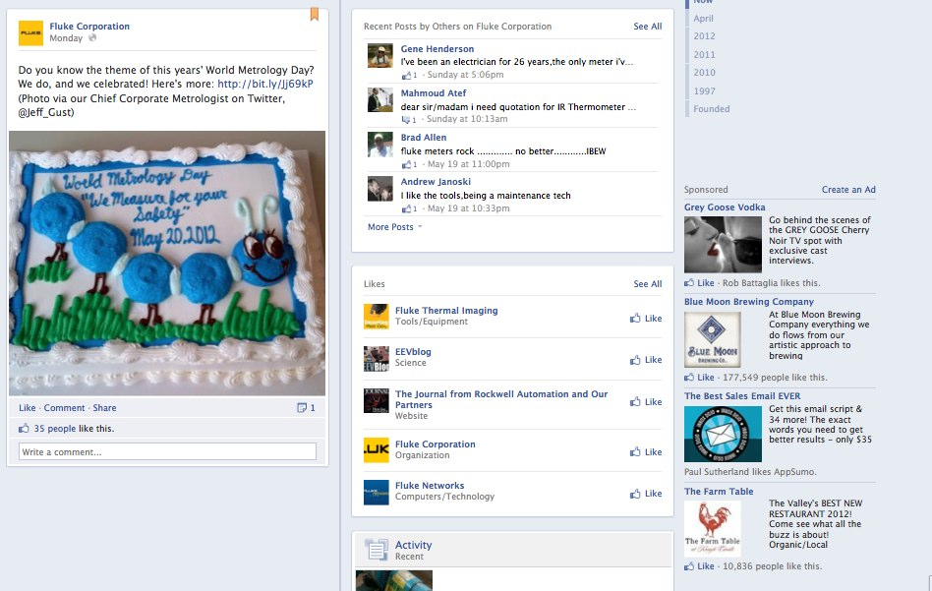

Slide 32
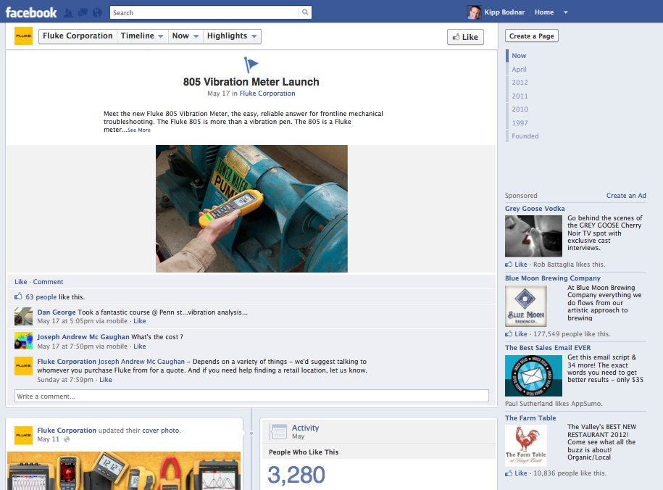

Slide 33
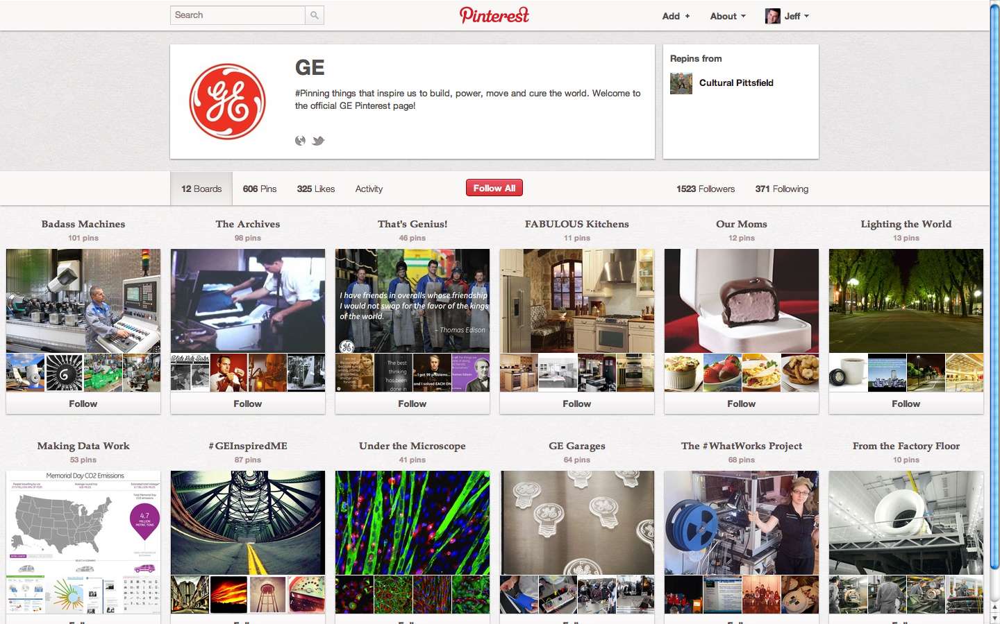

Slide 34
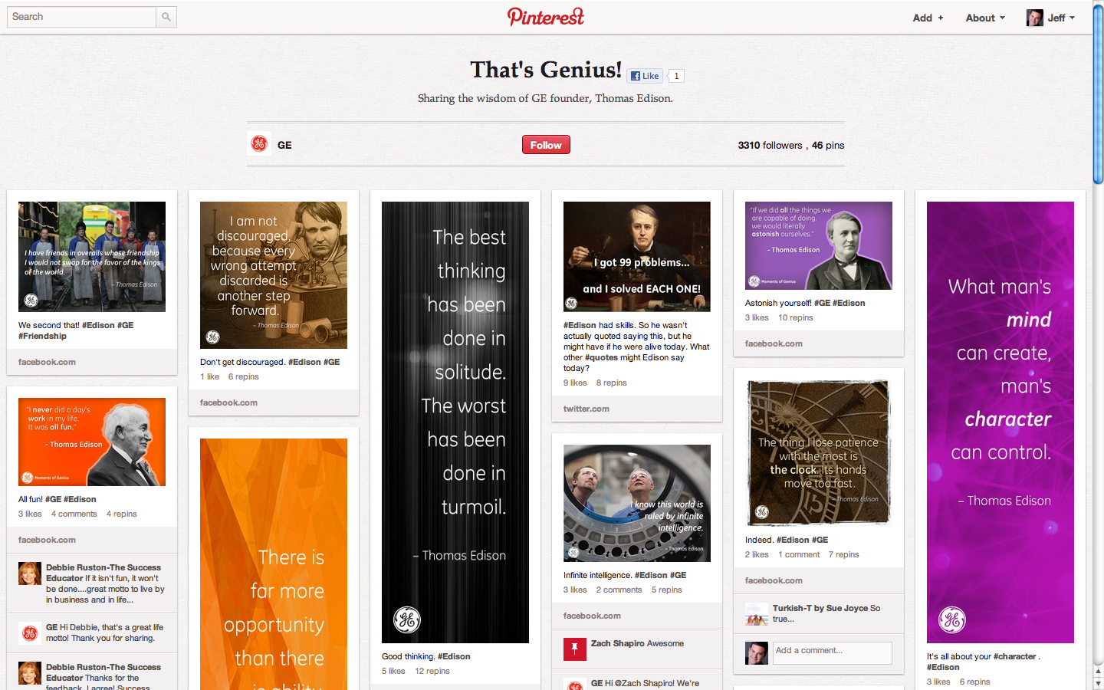

Slide 35
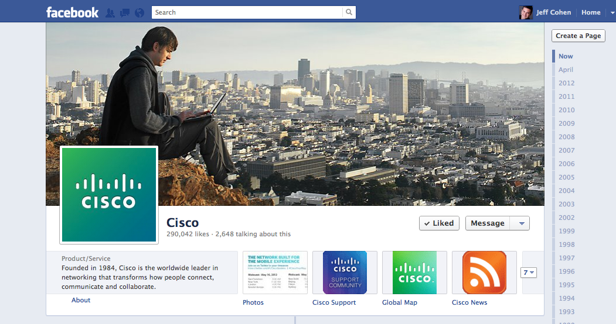

Slide 36
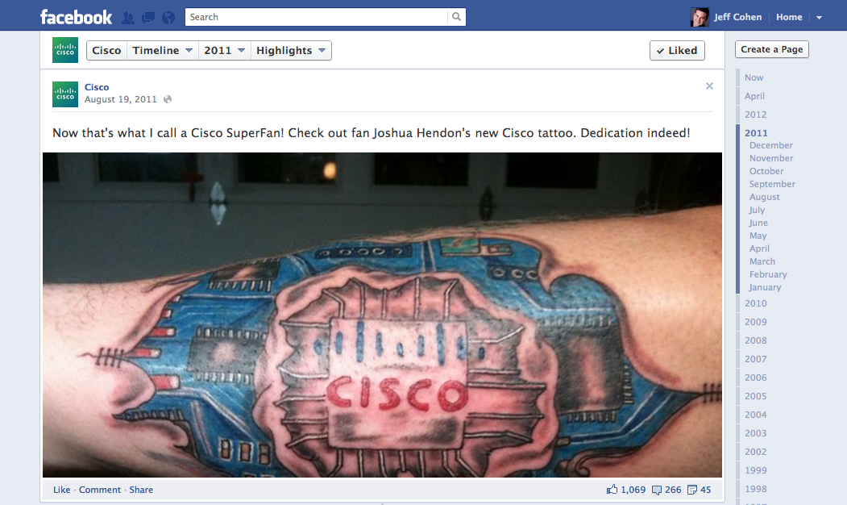

Slide 37
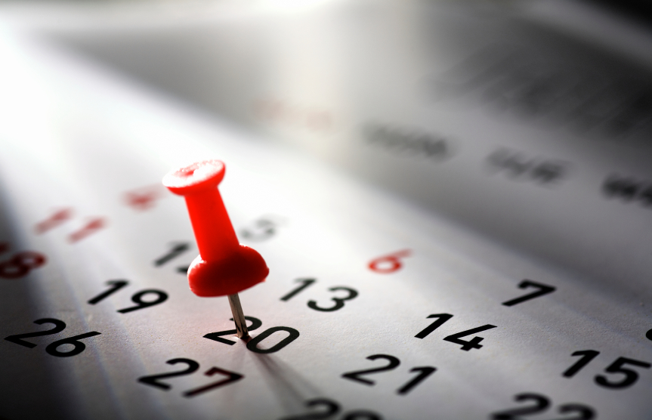
Be consistent.

Slide 38
“
Publishing and sharing content online is the single biggest lever to increase lead generation.
”
@JeffreyLCohen
Tweet This!
#B2BSM

Slide 39
1
Build a Network of Strong Ties
2
Influence Connections For Content Sharing
3
Master Social Conversion

Slide 40

Get people to share.

Slide 41
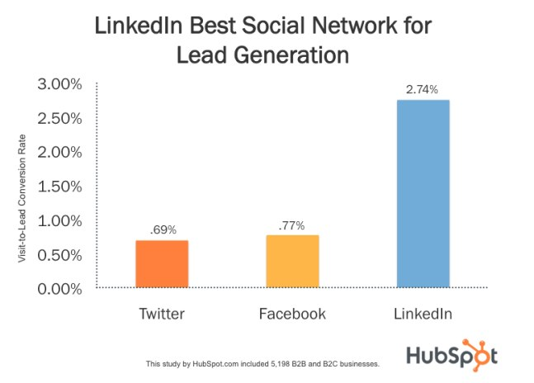

Slide 42
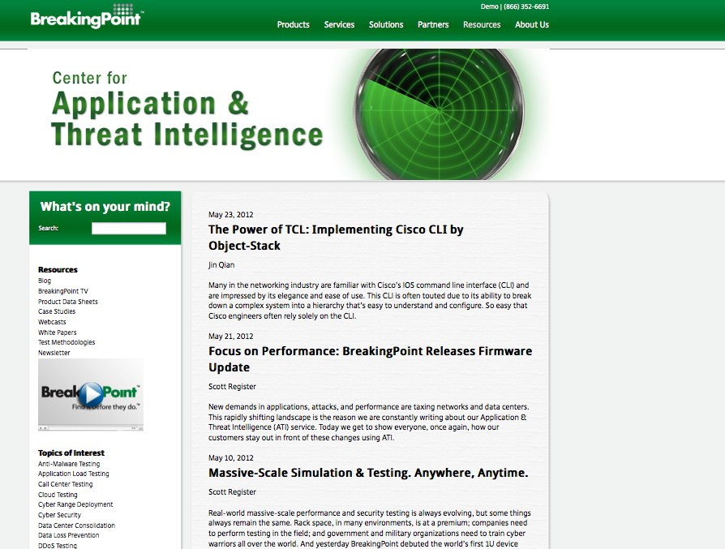
Notes:
update

Slide 43
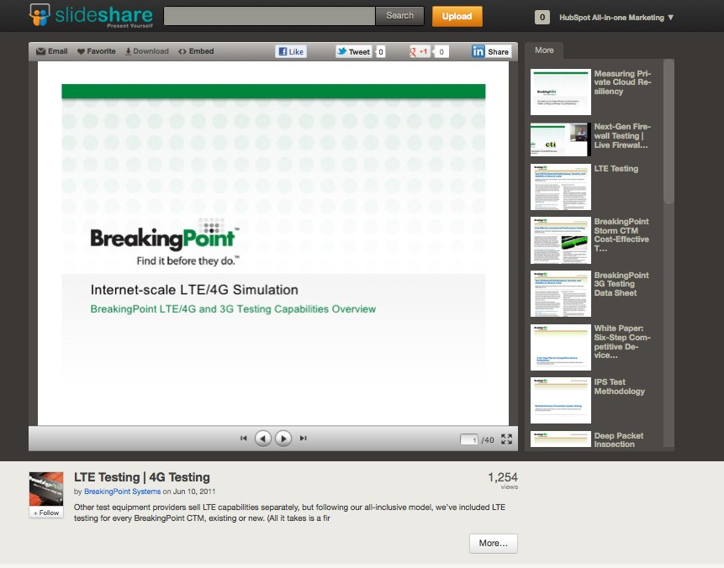

Slide 44


Slide 45
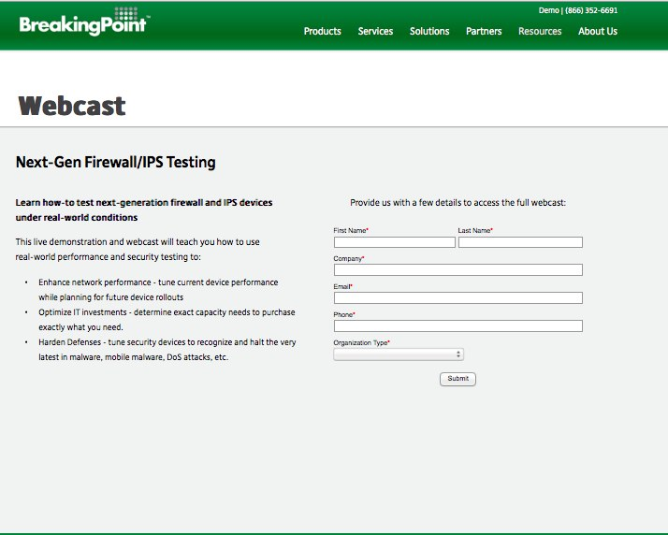

Slide 46
Closed Millions In Sales From Online Leads
ROI – 2800%!

Slide 47
1
Build a Network of Strong Ties
2
Influence Connections For Content Sharing
3
Master Social Conversion

Slide 48
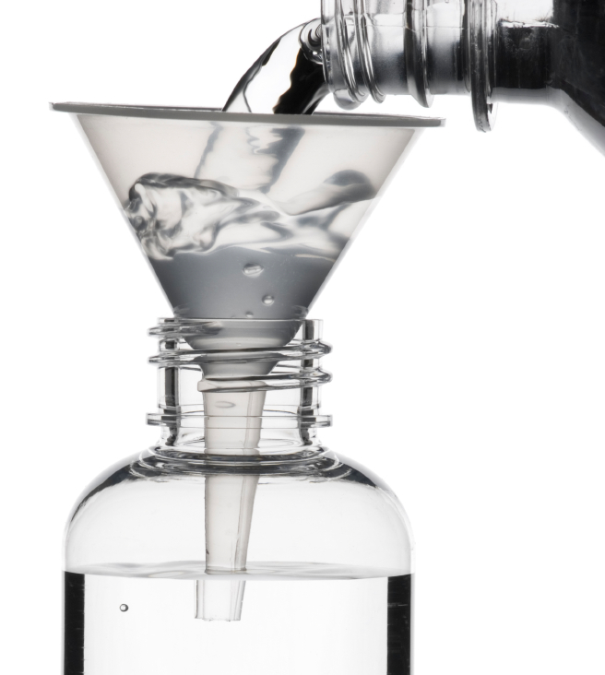
Social Conversion

Slide 49
The Two Sides of Social Conversion
On-site
Off-site

Slide 50
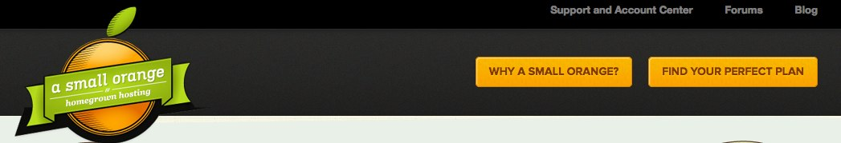
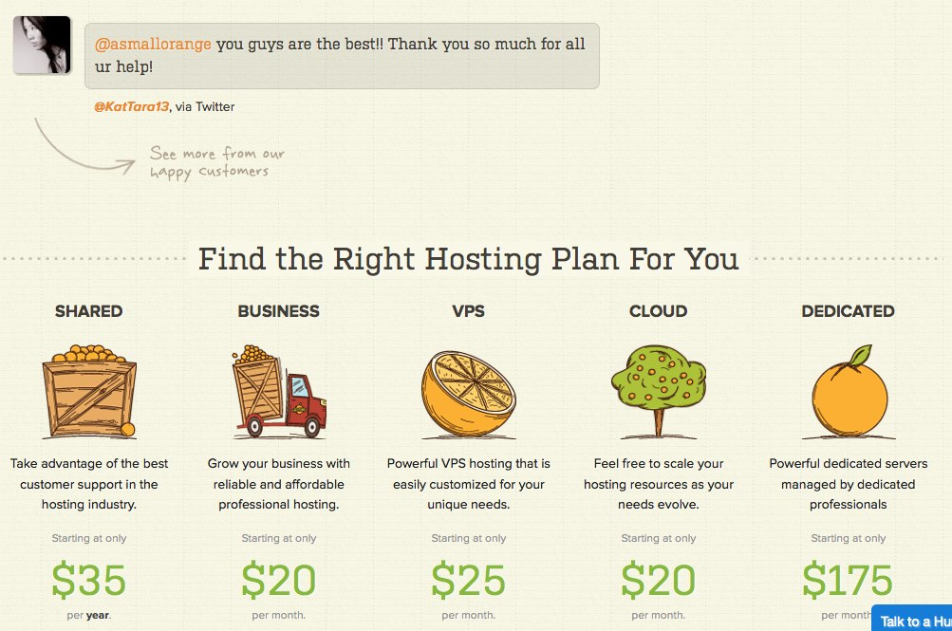
Notes:
Lets look at an example of embedded tweets for conversion
Small orange test
Results

Slide 51
SOCIAL CONVERSION ISN’T ONLY ABOUT LEADS

Slide 52
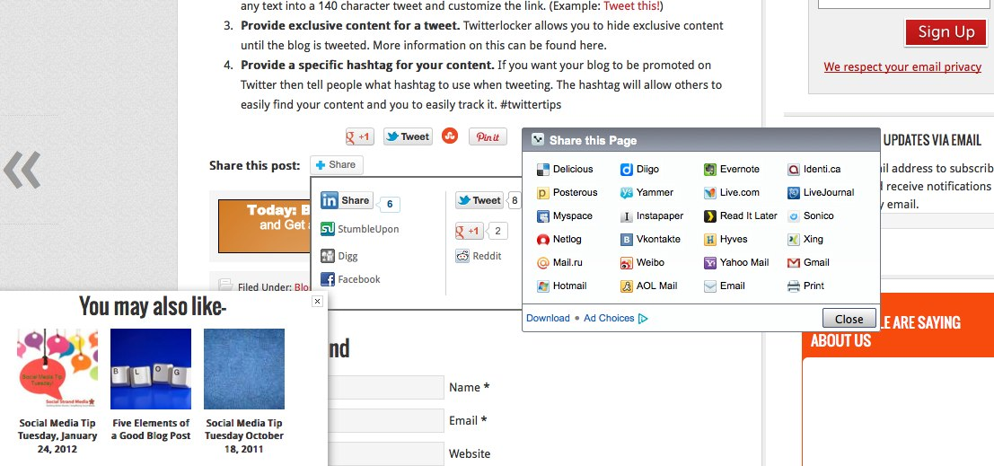
Really?

Slide 53
“
Create awesome content and reduce the friction around sharing it.
”
@KippBodnar
Tweet This!
#B2BSM

Slide 54
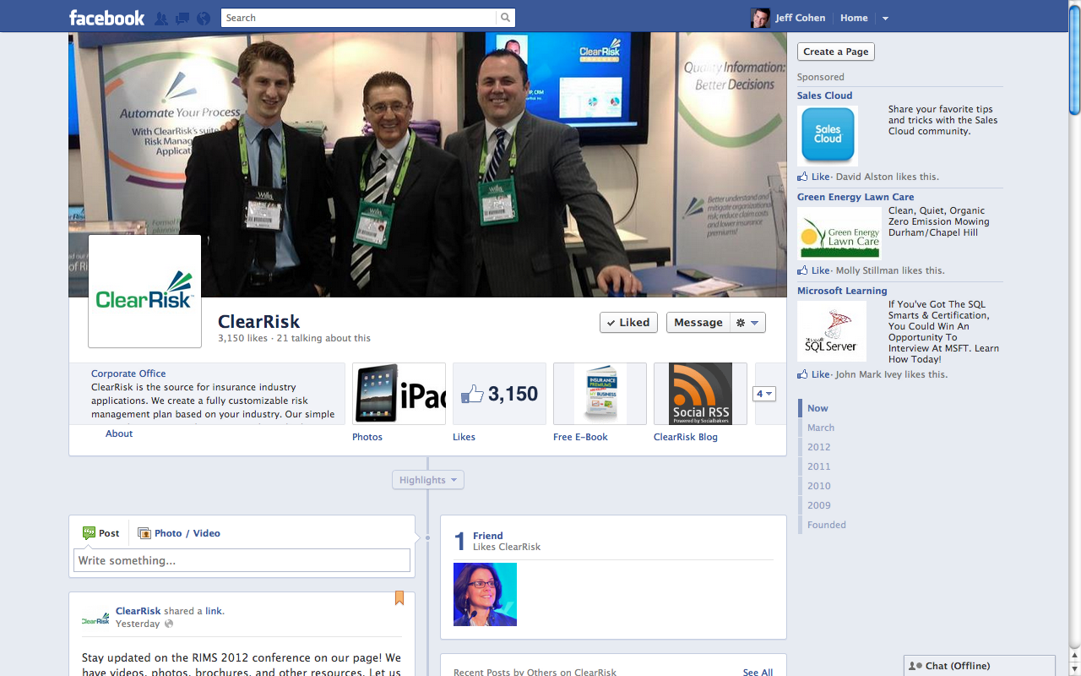

Slide 55
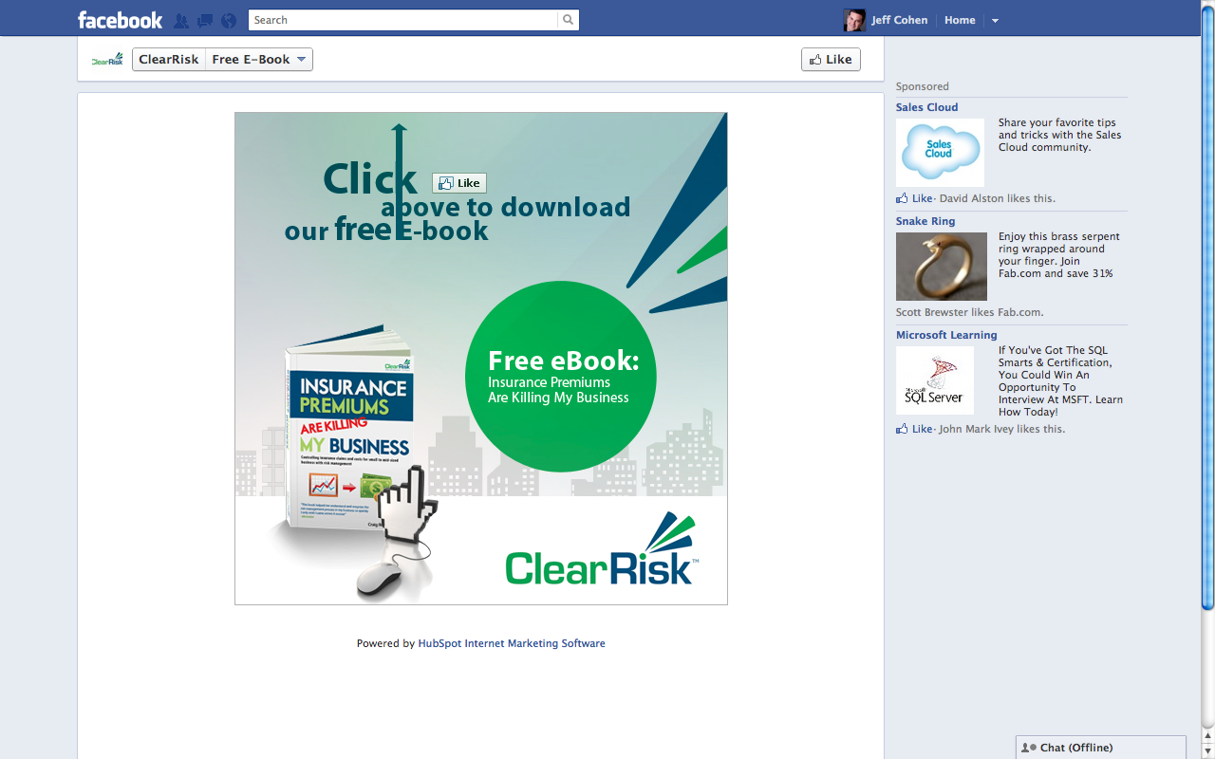

Slide 56
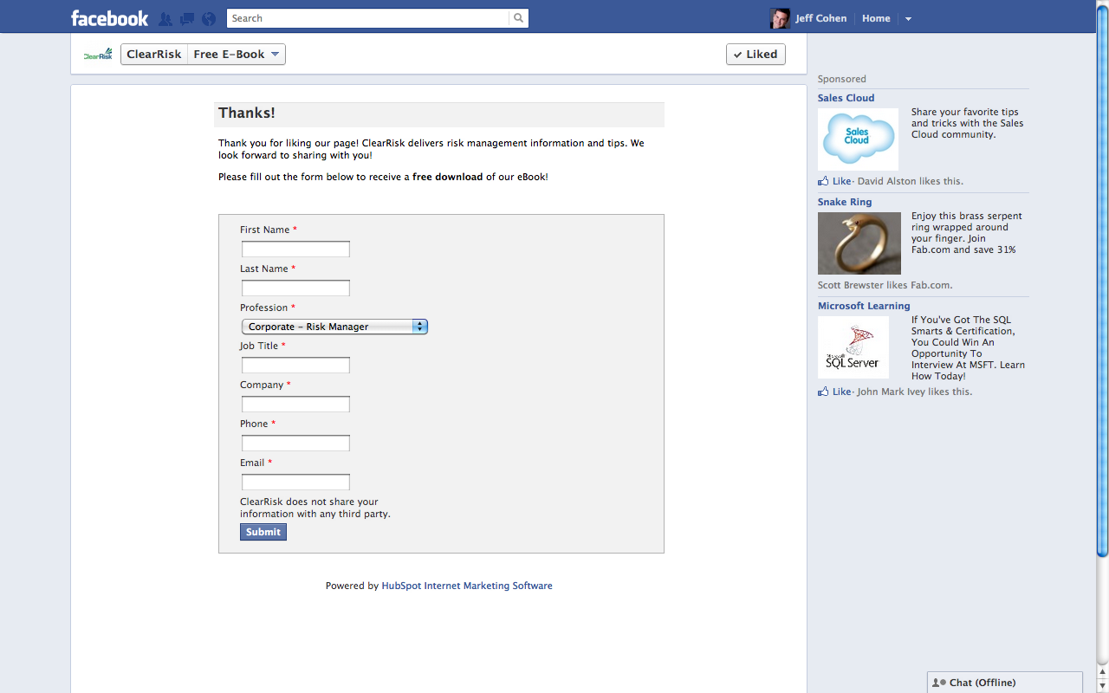

Slide 57
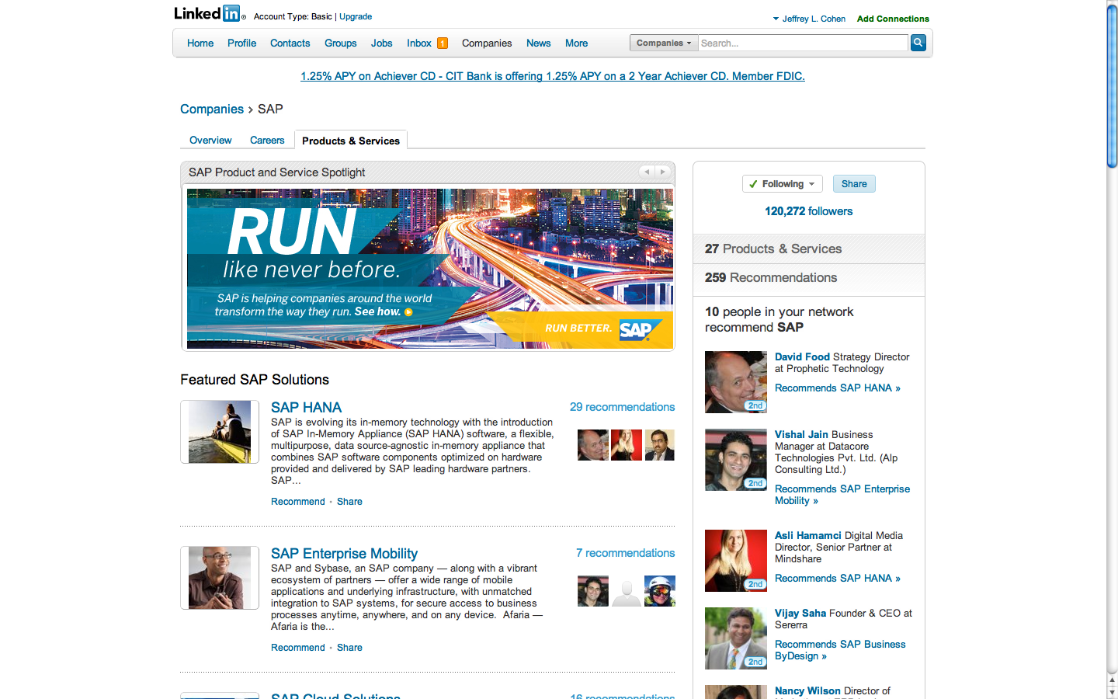

Slide 58
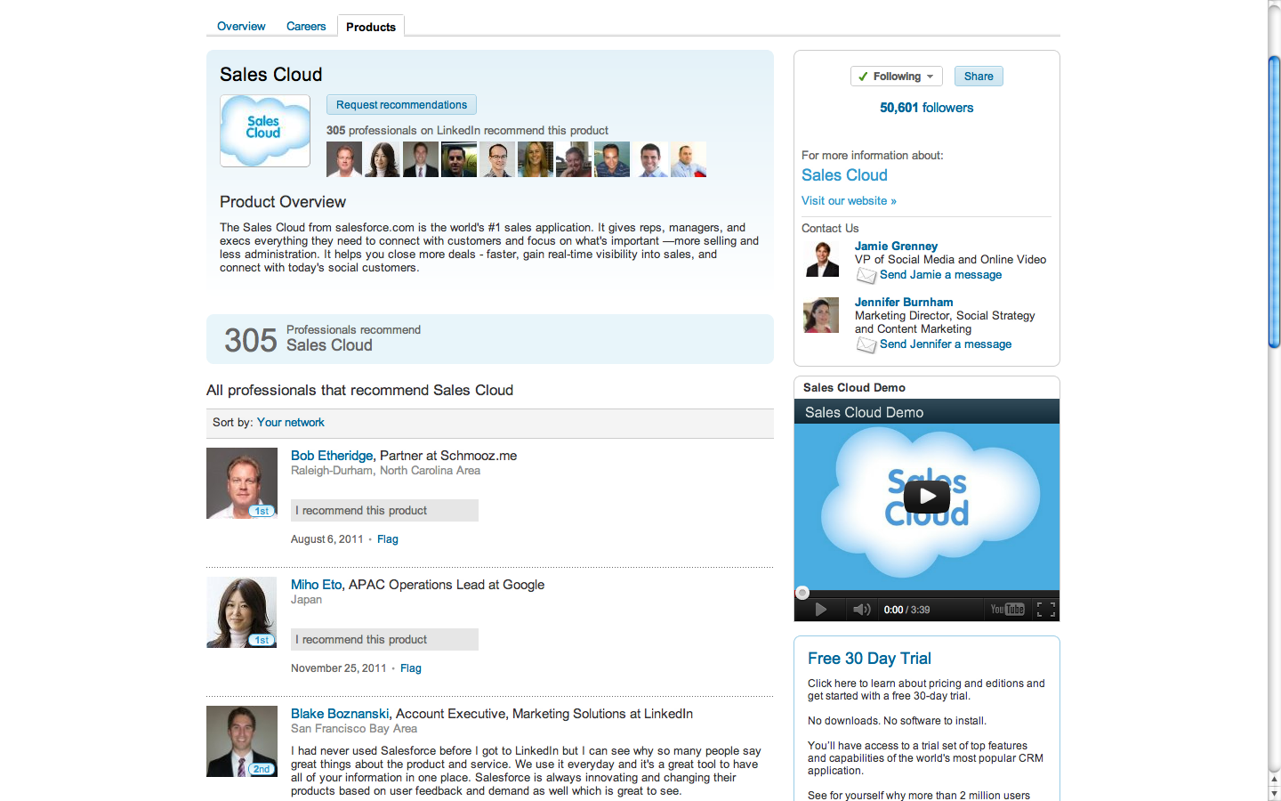

Slide 59
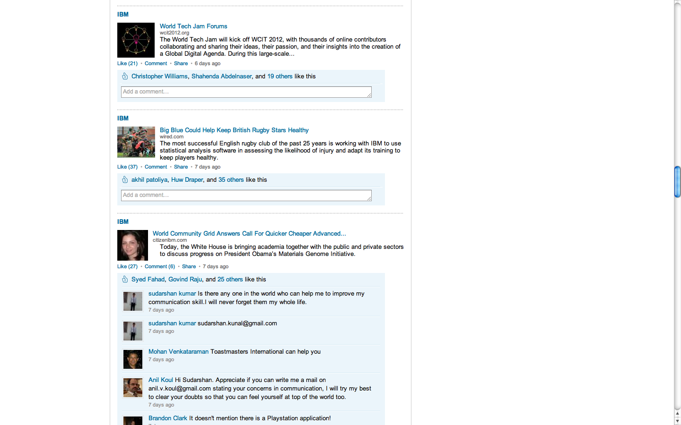

Slide 60
1
Build a Network of Strong Ties
2
Influence Connections For Content Sharing
3
Master Social Conversion

Slide 61

Prove the
CEO
Wrong

Slide 62
You’re the Star

Slide 63
THANK
YOU

