Slide 1

Mastering B2B
Social Media

Slide 2

I’m Brian Halligan.
Nice to meet you.
I’m Kipp Bodnar.
Nice to meet you.
@KippBodnar

Slide 3
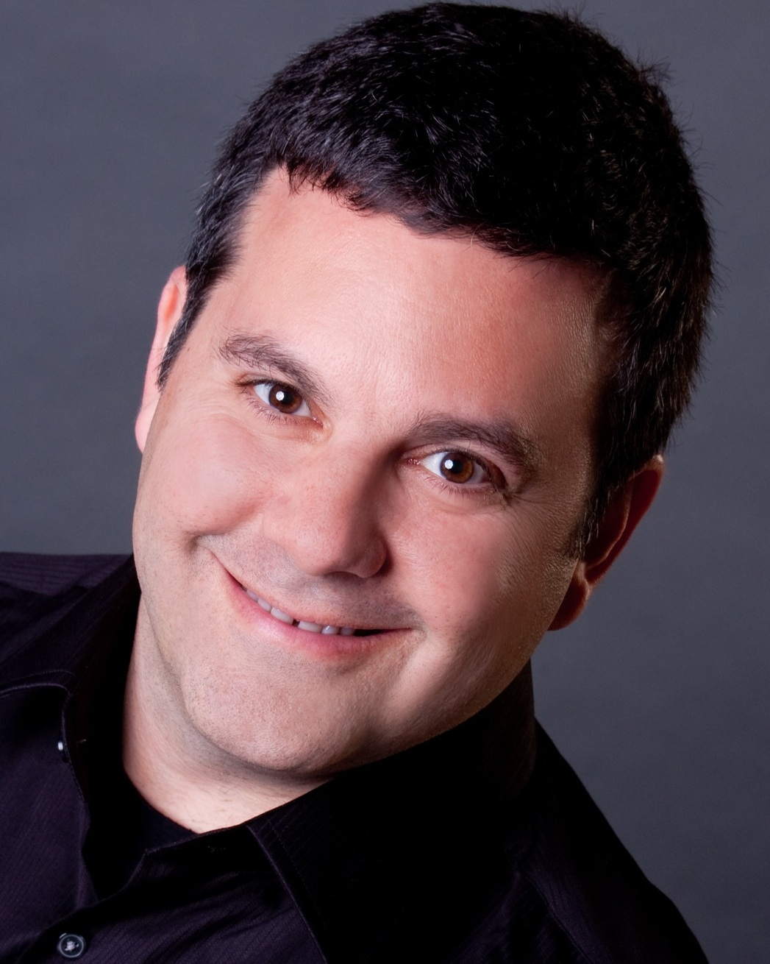
I’m Brian Halligan.
Nice to meet you.
I’m Jeff Cohen.
Nice to meet you.
@JeffreyLCohen

Slide 4

I’m Brian Halligan.
Nice to meet you.
We wrote The B2B Social Media Book.
amzn.to/b2bsm2

Slide 5
#B2BSM

Slide 6
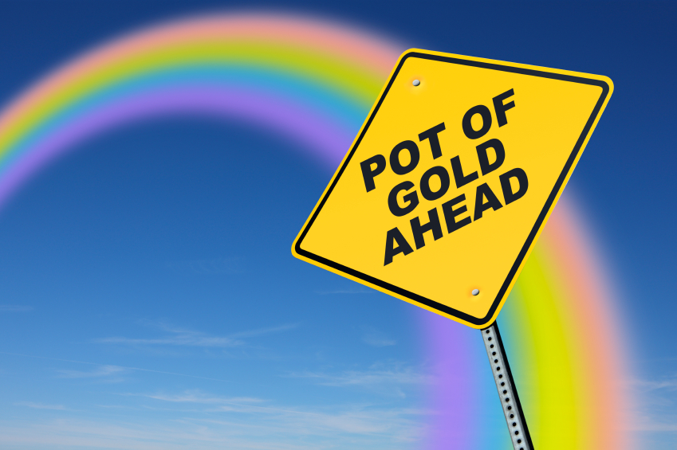

Slide 7

Your opportunity to shine

Slide 8
60%
of the sales cycle is over – before a buyer talks to your salesperson.
91
CORPORATE EXECUTIVE BOARD: bit.ly/zub2I7

Slide 9
B2B>B2C

Slide 10
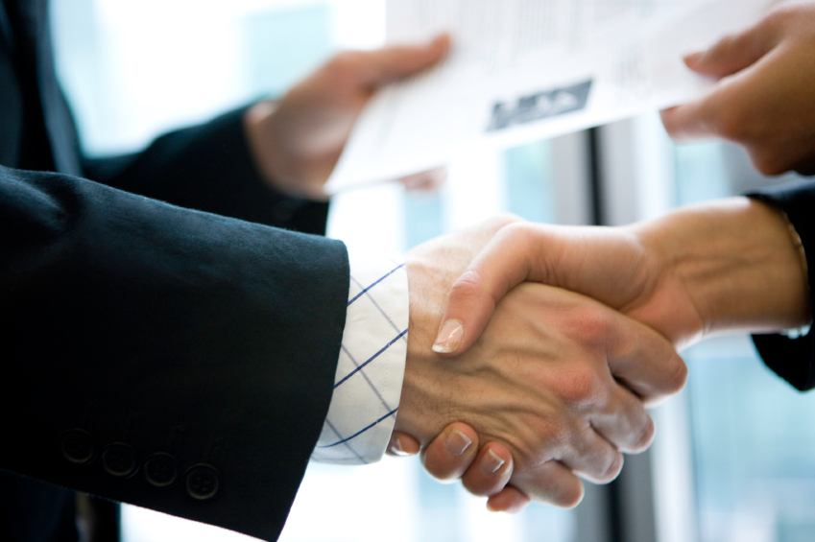
Relationship based sales

Slide 11

Already have
the expertise

Slide 12
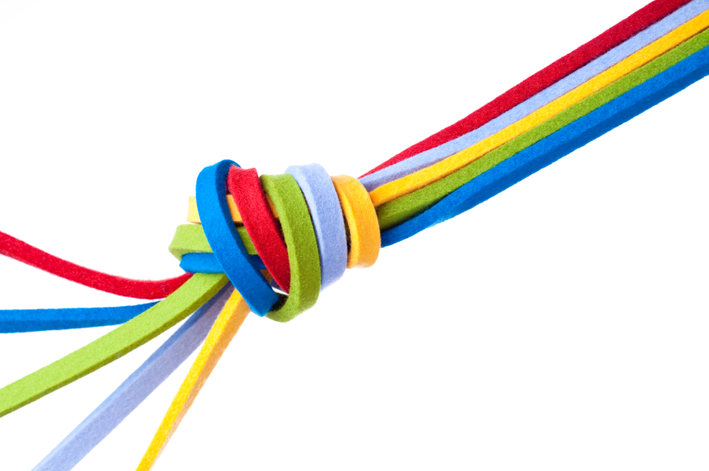
Clear customer Personas

Slide 13
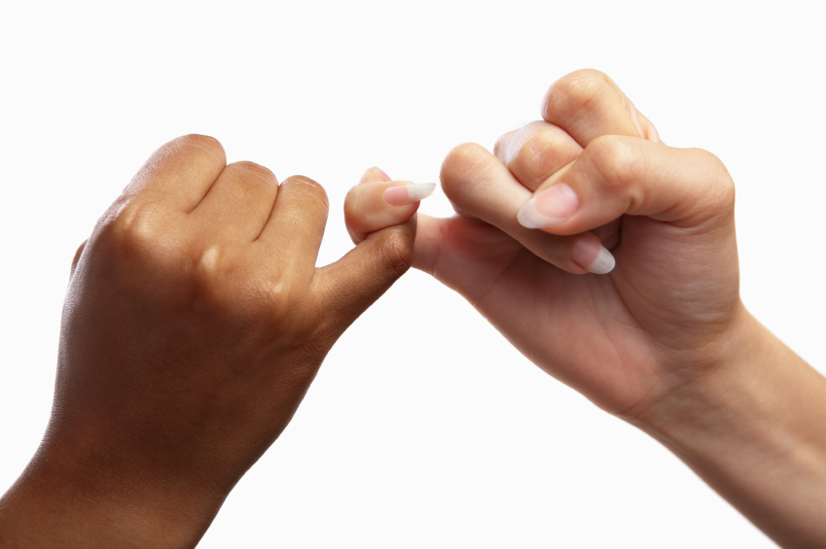
People to People

Slide 14
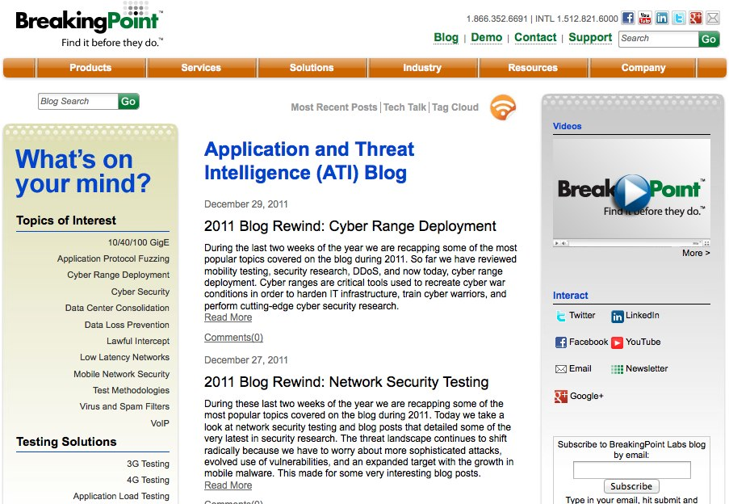

Slide 15
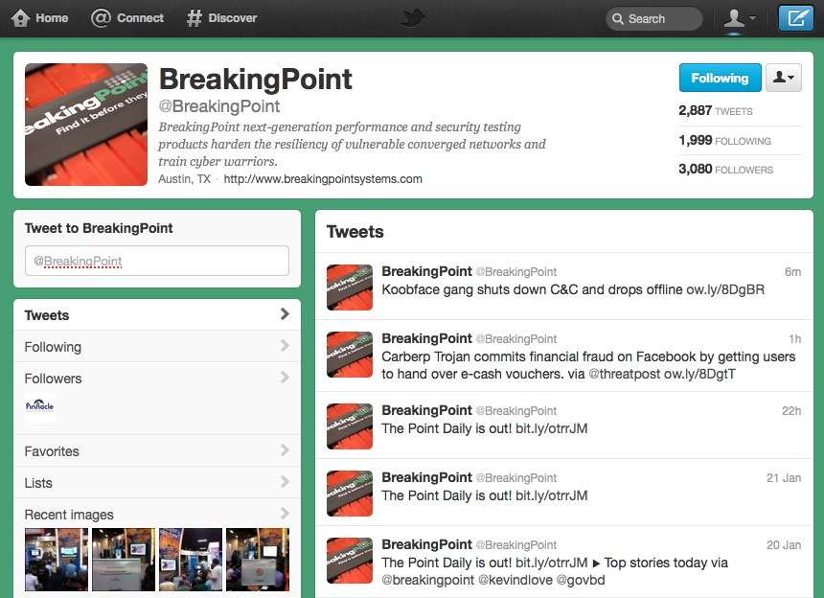

Slide 16
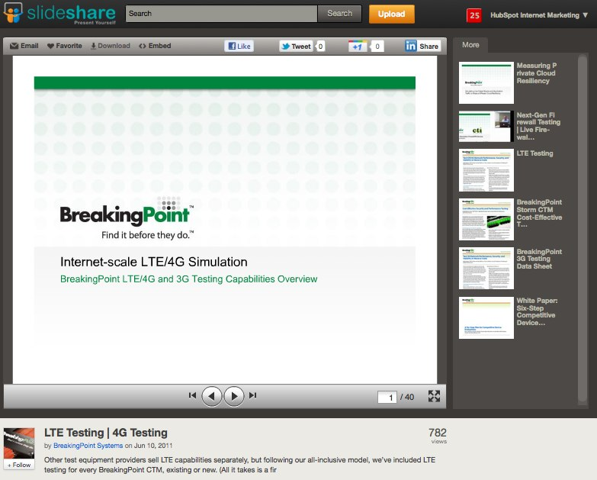

Slide 17


Slide 18
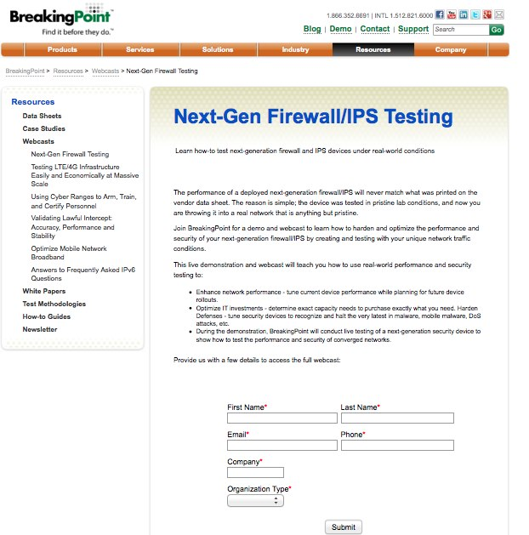

Slide 19
Closed Millions In Sales From Online Leads
ROI – 2800%!

Slide 20
#B2BSM

Slide 21


Slide 22
B2B Myths Busted

Slide 23

“
Marketing is an asset NOT an expense.
”
@KippBodnar
Tweet This!
#B2BSM

Slide 24
B2B SOCIAL MEDIA IS
ABOUT REACH BUILDING

Slide 25

The Social Web Rewards Reach

Slide 26
“
B2B companies should obsess about building reach as much or MORE than B2C companies.
”
@JeffreyLCohen
Tweet This!
#B2BSM

Slide 27
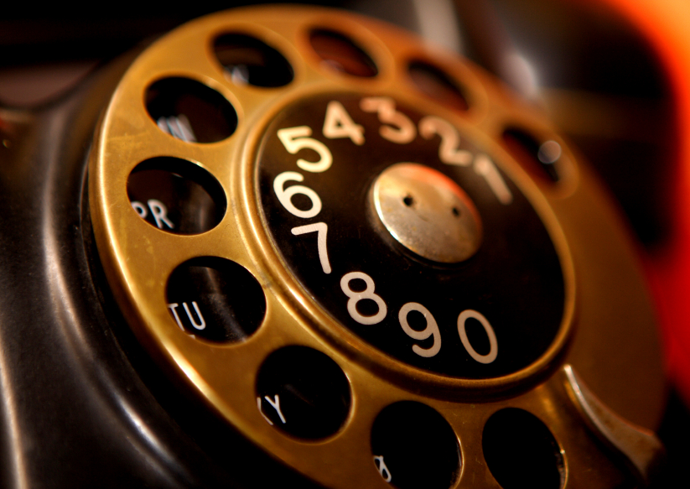
Social reach is the new
word-of-mouth referral engine

Slide 28

Share lots of links

Slide 29

BITLY, 9/2011
The shelf life of a social media link is 3 hours.
Notes:
Connect to milk and pour glass

Slide 30
THE
Links to company blog posts
10-4-1
Links to third-party articles
Link to a company landing page
RULE

Slide 31
B2B SOCIAL MEDIA IS
ABOUT SELLING

Slide 32
“
Your goal shouldn't be to buy leads. Your goal should be to buy customers.
”
@KippBodnar
Tweet This!
#B2BSM

Slide 33
73%
of CEOs
don’t believe
marketers drive revenue.
91
Fournaise Marketing Group: bit.ly/peNScq

Slide 34

Leads fix
the problem

Slide 35
How Social Media Leads Happen
1
Tweet
Landing Page
Form
Lead
Like
Blog Post
CTA
Landing Page
+1
Product Page
CTA
Landing Page

Slide 36
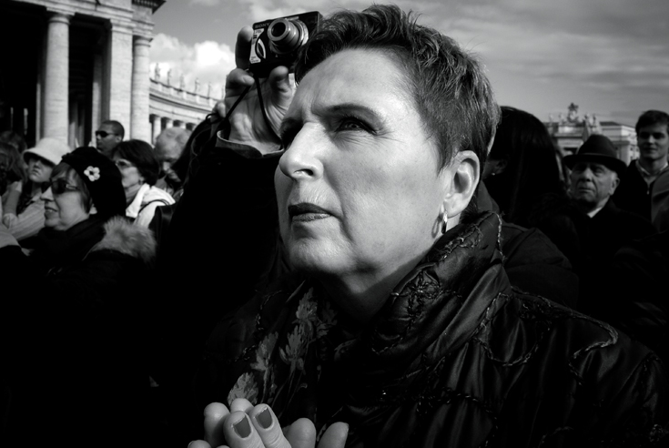
Dedicated
Monitoring
http://www.flickr.com/photos/giara/2211500258/

Slide 37


Slide 38
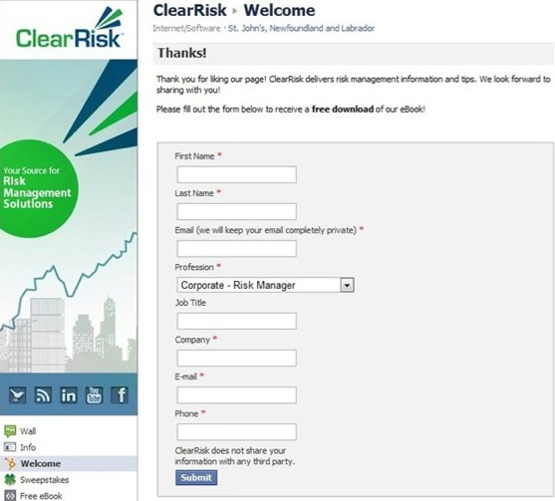

Slide 39

Place CTAs Everywhere

Slide 40

Improve
and Iterate

Slide 41
#B2BSM

Slide 42
B2B SOCIAL MEDIA HAS
CLEAR ROI

Slide 43
“
If you can’t count it, why do it?
”
@KippBodnar
Tweet This!
#B2BSM

Slide 44

Math Ahead

Slide 45
TLV-COCA
=
ROI (%)
COCA

Slide 46
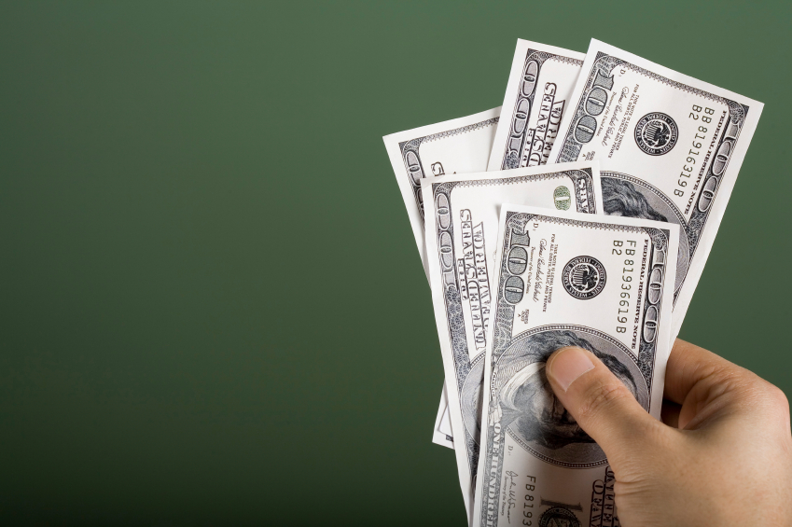
Total Lifetime Value

Slide 47

Cost of Customer Acquisition

Slide 48
First- Vs. Last-Action Attribution
Last-Action Attribution: Clicks on a PPC Ad
Attends Sales Call
Buys Product
Looks at Product Page
First-Action Attribution: User Clicks Link on Twitter
Signs Up For Webinar
Reads Blog Post

Slide 49

10K-3K
=
233%
3K

Slide 50
B2B SOCIAL MEDIA IS
ONLY ONE PIECE

Slide 51
“
Social media amplifies the effectiveness of offline marketing.
It doesn’t replace it.
”
@JeffreyLCohen
Tweet This!
#B2BSM

Slide 52

Trade shows
are social too

Slide 53
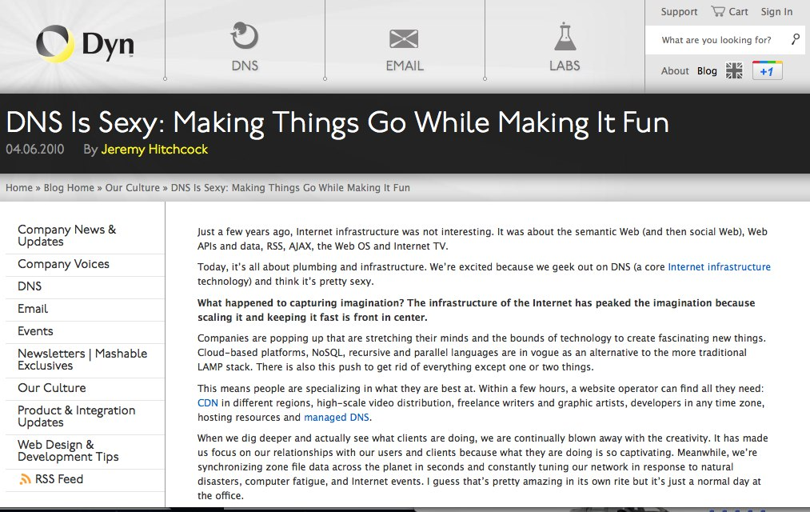

Slide 54
GOAL:
Use Social Media To Promote Offline Events

Slide 55
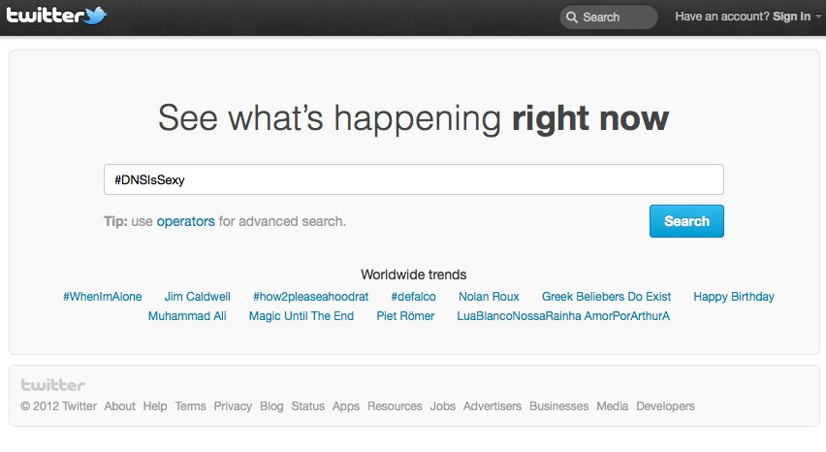

Slide 56
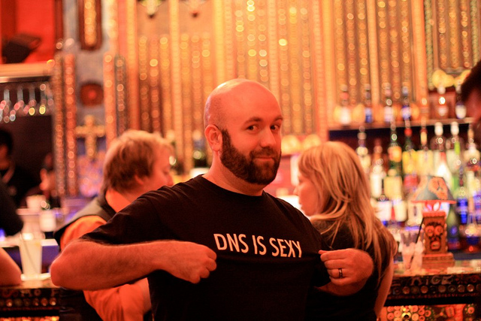
5,000 T-Shirts

Slide 57
RESULT:
235% Increase in event tickets distributed and 95% redeemed

Slide 58
THE BEST TIME EVER
FOR MARKETERS

Slide 59
“
Master B2B Social Media with reach, lead gen, data and integration with offline activities.
”
@KippBodnar
Tweet This!
#B2BSM

Slide 60
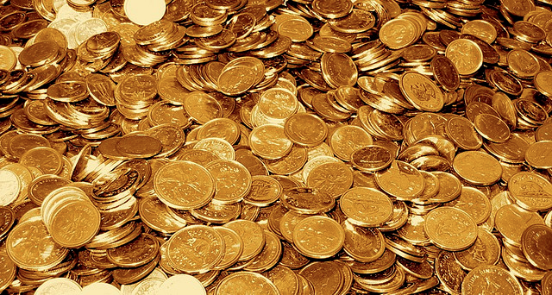
The Pot
of Gold
http://www.flickr.com/photos/tao_zhyn/442965594/

Slide 61
Prove the
CEO
Wrong

Slide 62
You’re the Star

Slide 63
THANK
YOU

Slide 64
I’m Brian Halligan.
Nice to meet you.
We wrote The B2B Social Media Book.
amzn.to/b2bsm2

