Slide 1

Mastering B2B
Social Media

Slide 2

I’m Brian Halligan.
Nice to meet you.
I’m Kipp Bodnar.
Nice to meet you.
@KippBodnar

Slide 3
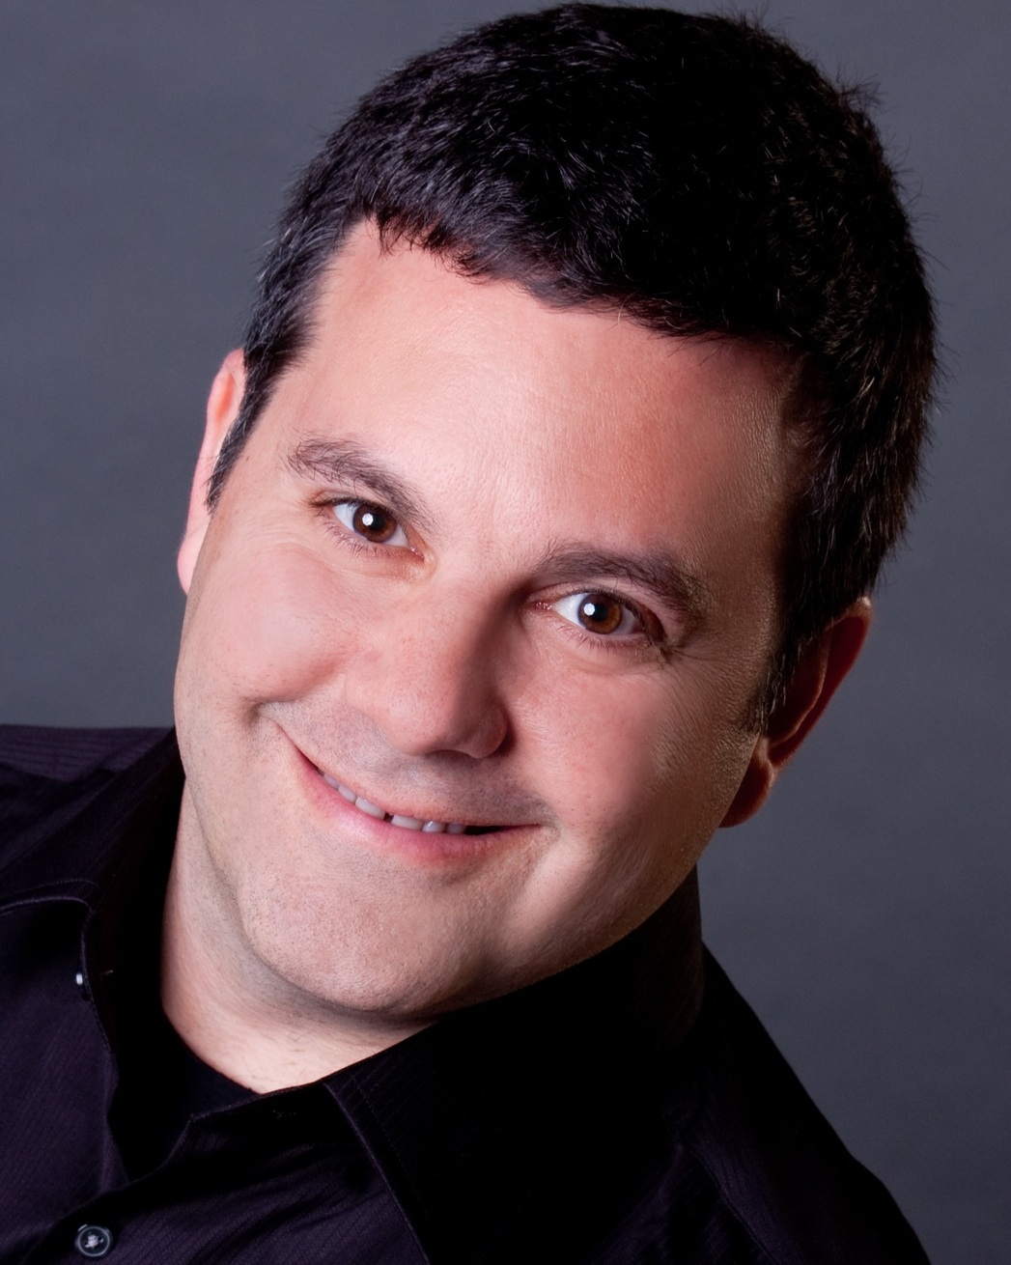
I’m Brian Halligan.
Nice to meet you.
I’m Jeff Cohen.
Nice to meet you.
@JeffreyLCohen

Slide 4

I’m Brian Halligan.
Nice to meet you.
We wrote The B2B Social Media Book.
amzn.to/b2bsm2

Slide 5
#B2BSM

Slide 6
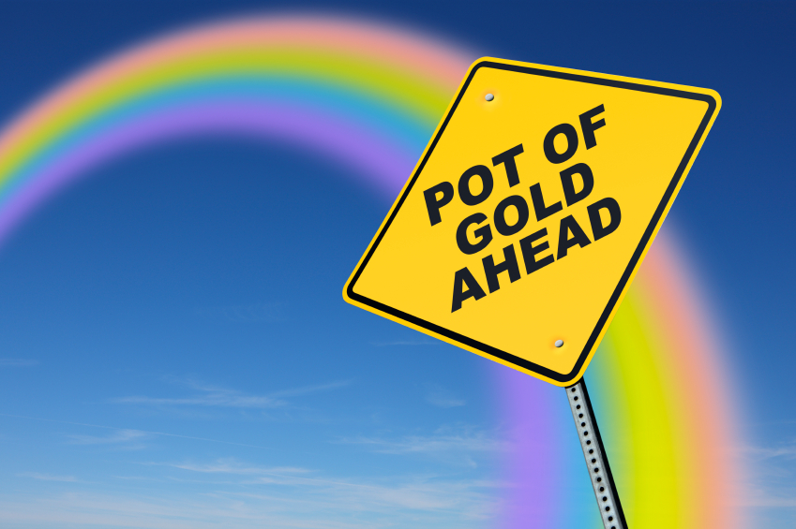

Slide 7
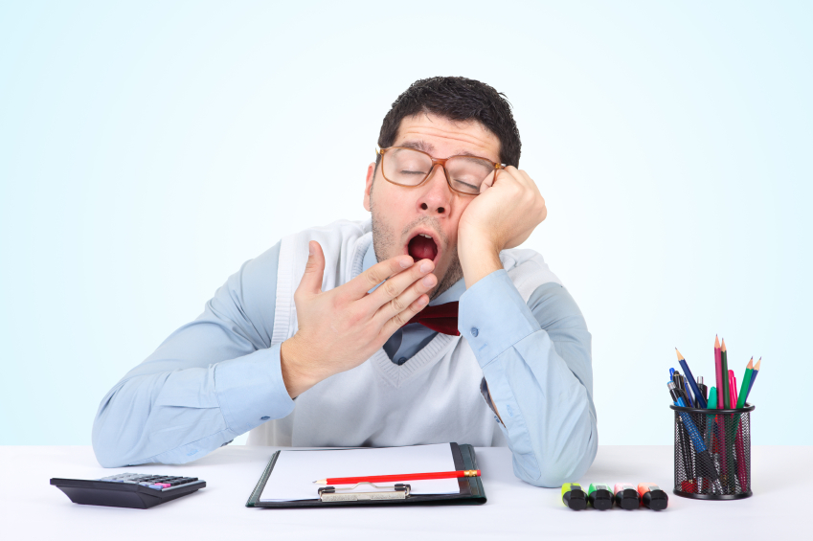
B2B isn’t Boring.

Slide 8
60%
of the sales cycle is over – before a buyer talks to your salesperson.
91
CORPORATE EXECUTIVE BOARD: bit.ly/zub2I7

Slide 9
B2B>B2C

Slide 10
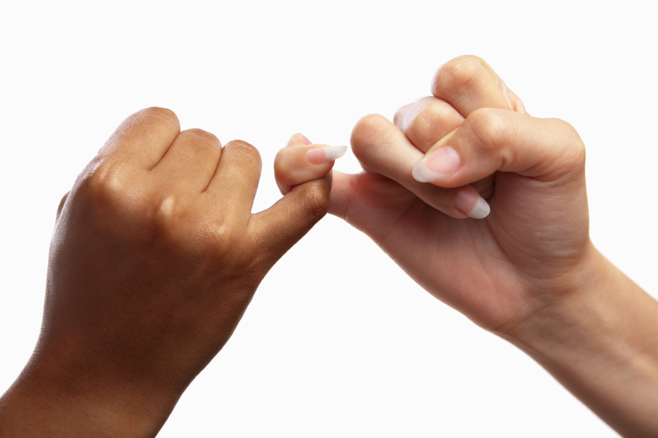
Business to People.

Slide 11

Your opportunity, to shine.

Slide 12
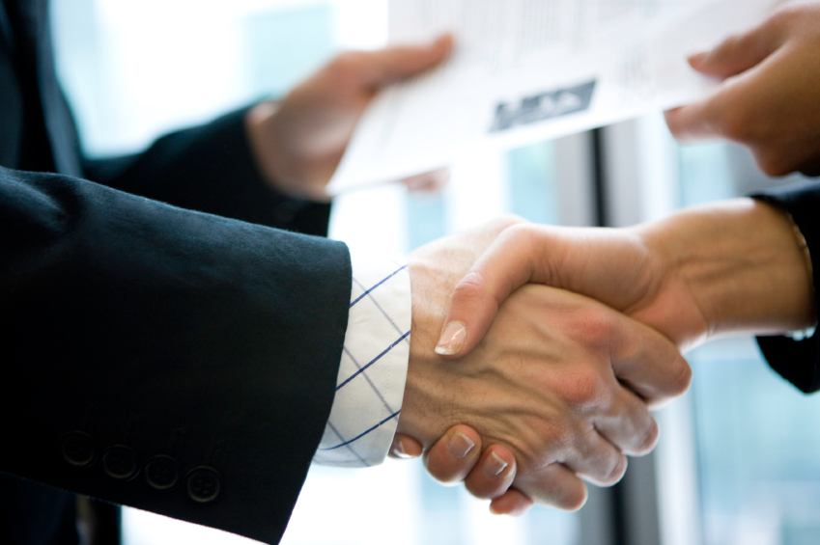
Relationship based sales.

Slide 13
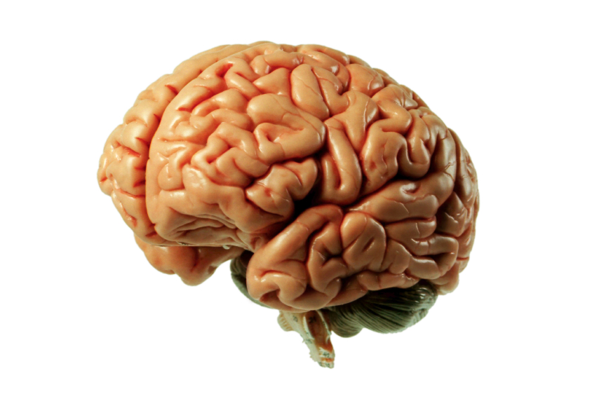
Already have
the expertise.

Slide 14
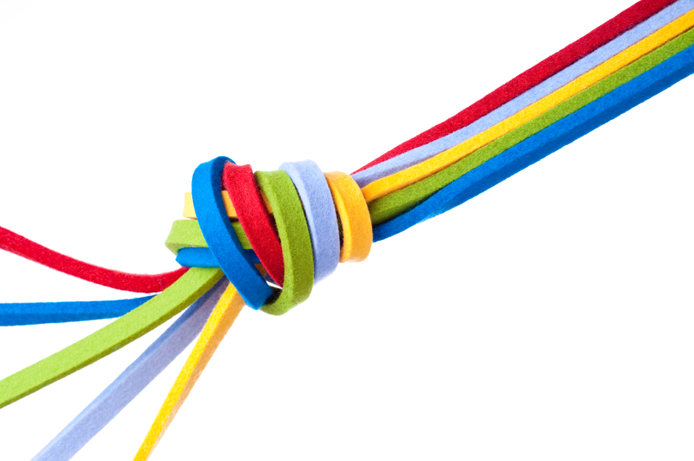
Clear customer Personas.

Slide 15
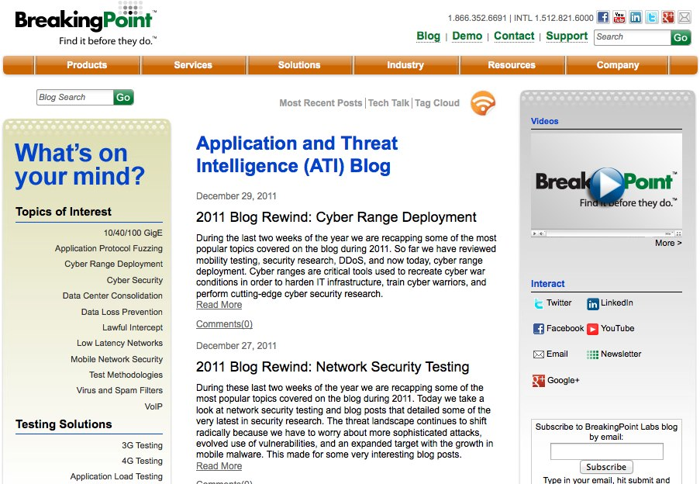

Slide 16


Slide 17
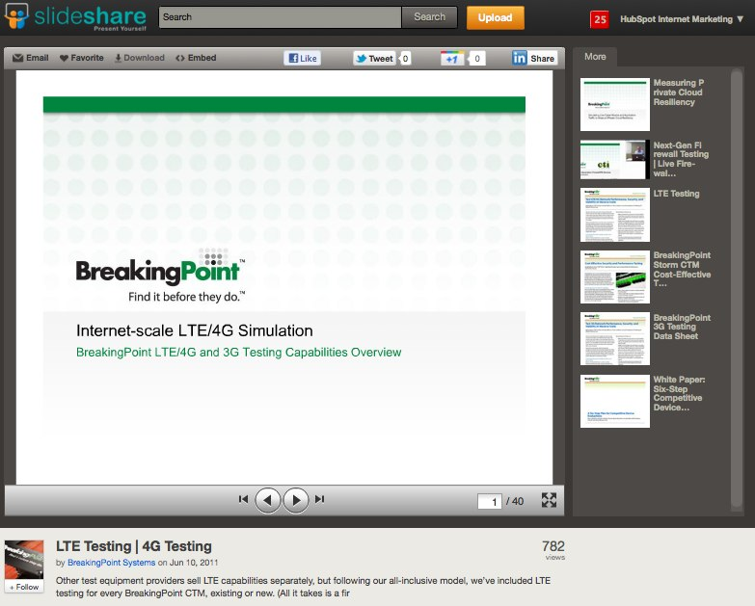

Slide 18
Closed Millions In Sales From Online Leads
ROI – 2800%!

Slide 19
#B2BSM

Slide 20


Slide 21
B2B Myths Busted.

Slide 22

“
Marketing is an asset NOT an expense.
”
@KippBodnar
Tweet This!

Slide 23
B2B SOCIAL MEDIA IS
ABOUT SELLING.

Slide 24
“
Your goal shouldn't be to buy leads. Your goal should be to buy customers. In order buy customers, you need to buy credibility.
”
@KippBodnar
Tweet This!

Slide 25
73%
of CEOs
don’t believe
marketers drive revenue.
91
Fournaise Marketing Group: bit.ly/peNScq

Slide 26

Leads fix
the problem.

Slide 27
How Social Media Leads Happen
1
Tweet
Landing Page
Form
Lead
Like
Blog Post
CTA
Landing Page
+1
Product Page
CTA
Landing Page

Slide 28
1
Get The Basics Right
2
Maximize Content Discovery
3
Create Conversion Ubiquity
4
Test and Fail Fast
5
Optimize for Maximum Leads

Slide 29

BITLY, 9/2011
The self life of a social media link is 3 hours.
Notes:
Connect to milk and pour glass

Slide 30

Share lots of links.

Slide 31


Slide 32
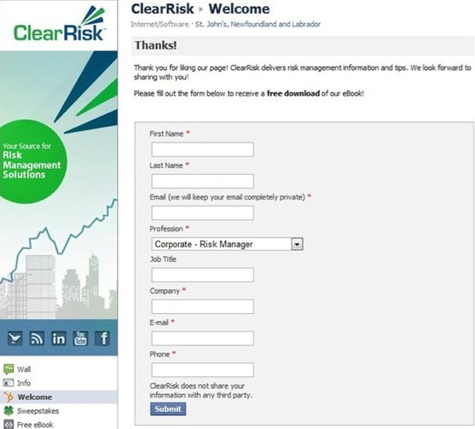

Slide 33
B2B SOCIAL MEDIA HAS
CLEAR ROI.

Slide 34
“
If you can’t count it, why do it?
”
@KippBodnar
Tweet This!

Slide 35

Math Ahead

Slide 36
TLV-COCA
=
ROI (%)
COCA

Slide 37
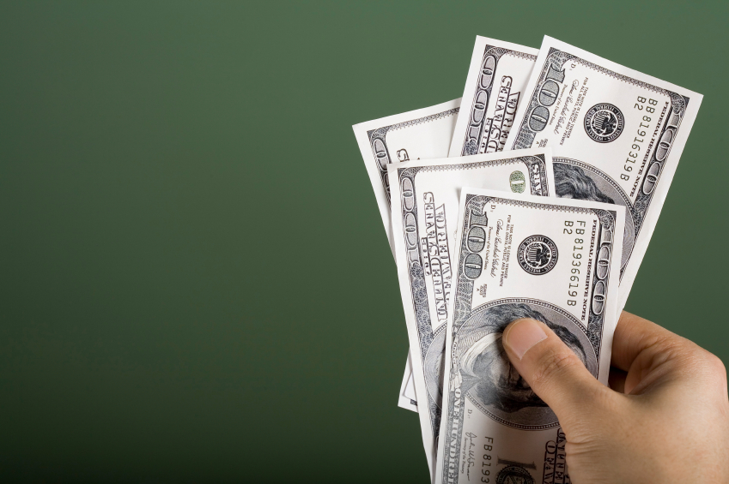
Total Lifetime Value.

Slide 38

Cost of Customer Acquisition

Slide 39
First- Vs. Last-Action Attribution
Last-Action Attribution: Clicks on a PPC Ad
Attends Sales Call
Buys Product
Looks at Product Page
First-Action Attribution: User Clicks Link on Twitter
Signs Up For Webinar
Reads Blog Post

Slide 40
10K-3K
=
233 (%)
3K

Slide 41
B2B SOCIAL MEDIA IS
ONLY ONE PIECE.

Slide 42
“
Social media amplifies the effectiveness of offline marketing, it doesn’t replace it.
”
@KippBodnar
Tweet This!

Slide 43

Trade shows
are social too.

Slide 44
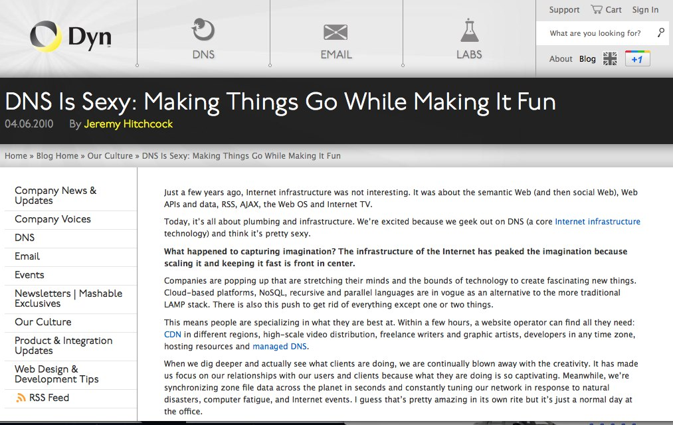

Slide 45
GOAL:
Use Social Media To Promote Offline Events

Slide 46
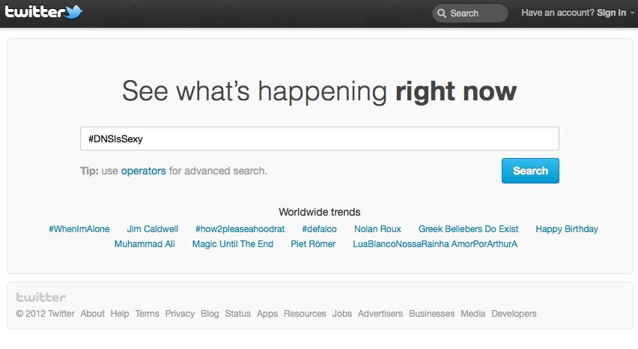

Slide 47
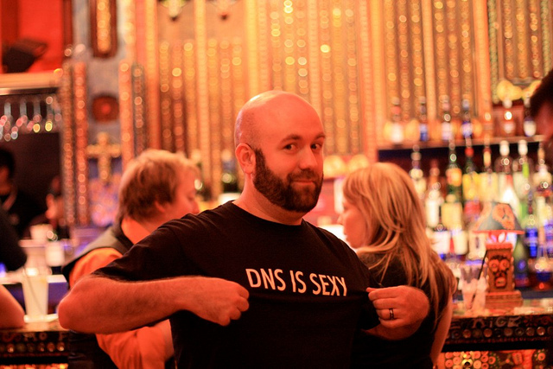
5,000 T-Shirts.

Slide 48
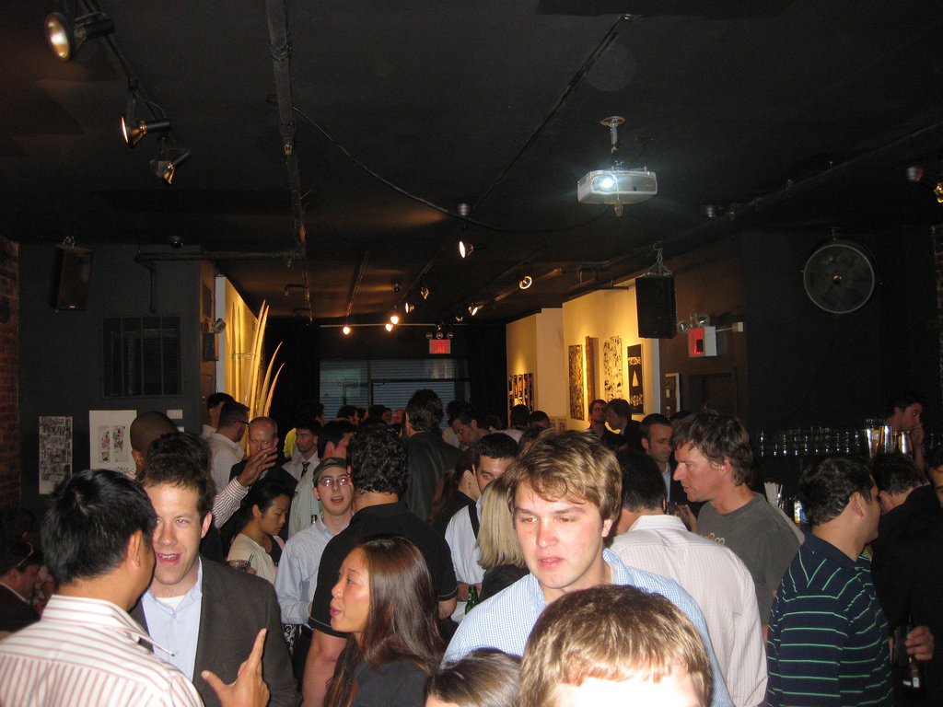

Slide 49
RESULT:
235% Increase in event tickets distributed and 95% redeemed

Slide 50
B2B SOCIAL MEDIA IS
ABOUT REACH BUILDING.

Slide 51
“
B2B companies should obsess about building reach as much or MORE than B2C companies.
”
@KippBodnar
Tweet This!

Slide 52

The Social Web Rewards Reach

Slide 53
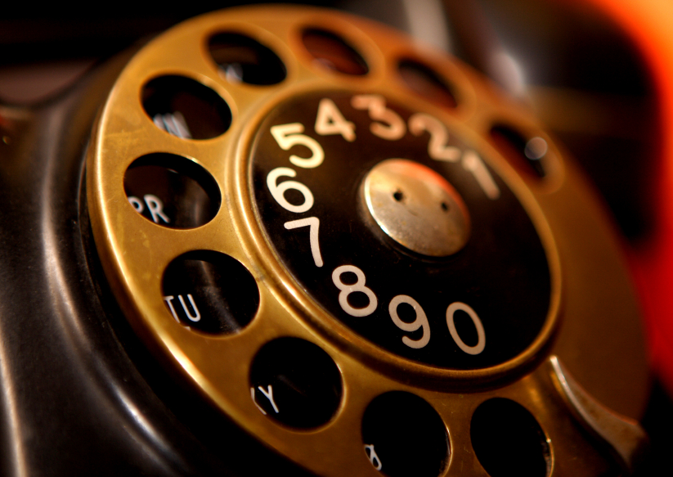
Social reach is the new
word-of-mouth referral engine .

Slide 54
THE
Links to company blog posts.
10-4-1
Links to third-party articles
Link to a company landing page.
RULE

Slide 55
You’re the Star.

Slide 56
THANK
YOU.

Slide 57
I’m Brian Halligan.
Nice to meet you.
We wrote The B2B Social Media Book.
amzn.to/b2bsm2

