Slide 1

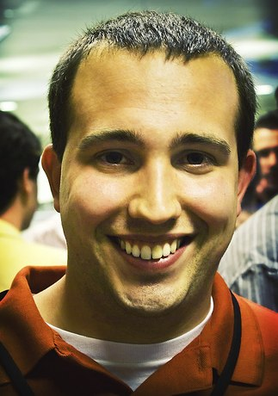

Social Media Lead Generation Builds Marketing Superstars
Kipp Bodnar - @KBodnar32
Inbound Marketing Manager

Slide 2

Define: Lead

Slide 3
Please Tweet questions and comments to @KBodnar32
The Hashtag is #SMLead.

Slide 4
Lead
Generation

Slide 5


Notes:
Customers behind secure firewalls

Slide 6
Social
Media

Slide 7

Notes:
Customers behind secure firewalls

Slide 8

Notes:
Customers behind secure firewalls

Slide 9
Misconceptions
End Today

Slide 10

Probelm

Slide 11
Problem: Generating More Leads With Less

Slide 12

5 Steps

Slide 13

Step 1: Get The Basics Right

Slide 14

Landing Page Tips

Slide 15

Offers That Rock

Slide 16

Think Like Publisher

Slide 17

Step 2: Maximize Content Discovery

Slide 18
Abstract Concepts
Framework: Maximizing Content Discovery for
Lead Generation With Social Media
Regular Content Creation
Dedicated Monitoring
1
2
3
4
Consistent Sharing
Prioritized Engagement

Slide 19

Step 3: Create Conversion Ubiquity

Slide 20
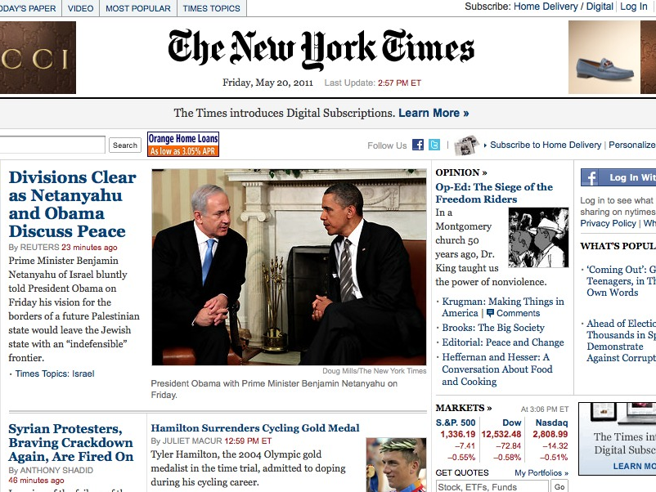
The New York Times Is The Competition

Slide 21
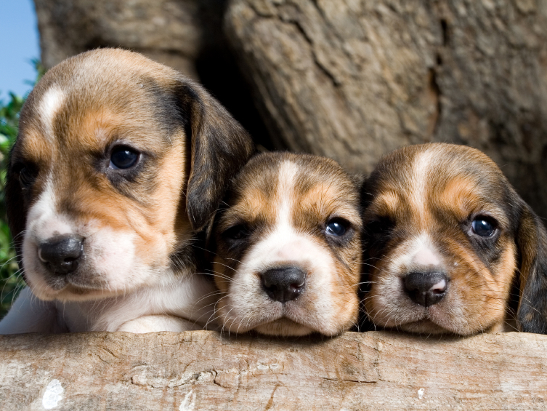
Tweeting Landing Pages Doesn’t Kill Puppies

Slide 22

Step 4: Test and Fail Fast

Slide 23
Test Framework

Slide 24
Abstract Concepts
Framework: How to Test Social Media Lead Generation Strategies
4
Step 4: Set action items following the experiment.
3
Step 3: Conduct an experiment retrospective.
2
Step 2: Set methodology for gathering data for success criteria.
1
Step 1: Set a clear qualitative objective.

Slide 25

Step 5: Optimize For Maximum Lead Flow

Slide 26
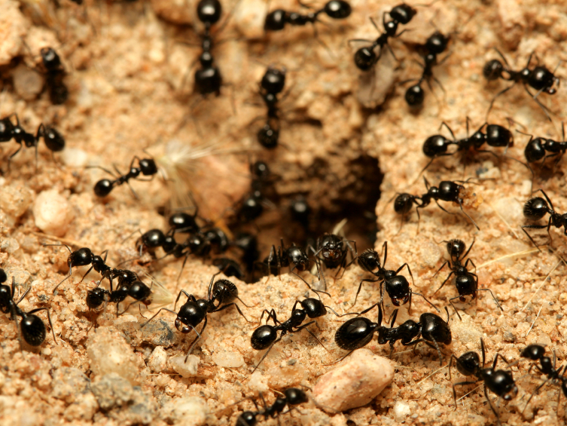
Conversion Rates
Vs. Traffic

Slide 27
Don’t Believe Me

Slide 28
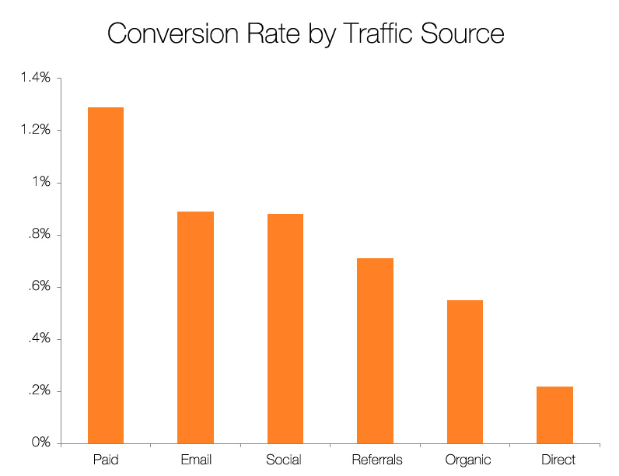
Source: Science of Lead Generation

Slide 29
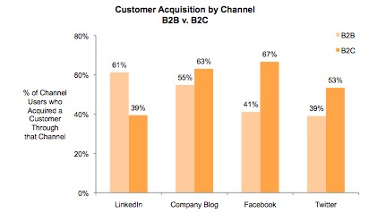
Source: State of Inbound Marketing Report - http://bit.ly/aewfHr

Slide 30
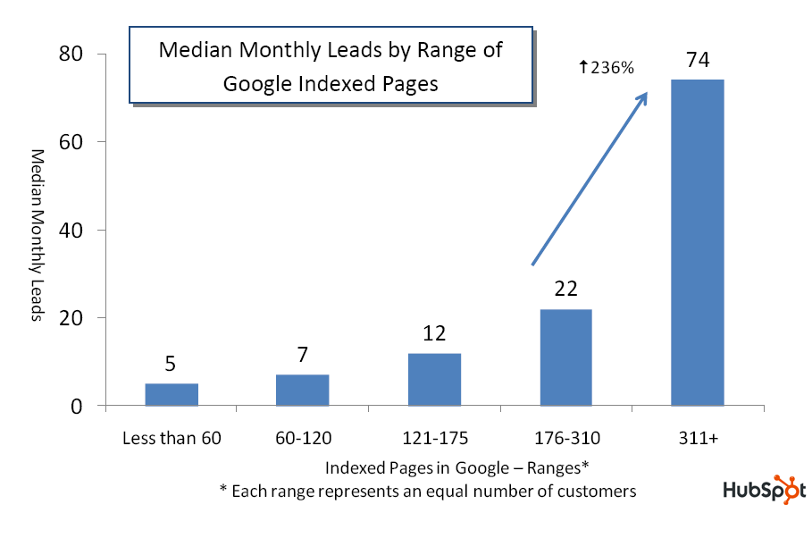
Source: State of Inbound Marketing Lead Generation Report - http://bit.ly/cVMpkn

Slide 31
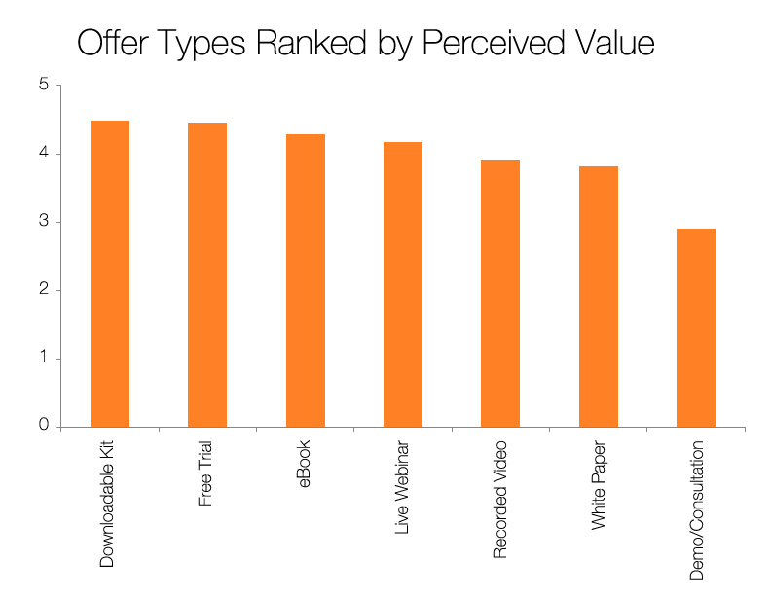
Source: Science of Lead Generation

Slide 32
The 5 Steps of Social Media Lead Generation
Step 1: Get The Basics Right
Step 2: Maximize Content Discovery
Step 3: Create Conversion Ubiquity
Step 4: Test and Fail Fast
Step 5: Optimize For Maximum Lead Flow

Slide 33

You’re The Star

Slide 34

Don’t Wait

Slide 35
End This Today

Slide 36
?’s
@Kbodnar32
Blog.Hubspot.com

Slide 37
Slides:

