Slide 1

AF CGO Leadership Briefing
12 Keys to Leadership
4 May 11
Brigadier General
Joseph S. Ward Jr.

Slide 2
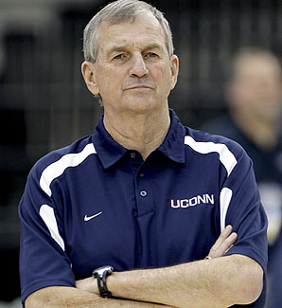
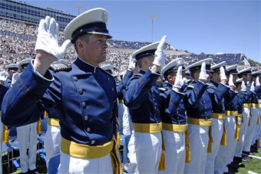

Your Charge…
Lead yourself first
“The first step toward success is leading yourself exceptionally well.”, John Maxwell
“To whom much is given, much is expected.”, Coach Jim Calhoun
You don’t have to be a supervisor or commander to be a leader.
Leadership is action...not a position.
Notes:
ars from now.

Slide 3
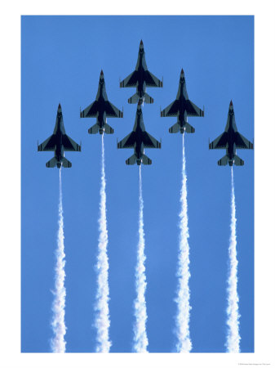

Your Charge…
Lead yourself first
Get off to a good start
Bring your “A” game; everyday.
Aim High and Shoot for the stars!
Take responsibility seriously, be accountable.

Slide 4




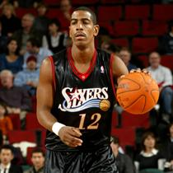
Your Charge…
Lead yourself first
Get off to a good start
Keep Improving
PME
Masters Degree
Career Progression
Continuous personal improvement is a life long goal.
Always strive to reach the next level—Keep climbing!
Don’t self eliminate—get PME and Masters done QUICKLY.
Readers are Leaders—Leaders are Readers!

Slide 5
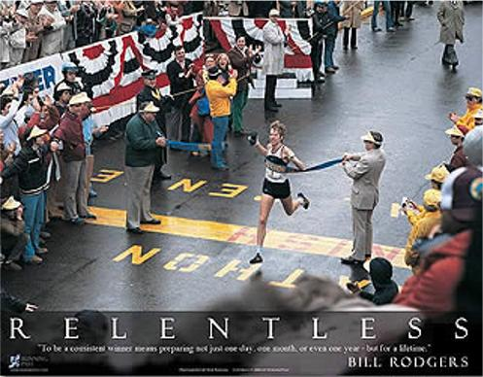

Your Charge…
Lead yourself first
Get off to a good start
Keep Improving
Go the extra mile
Bill Rodgers
The Extra Mile has no traffic jams.
Avoid doing the bare minimum.

Slide 6

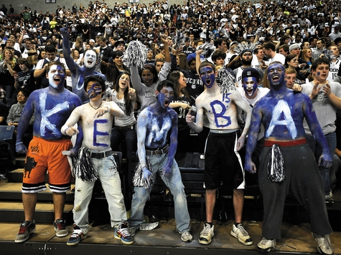
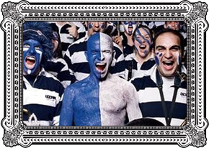
Your Charge…
Lead yourself first
Get off to a good start
Keep Improving
Go the extra mile
Get “Engaged”
What you get out of anything is always proportional to what you put in.
Put your full attention to every task at hand.
Engage and get plugged in—”connectivity” is key to success.

Slide 7
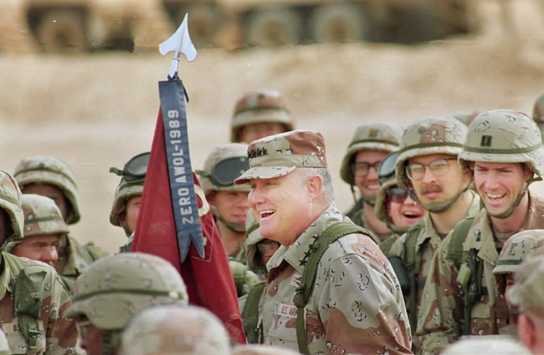
Your Charge…
Lead yourself first
Get off to a good start
Keep Improving
Go the extra mile
Get “Engaged”
Seek Leadership Opportunities
"Never let the fear of striking out get in your way.“ -George "Babe" Ruth
Be Visible; when you step up you stand out.
Seek out opportunities to lead; nothing compares to time in the ‘hot seat’.

Slide 8
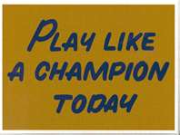


Your Charge…
Lead yourself first
Get off to a good start
Keep Improving
Go the extra mile
Get “Engaged”
Seek Leadership Opportunities
Do your best…TODAY!
“A soldier is always on parade” - Napoleon
Every job you’re given is worth your full effort.
You can’t afford to take a play off--always make sure you get back on defense.

Slide 9
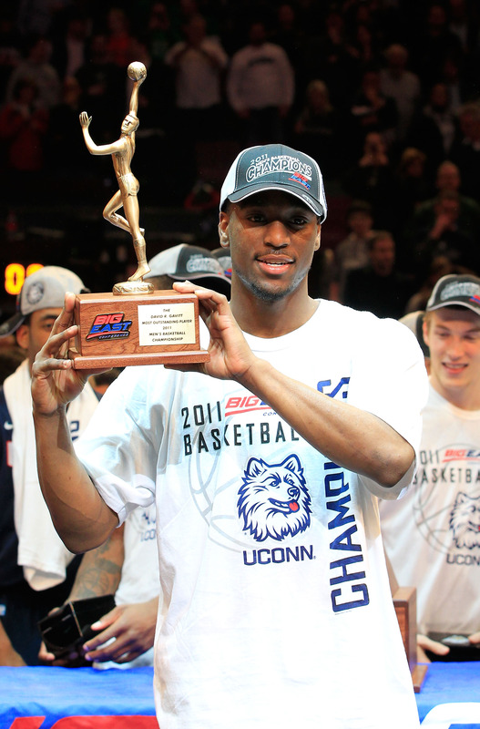
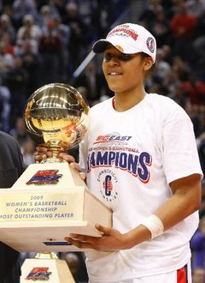
Your Charge…
Lead yourself first
Get off to a good start
Keep Improving
Go the extra mile
Get “Engaged”
Seek Leadership Opportunities
Do your best …TODAY!
Be a “Go-to” Player
Every team has one; every unit has one.
Strive to become your team’s ‘go to’ person.

Slide 10
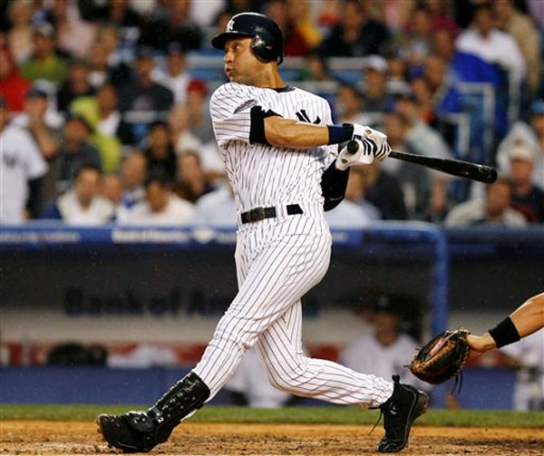
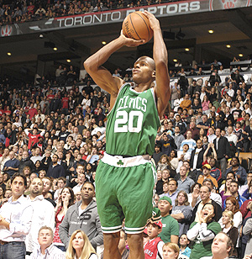
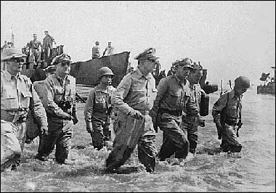
Your Charge…
Lead yourself first
Get off to a good start
Keep Improving
Go the extra mile
Get “Engaged”
Seek Leadership Opportunities
Do your best …TODAY!
Be a “Go-to” player
Lead by example
Respect is earned through your actions.
Authority earned through actions is stronger than authority given through position.
Lead both on the court and off the court.

Slide 11
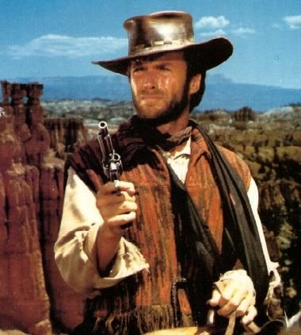
Your Charge…
Lead yourself first
Get off to a good start
Keep Improving
Go the extra mile
Get “Engaged”
Seek Leadership Opportunities
Do your best …TODAY!
Be a “Go-to” player
Lead by example
Learn from others
There are two types of leaders; good and bad--you can learn from both.
Use lessons learned through experience to improve your leadership skills.

Slide 12
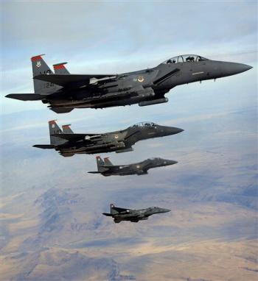
Your Charge…
Lead yourself first
Get off to a good start
Keep Improving
Go the extra mile
Get “Engaged”
Seek Leadership Opportunities
Do your best …TODAY!
Be a “Go-to” player
Lead by example
Learn from others
Be a good Wingman
Take good care of one another both on and off duty.

Slide 13


Your Charge…
Lead yourself first
Get off to a good start
Keep Improving
Go the extra mile
Get “Engaged”
Seek Leadership Opportunities
Do your best …TODAY!
Be a “Go-to” player
Lead by example
Learn from others
Be a good Wingman
Develop a Positive Mental Attitude
“Attitude is a little thing that makes a big difference.” -Winston Churchill
Attitude determines altitude.
Be an elevator—elevate those around you.
Is the glass “half full or half empty”—you make the choice.

Slide 14
Leadership
Brigadier General
Joseph S. Ward Jr.
Joseph.ward@pentagon.af.mil
703.697.0627
DSN: 227.0627

Slide 15
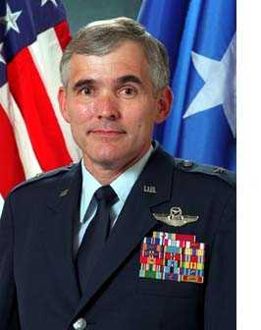
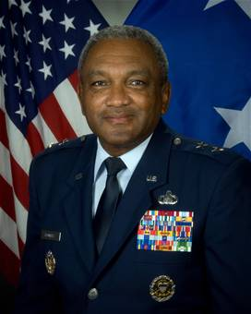
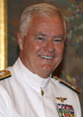
Learn From Others
What did I admire most of the leaders I admired most?
What did I admire most of the leaders I admired most?
Wing CC:
Emphasized value of recognition
Took the time to “teach” leadership
Functional Leader:
Took care of the troops
Maintained a positive mental attitude
Combatant Commander:
Made me feel a “valued” member of team
Comfortable in his own skin

