Slide 1
Force Management
Maj Gen Sharon Dunbar
Director, Force Management Policy
Deputy Chief of Staff, Manpower, Personnel and Services

Slide 2
Overview
The Strength of Our AF
Changing AF Culture
Diversity
Force Management
What It Means To You
Officer Competencies

Slide 3

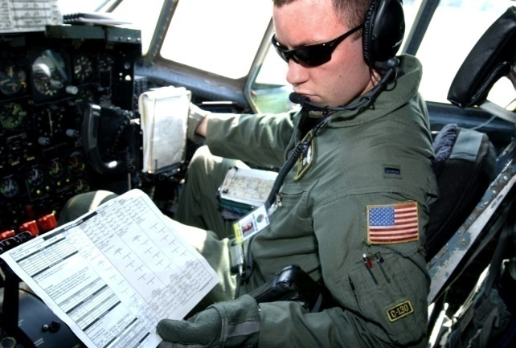




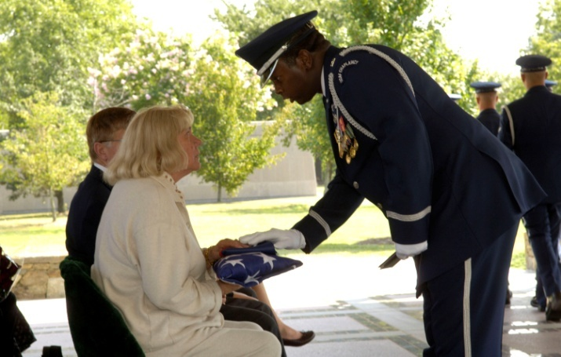
The Strength of Our Force
Officer – 65,000
Enlisted – 263,000
Civilians – 192,000
Families – 449,000
Retirees – 690,000
Survivors – 106,000
1.76 Million Airmen / Families
Notes:
3
3
1.76 Million people from several very diverse groups, each with unique needs.
We’re committed to giving every person outstanding personnel service…the key is we listen closely to what our customers need, and we take action to provide it.
Balancing the needs of all these groups certainly can be challenging, but the proud men and women in the A1 community find very effective solutions. For example, in response to requests from deployed Airmen to have a web-based system to conduct their personnel business from anywhere in the world, we modernized and computerized our business practices. However, some retirees did not own computers or feel comfortable using one; they were accustomed to having a person help them directly.
Because we emphasize communication with our customers, we were able to recognize and prevent this potential problem by establishing the Air Force Customer Service Center, giving our retirees, and all our customers, a person to speak with to take care of their personnel needs. As part of our Reposturing of AFPC, we’re transforming our Service Center into a “Total Force Service Center” to better manage the force using state of the art systems and best business practices…we’ll talk more on this when we look at the Personnel Services Directorate.
To meet the needs of our 1 3/4 million customer base requires a sizeable workforce.

Slide 4
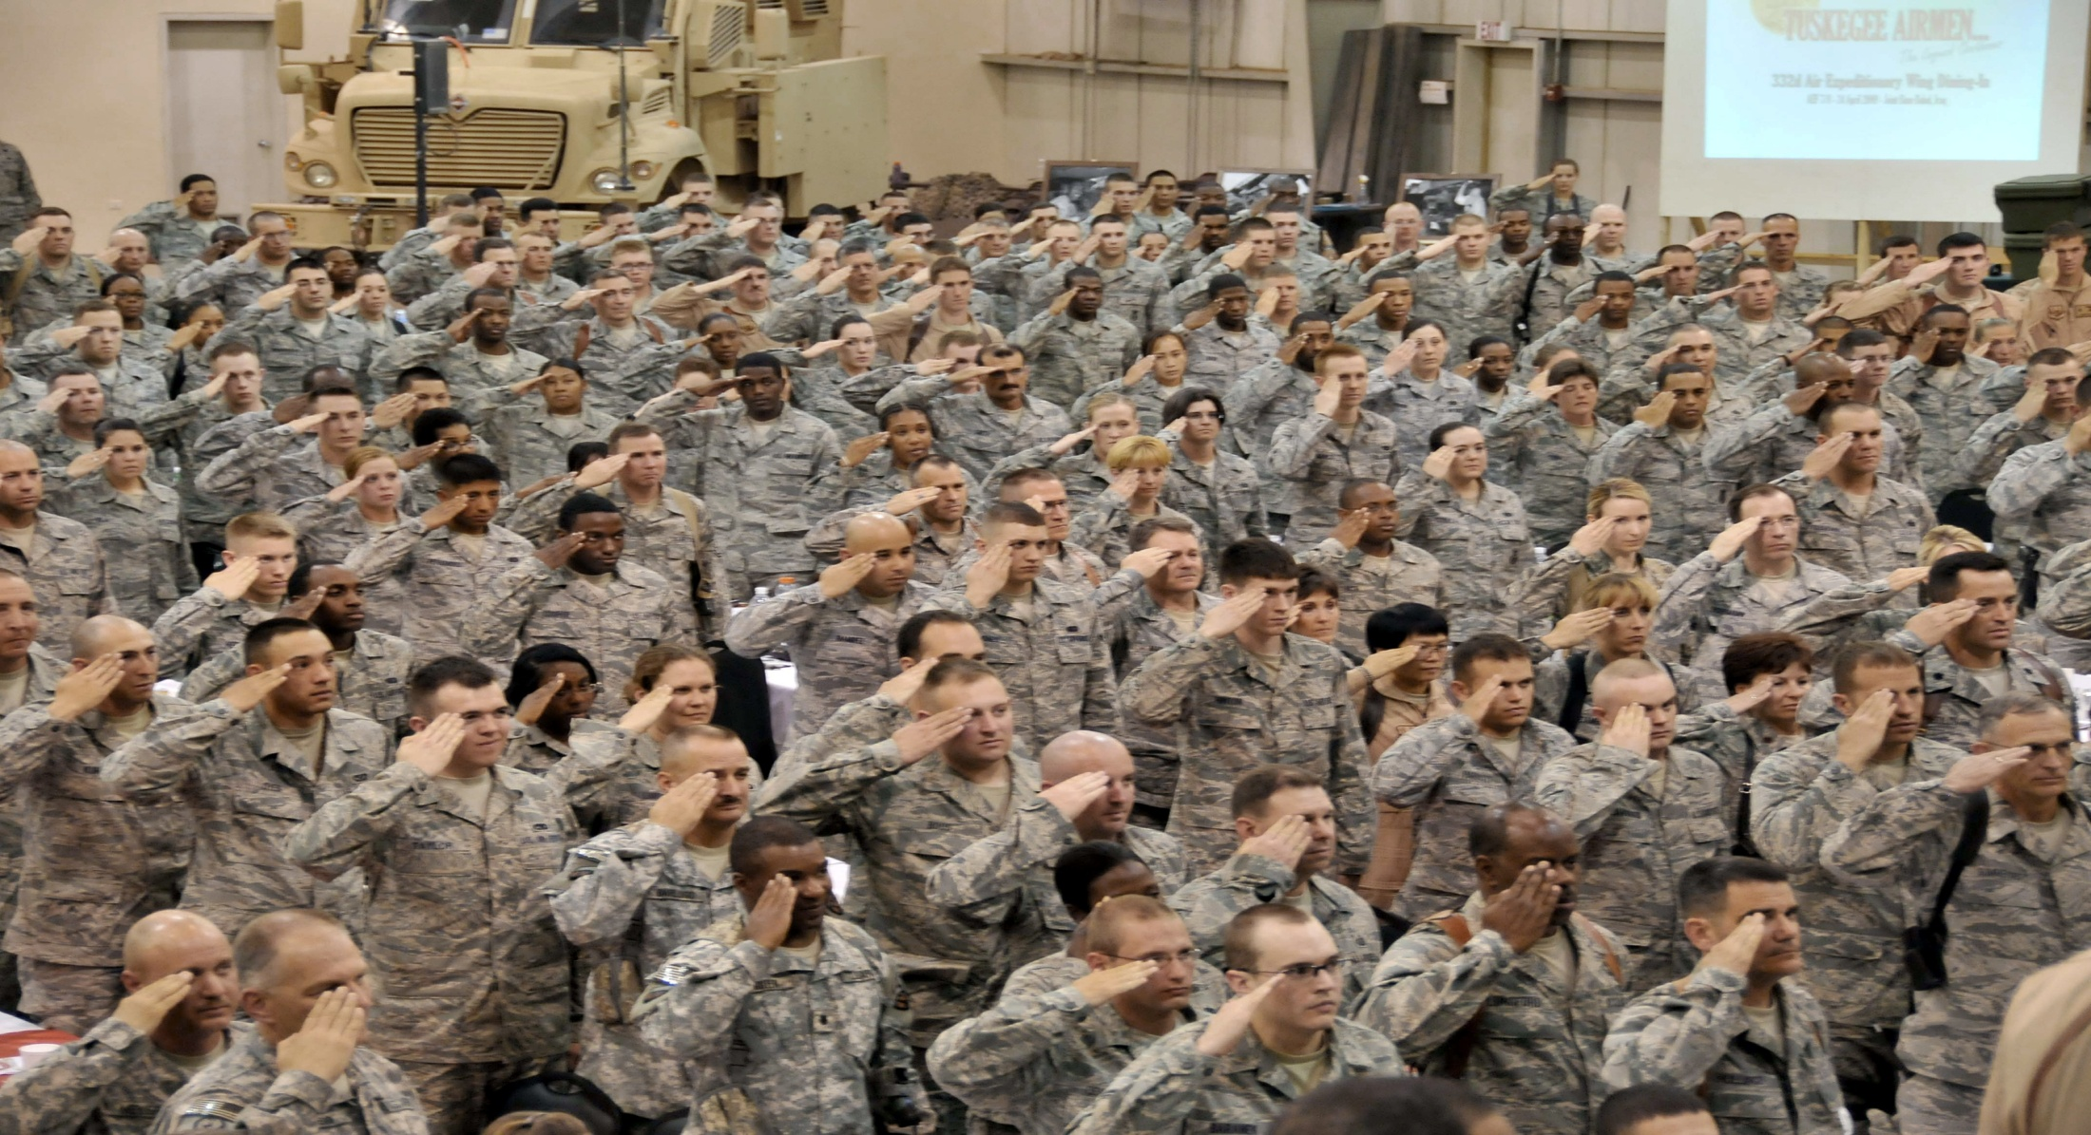
End Strength
Size
  Authorized and funded by Congress
  AF military E/S is both a floor and ceiling
    332,200 in FY11 → 332,800 in FY12
  Civilian E/S 192,267 in FY11 → 182,199 in FY12
Shape
  ~ 1:5 Officer/Enlisted Ratio
  AFSC composition driven by DoD & AF requirements
  Shifts in requirements are programmed into FYDP
    Recent: ISR (RPA, Intel), Nuclear, Acquisition
Force Management: Accessions, Cross-Flow, Normal Separations, Retirements, ARC Augmentation, Force Shaping

Slide 5
Influencers on Our Force
Society & Culture
Demographics
Diversity
New & Emerging Mission Requirements
Organizational & Competency Concerns
Skills & Qualifications
Individuals, their Families & Friends
International, Political & Fiscal Realities
5

Slide 6
DoD Total Obligation Authority
(In Millions)
Notes:
Note: The FY12 numbers do not include the supplemental and there is no FY13 supplemental request yet so the numbers for FY13 and beyond are base budget based on the current FYDP.
----------------
FY12 request baseline is $512B
The incremental costs of funding Overseas Contingency Operations (OCO), including ongoing efforts in Afghanistan and Iraq, are funded separately in the 2012 Budget.

Slide 7
Changing Air Force Culture
      Emerging Missions
        Remotely Piloted Aircraft (RPA)
        Afghanistan/Pakistan Hands
        Nuclear Enterprise Human Capital Management
      Air Reserve Component
        Total Force Integration
      Civilian Workforce
        Interchangeability, Deployments, Force Development, Mobility
      Diversity
        Work-Life Balance
      Greater Focus on Fitness
      Deliberate & Agile Force Management
7

Slide 8
Air Force Diversity
Attract, recruit, develop & retain a high-quality, diverse Total Force
Diversity is a composite of individual characteristics, experiences, and abilities consistent with Air Force Core Values…includes, but is not limited to:
  Personal life experiences
  Geographic background
  Socio-economic background
  Cultural knowledge
  Educational background
  Work background
  Language abilities
  Physical abilities
  Age
  Race
  Ethnicity
  Gender
  Philosophical/spiritual perspectives
Notes:
Vision: Be a leading competitor in the search for talent…”Influence the influencers”. Make an extra effort to be a positive example especially to members in the community who influence the youth: teachers, coaches, etc.

Slide 9
Officer Accession Challenges
  From 67M to 8M…
Total Population (Millions)
88% Ineligible
22%
93%
64%
Notes:
93% of College Grads are US citizens
64% of US Citizens meet weight standards

Slide 10
Enlisted Accession Challenges
  From 46M to ~14M…

Slide 11
Military Force Management Challenges
Highest retention 16 years – top to bottom
More high quality Airmen than we can promote/retain
Size and shape to meet authorized E/S
  Retraining, cross-flows, voluntary & involuntary separations
  Incentives to recruit, access and retain
  Few tools to shape force
  Constrained funding for special & incentive pay
Some high quality Airmen will separate/retire
  Not always a negative
  ARC Opportunities--Posture for civilian influence
Must size and shape the force to meet current & future mission requirements within authorized E/S
Notes:
The AF must operate within authorized, funded end strength (E/S)
Two challenges:
Size: Highest retention in 16 years
Shape: Imbalance among AFSCs; changing/emerging missions
More Airmen are serving than the AF is authorized
End of FY10: 2,335 Officers over E/S; Enlisted met E/S
End of FY11: Projecting up to 900 Officers over E/S; Enlisted met E/S
End of FY12: If not mitigated, Officer and Enlisted overage could reach 7K
Voluntary Separations approved based on Needs of the Air Force
Involuntary Separations decided based on quality / Needs of Air Force

Slide 12
FY11/12 Force Management Strategy
Must meet officer E/S by end of FY12—reduce:
  FY11 rated accessions from OTS
  OTS to minimum production level
  ROTC accessions/production
  AFA cadet strength to programmed 4K
Force Shaping & Reduction in Force for FY12
Lt Col and Col SERB for FY12
Continue vol measures: TIG Waiver; 8 vs 10; Blue to Green, etc.
Limited continuation of twice deferred Captains & Majors
Reduced Major promotion opportunity to 90%
Reinstituted Captain Line of the AF promotion board to 95%
Notes:
Goal is to meet ES by End of FY12.
We are reducing and cutting across the board to make each focused reduction (FSB/RIF/SERB) on AD threshold as small in scope as possible.
force Management is a multi year program, and you must be aware that beyond retention boards we are also making the promotion board process more competitive.
- FYI Numbers on these bullets: Reduce FY11 rated accessions from OTS (-59)
Reduce OTS to minimum accession levels (-240)
Execute Force Shaping & Reduction in Force for FY12 losses: Widen aperture across AFSCs; Quality cut

Slide 13
Retain a High-Quality Officer Force
Officer quality not balanced across Line AFSCs
  Some have met 3 retention boards
  Impact on future promotion boards, command, etc.
VSP is not a quality force program
  GOAL: Shape/size officer force by AFSC/capabilities
  OSD Policy: RIF eligibles, needs of Service
  AF approved based on AFSC requirements, ADSC authority
    Tolerable risk to current / future requirements
    Considered investments, replacement costs
RIF will focus on retaining quality
  GOAL: Size/shape for highest quality force
  Compete by Comp Cats/Year Groups—vs AFSCs
Retain the highest quality force;
Cross-flow to balance skills for the current and future fight
13
Notes:
Career fields who have meet a retention board 3 times: 2003 yr of the followin AFSC’s: 17D Cyber Ops; 21A Acft Mx; 38F Force Spt; 61B Beh Scientist; 61C Chem/Bio
13

Slide 14
FSB / RIF Eligibility
Force Shaping Board Competitive Categories / Year Groups
  LAF- J and MCS: 2006 - 2008
Reduction in Force Competitive Categories / Year Groups
  BSC: 2000 - 2001
  LAF: 2000, 2003 - 2005
  LAF- J: 2001 - 2003
Voluntary Separation Pay Program
  Enabled RIF retention increase to 95% -- from 90%
  Removed 9 year groups from Chaplains, LAF-J and MSC
  Chaplain and MSC no longer RIF eligible
Potential RIF Losses: 300
Notes:
In response to projected voluntary officer separations , the RIF board will now only select up to 5% of each competitive category and year group indentified as eligible; this compares to 10% as previously projected. In addition, the AF removed a number of year groups and competitive categories from the original eligibility criteria. We expect the RIF board will consider approximately 9,000 officers and be able to retain at least 95%. The numbers won’t be final until the RIF Board is convened.
Letty: This is the exact verbiage we used in the 21 Apr article.

Slide 15
FY11 VSP Methodology
OSD policy: offer to RIF eligibles; approve based on needs of AF
  Not an entitlement—application ≠ approval
  AF needs:
    Tolerable risk to current/future mission reqmts
      AFSC health/sustainment
      Critical skills
    Protect investments, consider replacement costs
      ADSCs, bonuses
Nearly 9,500 eligibles, ~10% applied
  Approved max within AF needs (~300)
  Disapproved those outside tolerable risk
    Still eligible for RIF—95% vs 90% retention

Slide 16
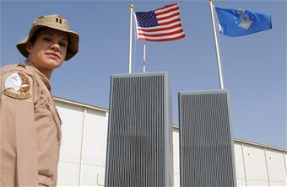
Non-Rated Line Officer Cross-Flow
  “Competitively selected” officers in top 50% of overmanned AFSCs
  Cyber, Aircraft Mx, Munitions & Missile Mx, Security Forces, Force Spt, Scientists, and Financial Mgmt (some exceptions)
  400 eligible officers
  Year Groups 2000 to 2007
Cross-Flowed Officers (rated and non-rated):
  Increased utility to AF
  Greater versatility
Notes:
NRLOC
A total of 424 officer records were available for the panel’s consideration, to include both volunteer and non-volunteer officers.
Not Eligible:
AF-sponsored advanced degrees (to include EWI), in-res IDE, Sq/CC or IDd for cmd, Dev Engrs who are TPS grads
Have DOS, including RIF/FSB selects; qual control indicators
Special quals: Cyber defense (17DXA), Nuclear SEIs, Psyops SEI
Officers in select year groups from 2002-2007 in Air Force specialty codes 17D, 21A, 21M, 31P, 38F, 61A/B/C and 65F, and 2000-2001 for 38Fs only, could compete to cross-flow into the 13D/L, 14N, 35P, 62E and 63A career fields.
Panel convened 14-18 Feb.
competitively select officers to cross-train into targeted career fields.
consisted of 5Air Force officers in the grade of O-6.
used the whole-person concept, including professional development

Slide 17
Non-Rated Line Officer Cross-Flow
56 volunteers met the panel (28 Exceptions-To-Policy)
  34 selected
  16 to SOF and ALO process
  6 not qualified for cross-flow
28 qualified non-vols selected
Panel Results: Gaining AFSCs
SOF | ALO | Intel | PA | Dev Engr | Prgm Mgr | Total
3 | 13 | 42 | 9 | 2 | 4 | 73
Notes:
There were 70 training seats available for this cross-flow panel, distributed among the 14N (Intel), 35P (Public Affairs), 62E (Developmental Engineer), and 63 (Acquisition Manager) career fields. Volunteer applicants could also request cross-flow consideration into the 13D (Control and Recovery) and 13L (Air Liasion Officer) career fields, but no training seat limitation was established for this panel.
Of the 424 records, 56 were volunteers for cross-flow of which 28 were HQ/A1P-approved Exception-to-Policy (ETP) applicants. The panel using a competitive process selected 50 volunteers and 23 non-volunteers for a total of 73 cross-flow officers. Of note, the 73 cross-flow officers included 16 volunteers for 13D and 13L release. The panel was unable to fill 13 of the 70 training seats all in the 62E, Developmental Engineer, career field due to a lack of officers with the required academic degrees.
The 23 non-volunteers comprised: one each from 21A (Aircraft Maintenance) & 21M (Munitions and Missile Maintenance), three from 31P (Security Forces), and 18 from 38F (Force Support). All the non-volunteers were from the 2005-2007 Year Groups (YGs), with one exception -- a 2002 YG 21A selected for 62E.
There were a total of 16 officers selected for release to the 13D and 13L functional/training managers for further assessment and consideration.
- Medical qualification still required despite “all in” concept

Slide 18
FY11 Board Timeline
2011
2012
 | JAN | FEB | MAR | APR | MAY | JUN | JUL | AUG | SEP | OCT | NOV | DEC | JAN | FEB | MAR | APR | MAY | JUN | S E P
FSB
VSP
RIF
Lt Col SERB
Col SERB
4 Feb RRF Acct
9-13 May Board
1 Oct DOS
1-31 Mar Apply
1 Oct DOS
22 Apr
RRF Acct
19-30 Sep Board
1 Feb DOS
26 Jun
RRF Acct
24-28 Oct
(Lt Col) Board
1 Mar Board DOS
1 Jun in lieu of DOS
11 Sept
RRF Acct
9-13 Jan
(Col) Board
1 Jun
Board
DOS
1 Sep
In lieu of
DOS
Notes:
Force Shaping Board (FSB): Board begin next week on 9 May; Mandatory separation is 1 Oct 11 for selected officers
Voluntary Separation Pay (VSP): 1-31 Mar 11 application window for RIF-eligible officers at 1.25 times the separation pay rate. Voluntary separations by 1 Oct 11.
Reduction in Force Board (RIF): Board on 19 Sep 11; Mandatory separation is 1 Feb 12
Lt Col Selective Early Retirement Board (SERB): Board on 24 Oct 11; Officers may volunteer in lieu of the SERB with retirements no later than 1 Jun 12; Officers selected for retirement by the
SERB must retire 1 Mar 12
Col SERB: Board on 9 Jan 12; Officers may volunteer in lieu of the SERB with retirements no later than 1 Sep 12; Officers selected for retirement by the SERB must retire 1 Jun 12

Slide 19
AF Institutional Competencies
IC Category | Competency | Sub-competency
Organizational | Employing Military Capabilities | Operational and Strategic Art
 |  | Unit, Air Force, Joint and Coalition Capabilities
 |  | Non-adversarial Crisis Response
 | Enterprise Perspective | Enterprise Structure and Relationships
 |  | Government Organization and Processes
 |  | Global, Regional and Cultural Awareness
 |  | Strategic Communication
 | Managing Organizations and Resources | Resource Stewardship
 |  | Change Management
 |  | Continuous Improvement
 | Strategic Thinking | Vision
 |  | Decision-making
 |  | Adaptability
People/Team | Leading People | Develops and Inspires Others
 |  | Takes Care of People
 |  | Diversity
 | Fostering Collaborative Relationships | Builds Teams and Coalitions
 |  | Negotiating
Personal | Embodies Airman Culture | Ethical Leadership
 |  | Followership
 |  | Warrior Ethos
 |  | Develops Self
 | Communicating | Speaking and Writing
 |  | Active listening
Notes:
What are they?
How were they created?
How are they used?
Institutional Competencies: A measurable cluster of skills, knowledge, and abilities required of all Airmen and are needed to operate successfully in a constantly changing environment. Key to ensuring the ability of all Airmen to operate successfully in a constantly changing operational environment. (Draft AFDD 1-1)
- The Air Force’s institutional competencies (IC) are key to ensuring the ability of all Airmen to operate successfully in a constantly changing operational environment
-- They represent those human capabilities that support performance across the widest array of Air Force tasks and requirements
-- They provide a common language and a set of priorities for consistency across the Air Force
-- These competencies apply to all Air Force personnel (military and civilian) regardless of occupation, function or organizational level
-- There is a variation in terms of proficiency levels across ranks and positions
- The Air Force presented its first IC model in Feb 2004 through AFDD 1-1, Leadership and Force Development
-- Since then, the model has gone through several revisions with the help of various contractors (ICF International, DDI, and RAND)
- The current IC list consists of 8 competencies and 24 subcompetencies spanning personal, people/team, and organizational categories.
--The IC list has been vetted/approved by the Force Management & Development council and is published via AFPD 36-26, AFI 36-2640, and AFI 36-2618
-Through these documents, the Air Force has established a deliberate process called the Continuum of Learning (CoL) to ensure all Airmen master and demonstrate these competencies at a level of proficiency appropriate to their rank/grade and job requirements
--One example of how the competencies are used within the CoL is that Air Force PME institutions have mapped their curriculum to each competency at the appropriate level of proficiency
-The importance of competency based development is growing and many other organizations have begun to implement similar competency models.
--The Air Force established the Rosetta stone process to ensure its members meet the requirements of these various models through the IC list

Slide 20
Officer Responsibilities
Adhere to AF standards
Review / update personnel records for accuracy
Review & understand performance assessments on feedback, OPRs, PRFs and RRFs
Use Feedback to ask candid questions
Seek mentorship & development opportunities
Consider continued service in the Total Force
Develop as a “Whole Person”

Slide 21
Whole Person Concept
POTENTIAL
Notes:
When you meet a board the Secretary of the Air Force directs board members to use the whole person concept. The Secretary has reviewed and approved the factors listed on this slide.
As you would expect, performance is the most important factor. How well an individual is performing in his or her current job is an important consideration of his or her potential for continued service. You’ll have the RRF, performance and training reports to review.
The rest of the factors are not listed in any particular order, but I would like to touch on a few of them.
We cannot offer a single definition of Leadership. For this we ask you to draw upon your own experience and evaluate an officer’s demonstrated leadership abilities and potential to assume staff and command positions in the future.
The AF usually recognizes Specific Achievements in the form of awards/decorations, but you should not overlook the narrative justification in the reports, because sometimes this is the only place where you will learn that an officer has been selected for awards specific to his or her career field.

Slide 22
Impacts of a Decade of Conflict
      Tenacious: Most Combat-Tested Force In History
      Total Force Team: Active Duty, Guard, Reserve, Civil Service
      Competitive: 16-Year Record High Retention Despite Tempo
      Highly Deployable
      Versatility and Resiliency
Notes:
Increasing Rate and Magnitude of Change … Changing Technology … Increased Globalization … Rate of Market Change … Cost Containment … Importance of KNOWLEDGE CAPITAL
KNOWLEDGE CAPITAL: INVEST IN PEOPLE AS A COMPETITIVE ASSET
International, Fiscal & Political Realities: Conflict…Cultural Awareness…End-strength…In-Sourcing…CAF Redux…
New/Emerging Missions: ISR, Cyber, IW, Nuclear
Competency Concerns: Nuclear, Acquisition, PA

Slide 23
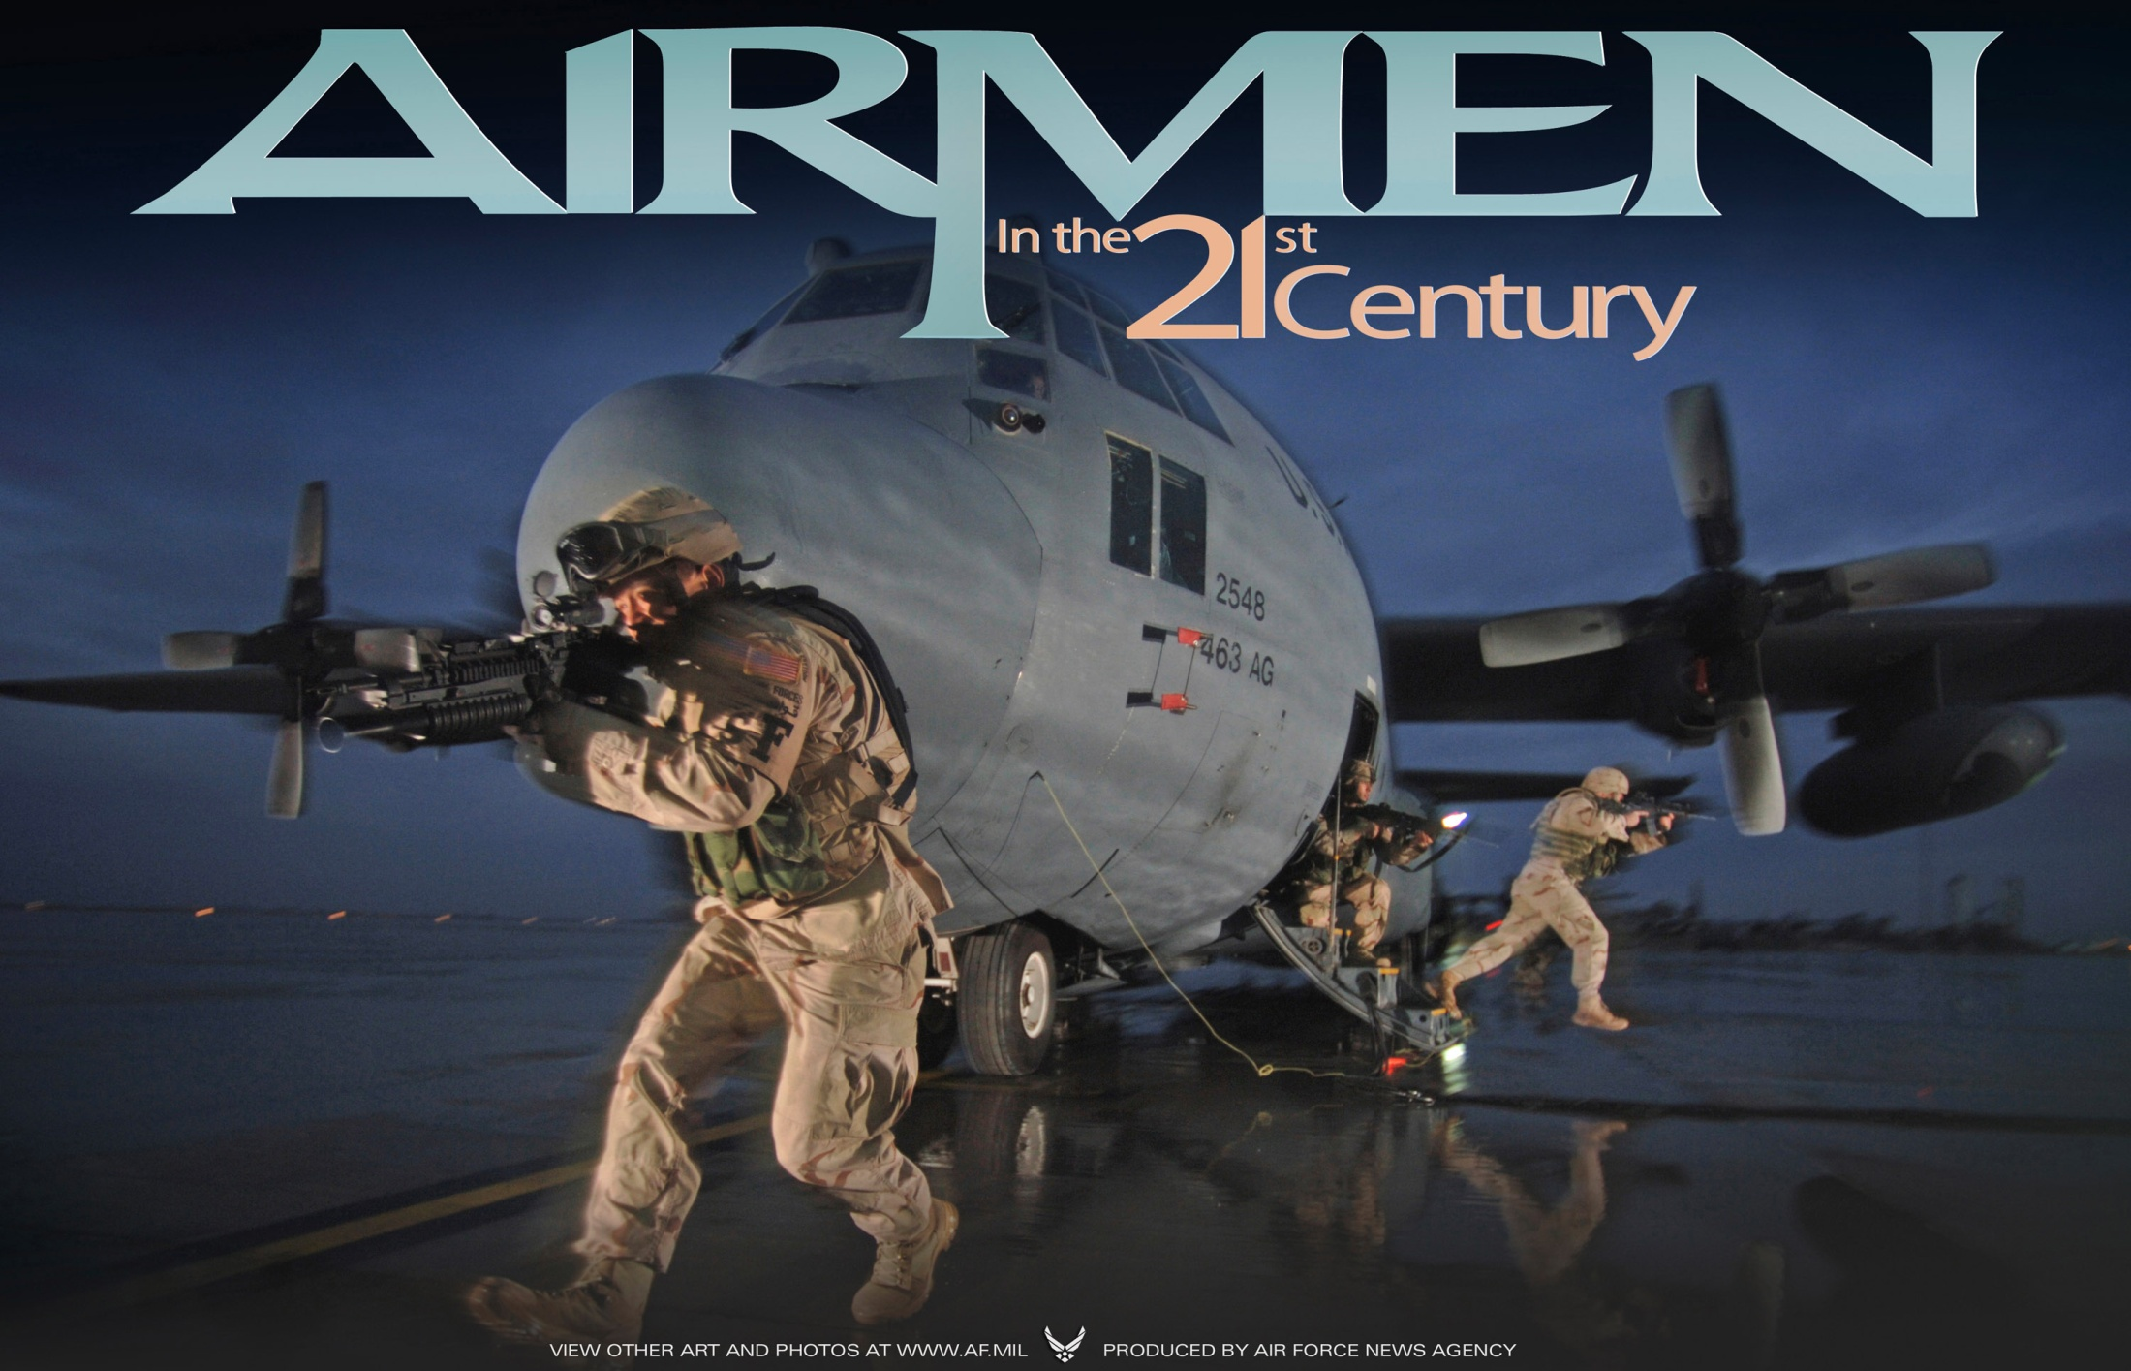
Questions?

