Slide 1


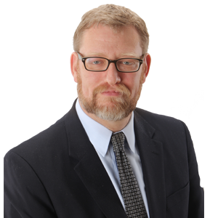
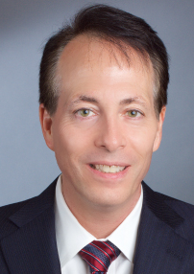
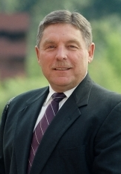
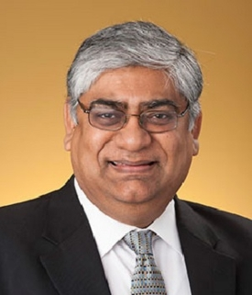
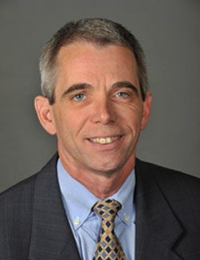
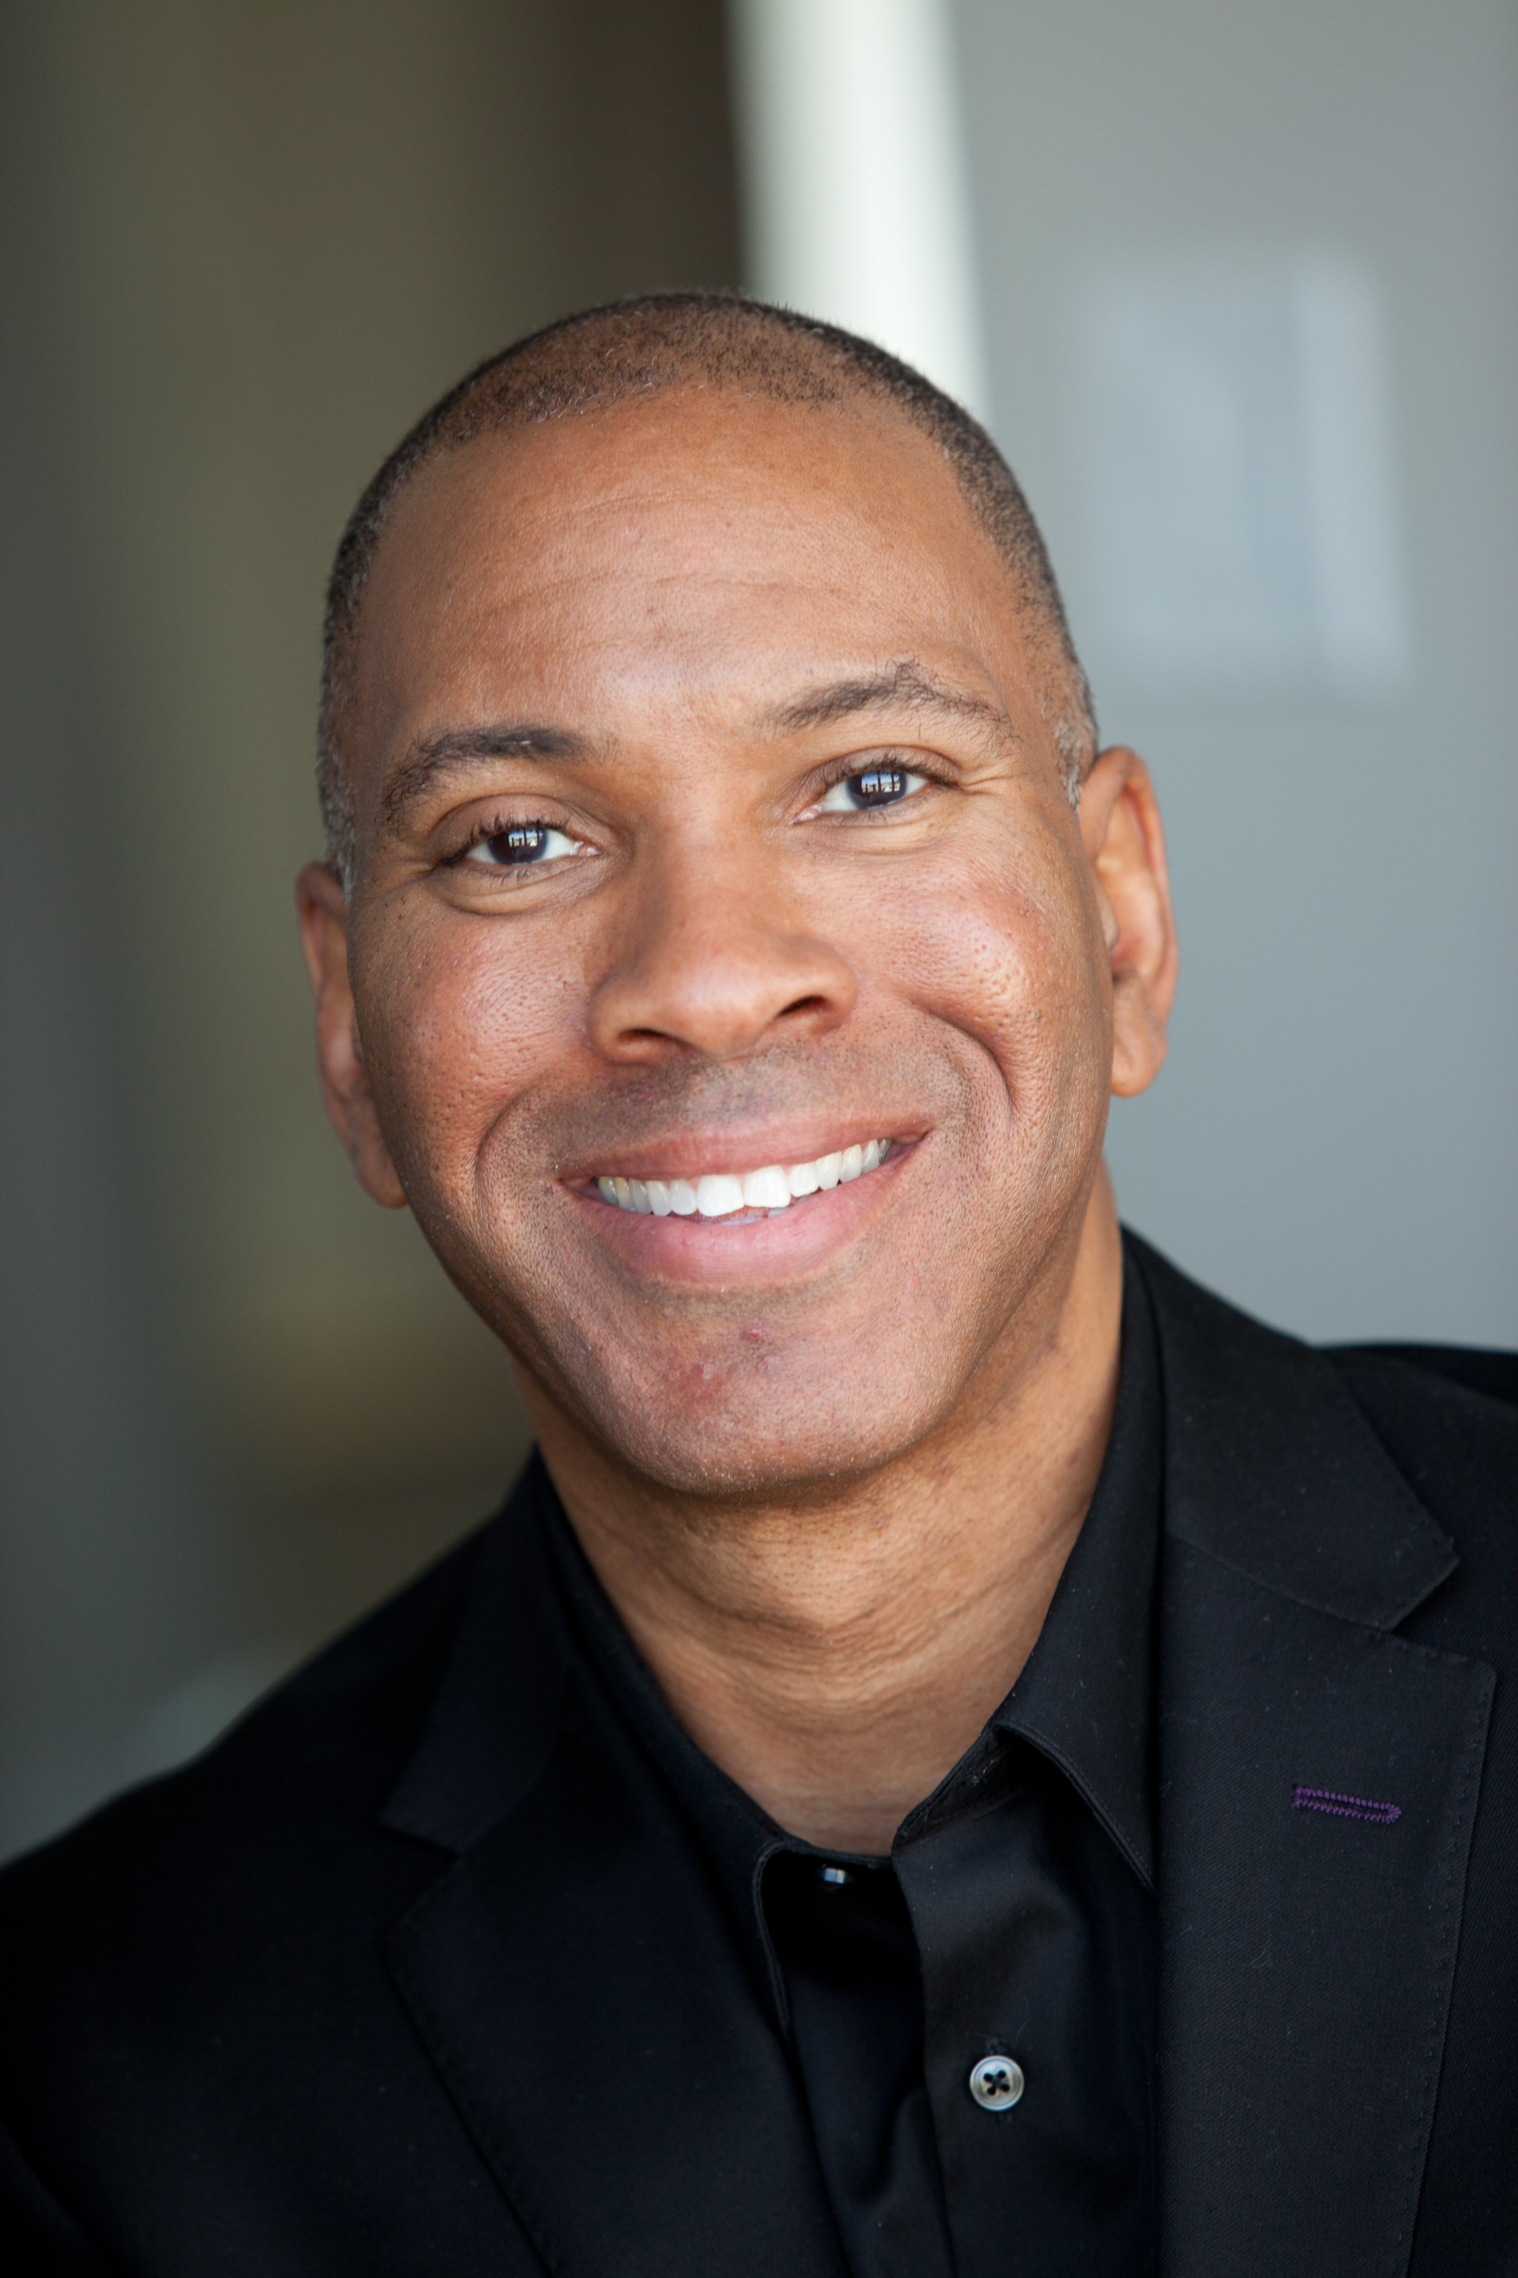
Forensic Accounting and Valuation—Opportunities in Practice, Research, and Education August 12, 2020
Panelists
Michael Blake
CFA, ASA, ABAR
James A. DiGabriele
Ph.D./DPS, CPA/ABV/CFF, CFE,
CFSA, FACFEI, Cr.FA, CVA
Darrell D. Dorrell
CPA, MBA, CVA, ASA,
CMA, ABV, CFF
Sridhar Ramamoorti
Ph.D., ACA, CPA/CITP/CFF, CIA, CFE, MAFF, CFSA, CGAP, CGFM, CRP, CICA, FCPA
Moderators
Brien K. Jones
Vice-President–Practice, Forensic Accounting Section
Chief Operations Officer and Executive Vice President
National Association of Certified Valuators and Analysts (NACVA)
Global Association of Certified Valuators and Analysts (GACVA) and Consultants’ Training Institute (CTI)
Richard Riley
Ph.D., CPA, CFE, CFF, CVA and President, Forensic Accounting Section
Brien K. Jones

Slide 2
Opening Remarks
Download PowerPoint at www.NACVA.com/AAAForensicAccounting
Sridhar Ramamoorti
Richard Riley
Brien K. Jones

Slide 3
Practice Segment
Michael Blake
James A. DiGabriele
Darrell D. Dorrell

Slide 4
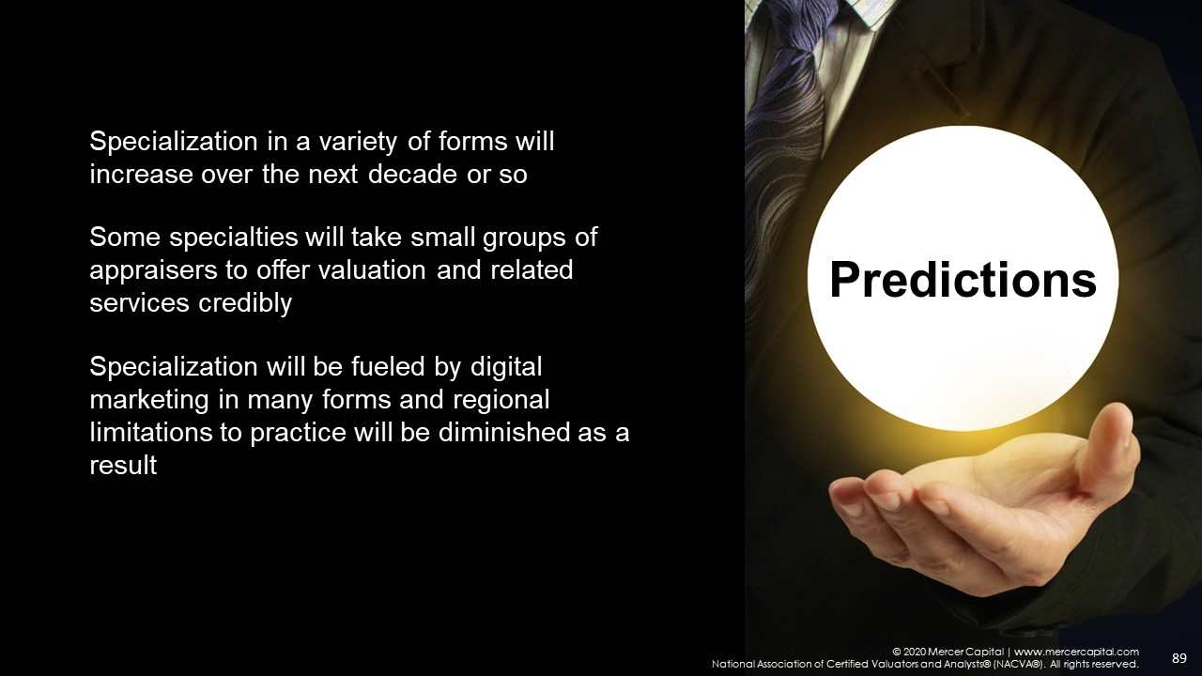
Practice SEgment
Source: Vision 2020—The Future of Our Profession and Your Role In It
Z. Christopher Mercer, Mercer Capital

Slide 5
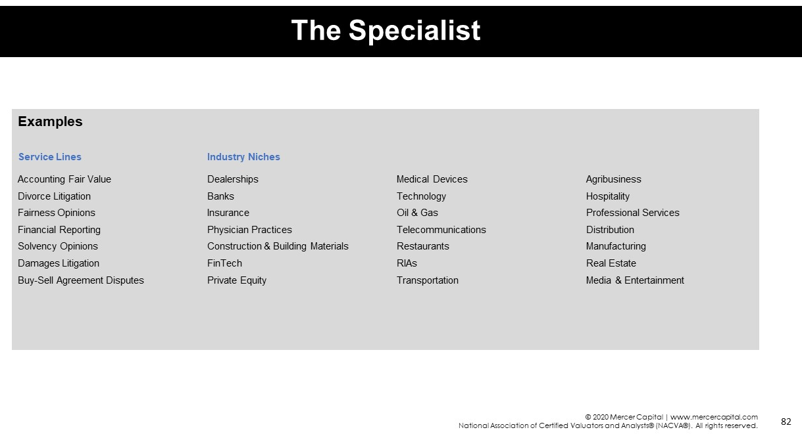
Practice SEgment
Source: Vision 2020—The Future of Our Profession and Your Role In It
Z. Christopher Mercer, Mercer Capital

Slide 6


Practice SEgment
Business Valuation, Financial Litigation, Forensic Accounting and/or
Financial Forensics
What is your academic background?
What are transferrable skills from traditional accounting that have benefitted your practice?
What led you to centering your practice around BV, Financial Litigation, Forensic Accounting and/or Financial Forensics services?
What are distinctions/definitions between BV, Financial Litigation, Forensic Accounting and/or Financial Forensics services?
Tell us about your practice and firm. What are your areas of specialty and what kind of cases are currently on your docket?
What do you find most rewarding and most challenging in your practice?
What would you define as most critical for someone thinking about focusing their practice in the BV, Financial Litigation, Forensic Accounting and/or Financial Forensics services marketplace?
What are critical sources of data, information, and resources that you use frequently?
What are your perspective on experts practicing BV, Financial Litigation, Forensic Accounting and/or Financial Forensics services services but without a professional designation and not adhering to generally accepted professional standards?

Slide 7

Practice SEgment
Business Valuation, Financial Litigation, Forensic Accounting and/or
Financial Forensics
What are your perspectives on emerging and trending areas of practice?
What efforts to you employ to distinguish your practice from other BV, Financial Litigation, Forensic Accounting and/or Financial Forensics services?
What are challenging aspects of dealing with and supporting your client and/or their attorneys? How do you overcome these challenges?
Do you find your practice is limited by geography or are you able to practice outside of your geographic area?
What kinds of fees do you generate? Are they different for various types of services provided?
What has been the biggest “shocker” you’ve experienced in your practice? Something that totally surprised you and caught you off guard. What did you learn from that experience?
Do you think this is a worthwhile profession for academicians and students entering the profession to pursue? Why and what advice or guidance would you offer?
What would be your hope for academia with regards to the future of the BV, Financial Litigation, Forensic Accounting and/or Financial Forensics services?

Slide 8



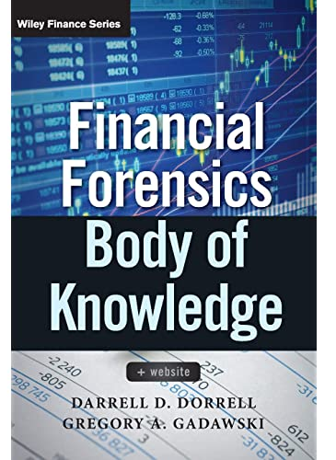
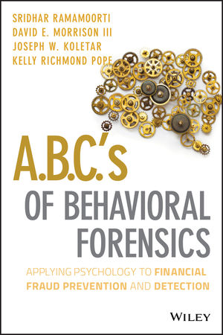
Practice SEgment
“The Art & Science of Investigating People & Money©.”
Current and Trending Book Sale

Slide 9
Professional Landscape
Brien K. Jones

Slide 10

Professional Landscape
Global Valuation Professional Organizations (VPOs)
Business Valuation, Financial Litigation, and Forensic Accounting
American Board of Forensic Accounting (ABFA)
American Society of Appraisers (ASA)
Appraisal Institute
Appraisal Foundation
Association of Insolvency & Restructuring Advisors (AIRA)
Association of International Certified Professional Accountants (AICPA)
Alliance of Merger & Acquisition Advisors (AM&AA)
Canadian Institute of Chartered Business Valuators (CBV Institute)
Chartered Financial Analyst Institute (CFA Institute)
Global Association of Certified Valuators and Analysts (GACVA)
Institute for Divorce Financial Analysts (IDFA)
International Growth & Exit Planning Association (IGEPA)
International Valuation Standards Council (IVSC)
National Association of Certified Valuators and Analysts (NACVA)
Royal Institution of Chartered Surveyors (RICS)
Turnaround Management Association (TMA)
World Association of Valuation Organisations (WAVO)
NOTE: This list is not inclusive of every global VPO.

Slide 11
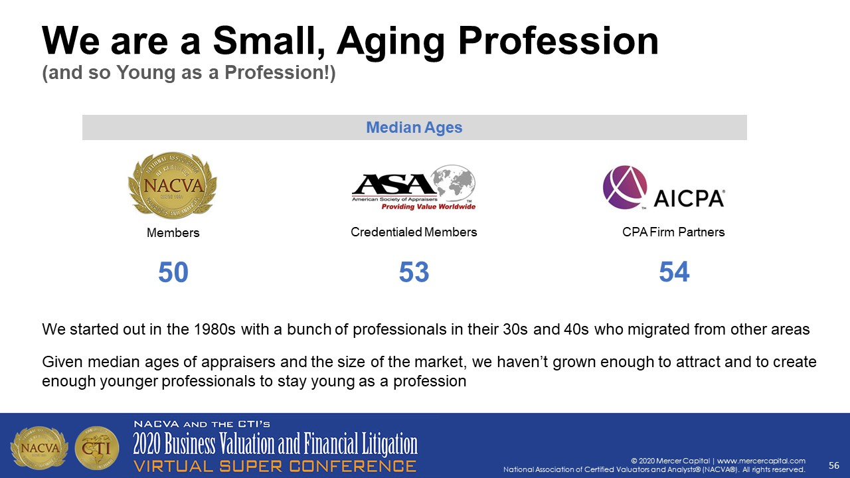

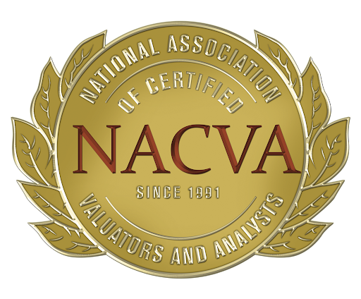
Professional Landscape
Global Valuation Professional Organizations (VPOs)
Source: Vision 2020—The Future of Our Profession and Your Role In It
Z. Christopher Mercer, Mercer Capital

Slide 12
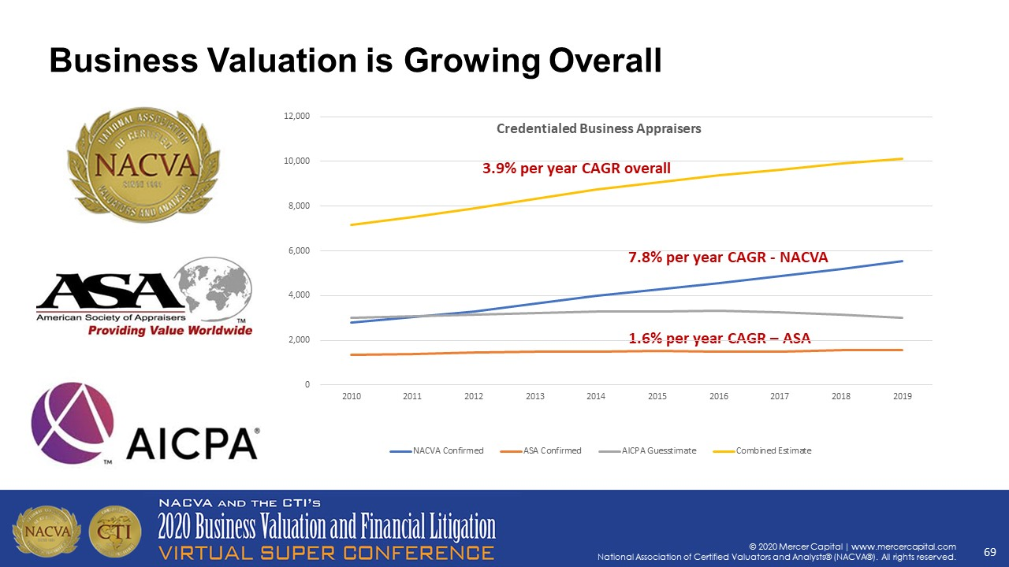
Professional Landscape
Global Valuation Professional Organizations (VPOs)
Source: Vision 2020—The Future of Our Profession and Your Role In It
Z. Christopher Mercer, Mercer Capital
GACVA

Slide 13
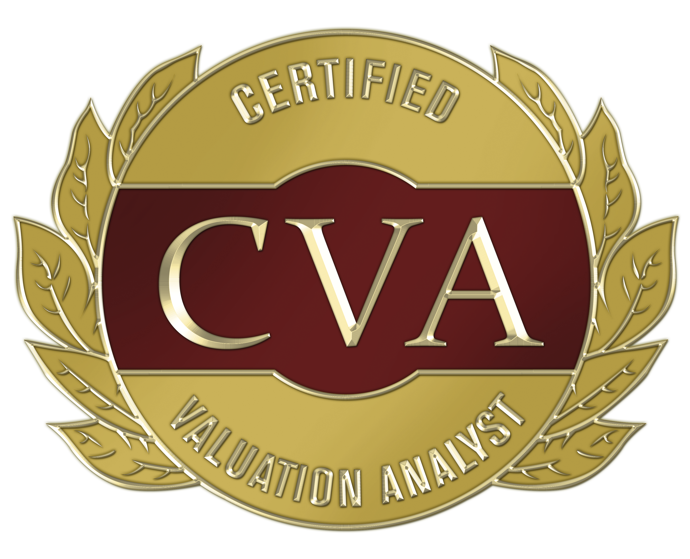

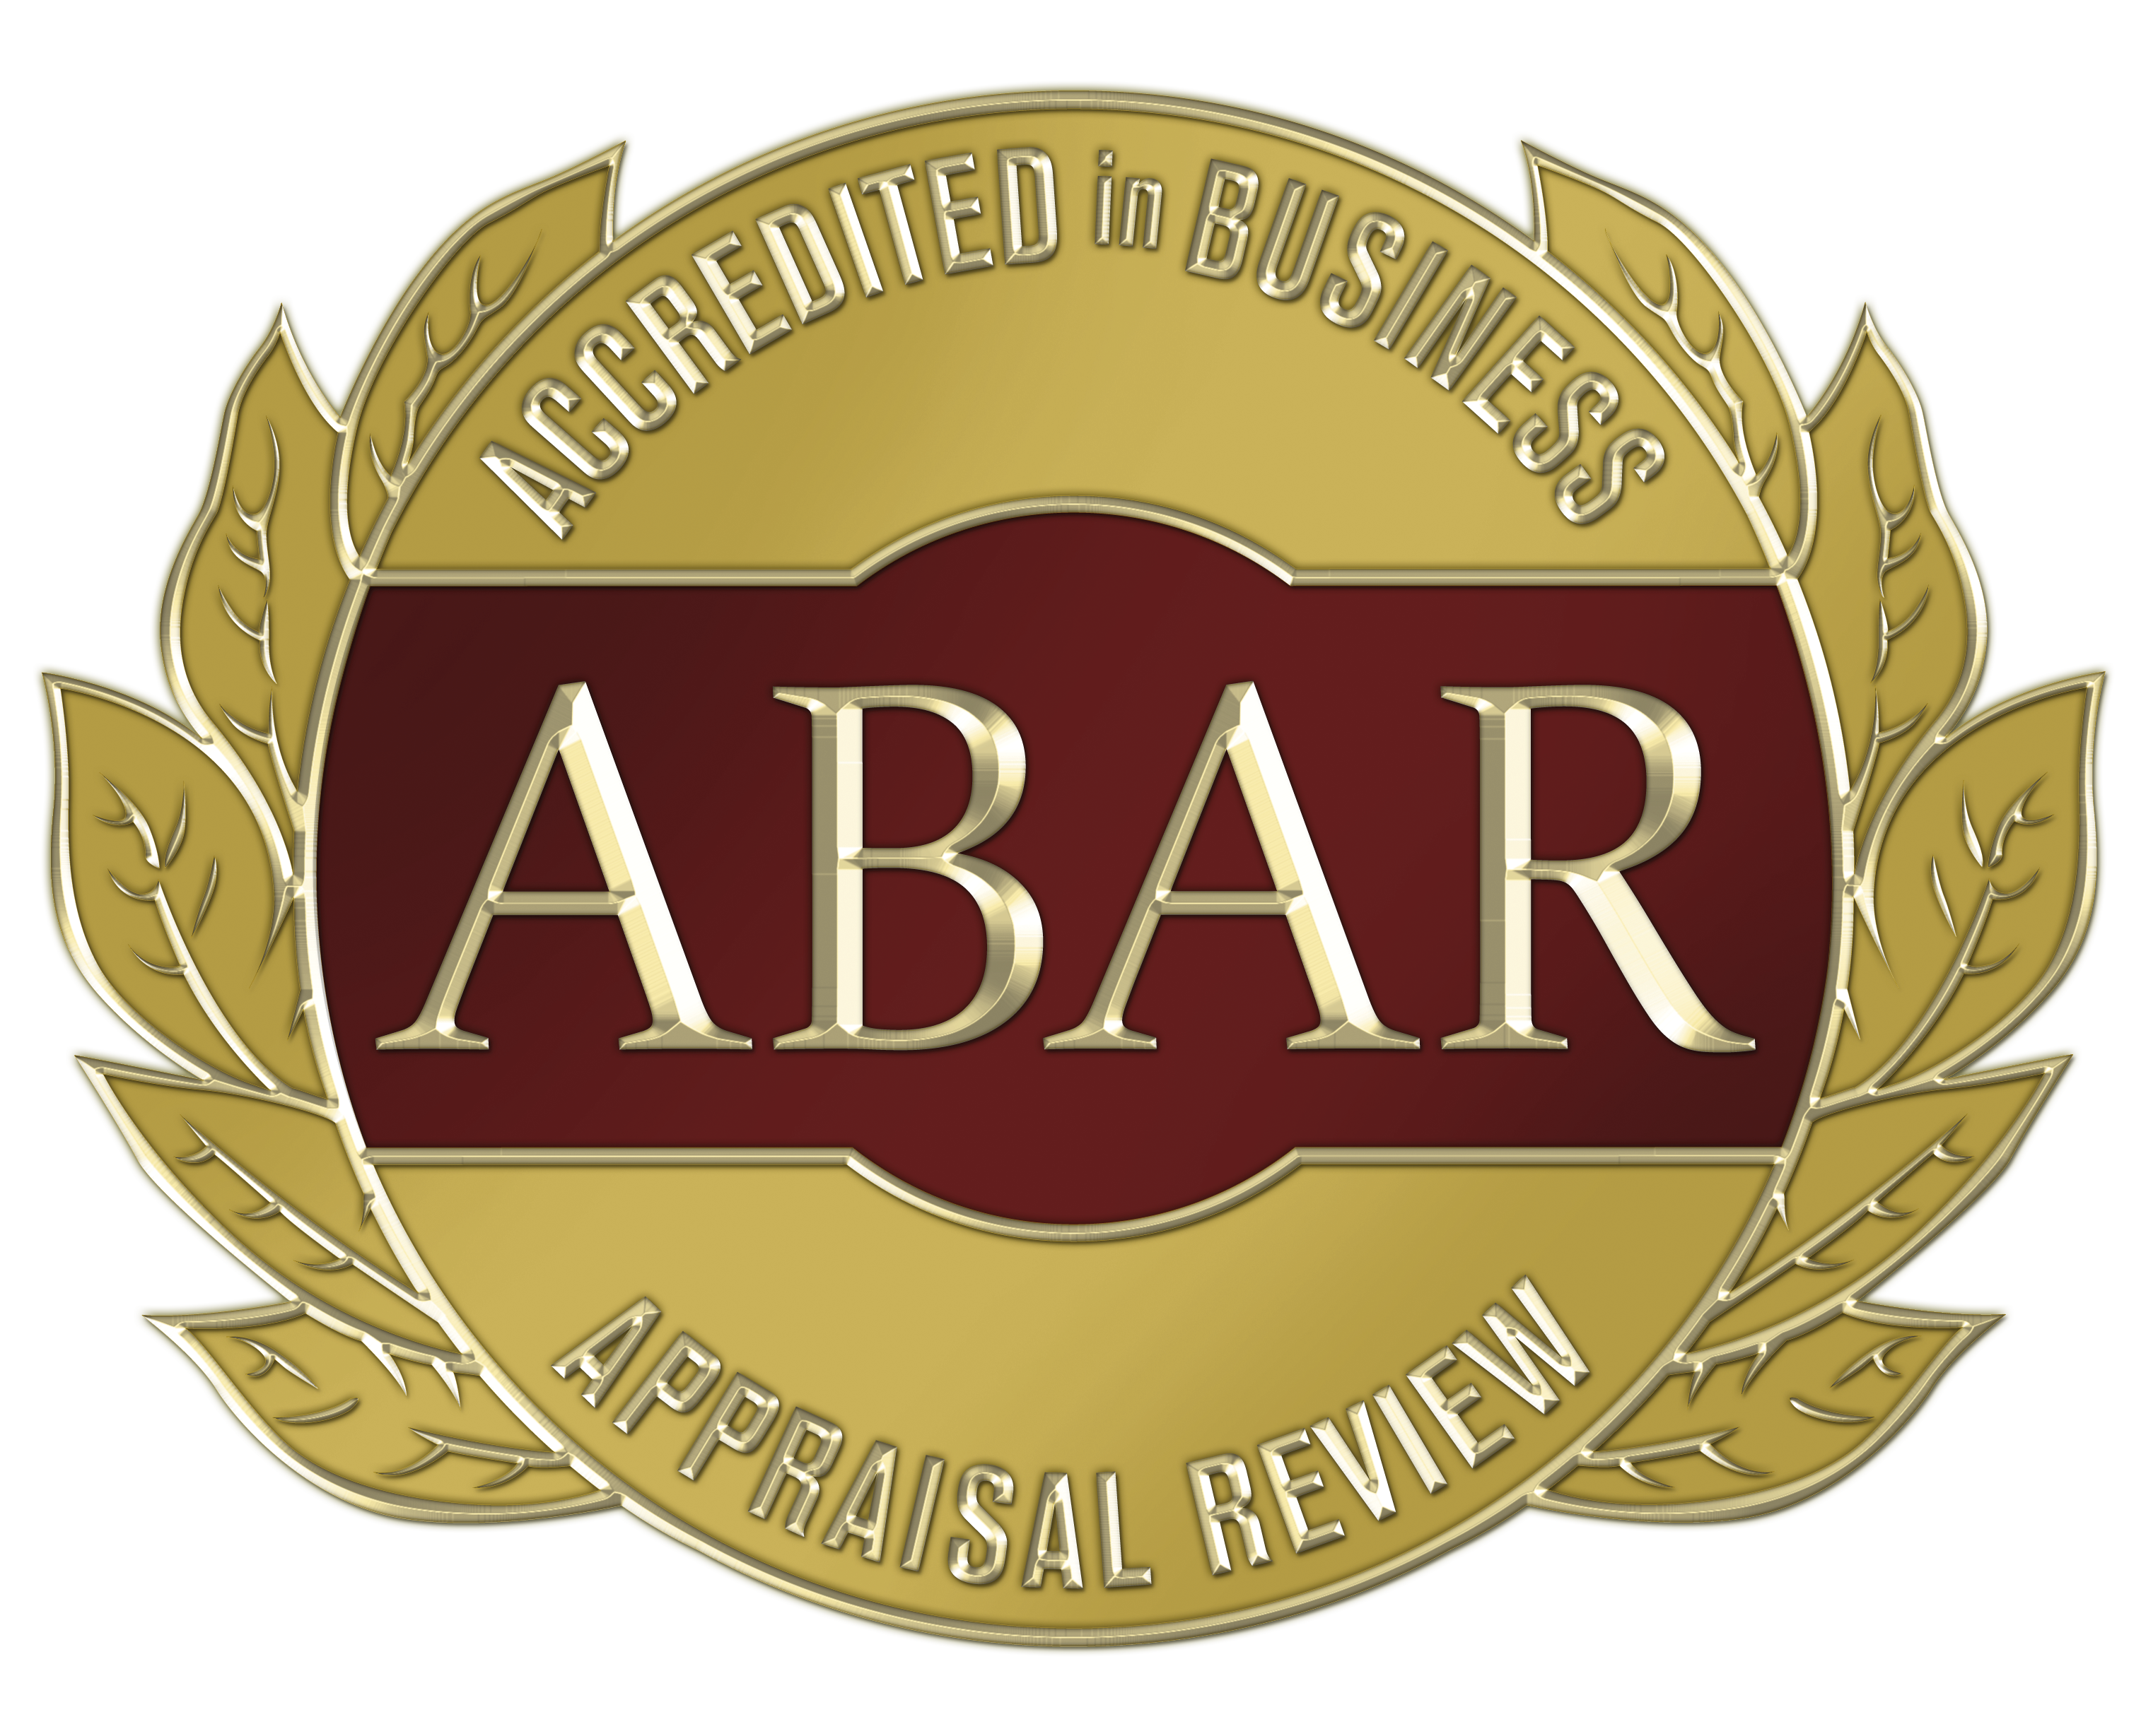
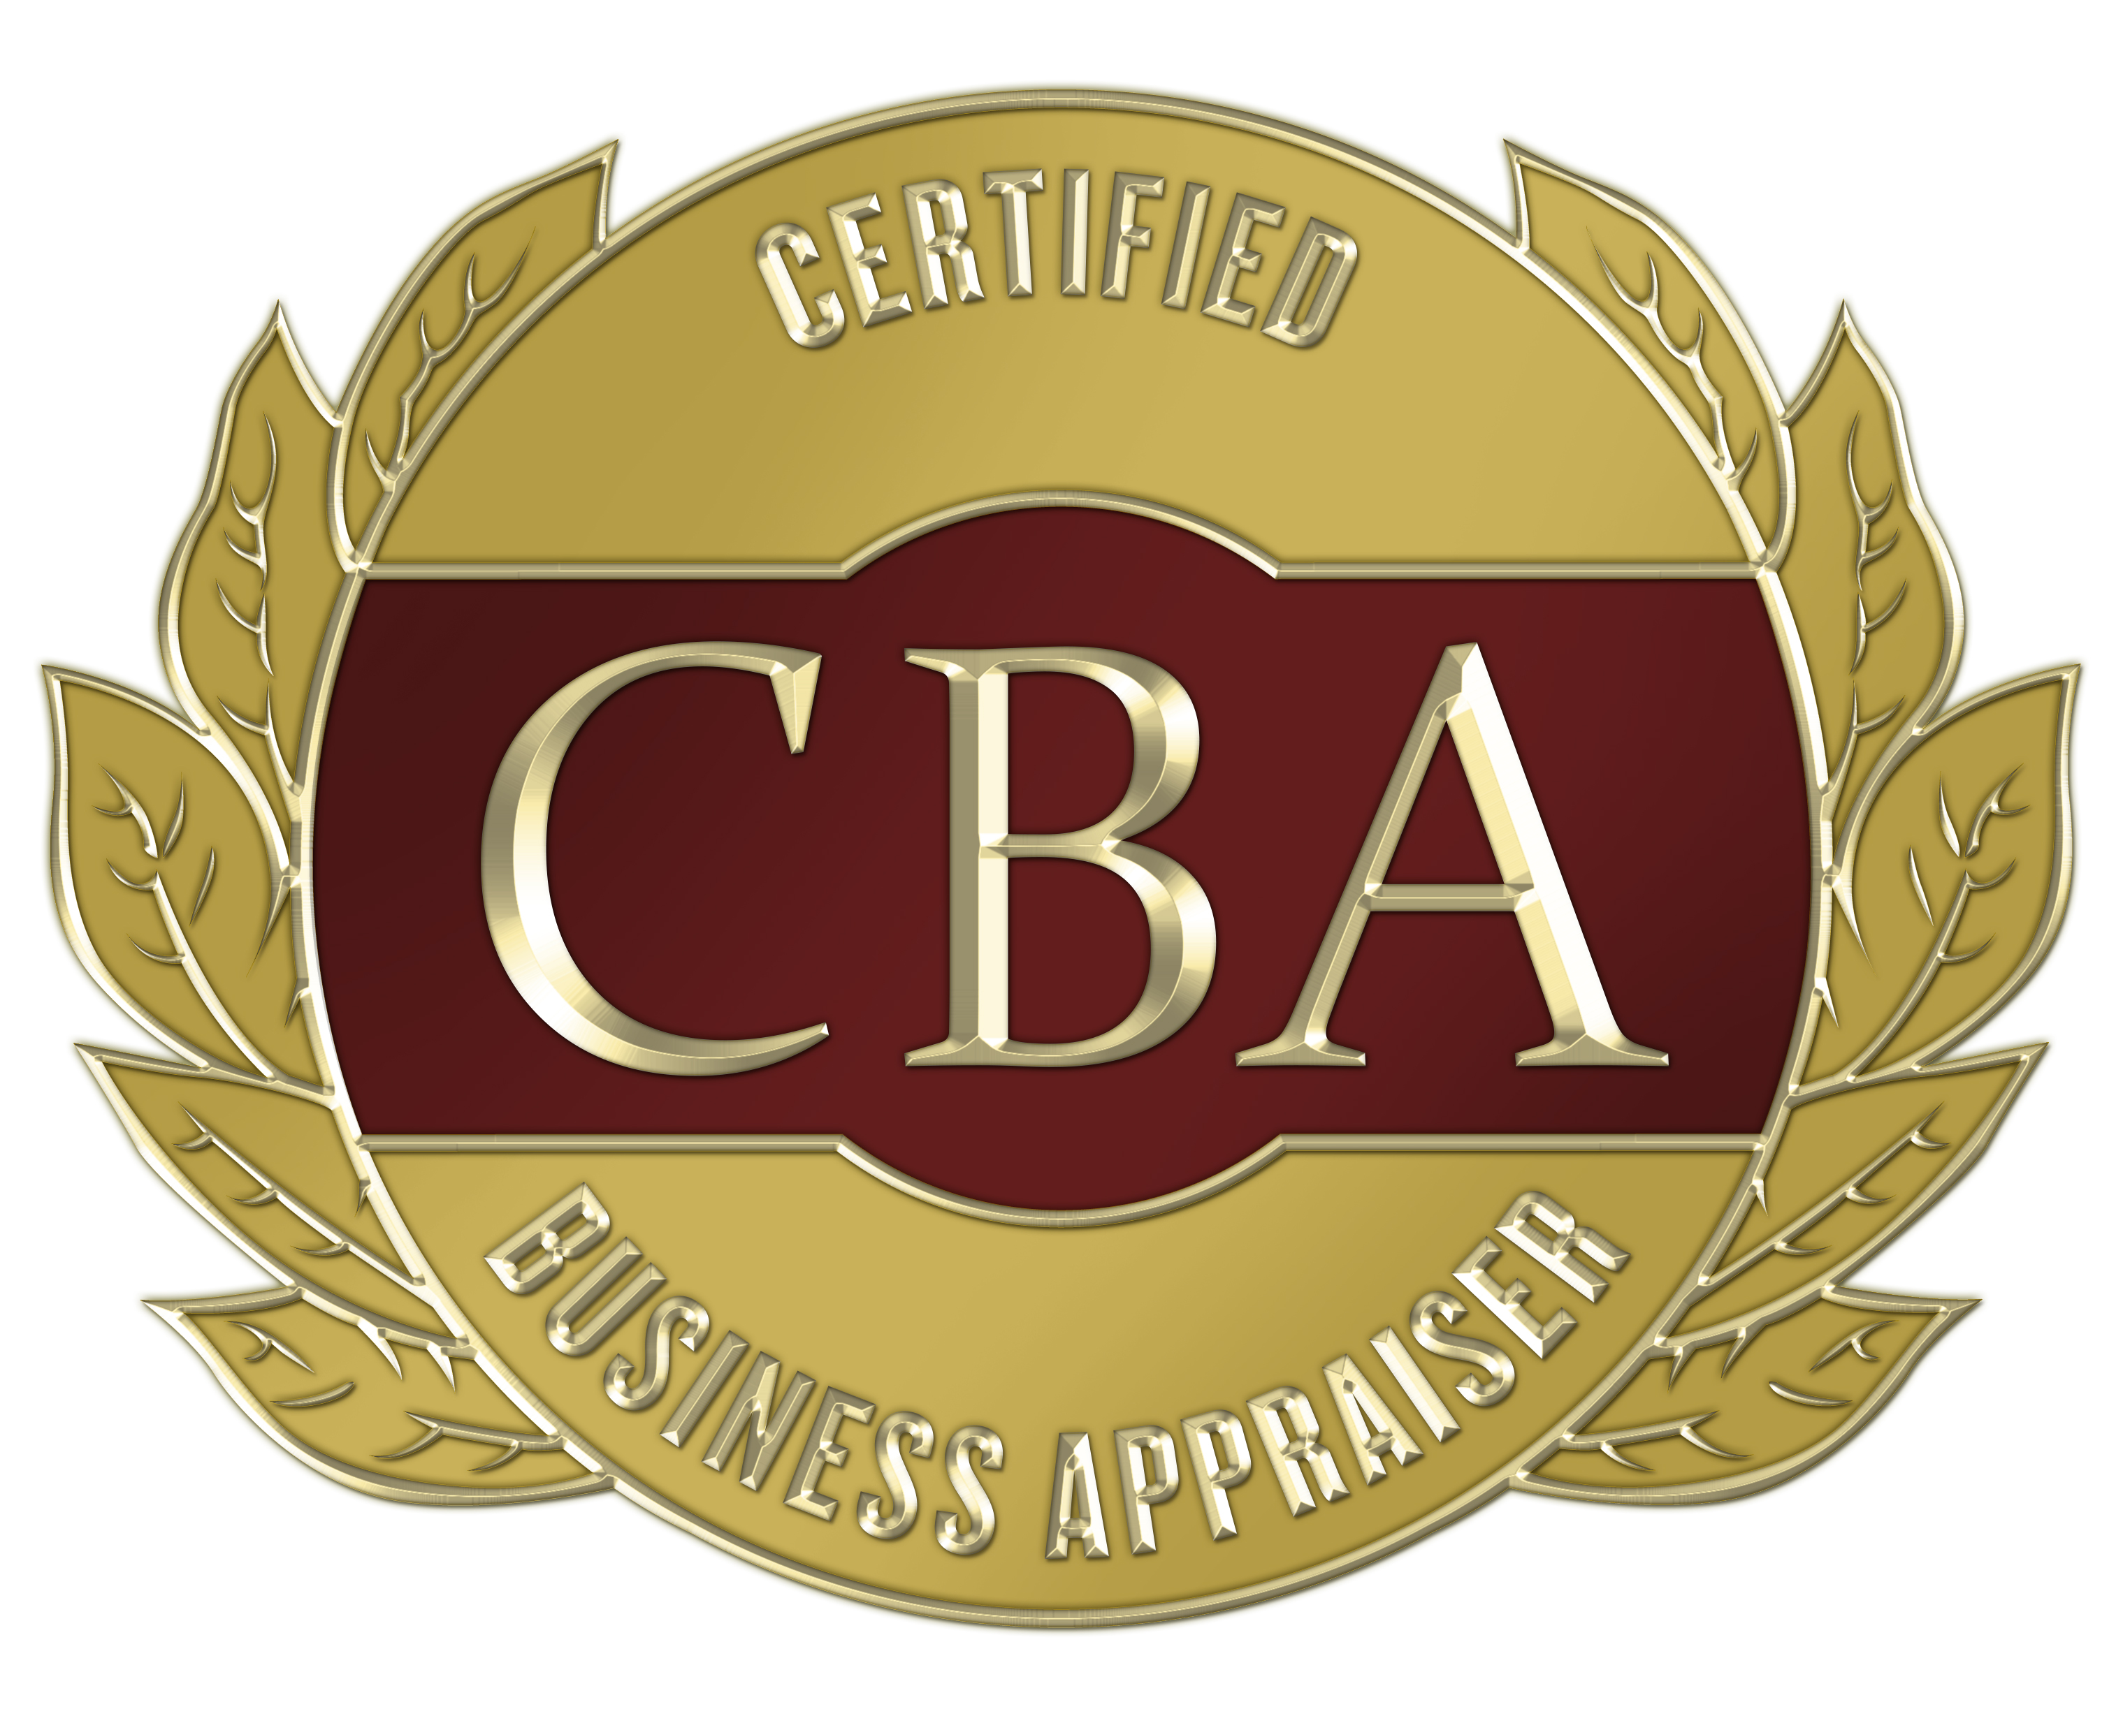
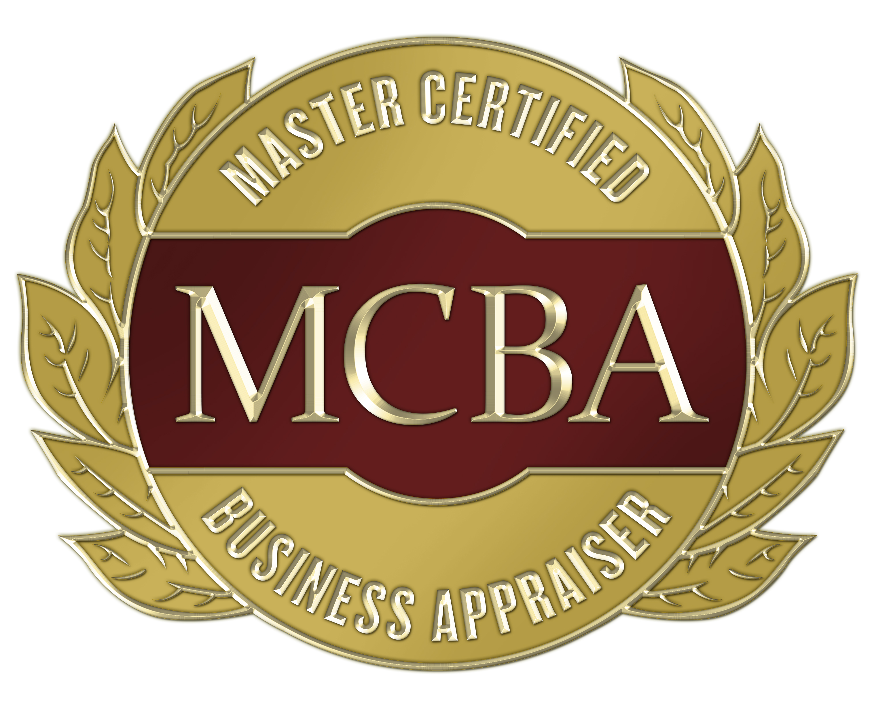



Professional Landscape
Business Valuation and Financial Litigation Support (BVFLS)
Professional Designations†
National Association of Certified Valuators and Analysts (NACVA)
Global Association of Certified Valuators and Analysts (GACVA)
*Institute of Business Appraisers (IBA)
Certified Valuation Analyst (CVA)
  Accredited by the National Commission for Certifying Agencies (NCCA) a division of the
  Institute for Credentialing Excellence (ICE) and the American National Standards Institute (ANSI)
Master Analyst in Financial Forensics (MAFF)
Accredited in Business Appraisal Review (ABAR) | Formerly a credential of the IBA. Credentialing program currently suspended.
Certified Business Appraiser (CBA) | Formerly a credential of the IBA. Credentialing program discontinued in 2016.
Master Certified Business Appraiser (MCBA) | Formerly a credential of the IBA. Credentialing program discontinued in 2016.
* In 2008, NACVA acquired the assets of the Institute of Business Appraisers (IBA).
†Organizations who have professional standards (North American | International) that are generally more in common with one another than there are differences.

Slide 14
Professional Landscape
Business Valuation and Financial Litigation Support (BVFLS)
Professional Designations†
American Society of Appraisers (ASA)
Accredited Senior Appraiser (ASA)
Accredited Member (AM)
Certified in Entity and Intangible Valuations (CEIV)
Association of International Certified Professional Accountants (AICPA)
Accredited in Business Valuation (ABV)
Certified in Entity and Intangible Valuations (CEIV)
Certified in Financial Forensics (CFF)
Canadian Institute of Chartered Business Valuators (CBV Institute)
Chartered Business Valuator (CBV)
Royal Institution of Chartered Surveyors
Associate Member (AssocRICS)
Chartered Member (MRICS)
Fellow Member (FRICS)
Certified in Entity and Intangible Valuations (CEIV)
†Organizations who have professional standards (North American | International) that are generally more in common with one another than there are differences.

Slide 15
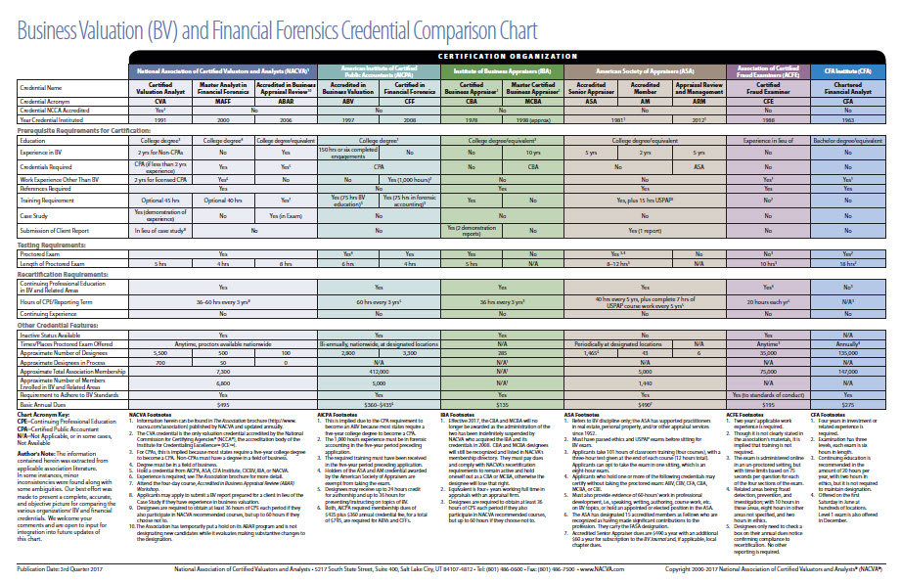
Professional Landscape
Business Valuation and Financial Litigation Support (BVFLS)
Professional Designations†
Click here to download chart.
Note: This chart is in update status. It may not reflect current comparison data. Please check with the respective organizations to confirm current credentialing policies.
†Organizations who have professional standards (North American | International) that are generally more in common with one another than there are differences.

Slide 16




Professional Landscape
Business Valuation and Financial Litigation Support (BVFLS) Professional Standards†
Professional Standards Comparison Chart
International Glossary of Business Valuation Terms
Professional Standards Comparison Chart
Opposing Experts Without Standards: What To Expect And How To Challenge Them | Request Free On-Demand Video
†Organizations who have professional standards (North American | International) that are generally more in common with one another than there are differences.

Slide 17
Practice & Research—Advancing Research through Practice Insights
James A. DiGabriele
Richard Riley

Slide 18
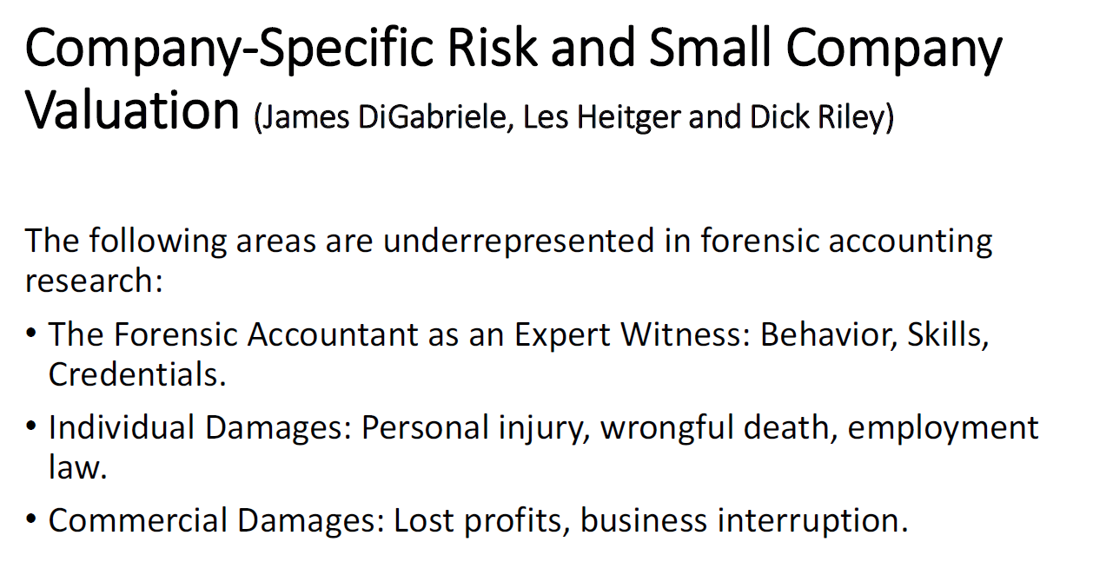
Practice & Research
Advancing Research through Practice Insights

Slide 19
Research & Practice—Advancing Practice through Research Insights
James A. DiGabriele
Richard Riley

Slide 20
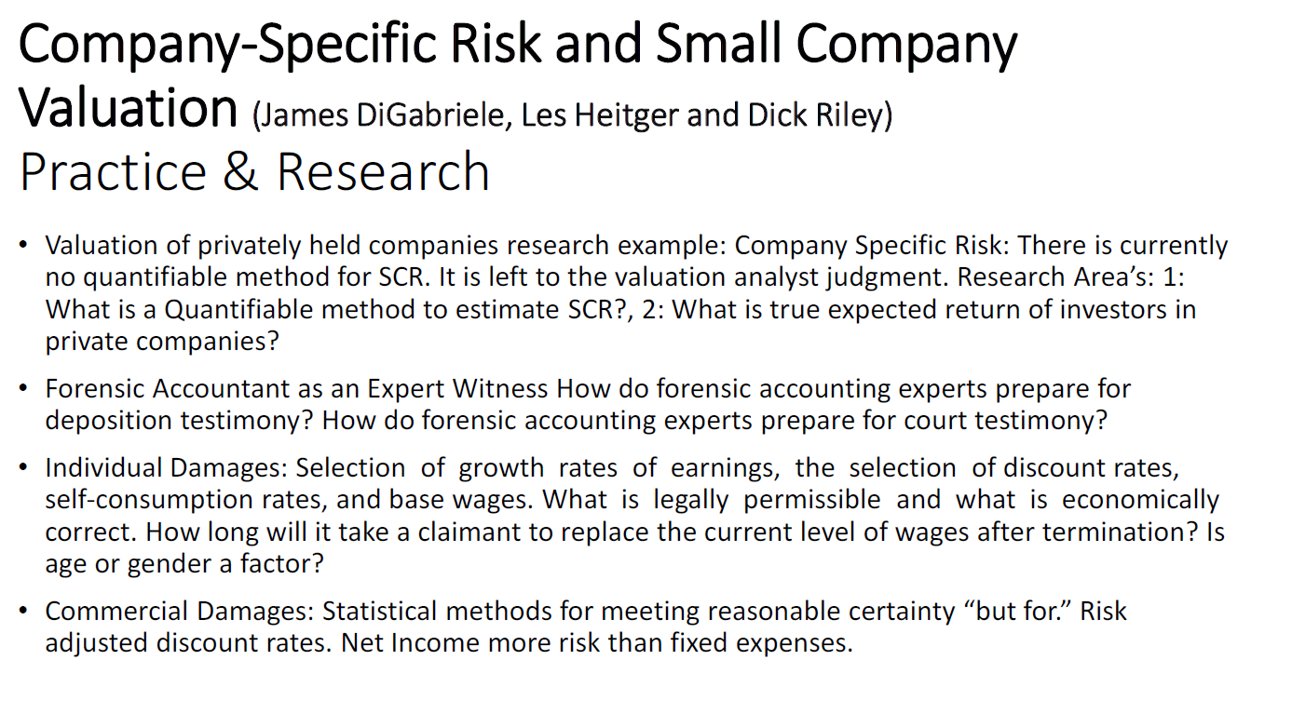
Research & Practice
Advancing Practice through Research Insights

Slide 21
Specialized Education
Michael Blake
Darrell D. Dorrell
Brien K. Jones

Slide 22

Specialized Education
Business Valuation and Business Consulting
Could you confidently advise your clients if they came to you faced with these issues?
An opportunity arises to sell or merge the business. | Video
They are faced with transitioning the business to family members or other partners. | Video
They are looking to expand the business and need to secure capital.
They are taking on new partners and need to determine buy-in price.
They are reaching retirement and considering an exit strategy. | Video
Business partners or shareholders are exiting, requiring the business to be divided or dissolved.
They are embroiled in financial litigation.
They want to focus energies to grow company value.
  Essentials of Business Valuation + Certificate of Educational Achievement (CEA)
  Current Update in Valuations
  Report Writing: Review and Analysis
  Business Valuation Report Peer Review
  Business Valuation in Litigation + Certificate of Educational Achievement (CEA)
  Drive Growth—The Business Advisor Boot Camp
  Transaction Advisory Services + Certificate of Educational Achievement (CEA)
  Four Pillars of Healthcare Valuation
  Certified Business Exit Consultant® (CBEC ®) Credentialing Program
  Industry Standards and Ethics
  Business Valuation Specialized Industries
  Financial Reporting
  Continuing Education On-Demand | More than 500 titles and growing
  Business Valuation Certification and Training Center | Credentialing Program for the Certified Valuation Analyst ® (CVA ®)
40% discount extended to Academicians for training programs.
Complimentary one-year Affiliate Membership by contacting Brien K. Jones with NACVA/GACVA on or before August 31, 2020.

Slide 23
Specialized Education
Financial Litigation, Forensic Accounting, and Expert Witness
Due to increased regulation and regulatory enforcement, an increasing number of financial crimes, and a record number of bankruptcies and corporate restructurings, the demand for financial litigation and forensic accounting services is set to soar.
Specialized financial litigation training provides an understanding of the professional responsibilities and legal underpinnings necessary to providing credible financial forensics services. Financial forensic experts need foundational and extensive specialized training in the methodologies and approaches for calculating damages, financial investigative and forensic accounting techniques, skills development for communicating with judges, attorneys, and juries, and practice building strategies being employed by successful and emerging financial forensic analysts.
  Essentials of Financial Litigation + Certificate of Educational Achievement (CEA)
  Bankruptcy, Insolvency, and Restructuring + Certificate of Educational Achievement (CEA)
  Business Valuation in Litigation + Certificate of Educational Achievement (CEA)
  Business and Intellectual Property Damages + Certificate of Educational Achievement (CEA)
  Business Interruptions and Lost Profits + Certificate of Educational Achievement (CEA)
  Commercial Damages and Lost Profits + Certificate of Educational Achievement (CEA)
  Fundamentals and Techniques for Conducting Fraud Investigations + Certificate of Educational Achievement (CEA)
  Matrimonial Litigation + Certificate of Educational Achievement (CEA) | Video
  Calculating Damages in Personal Injury + Certificate of Educational Achievement (CEA)
  Calculating Damages in Wrongful Death + Certificate of Educational Achievement (CEA)
  Industry Standards and Ethics
  Forensic Accounting Academy©
  Expert Witness Bootcamp
  Litigation Report Writing
  Continuing Education On-Demand | More than 500 titles and growing
  Foundations of Financial Forensics | Credentialing program for the Master Analyst in Financial Forensics®(MAFF)®
40% discount extended to Academicians for training programs.
Complimentary one-year Affiliate Membership by contacting Brien K. Jones with NACVA/GACVA on or before August 31, 2020.

Slide 24


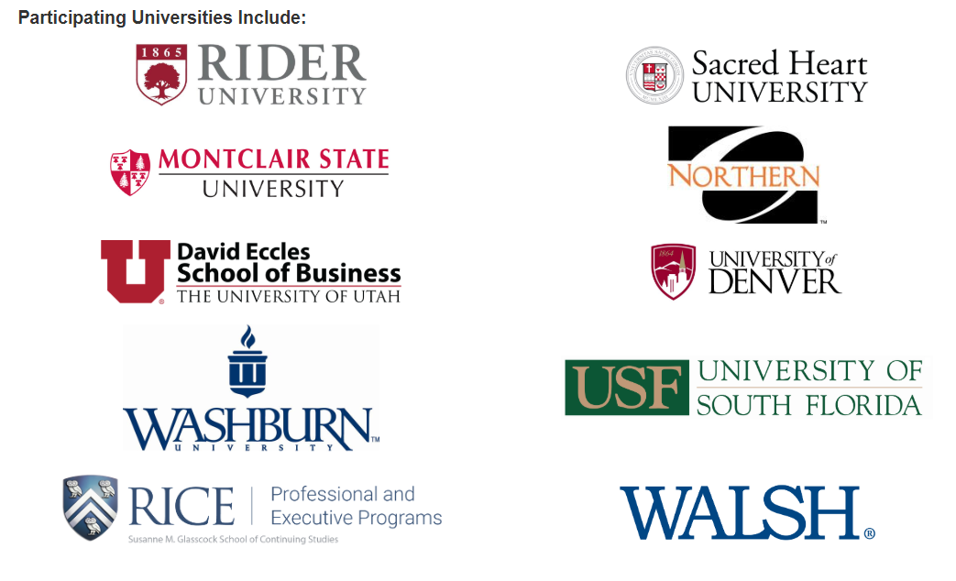

Professional Landscape
Business Valuation and Financial Litigation Credentialing Programs
National Association of Certified Valuators and Analysts (NACVA)
Global Association of Certified Valuators and Analysts (GACVA)
Certified Valuation Analyst (CVA)
  CVA Qualifications
Accredited by the National Commission for Certifying Agencies (NCCA) a division of the
Institute for Credentialing Excellence (ICE) and the American National Standards Institute (ANSI)
University CVA Credentialing Program &
Business Valuation Career Days
  Contact: Chanda Chuon, NACVA/GACVA Manager of Marketing Media and Strategic Partnerships
  P: 800) 677-2009
  E: ChandaC1@NACVA.com | Click to email.
Master Analyst in Financial Forensics (MAFF)
  MAFF Qualifications

Slide 25
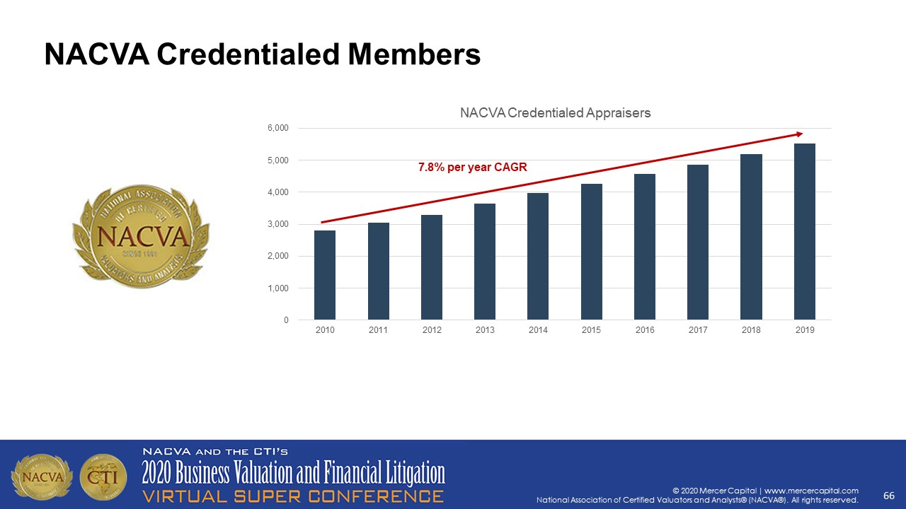
Professional Landscape
Business Valuation and Financial Litigation Credentialing Programs
Credential Designees
Source: Vision 2020—The Future of Our Profession and Your Role In It
Z. Christopher Mercer, Mercer Capital

Slide 26
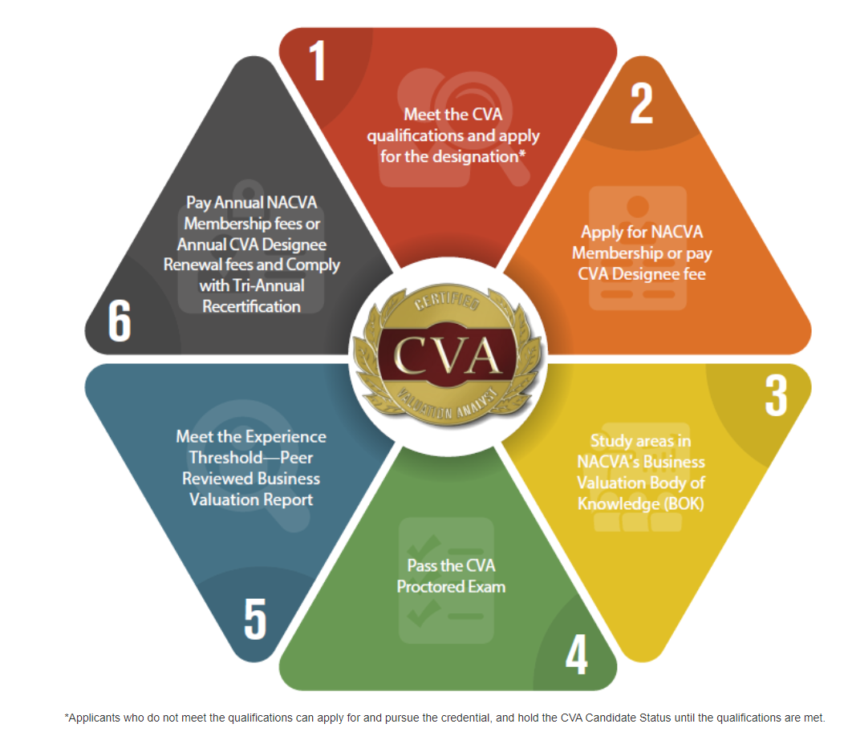
Professional Landscape
NACVA GACVA | Certified Valuation Analyst® (CVA ®)
Accredited by the National Commission for Certifying Agencies (NCCA) a division of the
Institute for Credentialing Excellence (ICE) and the American National Standards Institute (ANSI)
CVA Qualifications
CVA Designation Application
Core Body of Knowledge for Business Valuations
CVA Credentialing Resources
NACVA Valuation Credentialing Board
Faculty Insights | Lari Masten
Faculty Insights | Rob Stutz
Publications:
The Value Examiner®
QuickRead Blog
Broadcasts and Videos:
Around the Valuation World®
NACVA Video Network
Valuation Databases and
Valuation Analysis and Report Writing Software
EconAssist™ Subscription | Included with NACVA Membership
Social Media | NACVA on LinkedIn

Slide 27
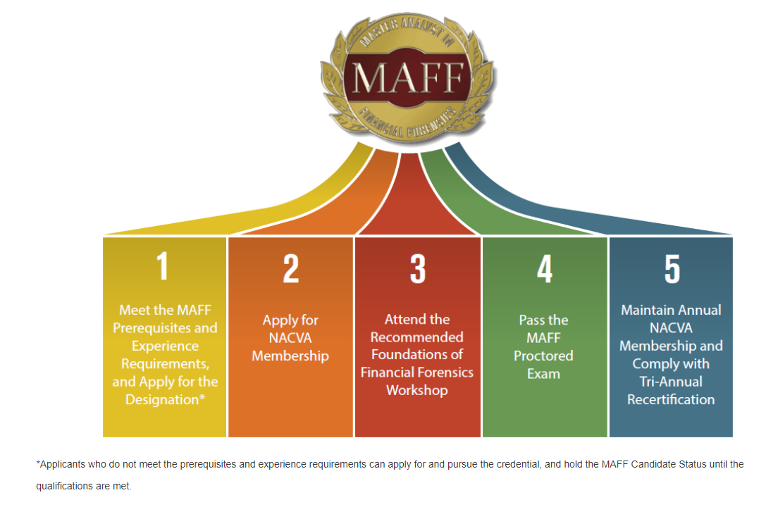
Professional Landscape
NACVA GACVA | Master Analyst in Financial Forensics® (MAFF ®)
MAFF Qualifications
MAFF Designation Application
Core Body of Knowledge for Master Analyst in Financial Forensics
NACVA Litigation Forensics Board
Publications:
Journal of Forensic and Investigative Accounting
The Value Examiner®
QuickRead Blog
Broadcasts and Videos:
Around the Valuation World®
NACVA Video Network
EconAssist™ Subscription | Included with NACVA Membership
Social Media | NACVA on LinkedIn

Slide 28
Closing comments and
Questions?

Slide 29
Thank you
Michael Blake
  P: (770) 286-3169
  E: msblake@bradyware.com
James A. DiGabriele
  P: (973) 243-2600
  E: digabrielej@mail.montclair.edu
Darrell D. Dorrell
  P: (503) 636-7999
  E: darrelld@financialforensics.com
Brien K. Jones
  P: (801) 486-0600
  E: BrienJones@NACVA.com
Sridhar Ramamoorti
  P: (937) 886-8318
  E: sramamoorti1@udayton.edu
Richard Riley
  P: (304) 293-7849
  E: Richard.Riley@mail.wvu.edu

