Slide 1

Thriving Practitioner Business Building Essentials
Session 6
Dr. Ritamarie Loscalzo

Slide 2

Recap

Slide 3

Authentic Business and Marketing Strategies
Who do you serve?
How do you serve them?
How do you enroll them?
How do you find them?
How do you manage your business?

Slide 4

Your Client’s
Journey to Health
Presentation with Karl Krummenacher – Mindshare https://drritamarie.com/CustomertJourneyTalk
Worksheets
https://ms365.io/PBS-Sheets

Slide 5
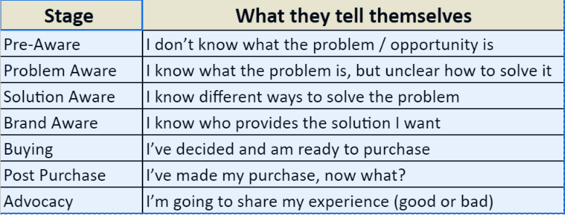
Customer Journey Workshop from Mindshare

Slide 6

Jenn Malecha’s Niche Process
PBSS Library
March 31, 2022 Session

Slide 7
What is it that you do?
I help (describe your client using characteristics /behaviors /themes) by (overcoming struggles) so they can (feel, have or do something they want)

Slide 8

Solving Their Most Burning Problems
“I am the solution to the problem that people most want solved.”
What keeps them up at night?
What is getting in the way of what they
want most?
How can you help?

Slide 9

Solution They Want to
Experience
Calm, relaxed mealtimes
Long and fruitful workouts
Calm and comfortable digestion
Peaceful periods
Harmonious menopause

Slide 10
Your Process
Burning Problem
Results They Crave

Slide 11

Define Your Signature System Process
Building blocks of your program
Steps you will take your client through
Each step is clear and reflects a benefit your client wants

Slide 12
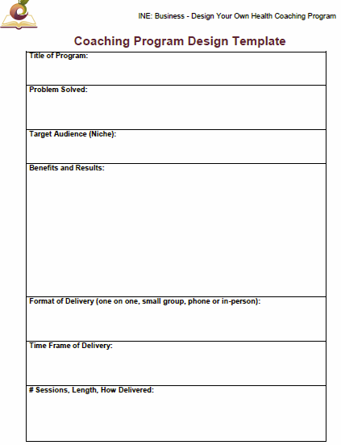
Coaching Program Template Components
Title of Program
Problem Solved
Target Audience (Niche)
Benefits and Results
Format of Delivery
(one-on-one, small group,
phone, or in-person)
Time Frame of Delivery
# Sessions, Length, How Delivered
Additional Elements (recordings,
recipe guides, menu plans, charts,
documents)
Process
Pricing
https://drritamarie.com/ProgramDesignTemplate

Slide 13
Lisa Sasevich’s
Signature System Process
PBSS
March 9, 2022 Session

Slide 14
Enrolling Clients
Offer Discovery Sessions
Conduct Enrollment Sessions
Onboarding

Slide 15
Webinar Components
Juicy Title
3 main data points
Lead in to your offer
Hook
Benefits
Downside of NOT taking action
Reason to buy NOW
Program components (short)
Risk reversal
Notes:
Literally, they’ll see your marketing and they’ll say, “THIS IS FOR ME! IT IS A SIGN
FROM THE DIVINE!”

Slide 16
Webinar Title Components
Number
(3 or 5)
Mistakes, myths, dangers, blunders, dangerous trends, secrets…
Audience
Consequence

Slide 17
Title Examples – Pleasure Based
“Top 3 Secrets Smart Health Seekers Know That Fill Their Lives With Vitality and Joy!”
“The top 3 Strategies that Healthy People Implement to Keep their Energy High and Their Hormones Balanced”
“3 Easy Lifestyle Hacks to Reduce Stress and Balance your Hormones”
“The Top 3 Foods to Eat Regularly to Increase Your Energy and Clear Your Foggy Brain”

Slide 18
Title Examples – Pain Based
“3 Massive Mistakes Women Make That Keep Them Overwhelmed and Exhausted”
“3 Dangerous Lifestyle Factors That Lead to Exhaustion, Overwhelm and Brain Fog” !”
“3 Myths That Diabetics Believe That Can Lead to Blindness, Amputation and Dialysis”
“3 Massive Mistakes That Successful Professionals Make That Keep them too Exhausted and Overwhelmed to Reach Their Full Potential for Productivity and Impact”

Slide 19
Webinar Intro
Self
  Brief origin story
  Why you’re doing this
  Establish your authority
Topic
Why Important
What you’ll cover
Reason to stay to end

Slide 20
Main data points
What?
Why important/ Ramifications of Not Doing?
How

Slide 21
What
Name it
Operational definition
Concrete examples, metaphors or stories to give your audience a better sense of WHAT this thing really is.
Counter example of the point.

Slide 22
Why Important
How knowledge of this data point will help them
What may happen if they don’t address this
Important of understanding this concept, and applying it as soon as possible.
Tell stories about what happened to other people when they didn’t understand and apply this concept.

Slide 23
How
Quick tips, tricks, and strategies for applying
Give Something that will benefit them even if they don’t buy anything from you
  Helpful online and offline resources
  A process they can use to decrease stress levels.
  A simple, practical action step or homework exercise that will help them implement
Suggest that they journal or reflect upon how they might use the information

Slide 24


Slide 25

Irresistible Offer
Results they desire
How your package will help them achieve
Cost of Inaction: Where they will stay without help
Excellent value
Bonuses
Instant signup incentives

Slide 26

Bonuses

Slide 27

Handle And Transform Objections
I can’t afford it.
I want to think about it.
I have to talk it over with my partner.
I’ll just do it on my own.
I’m too busy now; it’s not the right time.
I’m afraid I won’t follow-through

Slide 28

Cost of Inaction

Slide 29

Urgency

Slide 30

Offer
Discovery Call or
Small Program
  Modules
  Documents
  Checklists
  Assessments

Slide 31
Resources for Enrollment Conversations
Watch this
https://inemember.com/2021/05/how-i-made-40k-in-8-hours/ -- Includes links to my application and process
Jenn Malecha’s Consultation scripts and sample recordings
https://whb.today/consulttips
Jenn's Discovery Consult application https://wholistichealthboss.com/discovery-call/

Slide 32

Enrollment Conversation aka
Discovery Call Flow
Establish rapport
Explain how the call will go
*Ask questions to explore their desires and needs
Ask about what’s holding them back
Establish the gap between here and there
Show them how your services can close the gap
Give them a call to action (CTA)

Slide 33

After They Say YES
Enroll them – COLLECT payment – NOW
  At minimum a deposit
Celebrate - congratulate them
Immediate “stick” strategy - onboarding
Deliver your program and get results
Ask for a testimonial

Slide 34

Next Steps
Practice your Niche Pitch
Identify at least 5 people you know who you can help
Get out there – fb, Instagram, youtube, text
Finalize at least one package offer
Be prepared to offer a “downsell”
Finalize your presentation to offer a discovery call or blood chem analysis
Schedule discovery calls and make offers
Learn from NO

Slide 35
Your Dream Practice

Slide 36

Accelerate Your Next Steps

Slide 37

Practice Accelerator
One on one mentoring with DrRitamarie
Done for you funnel
Promotion to over 150,000 people
Dedicated small group of peers to support you

Slide 38
Upon Completion of Practice Accelerator You’ll Have Created
Lead capture funnel
E-book
Enrollment masterclass
Coaching program

Slide 39

You’re Protected
We guarantee you’ll get a return on your investment by end of program, or we’ll continue to work together until you do
You need to be coachable and do the work

Slide 40
Here’s What You Get
Be featured in our newsletter
Be interviewed on Facebook Live or a webinar
Be invited to publish articles on our blog.
Be launched to the 150,000-plus health-hungry audience it’s taken years to cultivate.
Step-by-step guidance to identify and remove the obstacles that have been holding you back
Direct access for questions, support, and direction.
Get yourself known and compensated well for your skills.

Slide 41

We’ll Kickoff With…
A 2-Hour Private Practice Analysis Call to create a personalized plan that will accelerate your practice growth
A Private “VIP Practice Revitalization Day” in person or virtual, to put strategies in place.

Slide 42

Ongoing Support and Mentorship
One-On-One Coaching Calls
Twice Monthly Small Group Mastermind Coaching Calls
“Done with You” Virtual Retreat Training and Mastermind Days

Slide 43

“Done for You” Lead Generation Funnel

Slide 44

“Done with You” Signature Talk
Get assistance with topic selection and structure.
Offer a strategy session or a program.
We can host it and promote to our list
Can be interview-style if desired.

Slide 45
Let’s discuss to see if it’s a fit
Only 3 spots open for 2024
https://drritamarie.com/applyNEPA

