Slide 1
The UN’s
8 Millennium Development Goals

Slide 2
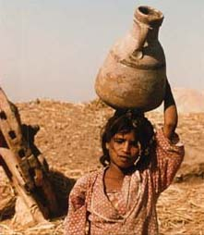
Planet Earth houses 6 billion children of God. One billion of us live in extreme material poverty.
Notes:
Planet earth houses 6 billion children of God. One in five of us live in extreme material poverty – with less than $1 a day on which to survive and fulfill their vocations.
We focus on these 1 billion people because for them, getting out of poverty is not a matter of more work. The extreme poor are some of the busiest, hardest working people in the world. The problem is that they do not have land – and without land, what can you do? They do not have an education, so they can’t get good work. They do not have savings, so when the rains don’t come, or when they get sick, it is a serious catastrophe.
Many people on earth are somewhat poor. But it is within their reach to make their lives better. Not so for the 1 billion poorest humans on earth. Without an external change, without credit and access to health care and education and clean water their lives will not improve. They are doing absolutely all they can do for themselves.

Slide 3
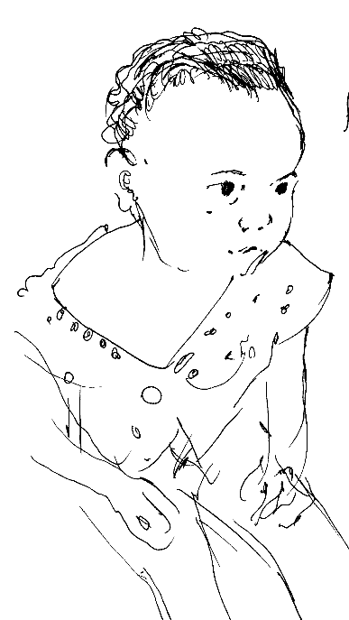
Where do the poor live?
Those living on less than $1 / day:
Notes:
As this slide shows, 2/3 of the world’s poor people live in Asia, and most of the rest live in Africa.
You might be surprised that Latin America has so few of the world’s poor people. That is because, relatively speaking, Latin America is less impoverished than other areas. And it doesn’t have as many people.
39% of the worlds poor live in South Asia – India and Pakistan and Bangladesh etc; 26% live in East Asia.

Slide 4
The World is trying to respond:
The United Nations
In September 2000, the United Nations, the World Bank Group, and 189 governments pledged to accomplish a set of eight goals and thereby reduce human suffering across the globe by 2015.
They said, "We will spare no effort to free our fellow men, women, and children from the abject and dehumanizing conditions of extreme poverty, to which more than a billion of them are now subjected.“
Notes:
What happened in September 2000 is that Kofi Annan gave a landmark speech, and the World Bank, the IMF, the United Nations, and the nations of the world together launched these Millennium Development Goals.
Of course many of these goals had been in existence for much longer – some for centuries. But this was the first time that the economic and political powers of the world agreed to work for a set of particular goals to reduce extreme poverty – and agreed to do work together.

Slide 5
The World is trying to respond:
The Episcopal Church
The Episcopal Church likewise passed a resolution in its General Convention which commits the Episcopal Church to endorsing the eight United Nations Millennium Development Goals (MDGs) and to working for their achievement.
There will be a similar resolution before our next diocesan convention.
Notes:
The Episcopal Church lives mainly through its people. And many of them have been active in the ground and in the hierarchies of the world, in advancing the MDGs. But the institutional church also tries to shape its own response to current issues in a way that reflects the values of Christ.
Passing a resolution enables church leaders – lay or ordained – to know that when they advocate the MDGs, they are advocating a priority that the Deputies and the bishops have also marked out as specially worthy of our attention. Passing a resolution itself does not change the world. But it may release and energize the grassroots people of the church, who can.
What is fascinating about the UN Documents was said very clearly by an Episcopalian editor. She said, “You know, when I read Kofi Annan’s speech, once I substituted the word “Church” for “United Nations” and I substitute the word “Epsicopalians” for the word “Nations”. And it was amazing! With these and a couple other substitutions, I read a very challenging speech for the Church, not just the UN.
It is true, as the Micah Challenge said: ‘the stated intentions of world leaders [to realize the MDGs] echo something of the mind of the Biblical prophets and the teachings of Jesus concerning the poor.

Slide 6
The World is trying to respond:
Other Churches
Other Churches are joining in. Why? The Micah Challenge, a group of Evangelical Churches, explains it this way:
“This is a unique moment in history,
when the stated intentions of world leaders [to realize the MDGs] echo something of the mind of the Biblical prophets
and the teachings of Jesus concerning the poor.”

Slide 7
The Millennium Development Goals (MDGs):
1. Eradicate extreme poverty and hunger
2. Achieve universal primary education
3. Promote gender equality and empower women
4. Reduce child mortality
5. Improve the health of mothers
6. Combat HIV/AIDS, malaria and other diseases
7. Ensure environmental sustainability
8. Develop a global partnership for development
Notes:
1.1 billion people live on less than $ 1 a day, and 815 million are hungry.
115 million school-aged children are out of primary school.
60% of those who do not go to primary school are girls
11 billion children die unnecessarily every year of preventable diseases
500,000 mothers die in childbirth – as many mothers die in childbirth as people than are murdered or killed in crime in all the world.
HIV/AIDS is a dread killer – the first one in recorded history that has decreased the life expectancy of many nations. Malaria and TB likewise are significant and difficult diseases.
One in three persons does not have clean water to drink.
We need to increase overseas development assistance from its current $58 billion.

Slide 8
The MDG’s
A closer Look

Slide 9
The MDGs – A closer look
1 Eradicate extreme hunger and poverty.
Specifically, the aim is, by 2015, to cut in half the proportion of people (starting at the 1990 proportion) whose income amounts to less than a dollar a day, and who suffer from hunger. About 1.1 billion people had less than $1 to spend today, and 840 million people were hungry.
Notes:
(just read out the description) OR tell this story:
Sex for Food (Story from Washington Office on Africa)
by Joseph Kalungu Sampa*
Pemba, a town in the southern Monze region of Zambia, has fewer than 5,000 inhabitants. …As I was having a drink at a grocery near the main road, I saw two boys and a girl between 6 and 13 years old picking up kernels of maize. The children told me that their mother sent them…
I asked them to show me where their mother was. We found her at home lying on a reed mat. … When I asked her what she did for a living, she looked at me for some time then looked down and sighed.
"My husband was discharged in 1994," she began. "He was our sole bread winner. I was a full time housewife and mother. I thought I would never have to earn an income. Food was never a problem and everything was well with us. We managed well with my husband’s income.
"Things changed after my husband left the army. He did not receive his benefits for two years, which meant the family had no income. My husband couldn’t cope and died of depression in 1997. Though his benefits came before he died, most of the money went to repay the debts we had accumulated. We experienced serious food shortages. We often went without a good meal for several days. My children always wore hungry and sad faces. I tried to sell vegetables but everyone else sold vegetables, too. Whatever I sold didn’t bring in much…
She paused, looked down with a clenched fist, hit her chest, and said, "Against my own will, against my faith, I became a walker. I slept with men for money. At first it tormented me and I found it extremely hard to understand. Today I do it with less difficulty."
"Do not ask me about sexually transmitted diseases," she said. "I may or may not be a carrier. But as long as I can afford a meal for my family, I am happy. I know that one day I will die of AIDS," she said, on the verge of tears. "But I can tell you that I find hunger more deadly than AIDS. AIDS kills in years. But hunger kills within days."
I had few words to say except to thank her for her time. She never mentioned school, health, entertainment, or clothing…only food. I realized that when you have no food, you have no choice.

Slide 10
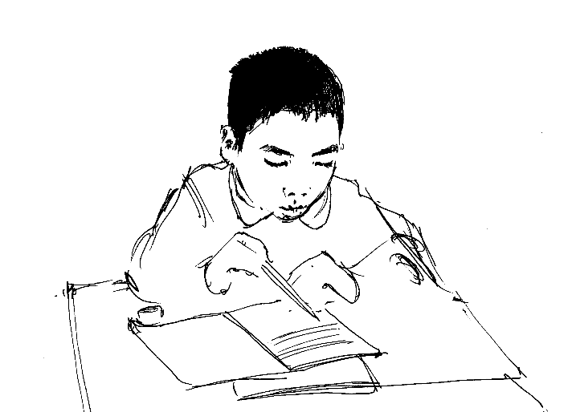
The MDGs – A closer look
2 Achieve universal primary education.
The aim: that all girls and boys complete primary school. Today 115 million school-aged children are not in school. The biggest number of these children live in South Asia – India, Pakistan, and Bangladesh. In Africa, only half of the school-aged children finish primary school. So far we are not making progress fast enough to achieve this goal of primary education by 2015.
Notes:
Girls’ Education in Guinea (Story from Washington Office on Africa)
by Joyce Sampson*
When a Guinean canning company promoted girls’ education on soup labels, it confirmed May Rihani’s theory that empowered people produce powerful results. Rihani is the director of Strategies for Advancing Girls Education (SAGE), a USAID-funded project whose mission is putting girls’ education at the forefront of the national consciousness.
Though educating young girls is vital to a country’s development, SAGE had to convince the Guinean people themselves that girls’ education is an engine for economic growth. Educated girls have the skills to earn a decent living. They marry later and bear fewer children. Their children are healthier, better nourished, and more likely to succeed in school.
SAGE’s strategy is to establish a national alliance of government and industry leaders; religious leaders; ministers of finance, planning, and health; religious leaders of all sects; women’s groups; and other non-governmental organizations. SAGE formed 18 local alliances to make girls’ education a national priority. The goal: to develop remedies and action plans that overcome the obstacle to girls’ education.
When Rihani first spoke to people in Guinea, they asked, "Who is going to do this for us?"
"You will do it for yourselves," she replied.
Two years later the Guineans are producing results. They have pooled resources, bartered for goods and services, pinpointed problems, and devised their own novel solutions, such as providing housing as an incentive to attract new teachers. In Lelouma, residents created an educational fund, added classrooms, and raised more that $5,000 to build their own secondary school. In Dougountouny, the local alliance constructed a new secondary school using its own resources and labor.
In Kaback, the local alliance built five new classrooms. By agreeing to purchase notebooks and other school supplies exclusively from one vendor, Kaback parents negotiated a discount that reduced school costs. Since the alliance started, the community has built three schools and is paying the salaries of eight teachers.
In Guendembou, the citizens mandated that girls make up one half of all new students enrolled in school. Residents partnered with a local radio station and organized an awareness campaign in local languages that included a music contest among schools.
"Education empowers individuals and communities to identify their needs and to find the resources to meet those needs," Rihani said. In addition to the local focus, "it was important to engage the religious and media sectors, government, nonprofits, and businesses simultaneously at the national and community levels."
There has been significant progress. Girls’ enrollment has risen. In 1990, 17 percent of girls attended school. Today 40 percent do. But sustaining change requires a deep sense of ownership and commitment from public and private sectors. With 60 percent of Guinean girls still not in the classroom, there is much more to be done.
The SAGE program, which operates in Guinea and
Mali, is implemented by the Academy for Educational Development (AED) and Plan International. The project provides technical and training assistance in girls’ primary education to USAID missions.

Slide 11
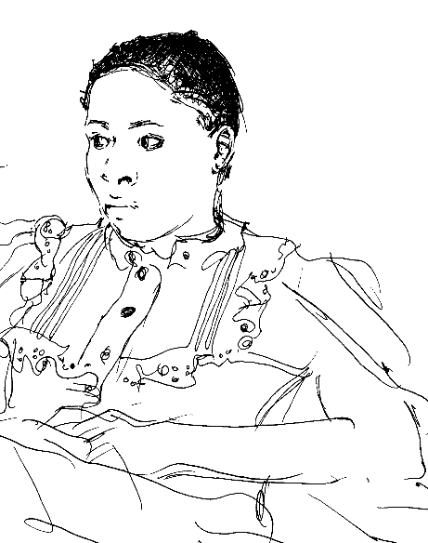
The MDGs – A Closer Look
3 Promote gender equality and empower women.
How? Many ways – like making sure that as many girls and young women have the chance to go to grade school, high school, and college education as boys.
Notes:
In Ghaziabad, a peri-urban slum area near Lahore, living conditions are crowded. Families share houses, renting one room each with a common courtyard; some do not have electricity for fans in the summer; children play around open sewers; many husbands are heroin addicts. Yet in this neighbourhood, a quiet transformation is taking place: women are learning to read.
They come, in classes of ten to sixteen, to a room of someone’s house, six days a week for two hours. That is a lot of time for a poor woman in a busy household. But as one student told a neighbour, trying to convince her to come to the school, “your work will never be over – mine isn’t; so just leave it for two hours.” Many women bring their primary school aged children, who are taught in a separate room using the same method. Classes are taught by women from their very neighbourhood – more often than not the teacher just recently attained literacy herself.
Many people say that literacy is just instrumental. And it is surely instrumental – literate women can read the numbers of buses or the labels on foods; they can open bank accounts and read electricity bills. But in Ghaziabad literacy is much more. ‘Graduates’ from the literacy class gather weekly to read together and so continue to deepen their knowledge about everything from the nutritional value of carrots and chick peas to the causes of breast cancer to the etiquette of discussions. Perhaps more significantly, though, the literacy programme has brought about deep changes in their sense of themselves as women.
For example, take the case of Shabnam, thirty-two years old, who was illiterate and is now a teacher at the school. She was married at sixteen, has two sons and two daughters, and lived with her husband and mother-in-law. She poetically described the effect the programme had had on her life as overturning the assumption that only men can make decisions: “Women think they are like a bud – that they do not understand with our own eyes. But we are not buds, we are mountains. We can do anything with our lives. So I tried to open my eyes, and my eyes were opened. From this kind of experience, one’s very humanity becomes energetic.”
Another significant example is a graduate called Nargis.[1] Nargis is a woman who was illiterate and wanted to be a doctor. She is now literate and teaches primary school children to read. But perhaps more significantly, like Shabnam her family situation is transformed. Previous to her class, neighbours reported that Nargis was unusually badly treated at home. She was very frightened of her husband and would often be absent from class if her husband was sleeping – she did not know if he might wake up and need a glass of water. Subsequently she has gained confidence – her classmate explained that all of them had learned one very important thing, which is that “We are equals with men. Someone should not beat us; if they do, with love, politeness, we should suggest that this is not a good road, this is to be retreated from.”
In one incident, the ability to read was dramatic. Four to five months after Nargis had begun the course, she was washing clothes at home. She took down her husband’s suit to wash it, and, noticing that there were papers in its pocket, removed them before soaking it. But when she took the papers from his pocket, she realized that these were divorce papers; they had been prepared in a registry office and her thumbprint had been forged. She was very nervous to have discovered these but took them swiftly to the elders of her family. These elders met with the elders of the husband’s family, and the situation was eventually resolved without the divorce. But when all was over, her husband asked her, “How did you know what these papers said?” “I can read now,” she replied quietly.
(Sabina Alkire, taken from Valuing Freedoms: Sen’s Capability Approach to Poverty Reduction) Oxford University Press 2002. [1] Name has been changed

Slide 12
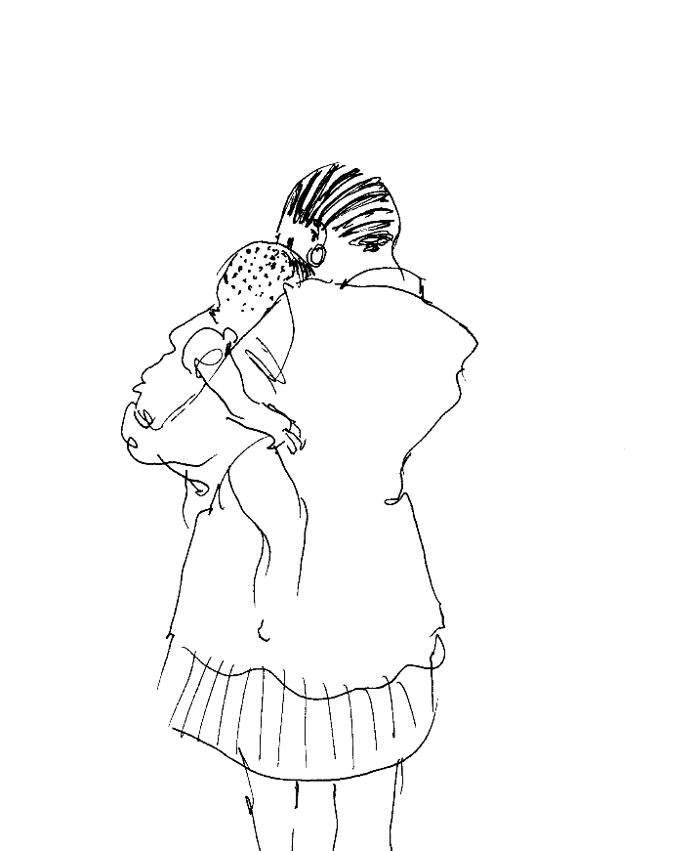
The MDGs – A Closer Look
4 Reduce child mortality.
The goal is to decrease by two-thirds the number of children who die before their 5th birthday. At present one small life slips away every three seconds – 11 million children a year.
Notes:
On the death of a child
Although this reflection has to do with the fourth goal of the eight Millennium Development Goals, I am writing it last. I’ve had a hard time deciding what to say. Some of you will have experienced first hand the death of a child, or through your ministry have found yourself sharing in such a tragedy. I have not. I won’t say, “I can imagine…,” because I can’t. I do know that it has been hard to look at photos of our children while preparing this reflection. It’s a universal reality, of course, and I will not try to argue here that a child’s dying is somehow different in the Global South than it is here, at least in terms of the pain involved. If I were to lift up the African reality, I would simply stress that when death is clearly preventable, then something needs to be done, and there is something that can be done about the ten million children worldwide who die each year from preventable illnesses. We need to do it.
The fourth Millennium Development Goal: Reduce by two-thirds the mortality rate among children under five. The target: 2015.
It’s not that progress is not being made. It is, but the change is painfully slow. The Human Development Report 2003 (just out from the UN Development Programme) reports that at the current rate of progress sub-Saharan Africa would not reach this goal of reducing the child-mortality rate until 2165, one hundred and fifty years after the target date. That’s shameful. And it’s not that the answers aren’t available. They are, and often are disarmingly simple: Mosquito netting, affordable antibiotics, vaccinations. And most vaccines cost only pennies per dose.
When the Gates Foundation provided $50 million for malaria research recently, the grant increased the world’s budget to confront a disease that continues to devastate Africa, and Africa’s children, by 50%. This is shameful. In the US and other wealthy countries, less than one percent of our children die before they reach six years old. In some of the world’s poorest countries, the figure is over 20%. This too is shameful. Our military expenditures in Iraq, now that the war is “over,” are around $4 billion a month. By 2011 the world will need about $1 billion per year to provide 80% of the children in the 75 poorest countries in the world with vaccines. We’re not anywhere close to meeting what is needed now. That says something about our priorities that is shameful as well. I did not know what to do with all of this, in this reflection, until I turned to Edward Hays’ wonderful Prayers for the Domestic Church. In his “prayer for a parent whose child has died,” he writes.
Do not take my tears and sorrow
As a sign of my unbelief that all who have died
Are resurrected to eternal life in You,
But, rather, see in these tears
A sign of my great love for my child.
We can act so that, for so many parents around our world, those words need not be said.
Yours faithfully,
Leon Spencer (Washington Office on Africa)

Slide 13
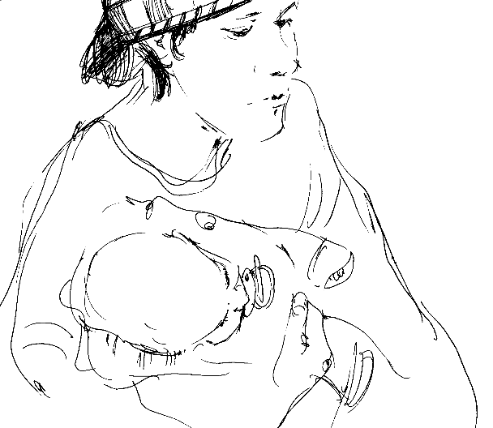
The MDGs – A Closer Look
5 Improve maternal health.
The target is to reduce maternal mortality by three-quarters. We think mothers are safe. But 500,000 mothers die in childbirth a year. Many women are afraid as their little one grows inside, afraid as they do the cooking and hum a lullaby, afraid they will die as they bring forth life.
Notes:
When in doubt, go to your mother’s
Several years ago my wife and I joined my African colleagues in Zanzibar for the annual meeting of ANITEPAM‘s Governing Council. (ANITEPAM is a network of African Anglican theological education programs, for whom I had worked during my years in Kenya.)
We got ourselves tear-gassed. It seems that, unbeknownst to us, a major treason trial was to begin the day we concluded our meetings, and our contingent of eight was celebrating a good session by visiting an open market near the courthouse.
By the time it had become clear something was up, we had become separated, and Karen and I and a colleague from Mauritius found ourselves inside a shop, behind metal doors, as police charged whomever they could find outside. When things died down, we began – with the young Zanzibari friend who had accompanied us – to work our way back to the old CMS guest house in the Stone City.
But around every turn we found more police, and tear gas wafting toward us, and it was clear that the young man was getting frustrated. At last he reached his conclusion about what to do with his charges, and he began to take us through back yards and housing compounds until finally… We came to his mother’s place.
When in doubt, go back to your mom. Mothers are good to have around.
To reduce maternal mortality by three-quarters by 2015: That is the fifth Millennium Development Goal.
I do not mean to equate our little adventure with the tragedy of the death of a mother, but it was an endearing reminder to me of the place of mothers in our lives. It seems to be a universal response:
Why else would a set of only eight Millennium Development Goals contain one specifically to do with the life of the mother?
When I visit my own mother, these days, she’s very confused. “Who are you?” she asks when I get her attention. She’s well into her nineties. I’ve had her, and her love, all my life. It is a faith-affirming goal to help children throughout the world to have mothers even for part of theirs. Yours faithfully, Leon Spencer (Washington Office on Africa)

Slide 14
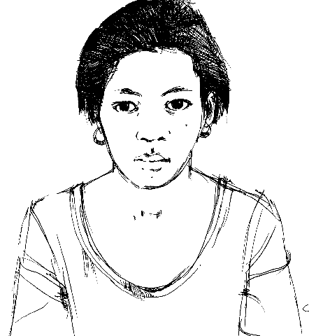
The MDGs – A Closer Look
6 Combat HIV/AIDS, malaria, and other diseases.
Reverse the spread of these dread diseases by 2015.
Notes:
Microcredit Helps Uganda’s AIDS Orphans
by Anthony Matthews* (from Washington Office on Africa)
One in every four families in Uganda cares for a child orphaned by AIDS. With per capita income in Uganda at roughly $300 a year, new mouths to feed and minds to education put tremendous strain on household resources.
With the technical expertise of the International Fund for Agricultural Development (IFAD) and financial support from the Belgian Survival Fund, the Ugandan Women’s Effort to Save Orphans (UWESO) has pioneered the use of microcredit to help Uganda take care of its children.
UWESO was founded in 1986 by First Lady Janet Kataha Museveni to provide food, clothing, blankets, and other necessities to children orphaned by Uganda’s civil conflict. By 1990. UWESO realized that its original relief approach was no longer working. The AIDS epidemic was shattering Ugandan families and the support system they once offered. So UWESO began working with IFAD to transform itself into a development organization. … UWESO … has provided loans to 6,447 clients who care for more than 30,000 AIDS orphans. All clients who receive loans from UWESO live below the poverty line.
UWESO uses a "solidarity group lending" approach. It gathers clients, 90 percent of whom are women, into small groups, then gathers 10 of these groups into "clusters" that meet for about an hour a week. Clients learn principles of business and loan management. After 10 weeks clients can access their first loan. The interest rate is 3 percent…. Payments are made weekly over four months. UWESO has a 90 percent repayment rate.
Sixty-five year old Namayanja Paulina can testify to the success of UWESO’s microcredit program. Six of her sons have died from AIDS. This left Namayanja struggling to provide for the 16 young children they left behind. The safety net once provided by her extended family had vanished.
Then Namayanja learned about UWESO’s microcredit program from one of its local volunteers. She joined UWESO’s Savings and Credit Scheme last April, and took out two loans. The first was for $55 and the second for $100. With this money she expanded her business selling bananas. From her home, Namayanja also sells soap, cooking oil, matches, kerosene, and other basic goods to villagers who would otherwise have to walk many miles into town.
"Now I can give my children three meals a day, I can afford their school fees and people ask me for money," she says with pride.
Namayanja has never been late making her payments on her loans. Each week she earns up to $5.50. She plans to continue borrowing from UWESO to build a small shop for her growing business. That way, her grandchildren will be able to support themselves when she dies.

Slide 15

HIV AIDS and Africa:
December 2003
Approximately 42 million people are now living with HIV/AIDS (34-46m).
Of these, 95% live in developing countries.
70% of all people with HIV/AIDS live in Sub-Saharan Africa
In Africa women between 15 and 24 years old are twice as likely to be infected as men.
About 30% of people living with HIV/AIDS worldwide live in southern Africa, an area that is home to just 2% of the world’s population.

Slide 16
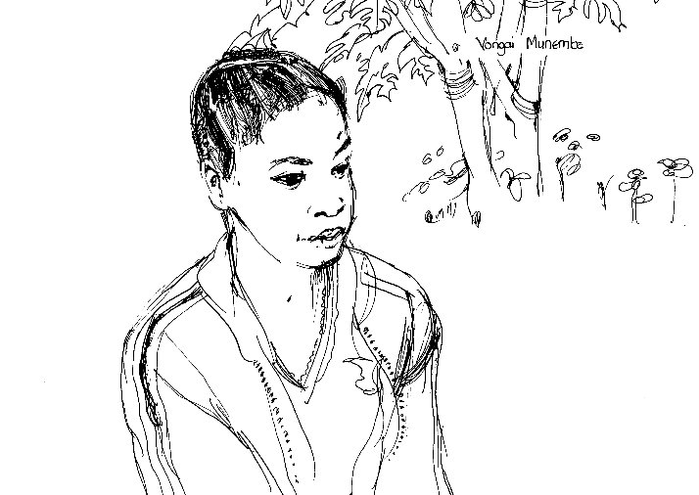
MDGs – A Closer Look
7 Ensure environmental sustainability. How?
Make drinking water safer – 1 in six of us drink water that may make us sick.
Also, improve the lives of 100 million of the 924 million slum dwellers in our cities.
And control gas emissions.

Slide 17
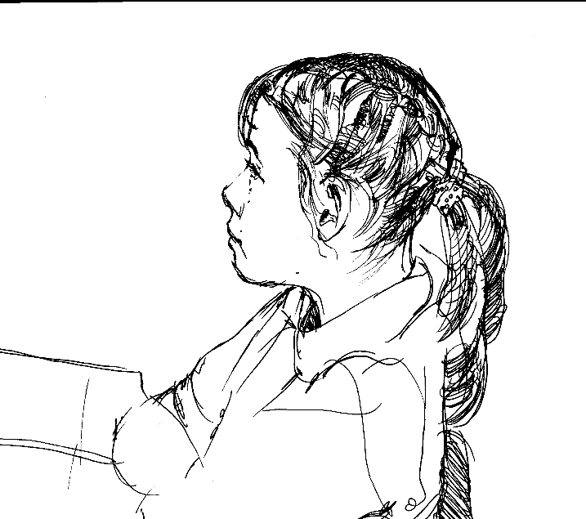
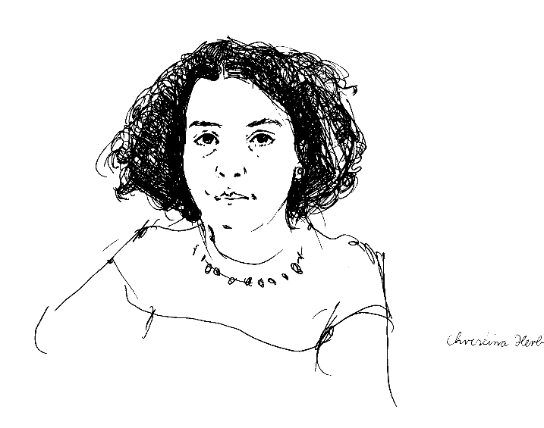
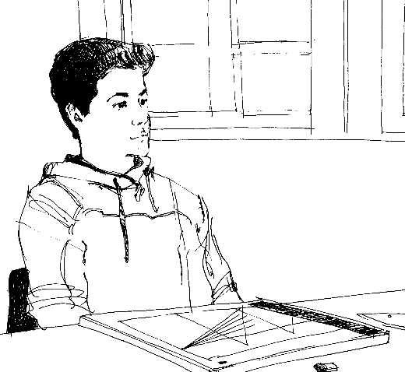
MDGs – A Closer Look
8 Develop a global partnership for development.
Enable donors, governments, corporations, faith based groups, non-governmental organizations, and individuals work together to achieve the MDGs.
Notes:
Partnership isn’t easy
The final Millennium Development Goal is this: Create a global partnership for development.
Of course, as in the other goals, there are indicators here too – debt cancellation for the poorest countries, fair trade, development assistance, and so on – but I don’t want to talk about that much, though all are critical to a more just world. I will just note in passing that the international debt issue is still with us; and the United States preaches about free trade in inverse proportion to the degree it practices it, and says little about fair trade, unless it sees itself as aggrieved; and we aren’t really even struggling to reach 0.7% of GNP in development assistance.
I can talk about that stuff at length (ask me sometime!), but it’s toward a theology of partnership that I want to write about in this final reflection. I’ve struggled with it for years, and I’m convinced that here is a place where the Church can and should speak, and should do so powerfully and prophetically.
It’s ironic, really, that this particular Millennium Development Goal talks about a “global partnership.” The secular world didn’t discover the idea. We’ve known about it for 2,000 years. It’s just sometimes we haven’t said it, or lived it out, very well. The recent popularity of ubuntu theology, of relatedness, reminds me of the remark John Mbiti made years ago, that an African would never say, “I think, therefore I am.” Instead he or she would say, “I am related, therefore I am.”
To me the answer to the question of engagement by people of faith in the issues raised by the Millennium Development Goals is not that Africa – nor indeed the rest of the world - is so needy but that we are simply related. Full stop. If we are all children of God, and for many, brothers and sisters in Christ – another one of those occasional “nice thoughts” – then we seek to be engaged as related people. If we were to struggle with what this means – and using the word “partners” is insufficient unless it is part of a real struggle – this reason for engagement takes us in all sorts of directions. It may well mean that we become engaged in these goals… as advocates, care-givers, pastoral ministers, whatever. But it also may mean we allow ourselves to be needy too, to see in these goals a message to us.
It may mean we don’t do projects at all, but embrace a ministry of presence. It may mean that, contrary to dominant American impulses, we are just quiet for awhile, we listen, we don’t organize anything or do anything for “them.” We are just present. My suspicion is that God would be present too, and maybe nod and say that there is still some hope for us all. Yours faithfully, Leon Spencer (Washington Office on Africa)

Slide 18
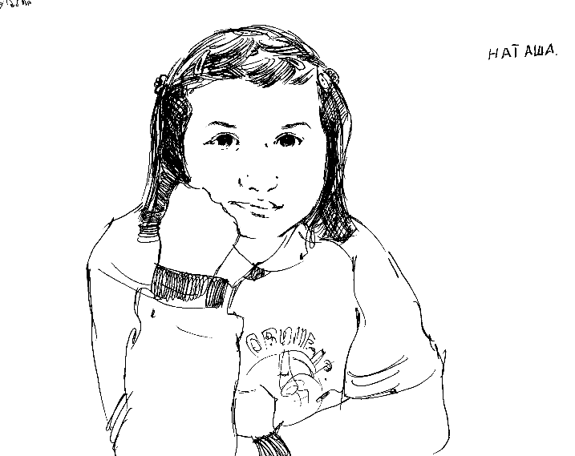
Of course meeting the MDGs doesn’t make all our problems go away. The MDGs do not stop war; they do not include all human rights. These things also deserve our utmost attention.
Notes:
The Millennium Declaration that Kofi Annan handed out in 2000 was wider than these, and included ideas about human rights and peace. These are also very active priorities of the UN.
Just to give you an idea of the millennium, one whole section talked about "peace, security, and disarmament" in great detail. It talked about the need to make legal systems work so police protect rather than hurt the poor, and so criminals are caught. It speaks of replacing the culture of reaction with
one of prevention so as to diminish armed conflicts around the globe. There
is emphasis on management reforms of peacekeeping, enhanced support of
peace-building on the ground. With respect to sanctions, the aim is to
minimize their impact on civilians. The discussion of how disarmament
relates to human security ranges from halting the spread of weapons of mass
destruction to ridding the world of landmines.
Other sections of the report touch on environmental issues, including the
devastating impact that flows from climate change; protecting those made
vulnerable -- especially women and children -- from dispacement and
humanitarian emergencies; and human rights and good governance. One portion
of the report is devoted to the special needs of Africa as they relate to
debt burden and HIV/AIDS.

Slide 19
But even in war, far more people perish of poverty-related causes than die in battle.
Nearly every year more mothers die in childbirth than people die in combat.
Poverty is huge. And we could prevent and halt some conflicts by reducing poverty. We could. The power is in our hands.
That’s why the United Nation’s MDG slogan is: “No Excuses”

Slide 20
Yes, but what will it cost?

Slide 21
$100 Billion per year between 2000 and 2015

Slide 22
That’s a staggering Amount
At present, the developed countries provide $58 billion in overseas development assistance. This has to double.
That is, we will need at least an additional $30 to $50 billion every year from now until 2015.
That’s a lot of money! But is it really?

Slide 23
In 2002 the US gave $13.3 billion in Development Assistance, up 15% from 2001 and the most of any country.
US Military Expenditure is $399 billion.
In 2003 the US spent over $75 billion on the War in Iraq.
Budgets reflect priorities. We could give more – it’s not asking much.

Slide 24
(in $ millions) | Development Assistance ‘02 | % of GNI
Australia | 989 | 0.26
Austria | 520 | 0.26
Belgium | 1 072 | 0.43
Canada | 2 006 | 0.28
Denmark | 1 643 | 0.96
Finland | 462 | 0.35
France | 5 486 | 0.38
Germany | 5 324 | 0.27
Greece | 276 | 0.21
Ireland | 398 | 0.40
Italy | 2 332 | 0.20
Japan | 9 283 | 0.23
Luxembourg | 147 | 0.77
Netherlands | 3 338 | 0.81
New Zealand | 122 | 0.22
Norway | 1 696 | 0.89
Portugal | 323 | 0.27
Spain | 1 712 | 0.26
Sweden | 1 991 | 0.83
Switzerland | 939 | 0.32
United Kingdom | 4 924 | 0.31
United States | 13 290 | 0.13
TOTAL DAC | 58 274 | 0.23
The World’s biggest givers:
United States
Japan
France
Germany
United Kingdom
Total ODA = $58 billion
Gold = give 0.7% already
The US is the world’s biggest
giver in real terms,
but the world’s smallest
giver in percentages.
[1] Of donor countries in 2000 US$
[2] to least developed countries as a percentage of total ODA
[3] as a % of GNI

Slide 25
Why should we give 0.7% Overseas?
Because we forget to give outside of our borders !

Slide 26
Americans are a generous people. We give of our time, our love, our money.
But less than 2% of Americans’ gifts leave our country.
Of the $241 billion we gave, only $4.6 billion – less than 2% - supported international programs relating to peace and security, arts and culture, poverty alleviation, education, health, and the environment.
(Giving USA 2003, AAFRC Trust for Philanthropy.)
The 0.7% rule reminds us to send some of our tithe, some of our donations, some of our gifts, to our sisters and brothers overseas. Send more if you can by all means! But please send some.

Slide 27
Where did 0.7% come from?
In 1970, the United Nations General Assembly identified 0.7% as a target for international development assistance.
Since then, world leaders regularly re-affirm 0.7%. It would be enough. It is especially important to give 0.7% now that we have promised to achieve the MDGs.

Slide 28
What’s New?

Slide 29
What’s New on Poverty?
From 1990 to 2004, poverty in Latin America and the Caribbean showed minimal improvement in terms of development, while poverty in sub-Saharan Africa is pervasive and increasing.
Goal – reduce by ½ the number of people living on less than $1/day by 2015

Slide 30
What’s New on Primary Education?
One in four adults in the developing world - 872 million people - is illiterate.
More than 100 million children remain out of school.
46% of girls in the world's poorest countries have no access to primary education.
More than 1 in 4 adults cannot read or write: 2/3 are women.
Universal primary education would cost $10 billion a year - that's half what Americans spend on ice cream.
Young people who have completed primary education are less than half as likely to contract HIV as those missing an education. Universal primary education would prevent 700,000 cases of HIV each year - about 30% all new infections in this age group.

Slide 31
What’s New on Gender Equality?
Of the 1.3 billion people living in poverty around the world, 70% are women. (Source: World Revolution -
Women do about 66% of the world's work in return for less than 5% of its income. In the least developed countries Nearly twice as many women over age 15 are illiterate compared to men. (Source: UNFPA-
Two-thirds of children denied primary education are girls, and 75% of the world’s 876 million illiterate adults are women.
Women work two-thirds of the world's working hours, produce half of the world's food, and yet earn only 10% of the world's income and own less than 1% of the world's property. (Source :World Development Indicators, 1997, Womankind Worldwide)

Slide 32
What’s New with Child Mortality
In our world today nearly 11 million children under the age of 5 die in the world every year –
well over 1,200 every hour
Most from easily preventable or treatable causes.
  Malaria, TB, HIV/AIDS, etc.

Slide 33
What’s New with the Health of Mothers?
More than 500,000 women die in pregnancy and childbirth – that’s 1 death every minute
99% of those are in developing countries
  Parts of Africa the rate is 1 in 16 (as opposed to the North America’s rate of 1 in 3,500)

Slide 34
What’s new on combating HIV/AIDS, Malaria, etc
AIDS experts estimate that it will cost more than $10.5 billion a year to fight AIDS globally - that price tag will escalate to more than $15 billion a year by 2007. Wealthy countries currently spend less than $4 billion on global AIDS
Each year, malaria causes at least 300-500 million clinical cases and 1 million deaths a year – about 3000 a day in Sub-Saharan Africa, where 9 out of 10 malaria deaths occur.
In sub-Saharan Africa, there are currently 4.1 million people with AIDS who are in immediate need of life-saving anti-retroviral drugs. At the end of last year, only an estimated 50,000 of these people were able to take these drugs.
In Zambia, 12% of the children have been orphaned by HIV/AIDS.
Every day in Africa, 6,500 people die and another 9,500 contract the HIV virus - 1,400 of whom are newborn babies infected during childbirth or by their mothers' milk

Slide 35
Combating HIV/AIDS, Malaria, slide 2
Currently more than 11 million children in Africa have lost at least one parent to HIV/AIDS; that number is expected to reach 20 million by 2010
5 people die from AIDS every minute.
Almost 3 million children are living with AIDS and 4 million have died of AIDS since the epidemic began
There are 42 million people living with HIV and AIDS worldwide. It is a global emergency claiming approximately 8,000 lives every day in some of the poorest countries.
1 in every 100 people worldwide is HIV positive: One third of them are aged 15-24

Slide 36
What’s new on ensuring our environment sustainability?
More than 2.6 billion people – more than 40 percent of the world's population – do not have basic sanitation.
More than 1 billion people have no access to safe sources of drinking water.
Forests, which contribute to the livelihoods of more than a billion people living in extreme poverty, continue to shrink in Africa, Latin America and parts of Asia

Slide 37
What’s new in developing a global partnership for development?
The United Nations estimates that unfair trade rules deny poor countries $700 billion every year. Less than 0.01% of this could save the sight of 30 million people.
International trade is worth $10 million a minute. 70% of this is controlled by multinational corporations.
The poorest 49 countries make up 10% of the world's population but account for only 0.4% of world trade. Their share has halved since 1980.
Rich countries spend $100 billion a year to protect their markets with tariffs, quotas and subsidies - this is twice as much as they provide in aid for developing countries.

Slide 38
Global partnerships (slide 2)
Every year Sub-Saharan Africa, the poorest region of the world, spends $14.5 billion repaying debts to the world's rich countries and international institutions such as the World Bank and International Monetary Fund.
Debt cancellation needed by the world's poor: US$ 300bn. Debt relief promised by creditors so far: US$ 110bn. Debt cancellation delivered by July 2003: US$ 36bn
Spread over 20 years, the cost of cancelling the debts of the 52 Jubilee 2000 countries is only one penny a day for each person in the industrialised world.
Ethiopia, a country with one of the highest mortality rates in the world, the $197m spent on servicing the national debt in 2001 could have fully financed provision of a basic package of health care for mothers and children.
The money spent on debt repayments could provide water for around 1.3 billion people.

Slide 39
And yes, we have the devastation of Katrina and relief from the tsunami
We cannot forgot them either!

Slide 40
What’s New at the UN?
World Summit of World leaders September 14-16 to review the status of the MDG’s
Some reports: Results are Mixed
  40 Page “Outcome Document”
  Pledging continued commitment on the MDG’s as in the 2000 declaration
  Bush stated: “private trade and investment in promoting development "dwarfs official development assistance. . . So we need to help countries do the types of things that will invite private capital flows,"

Slide 41
What does this mean to us as Christians
Gospel Imperative Matthew 25:35
I was hungry and you gave me food, I was thirsty and you gave me something to drink, I was a stranger and you welcomed me,
I was naked and you gave me clothing, I was sick and you took care of me, I was in prison and you visited me.'
'Truly I tell you, just as you did it to one of the least of these who are members of my family, you did it to me.'

Slide 42
What does this mean to us
As Those interested in World Mission
This is the environment that we carry the gospel into.
Hunger, poverty, poor health, lack of education are both an obstacle and an opportunity for the hearing of God’s message of love to his people.
We can make the difference.

