Slide 1

The Millennium Development Goals
…and what we can do

Slide 2
In September of 2000
the United Nations and its member states
pledged to accomplish a set of 8 goals
to reduce human suffering across the globe
by 2015

Slide 3
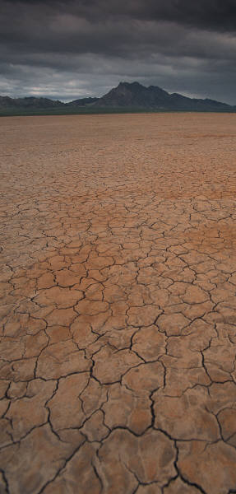
Some facts about Human Suffering in 2006
More than 800 million people go to bed hungry every day
Every 3.6 seconds another person dies of starvation
Every year, 6 million children die from malnutrition before their 5th birthday

Slide 4
More than a billion people lack access to clean water and basic sanitation
5 million people, mostly children, die each year from water-borne diseases
Every 30 seconds a child dies of malaria
HIV/AIDS kills 6,000 people a day
while infecting 8,200 more

Slide 5
Civil war and political unrest displace millions from their homes
Meanwhile…
high trade barriers prevent exports from gaining access to world markets
and weak governments drown in unsustainable debt

Slide 6
In 2006
famine, drought, disease and war
combine to create unimaginable human suffering
In all, more than 1.2 billion people are living in extreme poverty
… and it doesn’t have to be that way

Slide 7
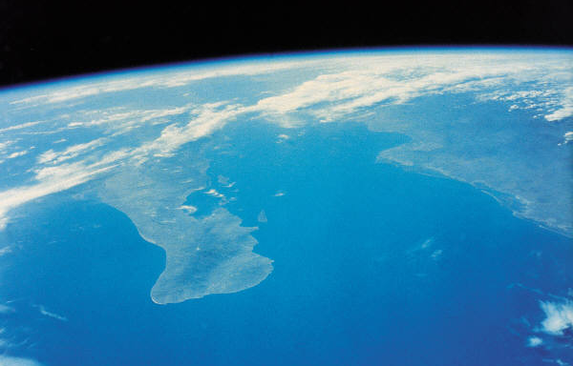
The Millennium Development Goals
represent a plan for ending extreme poverty

Slide 8

Clean water for all

Slide 9
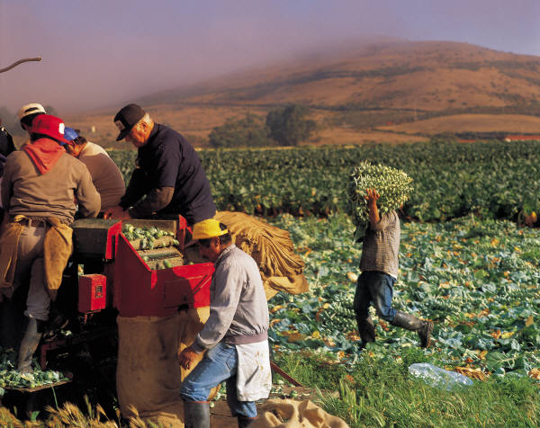
Feeding the hungry

Slide 10
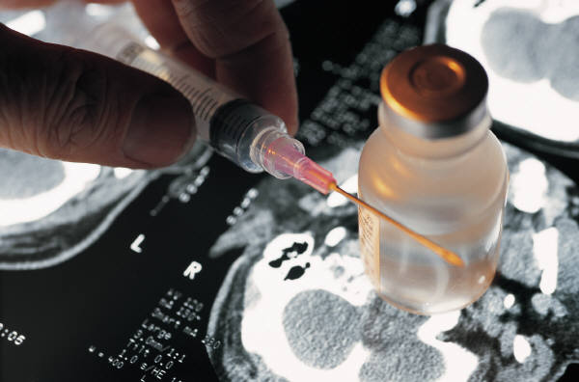
Healing the sick

Slide 11
Improving maternal health

Slide 12
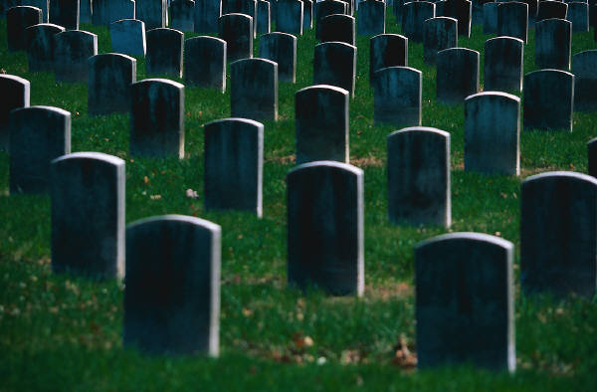
Reducing child mortality

Slide 13
School for every child

Slide 14
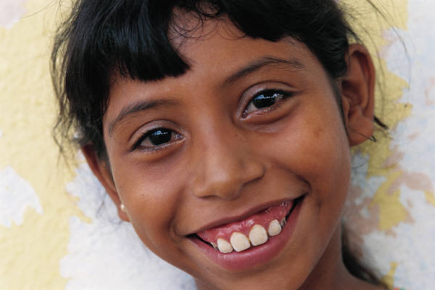
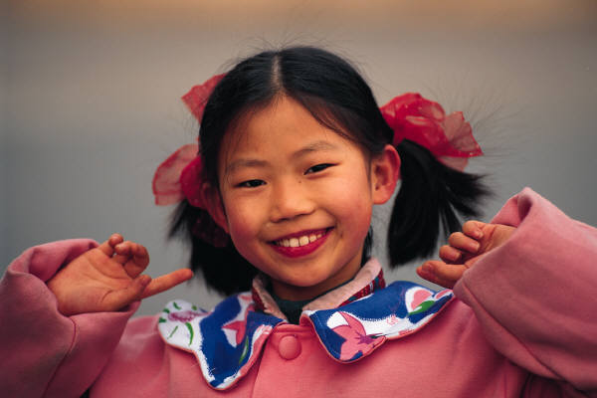
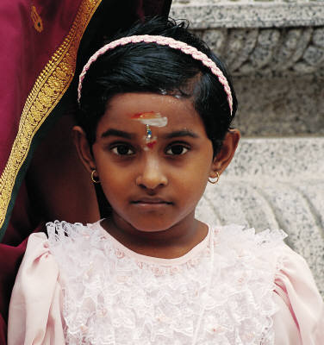
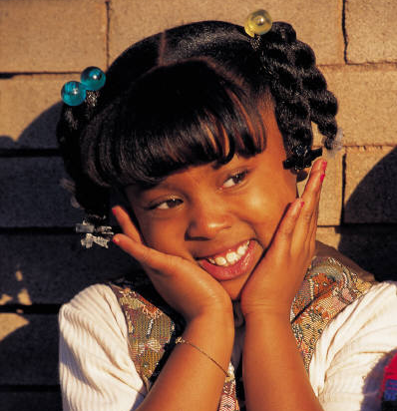
Empowering women

Slide 15
Global Partnerships
between:
Governments
Businesses
Churches
Individuals

Slide 16
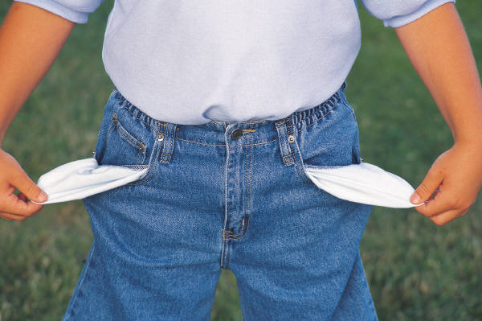
But how much will it cost?

Slide 17
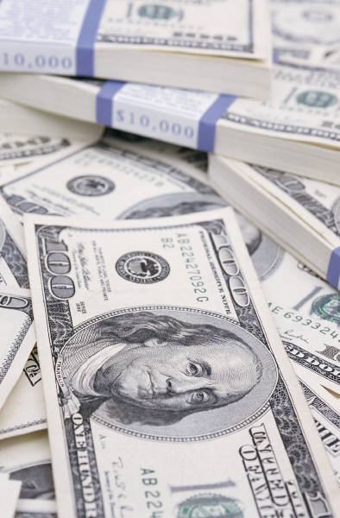
100 Billion Dollars
…a year

Slide 18

SAY WHAT!!!
That’s a lot of money
How do we do that?

Slide 19
CURRENT LEVEL
TARGET LEVEL

Slide 20
We can educate others

Slide 21
We can vote

Slide 22

We can contact our elected representatives

Slide 23

We can give .7% of our own income

Slide 24
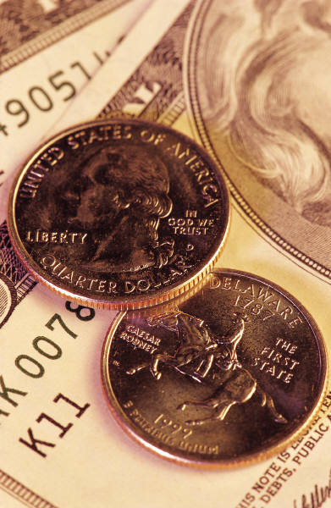
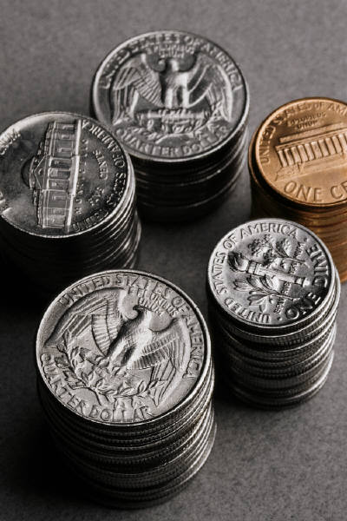
What is .7%
Income | A year | A day
$15,000 | $105 | 28 cents
$25,000 | $175 | 48 cents
$35,000 | $245 | 67 cents
$45,000 | $315 | 86 cents
$55,000 | $385 | $1.05
$65,000 | $455 | $1.25
$75,000 | $525 | $1.43
$85,000 | $595 | $1.63
$95,000 | $665 | $1.82

Slide 25
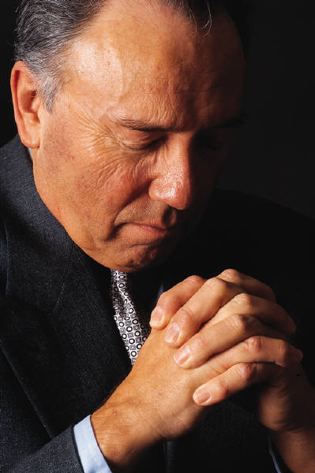
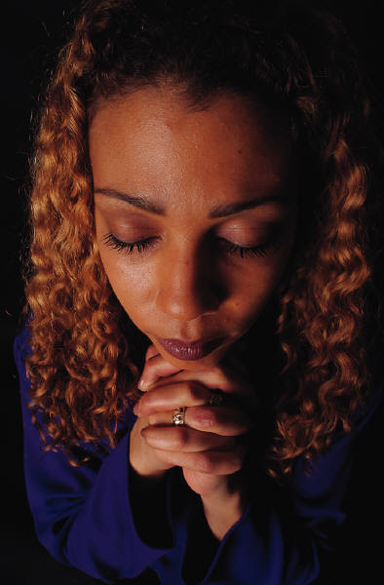
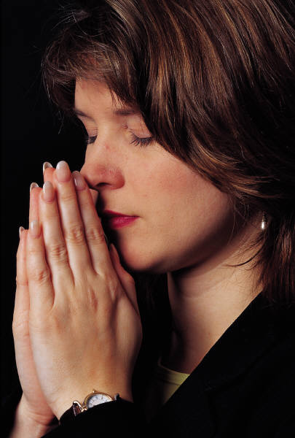
We can pray

Slide 26
“Truly, I tell you, as you did it for the least of [my brothers]… you did it for me.”
Matthew 25:37-40

Slide 27
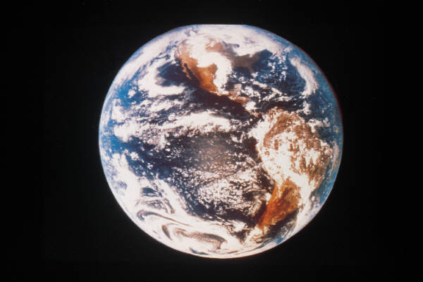
Together we are One

Slide 28
Want to learn more?
For resources and information about What One Person, Congregation and Diocese Can Do, go to
www.E4GR.org

Slide 29
“The Millennium Development Goals
…and what we can do”
was adapted from materials published by
Episcopalians For Global Reconciliation
www.episcopalglobalreconciliation.org
Images courtesy of
Microsoft Office Media Content CD 2002
Created by
Eric Hopkins
St. George’s Church
York Harbor, ME USA
2006

