Slide 1
Steps to Success
Integrating Immigrant Professionals
in the United States
James Witte
George Mason University
November 19, 2015

Slide 2

Today’s Agenda
Setting the Stage
The Six City Study
Findings
Recommendations
Photo credit: atic12, copyright 123rf

Slide 3
Setting the Stage
The nonpartisan Migration Policy Institute estimates that nationwide there are 968,000 foreign-educated immigrants who are un- or under-employed, often in low-wage jobs.
That’s brain waste.
Source: Migration Policy Institute analysis of US Census Bureau data.

Slide 4
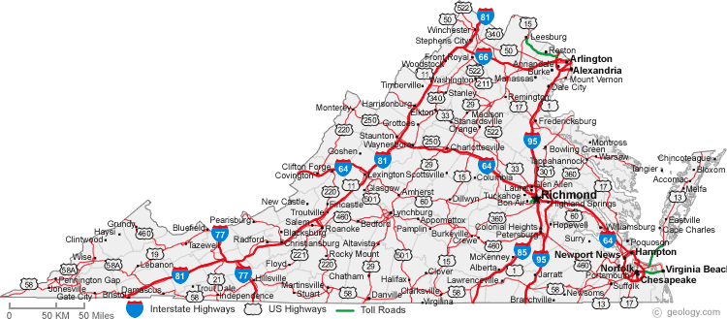
Setting the Stage: Here in Virginia
Low-wage work or unemployment is a reality for 41,500 college-educated immigrants in VA—that is 21% of the state’s 245,000 foreign-born workers with college degrees
http://www.migrationpolicy.org/research/brain-waste-US-state-workforce-characteristics-college-educated-immigrants

Slide 5
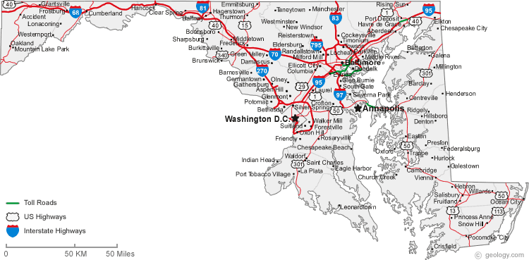
Setting the Stage: In Maryland
Low-wage work or unemployment hits 44,000 college-educated immigrants in MD—that is 20% of the state’s 223,000 foreign-born workers with college degrees
http://www.migrationpolicy.org/research/brain-waste-US-state-workforce-characteristics-college-educated-immigrants

Slide 6
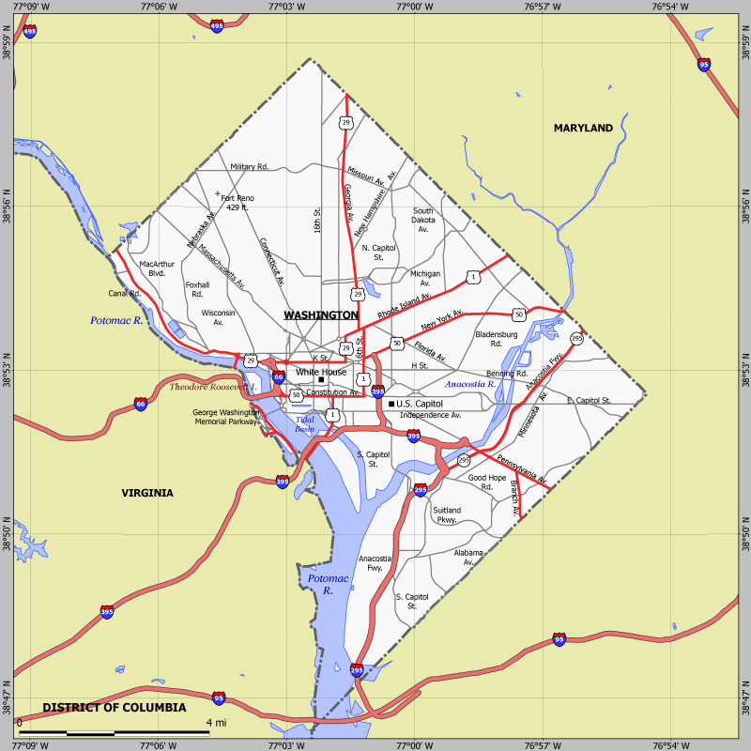
Setting the Stage: In DC
Low-wage work or unemployment faces 5,000 college-educated immigrants in DC—that is 16% of the state’s 31,200 foreign-born workers with college degrees
http://www.migrationpolicy.org/research/brain-waste-US-state-workforce-characteristics-college-educated-immigrants

Slide 7

Why? Only Data Could Tell Us the Answer
First-of-its-kind study about the economic success of college-educated immigrants in the United States
Data from 4,000+ online respondents and 5,500+ audio respondents
Focus on six US metropolitan areas… hoping to extend the list, with DC metro area already on board

Slide 8

The Six Cities Study: We Asked
What factors help people succeed?
What barriers hold people back?

Slide 9
The IMPRINT Survey Six Cities
Seattle
Boston
Detroit
Philadelphia
San Jose
Miami

Slide 10

Who Did We Reach Online?
Overwhelmingly (93%) of working age
In the labor force (88%)
Majority (61%) female
Oversampled arrivals within past five years (36%)
Photo credit: Ashwin Kharidehal Abhirama, copyright 123rf
Notes:
ACS/Census for the six cities shows that college-educated immigrants slightly less likely be female (53%) and definitely less likely to be recent arrivals (16%) compared to our respondents

Slide 11

So What Did We Find?
Our findings fell intro three broad categories:
Achievement of success
City-specific variations in results
Factors correlated with success
Photo credit: Daniel Ernst, copyright 123rf

Slide 12
How We Analyzed Success
Three definitions, progressively more stringent:
Earnings success: Employed and earning at least $50,000 per year
Skills success: Earning at least $50,000 and making at least “some use” of higher education on the job
Professional success: All of the above plus working in a managerial or professional occupation

Slide 13
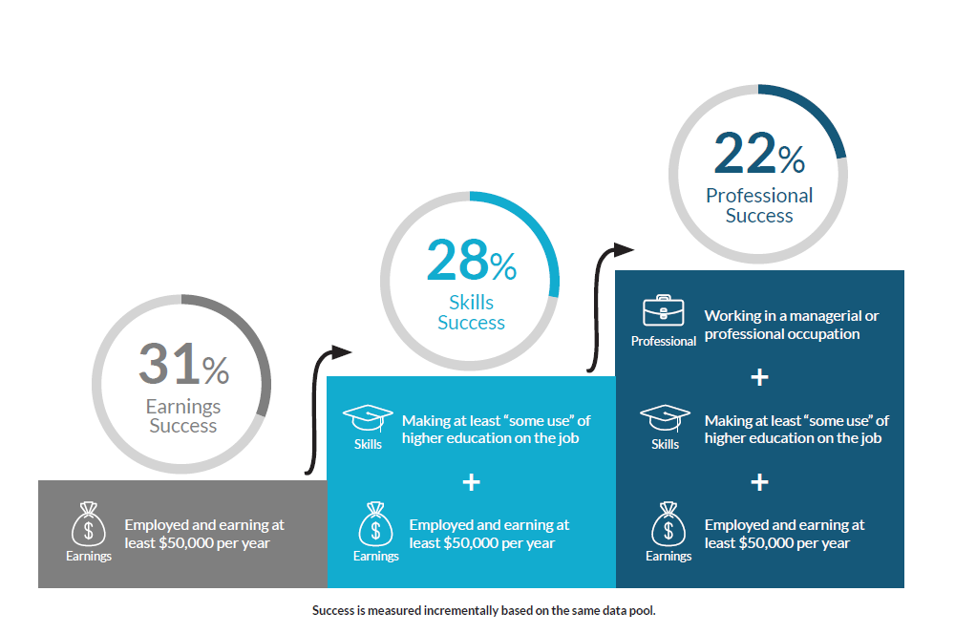
Degree of Success at Each Level

Slide 14
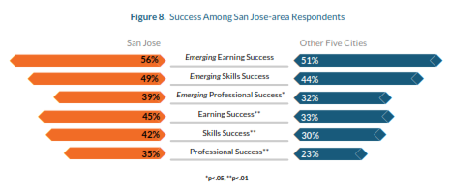
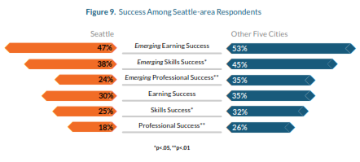
Success Varies from City to City

Slide 15
Higher Education in the US Improves Chances of Success

Slide 16

English Matters
Better English, better outcomes
True on multiple measures (English as primary language, English spoken ability, reading, etc.)
Significant differences even between “Very Well” and “Well”
Image credit: Anastasiya Ramaneka , copyright 123rf

Slide 17

Immigrant Professionals Are Still Striving
Self-improvement is popular and continues after arrival
Respondents invest in English classes
Additional US higher education;
Many plan to participate in more education & training
Photo credit: Wavebreak Media Ltd, copyright 123rf

Slide 18

Translating Credentials
Both applying for evaluation of foreign credentials and applying for US professional licensure were linked to greater success
Evaluation can help US employers or universities to understand the value of foreign credentials
Photo credit: Alexander Sidorov, copyright 123rf
Notes:
Most professions in the US are not licensed; more research needs to be done on variations on this issue.

Slide 19

The Power of Social Capital
Immigrants with many friends, more likely to be successful
Which comes first?
Do cities with more immigrants have more ready-made social capital to offer newcomers?
Photo credit: Andres Rodriguez, copyright 123rf
Notes:
We don’t know whether “friends” here refers to fellow immigrants in the same ethnic community, to other immigrants, or to US-born friends. This is an important question that merits further research.

Slide 20
More Friends, Greater Success

Slide 21
Achieving Professional Success*: A Multivariate Logistic Regression Model
Independent Variable | Direction of Coefficient | Exponentiated (B)
Female | - | 0.53
In US 6 years or longer | + | 3.24
Speaks English very well | + | 2.96
Higher education in US | + | 1.47
Many friends and family can rely on for support | + | 1.54
N=2,033 cases in labor market with complete data
Nagelkerke Pseudo R² = .174
* Earning $50K, using higher education and in professional
or managerial occupation

Slide 22

Overcoming Barriers
Most respondents reported having faced barriers (in finding employment
In general, respondents with more time in the US were less likely to report barriers
Photo credit: Steve Lovegrove, copyright 123rf
Notes:
The longer-term immigrants may have forgotten about or minimized barriers they faced years ago

Slide 23
Types of Barriers Faced by Respondents

Slide 24

The Take-Homes
Success takes time - so start now!
“Lateral transfers” are rare
Every bit of improved English matters
Networking & weak ties are under-utilized
A critical mass of fellow immigrants may be helpful
Photo credit: Borges Samuel, copyright 123rf

Slide 25

Policy Recommendations for Service Providers
Emphasize English
Foster networking and weak ties
Encourage “Made in America” supplements
Connect mainstream providers & specialized services
Photo credit: Antonio Guillem, copyright 123rf
See detailed policy recommendations in our full report.

Slide 26

Policy Recommendations for Funders
Fund programs that foster key skills
Use philanthropic dollars to bridge public funding streams
Support research on English learning
Document and publicize successful models
Photo credit: Leung Cho Pan, copyright 123rf

Slide 27

Policy Recommendations for Government Officials
Fully fund adult education and workforce programs
Improve data collection for this population
Identify opportunities within government for immigrants to acquire American workplace experience
Photo credit: Andres Rodriguez, copyright 123rf

Slide 28
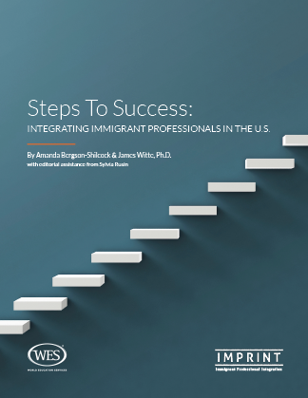
Steps to Success: Integrating Immigrant Professionals in the U.S.
First-of-its-kind study documents multiple factors that correlate with the successful integration of immigrant professionals.
Key findings include:
Social capital is powerful
English really matters
Immigrants take enterprising approaches to self-improvement
Provides recommendations for:
Service Providers
Funders
Policy Makers
www.imprintproject.org/stepstosuccess/

Slide 29



Contact Us
Jim Witte
Director & Professor of Sociology, Institute for Immigration Research, George Mason University
703.993.2993
jwitte@gmu.edu
iir.gmu.edu
Amanda Bergson-Shilcock
Senior Policy Analyst, National Skills Coalition
215-285-2860
amandabs@nationalskillscoalition.org
www.nationalskillscoalition.org
Stacey K. Simon
Director, IMPRINT
212-219-7988
stacey@imprintproject.org
www.imprintproject.org

