Slide 1

Color blue walk 1

Slide 2
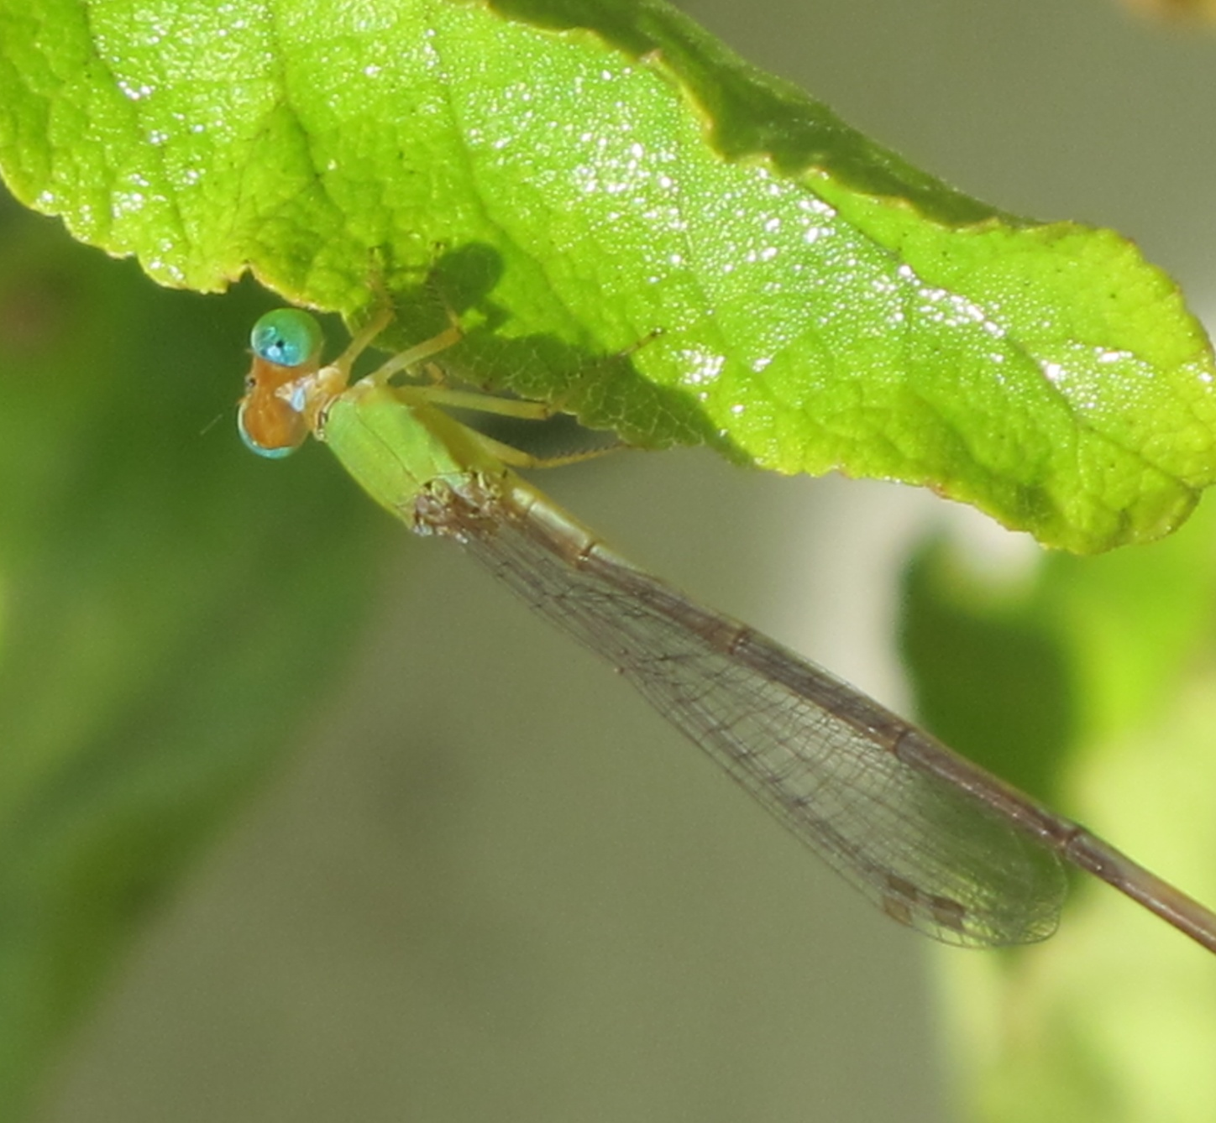
Turquoise

Slide 3
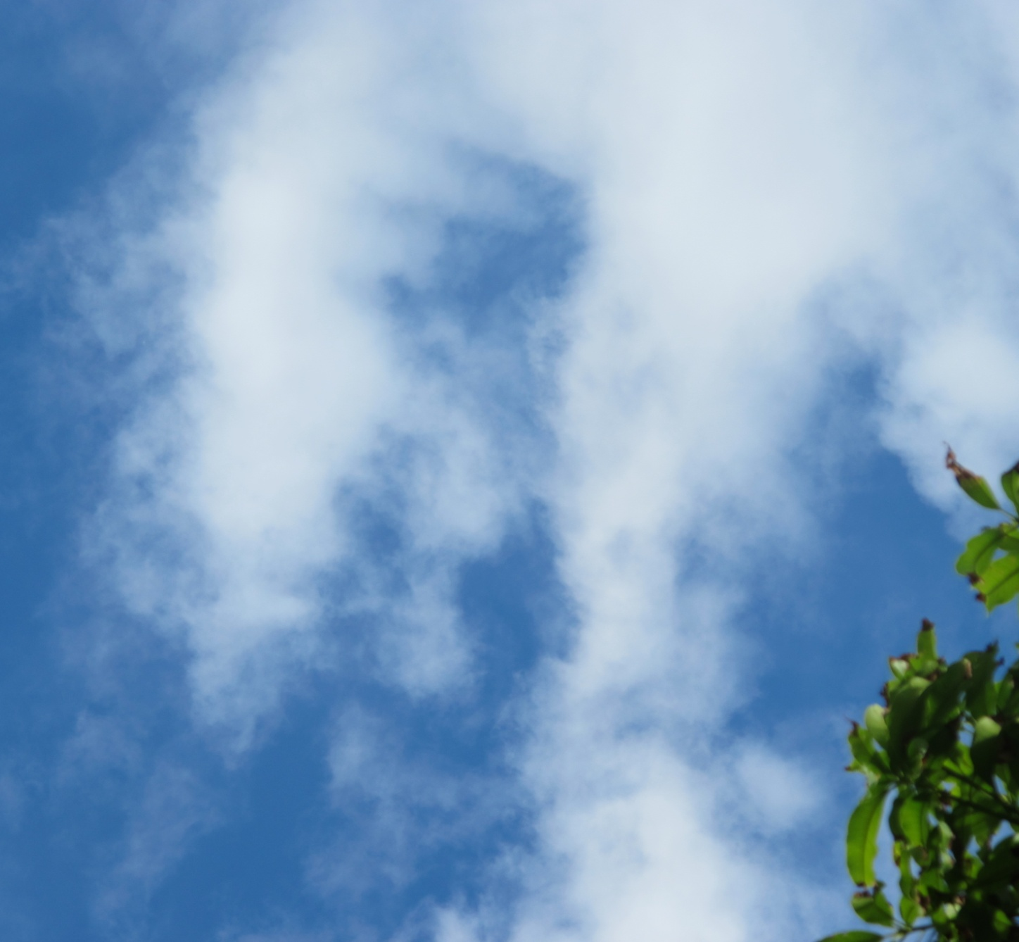
Azure

Slide 4
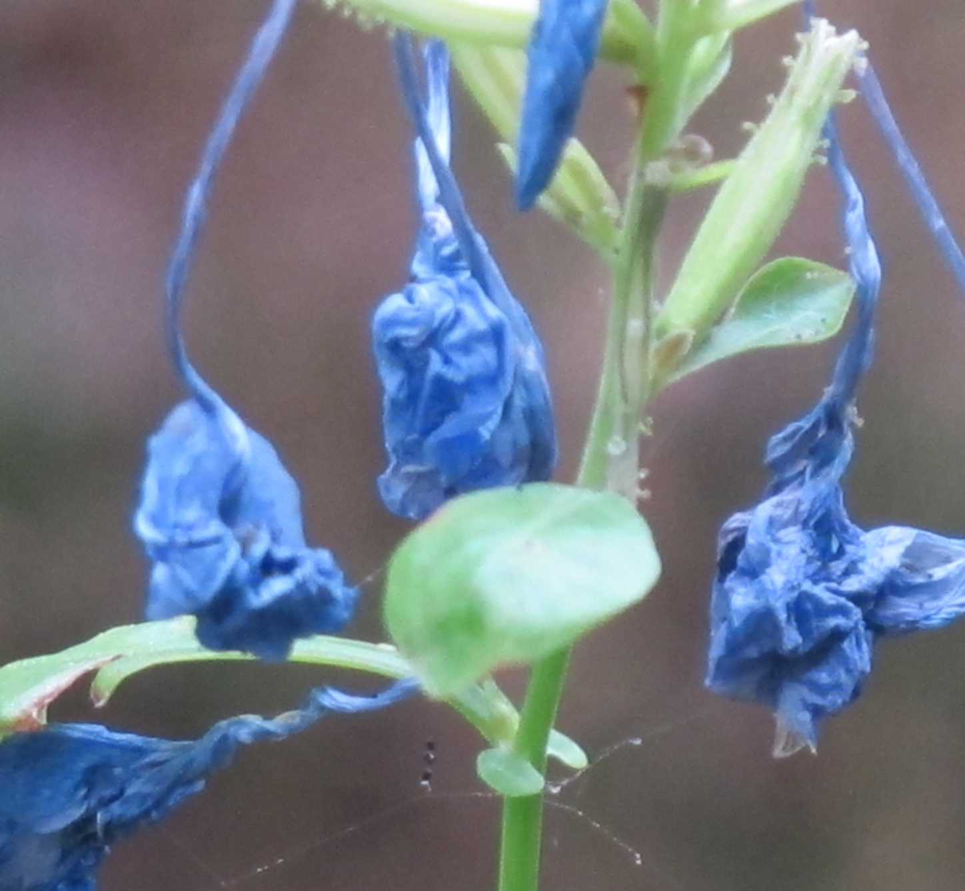
Royal blue

Slide 5
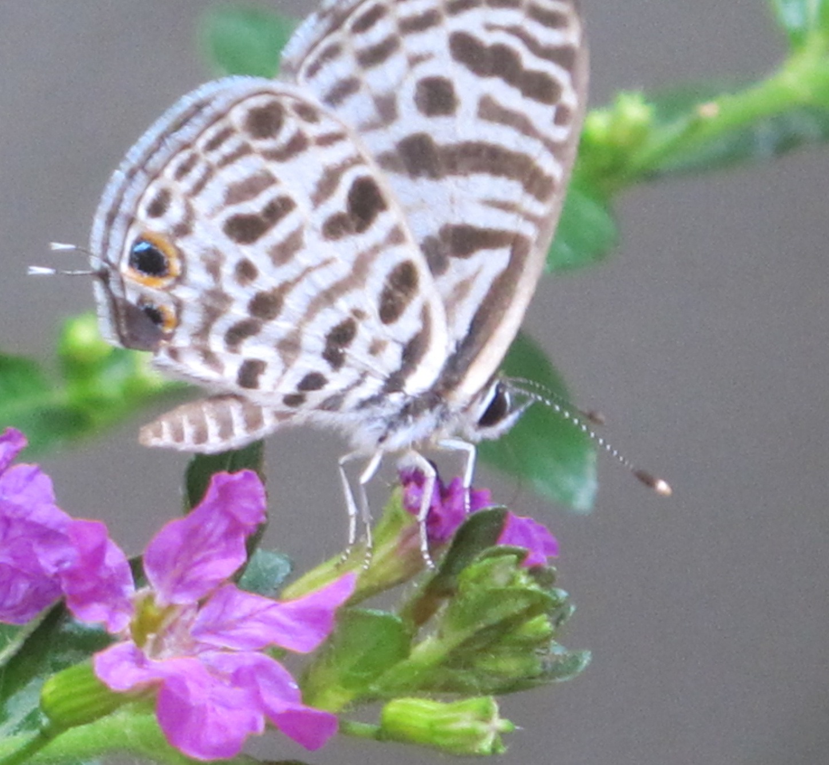
Baby blue

Slide 6
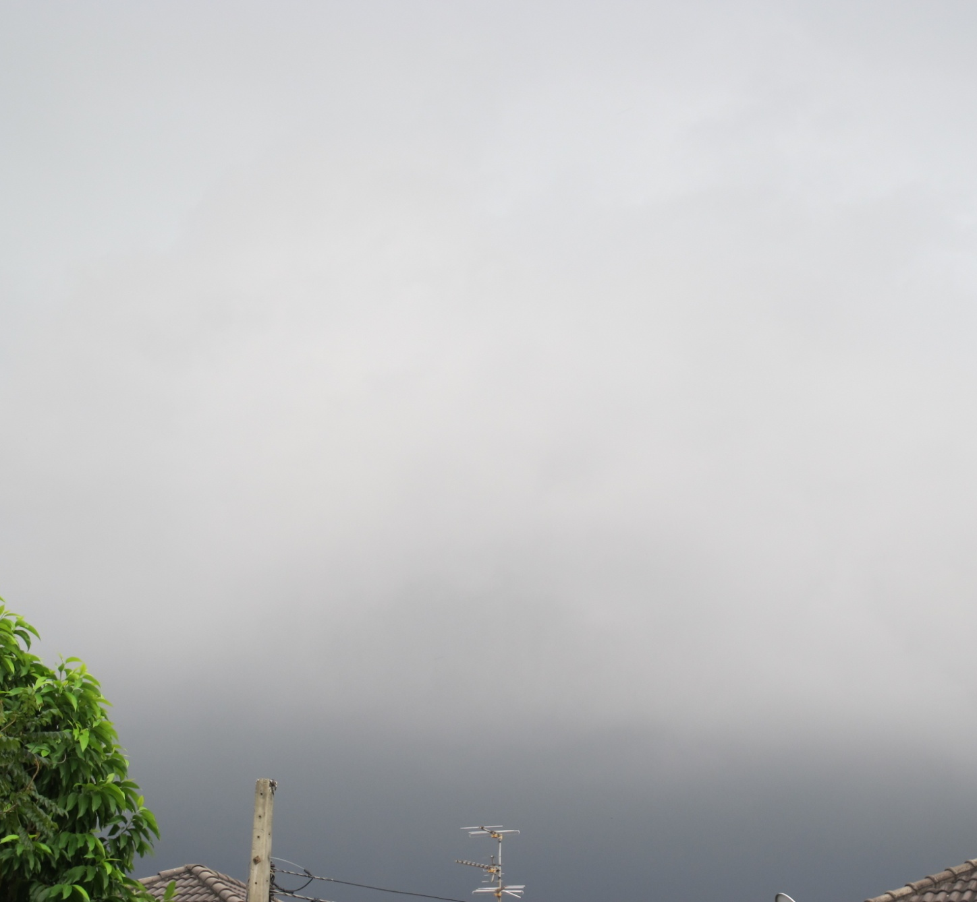
Blue-gray

Slide 7
Color blue walk 2

Slide 8
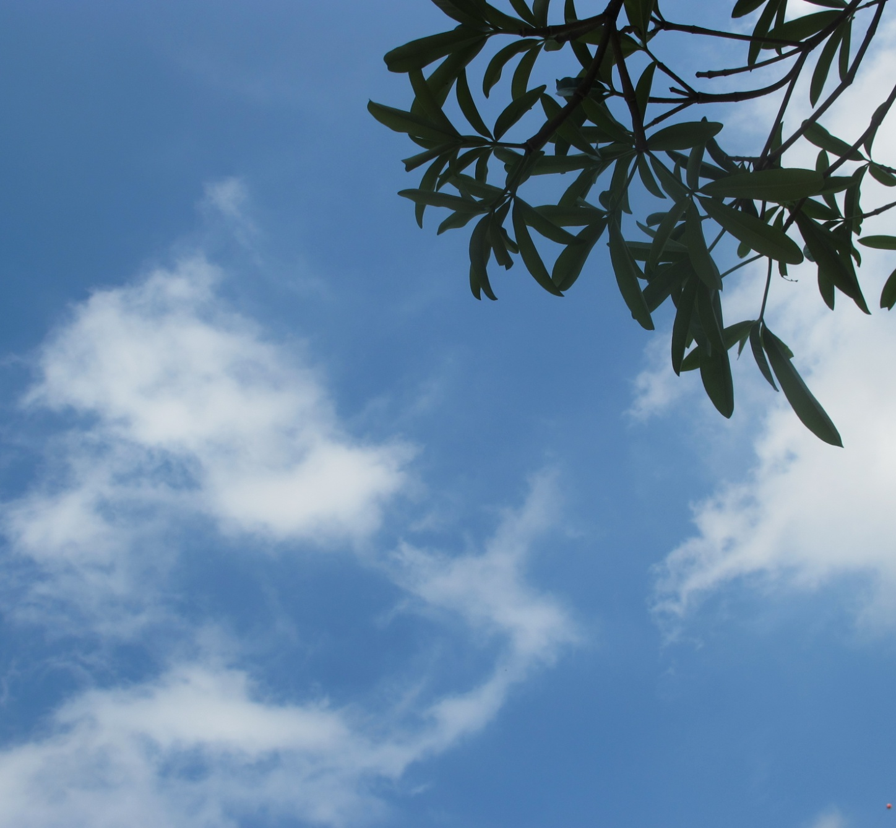
Bleu de France

Slide 9
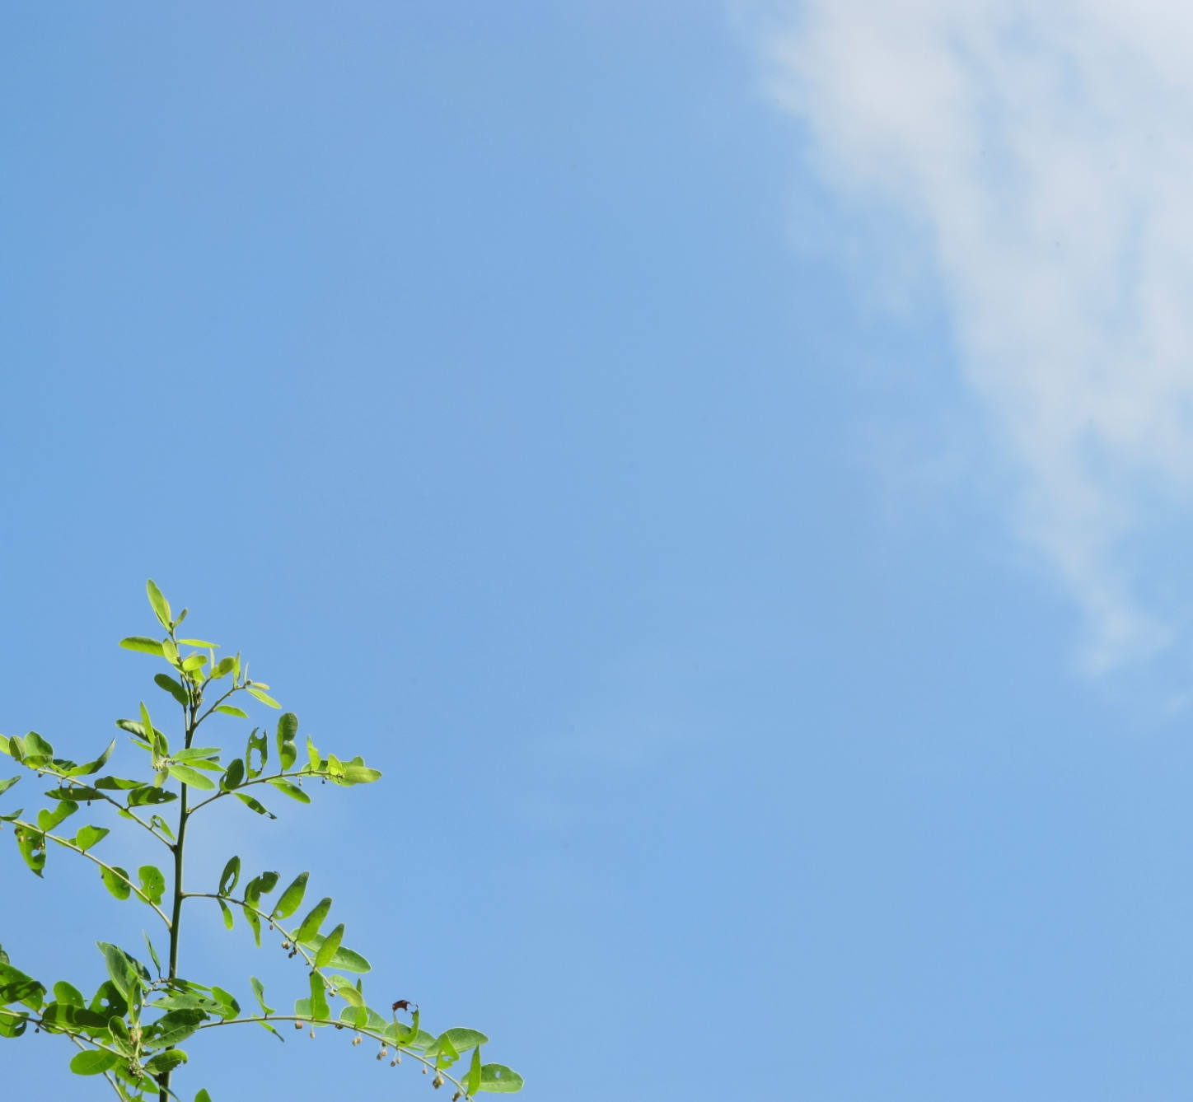
Baby blue

Slide 10
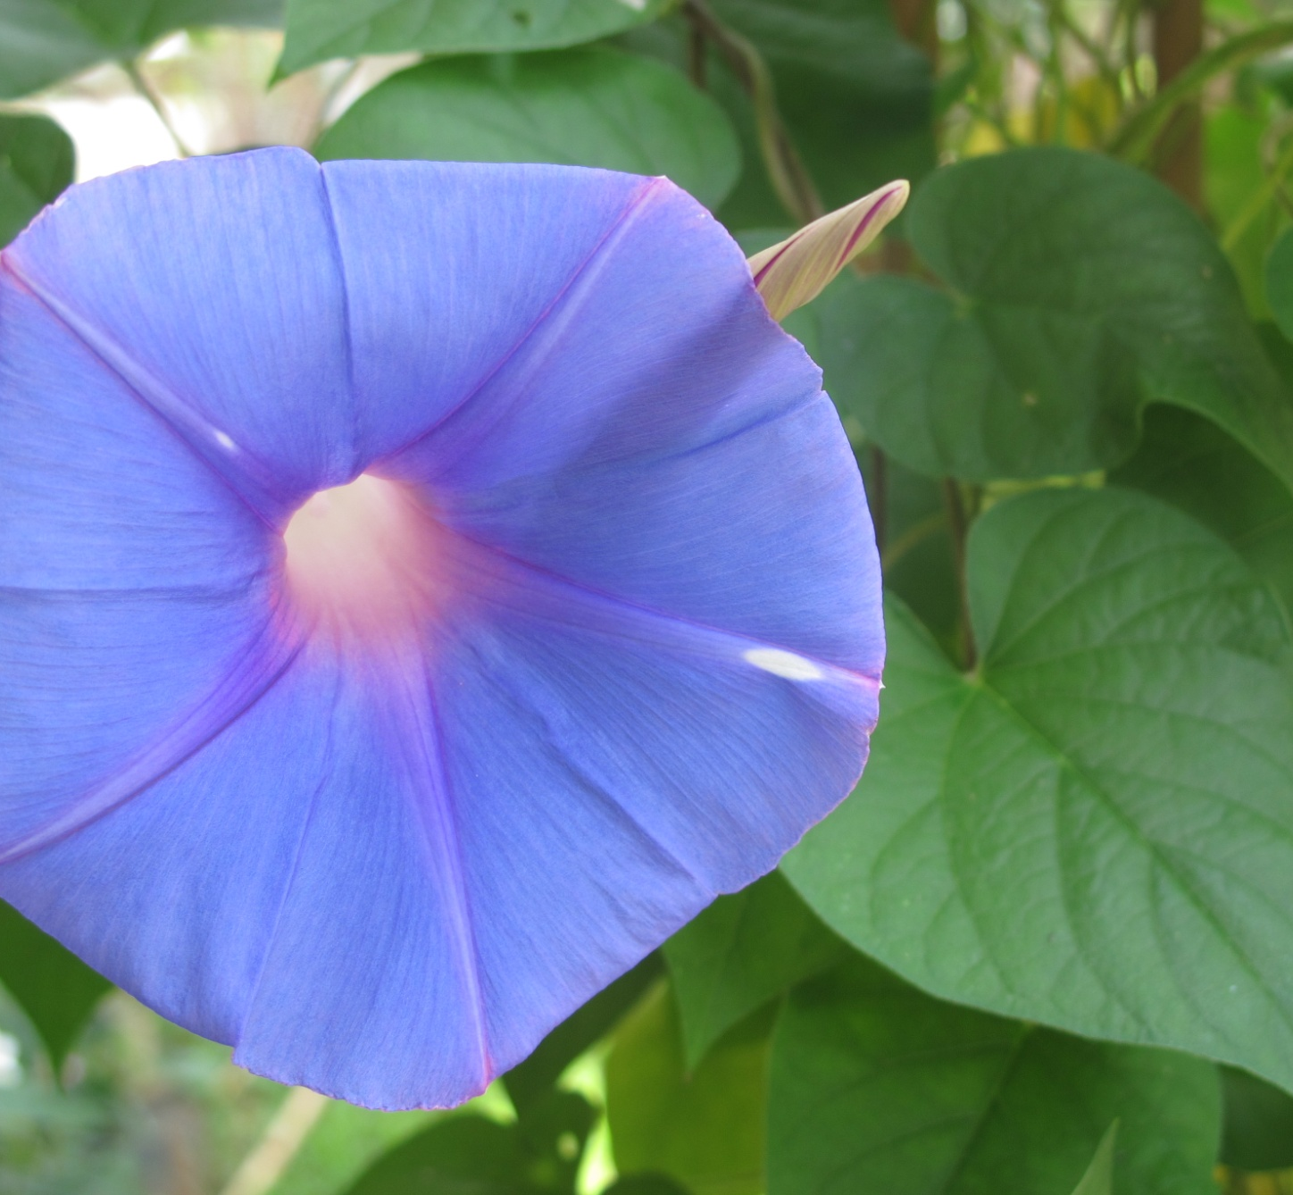
Cornflower blue
Iris

Slide 11
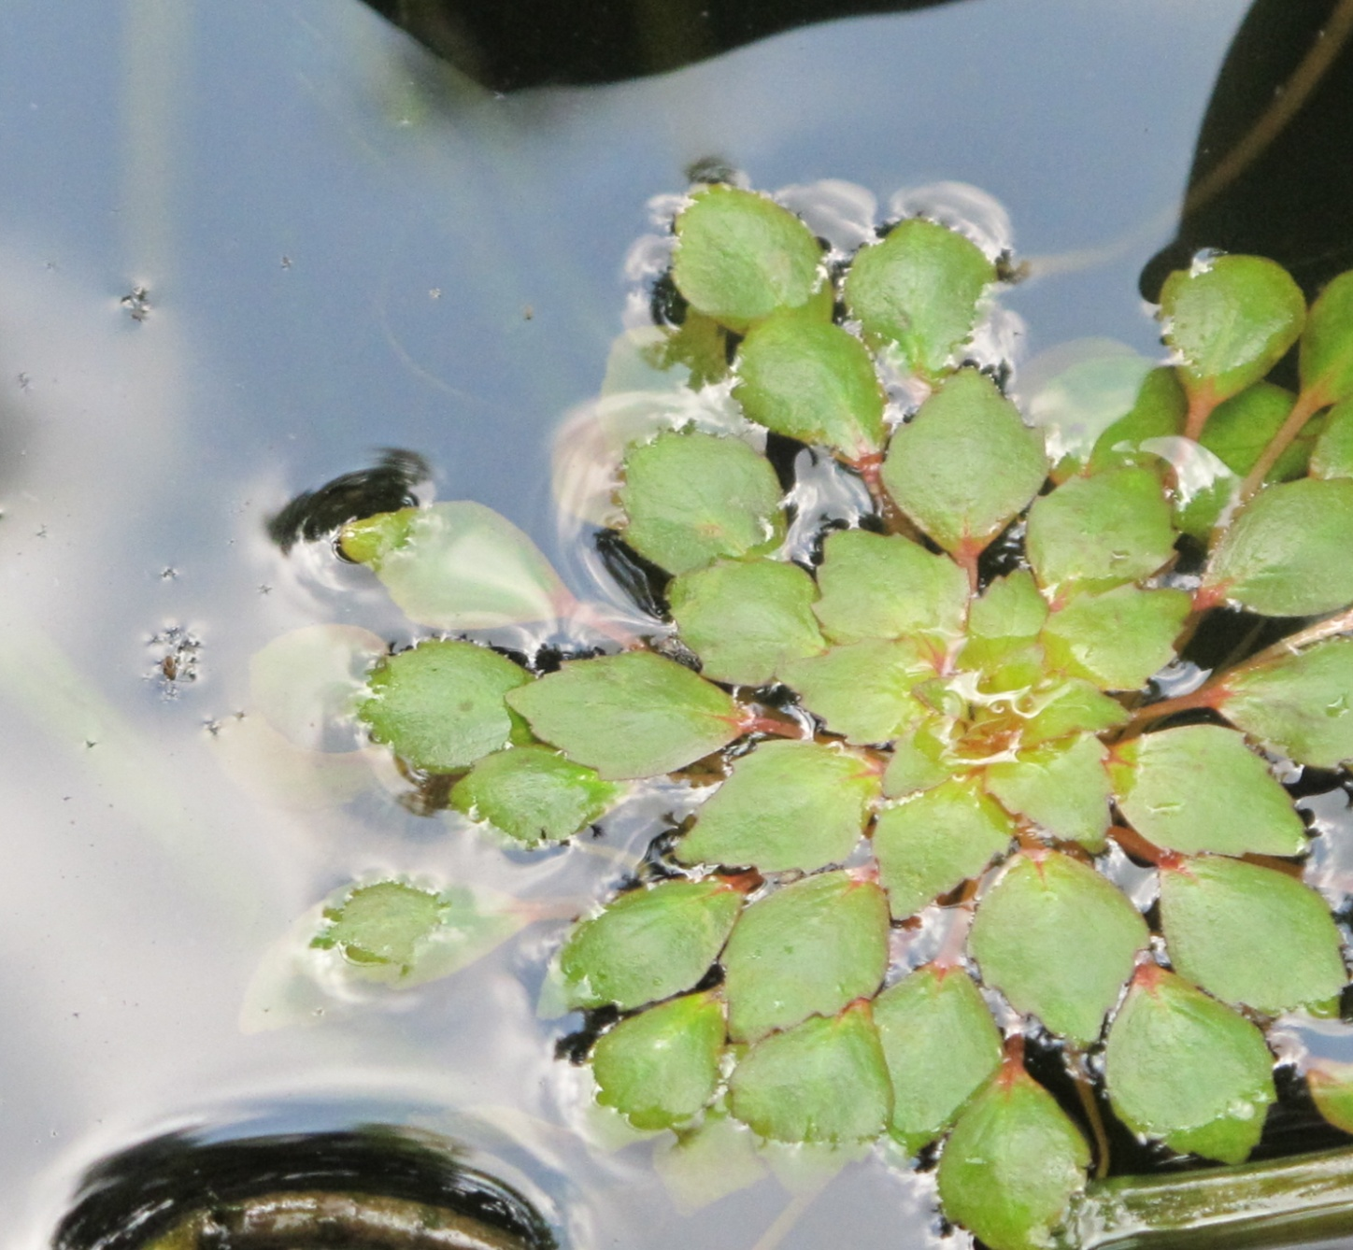
Glaucous
blue

Slide 12
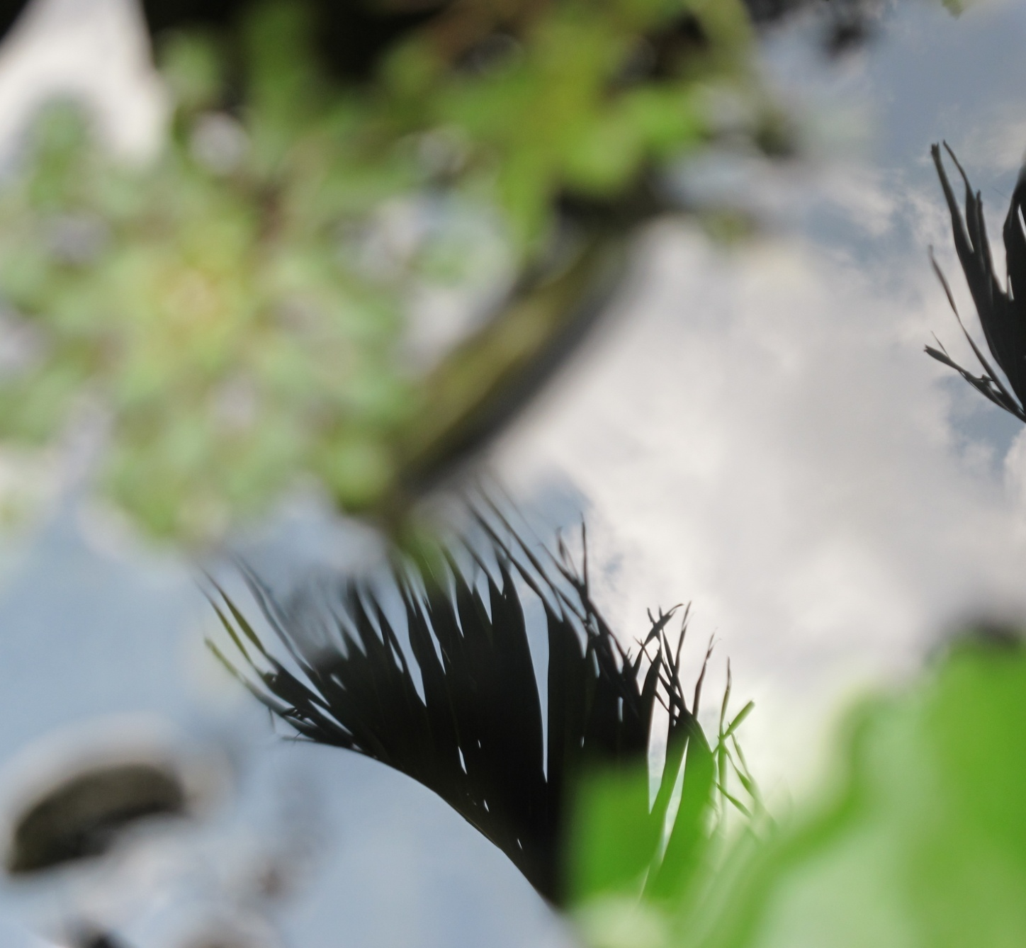
Carolina blue

Slide 13
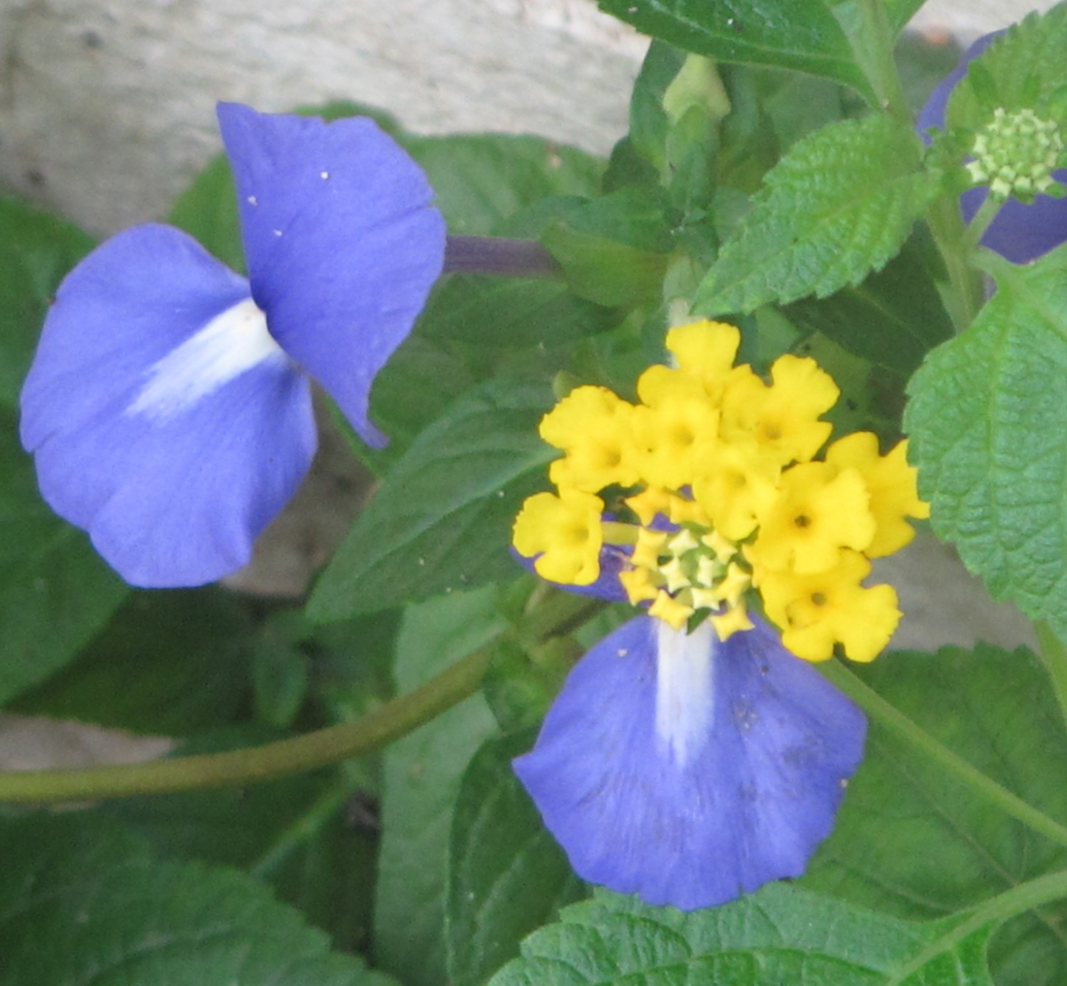
Sapphire

Slide 14
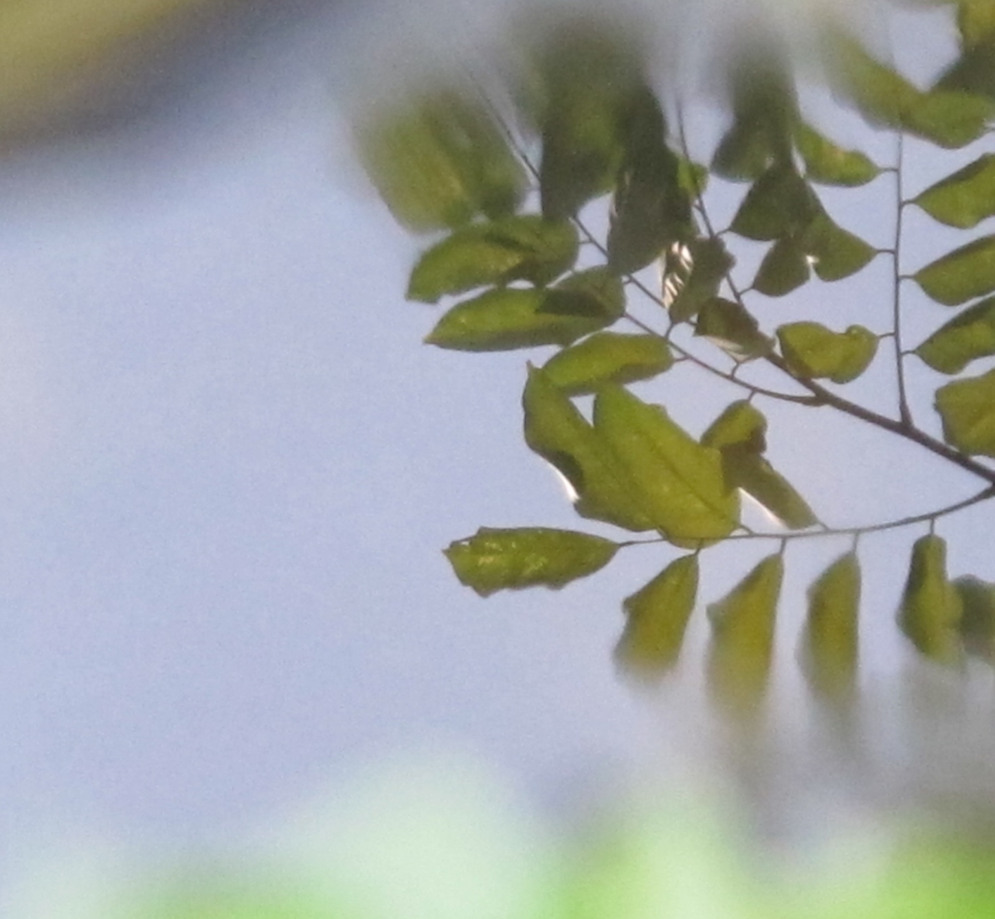
Periwinkle

Slide 15
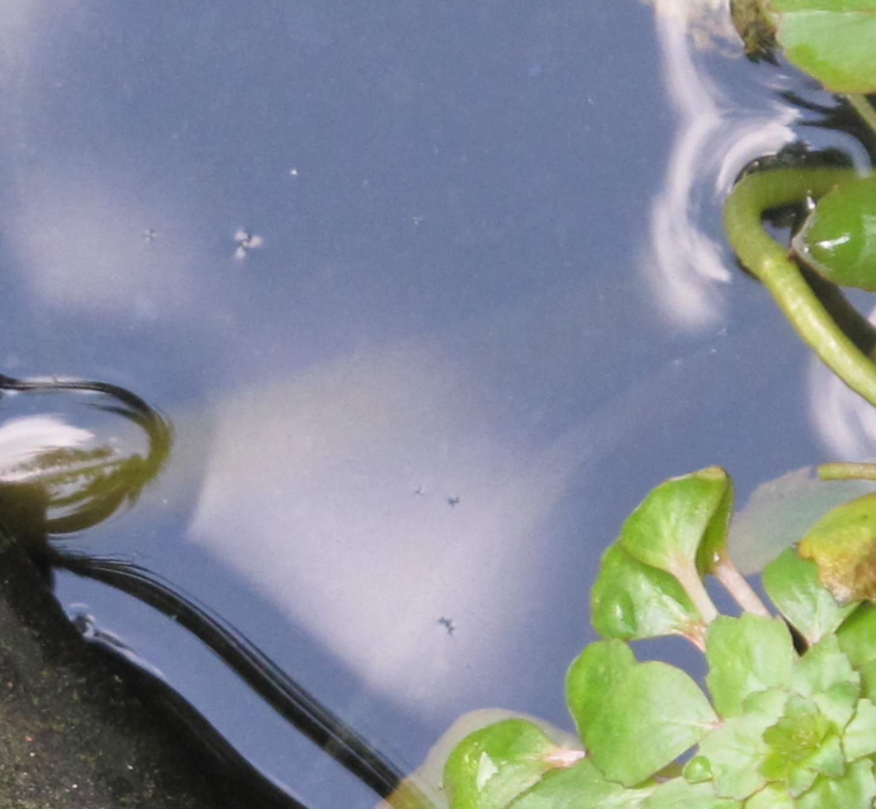
Denim

Slide 16

Tufts blue

Slide 17
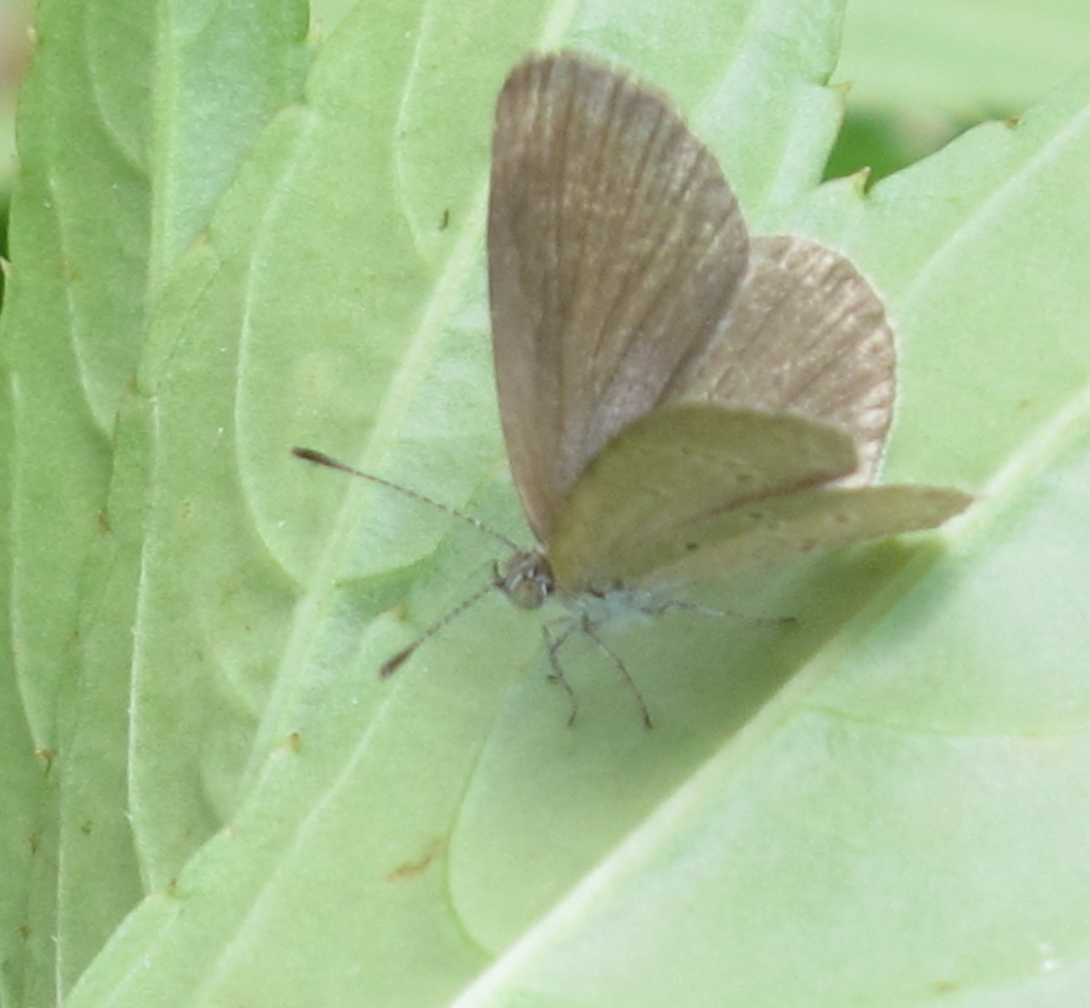
Powder blue

Slide 18
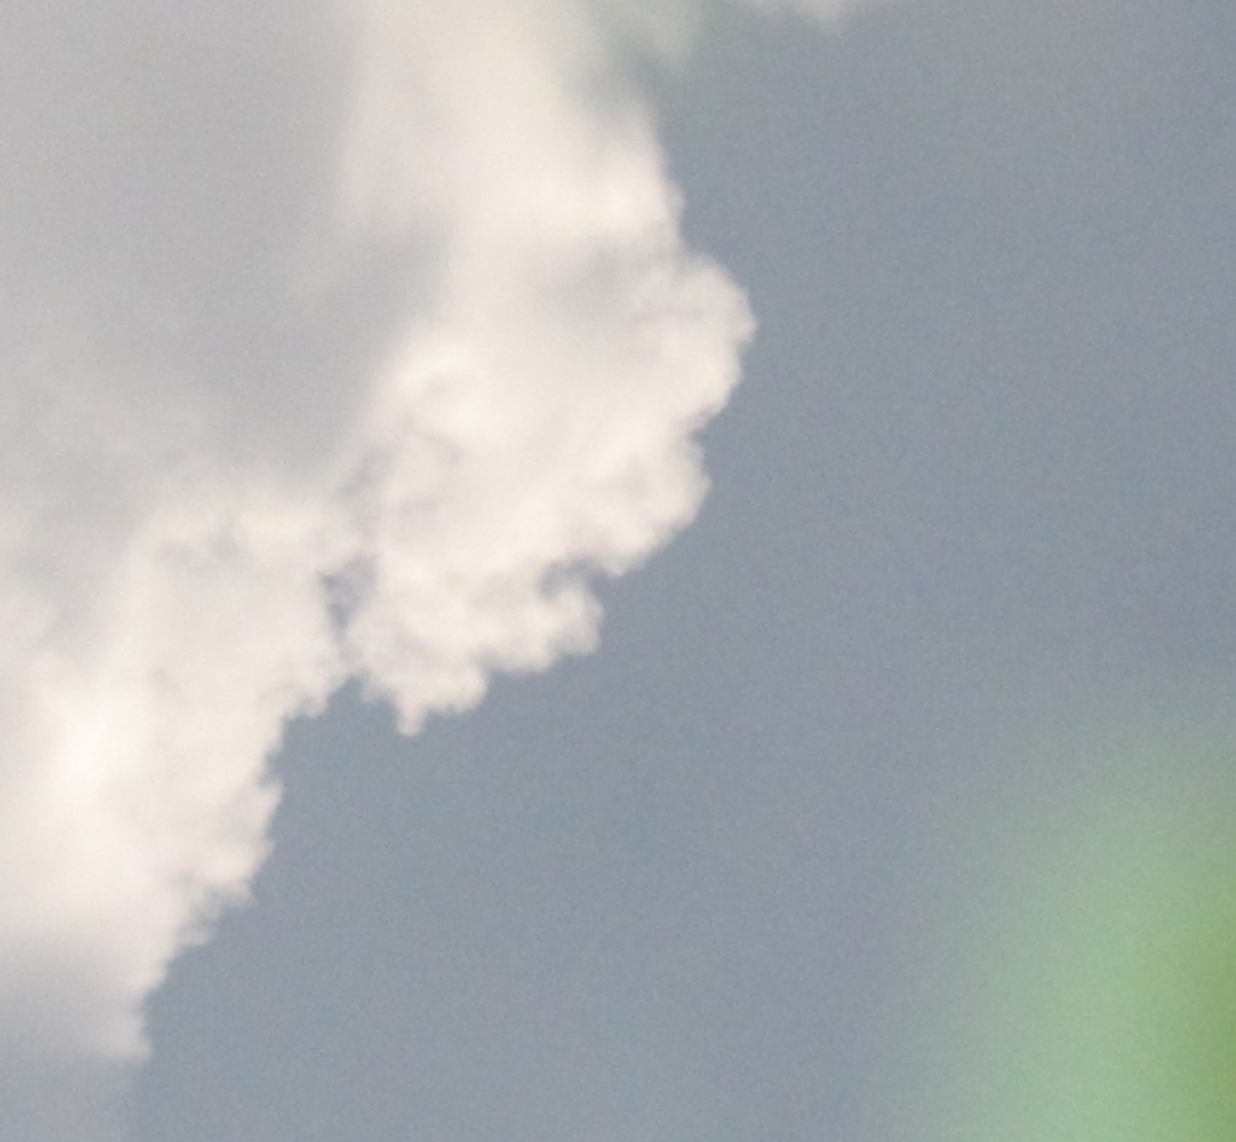
Blue-gray

Slide 19
Color blue walk 3

Slide 20
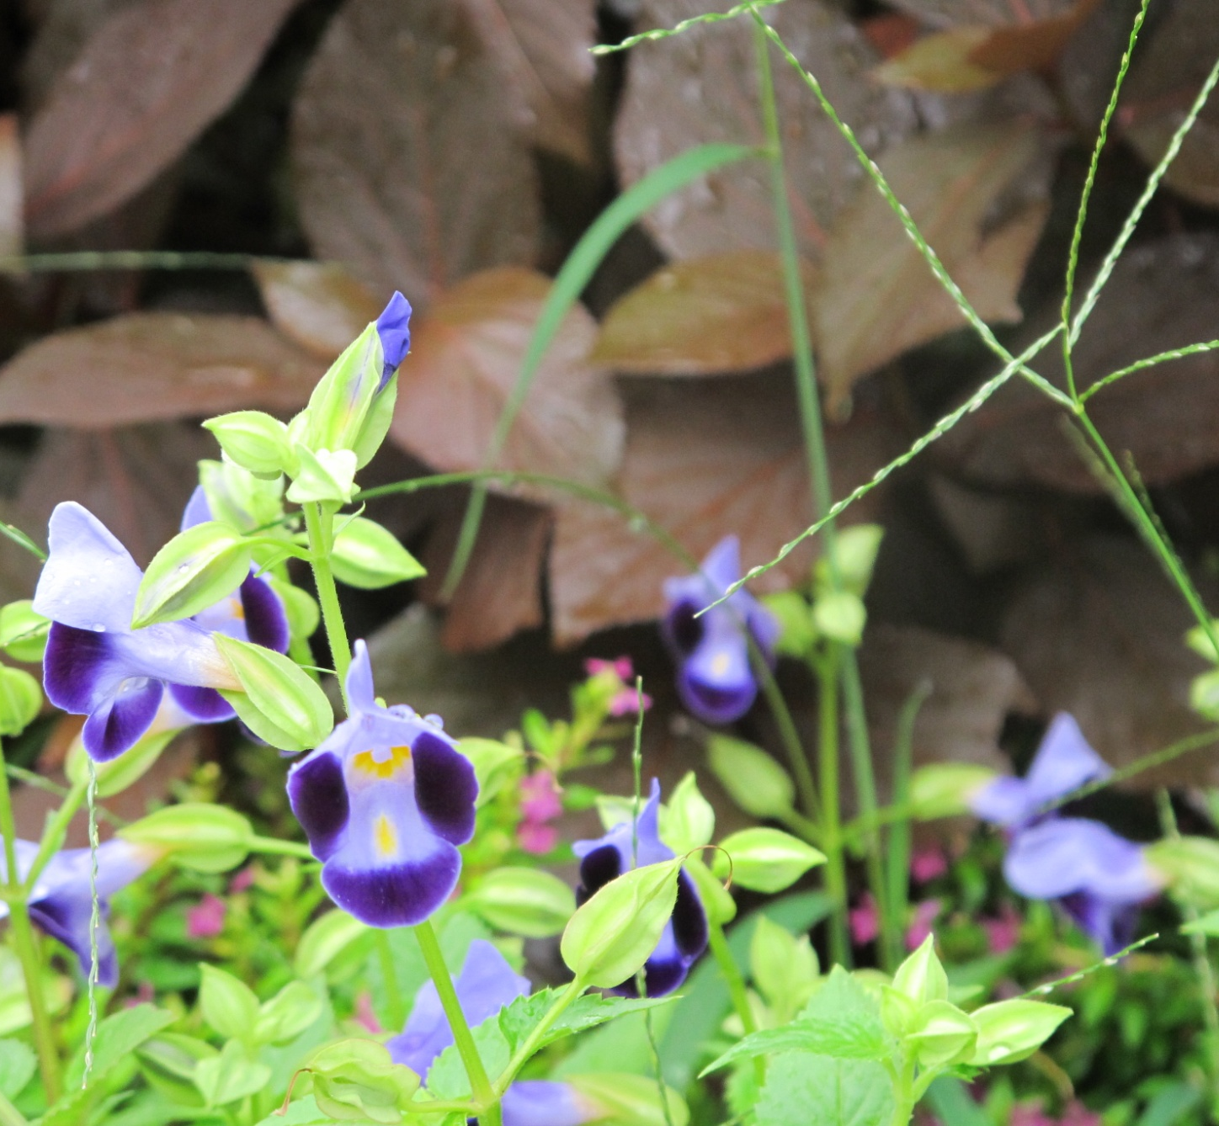
Palatinate
Periwinkle
Indigo

Slide 21
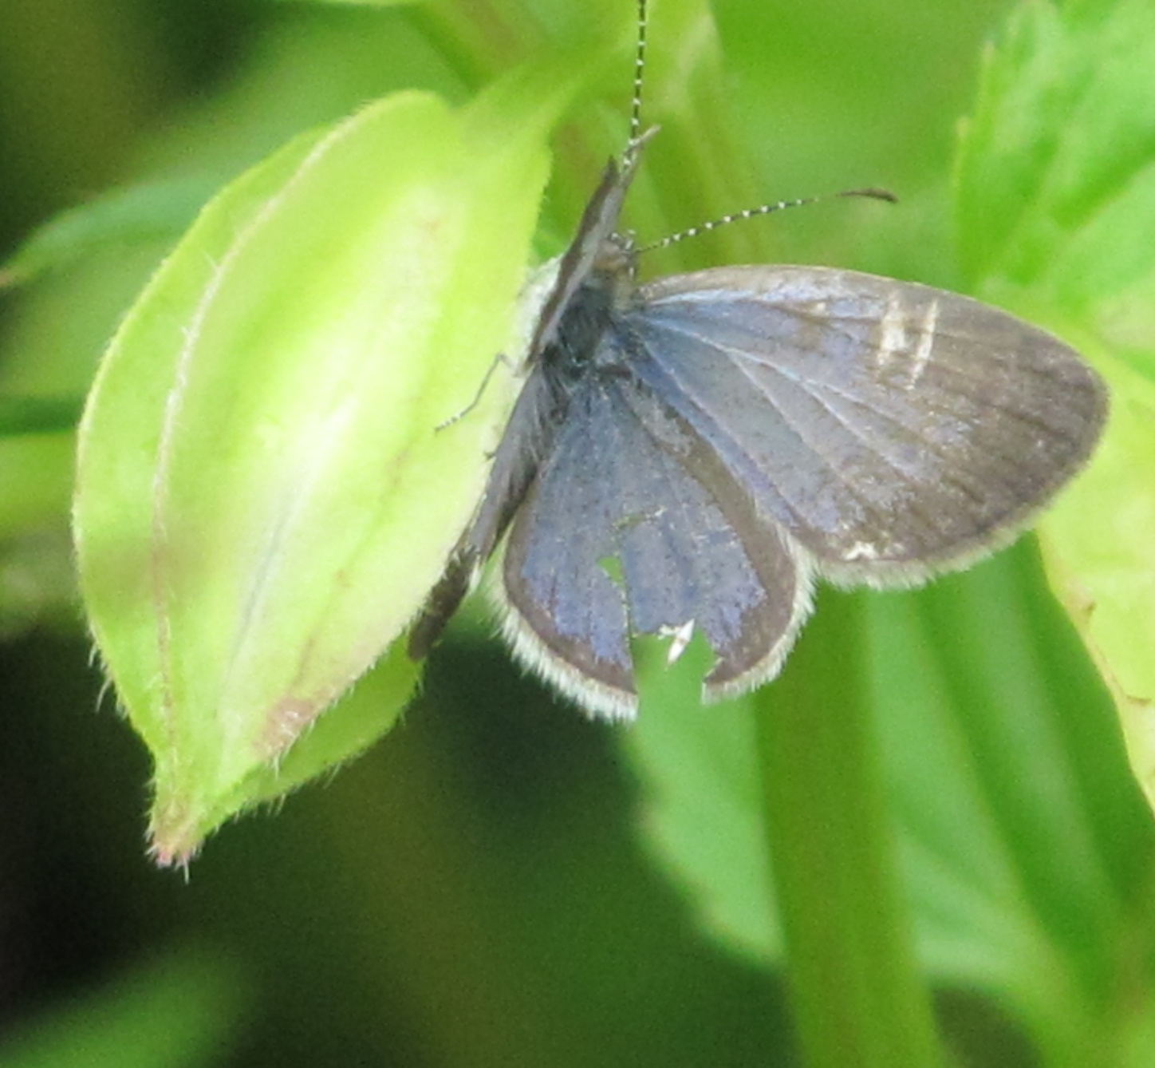
Blue-gray

Slide 22
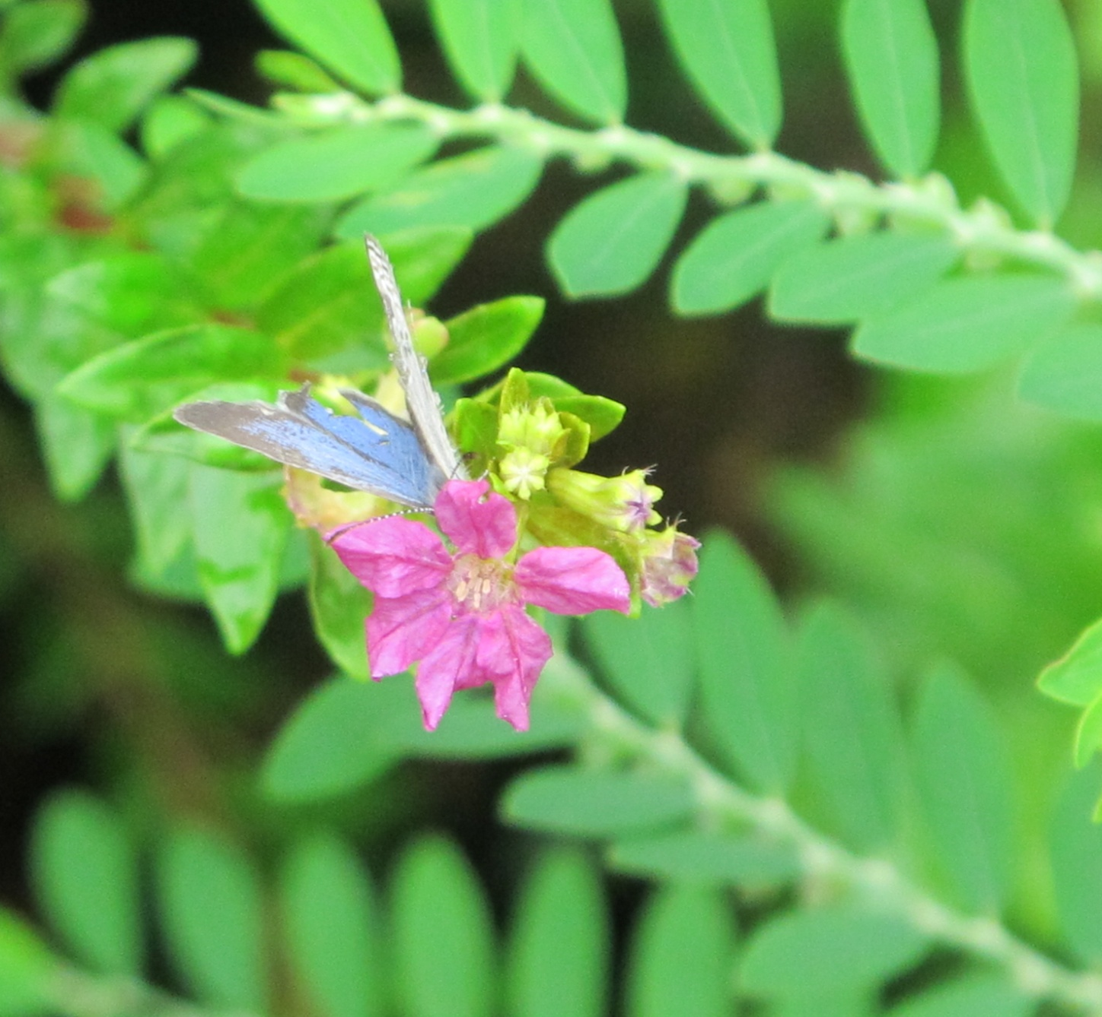
Cornflower blue

Slide 23
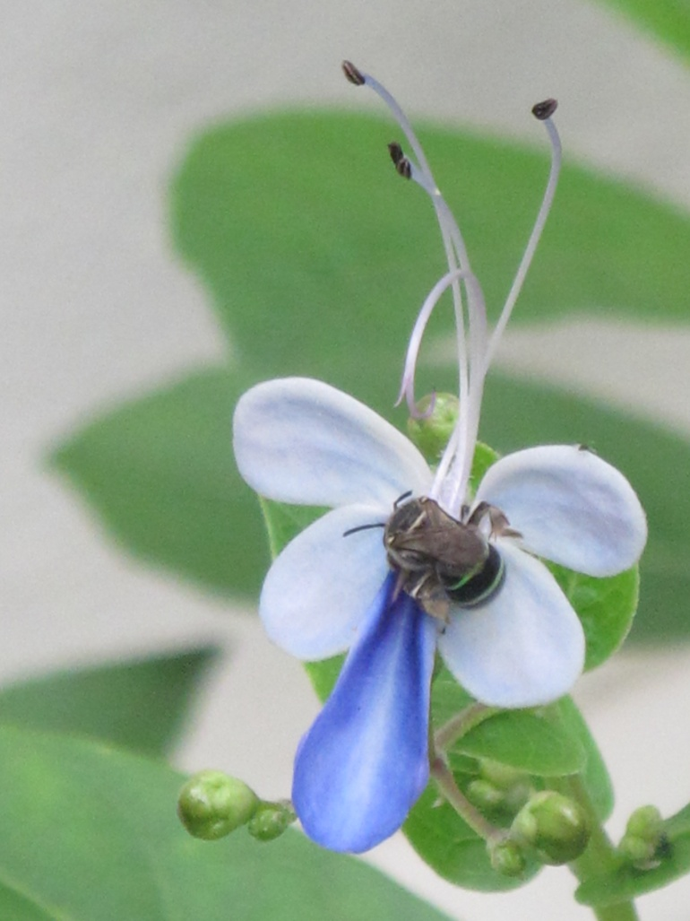
O Lord, our Lord, how majestic is your name in all the earth!

Slide 24
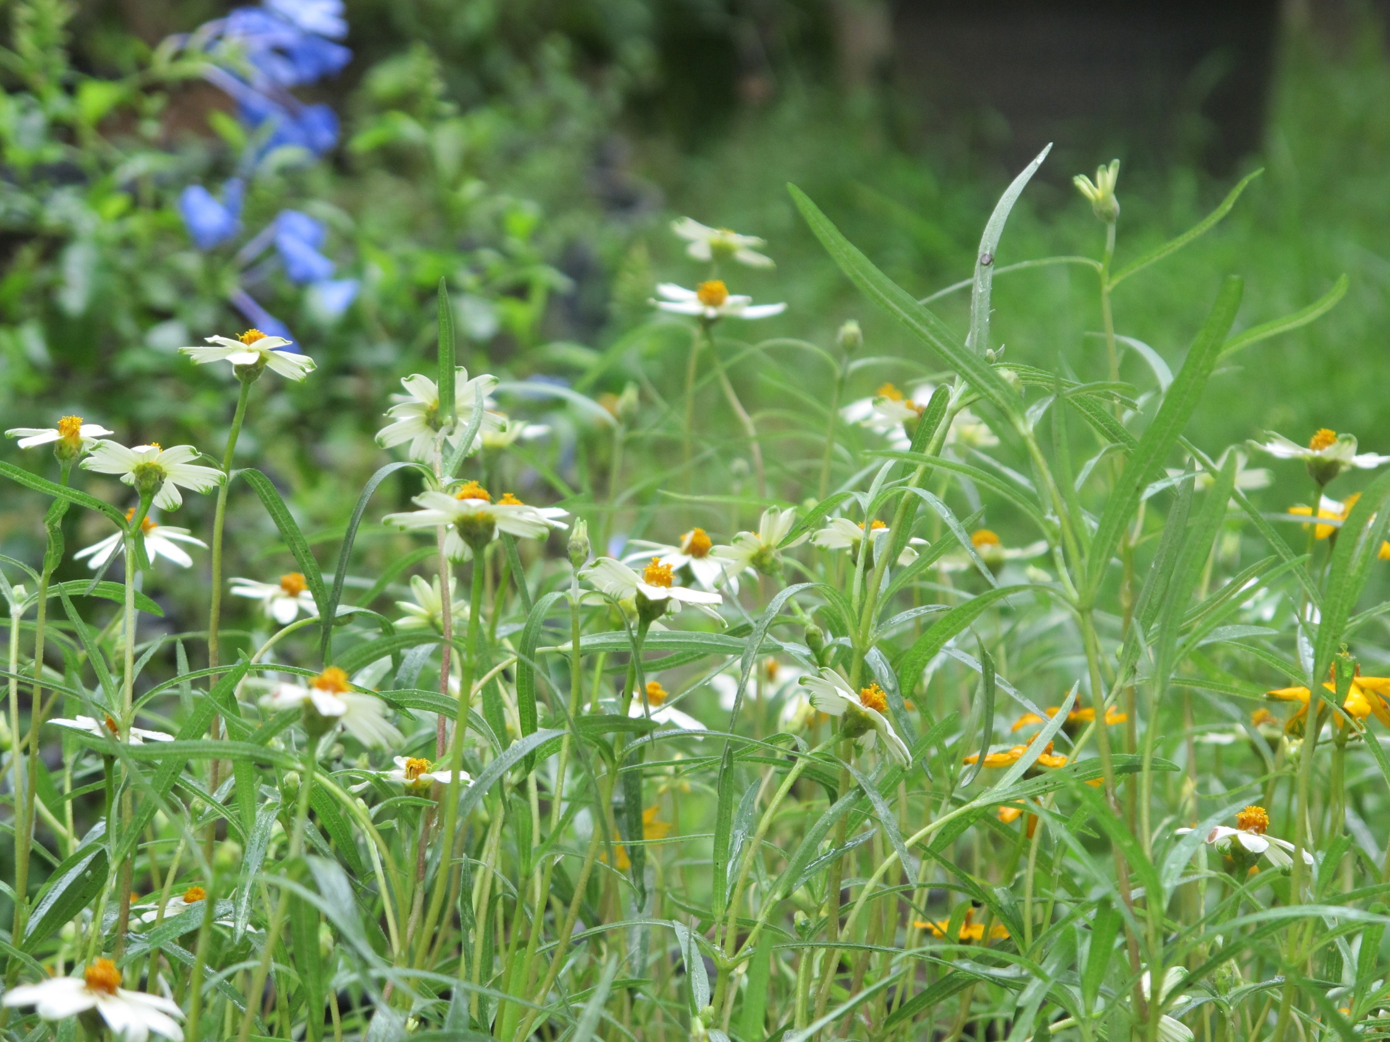
Locations: The Somanas family’s garden,
Sirithonville neighborhood, and Thonburirom Park,
Bangkok, Thailand
October 2012

